Slide 1
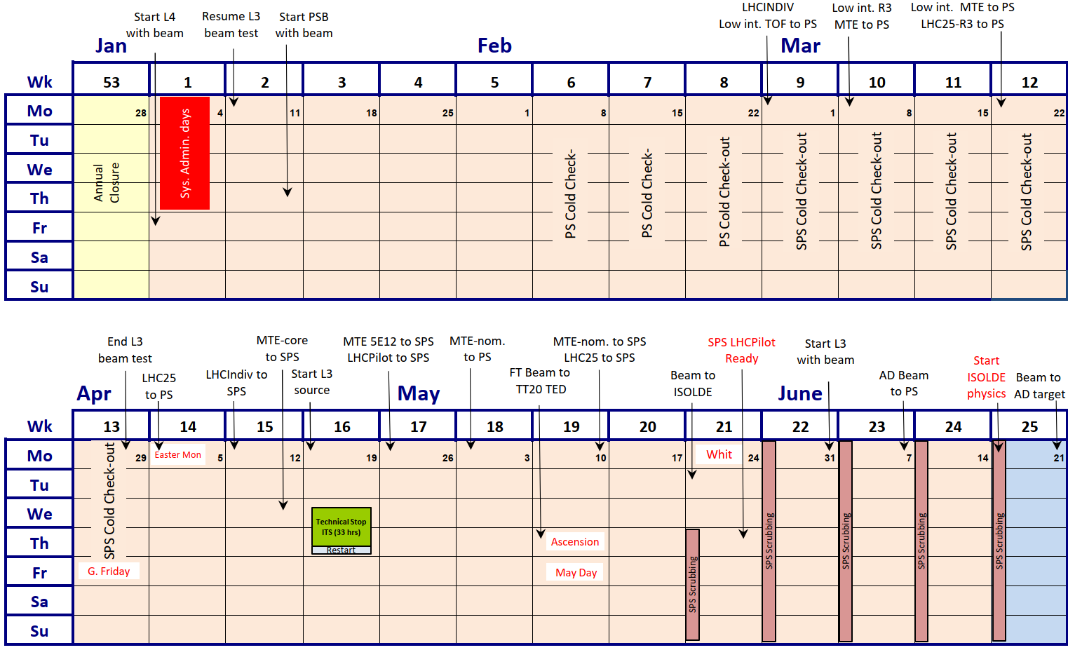
2021 accelerator schedule: Q1-Q2
Last version: https://edms.cern.ch/document/2442568/1.1

Slide 2


Main priorities for early 2021 (from January)
Items to completed/prepared before start with beam
  Pulse 40 MHz cavity: early February
    Digital cavity controller together
    AVC surveillance prototype module
    Need clear path for operational roll out during 2021 run
  Pulse 200 MHz system with μTCA controller: February
    Proof-of-principle with prototypes
    Validate mTCA cavity controller
    Define strategy for operational implementation in YETS21/22
  Prepare phase measurement of digital beam control: March
    Open loop phase between beam and 10 MHz cavity vector sum
    Two harmonic simultaneously
    Following harmonic number changes
    Validate major parts of digital beam control
Completed
Ongoing
Delayed in favour of AVC surveillance

Slide 3
Status of activities in PS CB and nearby (b. 151)
Remaining cabling
  Phase program and phase loop gain functions ready
  MakeRule for virtual start-stops, transition crossing
AVC surveillance
  Tested with 40 MHz and 200 MHz PIN diodes
  Series production
200 MHz AVC loop
  Tests with 200 MHz cavity successful (including modulation)
Digital radial loop
  Operational for high-intensity pick-ups since ~4 weeks
  Low-intensity pick-ups also connected?

Slide 4
Status of activities in PS CB and nearby (b. 151)
10 MHz cavity measurement system
  First iteration (5 kHz sampling rate) working perfectly
  Scaling of detected voltages?
  Additional cable for harmonic number data?
Coupled-bunch feedback
  Feedback with pre-LS2 firmware re-commissioned
  Tests ongoing with new firmware: very encouraging!
Barrier bucket generation
  Outstanding issue with function generation?

Slide 5
Re-commissioning of LLRF with beam
  RF CPS eLogbook: http://elogbook.cern.ch/eLogbook/eLogbook.jsp?lgbk=382
  PS-OP eLogbook: https://logbook.cern.ch/elogbook-server#/logbook?logbookId=683
  Ongoing and next steps
  Beam commissioning
  Extraction train distribution
    Lab tests well advanced (non-blocking issue with fsync measurement)
    Frontend installed in CR25, cabling to be competed → Heiko
    Discussions with BE-CMM (Emmanuel): front-end for optical TX in CR13
      Cabling for PIX.TREV, TRF, TRFSYNC and PAX.TFID, TREV, TRV
  Multi-harmonic feedbacks for high-frequency cavities
    Pre-LS2 Inspector panels revived
    Close to completion, commissioning with beam?
  Phase measurement of digital beam control
    Firmware for Gigabit links between boards

Slide 6

Low-level RF hardware status
System | Status | Comment
10 MHz cavity phasing |  | Without beam, before day 1
20 MHz cavity phasing |  | Beam-based
40 MHz cavity phasing |  | Beam-based, first iteration
80 MHz cavity phasing |  | Beam-based, first iteration
200 MHz cavity phasing | 26/03 | Beam-based, prerequisite for controlled longitudinal blow-up
Digital ΔR receivers
10 MHz 1-turn delay feedback | 08/04 | First iteration, expected beam quality improvement
10 MHz measurements |  | New system online since yesterday
40/80 MHz multi-harmonic FB
Analogue coupled-bunch feedback C10-86/10-96
Coupled-bunch feedback (Finemet cavity) |  | Needs higher intensity, at least LHC25ns at 9.4 ∙ 10¹² p/p
Completed
Ongoing
To be done

Slide 7
High-power RF hardware status
System | # | Status | Comment
10 MHz | 11 |  | Ready from day 1
20 MHz | 2
40 MHz | 2
80 MHz | 3
200 MHz | 6 |  | Spare cavity?
Finemet | 1
Completed
Ongoing
To be done
Smooth re-commissioning of RF power systems
Thanks to extensive preparation ahead of first beam

Slide 8
Setting-up of beams
Hardware commissioning | PoP | Performance | Comment
Single-bunch LHC-type, LHCINDIV |  |  | Taken by SPS
TOF
SFTPRO |  |  | Taken by SPS
LHC 25 ns, triple splitting h = 7 double batch transfer |  |  | Final polishing
LHC 25 ns, BCMS h = 9 double batch transfer |  |  | Duration of BC and merging
AD, batch compression at 26 GeV
Completed
Ongoing
To be done
Proof-of-principle checks completed for (almost) all beams

