Slide 1
Introduction to IPPOG and the Particle Physics Masterclasses
A High Energy Afternoon (for a change)!
P. Abreu, LIP and IST & S. Goldfarb, Univ Melbourne, IPPOG Co-Chairs
L. Levchuk & S. Lukyanenko, National Academy of Sciences of Ukraine, Local Particle Physicists
U. Bilow, Technical Univ Dresden & K. Cecire, Univ Notre Dame, IPPOG Masterclass Coordinators
S. Wood, Univ Notre Dame, QuarkNet Masterclass Coordinator
N. Mysko-Krutik & M. Barabashko, B. Verkin ILTPE of NASU, Local Organisers
II IAS Conference on Condensed Matter & Low Temperature Physics, Kharkiv, Ukraine, 10 June 2021

Slide 2
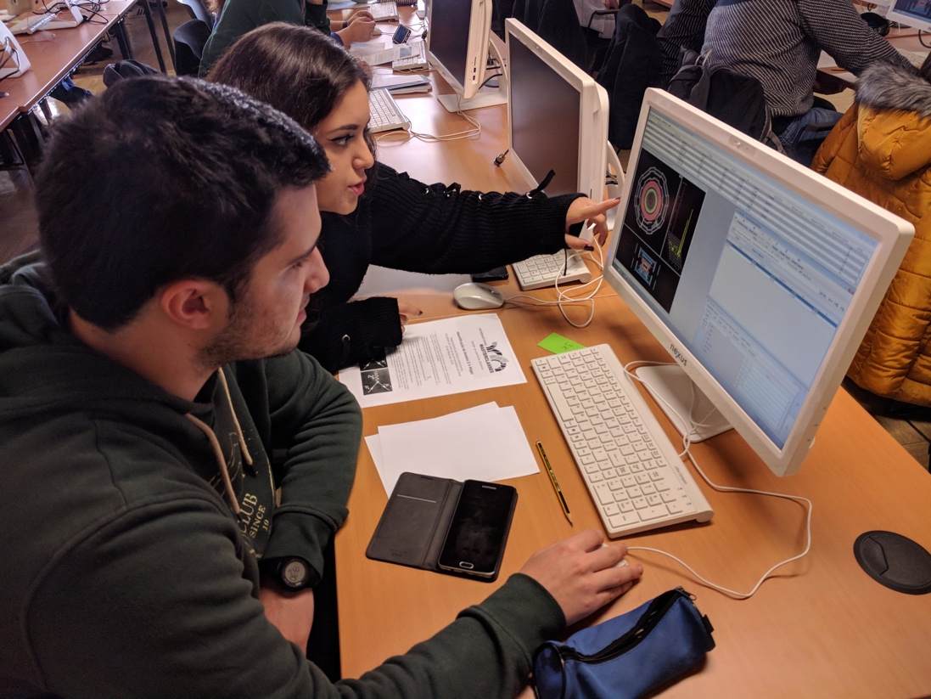
Who are we?
International Scientific Collaboration
  Active Researchers with Experience in Education & Outreach
  Experts in Communication & Education
Global Network Building
  37 members: 30 countries, 6 experiments, 1 intl lab (CERN)
  2 associate members: 2 national labs (DESY, GSI)
Global Outreach Organisation
  International Particle Physics Masterclasses
  World-Wide Data Day, Global Cosmics, etc.
Local Outreach Support
  Sharing of expertise, best practices, material database
  Resources to support events, kick-start activities

Slide 3
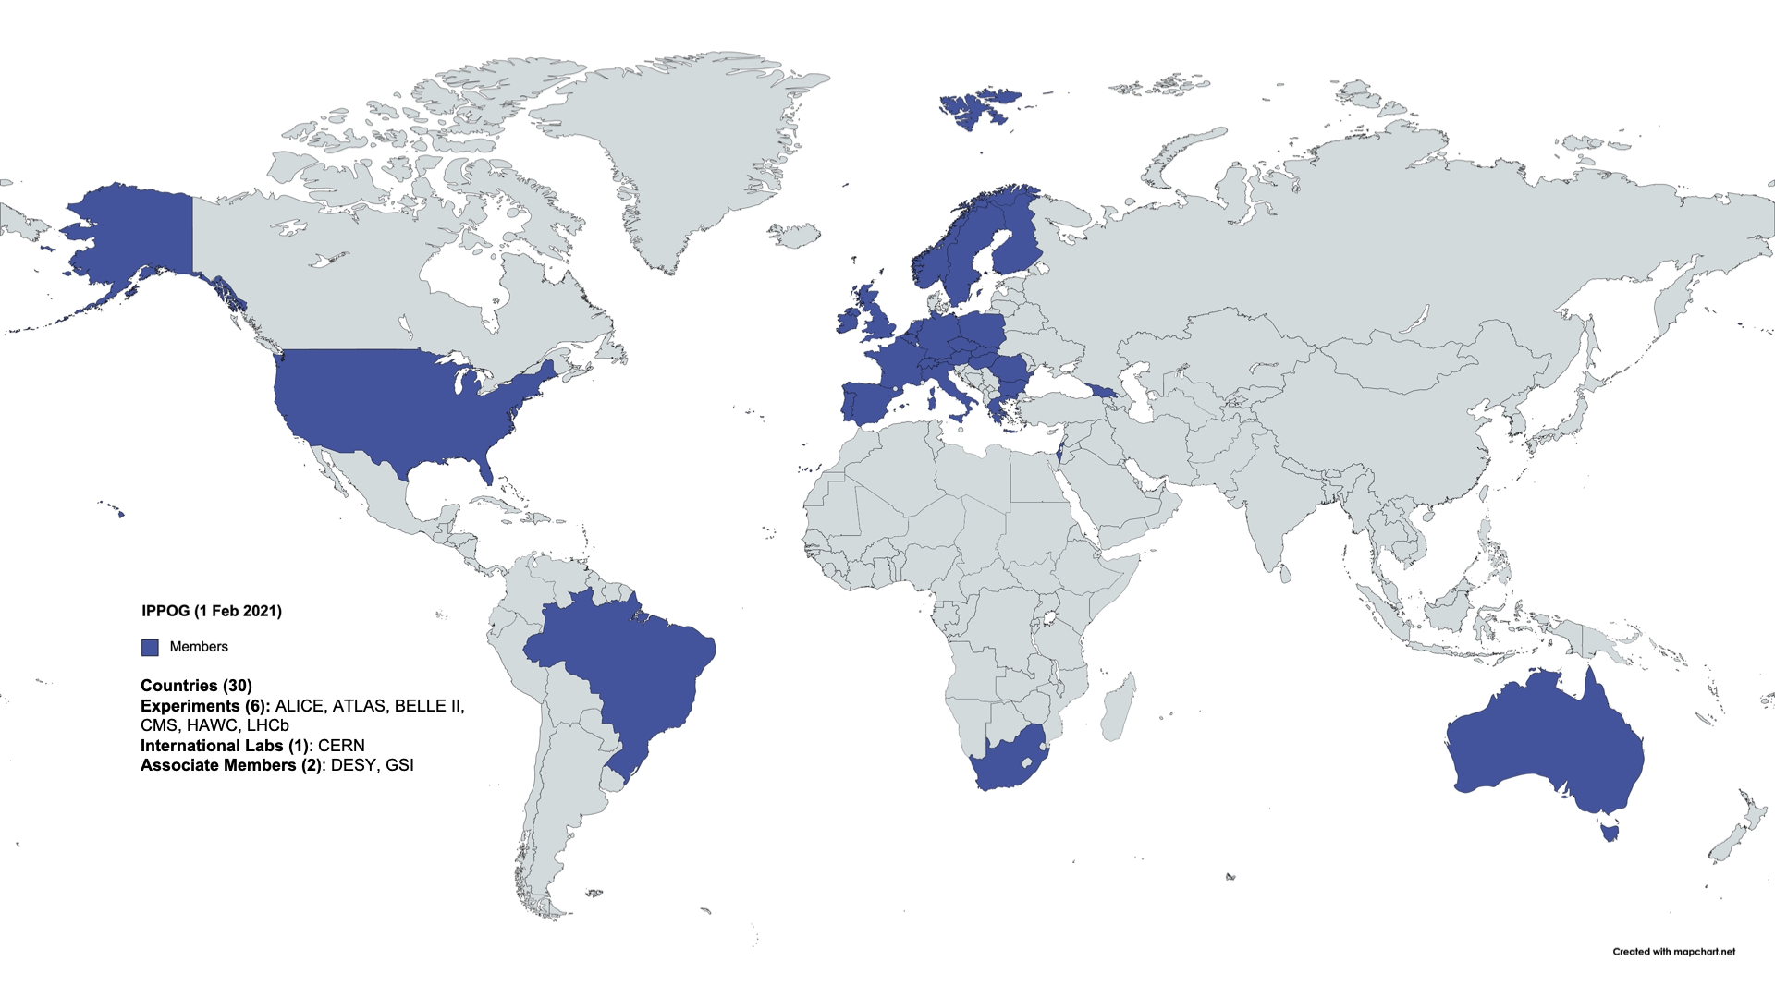
?
IPPOG Membership
30 Countries, 6 Collaborations, 1 International Lab, 2 National Labs

Slide 4
Organisation
Chairs
  Steven Goldfarb (University of Melbourne) 2017-2022 (2nd term)
  Pedro Abreu (LIP, IST Universidade de Lisboa) 2020-2022 (1st term)
Core Team
  Strategic Development & Communication: Barbora Gulejova (Universität Bern)
  Administrative Support: Anita Bens (CERN)
Coordination
  Masterclasses: Uta Bilow (Dresden University), Ken Cecire (University of Notre Dame)
  Global Cosmics: Sabine Hemmer (INFN), Carolin Schwerdt (DESY)
Organisational Bodies
  Advisory Boards & Committees: Finance, Speakers & Publications
  Steering Groups: Masterclasses, Global Cosmics, Web Development
  Working Groups: Bringing Masterclasses to New Countries, Explaining Particle Physics Hot Topics, Exhibits & Public Events

Slide 5
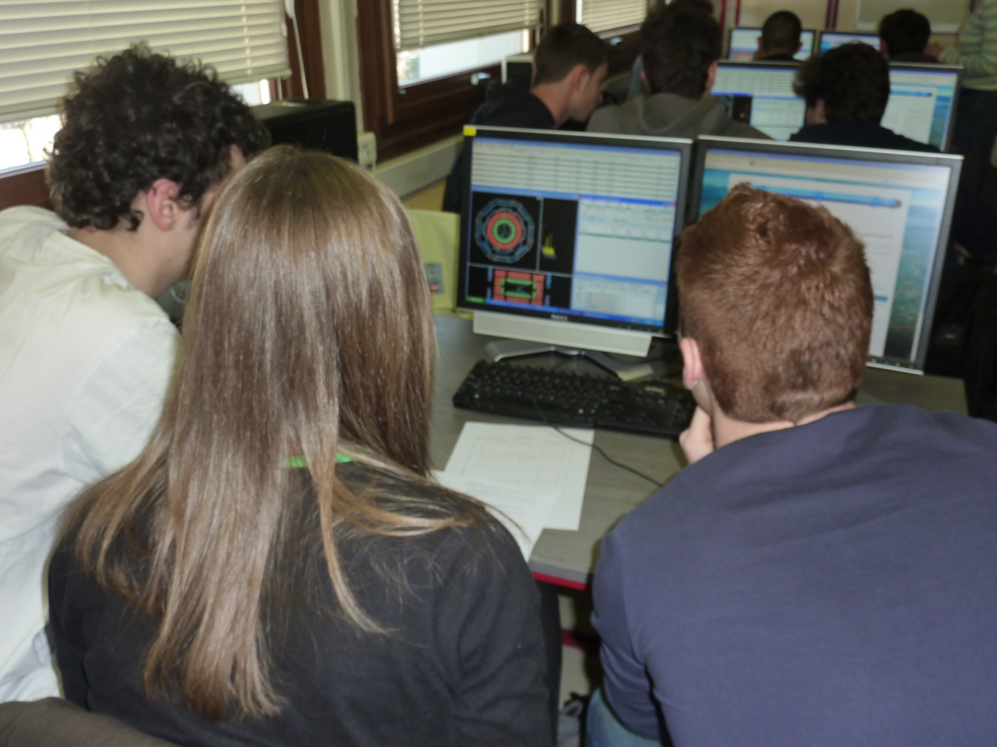
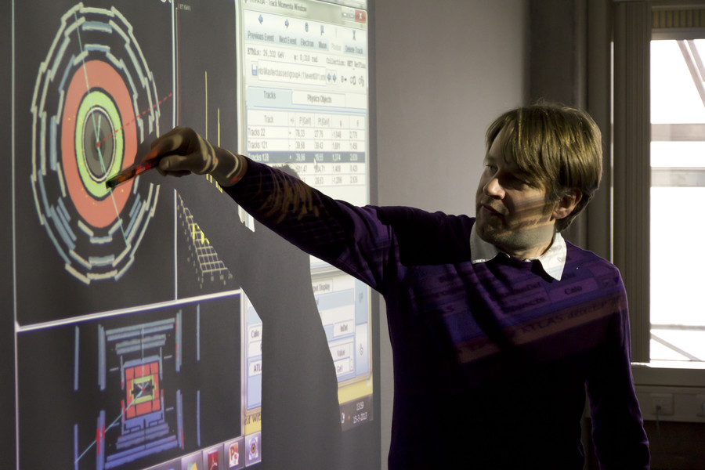
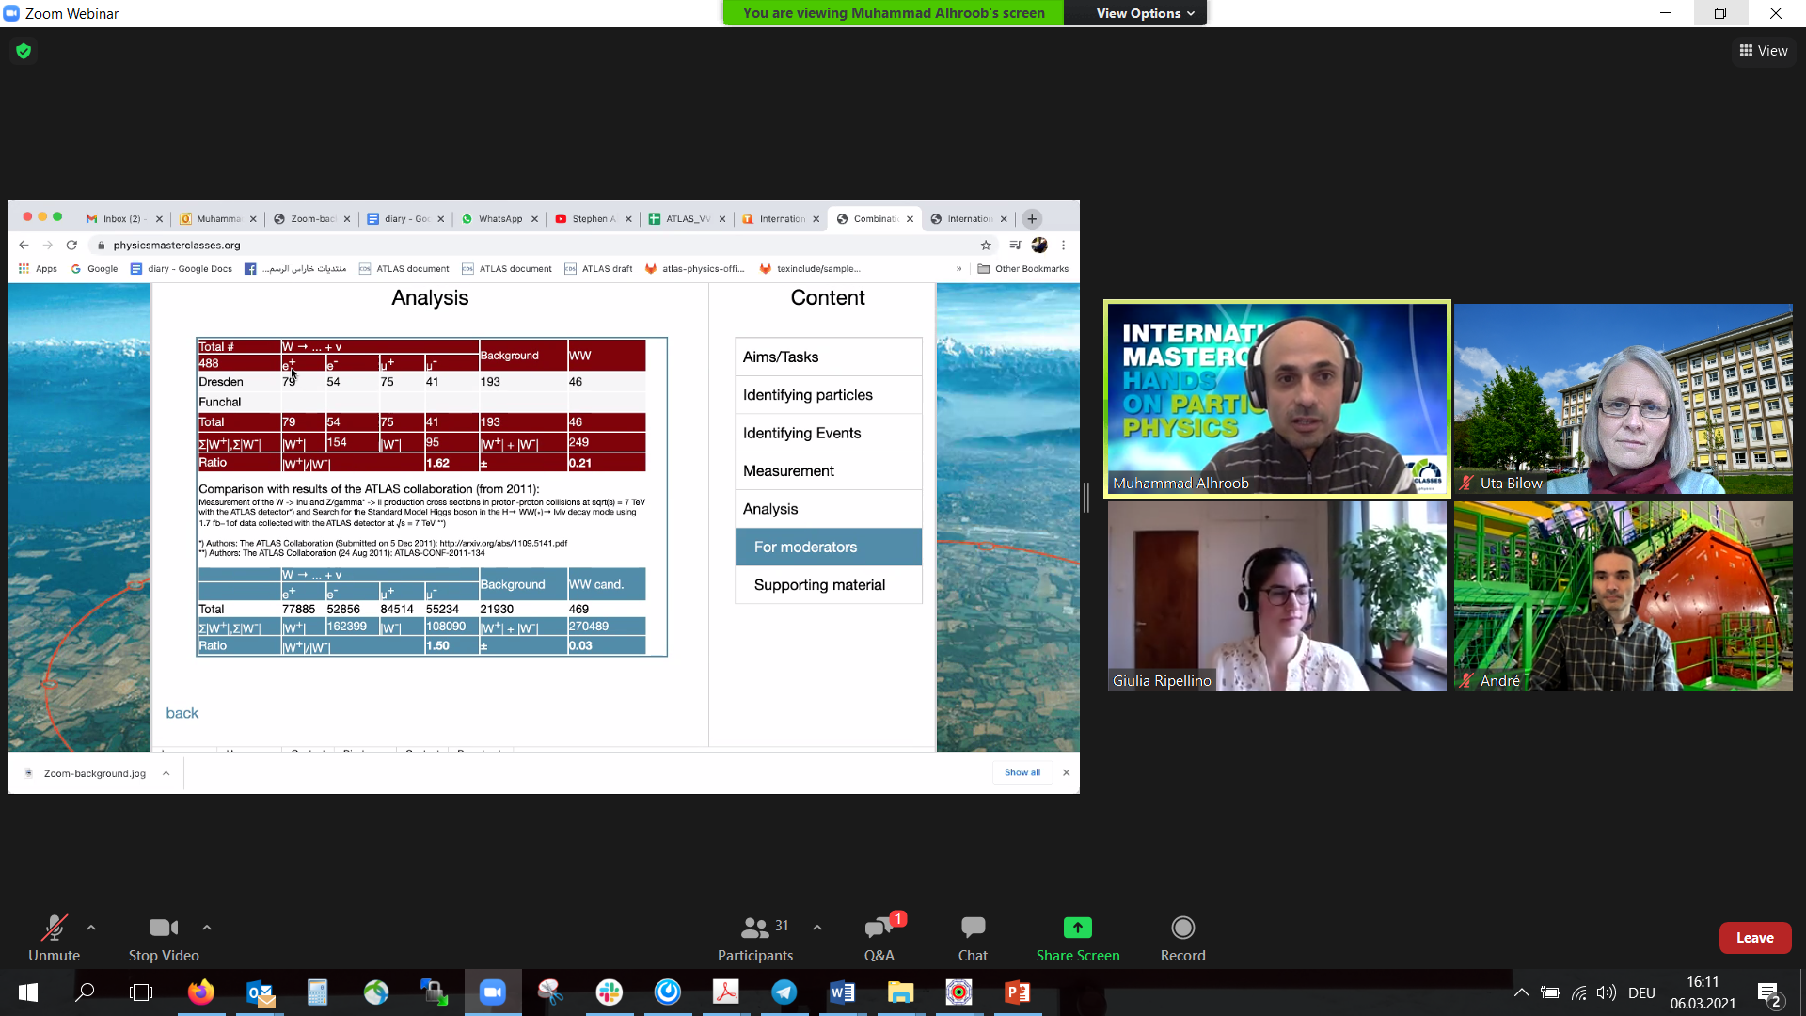
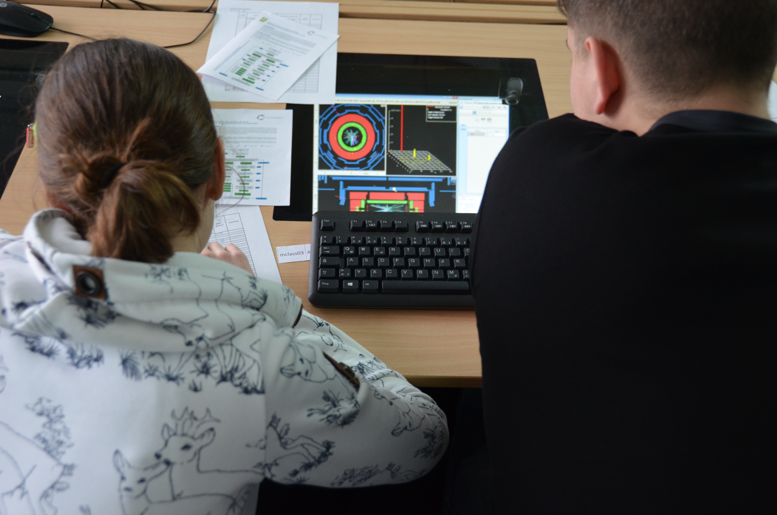
International Particle Physics Masterclasses
The Flagship of IPPOG
  Students become “Researchers for a Day”
  Invited to research institute or university
  Introductory lectures on research
  Use analysis tools to examine real data
  Worldwide videoconference w/other students
2019
  60 countries, 220 labs, 14,000 students
2021 (11 Feb – 27 Mar)
  Feb 11 (UN Day Women & Girls in Science): 7 groups
  CERN (LHC): 137 Masterclasses, 5192 students
  GSI (Particle Therapy): 33 Masterclasses
  KEK (Belle II): 5 Zoom sessions
  FNAL (LHC, Neutrino): 38 Masterclasses, 600 students

Slide 6
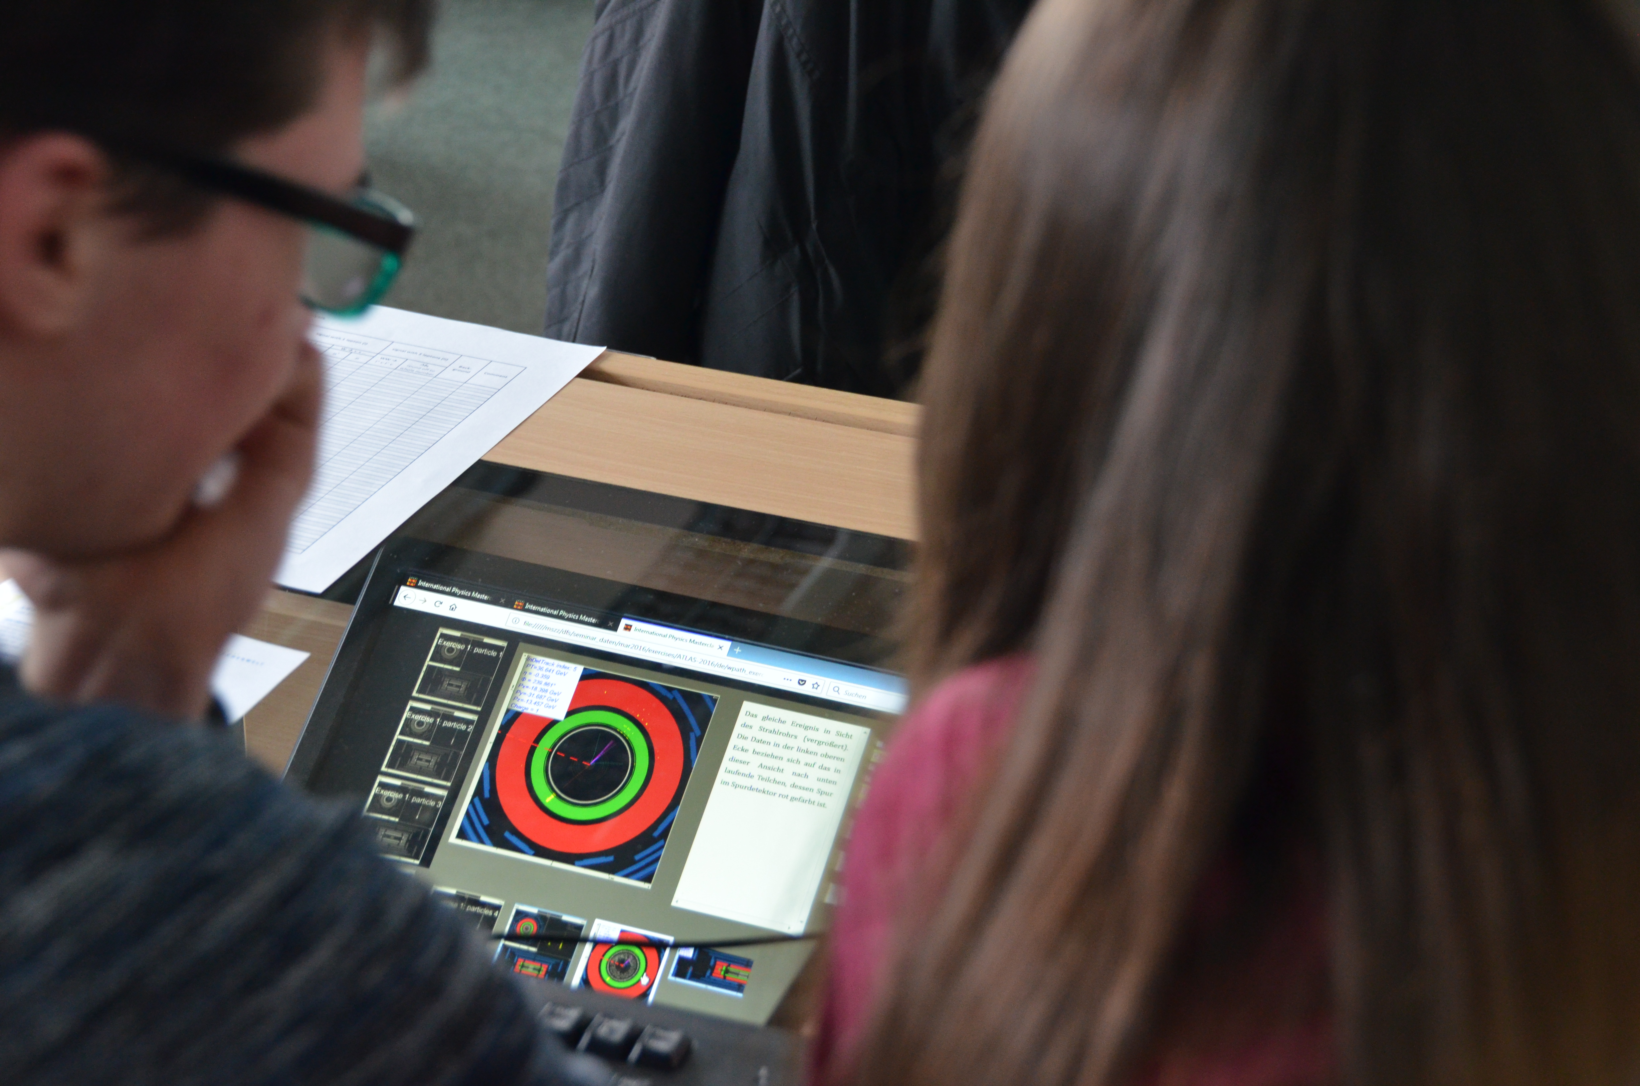
This Afternoon…
Get some coffee, you are going to be a High Energy physicist
  14:00 – Welcome by the IPPOG Chairs (Us)
  14:30 – Introduction to Standard Model, LHC, and CMS (Leonid Levchuk)
  15:30 – Break
  15:45 – Introduction to the CMS Masterclass (Uta Bilow, Ken Cecire, Your Mentors)
  16:30 – The CMS Masterclass Measurement (You)
  17:30 – A Mini-Conference to Discuss Results (All of You)
  18:00 – End of Programme
Throughout the Afternoon
  Please ask questions!
  We want you to run these next year!

Slide 7
Your Mentors
QuarkNet
  Marla Glover, Joel Klammer, Jeremy Wegner, Susan Wetzler, Shane Wood
Local
  Philip Kuznietsov, Olha Kravchuk, Bohdan Bidenko, Валерия Чекубашева, Владимир Роговец, M Kolodyajna, Alex Leonov, Eugene Petrenko, Sergei Poperezhai, Ксения Минакова, Ян Костиленко, Валентин Коверя, Ана Бойченко

