Slide 1
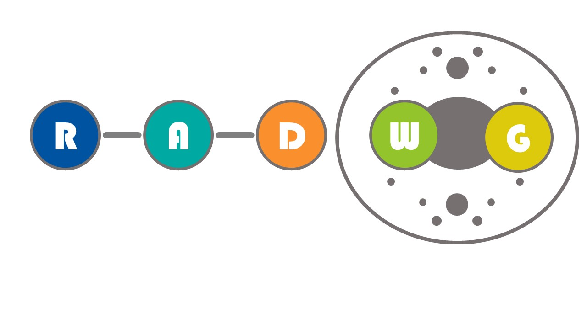
RADWG Meeting June 2021
Salvatore Danzeca BE-CEM-EPR on behalf of the RADWG

Slide 2
AGENDA
Introduction
Activities Overview by Rudy Ferraro
Focus on: Bipolar Junction Transistors by Rudy Ferraro
TE-MPE: LHC Interlock Status and Test Results by Raffaello Secondo
TE-VSC: Vacuum and Cryogenic system development Status and batch test responses by Vilde Flognfeldt Rieker
BE-CEM: RaToPUS Status and considerations after radiation tests by Lalit Patnaik
Postponed

Slide 3

RADWG Mandate
It provides support to the accelerator sector equipment groups for the assessment of radiation tolerance of electronic equipment to be installed in radiation exposed areas.
It is as a forum for electronic engineers to discuss
  design practices
  radiation tests
  radiation induced failures in the accelerators.
It coordinates radiation test campaigns inside and outside CERN
The RADWG is a pillar of the R2E Project

Slide 4
RADWG Organization
R2E Project
Project Leader: Ruben Garcia Alia
RADWG
Chair: Salvatore Danzeca BE-CEM
Manoel Barros Marin SY-BI
Scientific sectaries: Gilles Foucard BE-CEM
Rudy Ferraro BE-CEM
MCWG
Chair: Ruben Garcia Alia SY-BI
Scientific sectary: Giuseppe Lerner BE-CEM

Slide 5
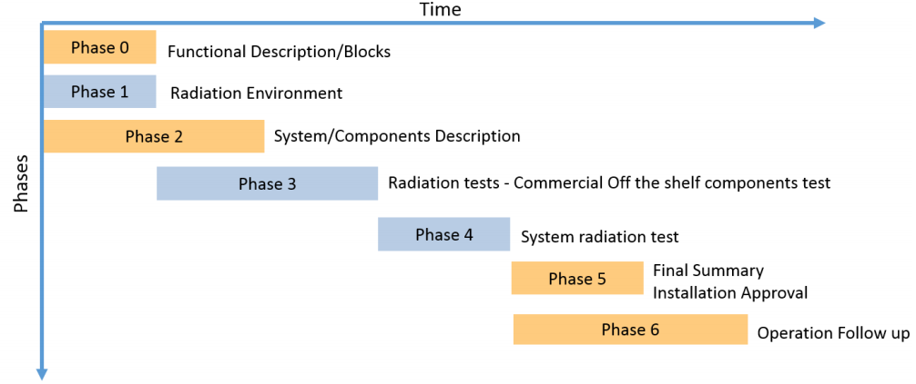
CERN RHA Guideline for COTS-based system
Within the R2E project we have defined the process for system qualification:
Provide advices and support for component type & technology choice
Collect Test request
Test & Reporting
Provide support on system failure analysis and mitigation
@ CERN RHA Guideline
Provide advices in early development stages for component choice
Help analyzing system failure observed in operation or during system-level test and propose mitigation techniques or part replacement candidates
Testing of electronic components by R. Ferraro (BE-CEM-EPR )

Slide 6


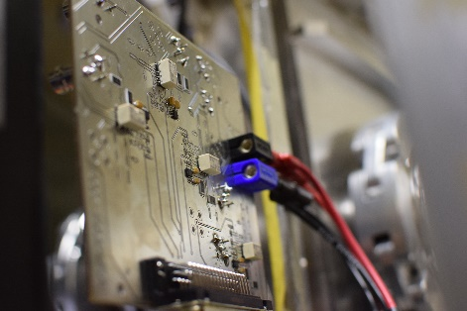
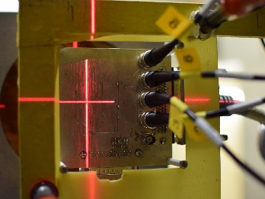
Radiation test service – BE-CEM-EPR
Request collection
The requests for radiation testing are collected and processed selecting the most suitable methodology and facilities
Database and Publication
The results are collected, stored and in EDMS and published in the RADWG database to allow an easy research of the best candidates for the new radiation tolerant designs
01
Test planning and structure
06
02
Each component/system is analyzed, and all the possible radiation effects are taken into account for planning the test and structure it
Result analysis
The results are analyzed during and after the tests for each component considering the end application and the possible operational issues
Board and instrumentation preparation
05
03
For each component a dedicated set of test board is prepared and the associated instrumentation is chosen to face the complexity of the radiation test
04
Testing
The test are carried out at CERN facilities such as CHARM or Co60 and in external facilities. The transport, personnel and instrumentation are selected considering the peculiar aspect of each facility
Testing of electronic components by R. Ferraro (BE-CEM-EPR )

Slide 7
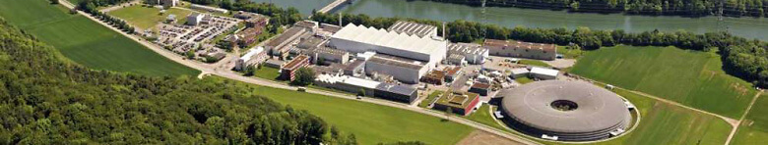

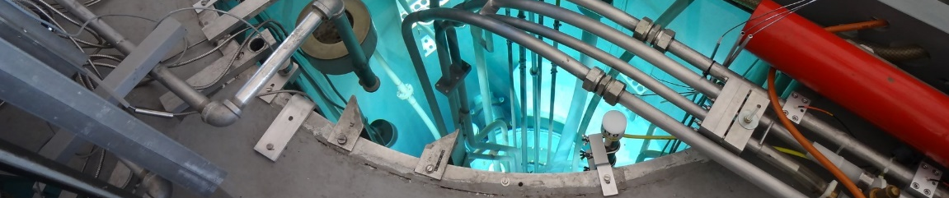

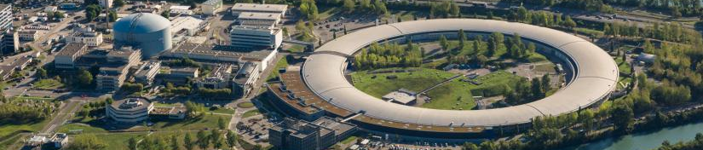

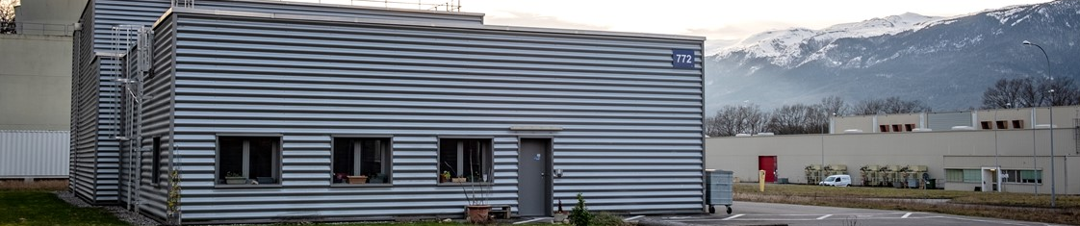

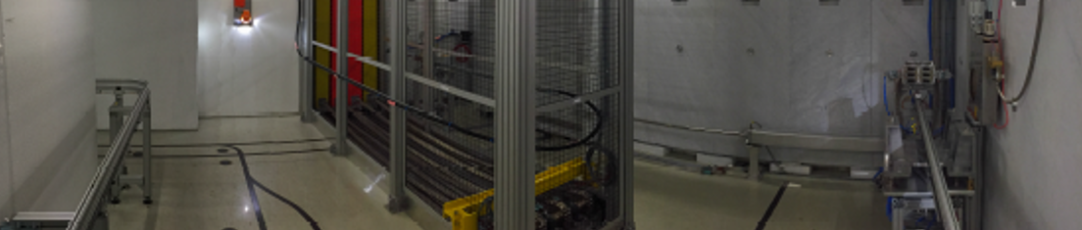

Where do we test: Key point is the facilities
PSI-PIF – Switzerland, Viligen
  30-220 MeV Proton beam
  Combined SEE, TID, DD Tests
  5 Years collaboration agreement with CERN
Paul Scherrer Institut
JSI – Slovenia, Ljubljana
  Triga Mark II Nuclear Reactor
  DD, TID
  Punctual use, possibility to make a contract
Jožef Stefan Institute
ILL – Genoble, France
  Thermal Neutron Beam
  Thermal neutron sensitivity Tests
  Punctual use, possibility to make a contract
Institut Laue-Langevin
CC60 – Switzerland, CERN
  10 Tb Cobalt 60 Source
  TID Tests
  Available all the year
CERN Cobalt 60 Facility
CHARM – Switzerland, CERN
  Representative LHC Radiation mixed-fields
  SEE, TID, DD
  Not available during technical stops
CERN High energy AcceleRator Mixed field
Testing of electronic components by R. Ferraro (BE-CEM-EPR )

Slide 8
Where do we test: Key point is the facilities
PSI-PIF – Switzerland, Viligen
  30-220 MeV Proton beam
  Combined SEE, TID, DD Tests
  5 Years collaboration agreement with CERN
Paul Scherrer Institut
JSI – Slovenia, Ljubljana
  Triga Mark II Nuclear Reactor
  DD, TID
  Punctual use, possibility to make a contract
Jožef Stefan Institute
Component-level Testing
ILL – Genoble, France
  Thermal Neutron Beam
  Thermal neutron sensitivity Tests
  Punctual use, possibility to make a contract
Institut Laue-Langevin
System-level Testing
CC60 – Switzerland, CERN
  10 Tb Cobalt 60 Source
  TID Tests
  Available all the year
CERN Cobalt 60 Facility
CHARM – Switzerland, CERN
  Representative LHC Radiation mixed-fields
  SEE, TID, DD
  Not available during technical stops
CERN High energy AcceleRator Mixed field
Testing of electronic components by R. Ferraro (BE-CEM-EPR )

Slide 9
PSI Radiation test campaigns
PSI Facility Updates
Test date | Components | Test group | Equipment owner
March | Regulators, OpAmps, MCU , FPGA | BE/CEM | TE/VSC – BE/CEM
May | ATLAS testing + bidirectional bus + oscillators + Comparators | EP/UAT EN/SMM | ATLAS , TE/MPE , BE/CEM
June | ATLAS testing , PLL , Regulators | EN/SMM | ATLAS, SY/BI , TE/VSC
July 3-4 | ATLAS testing + DC Fan testing | EN/SMM | BE/BI – TE/VSC – TE/MPE – BE/CO
August 7-8 | NOT Possible to test another slot will be available in 2021
September 4-5
October 2-3
October 30-31

Slide 10

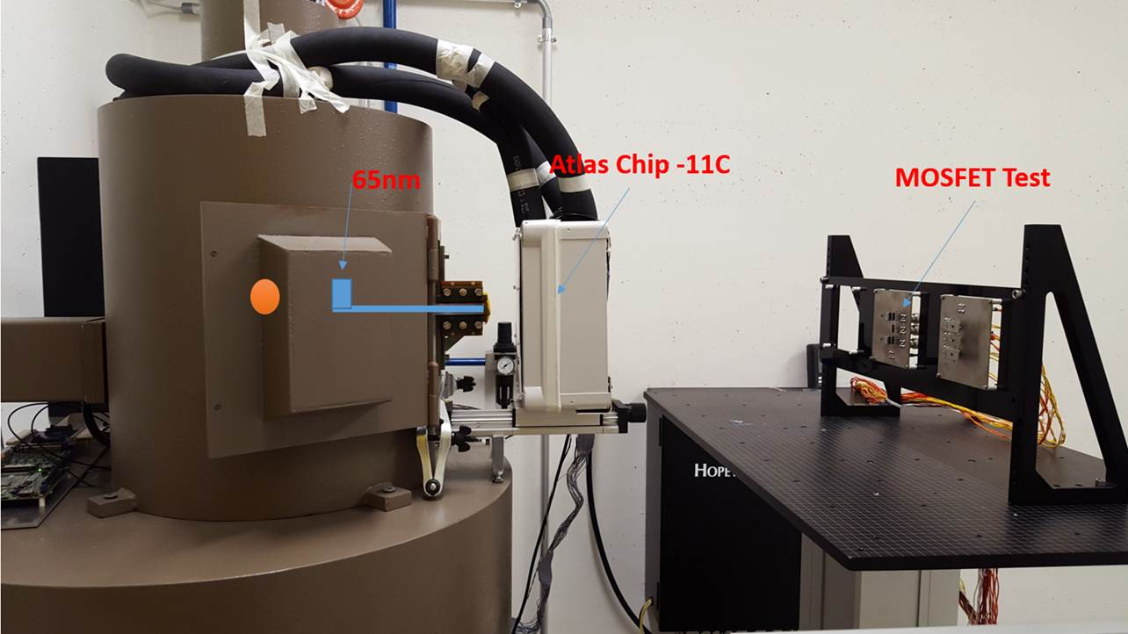
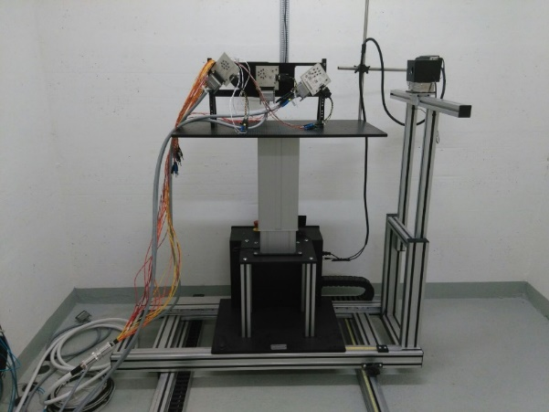
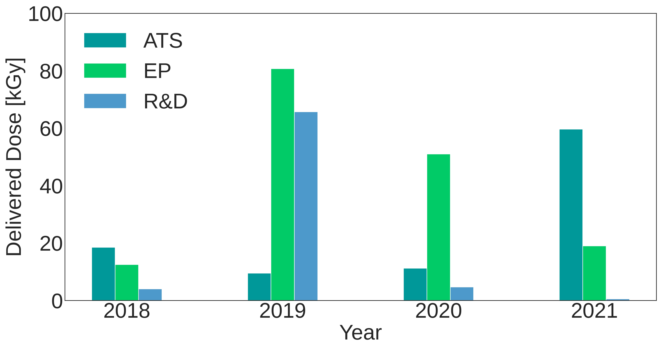
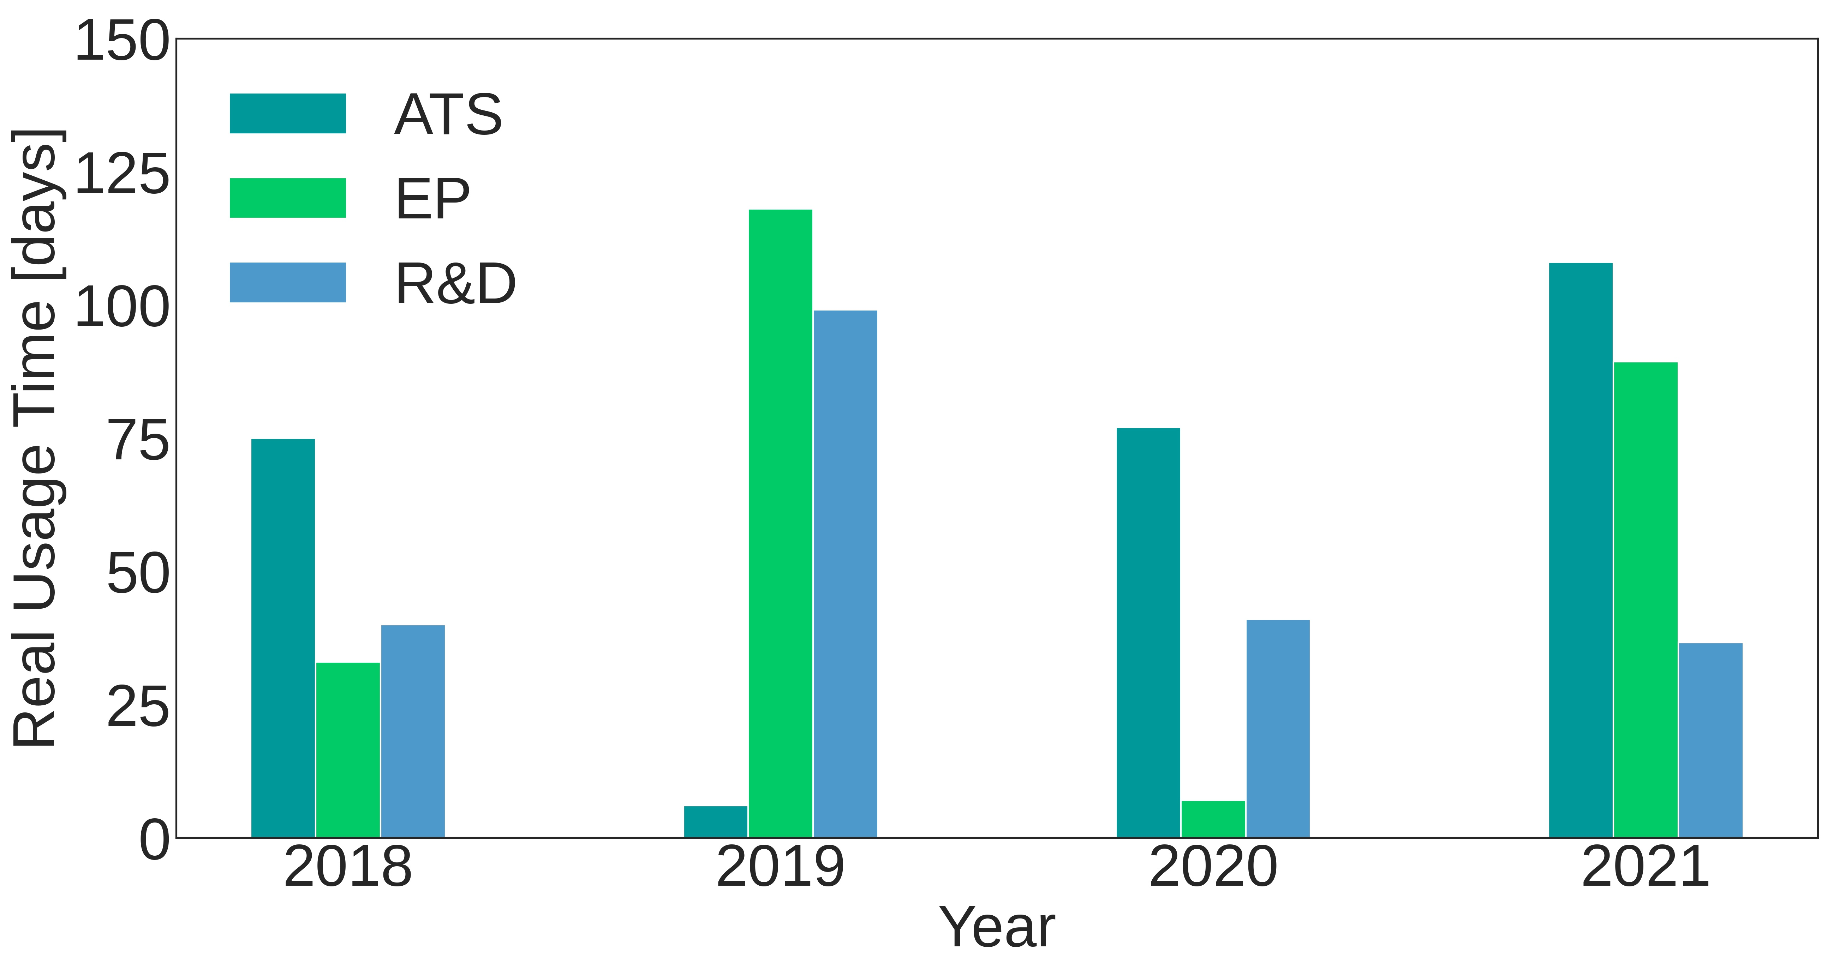
⁶⁰Co facility @ CERN
Co60 source 10TBq
dose rates from 20Gy/h up to 0.36Gy/h
Inside the irradiator setup: 200Gy/h to 100Gy/h on a small surface
Users can run in parallel
Users | Sector | Dose (Gy) | Time (days) | Experiment | Status
I. Ortega Ruiz | ATS | 60 k | ~100 | XBPF | Done
M. Rizzo | R&D | 1 k | ~40 | FGDOS | Done
M. Tornay | R&D | 2.4 k | ~15 | TC310 | Done
L. Marcon | EP | 10 k | 18 | CWDM Link | Done
V. Ryjov | EP | 1.6 k | 32 | ELMB2 | Done
A. Tarek | EP | 100 | 0.3 | LVPS | Done
A. Miranda | ATS | 100 | 1.5 | WIC PLC | Ongoing
M. Rizzo | R&D | 200 | 2.5 | FGDOS | Ongoing
D. Di Francesca | R&D | 10 | 1 | OFD | 9-14 June
V. Rieker | ATS | NA | 3 | HV Cables | 14-20 June
C. Clement | EP | ~220 | 10 | TileCal readout board for HL-LHC | 21-30 June
E. Auffray | EP | ~100 k | - | detector samples | Waiting for the New source

Slide 11
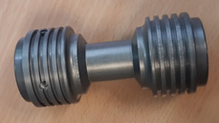
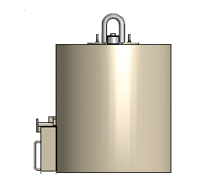
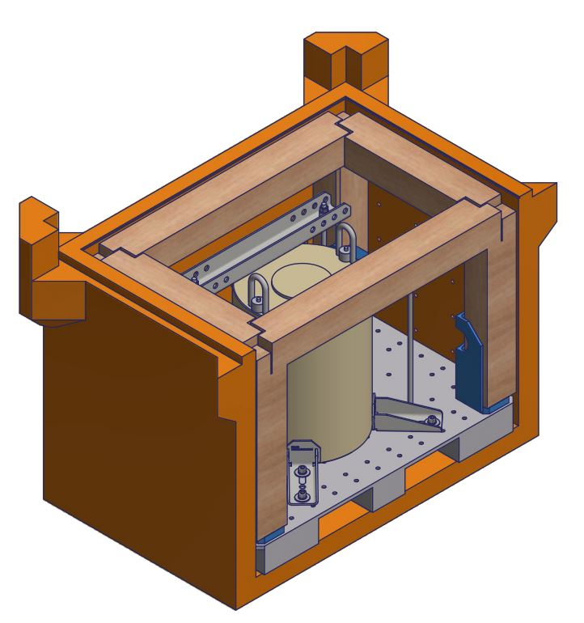
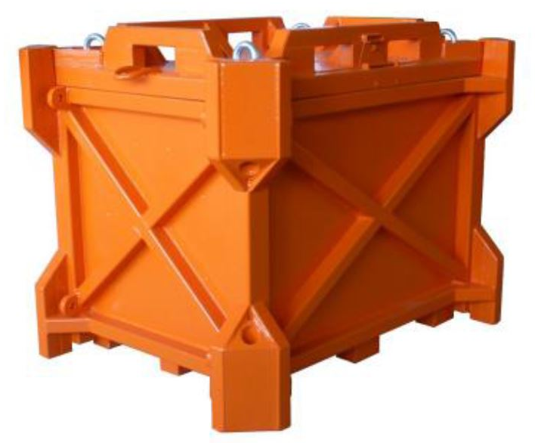
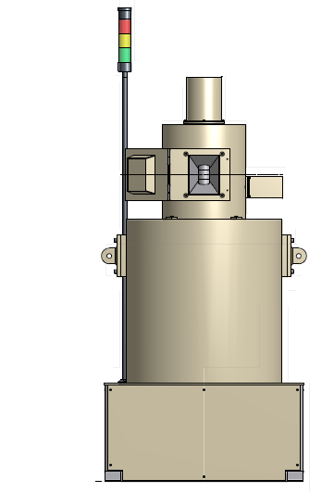
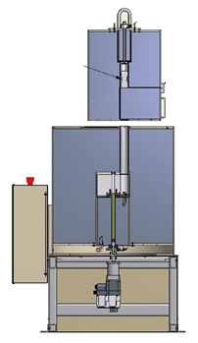
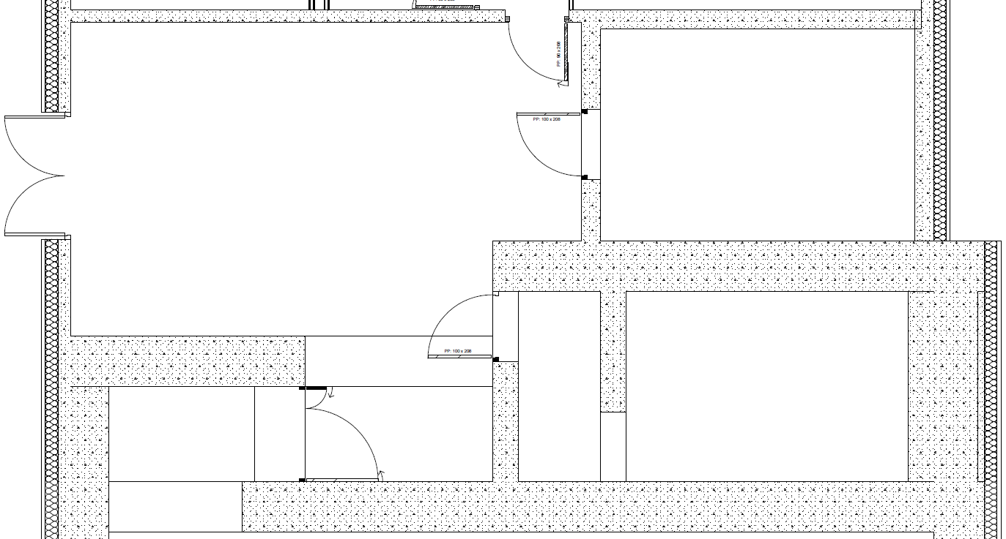
Installation Strategy for the new Co60 Source
Gamma Service produces the new source of 100TBq and loads it in a small container called rabbit, provided by Hopewell
The rabbit is stored in in the transfer shielding
The transfer shielding is stored in the shipping container and transported to CERN by Gamma service
The container is open, and the transfer shield is extracted
The transfer shield is brought next to the irradiator
The transfer shield is lifted on top if the irradiator
The drawer is open and the rabbit fells in the irradiator
Once the rabbit is loaded, the irradiator can be
closed and tested
Rabbit
Transfer Shielding
Shipping Container
Buffer Zone R-001
Irradiation Room
08/06/2021
11

Slide 12

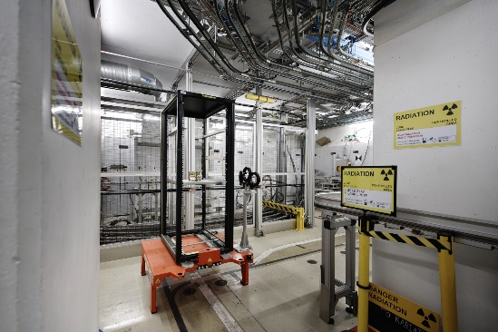
CHARM Facility
New CHARM Website
Test requests : https://charm.web.cern.ch/content/radiation-test-request
Beam in CHARM should start in week 42 allowing 4 weeks of operation
Current EA Renovation schedule might allow to start beam in week 38 allowing 8 weeks of operation (tbc)
Facility will need commissioning (1-2 weeks) delaying the effective start and the operational weeks
User | Type of equipment to be tested | Institute-Company | Target Dose [Gy]
Jelena Spasic | Quench detection system (new bus-bar detector, new nanoFIP fieldbus client, old symmetric quench detector) | CERN | 500
Cristina Fernández Bedoya | Digital electronic boards (30x10 cm) | CIEMAT | 50
Edward Nowak | DQHDS for IPQ/IPD/IT, EDA-04198, HL-LHC | CERN | tbd
Miguel Cerqueira Bastos | DCCT - 120A current measuring trasnducer | CERN | 400
Sabino Meola | irradiation test for CMS improved-RPC Front-End electronics | Cern (CMS - RPC group) | 60
Nikolaos Chatzigeorgiou | Penning conditioning electronics for vacuum gauges (for LS3 production) | CERN | 500
Nikolaos Chatzigeorgiou | Power supply electronics for vacuum gauges (for LS3 production) | CERN | 500
Nikolaos Chatzigeorgiou | Pirani conditioning electronics for vacuum gauges (for LS3 production) | CERN | 500
Nikolaos Chatzigeorgiou | Piezo conditioning electronics for vacuum gauges (for LS3 production) | CERN | 500
Stephane Burger | MicroCameras New Radiation Hard. BeamCam | CERN / MicroCameras | 400 (can we think of the same approach as for the BASLER camera test - CHARM035 & 037--> 1x low rate period and 1x higher rate period?)
Adrian Miranda Fontan | PLC (Programable Logic Controller) | CERN | 40

Slide 13

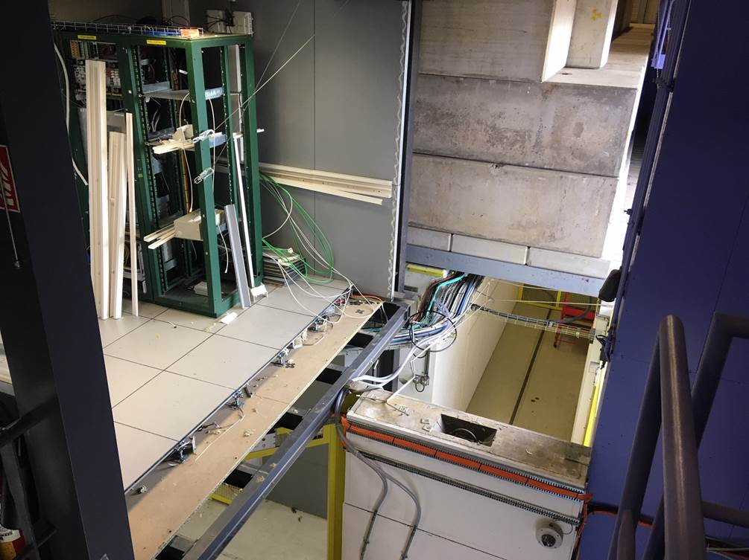
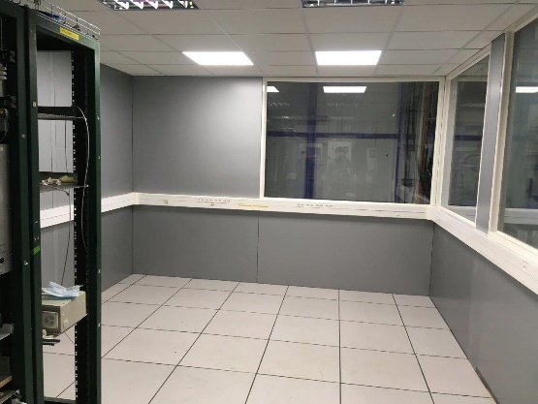
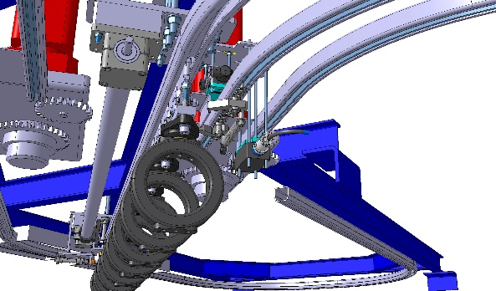
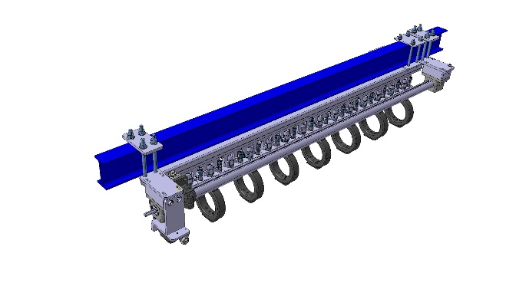
Upgrade
Extension of the CHARM control room
New cables in the overhead conveyer
Movable Diamond detector BLM for in-spill dosimetry (with SY-BI)
New Beam instrumentation in the T8 (with IRRAD, BE-EA and BE-BI)
Telescopic feet and controls for new T8 instrumentation (with CEM-MRO)
On going: Automatic cable chain insertion system BE-EA

Slide 14
Other facilities testing
Thermal Neutrons
  10hours of beam time in ILL with Thermal Neutrons for SRAM and FPGA characterization on the 1st of July
JSI
  DD test of TE/MPE optocoupler to be shipped for passive irradiation
  Possibility to test other bipolars in the same campaign

Slide 15
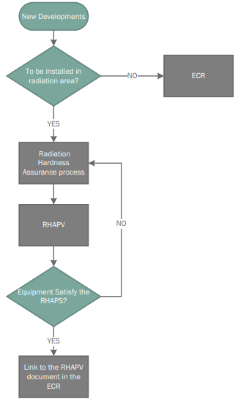
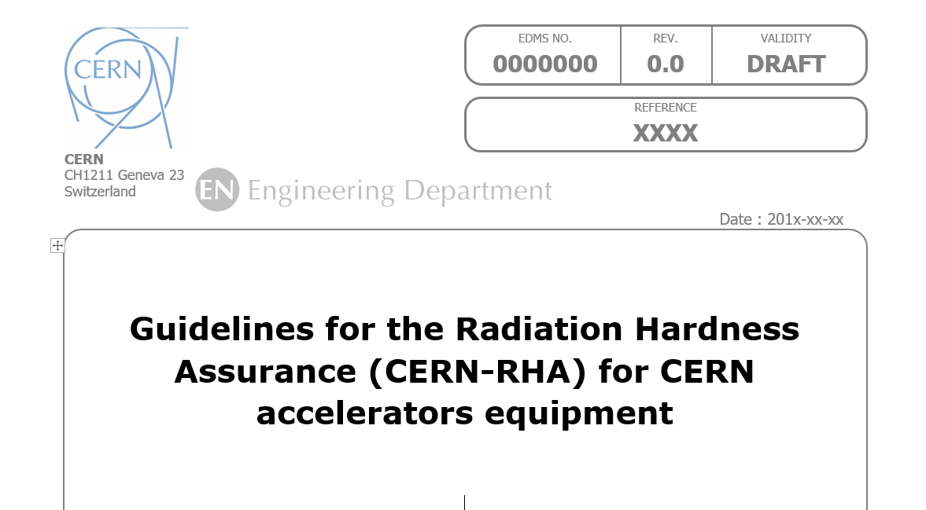
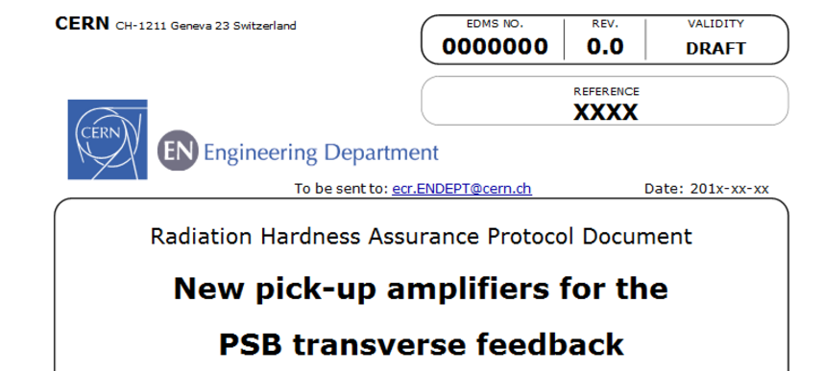
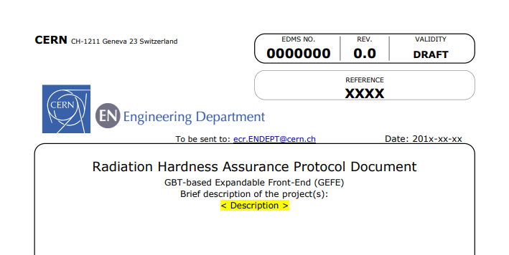
RHA validation procedure
A system radiation hardness assurance (HRA) procedure was developed within the R2E project:
Linked to the Engineering Change Request (ECR) as final validation
  Check-box in ECR template for electronics installed in possible radiation area
Contains the RHA Project Validation (RHAPV) document as cornerstone
  The RHA for the various developments is reviewed and approved by R2E project management, ensuring an independent check with respect to system developers and testing activity
Radiation Hardness Assurance Project Validation (RHAPV) document
Example of a filled document can be found here
Radiation Hardness Assurance Procedure (RHAP) document
GEFE RHAPV
Testing of electronic components by R. Ferraro (BE-CEM-EPR )

Slide 16
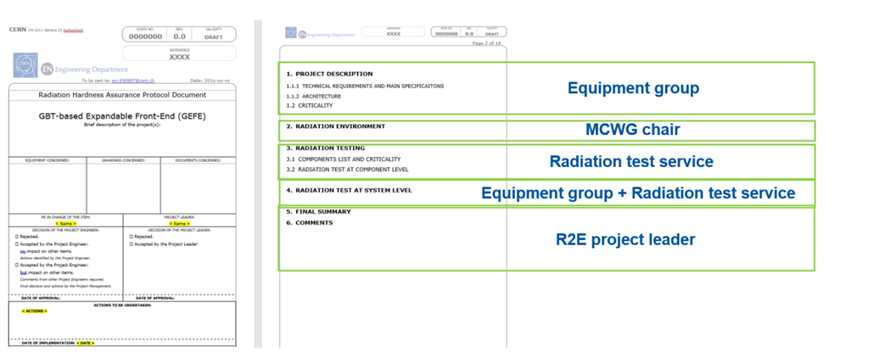
RHA Project Validation (RHAPV) details
Testing of electronic components by R. Ferraro (BE-CEM-EPR )

Slide 17
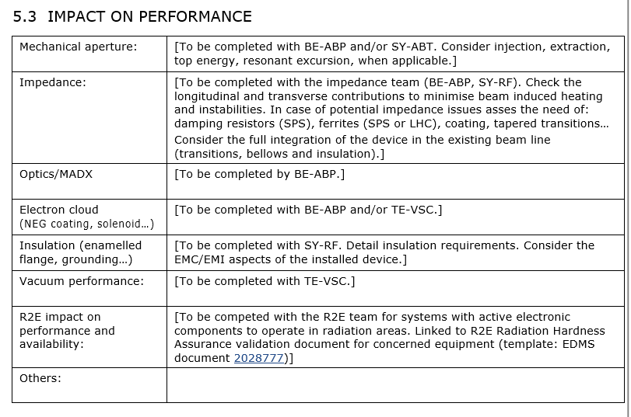
ECR Template

Slide 18
THANK YOU

