Slide 1
RADWG Activities Overview
Rudy Ferraro (BE-CEM-EPR)
RadWG Workshop – 8 June, 2021

Slide 2
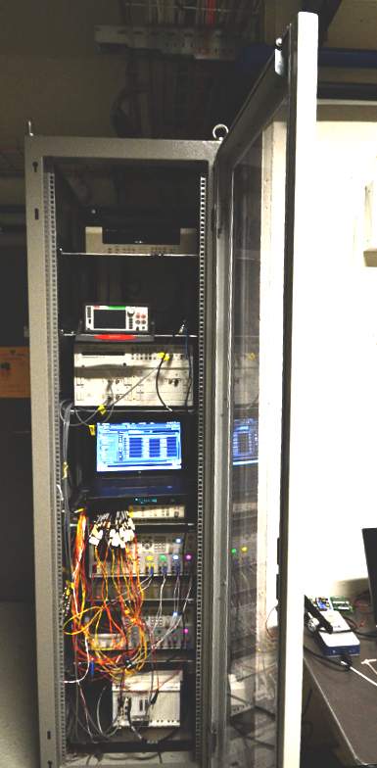
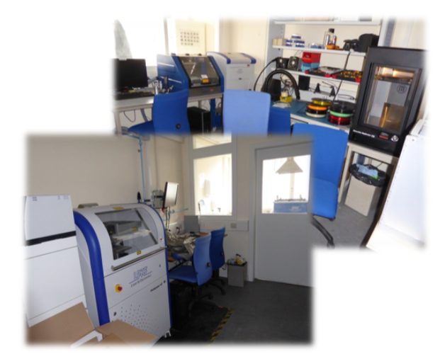
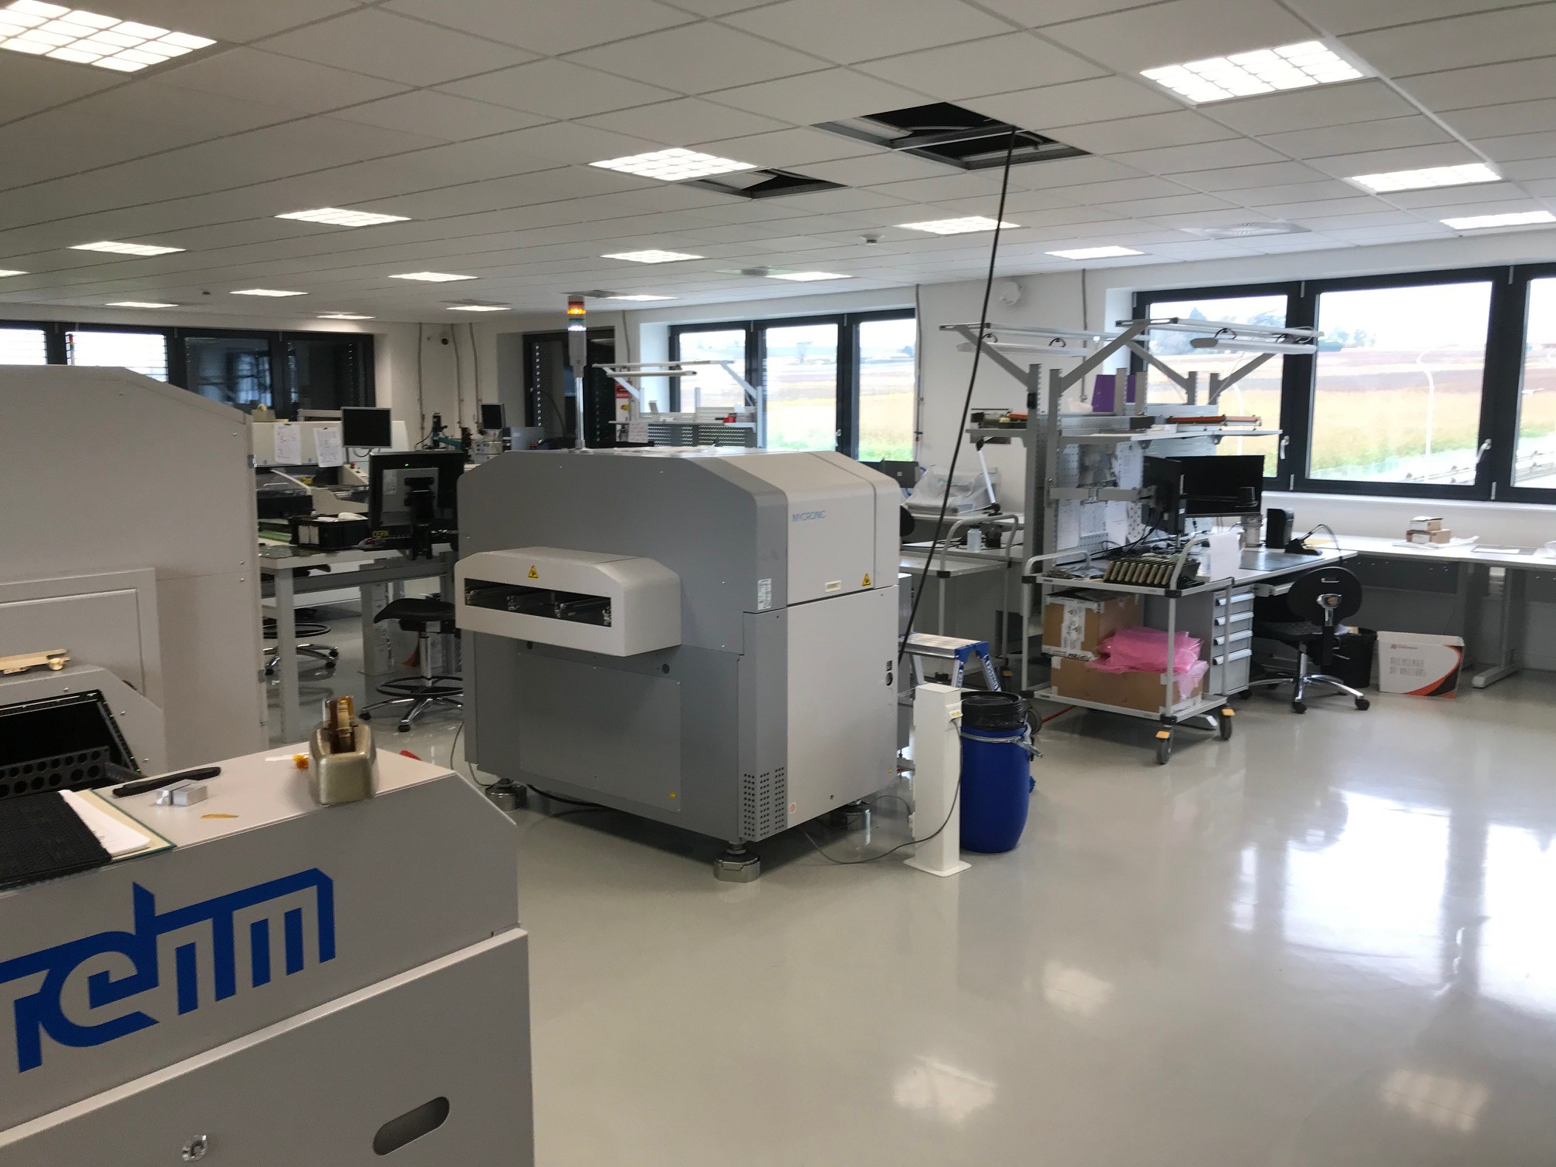
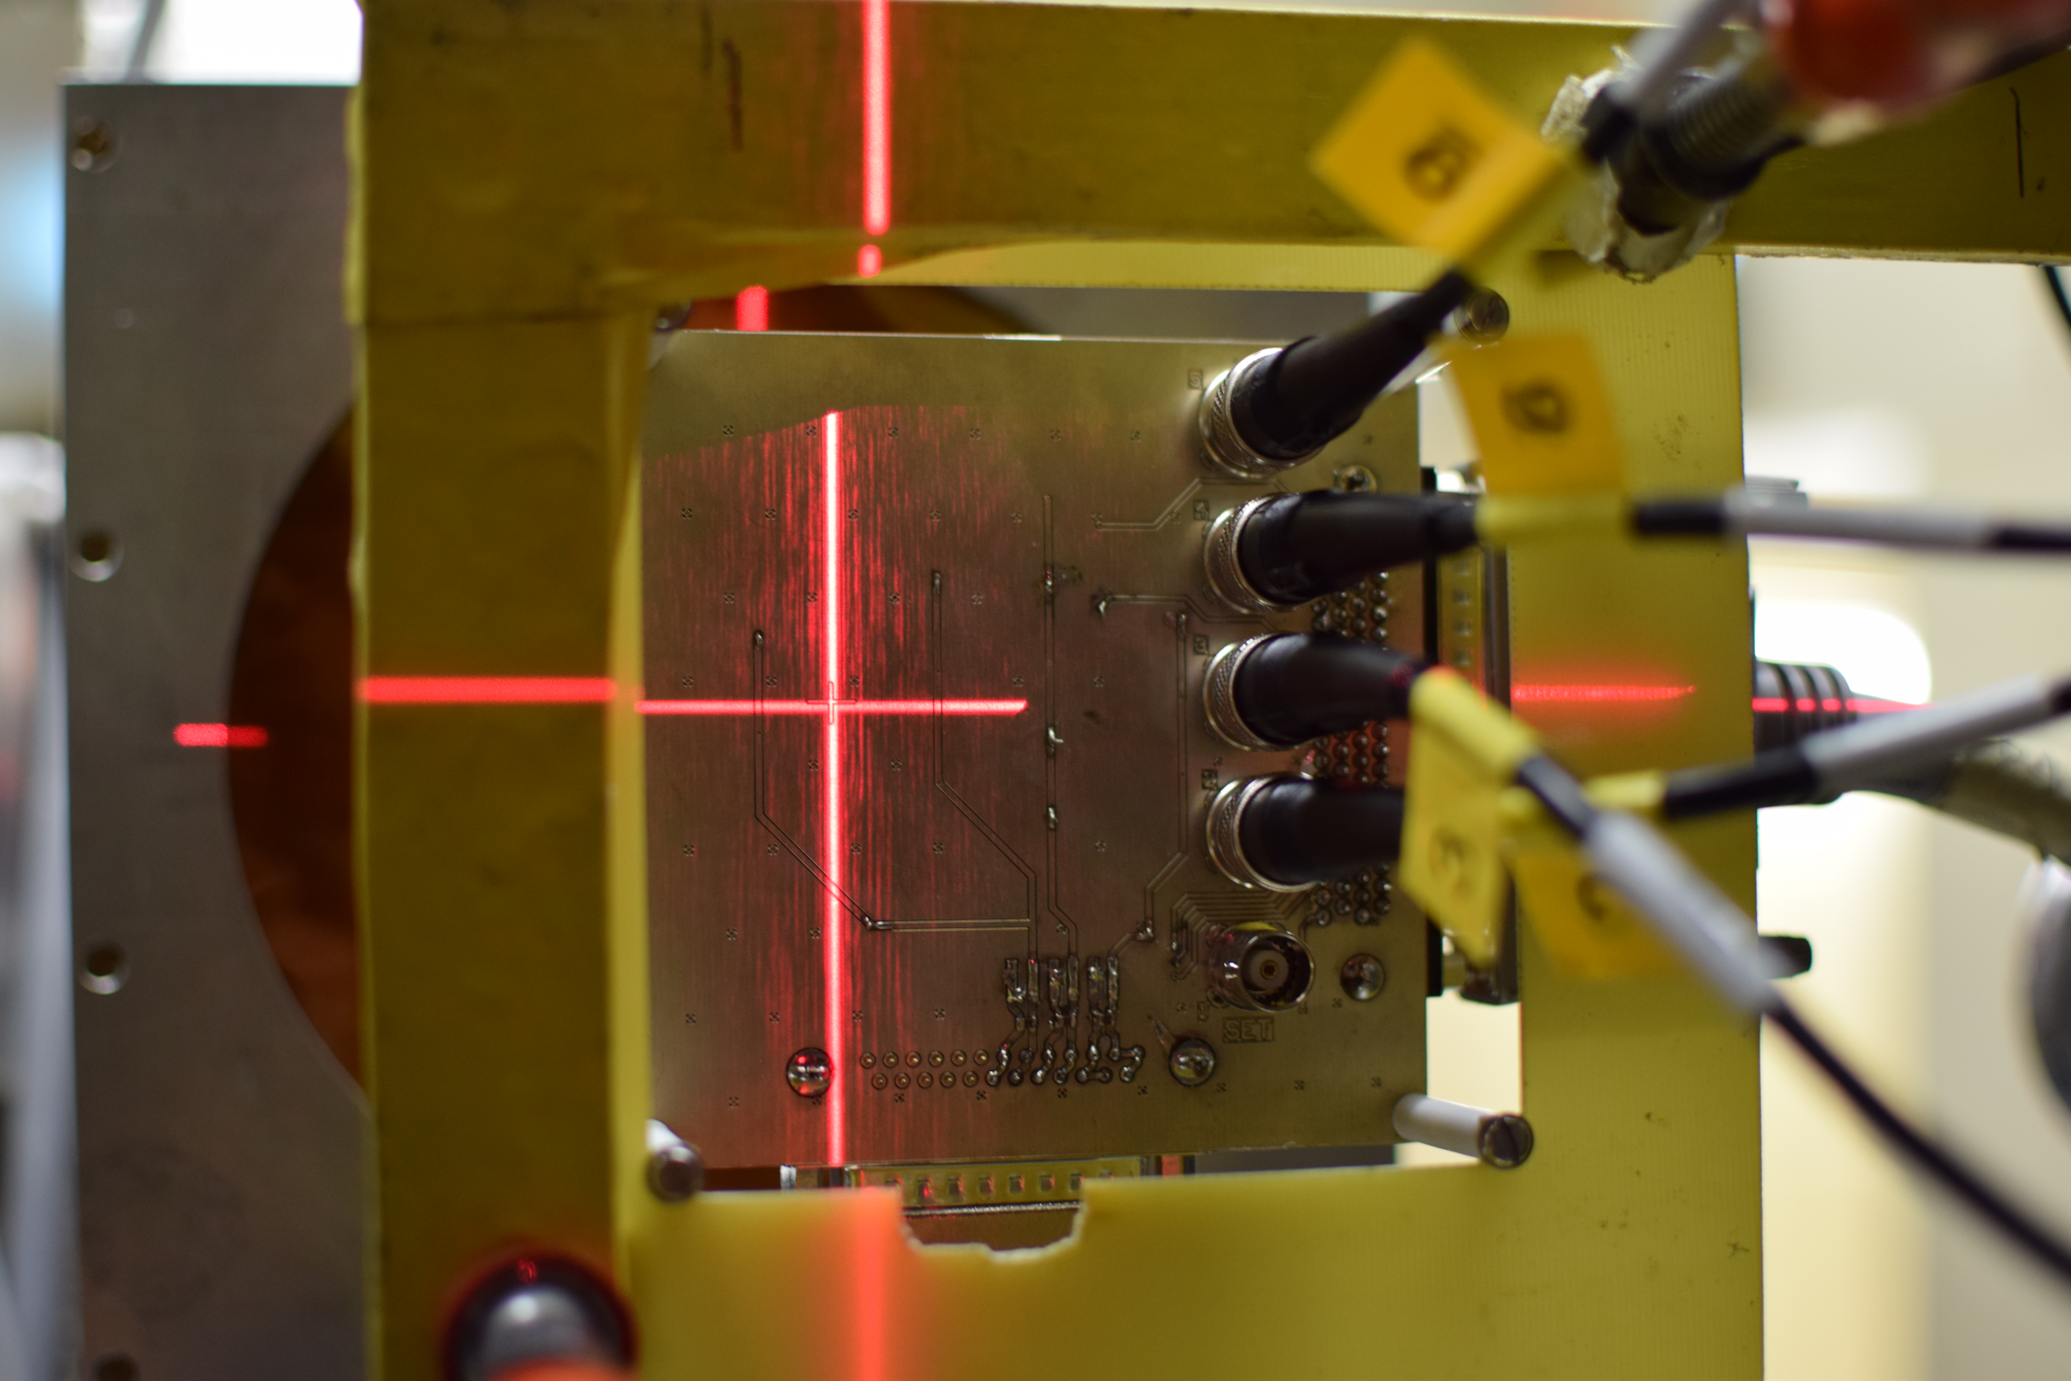
Radiation Test Service
BE-CEM-EPR provides, through R2E resources, the service of radiation testing of electronic components supporting the Radiation Working Group (RadWG)
19/1-019 Rapid Prototyping lab
107/1-A10 Main PCB Assembly Atelier
PSI Beam Line
CC60 Instrumentation
RADWG Activities Overview by R. Ferraro (BE-CEM-EPR )

Slide 3
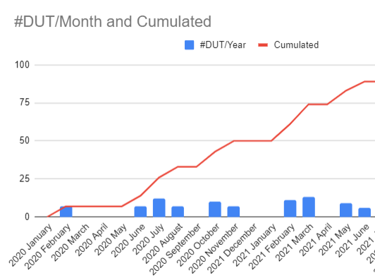
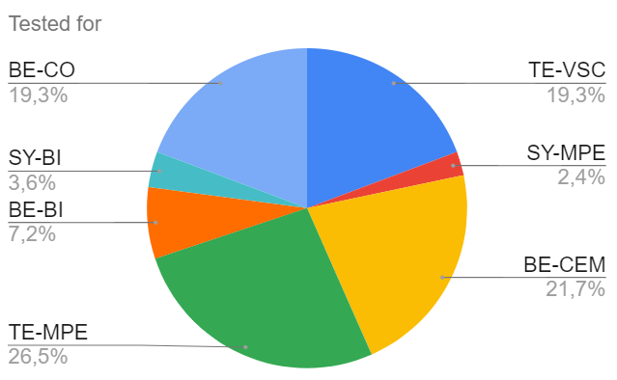
2020-2021 in Numbers
100 requests collected
90 components & Systems tested
  New components but also a lot of system consolidation
15 Radiation campaigns (10*PSI, 4*CC60, 1*ILL)
All the equipment groups in charge of new developments requested to qualify their selected components
Covid lockdown
RADWG Activities Overview by R. Ferraro (BE-CEM-EPR )
Notes:
Add images of facilities

Slide 4
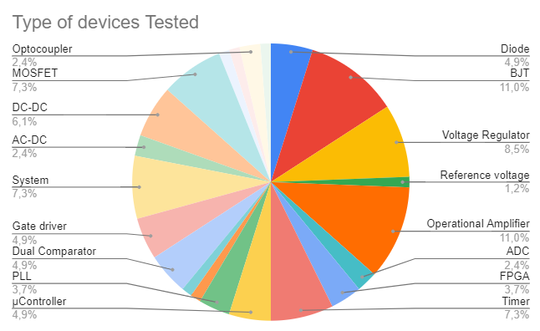




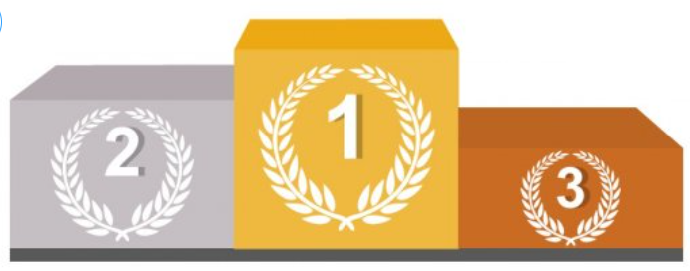
2020-2021 in Numbers
Regulators & converters
Opamps
BJT
Most Tested Devices
RADWG Activities Overview by R. Ferraro (BE-CEM-EPR )
Notes:
Link to the radWG database

Slide 5
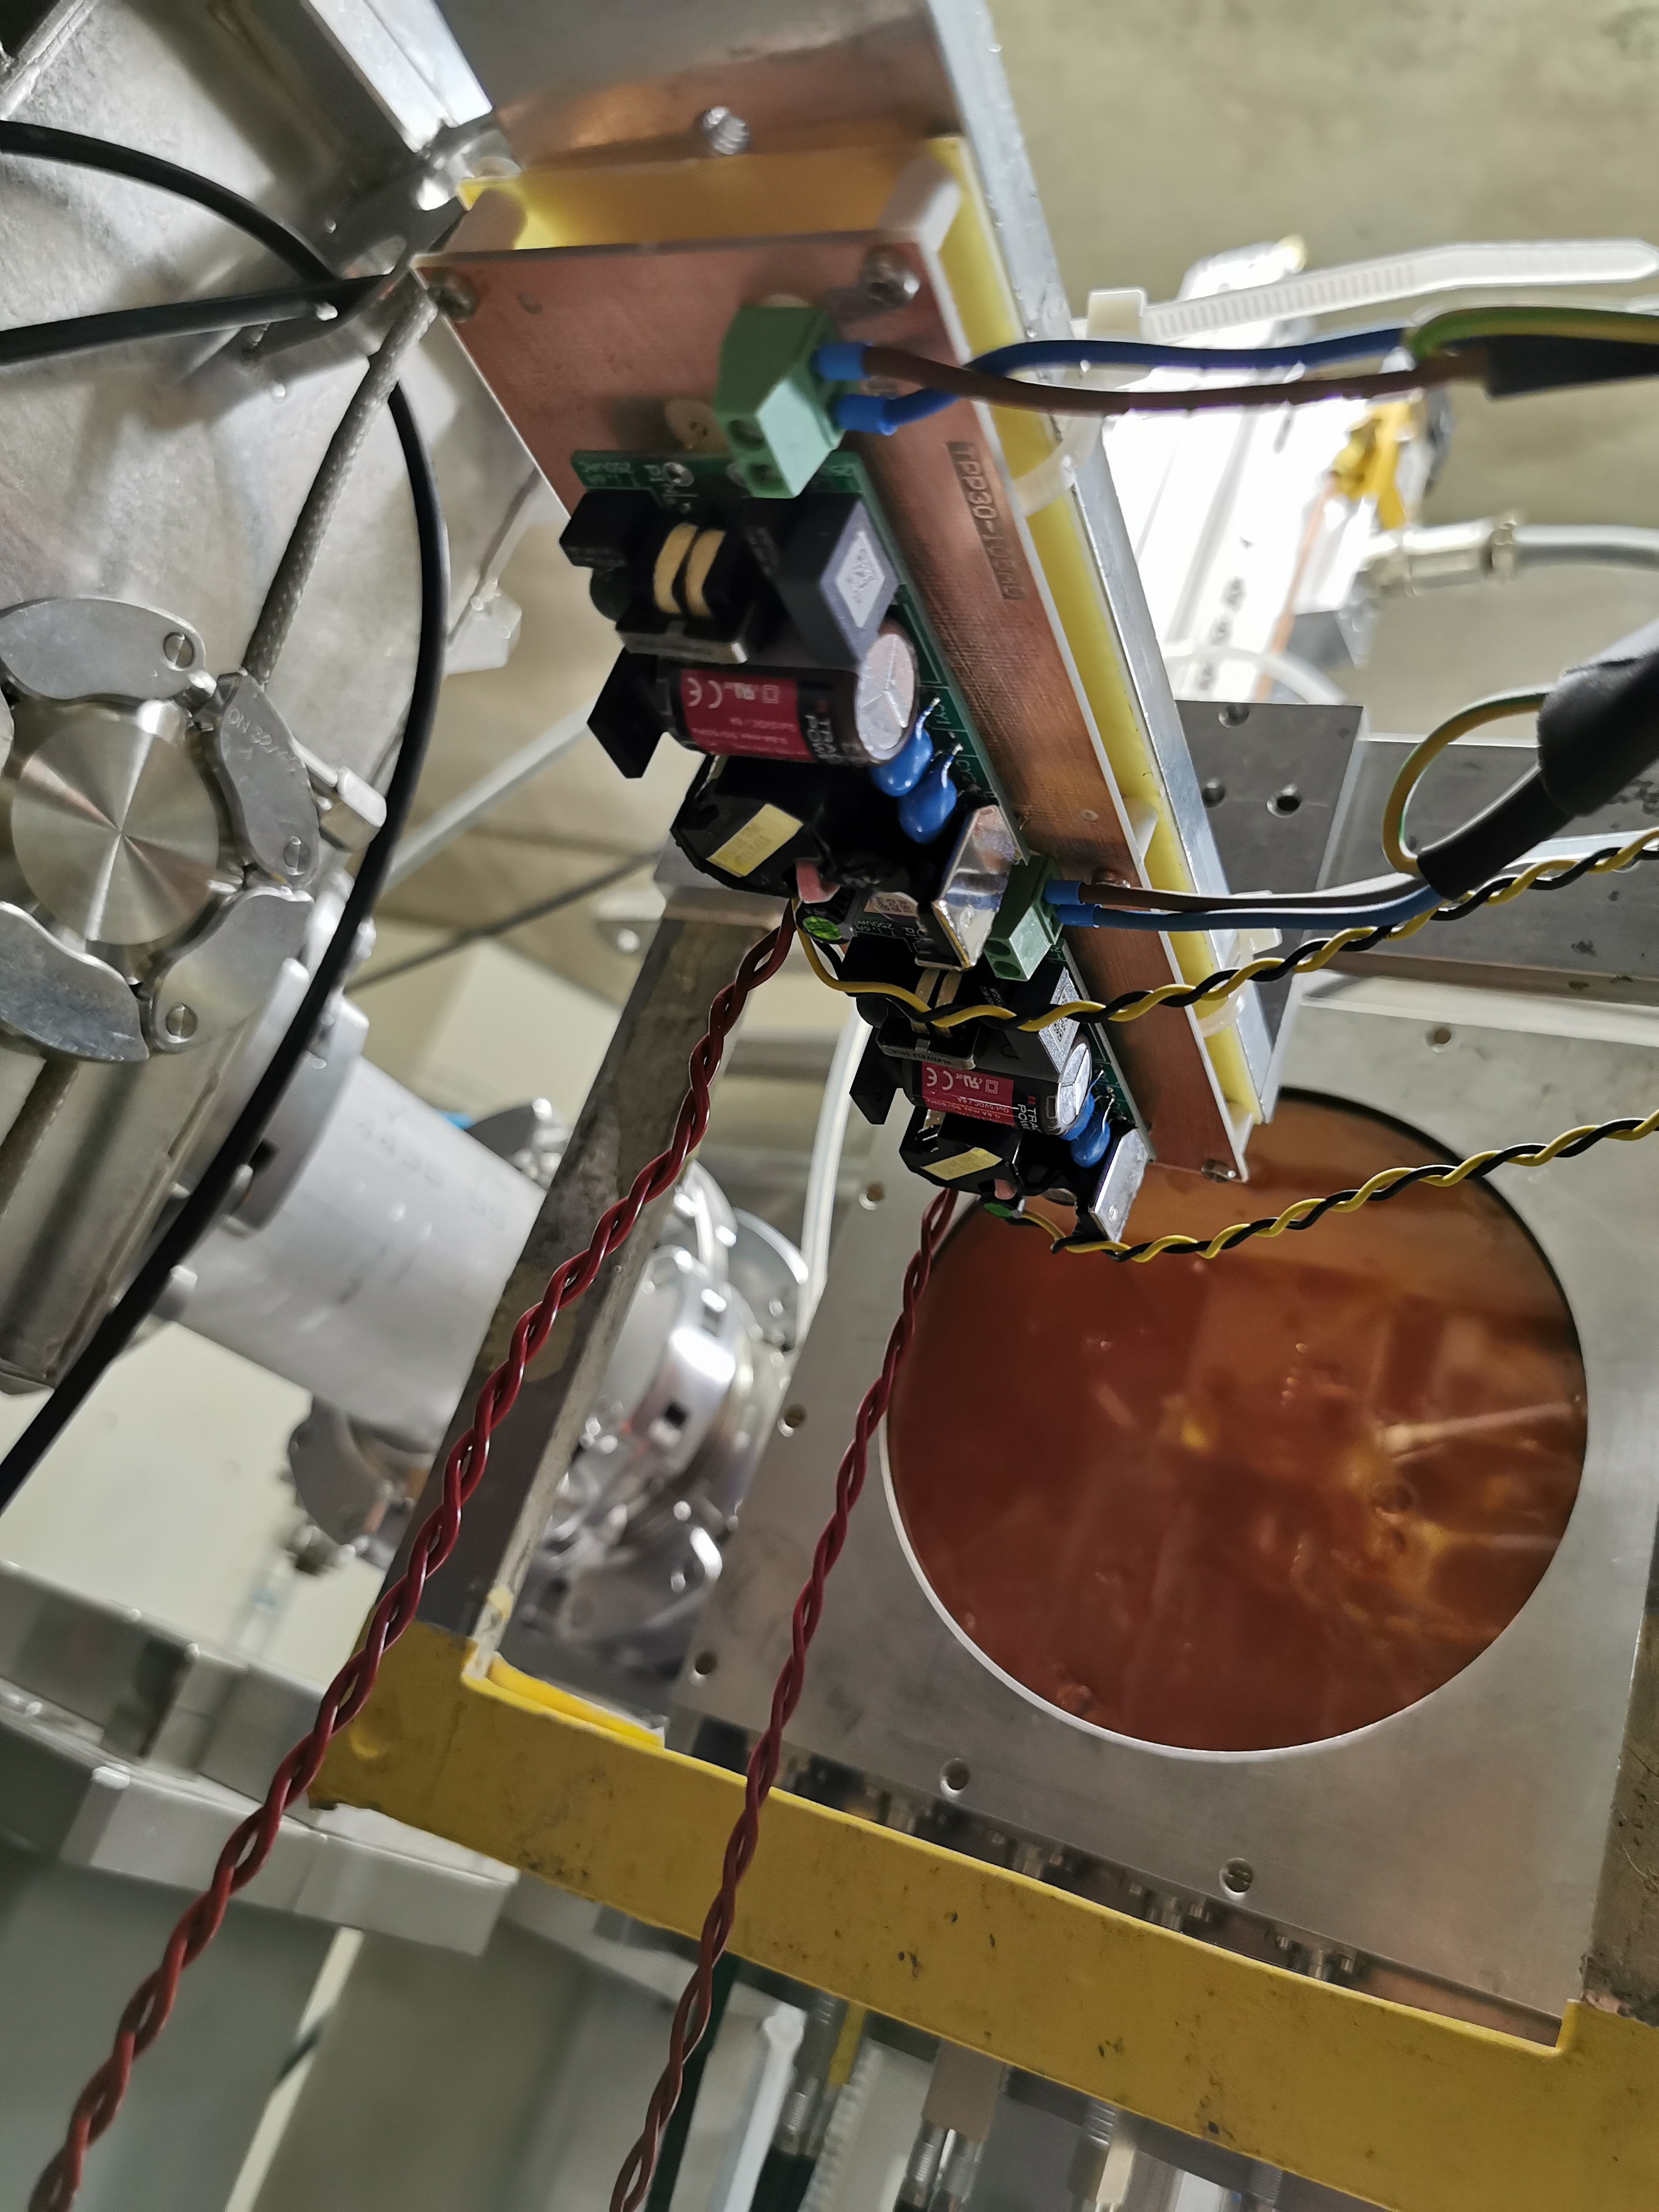
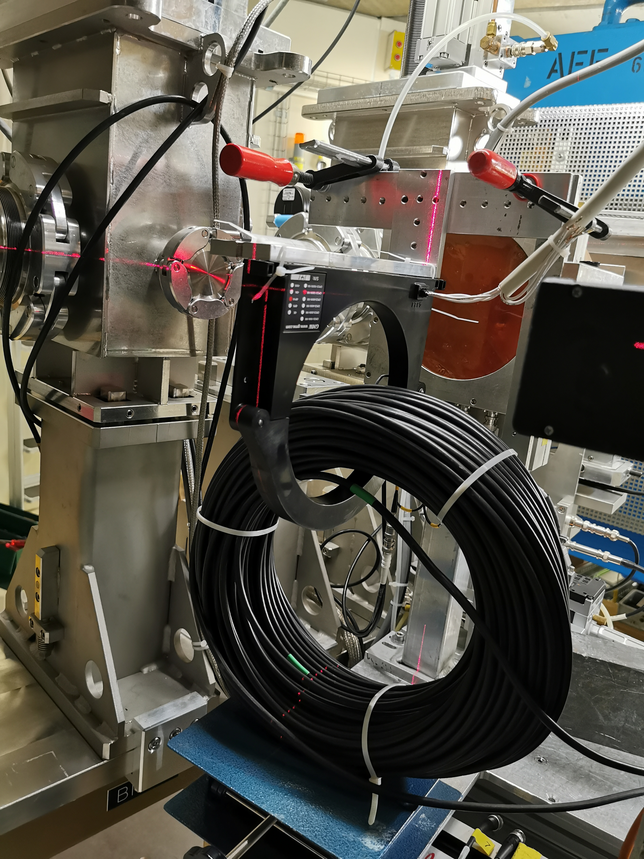
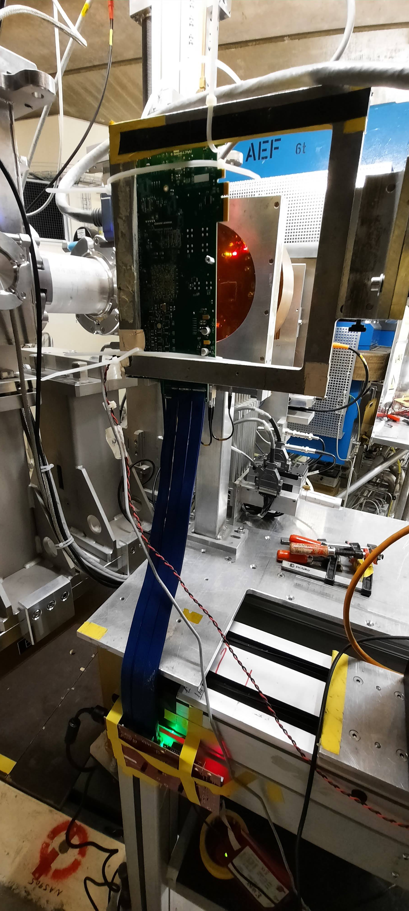
2020-2021 in pictures
DC-DC Converters
Current Probe
FPGAs
RADWG Activities Overview by R. Ferraro (BE-CEM-EPR )

Slide 6
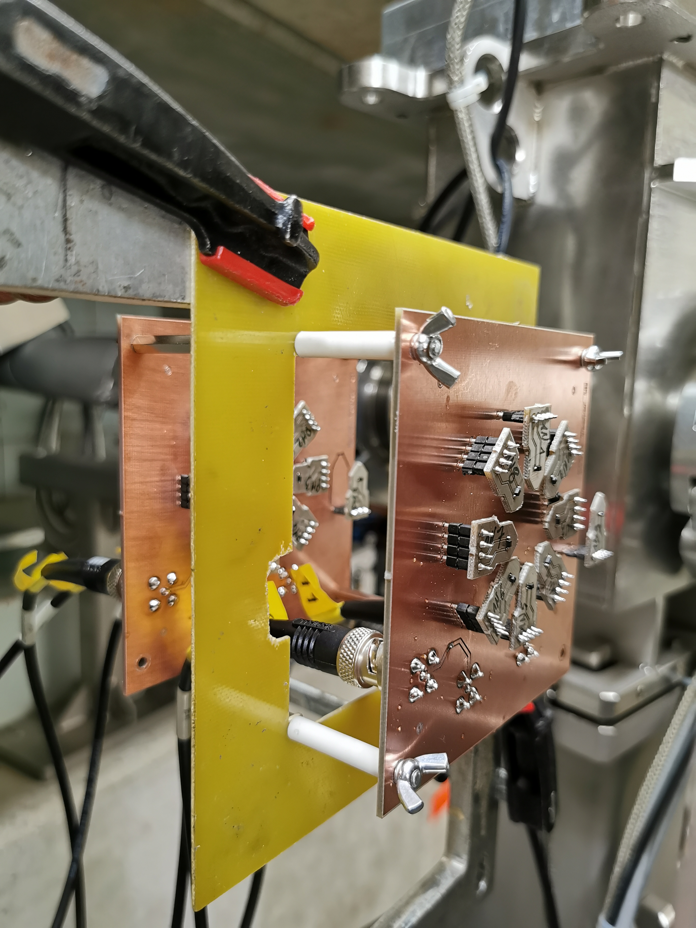
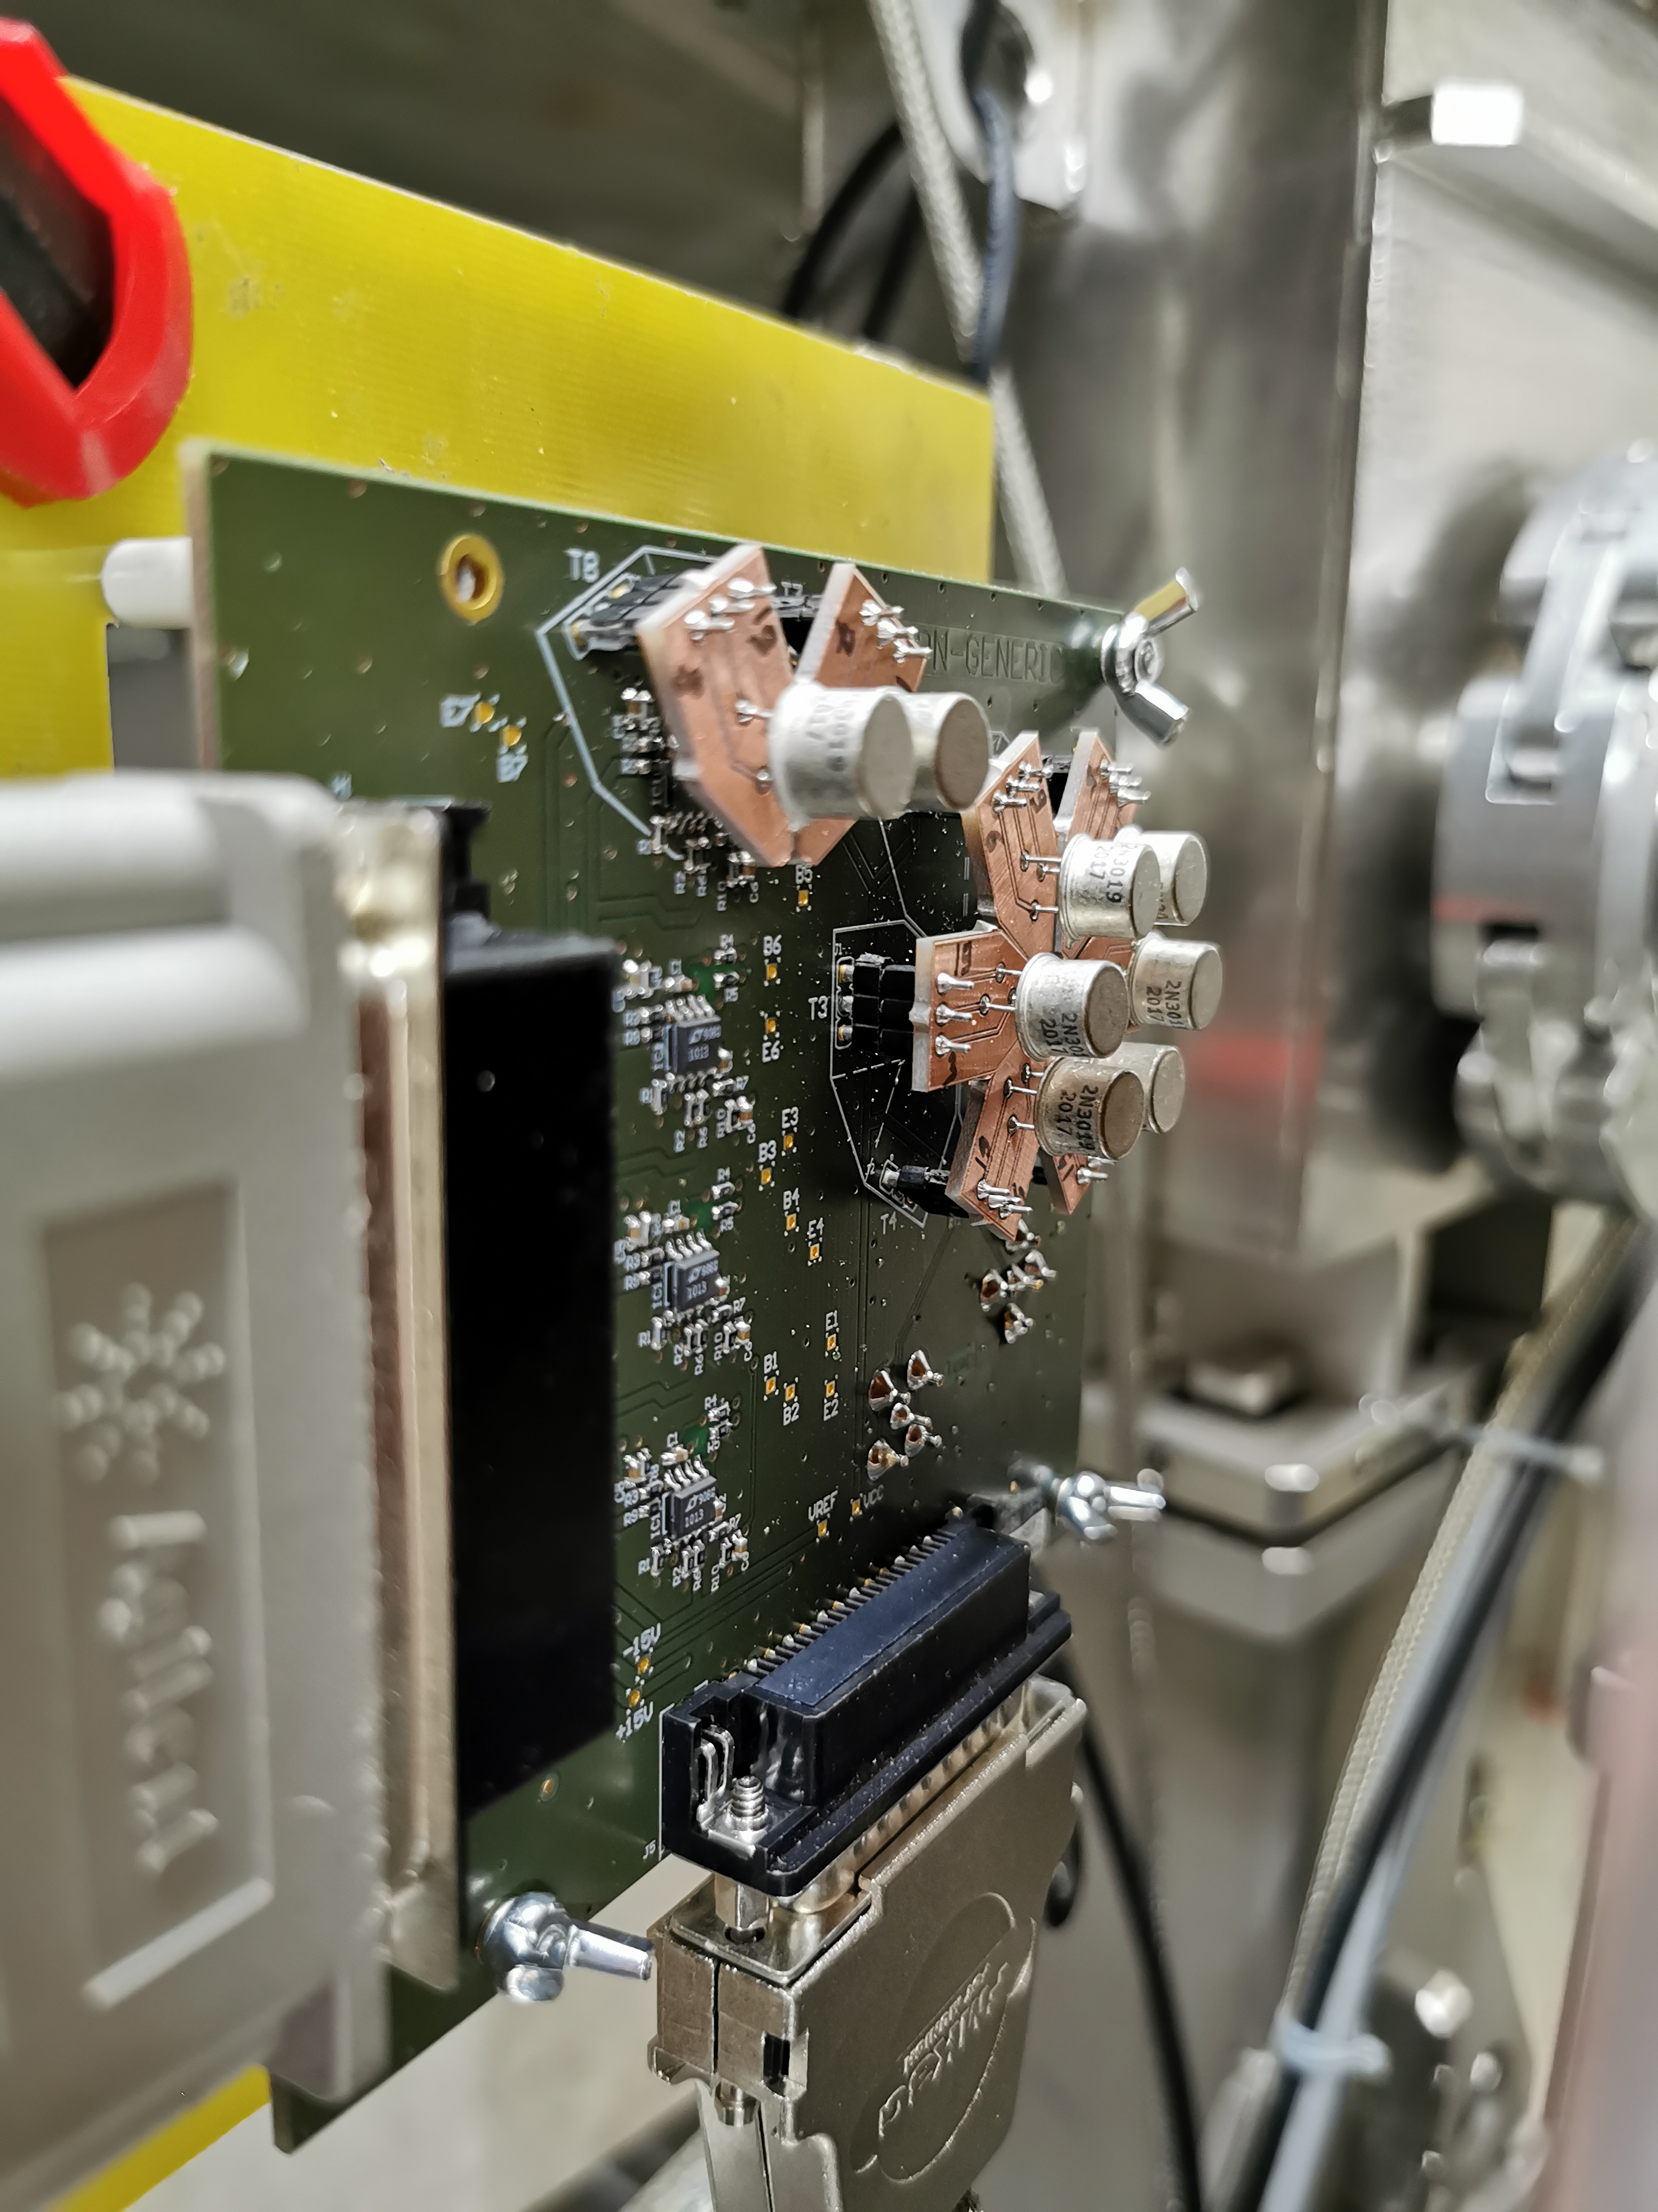
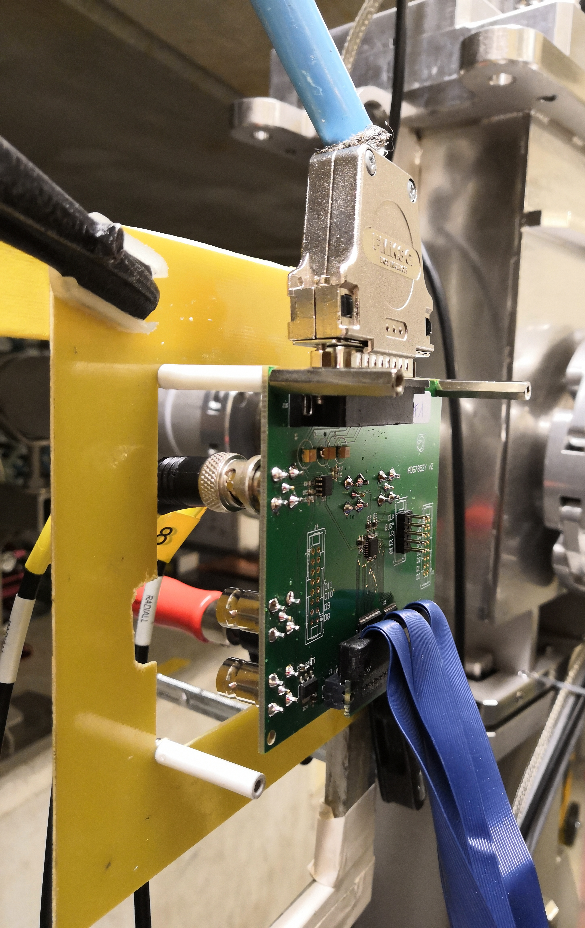
2020-2021 in pictures
BJTs
More BJTs
ADCs
RADWG Activities Overview by R. Ferraro (BE-CEM-EPR )

Slide 7
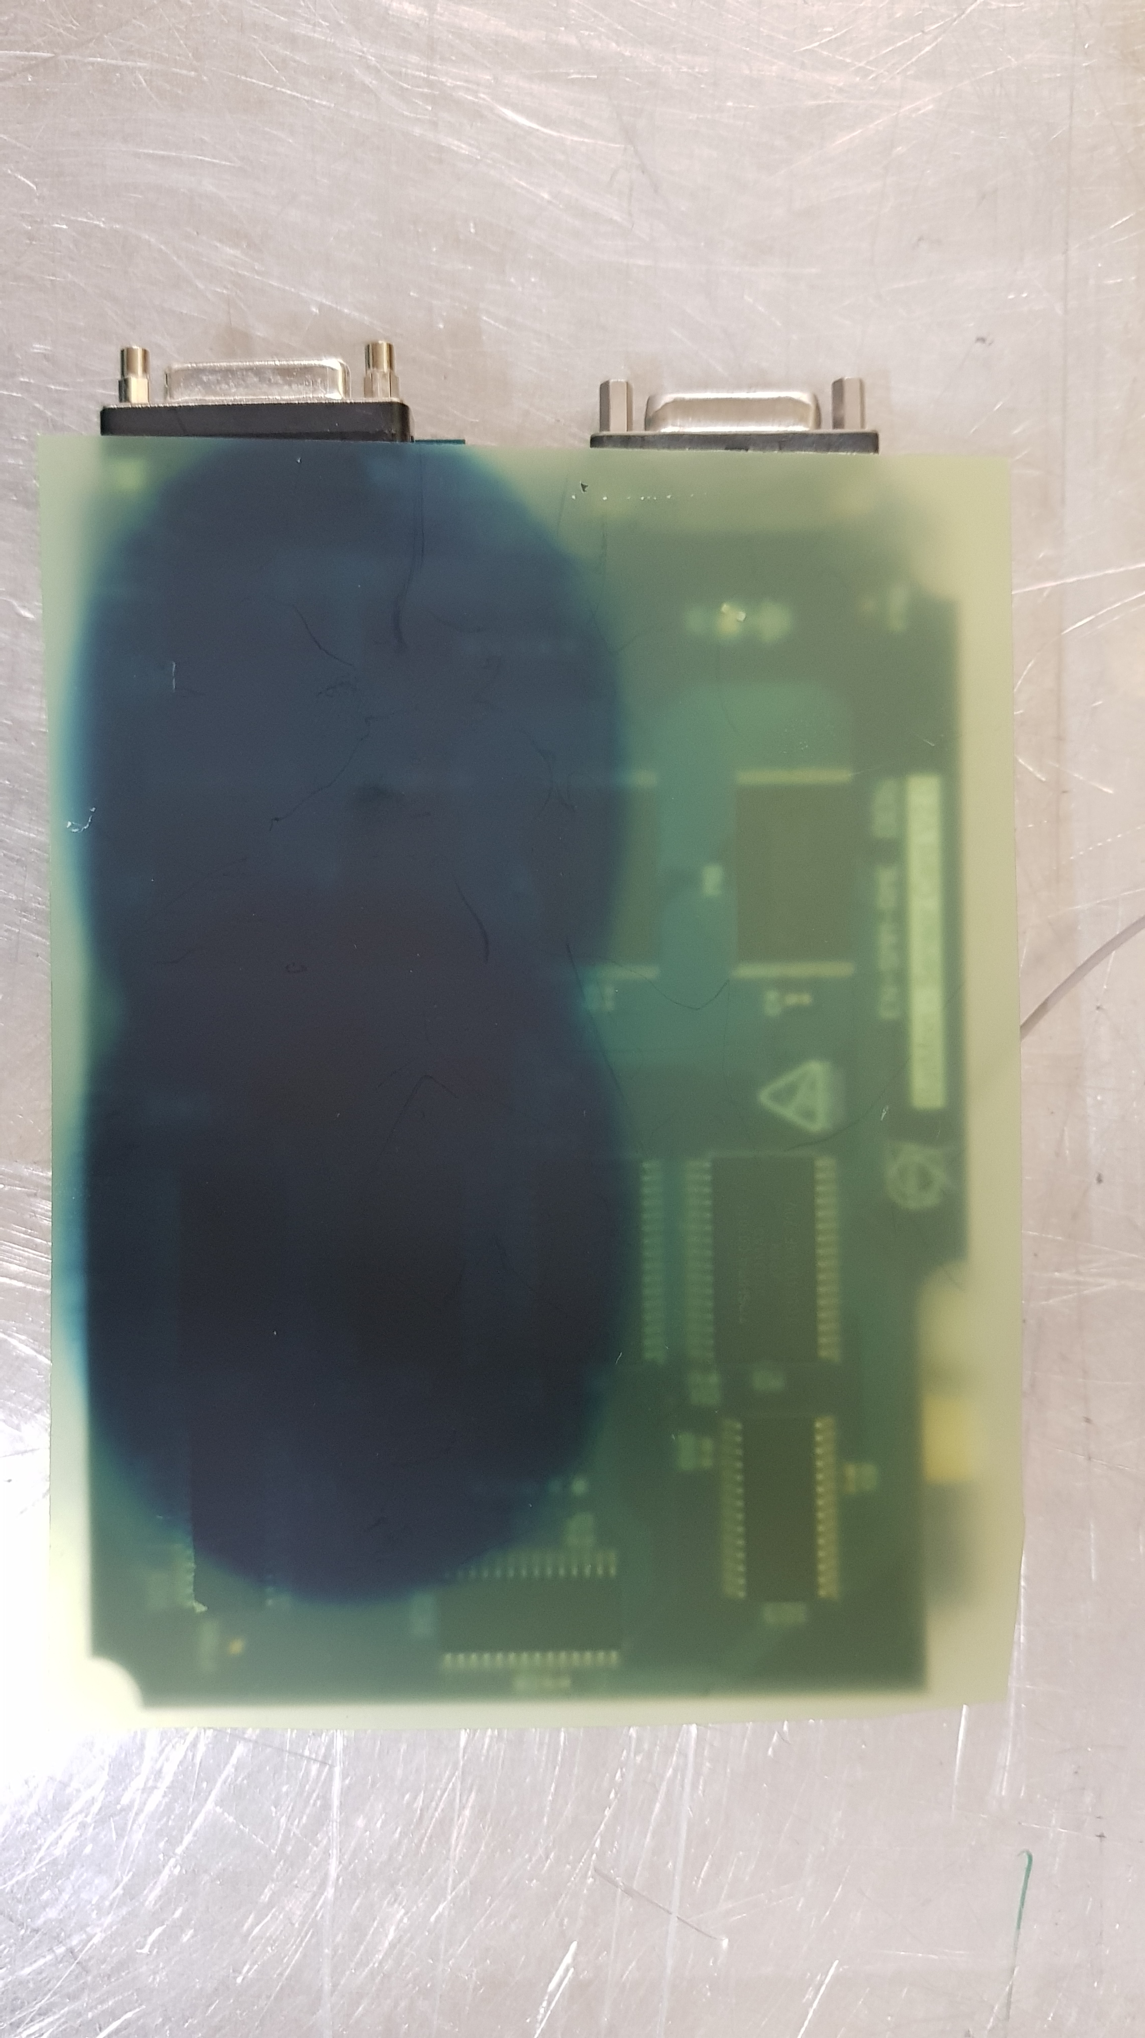
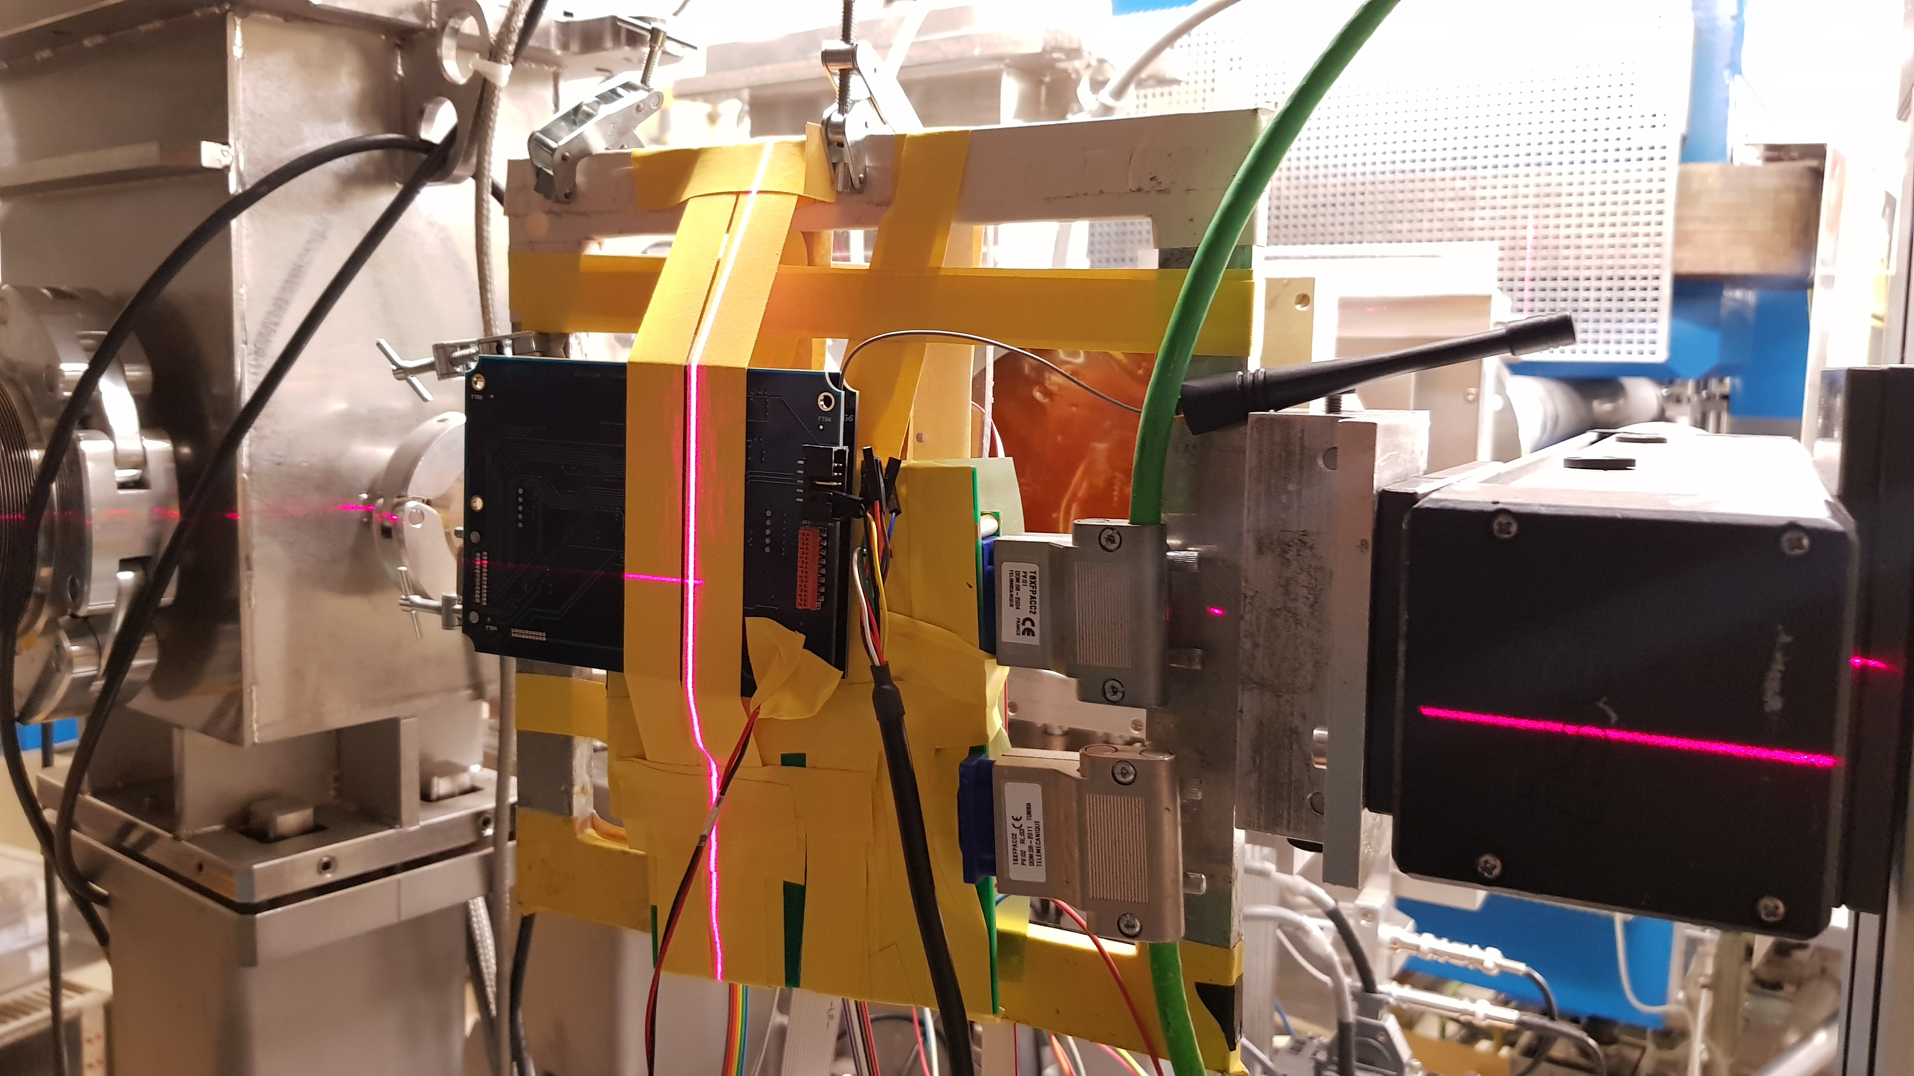
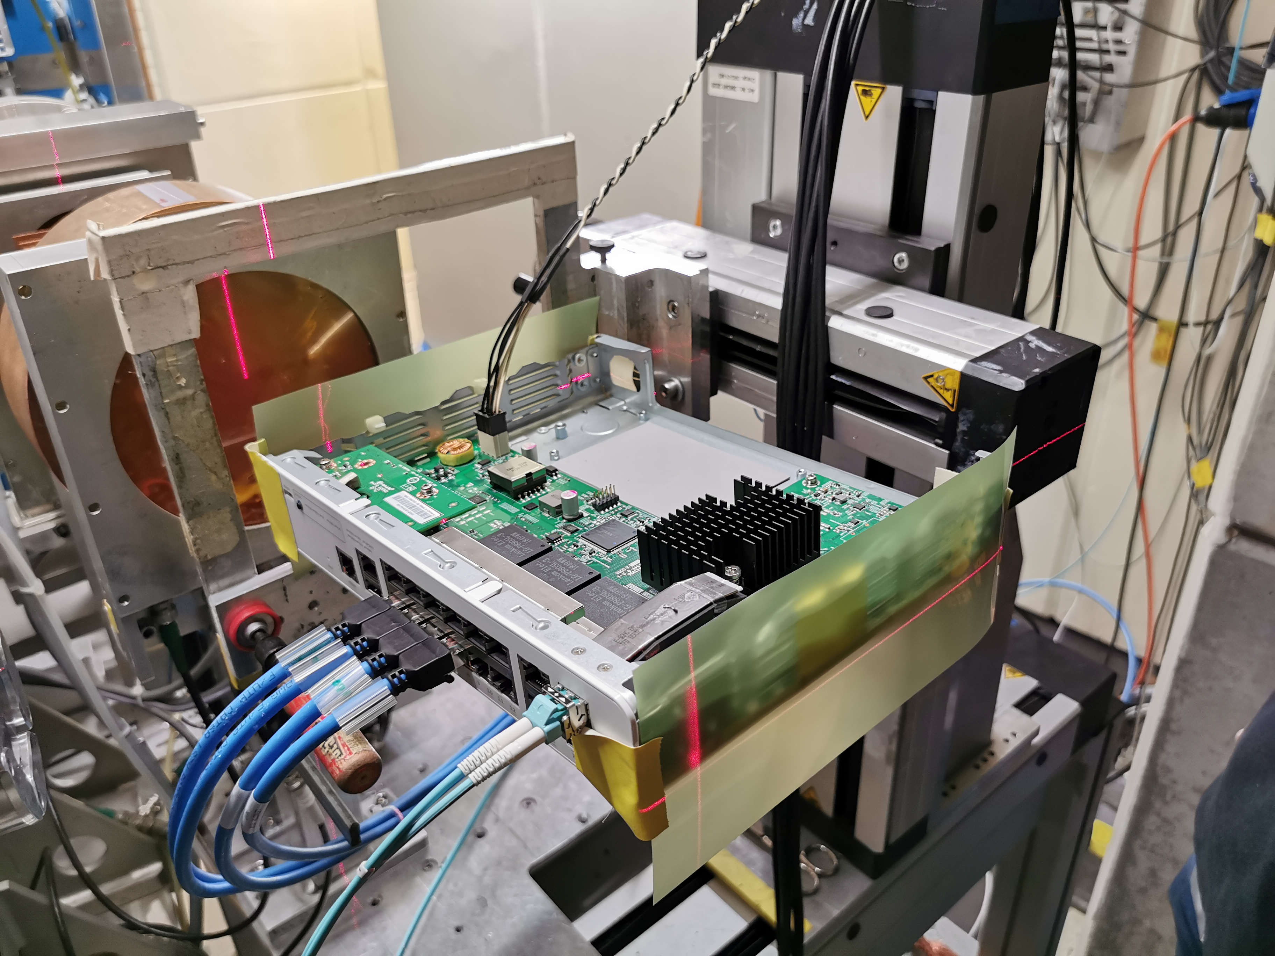
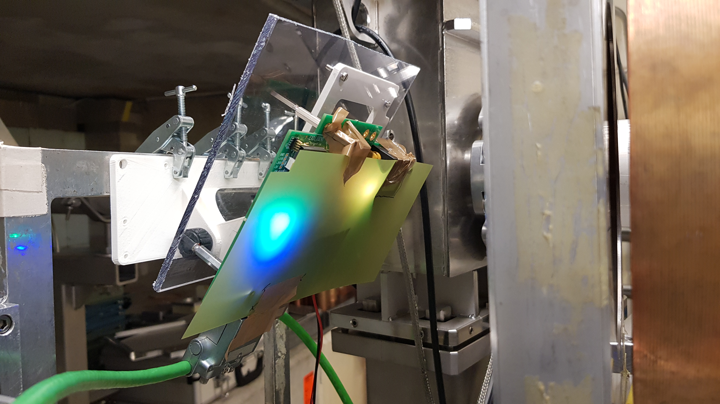
2020-2021 in pictures
PSI not meant for System level tests
But tests need due to urgency of the system qualification
Challenging due to size and setup limitations
“Nothing beat CHARM”
BE-CEM
Monimod
BATMon
BE-CEM-EDL
Powerlink router
WorldFip Cu-Cu repeater
BE-BI
BE-OP
RADWG Activities Overview by R. Ferraro (BE-CEM-EPR )

Slide 8
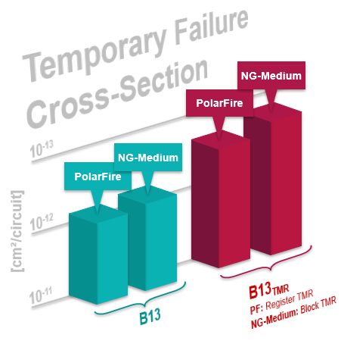
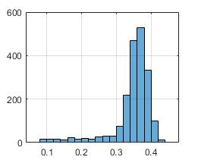
Recent outcomes
New FPGA qualifications: PolarFire & NanoXplore
  PolarFire SEE sensitivity one order less of magnitude wrt SmartFusion
  PolarFire programmability > 2.5 kGy !! (SmartFusion ~ 100 Gy)
  No increase of propagation delay up to 5 kGy !
  High sensitivity to thermal neutrons
  Reports: 2475661; 2319932; R2E presentation
  Research: Use of Benchmark test circuit for qualification
DFF
5 kGy
^{[cm²/FF]}
FF
FF Logic
FF_{TMR}
FF logic_{TMR}
PolarFire Propagation delay increase [%]
A.Scialdone ‘FPGA Qualification and Failure Rate estimation Methodology for LHC Environments Using Benchmarks Test Circuits’, oral RADECS2021
RADWG Activities Overview by R. Ferraro (BE-CEM-EPR )

Slide 9
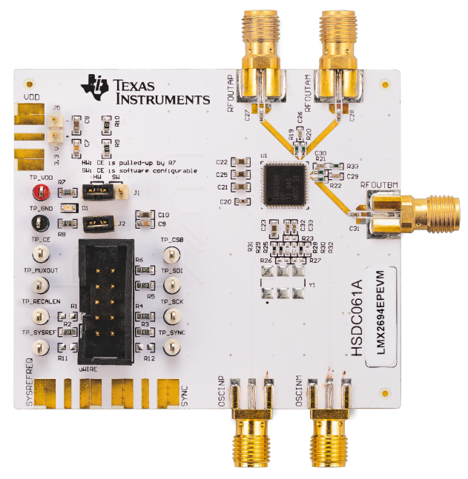
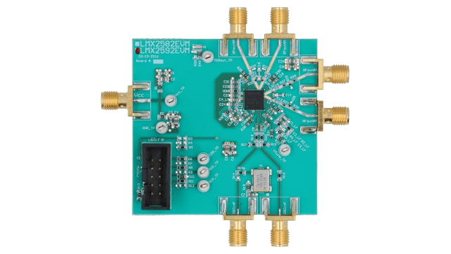
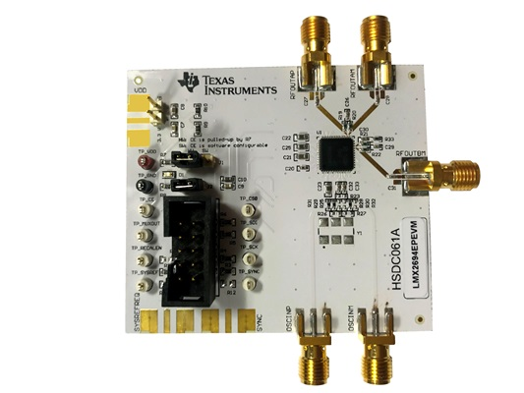
Recent outcomes
5 GHz PLL testing in collaboration with SY-BI for new LHC BPS
LMX2594EVM
LMX2592EVM
LMX2694EPEVM
RADWG Activities Overview by R. Ferraro (BE-CEM-EPR )

Slide 10
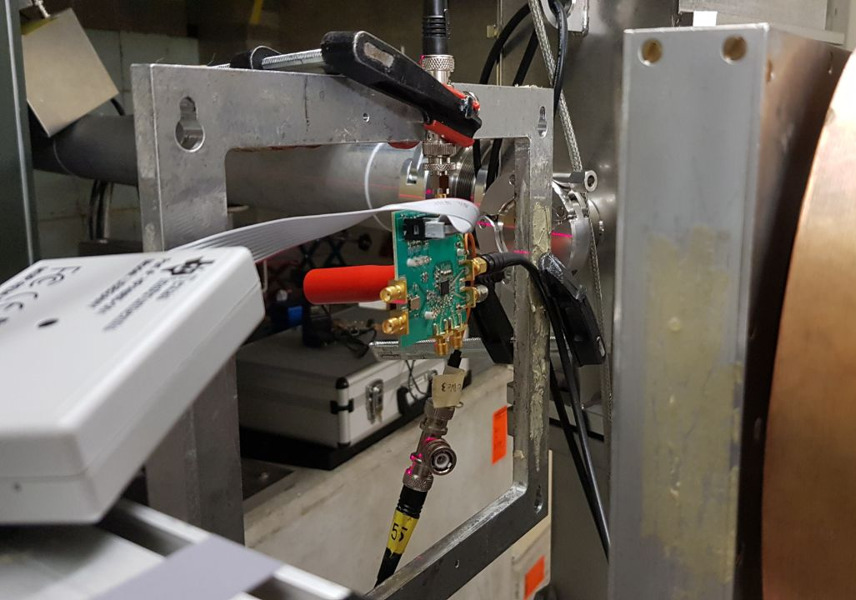
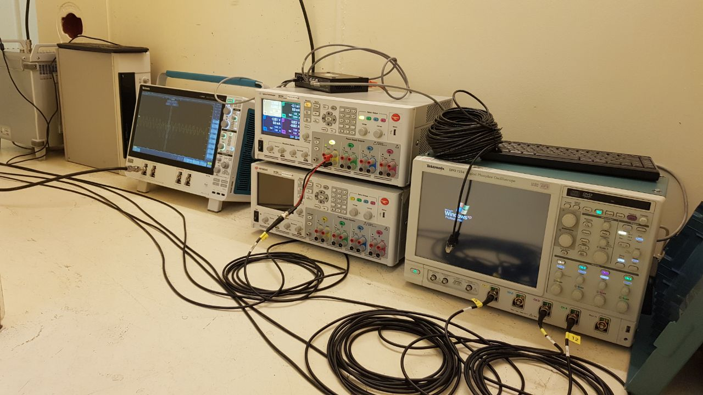
Recent outcomes
5 GHz PLL testing in collaboration with SY-BI for new LHC BPS
  Challenging test setup to keep signal integrity through 15 meters of cables and multiples splitters
  Devices tested in active monitoring online SEE (SEU & Transients) and TID degradation (Phase Noise & Spectrum)
  Tested last week-end → Report coming
RADWG Activities Overview by R. Ferraro (BE-CEM-EPR )

Slide 11
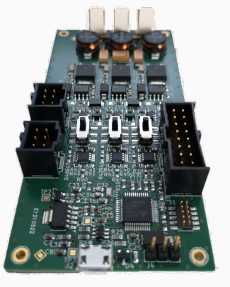
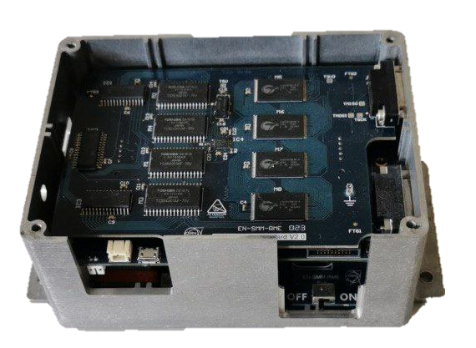
Recent outcomes
µControllers qualifications
  9 reference tested
  Two systems with SAMD21 µController developed: BATMon, Monimod
  Research on Benchmark testing: M. Giordano, ‘General Purpose and Neural Network Approach For Benchmarking Microcontrollers Under Radiation‘, RADECS2021
Monimod
(BE-CEM-EDL)
Low power/Quiescent current qualifications
  Very challenging to find suitable candidates → higher degradation rate than standard components
  Different test methodologies employed → Sleep mode, Duty Cycle mode..
  Research on testing methodology: A. Zimmaro, ‘Testing and Validation Methodology for a Radiation Monitoring Systems for Electronics in Particle Accelerators ‘, RADECS2021
BatMON
(BE-CEM-EPR)
RADWG Activities Overview by R. Ferraro (BE-CEM-EPR )

Slide 12
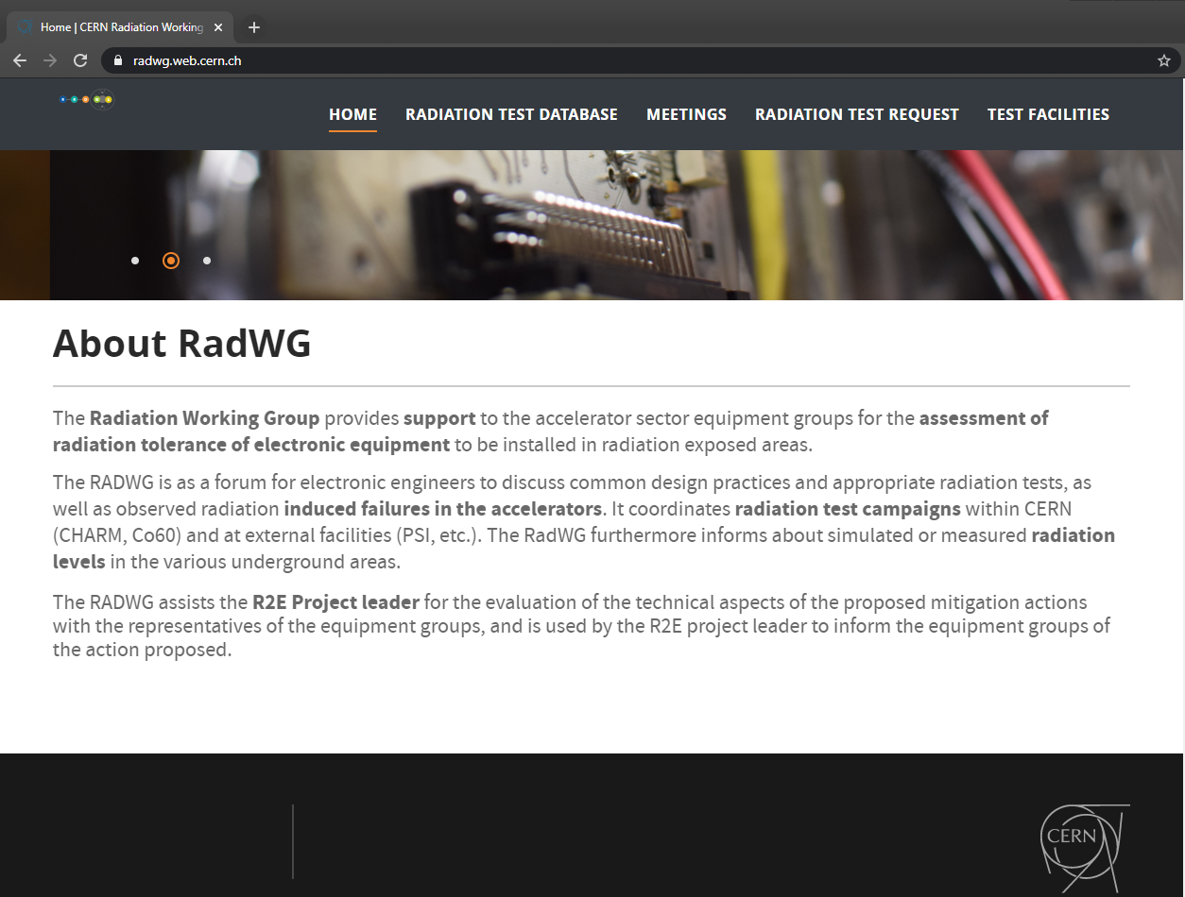
Test results analysis and reporting
180 users subscribed to the mailing list lhc-proj-radwg-members
The website https://radwg.web.cern.ch/ embeds an User-Friendly database
  More than 460 reports from the 2011 up to 2021
It embeds also the TE-EPC component list and tests
The service produces reports in a common template for all the components tested
  Test reports template ensure a coherent reporting
The service maintains two databases accessible by all the equipment groups
https://radwg.web.cern.ch
RADWG Activities Overview by R. Ferraro (BE-CEM-EPR )

Slide 13
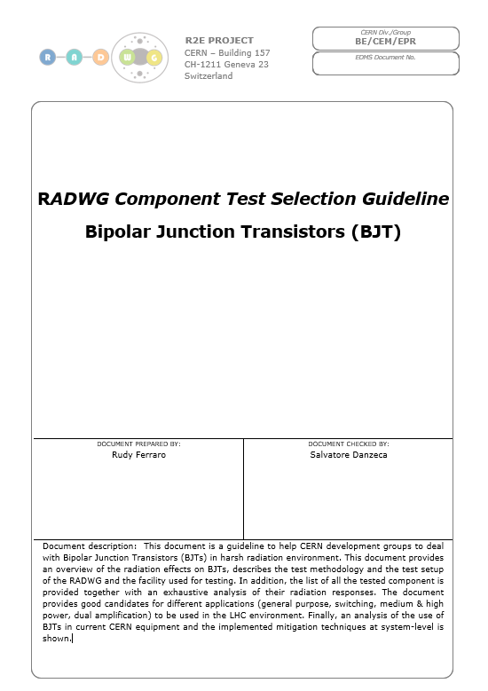
New guidelines for component testing & selection
Limitations on the use of the database:
  Bigger and bigger amount of reports to be read
  Not easy to compare components parameters
  No straight way to compare the different radiation responses
  Some components are obsolete
  → Equipment groups can easily miss good candidates for their projects
Lead to the creation of a new type of document that contains:
  List of the tested components with important parameters and radiation tolerance
  Overview of the radiation effects
  RADWG Test Methodology
  RADWG Test circuits
  Discussion on the test facilities that can be used
  Analysis components’ response for different sub-categories
  List of components used in the CERN systems and discussion of the implemented mitigation techniques
RADWG Activities Overview by R. Ferraro (BE-CEM-EPR )

Slide 14
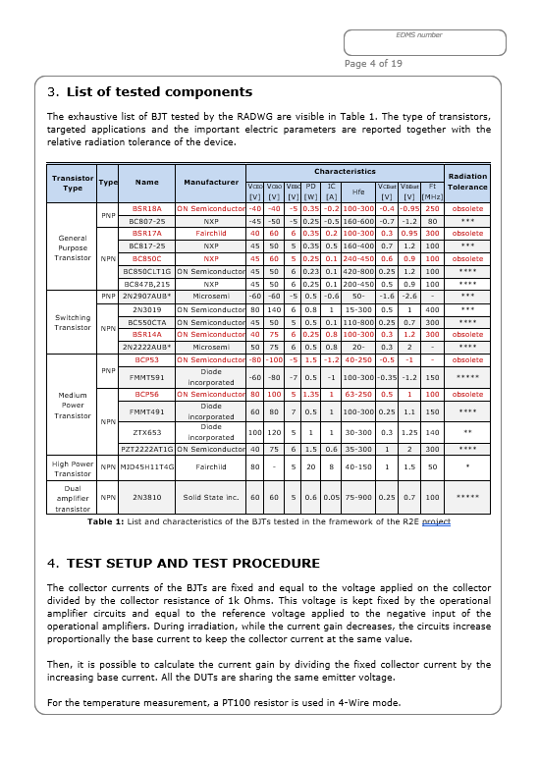
New guidelines for component testing & selection
Objective:
Facilitate the search of candidate for the development groups
Provide a guideline per type of components:
  Regulators, MOSFET, FPGA, opamp etc…
The redaction of each document will be followed by a “Focus on:” presentation during the RadWG workshop
Each document will be put on EDMS and a notification will be sent to all the members of the RadWG mailing list
Documents will be updated regularly with the latest components
First documents to be delivered:
  BJT → Within 2 weeks (presentation today!)
  Voltage regulators → September
  MOSFET → September
RADWG Activities Overview by R. Ferraro (BE-CEM-EPR )

Slide 15
Conclusions
BE-CEM-EPR provides the service of radiation testing of electronic components supporting the Radiation Working Group (RadWG)
Testing activities never stopped with COVID19
Research on test methodology and qualification strategies are always ongoing to improve furthermore the quality of the service
  Benchmark for µController & FPGA
A lot of tests performed anticipating future needs for CERN applications
  Extensive state-of-the-art FPGA qualification
Creation of the ‘RadWG Component Selection Guideline’ documents to help equipment groups to deal with the database and select candidates for their systems
RADWG Activities Overview by R. Ferraro (BE-CEM-EPR )

Slide 16
Thank you for your attention!

