Slide 1
Focus on:
Bipolar Junction Transistors
Rudy Ferraro (BE-CEM-EPR)
RadWG Workshop – 8 June, 2021

Slide 2
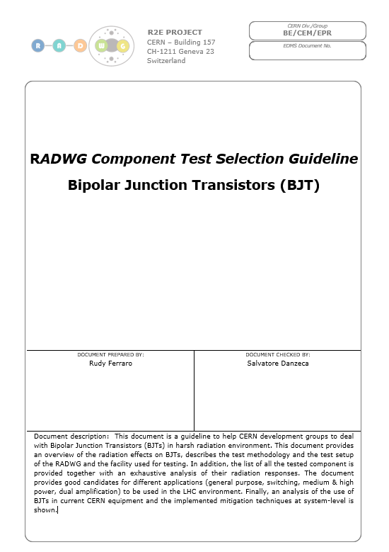
Introduction
Kick-off of the ‘RadWG Component Selection Guideline’ documents!
First one dedicated to Bipolar Junction Transistor(s)
The writing of this document implied a tremendous amount of work:
  (Re-)processing of test data from 39 test campaigns
  Analysis made complex due to various test data format used through the years
  Number of measured parameters increased with time
Guideline & Presentation summary:
  Complete BJT list with characteristics
  Radiation effects on BJTs
  LHC environment and qualification implications
  Test circuit & setup
  Test methodology
  Analysis of BJTs response
R. Ferraro (BE-CEM-EPR) - Focus on: Bipolar Junction Transistors

Slide 3
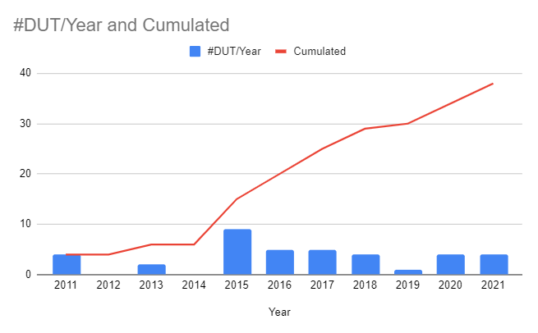
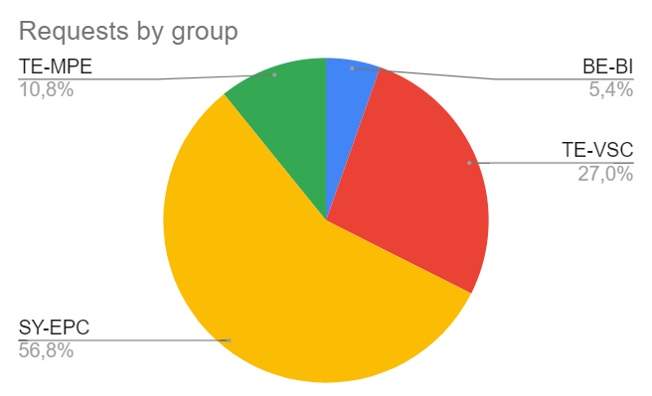
BJT Testing in numbers: when and who?
10 years of BJT Testing
49 Radiation campaigns performed
19 different references tested
Most of the BJT tested for (and by) SY-EPC for LHC power converters
R. Ferraro (BE-CEM-EPR) - Focus on: Bipolar Junction Transistors

Slide 4
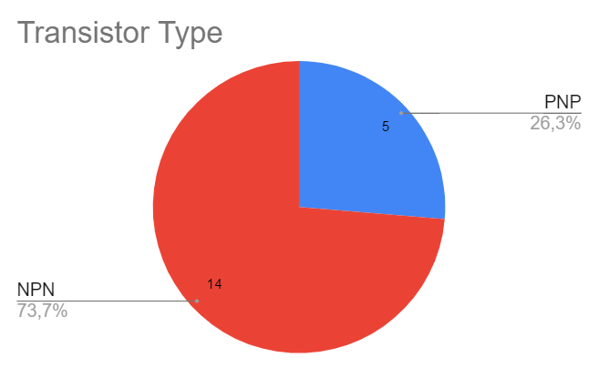
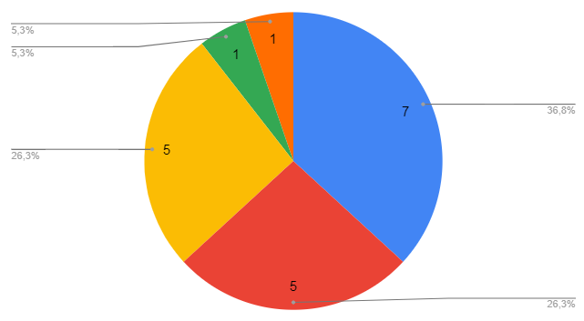
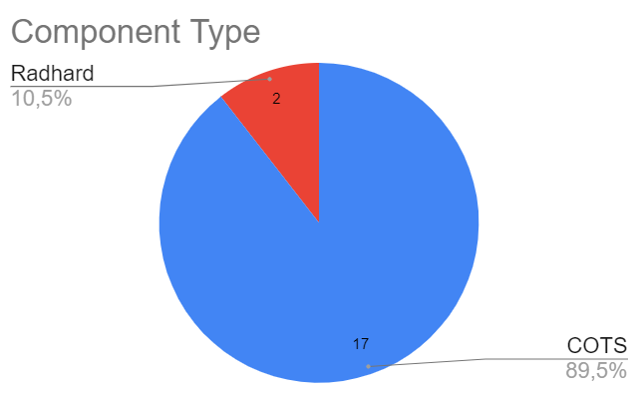
BJT Testing in numbers: characteristics
Transistor Application (from datasheet)
Dual Amplifier
High Power
General Purpose
Medium Power
Fast Switching
R. Ferraro (BE-CEM-EPR) - Focus on: Bipolar Junction Transistors
Notes:
Modify numbers for component types

Slide 5
List of tested BJT
Application | Type | Reference | Manufacturer | Characteristics |  |  |  |  |  |  | Radiation Tolerance
 |  |  |  | VCEO [V] | VCBO [V] | VEBO [V] | PD [W] | IC [A] | Hfe | Ft [MHz]
General Purpose Transistor | NPN | BC807-25 | NXP | -45 | -50 | -5 | 0.25 | -0.5 | 160-600 | 80 | ***
 | NPN | BC817-25 | NXP | 45 | 50 | 5 | 0.35 | 0.5 | 160-400 | 100 | ***
 |  | BC850CLT1G | ON Semiconductor | 45 | 50 | 6 | 0.23 | 0.1 | 420-800 | 100 | ****
 |  | BC847B,215 | NXP | 45 | 50 | 6 | 0.25 | 0.1 | 200-450 | 100 | ****
Switching Transistor | PNP | 2N2907AUB* | Microsemi | -60 | -60 | -5 | 0.5 | -0.6 | 50- | - | ***
 | NPN | 2N3019 | ON Semiconductor | 80 | 140 | 6 | 0.8 | 1 | 15-300 | 400 | ***
 |  | BC550CTA | ON Semiconductor | 45 | 50 | 5 | 0.5 | 0.1 | 110-800 | 300 | ****
 |  | 2N2222AUB* | Microsemi | 50 | 75 | 6 | 0.5 | 0.8 | 20- | - | ****
Medium Power | PNP | FMMT591 | Diode incorporated | -60 | -80 | -7 | 0.5 | -1 | 100-300 | 150 | *****
 | NPN | FMMT491 | Diode incorporated | 60 | 80 | 7 | 0.5 | 1 | 100-300 | 150 | ****
 |  | ZTX653 | Diode incorporated | 100 | 120 | 5 | 1 | 1 | 30-300 | 140 | **
 |  | PZT2222AT1G | ON Semiconductor | 40 | 75 | 6 | 1.5 | 0.6 | 35-300 | 300 | ****
High Power | NPN | MJD45H11T4G | Fairchild | 80 | - | 5 | 20 | 8 | 40-150 | 50 | *
Dual amplifier | NPN | 2N3810 | Solid State inc. | 60 | 60 | 5 | 0.6 | 0.05 | 75-900 | 100 | *****
High frequency
Higher power dissipation
Higher max collector current
High power dissipation
High max collector current
Characteristics and relative radiation tolerance of all BJTs visible in a single document!
R. Ferraro (BE-CEM-EPR) - Focus on: Bipolar Junction Transistors

Slide 6
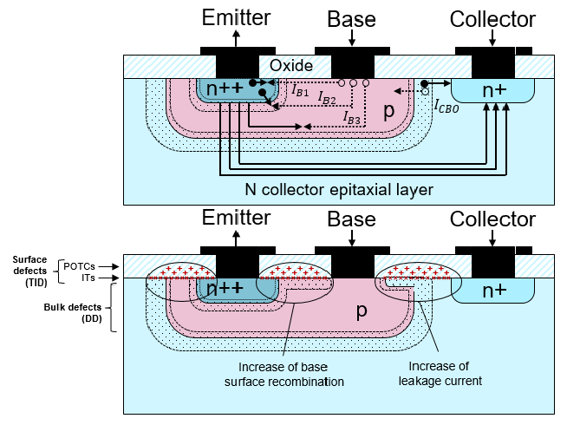
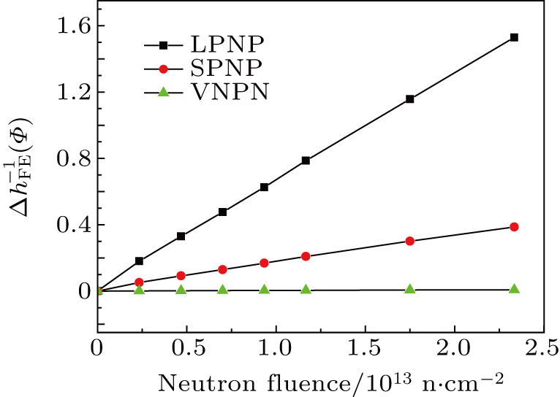
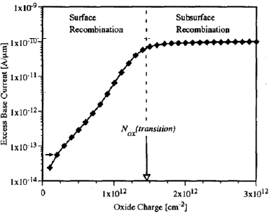

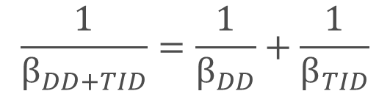

Radiation Effect on BJT
Bibliography of radiation effects presented in the document
Main parameters affected: V_{be} and $β=Ic/Ib$
Radiation effects: TID & DD
Current-gain degradation:
$$\frac{1}{β_{DD+TID}}=\frac{1}{β_{DD}}+\frac{1}{β_{TID}}$$
TID: Positive charges trapped in oxide (POTCs)
Interface Trap (ITs)
→ increase of leakage current
→ increase of surface recombination
DD: Bulk defects
→ increase of surface recombination
[Ref]
[Ref]
DD induces a linear increase of $β$⁻¹
TID induces a sublinear increase of $β$⁻¹
R. Ferraro (BE-CEM-EPR) - Focus on: Bipolar Junction Transistors

Slide 7
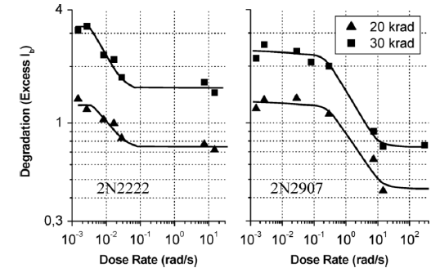
Radiation Effect on BJT
Bibliography of radiation effects presented in the document
[Ref]
Main parameters affected: V_{be} and $β=Ic/Ib$
Radiation effects: TID & DD
Current-gain degradation:
$$\frac{1}{β_{DD+TID}}=\frac{1}{β_{DD}}+\frac{1}{β_{TID}}$$
Enhanced Low Dose Rate Sensitivity (ELDRS) effect:
Lower the dose rate → higher the degradation
TID: Positive charges trapped in oxide (POTCs)
Interface Trap (ITs)
→ increase of leakage current
→ increase of surface recombination
DD: Bulk defects
→ increase of surface recombination
[Ref]
[Ref]
DD induces a linear increase of $β$⁻¹
TID induces a sublinear increase of $β$⁻¹
R. Ferraro (BE-CEM-EPR) - Focus on: Bipolar Junction Transistors

Slide 8
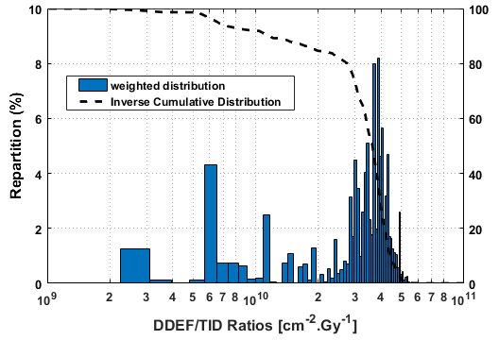
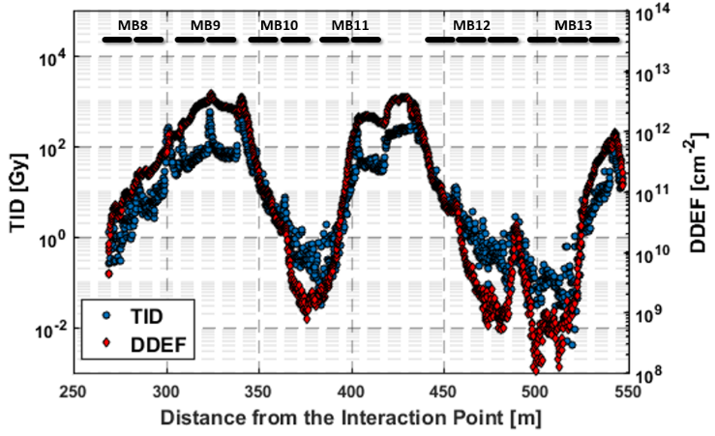
LHC environments and qualifications implications
CERN Accelerators fields composed of mixed particles
  Components exposed to both TID & DD
  But with the high neutron dominance DD
  mechanisms tend to dominate
Electrons (<10⁸)
Neutrons
Wide variety of DDEF/TID Ratio:
  From 10⁹ up to 10¹¹ cm⁻².Gy⁻¹
Protons
90% of the ratio are above 10¹⁰ cm⁻².Gy⁻¹
  10 times less TID than 200 MeV protons for the same DD
200 MeV
BJTs in this environment will mainly suffer from DD, even though TID contribution should not be neglected
  (R.Ferraro, IEEE Trans. Nucl. Sci. 66 (2019) 1548 - 1556)
R. Ferraro (BE-CEM-EPR) - Focus on: Bipolar Junction Transistors

Slide 9




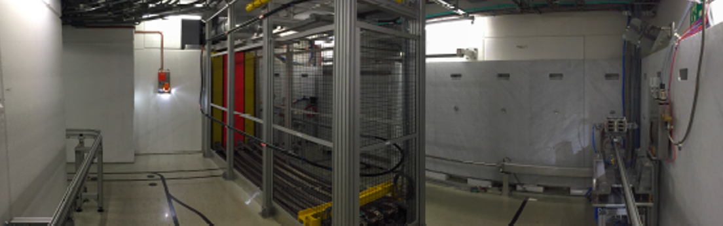
Test Facilities
Ideal Protocol:
Qualification against TID and DD at PSI
Qualification at CC60 to obtained individual ELDER TID response
Validation at CHARM
In general use of radiation design margin is used instead of performing (2), which combined to the fact that DD dominates should ensure a safe margin before validation at CHARM
CC60 – Switzerland, CERN
  Cobalt 60 Source → TID Only
  Can be used to assess individual TID response
  ELDRS Test possible
  Annealing Test
  Requires a second test for DD
CERN Cobalt 60 Facility
PSI-PIF – Switzerland, Viligen
  200 MeV proton → TID + DD
  High TID Contribution wrt LHC fields ‘worst-case’
  No ELDRS or Annealing test possible
  High availability → Qualification ok knowing limitations
Paul Scherrer Institut
CHARM – Switzerland, CERN
  Representative LHC Radiation mixed-fields → TID+DD
  Representative TID/DD ratio [see Radsaga presentation]
  Some positions ELDRS compatible
  Annealing test possible but not practical
  Lower availability than PSI
CERN High energy AcceleRator Mixed field
R. Ferraro (BE-CEM-EPR) - Focus on: Bipolar Junction Transistors

Slide 10
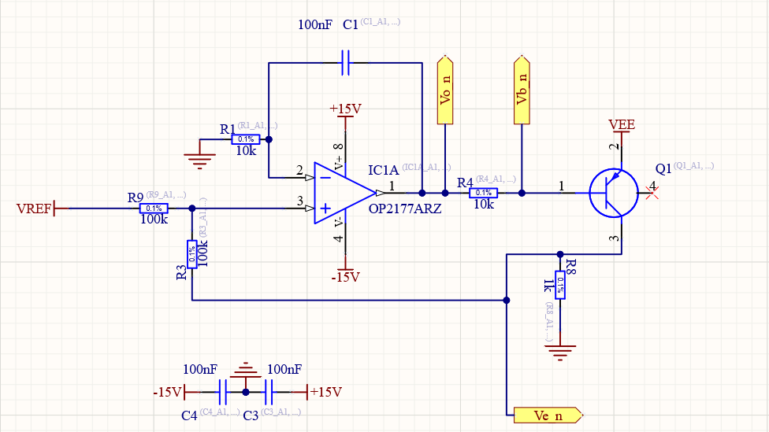
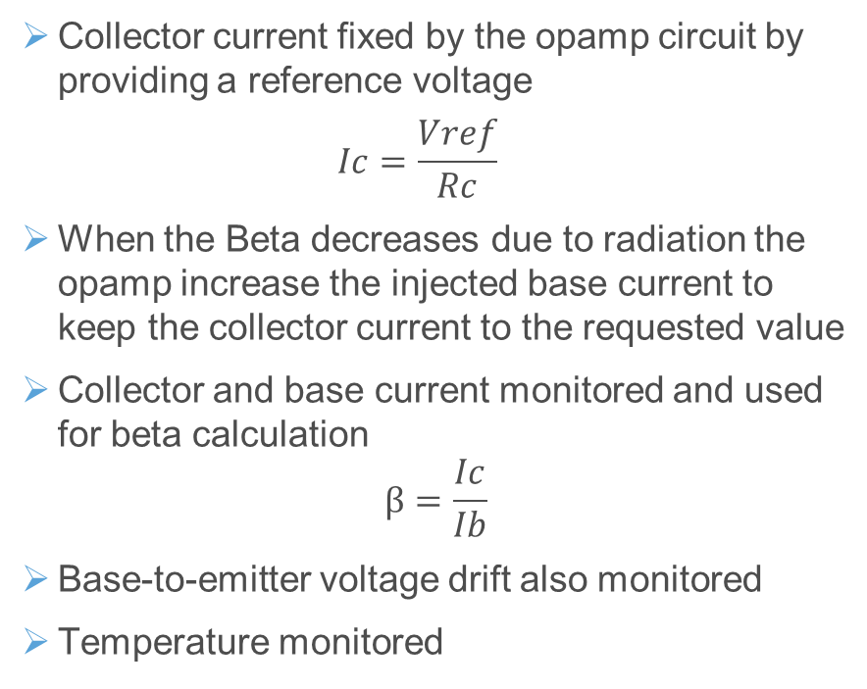
RADW BJT Test Circuit
Collector current fixed by the opamp circuit by providing a reference voltage
  $$Ic=\frac{Vref}{Rc}$$
When the Beta decreases due to radiation the opamp increase the injected base current to keep the collector current to the requested value
Collector and base current monitored and used for beta calculation
$$β=\frac{Ic}{Ib}$$
Base-to-emitter voltage drift also monitored
Temperature monitored
At PSI only the BJT is placed in beam
At cobalt & CHARM tested radiation tolerant opamps are used
R. Ferraro (BE-CEM-EPR) - Focus on: Bipolar Junction Transistors

Slide 11
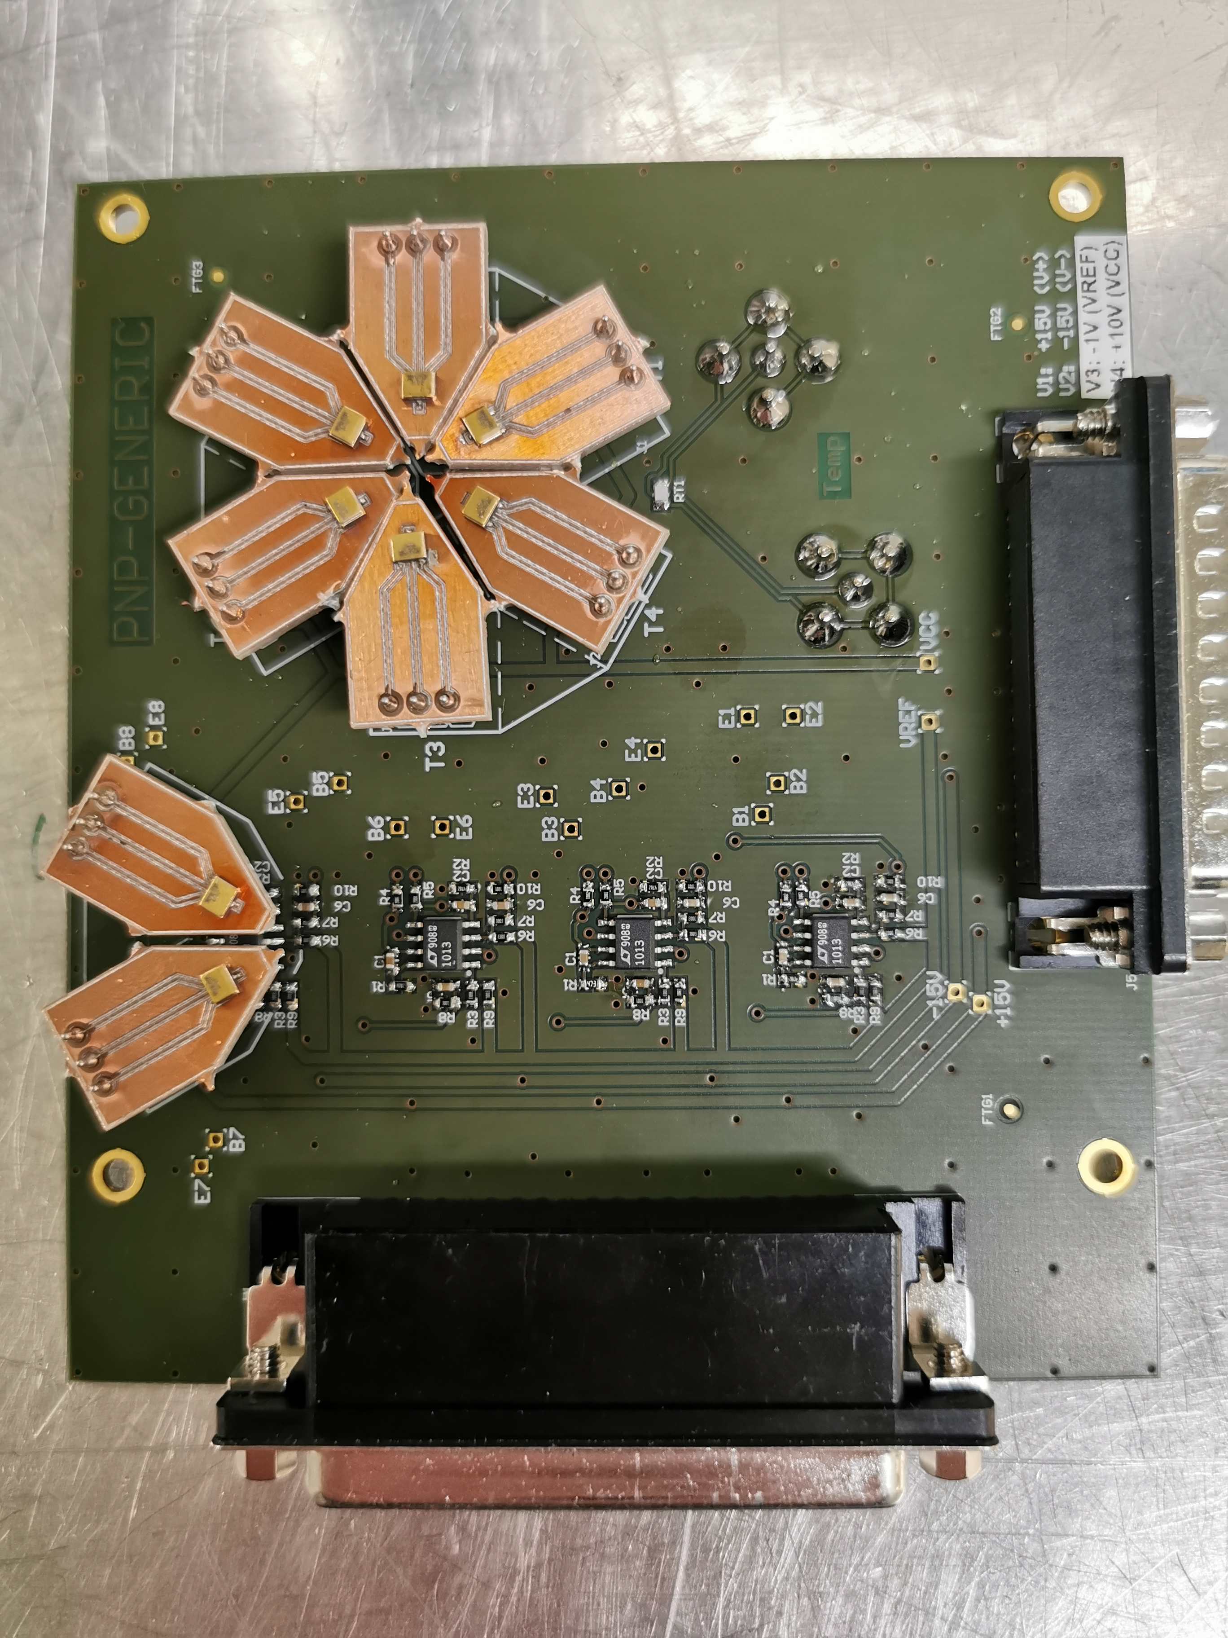
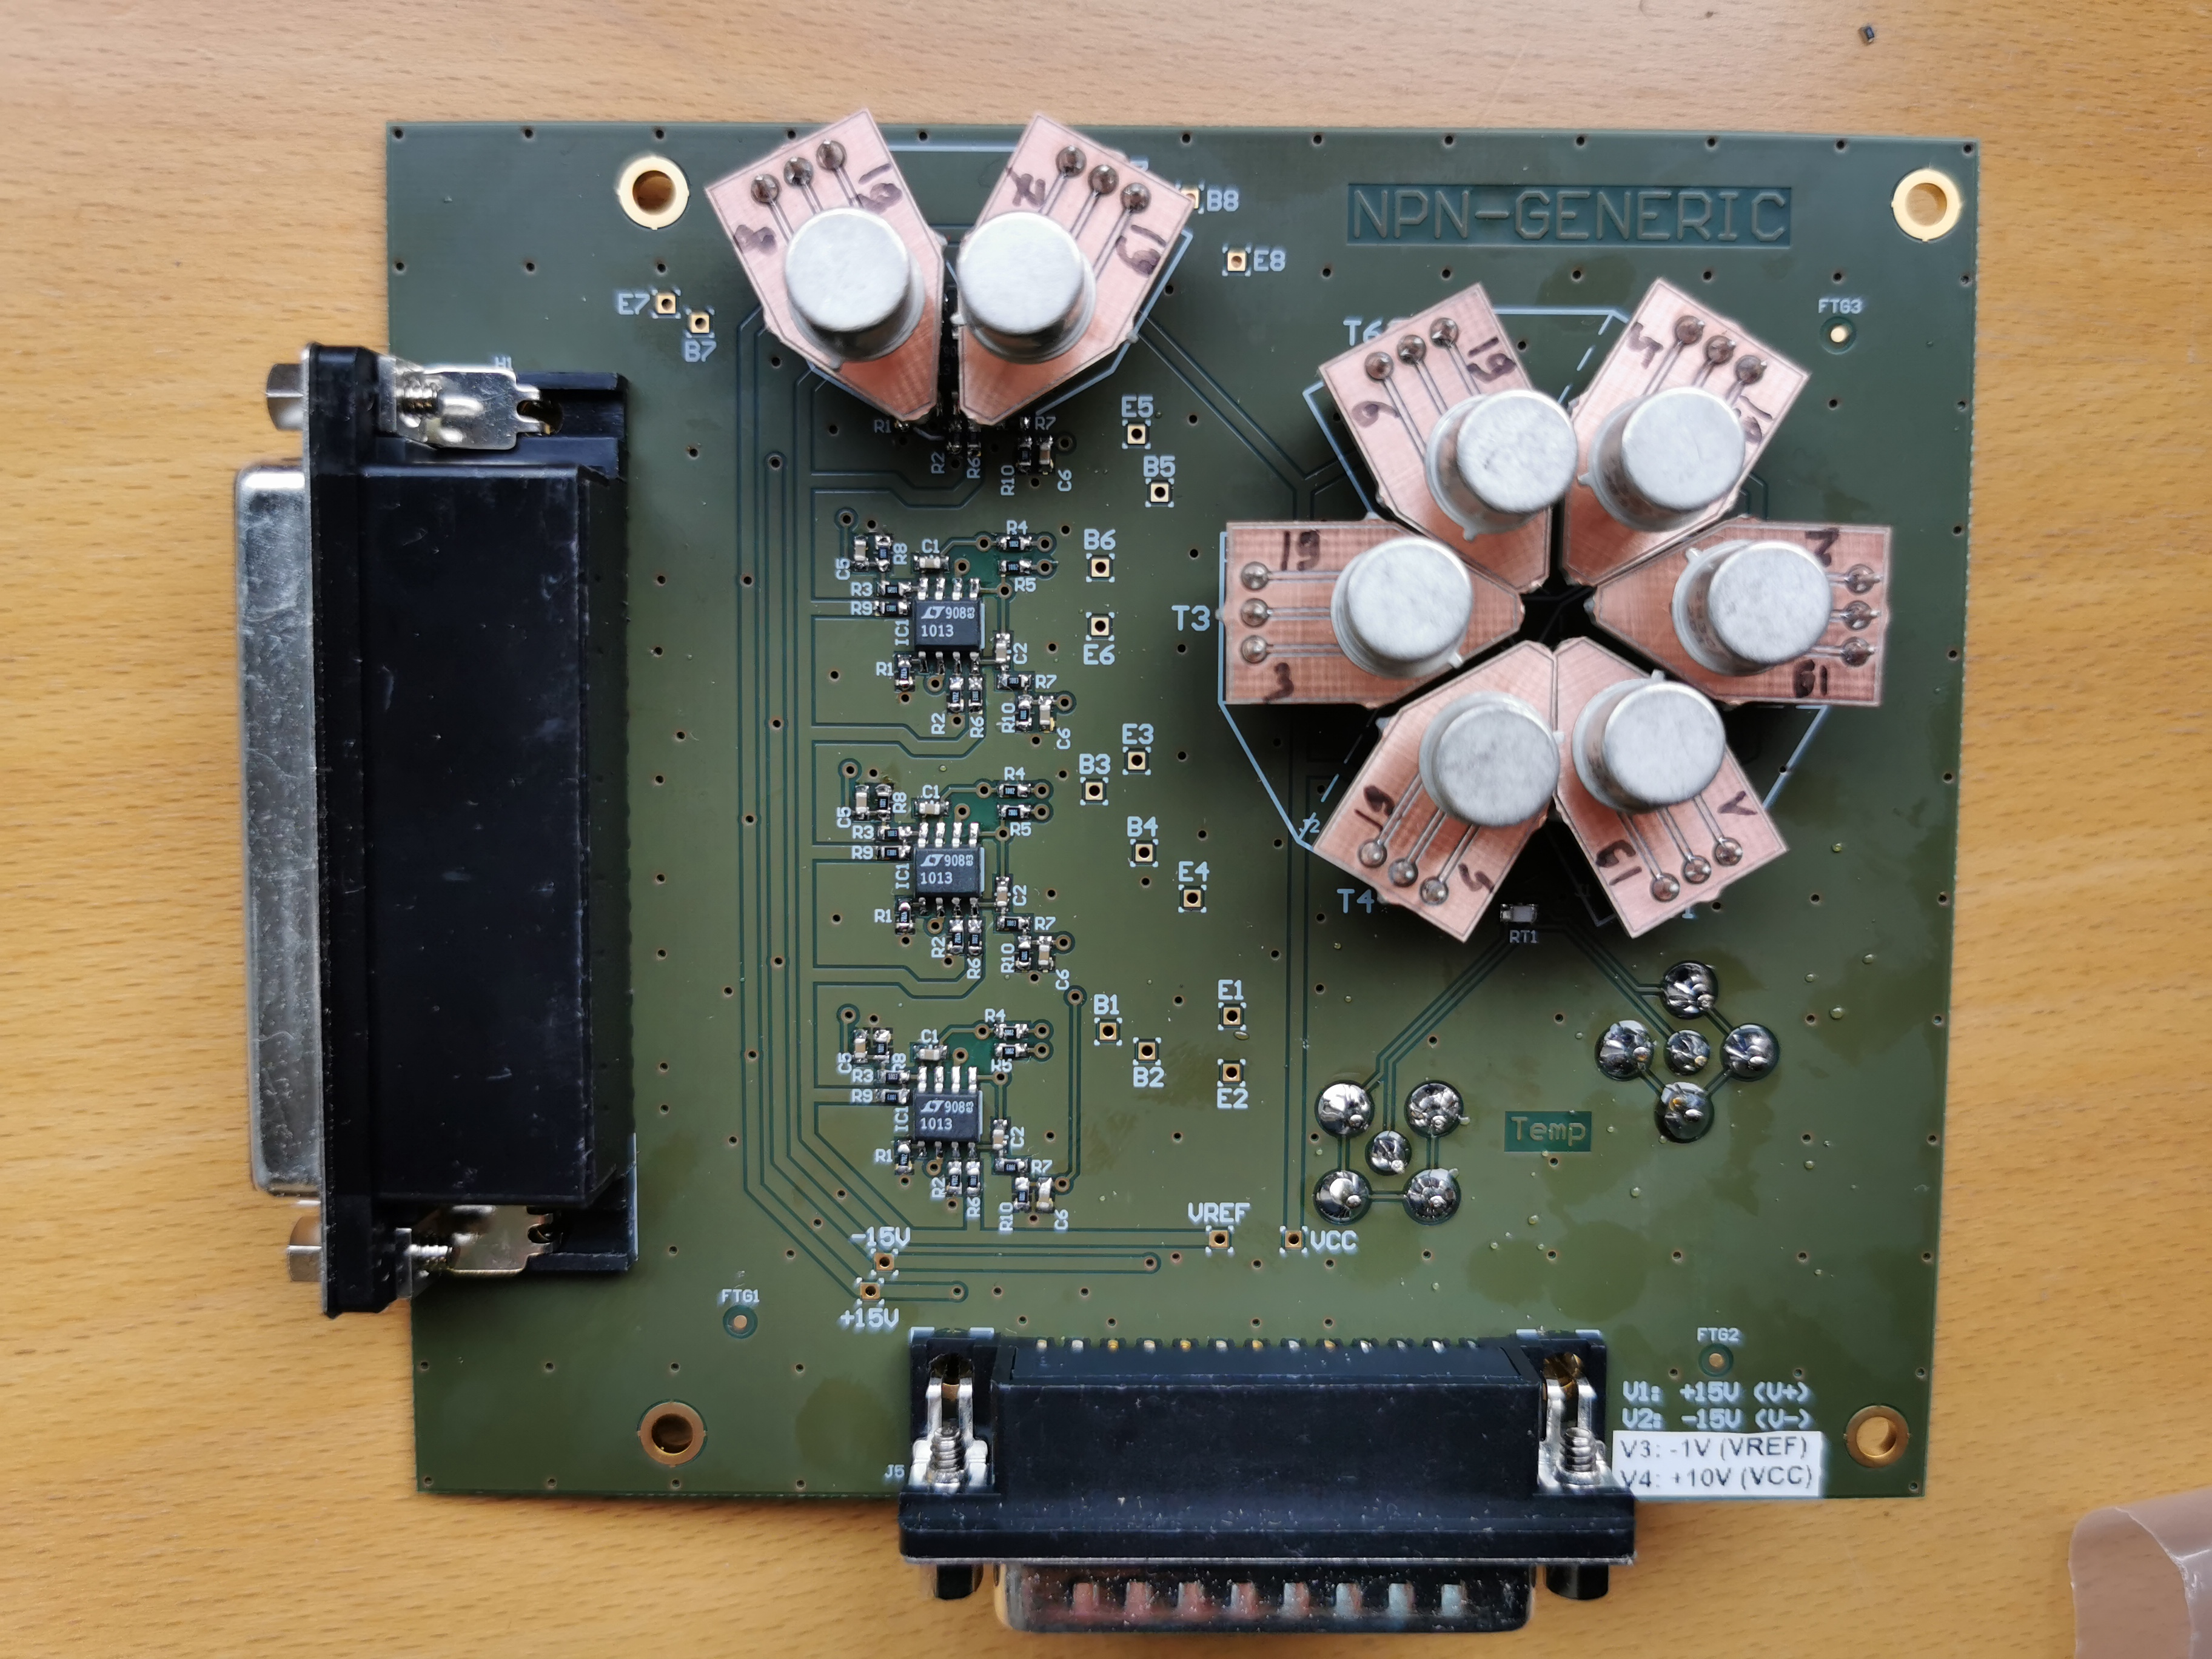
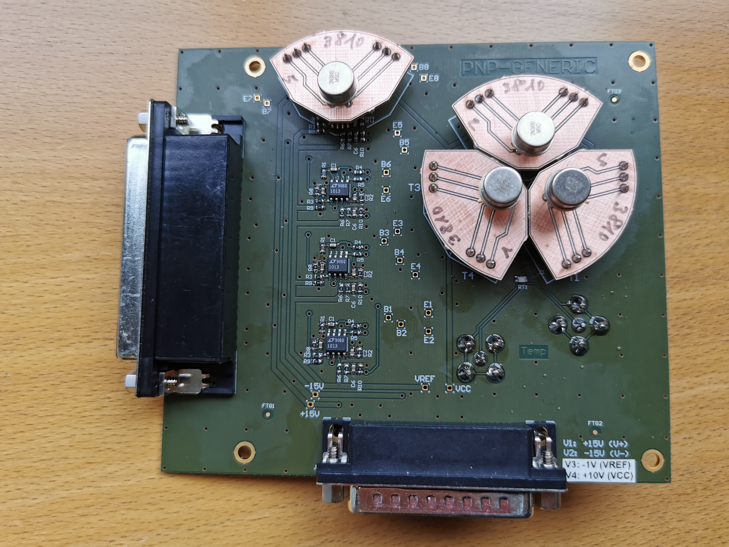
Examples of test boards
Test boards made modular for easy change of DUTs:
2N2222AUB
2N3819
2N3810
Boards can be stacked using the same setup to increase number of DUTs
R. Ferraro (BE-CEM-EPR) - Focus on: Bipolar Junction Transistors

Slide 12
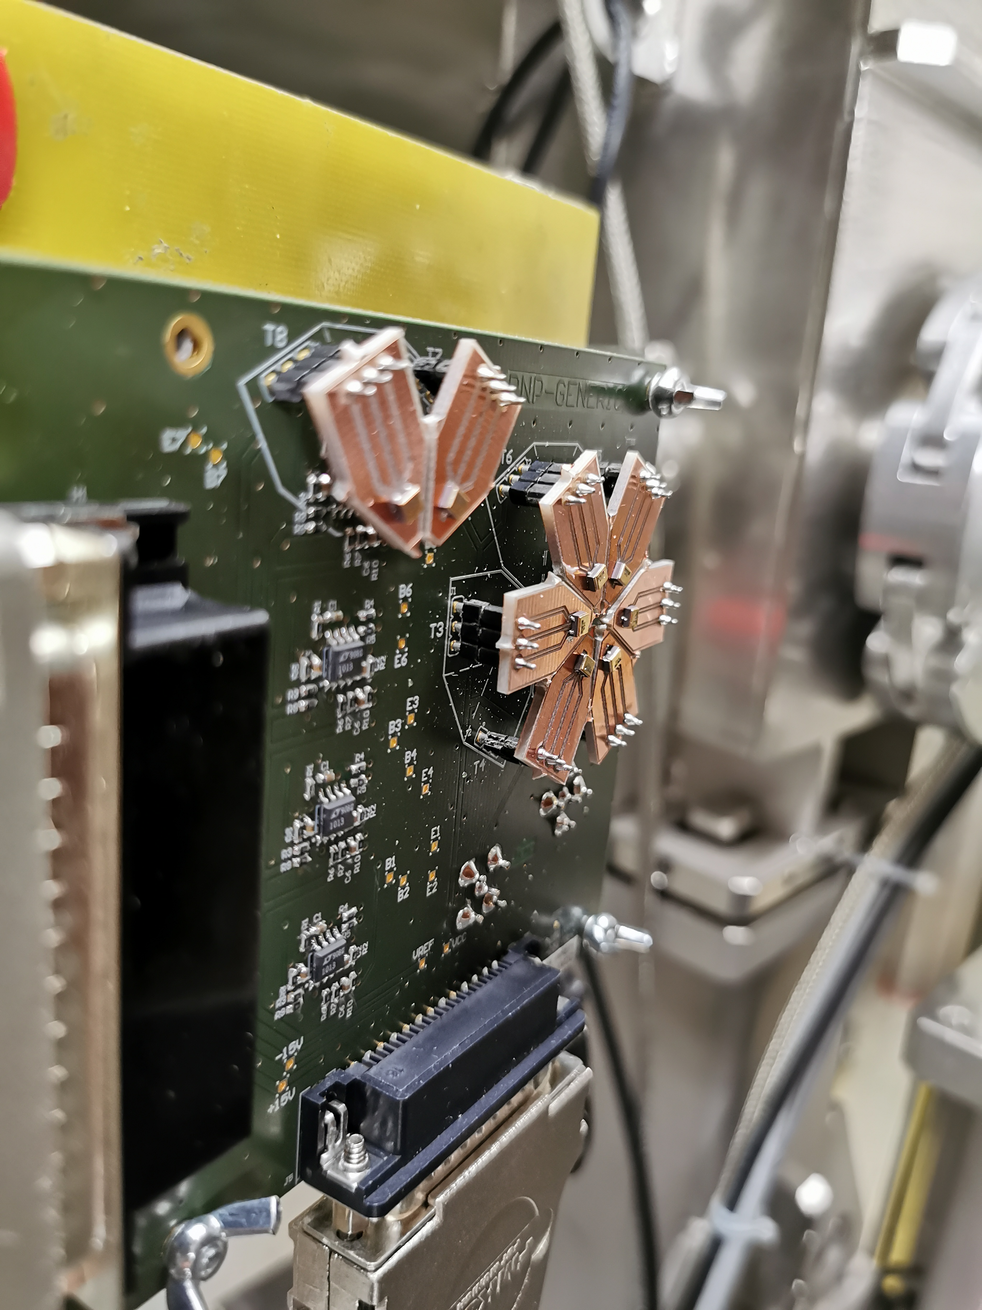
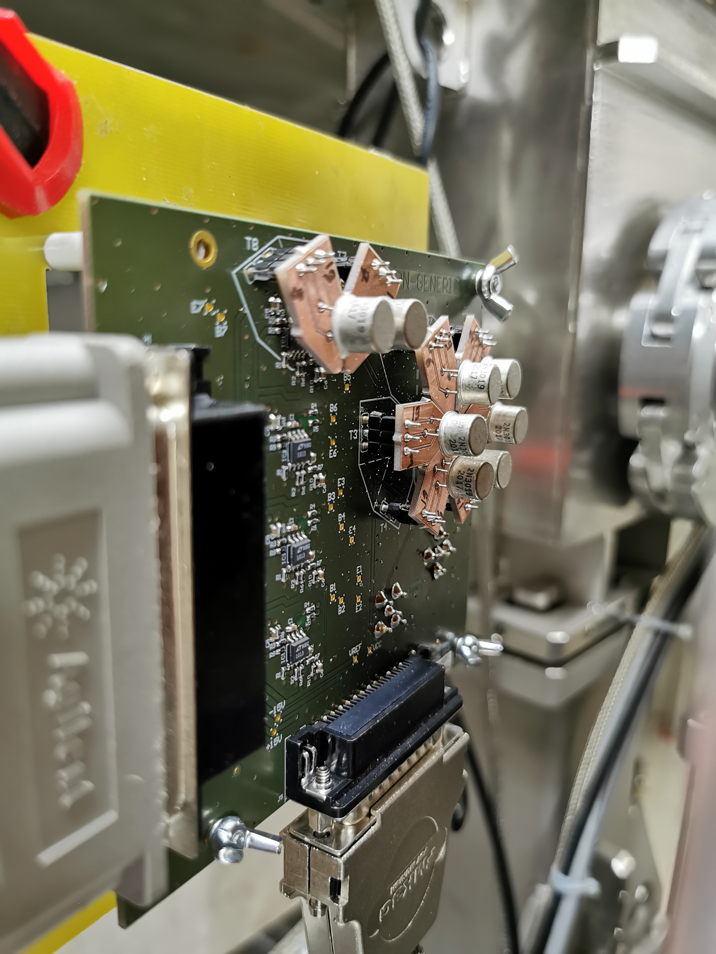
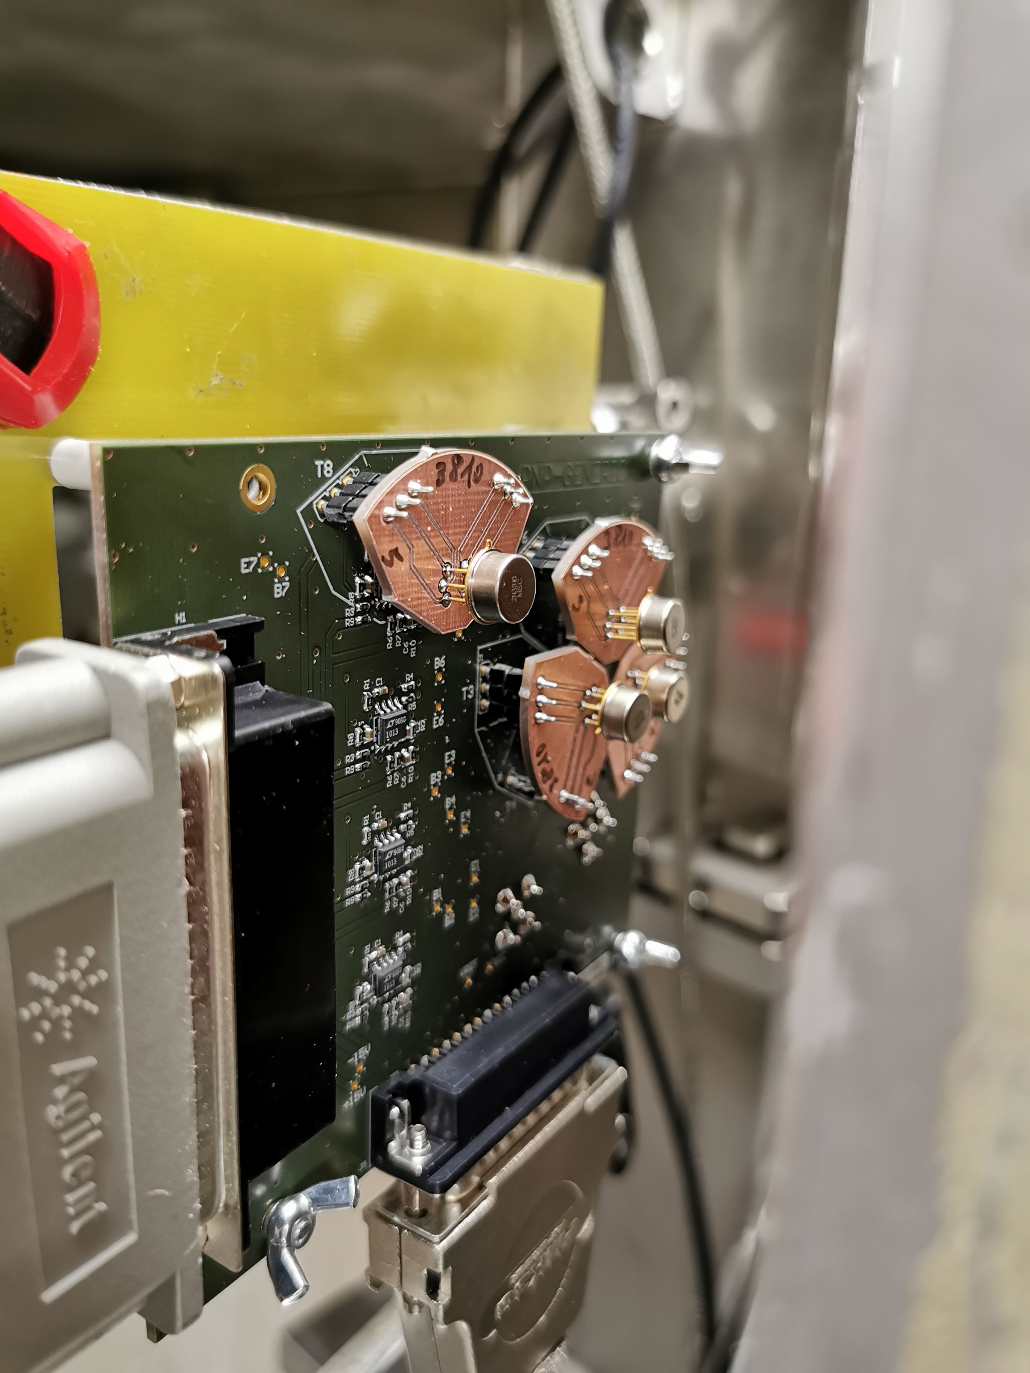
Examples of test boards
2N2222AUB
2N3819
2N3810
R. Ferraro (BE-CEM-EPR) - Focus on: Bipolar Junction Transistors

Slide 13
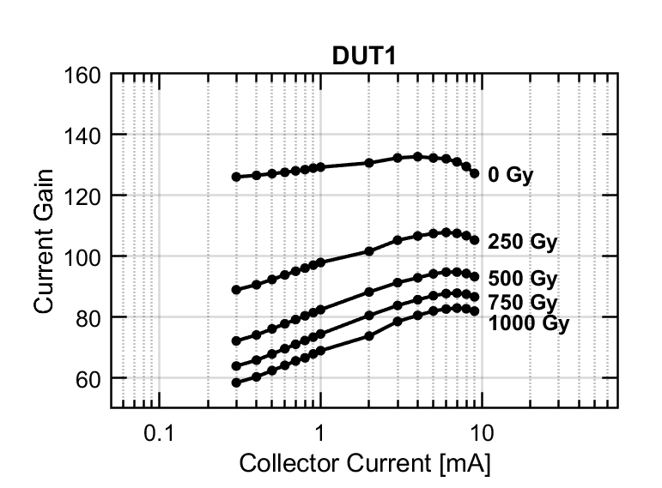
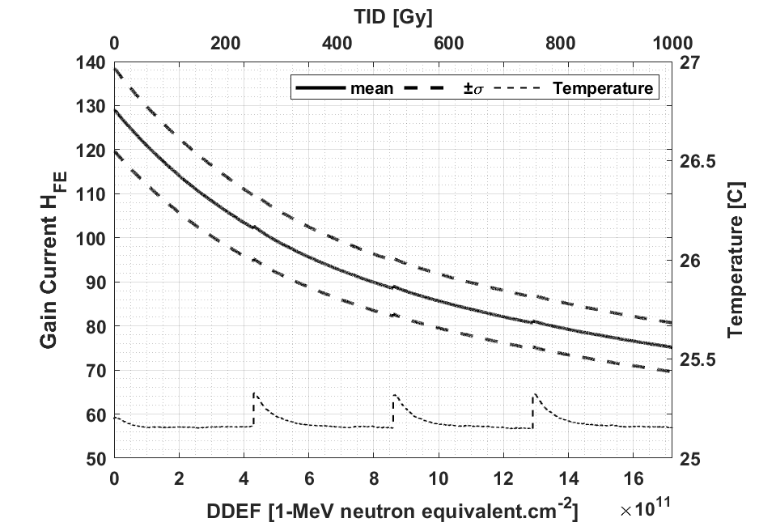
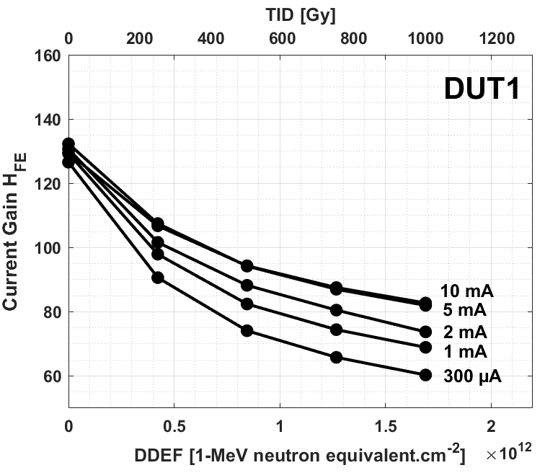
Test Methodology
Beta degradation measured continuously
Beta = f(Ic) measured at different steps
Extraction of beta degradation for different Ic
300 uA
1 mA
2 mA
5 mA
General rule:
Lower the current, higher the degradation
If no specific request:
General purpose BJT: Ic = 1 mA
Switch transistor BJT: Ic = 1 mA
Power transistors: Ic = according to system
R. Ferraro (BE-CEM-EPR) - Focus on: Bipolar Junction Transistors

Slide 14
Test Methodology
Beta degradation measured continuouslyc
Beta = f(Ic) measured at different steps
Extraction of beta degradation for different Ic
Before 2020:
Beta degradation only with selected biasing collector current
From 2020:
Complete beta characteristics measurement implemented to allow the estimation of the degradation for different collector currents
300 uA
1 mA
2 mA
5 mA
General rule:
Lower the current, higher the degradation
If no specific request:
General purpose BJT: Ic = 1 mA
Switch transistor BJT: Ic = 1 mA
Power transistors: Ic = according to system
R. Ferraro (BE-CEM-EPR) - Focus on: Bipolar Junction Transistors

Slide 15
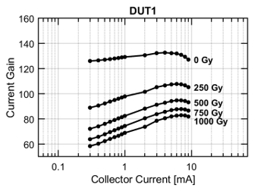
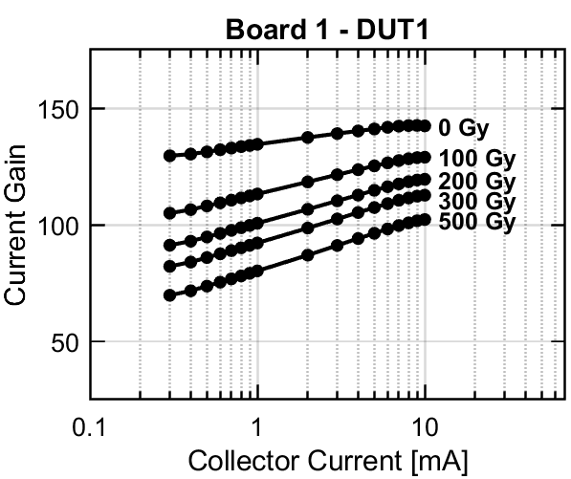
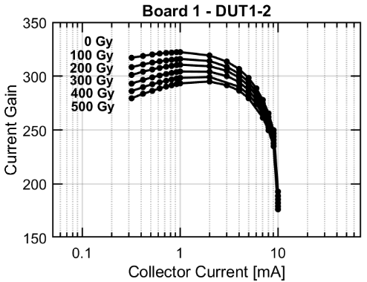
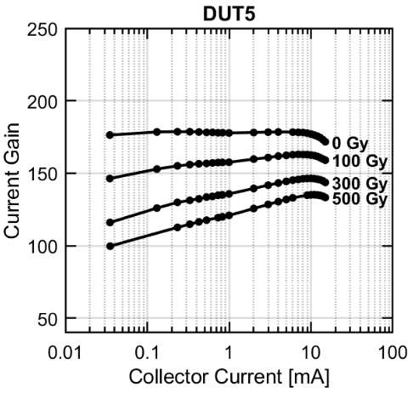
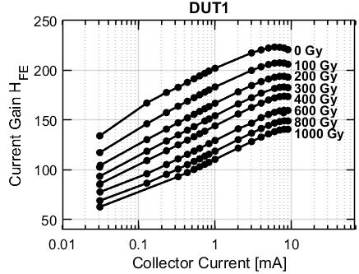
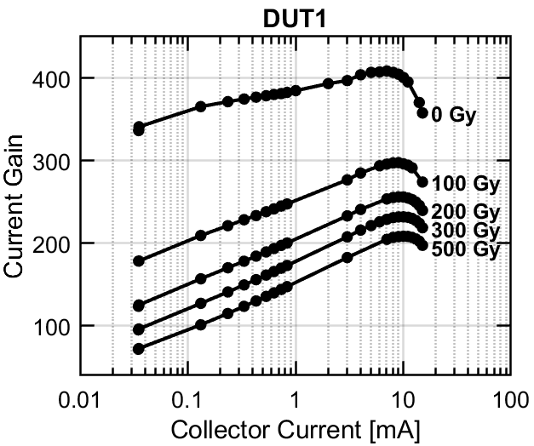
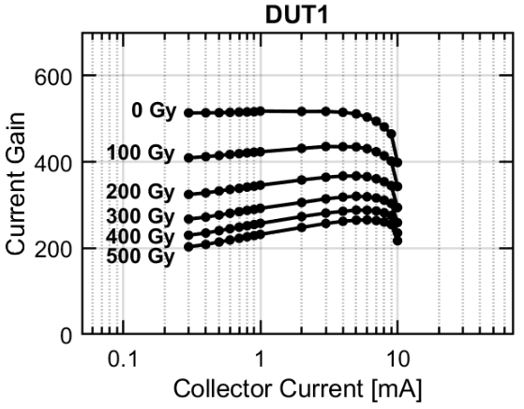
Examples of characteristic degradations
2N2907AUB
2N3019
2N3810
PZT2222
2N2222AUB
BC487
BC850
R. Ferraro (BE-CEM-EPR) - Focus on: Bipolar Junction Transistors

Slide 16
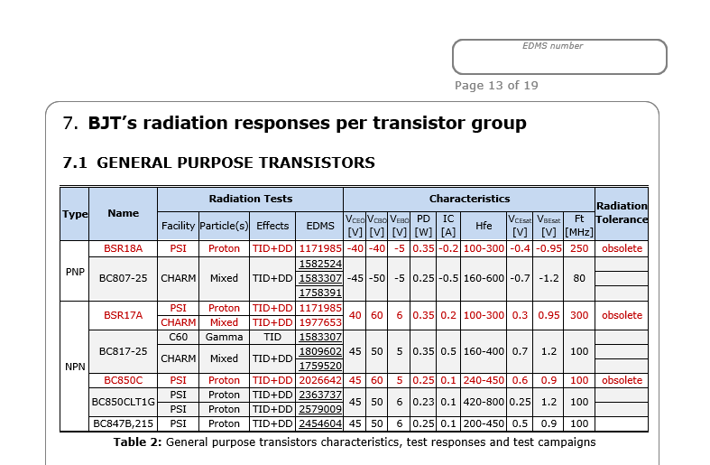
BJT test results analysis per application
Documents contains a comparative analysis per type of application with exhaustive list of performed test
Component's characteristics
Radiation responses for each lot with:
  Facility
  Particle
  Effects
  EDMS link
Obsolete components
Analysis of lots-to-lots and TID vs DD response discussed when possible
R. Ferraro (BE-CEM-EPR) - Focus on: Bipolar Junction Transistors

Slide 17
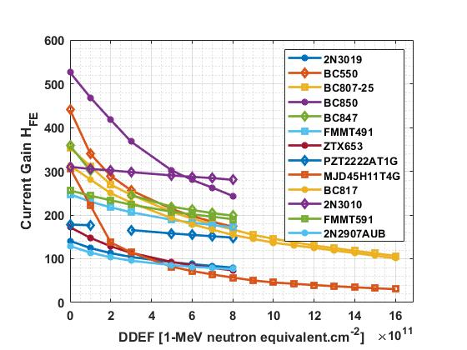
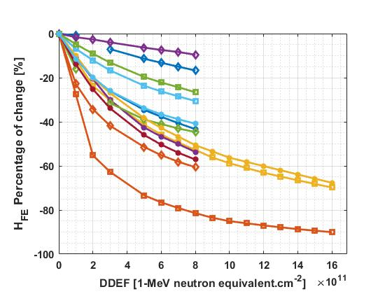
BJT Response comparisons
Comparison of combined TID-DD responses (mostly from PSI, some from CHARM)
  Only DDEF axis showed since the TID axis is different for CHARM/PSI
Various initial gains
Various sensitivities
Various sensitivities
R. Ferraro (BE-CEM-EPR) - Focus on: Bipolar Junction Transistors

Slide 18
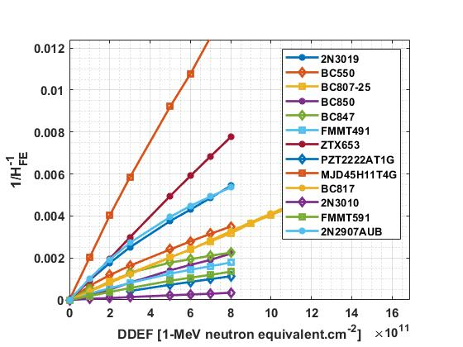

BJT Response comparisons
Comparison of combined TID-DD responses (mostly from PSI, some from CHARM)
  Only DDEF axis showed since the TID axis is different for CHARM/PSI
$$∆\left(\frac{1}{β}\right)$$
High linearity of the response:
→ Strong indication that the DD mechanisms dominates
Various sensitivities
R. Ferraro (BE-CEM-EPR) - Focus on: Bipolar Junction Transistors

Slide 19
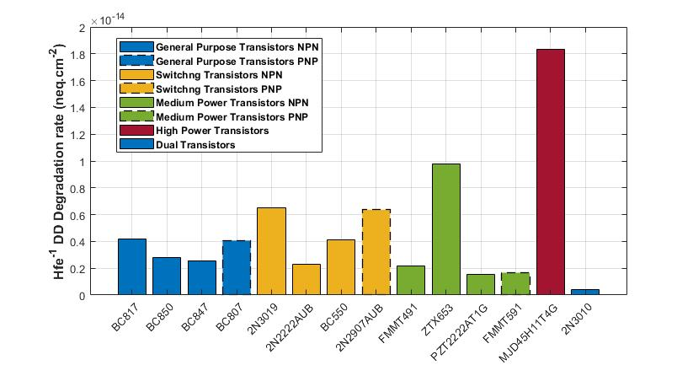
BJT Sensitivity comparisons
Quantitative comparison between the devices possible by means of the $∆\left(\frac{1}{β}\right)$ slopes
No significant differences between the groups
Good candidates can be found for all the type of applications
Radhard devices are not the best ones (hardened mainly against TID and not DD)
Radhard devices
R. Ferraro (BE-CEM-EPR) - Focus on: Bipolar Junction Transistors

Slide 20

Best candidates
It depends!
Minimum gain acceptable?
Maximum relative degradation?
High speed?
High power?
Target Dose and DD?
You will find all the info in the document to find the candidates that comply with your project requirements..
.. If not, you are very welcome to send us a list of BJT to be tested !
R. Ferraro (BE-CEM-EPR) - Focus on: Bipolar Junction Transistors

Slide 21
Conclusions
New ‘RadWG Component Selection Guideline’ documents introduced
One document per type of components will be provided
These documents will help the CERN development to understand the radiation effects, the test methodology and to have access to an exhaustive analysis of the radiation response in a single document
The first document dedicated to BJTs will be released within 2 weeks and link will be sent through the RADWG mailing list
Future reports to be presented during the next RADWG:
  MOSFET
  Regulators
We really hope these documents will be useful to you
R. Ferraro (BE-CEM-EPR) - Focus on: Bipolar Junction Transistors

Slide 22
Thank you for your attention!

Slide 23
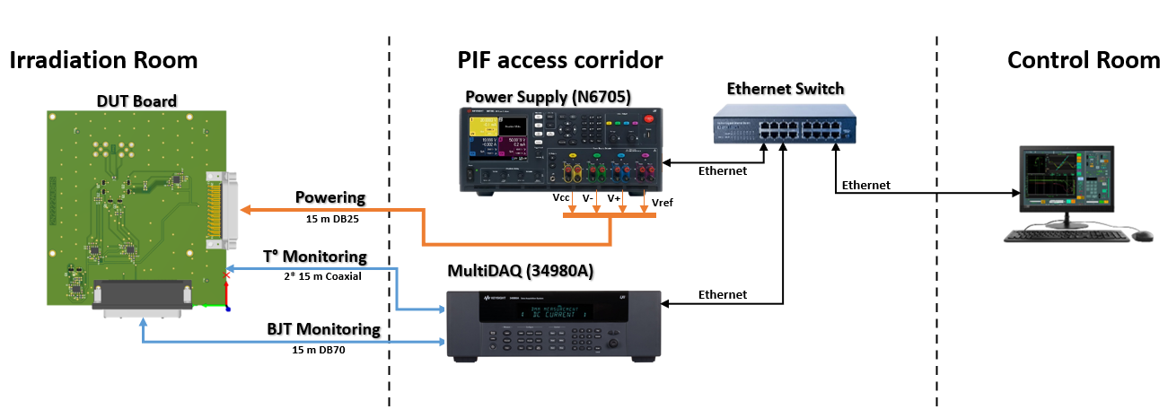
RADW Test Setup
Testing of electronic components by R. Ferraro (BE-CEM-EPR )

Slide 24
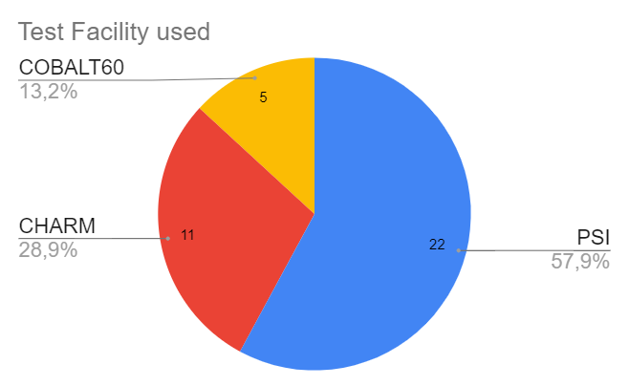
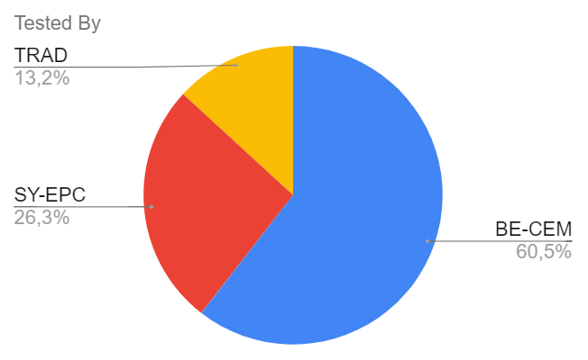
BJT Testing in numbers: when and who test?
Testing of electronic components by R. Ferraro (BE-CEM-EPR )

