Slide 1

The Beam Interlock System User Interface (CIBU) Overview and Radiation Tests Results
Raffaello Secondo
on behalf of TE-MPE-MI
8th June 2021

Slide 2
Beam Interlock System (BIS) Concept
USER PERMITS
BEAM PERMITS
1
User Systems
14
User
Interface (CIBU)
Beam
Interlock
Controller
TARGET SYSTEM
(BEAM DUMP)
14
<4m
Current Loops
SOFTWARE PERMIT (SIS)
Single-Mode
Optical Fibers
<1200 m
RS-485
OR
>1200 m
Fiber Optics
∑(USER PERMITS = TRUE) → BEAM PERMIT = TRUE
BIC: main controller, acts as concentrator collecting USER PERMITS, generating BEAM PERMIT

Slide 3
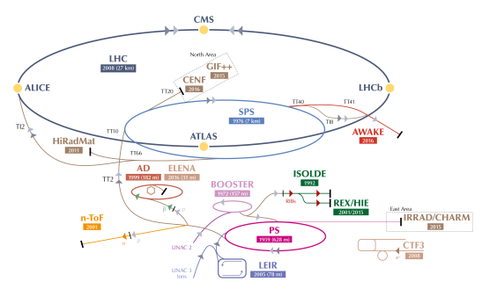
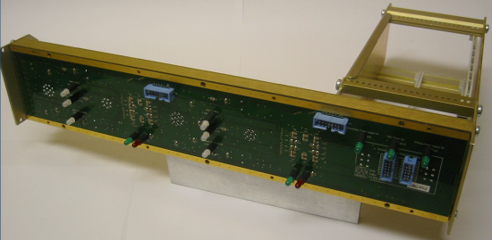
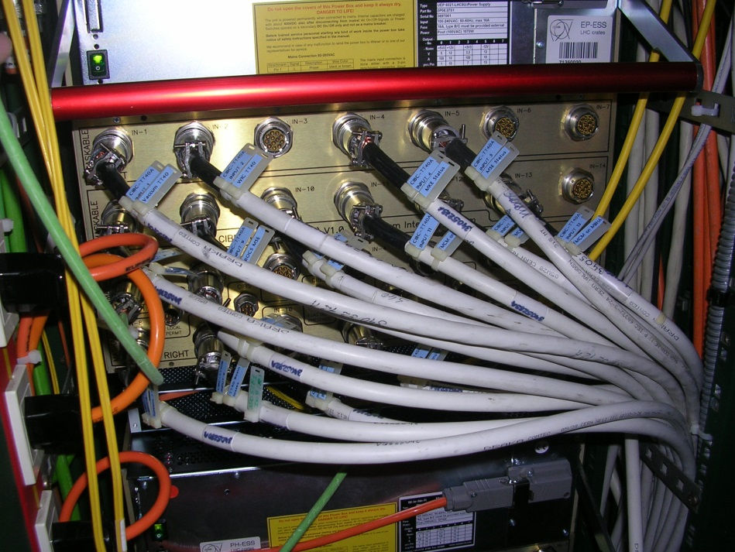
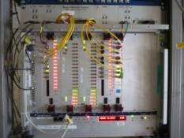
Beam Interlock System (BIS) User Interface (CIBU)
LHC : ~150 CIBUs
SPS and Injectors: ~350
User Interface (CIBU)
Beam Interlock Controller
User
Permit A
User Permit A
BEAM
PERMIT
USER SYSTEMS
(PIC, FMCM, BLM etc..)
User
Permit B
Rear
Front
User Permit B

Slide 4
CIBU Positions - LHC
CCR
Point1
  L1: RR13, US151, SR1,
  R1: RR17, USA151, USA152, US15, US153
Point 2:
  L2: UA23, SR2
  R2: UA23, UA27, CR4
Point 3:
  U3: UJ33
  S3: SR3
Point 4:
  R4: UA47, US451, UX45
  L4: UA43, SX4, SR4
Point 5:
  R5: USC55, RR57
  L5: RR53, USC55, SR5
Point 6:
  R6: UA67, SR6, US65, UA67
  L6: UA63, SR6, US651
Point 7:
  U7: RR73, RR77, TZ76
  S7: SR7
Point 8:
  R8: UA87, UX85, UX85 (platform)
  L8: UA83, US851, SR8
2x CIBU in the RR → 12 total

Slide 5
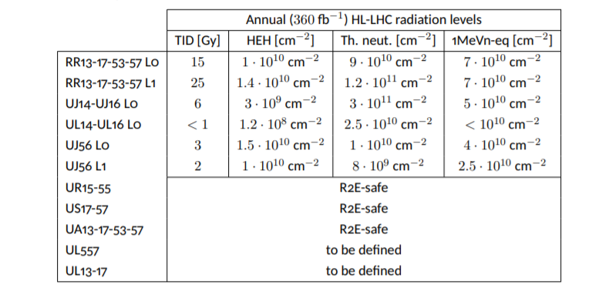
Target Radiation Levels
HL-LHC Radiation Level Specification:
https://edms.cern.ch/document/LHC-N-ES-0001/1.0
Hi-Lumi, RR (L1) ultimate scenario: 4000 fb⁻¹
TID = ~280 Gy
Max. HEH fluence/year = ~ 1.4x10¹⁰ cm⁻²
HEH total fluence = ~1.6 x10¹¹ cm⁻² total
1MeVn-eq fluence = ~ 8 x10¹¹ cm⁻²

Slide 6
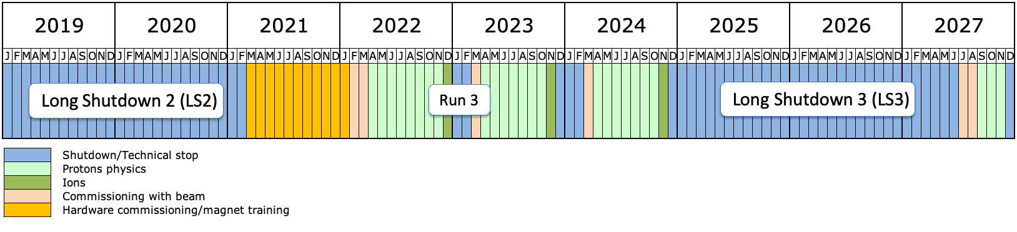
Planning and Strategy
BIS v2: first installation planned during LS3
CIBU spares BISv1 running low
  CIBUv1 components hard to find
  Priority: CIBU preliminary design to be compatible with BIS v1
Focus on ONE design:
  COTS from available databases
  BE-CEM-EPR: Purchase components + hold the Lot purchased + Radiation Test and report
Aiming at a full system validation at CHARM
Evaluate and Test Components
CHARM
First BISv2 Installation
LHC
schedule

Slide 7
Choice of Components
CRITICAL
User Interface (CIBU)
Beam Interlock Controller
User
Permit A
User Permit A
BEAM
PERMIT
USER SYSTEMS
(PIC, FMCM, BLM etc..)
User
Permit B
Rear
Front
User Permit B
MONITORING:
2x Power supply monitoring
On board voltages
User Input Current

Slide 8
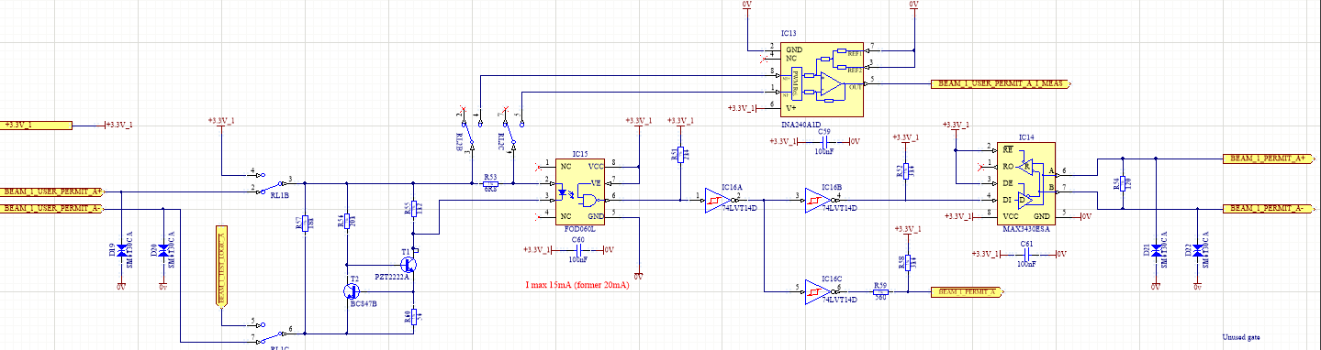
COTS selection - Critical
CRITICAL
Component | Function | Second choice
FOD060L (AlGaAS) | High speed optocoupler 3.3V | Broadcom/Avago HCPL-060L (GaAsP)
MAX3430 | RS485 Transceiver | MAX13448E
BC847B and PZT2222A | NPN transistors | -
74LVT14D | Schmitt Trigger | -
CIBU v2 schematic
RS-485
OUTPUT
USER INPUT

Slide 9
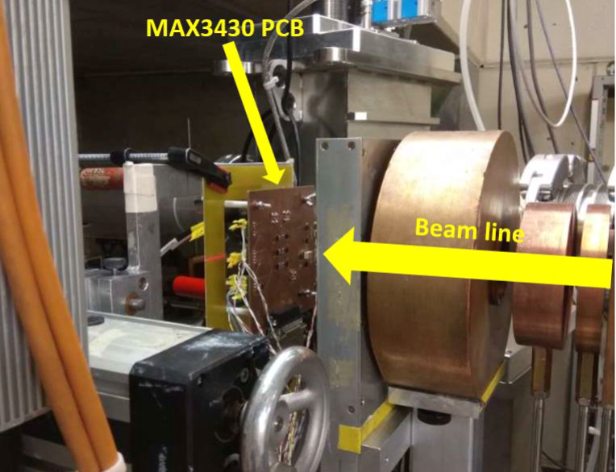
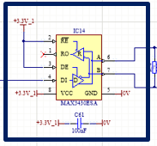
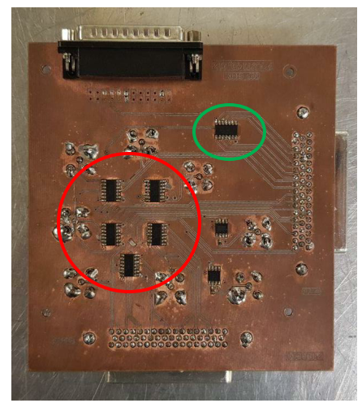
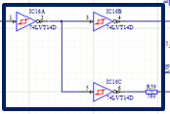

Radiation Tests Results
Tests carried out at PSI by BE-CEM-EPR
  RS485 driver MAX3430
  Report: EDMS #2417502
  No errors on RX side. Fail-safe feature tested.
  Reached TID 500 Gy and HEH fluence 8.5x10¹¹ cm⁻².
  SETs observed in data transmission, average device cross-section
  σ = ~ 1x10⁻¹¹ cm² in worst case conditions
Schmitt Trigger 74LVT14D
Report: EDMS #2417025
TID 500 Gy, HEH fluence 8.5x10¹¹ cm⁻²
No large variation/degradation of all
quantities
BJT Transistors: BC847B and PZT2222AT1G
Report: EDMS #2454604
TID 500 Gy, HEH fluence 8.5x10¹¹ cm⁻²
Worst case degradation of 40%, within the manufacturer specifications
74LVT14D Test Board
Courtesy of BE-CEM-EPR

Slide 10
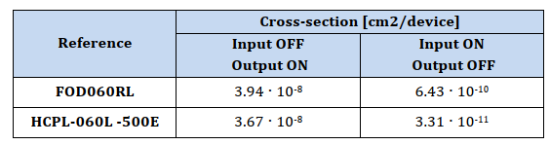
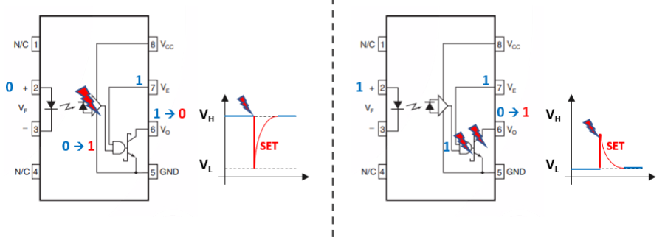
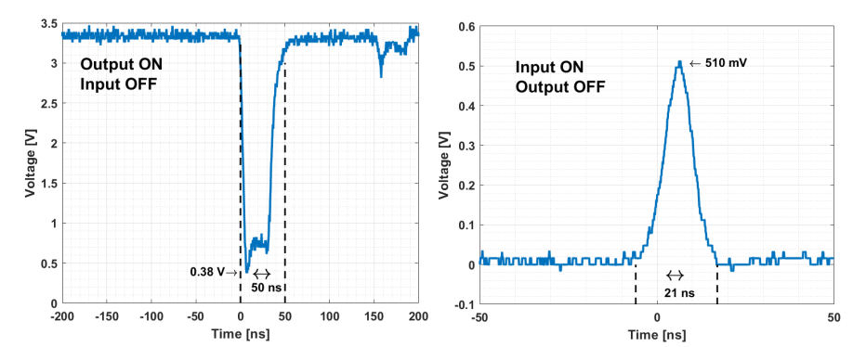
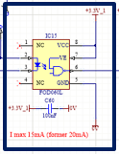
Radiation Tests Results - Optocoupler
FALSE → TRUE
TRUE→FALSE CRITICAL
  FOD060: ~ 128 SET in 2x10¹¹ cm⁻²
  HCLP-060L: ~ 7 SET in 2x10¹¹ cm⁻²
  No variation of shape and pulse duration
Present CIBU optocoupler σ_{_SEE} = 8.3 x 10⁻¹⁰ cm²
Report: EDMS #2416544
DDEF:
  FOD060L: ~ 9x10¹² cm⁻² 1MeV neq (AlGaAs)
  HCPL-060L: ~ 5x10¹² cm⁻² 1MeV neq (GaAsP)
Strong response to TID and DD.
Neutrons test foreseen.
Courtesy of BE-CEM-EPR
BA6-Extraction

Slide 11
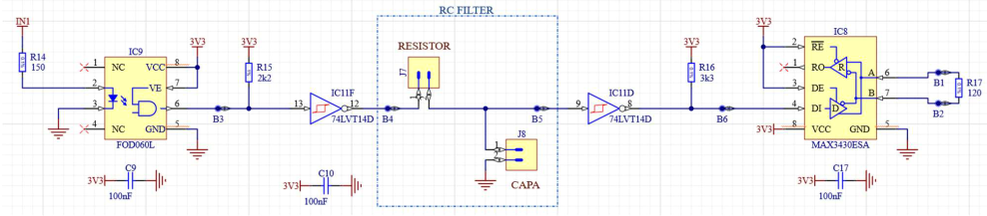
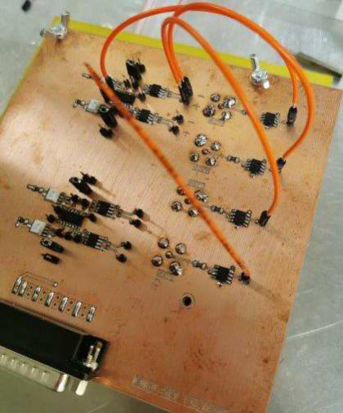
Radiation Tests Results – Full CIBU critical Chain
@500 Gy and HEH 8.5x10¹¹ cm⁻²:
38 SETs
19 SETs
0 SETs
Steps of 100 Gy and 1.7E11 p/cm2 fluence
Reached 500 Gy and HEH 8.5 x10¹¹ cm⁻²
Hi-Lumi ultimate target: TID 280 Gy, HEH 1.4x10¹⁰ cm⁻² max. annual
Report: EDMS #2415099
Total cross-section σ < 4.4 x 10⁻¹² cm⁻² (95% confidence)
Courtesy of BE-CEM-EPR

Slide 12
COTS selection – Non critical
MONITORING
Component | Function | Comments
INA240 | Current Sense Amplifier | Tested
AD7291 | 12-bit ADC + I2C | Tested
TPS3808G12DBVT TPS3808G33DBVT | FPGA supervisory circuit | Scheduled for Test
M2GL005-TQ144 | IGLOO2 FPGA | Tested (purchase new Lot)
POWER
Component | Function | Comments
LT3083 | LDO Voltage Regulator | Tested (purchase new Lot)
FSV1060V | Schottky Diode | Scheduled for Test
TPP40-105 | AC/DC Power Supply | Test foreseen

Slide 13
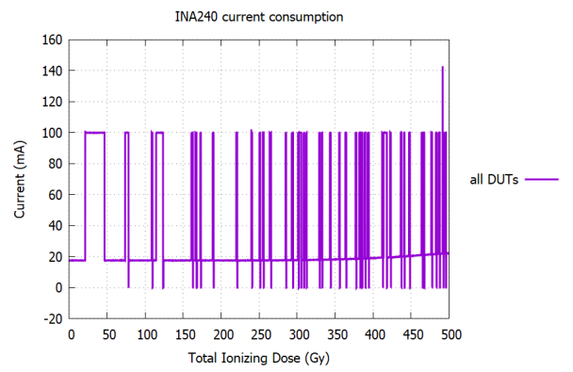
Monitoring components results
MONITORING
Component | Function
INA240 | Current Sense Amplifier
AD7291 | 12-bit ADC + I2C
TPS3808G12DBVT TPS3808G33DBVT | FPGA supervisory circuit
Igloo2 | FPGA
INA240
EDMS #2588515
Reached 500 Gy and HEH 8.61 x10¹¹ cm⁻²
High SEL cross-section
AD7291
EDMS #2591354
Reached 500 Gy and HEH 8.61 x10¹¹ cm⁻²
No SEL, SEU, SEFI observed
No increase in current consumption
USER INPUT
Courtesy of BE-CEM-EPR

Slide 14
Conclusions and Plans
  CIBU v2:
    Highly critical generic interface with users connected to the BIS.
    Foreseen deployment in the RRs during Hi-Lumi.
  Strategy:
    Focus on one unique design
    BE-CEM-EPR procurement and tests at component level at PSI
    Full critical circuit qualified
  Planned Activities
  Test Monitoring
    on-board ADC qualified
    INA240: high SEL cross-section
    FPGA supervisory circuit to be tested
  Power Supply Unit: Radiation tests to be planned
  Neutron Test on optocouplers.
  System level test at CHARM in 2021/2022 to validate the system

