Slide 1
R2E and Procurement for Vacuum Controls
Vilde F. Rieker (TE-VSC-ICM)

Slide 2
Overview
Project Overview
Timeline
New LOG stage
Component procurement
PSI test results
Summary and further work

Slide 3
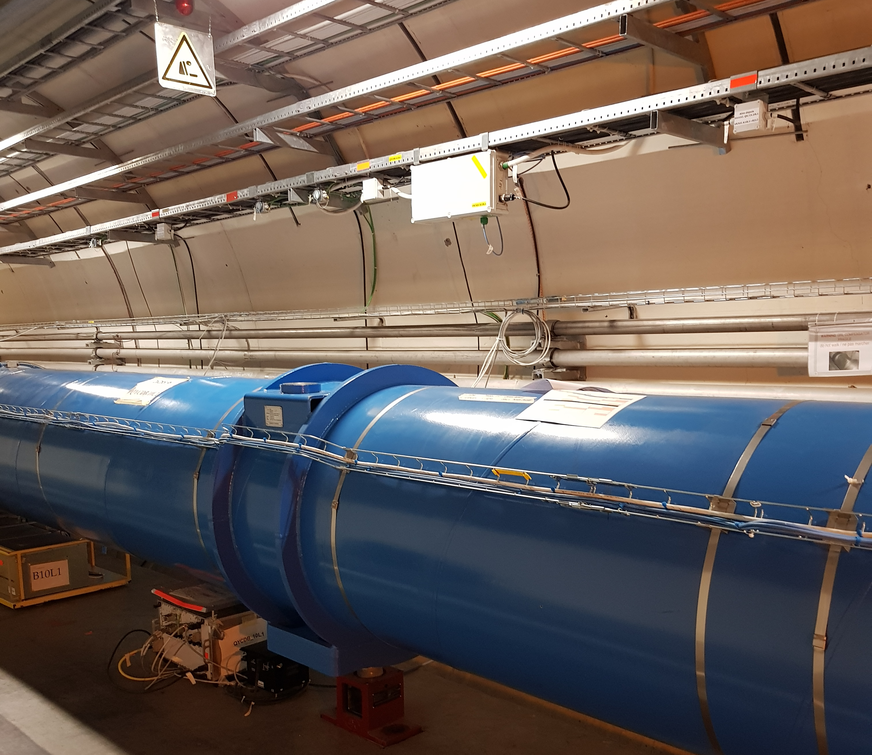
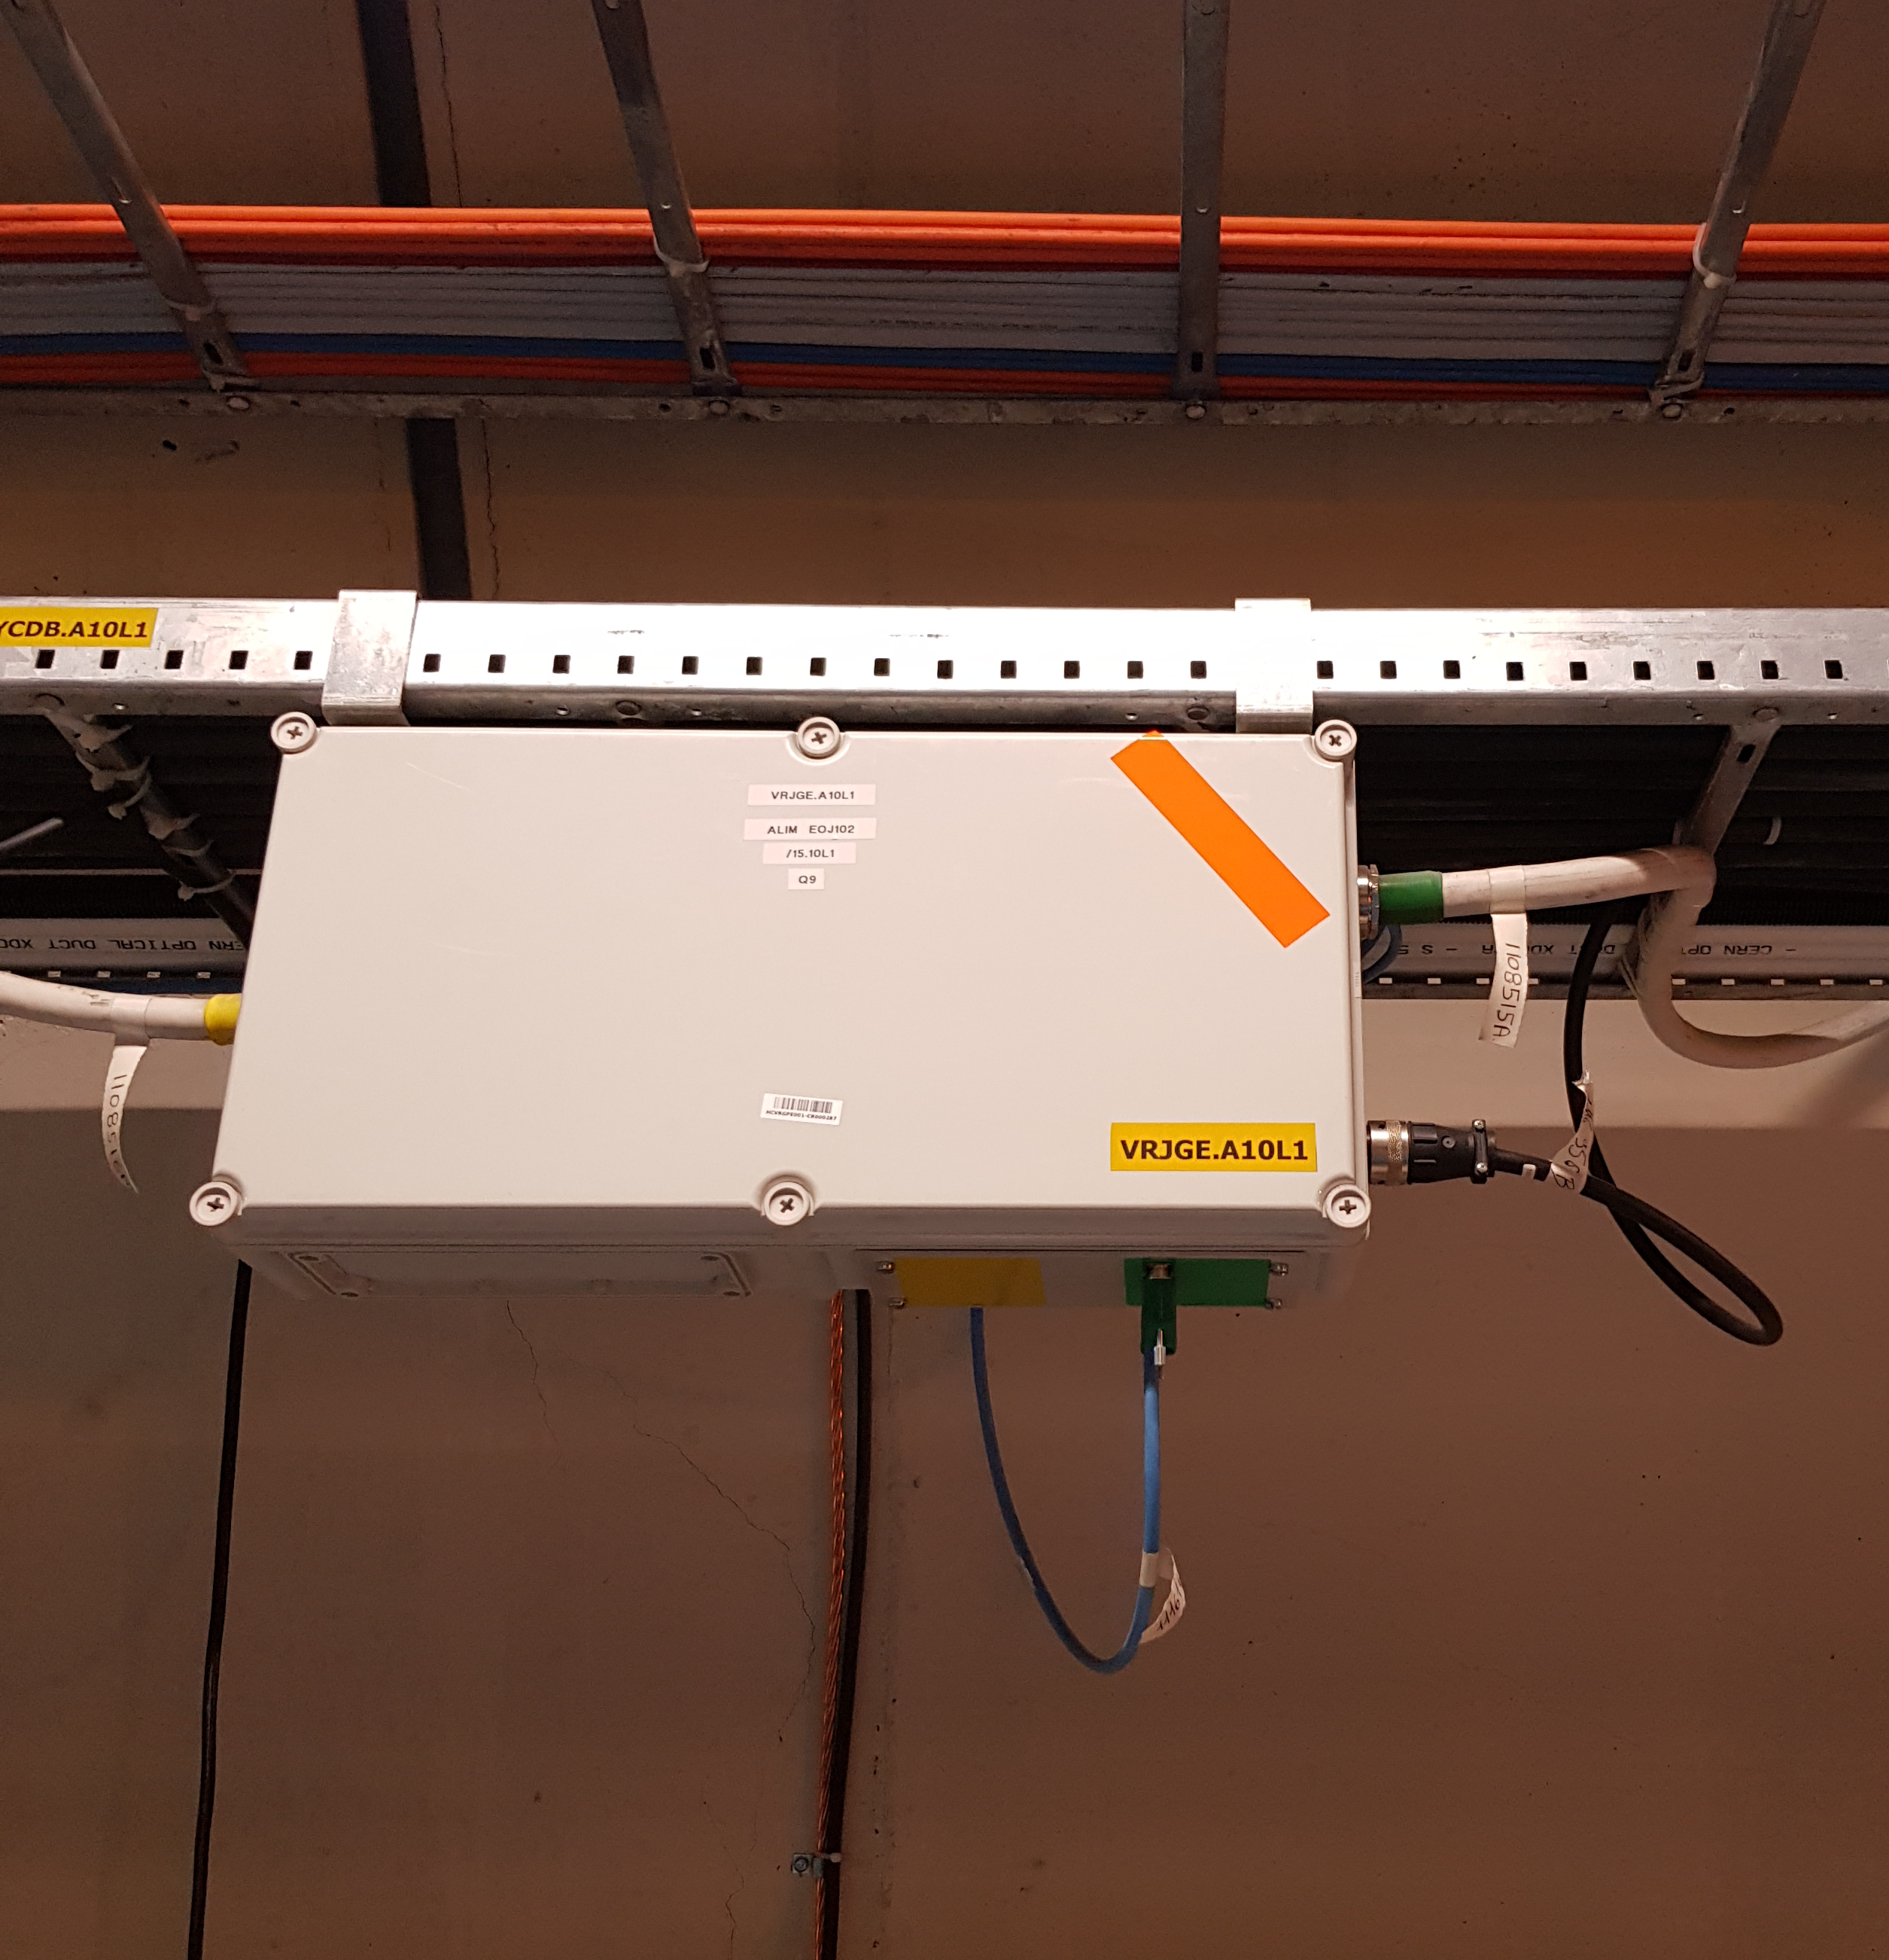
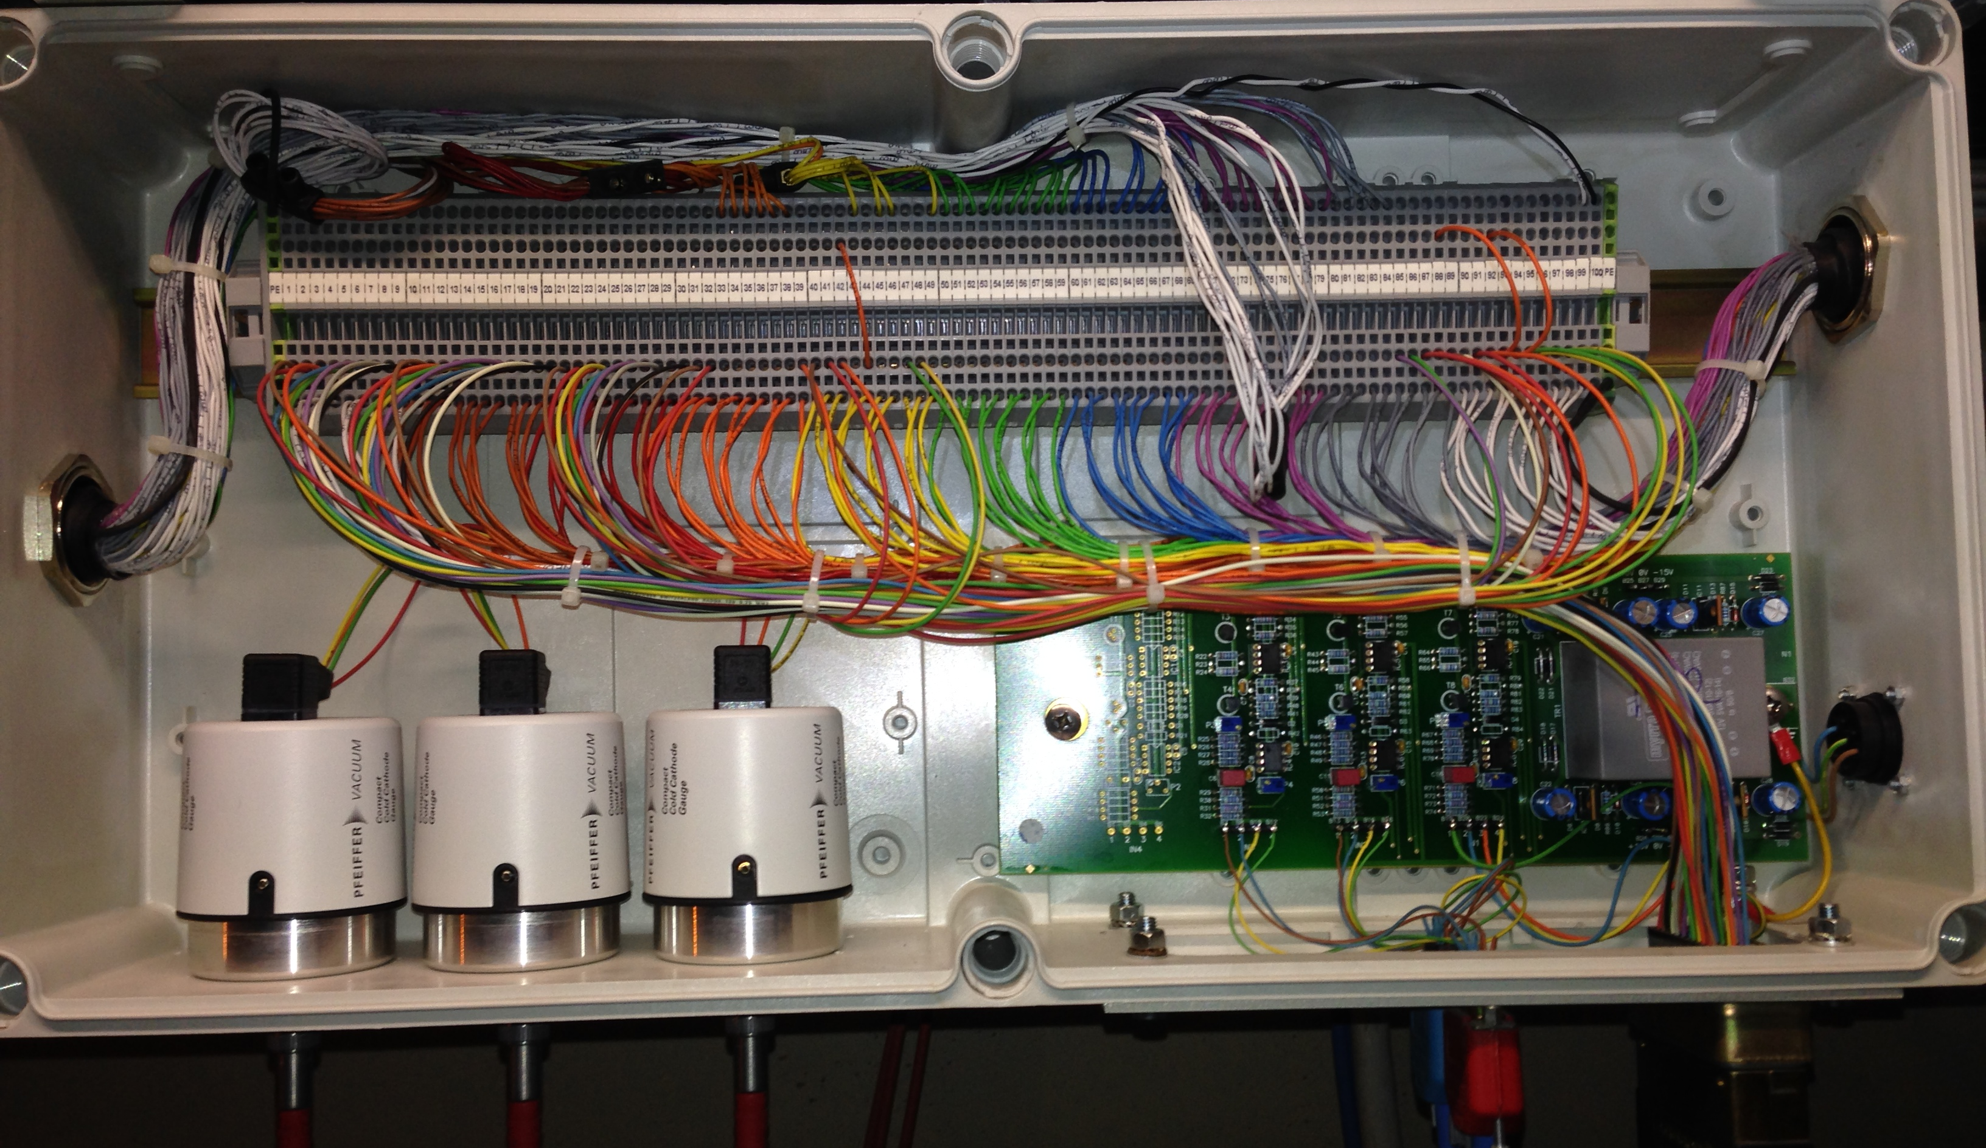
Project Overview
Non-RadTol industrial system
Challenging access, fixed, 0-10 V transmission
Notes:
In the LHC about 24km vacuum chambers in the DS/ARCs
Thermal insulation vacuum range 10E-8 mbar (High Vacuum)
Beam vacuum range below 10E-10 mbar (Ultra-High Vacuum)
3 sensors with deported electronics to measure pressure: Piezo, Pirani, Penning
Electronics fixed above dipole magnet – difficult access
Non-modular resulting to long interventions and commissioning campaigns
0-10V signal transmission resulting to signal losses and noise coupling

Slide 4
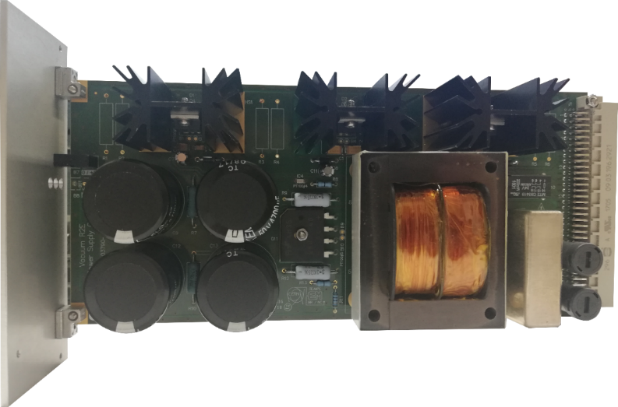
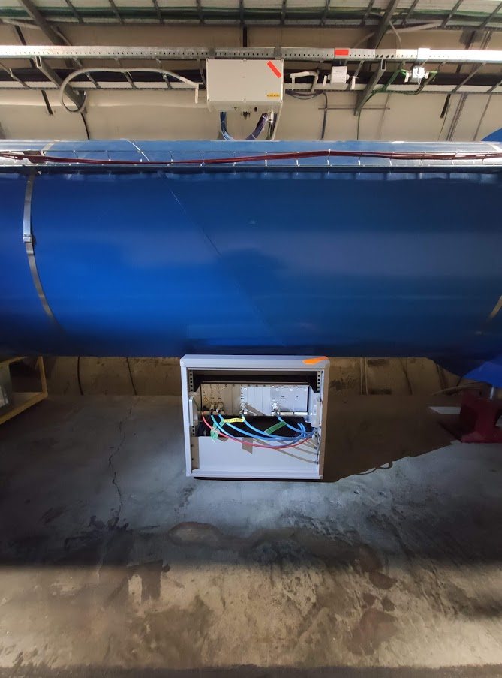
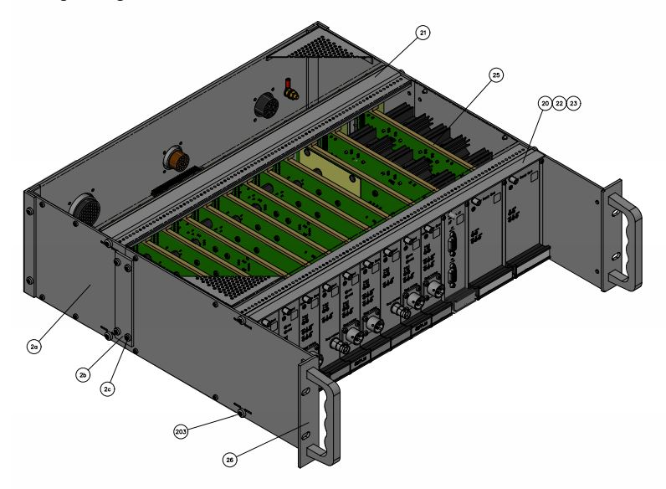
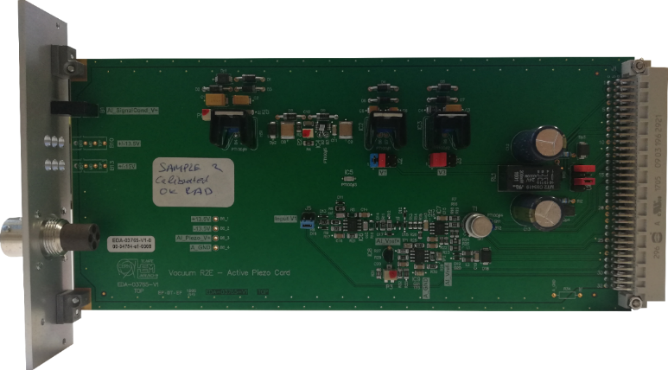
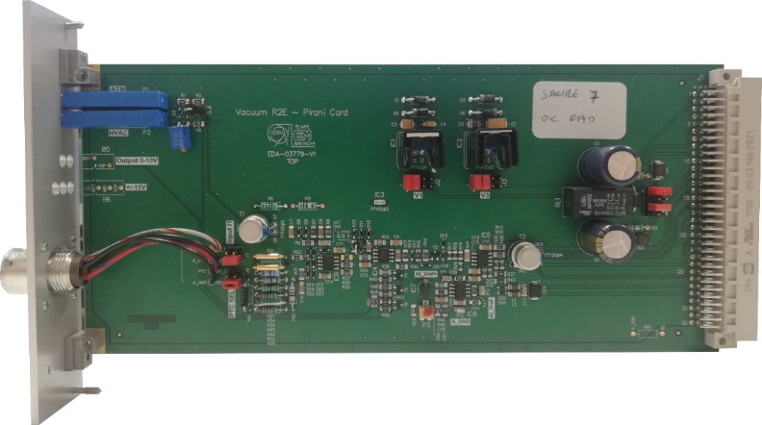
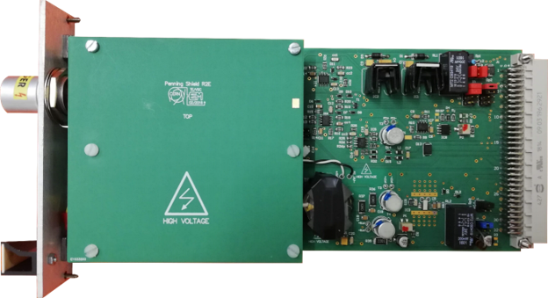
Project Overview
RadTol up to 500 Gy
Easy access, modular, 4-20 mA transmission
Power supply
Piezo conditioning
Pirani conditioning
Penning conditioning
Notes:
Mini-rack with 3U euro-crate beneath dipole magnet – easy access
Modular electronics reducing intervention times and commissioning campaigns
4-20mA transmission resulting to no signal losses and reduced noise coupling
500Gy development goal, safety factor x2.5 for DS

Slide 5
Timeline
Conseptual design,
Simulations and
COTS candidates
System level tests at CHARM and DS production of 180 cards and 50 crates
ARC production, testing and calibration of 1300 cards and 180 crates
DS commissioning
ARC commissioning
RN2
LS2
RN3
LS3
2016
2017
2018
2019
2020
2021
2022
2023
2024
2025
2026
2027
COTS screening at PSI and sub-module tests at CC60 and CHARM
DS installation
ARC batch verifications at PSI and system verification at CHARM
ARC installation

Slide 6
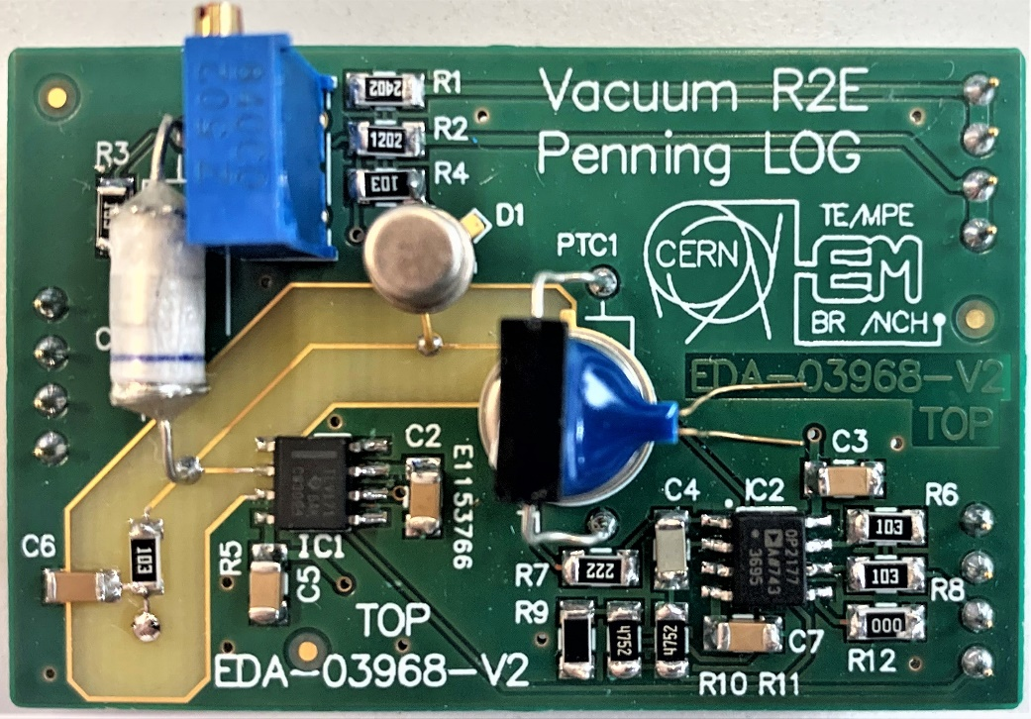
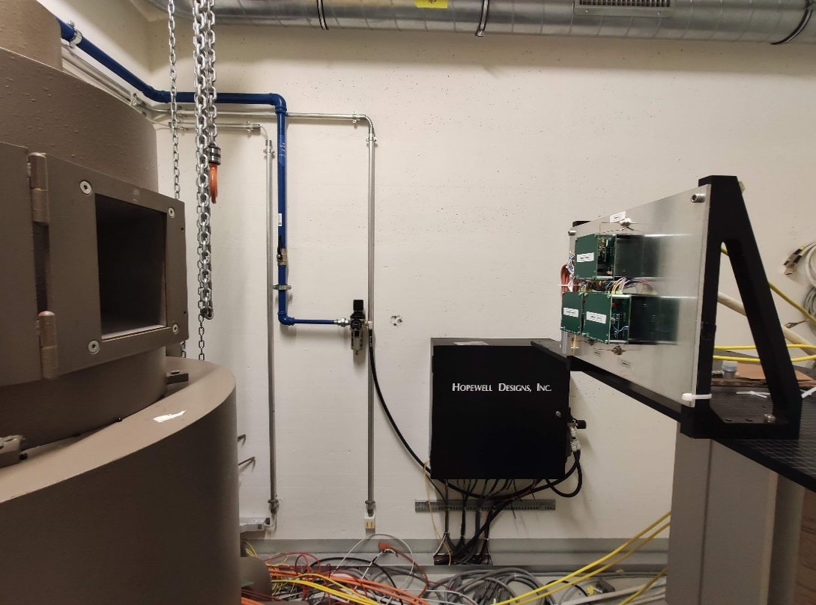
Logarithmic Stage for Penning Signal Conditioning
Used for I-V conversion in the Penning electronics
Previously used with the electrometer-grade OPA128
  Not needed for 10-9 mbar
  Expensive and obsolete
Two alternatives: OPA171 and TLV171 tested at CC60

Slide 7
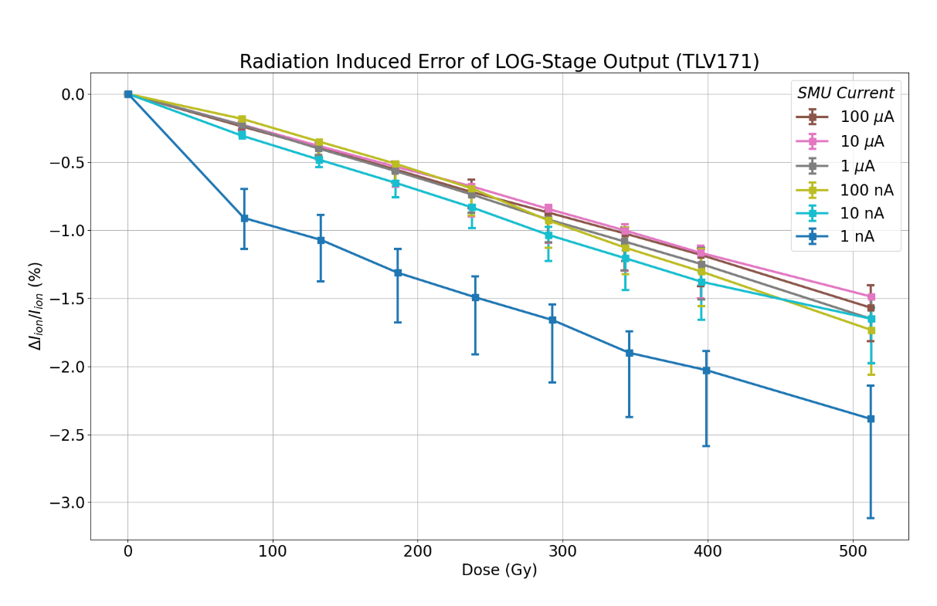
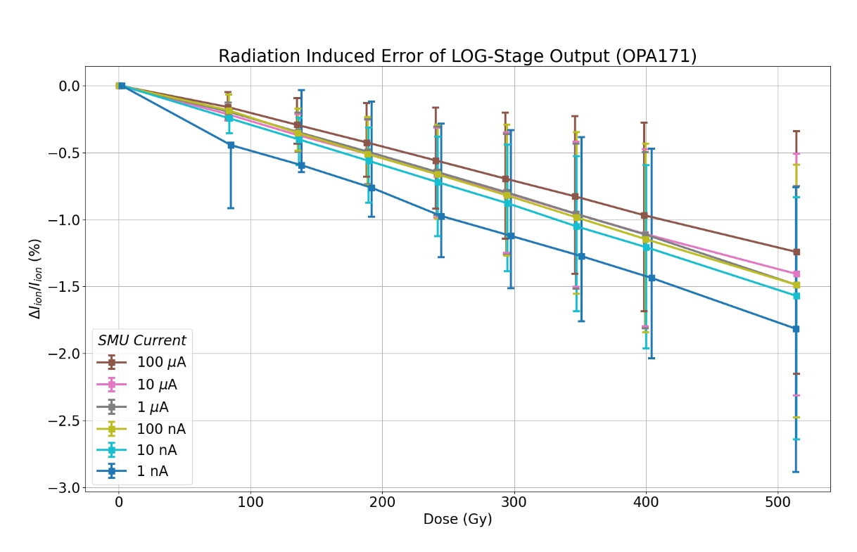
Logarithmic Stage for Penning Signal Conditioning
Notes:
The TLV171 version gives pressure readout signal with less than 3.5% error after 500 Gy
The OPA171 version yields less than 3% error after 500 Gy
Need less than 10% pressure readout error for entire card
The accumulated error will be higher due to added effects of additional radiation-sensitive components of the card (such as the 2N3019 NPN BJT driving the 4-20 mA output).
Samples have only been tested for TID, and the effect of displacement damage will be tested for the selected component at CHARM this Fall

Slide 8
Procurement
Component | Manufacturer | Device type | Cards | Procurement Qty. (LS2 Stock) | LS3 Production Qty.
PAD1 | InterFET | Diode | Penning | 420 (61) | 480
2N3019 | NTE | NPN BJT | Penning, Pirani, Piezo | 3000 (5) | 2603
2N3810 | Microsemi | PNP Dual BJT | Penning | 400 (134) | 480
UA7824CKCS | TI | +24 V positive regulator | Power supply | 600 (575) | 1074
UA7815CKCS | TI | +15 V positive regulator | Penning, Pirani, Piezo | 1100 (178) | 1162
TPS7A3001DGNT | TI | Adjustable negative regulator | Piezo | 250 (155) | 201
TPS7A4901DGNT | TI | Adjustable positive regulator | Penning, Piezo | 750 (222) | 708
TL1431MDREP | TI | Voltage reference | Penning, Pirani, Piezo | 1490 (78) | 1162
OP2177CRZ | Analog | Operational amplifier | Penning, Pirani, Piezo | 4000 (996) | 4245
OPA171AID | TI | Operational amplifier | Penning | 500 (0) | 480
Notes:
10 references, 12500 pcs
Required quantity for all cards (penning pirani, piezo, power supply) including
test-cards Charm (10)
pre-series cards (10)
Series (PN=344, PR=344, PZ=132, PS=387)
Account for 10% losses in production
20% spares (of total)

Slide 9
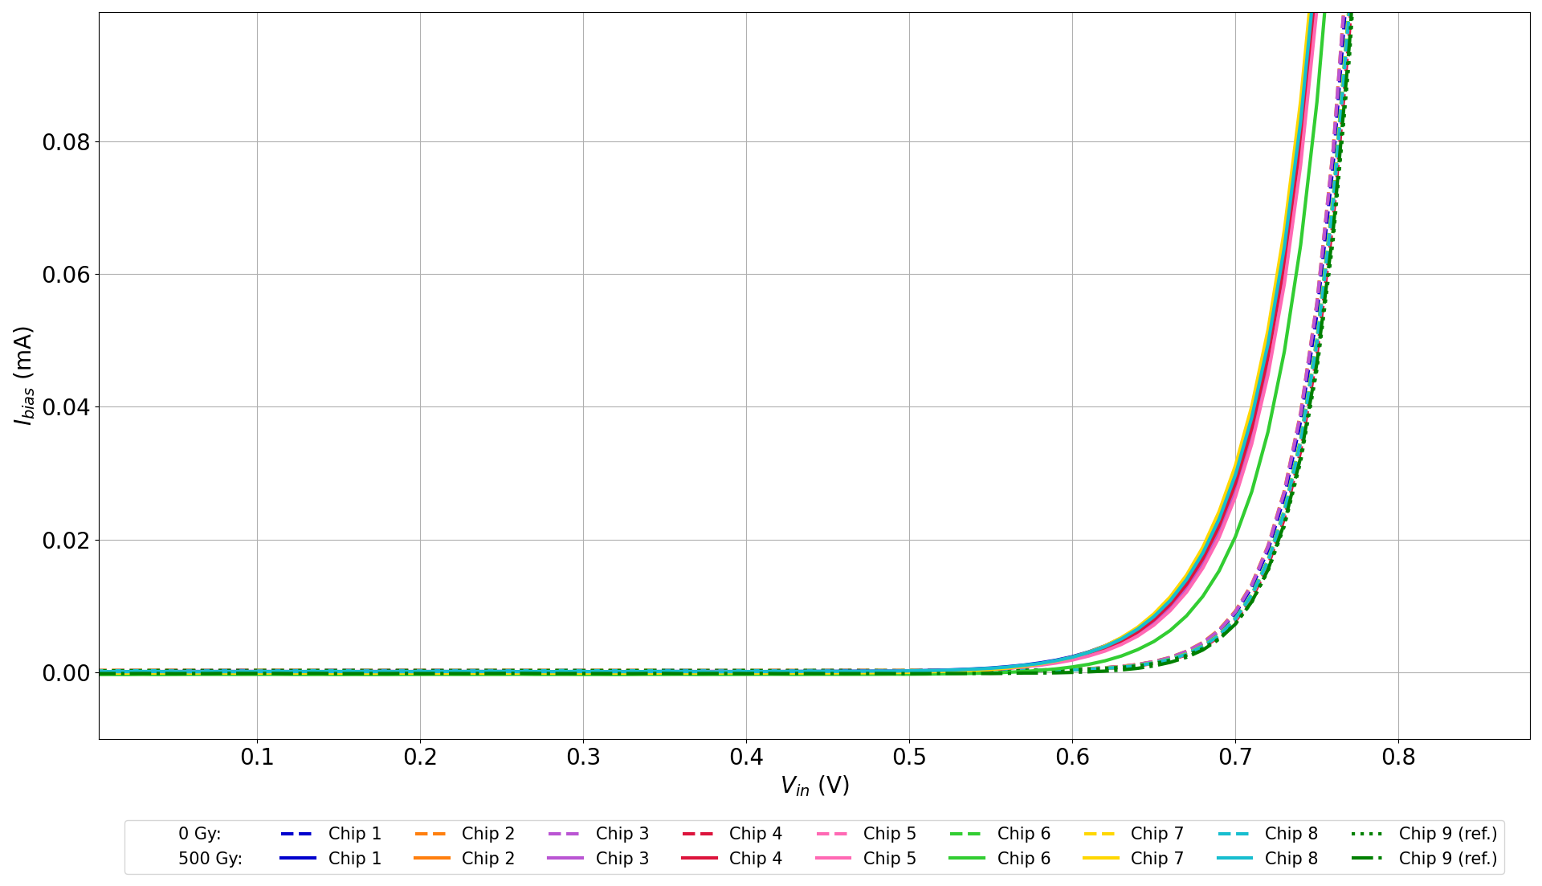
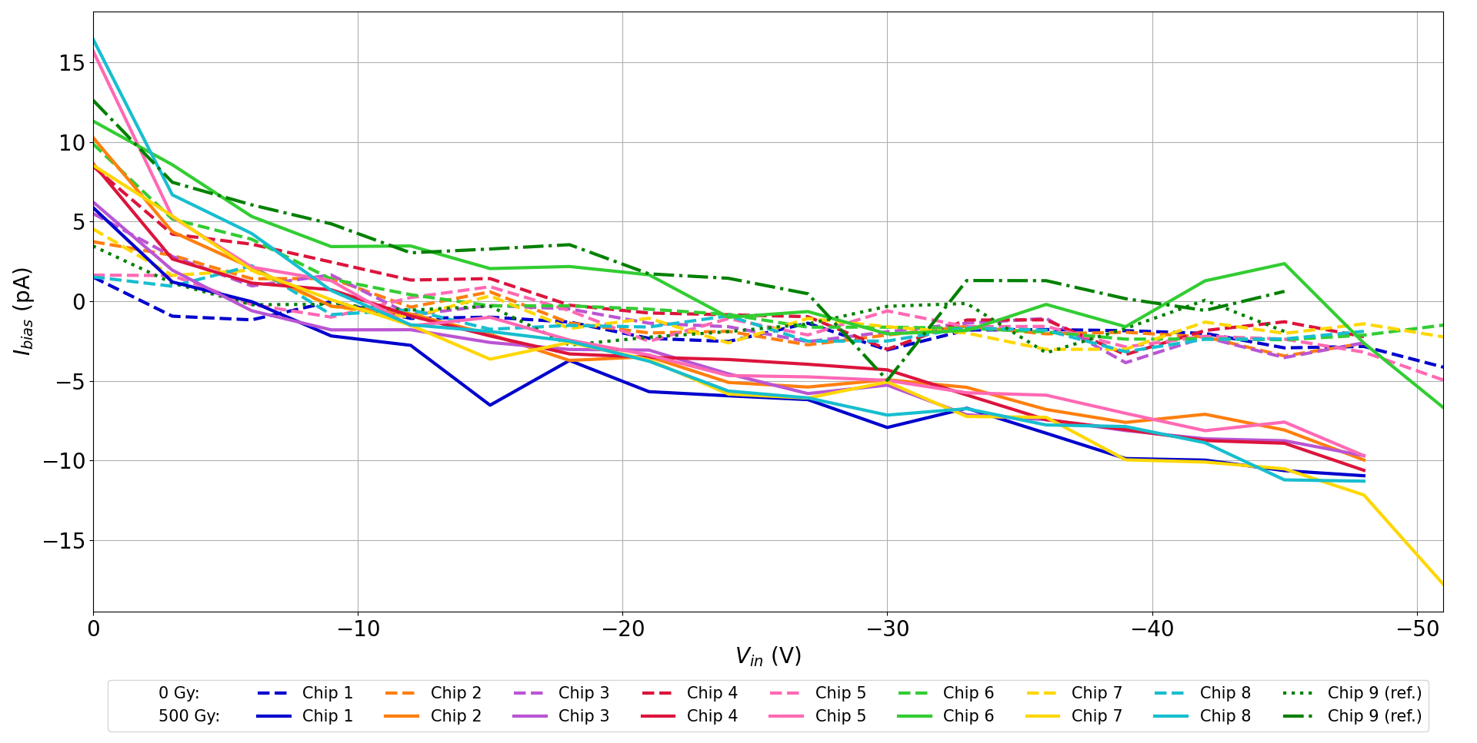
PSI Batch Verification: PAD1
Accepted
Forward bias
Reverse bias
< 50 pA
Notes:
Diode
Max leakage increase: 50 pA to sustain the 1E-10 mbar pressure range.
Max -45 V to avoid breakdown according to datasheet

Slide 10
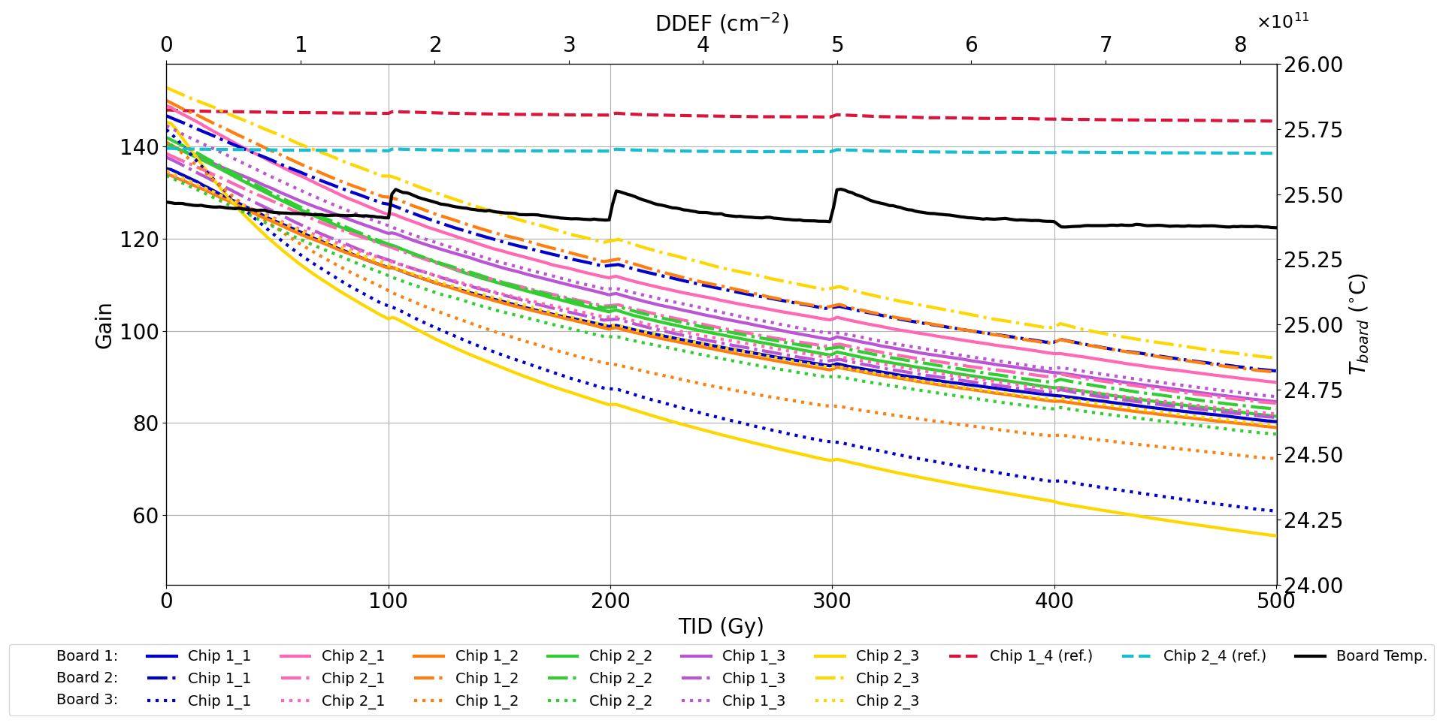
PSI Batch Verification: 2N3019
Accepted
>20
Notes:
NPN BJT
Minimum gain of 20 to provide enough electrical current for 4-20 mA signals and pirani filament.

Slide 11
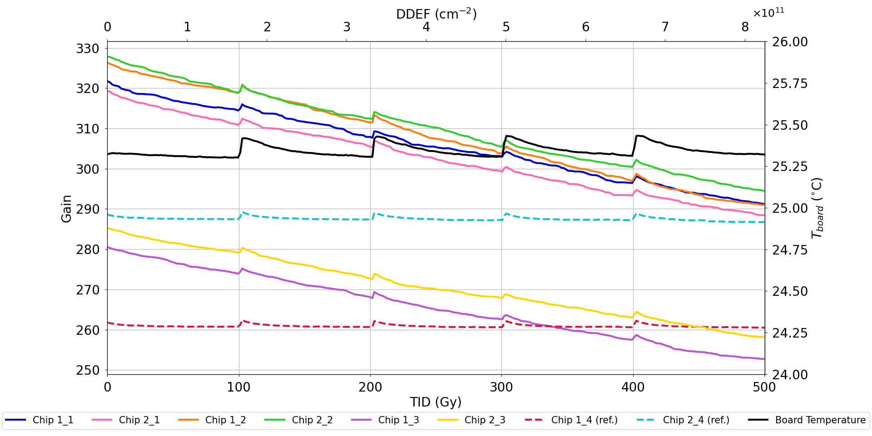
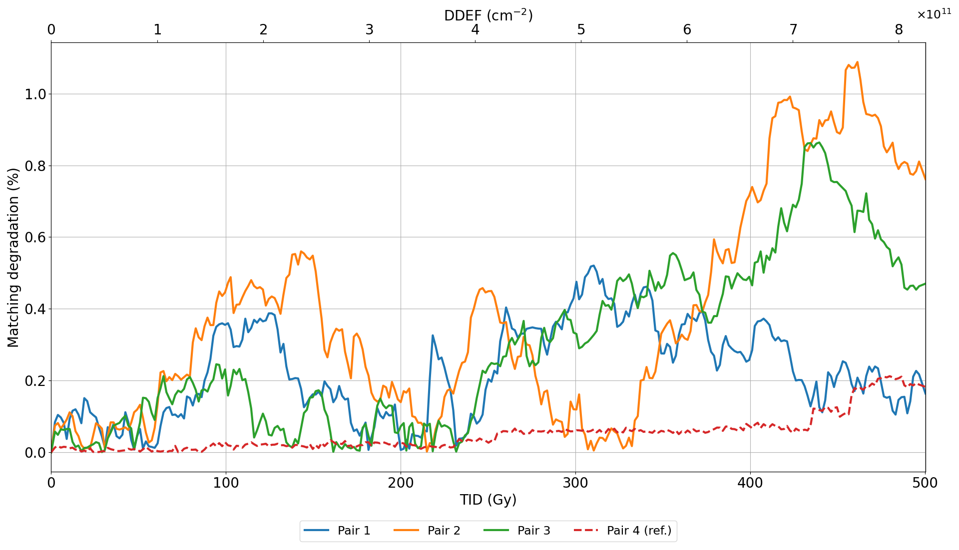
PSI Batch Verification: 2N3810
Accepted
< 10 %
> 100
Notes:
PNP BJT
Minimum gain of 100 to avoid error in high pressure range
Matching better than 10% for 10% pressure accuracy

Slide 12
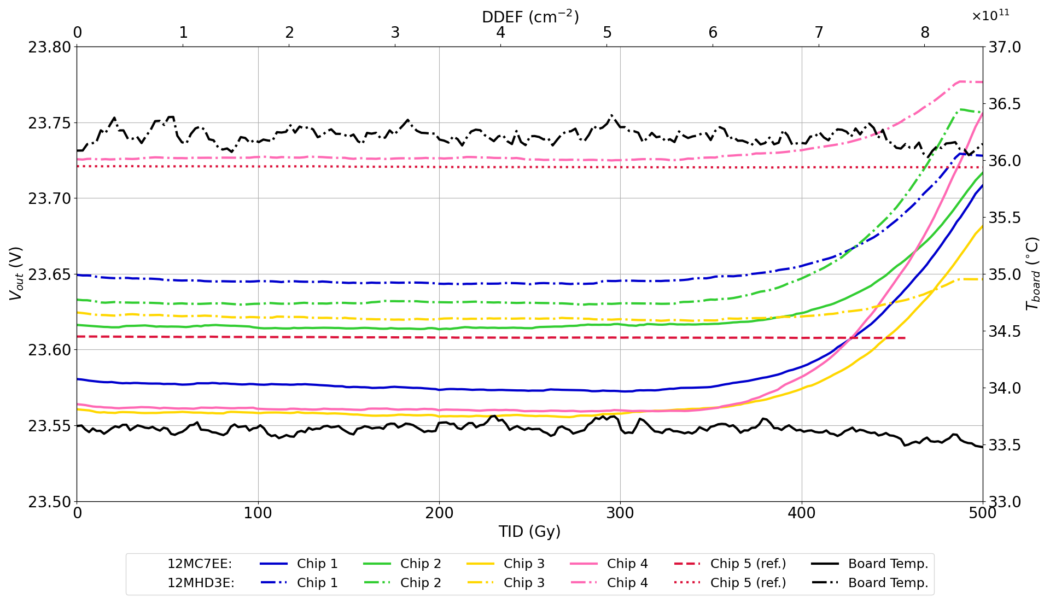
PSI Batch Verification: UA7824
Accepted
< 30 V
> 17.5 V
Notes:
+24V regulator
Max Vout = 30 V, min Vout = 17.5 V to avoid loss of post regulation in the system or complete failure

Slide 13
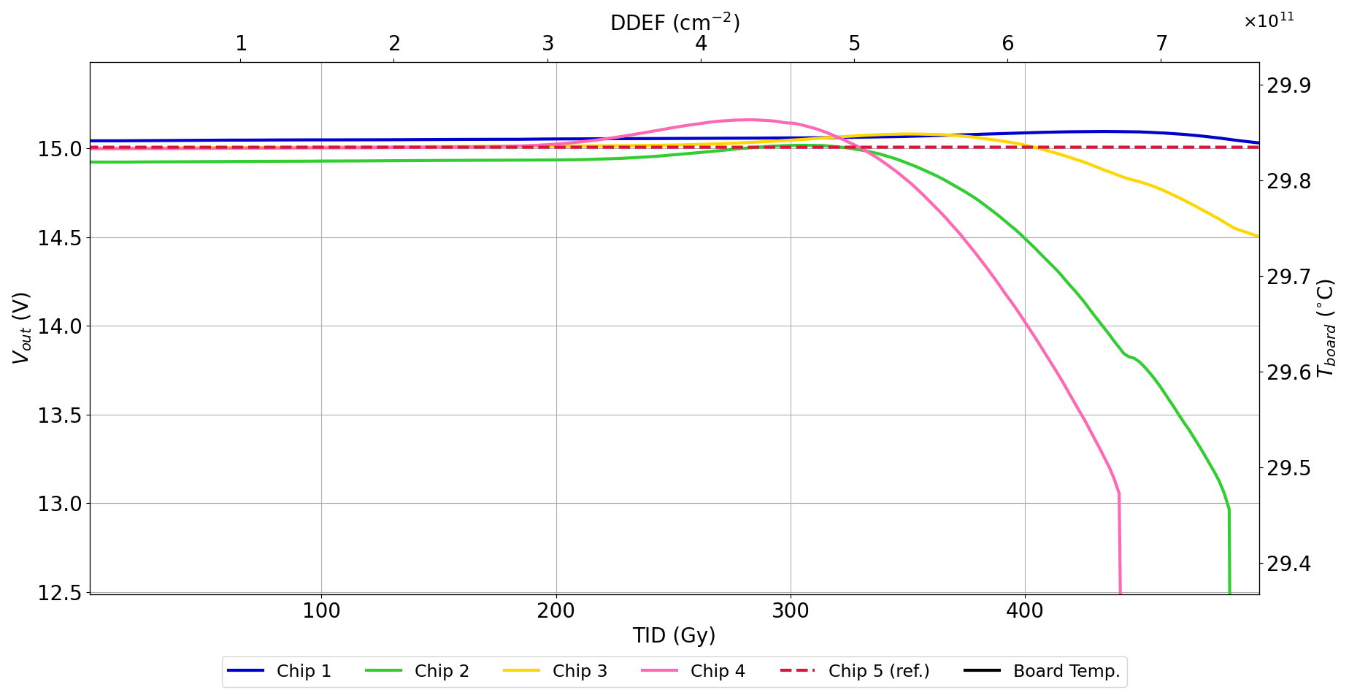
PSI Batch Verification: UA7815
Rejected
< 14 V
Notes:
+15 V regulator
Requirement: between 14 and 18 V to avoid destruction of operational amplifiers or saturation of 4-20 mA readout signals
2/4 ceased to function between 400 and 500 Gy
Expect earlier failure at CHARM

Slide 14
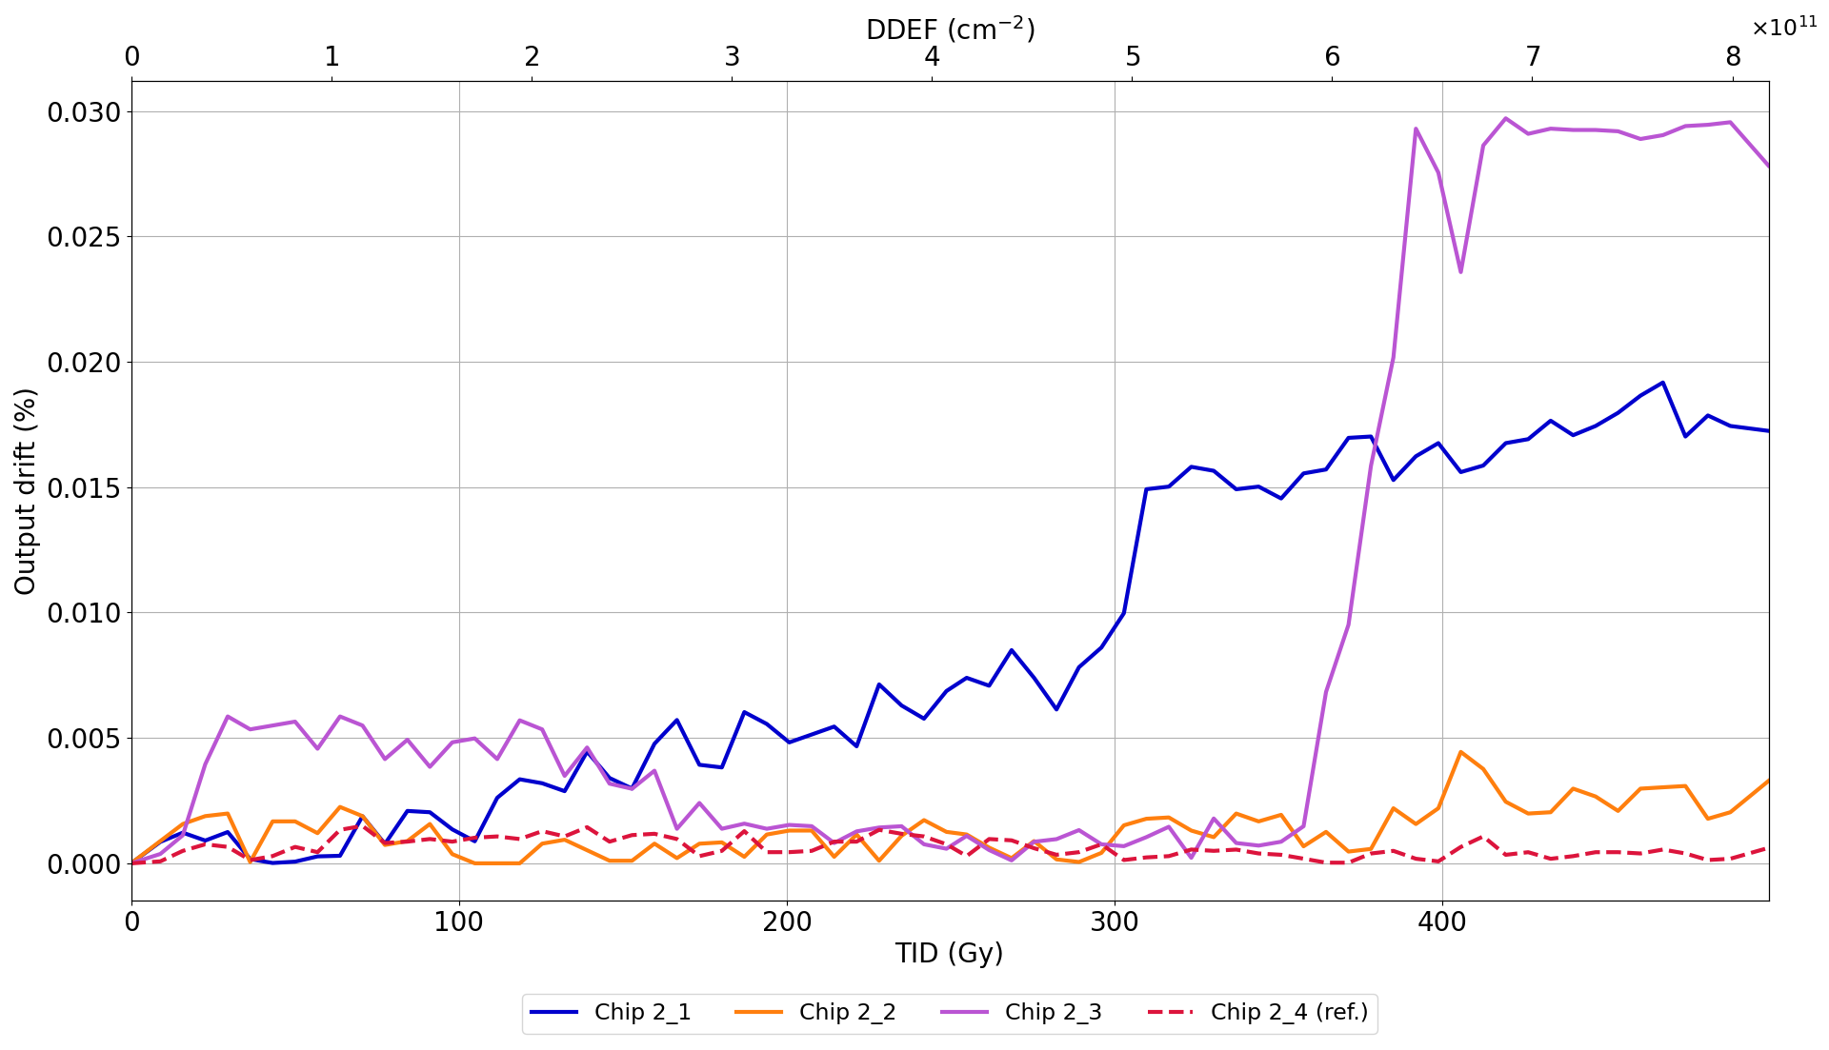
PSI Batch Verification: TPS7A3001
Accepted
< 10 %
Notes:
Adjustable negative regulator
Max Vout deviation: (1.35 V) 10% for 10% pressure readout accuracy

Slide 15
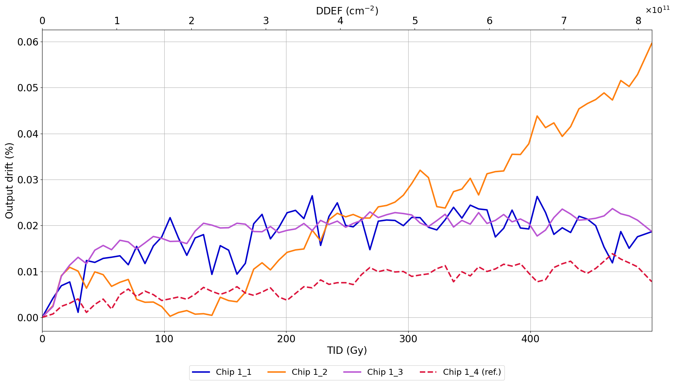
PSI Batch Verification: TPS7A4901
Accepted
< 5 %
Notes:
Adjustable positive regulator
Max Vout deviation: (1.35 V) 10% for 10% pressure readout accuracy
Max deviation ±5% for Penning high voltage

Slide 16
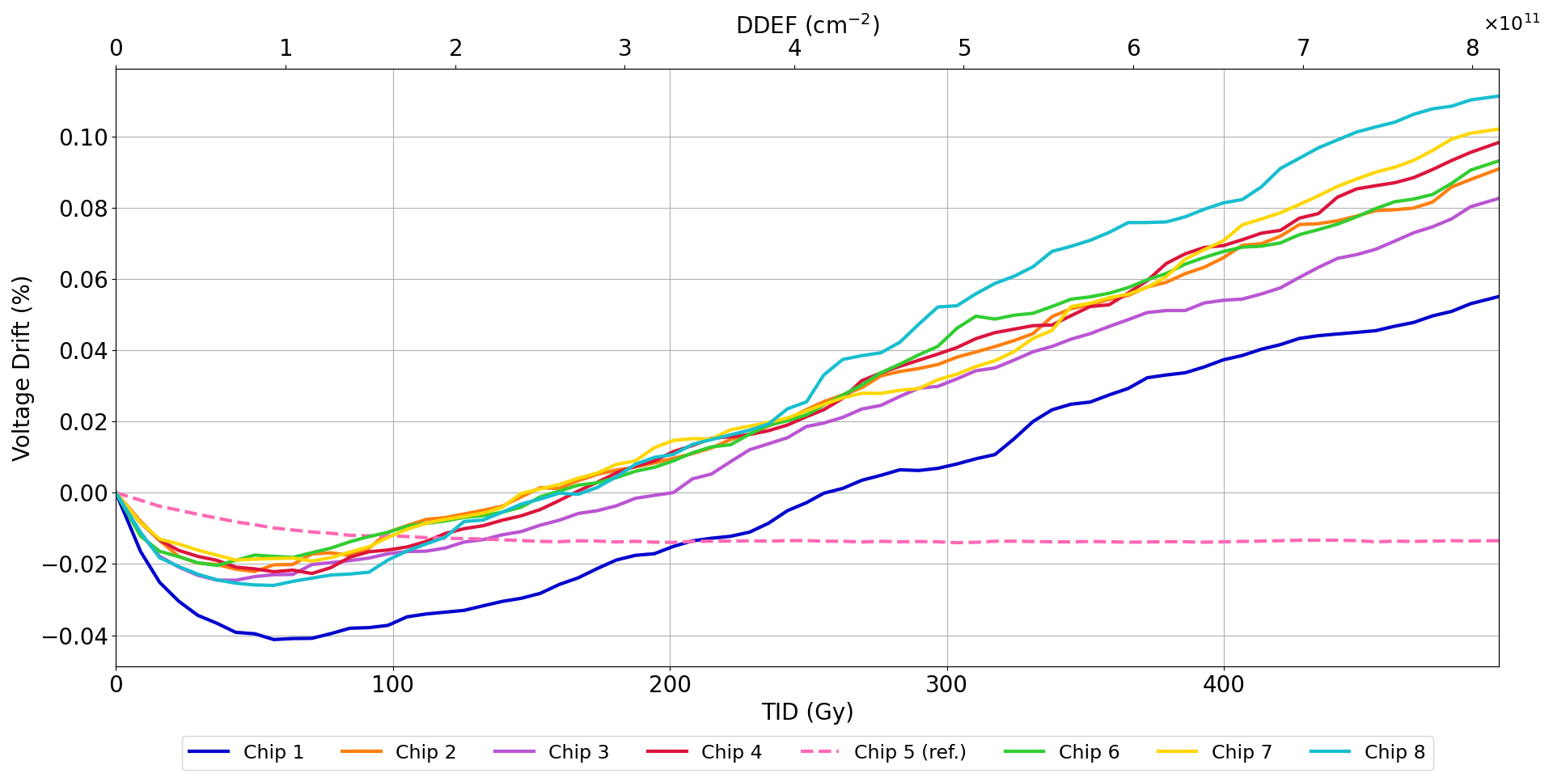
PSI Batch Verification: TL1431
Accepted
< 1 %
0 SETs detected
Notes:
Voltage reference
Max Vout deviation (absolute):
Penning: Max 1% (50 mV) Vout deviation for 10% pressure readout accuracy
(Piezo: Max 10% (500 mV) Vout deviation for 10% pressure readout accuracy)
(Pirani: Max 2% (100 mV) Vout deviation for 20% pressure readout accuracy)
0 SETs

Slide 17
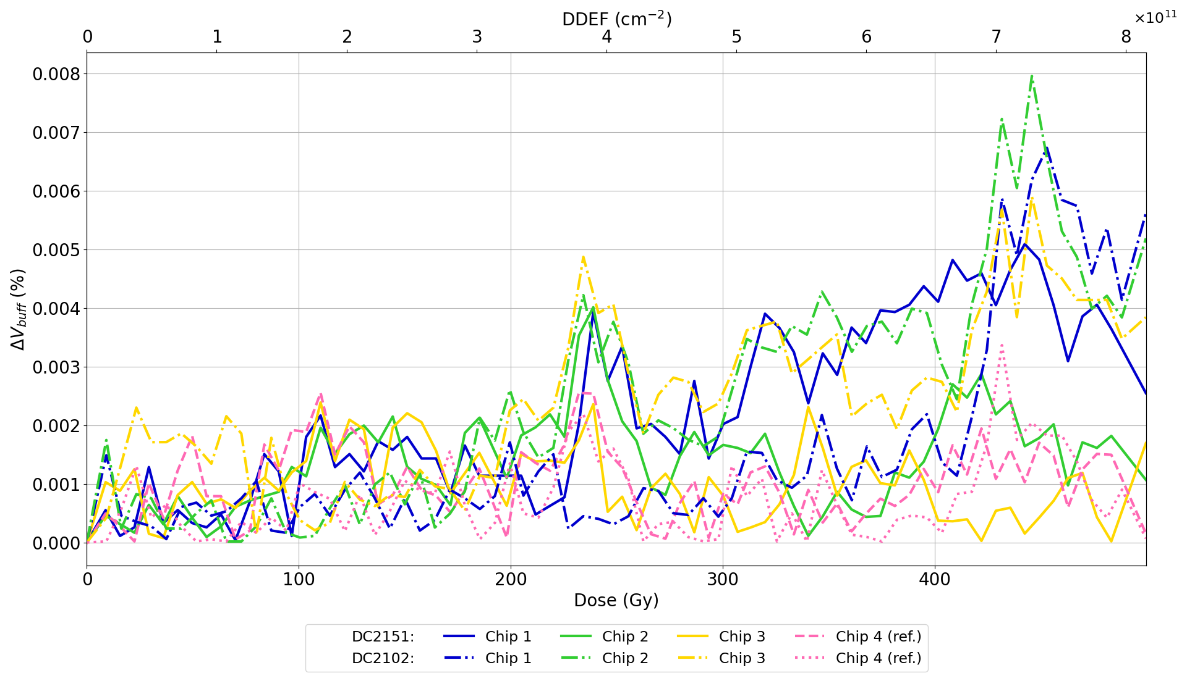
PSI Batch Verification: OP2177
Accepted
< 1 %
84 SETs (σ = 2.21·10⁻¹¹ cm²/device)
75 SETs (σ = 2.48·10⁻¹¹ cm²/device)
Notes:
Opamp
Max Vout deviation: 57.6 mV (is this 10%? Of what?) for 10% pressure readout accuracy
DC2101 = 84 SETs (x-section of 2.48x10-11 cm2/device)
DC2151 = 75 SETs (x-section of 2.21x10-11 cm2/device)

Slide 18
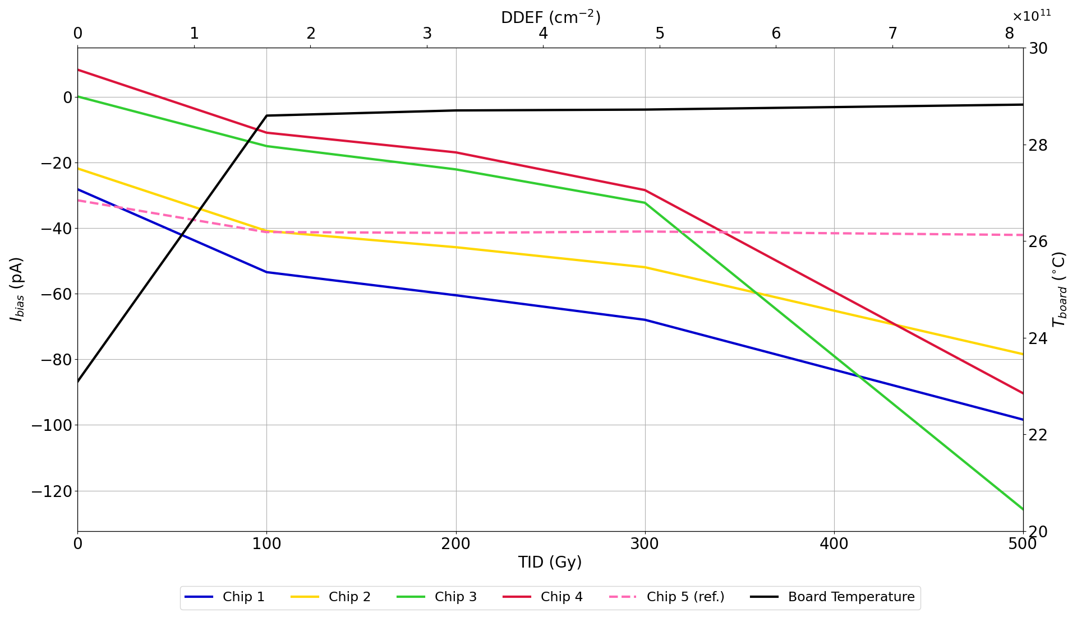
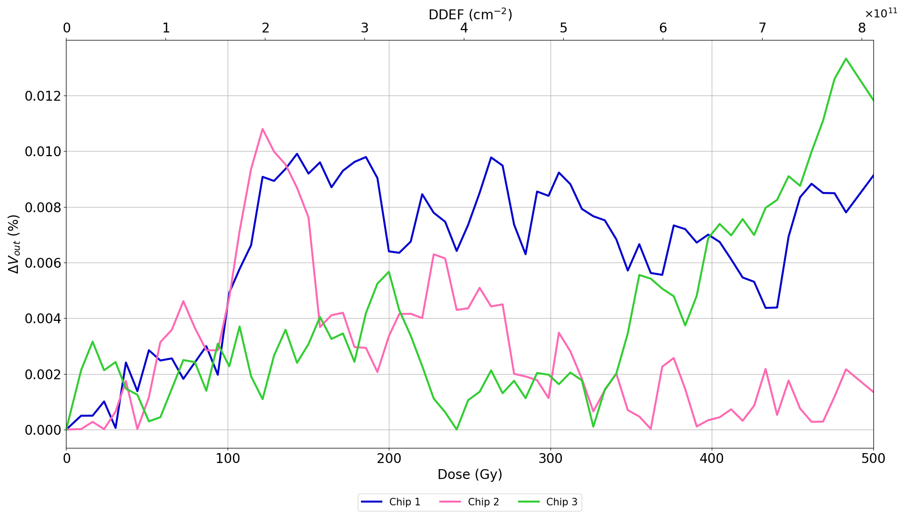
PSI Batch Verification: OPA171
Accepted
< 1 %
< 1000 pA
43 SETs (σ = 1.69·10⁻¹¹ cm²/device)
Notes:
Opamp
Max Vout deviation: 57.6 mV (is this 10%? Of what?) for 10% pressure readout accuracy (missing ref…)
Max Ibias increase: 1000 pA to sustain the 1E-9 mbar pressure range.
* 43 SETs

Slide 19
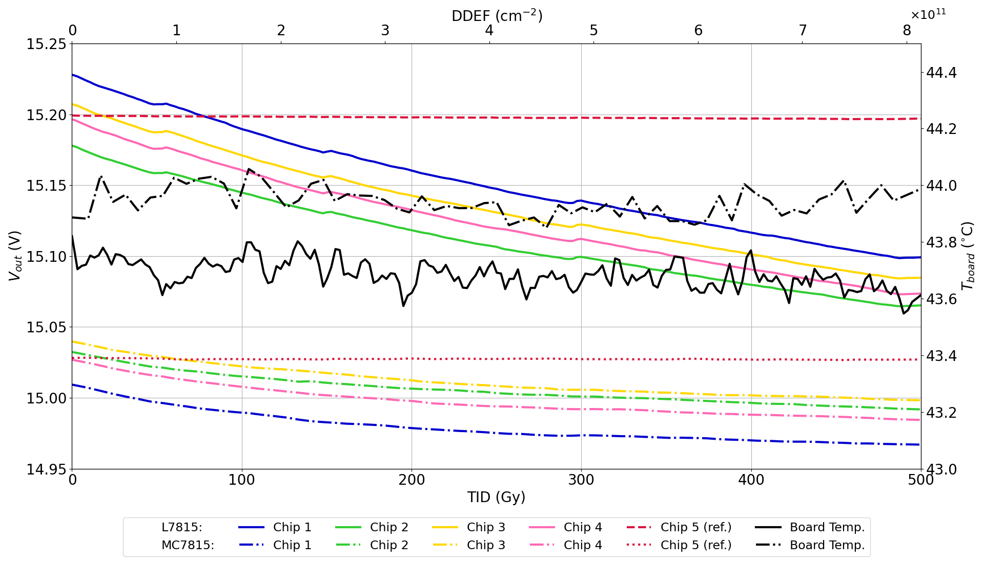
PSI Batch Selection and Verification: L7815 – MC7815
< 18 V
> 14 V
Notes:
+15 V regulator
Requirement: between 14 and 18 V to avoid destruction of operational amplifiers or saturation of 4-20 mA readout signals
MC7815 better?

Slide 20
Summary and Further Work
OPA171 will replace OPA128 as a more cost-effective alternative
All components except for the UA7815 passed the 500 Gy proton test at PSI
MC7815 from ON has been chosen as a replacement
CHARM system-level tests for LS3 production (Oct 2021)

Slide 21
Special thanks to:
Salvatore Danzeca
Panagiotis Gkountoumis
Gilles Foucard
Matteo Brucoli
Rudy Ferraro
Ruben Garcia Alia
Gregory Pigny
Nikolaos Chatzigeorgiou
Alexandre Correia

