Slide 1
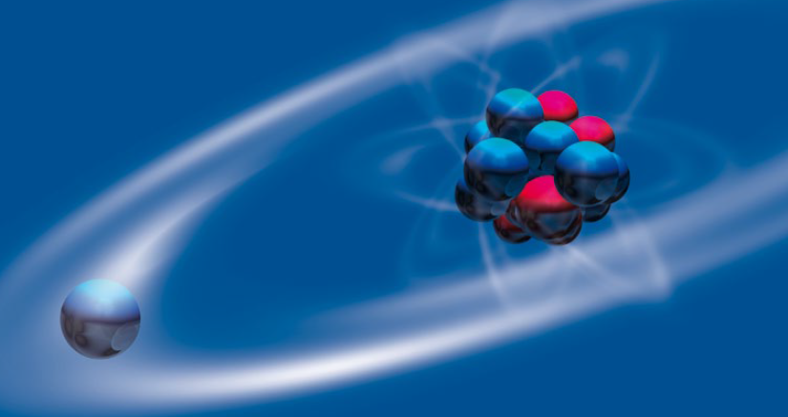
Physics Highlights and Challenges:
Nuclear Physics
Gerda Neyens
KU Leuven, Belgium

Slide 2
Nuclear-physics research: aim
Progress in nuclear theory
Progress in experiments
Outlook and perspectives
Conclusions
Thanks to P. Van Duppen, N. Kalantar, C. Scheidenberger, P. Greenlees, Y. Leifels, P. Roussel Chomaz, W. Korten, … for input

Slide 3
Nuclear-Physics Research - Aim
Unravel the fundamental properties of nuclei from their basic constituents
Investigating the strong and weak interaction at work in the nuclear medium → competing with the electromagnetic force in the heaviest isotopes
Establishing the limits of existence
More in talk by Marek Lewitowicz
~ 3000 more predicted by nuclear models (produced in reactions in stars)
~ 3300 radioactive isotopes produced and studied at accelerator facilities
Erler,- Nature 486 (2012)

Slide 4
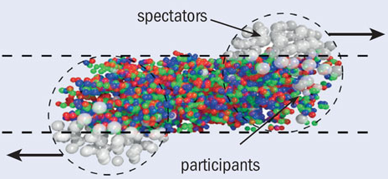
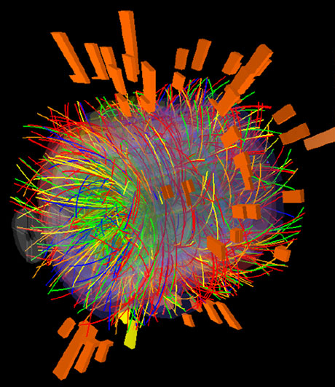
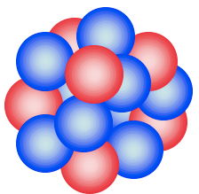
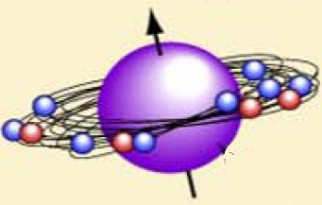
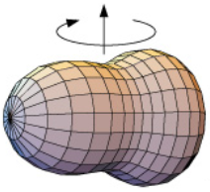
Nuclear-Physics Research - Aim
Experimental investigations explore 3 extremes:
Link to Hadron Physics (see J. D’Hondt, M. Lewitowicz)
Strong links to
  Nuclear Astrophysics / Nucleosynthesis
  Fundamental Interactions and Symmetries
  Atomic Physics / Chemistry (e.g. heavy element region)
  Societal Aspect (e.g. medical radioisotopes)
Energy
N/Z - isospin
Er (Z=68) neutron drip line: N≈154 - 162
Spin - Deformation
Data up to
N=112
Z
Erler,- Nature 486 (2012)

Slide 5
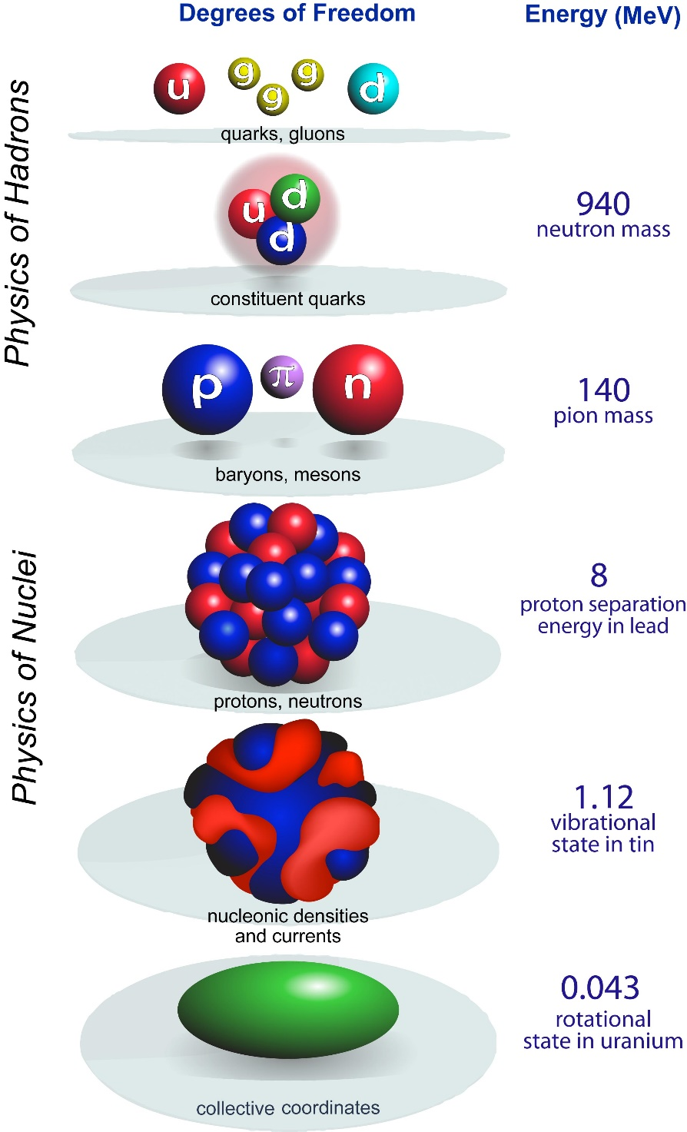
Nuclear theory:
how are nuclei made and organized?
See Jorgen d’Hondt and M. Lewitowicz for quark-gluon and hadron physics
QCD
Effective Field Theory
“Ab-initio Calculations”
Configuration Interactions
Density Functional Theory
Collective Models
0.000008
²²⁹Th
Courtesy: W. Nazarewicz - MSU, T. Duguet - CEA

Slide 6
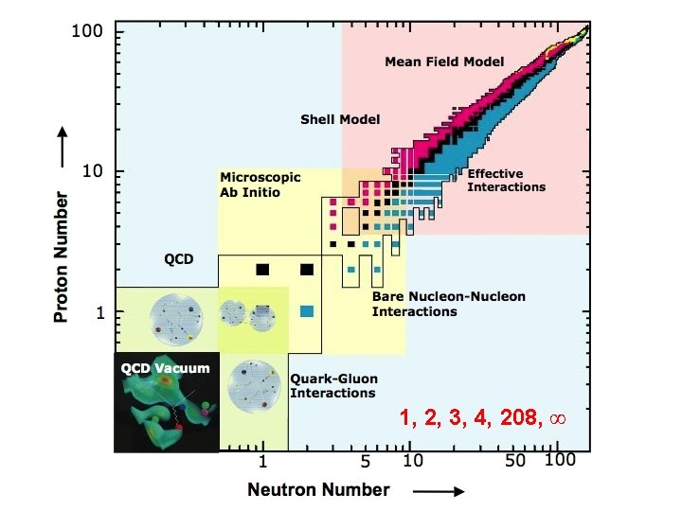
The application domain of nuclear theories
From lattice-QCD towards multi-nucleon systems
Density Functional Theories
DFT: nucleons moving within their own self-consistently-generated
mean field
Configuration Interaction Theories
CI: many-body methods using ab-initio or empirical nucleon-nucleon interactions
Ab-initio: nn-interaction derived from QCD through chiral EFT + exact solution of the many-body problem
Courtesy: W. Nazarewicz – MSU

Slide 7
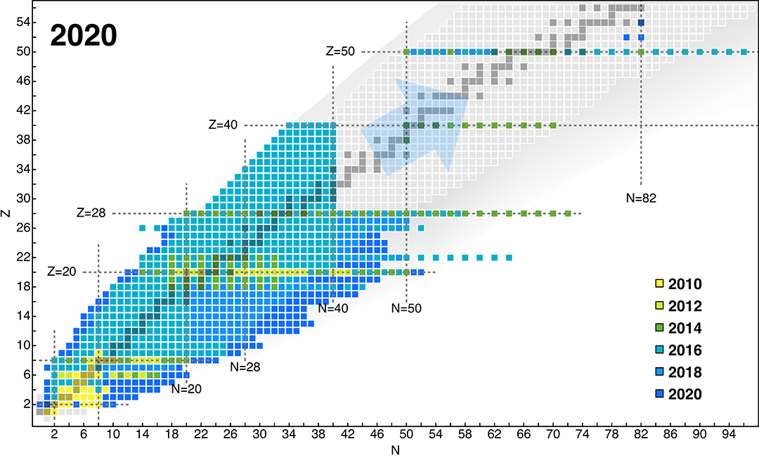
The rising of ab-initio nuclear theories
A-body Schrodinger Equation
Interactions derived from QCD (Chiral EFT)
Variety of Quantum Many Body methods
¹⁰⁰Sn
¹³²Sn
⁷⁸Ni
⁴⁰⁻⁵⁴Ca
¹⁶⁻²⁶O
H. Hergert, Frontiers in Physics 8 (2020) 379

Slide 8
Ab-initio calculations now reach ¹³²Sn
Magnetic moments of Z=49 indium isotopes up to magic N=82
Interactions from chiral EFT
Bare magnetic operator derived self-consistently
Bare nucleon g-factors
A textbook example for the nuclear shell model.
BUT ONLY ¹³¹In is single-particle like !
Calculations by T. Miyagi, J. Holt and S.R. Stroberg
A. Vernon et al., Nature (2022) accepted

Slide 9
Density functional theories
towards spectroscopic accuracy
Magnetic moments of Z=49 indium isotopes up to magic N=82
DFT-HF including time-symmetry breaking contributions to the mean field
Calculations by J. Dobaczewski and J. Bonnard
A. Vernon et al., Nature (2022) accepted

Slide 10

Ab Initio Limits of Atomic Nuclei
Neutron drip-line experimentally confirmed up to Z=10 (Ne)
D.S. Ahn et al., PRL 123 (2019) 212501
Proton drip-line experimentally confirmed for all elements on earth (and up to Z=93 Np for odd-Z)
Z.Y. Zhang et al., PRL 122 (2019) 192503
Ab-initio predicted drip-lines up to Z=26 (Fe)
Lanzhou, China
S.R. Strobergh, J. Holt, A. Schwenk, J. Simonis, PRL 126, 022501 (2021)

Slide 11
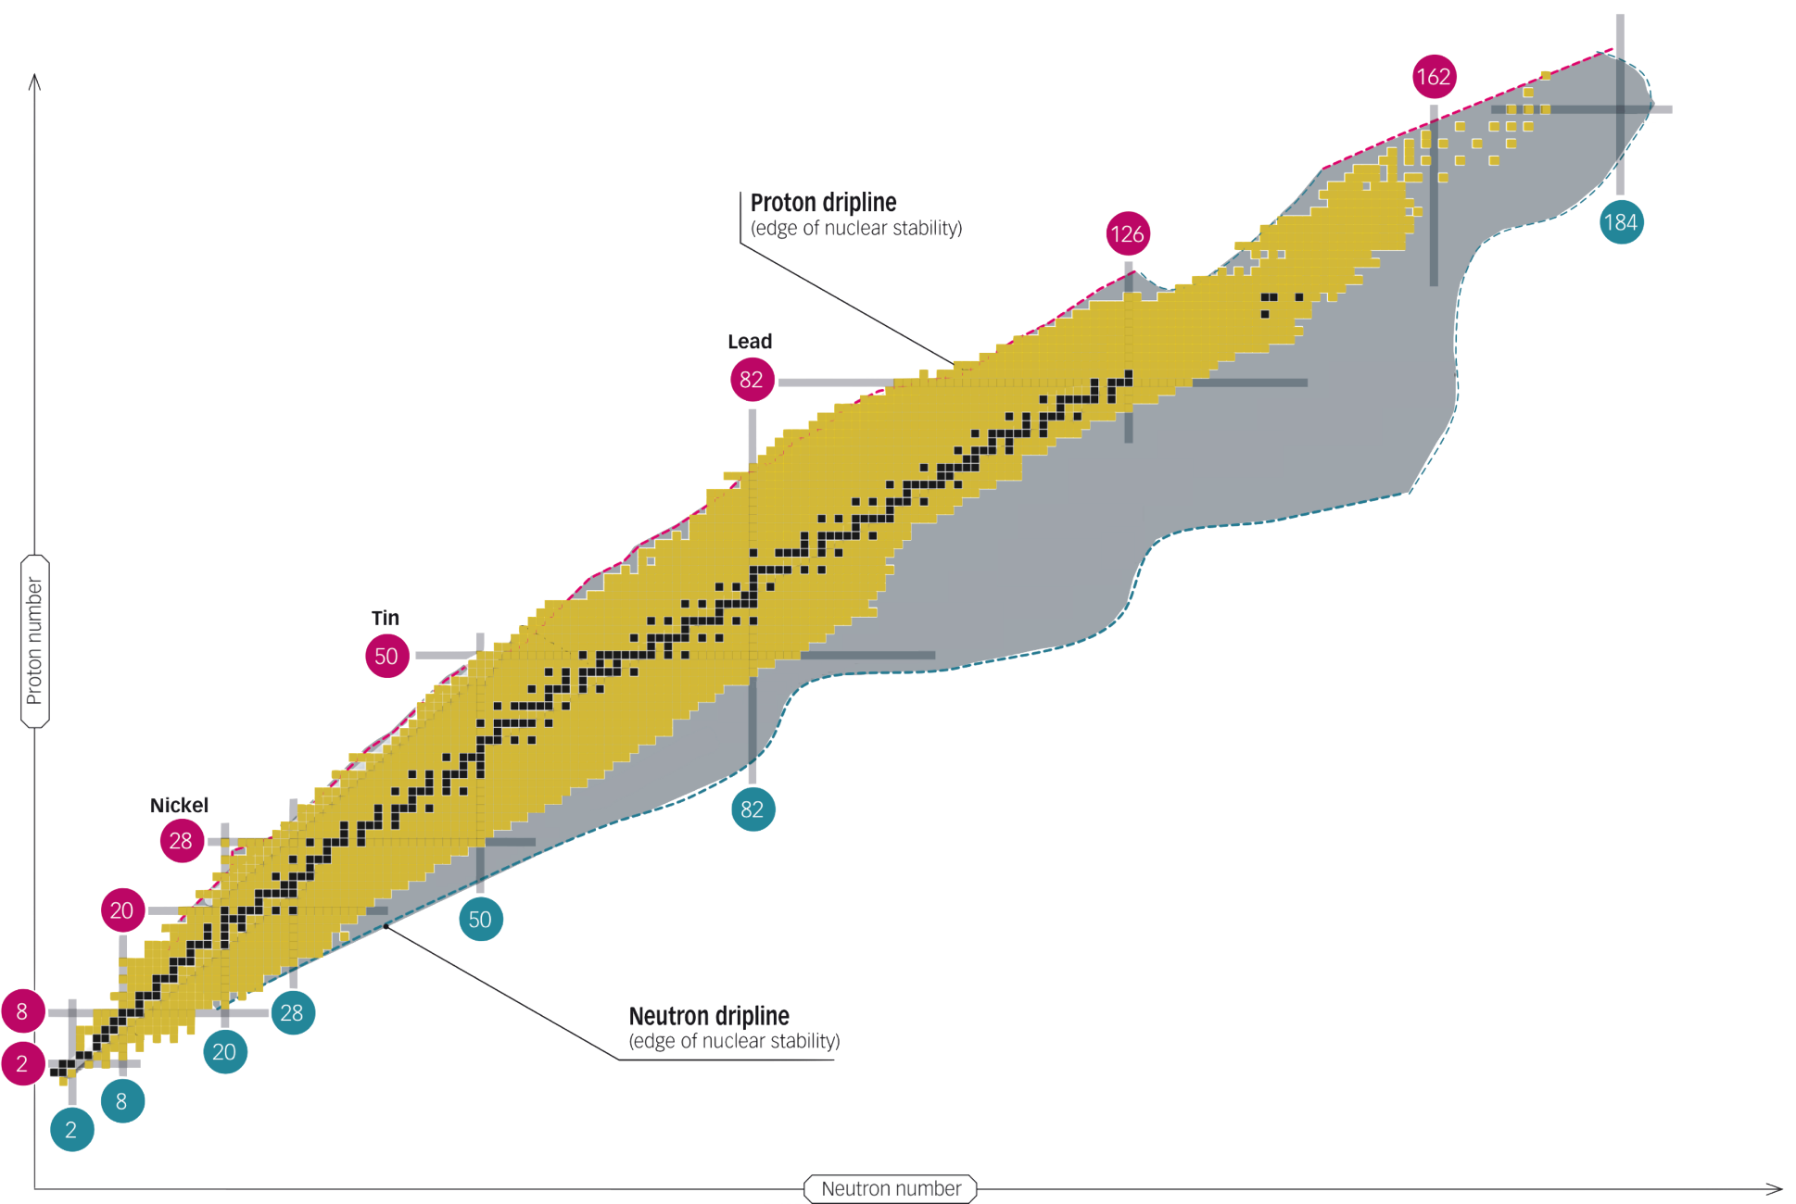
Experiments: A tour around the chart of nuclei
The heaviest Island of Stability
^{229m}Th – towards a nuclear clock
²²⁵Ra(F) – octupole deformation and EDM
¹⁰⁰Sn (Z,N=50):
Q_{β}(¹⁰⁰Sn), mass ^{99,100}In,
charge radius of ⁹⁶Ag
⁸⁸Ru spectroscopy
Exploring the r-process path along N=126
Isotope shifts as probes for dark matter and nuclear structure
⁶⁸Ni: Neutron skin from charge radius and dipole polarisibility
³¹F and ³⁴Ne: neutron drip-lines established for Z=9 and Z=10
²⁹F: a new 2-neutron halo nucleus
⁴He charge radius from muonic He
A new limit on the neutron EDM
Antimatter precision experiments

Slide 12


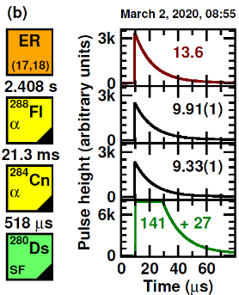
The heaviest island of stability
The center of the Island of Stability: it is not at Z = 114
Chart of nuclei of superheavy nuclei
First detailed nuclear spectroscopy of flerovium (Z=114) decay chains with TASISpec+ at TASCA recoil separator
Discovery of new isotope ²⁸⁰Ds (Z=110) provides first sequence of α-decay energies across Z=114 shell gap
Discovery of excited 0⁺ state in ²⁸²Cn (Z=112): shape coexistence
➔ together with extensive triaxial beyond mean-field theory these findings suggest that there is no pronounced shell gap at proton number Z=114
Focus shifts to heavier elements: 120? 126?
²⁸²Cn
Center?
²⁸⁰Ds
Calculated shell stabilization energy (Sobiczewski et al.)
Colored boxes: known nuclei
A. Såmark-Roth et al., Phys. Rev. Lett. 126 (2021) 032503
J.L. Egido & A. Jungclaus, Phys. Rev. Lett. 125 (2020) 192504; ibid., 126 (2021) 192501
Spokesperson: D. Rudolph, Lund. Univ.
Courtesy: Y. Leifels

Slide 13


Terra incognita: first spectroscopy south-east of ²⁰⁸Pb
Towards the r-process path along N=126
Study single particle states in ²⁰⁷Hg for the first time using Transfer Reaction:
²⁰⁶Hg (1.52 GeV) + d → ²⁰⁷Hg + p
208Pb
Gd(Z=64)
Excited levels in ²⁰⁷Hg
Proton counts
(5/2⁺)
(3/2⁺)
9/2⁺
(7/2⁺)
Binding energy of the neutron in different orbits is extracted
Allows to predict the last N=127 isotone with bound neutrons: Gd (Z=64)
Proton Energy (MeV)
Tang et al., PRL 124, 062502 (2020)

Slide 14
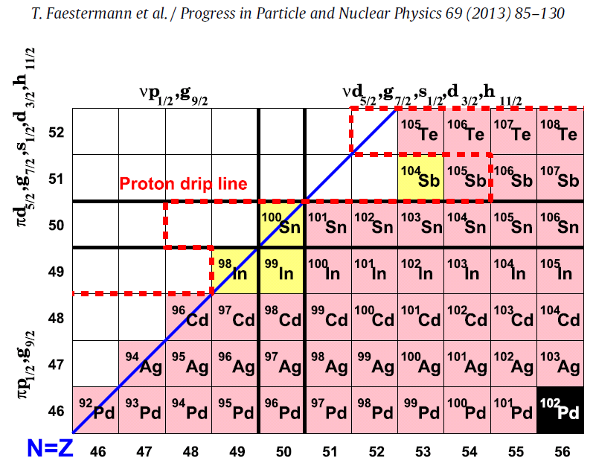

The ¹⁰⁰Sn region
self-conjugate and doubly-magic: N,Z=50
➔ Testing ab-initio nuclear theory near the proton drip-line
Q_{β} and B(GT) ¹⁰⁰Sn
⁹⁹Sn
⁹⁷In
Masses of ^{99,100}In
⁹⁵Cd
Charge radius of ⁹⁶Ag
⁹³Ag

Slide 15
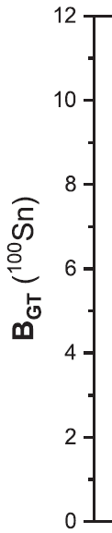



β decay of ¹⁰⁰Sn (Z,N=50)
New GT-strength: smaller than previous and more precise,
consistent with extrapolated value from systematics
Ab-initio CC calculations including
2-body currents (full symbols)
Impact on Neutrinoless Double β Decay
Exp GSI-2: Hinke,- Nature (2012)
Increased radioactive beam rates expected at:
BUT …
Exp RIKEN: Lubos,- PRL 122 (2019) Theory: Gysbers,- Nature Physics (2019)

Slide 16

Mass of ⁹⁹In and ¹⁰⁰In (Z=49)
MORE DATA NEEDED !
Use mass of ¹⁰⁰In and Q_{β}(¹⁰⁰Sn) to improve the mass-value of ¹⁰⁰Sn
Conflicting results on beta-decay Q-value of ¹⁰⁰Sn:
D. Lubos et al., PRL 122, 222502 (2019) (RIKEN)
Q_{β} = 3.71(20) MeV
C.B. Hinke et al., Nature 486 (2012) 341 (GSI)
Q_{β} = 3.29(20) MeV
➔ Trend in the masses indicates that the mass of ¹⁰⁰Sn using RIKEN result on GT decay is inconsistent with expected trend
M. Mougeot et al., Nature Physics 17 (2021) 1099–1103

Slide 17
Increase in the charge radius of ⁹⁶Ag
Trap-assisted laser spectroscopy
Towards ultimate sensitivity
Detection rate ⁹⁶Ag: 1 count / 3 minutes
Challenges modern DFT approaches near ¹⁰⁰Sn
M. Reponen, R.P. de Groote et al., Nature Communications 12 (2021) 4596

Slide 18
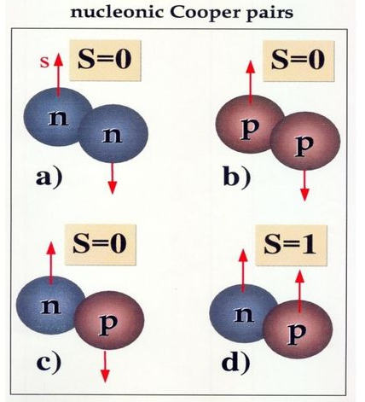


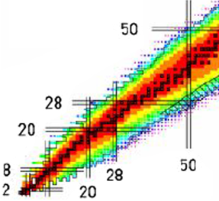
N=Z isotopes: study p-n (iso-scalar) pairing correlations
Nucleons can form strongly correlated pairs which impacts strongly on nuclear structure.
Only in N=Z nuclei will the p-n (isoscalar) pairing be important, as protons and neutrons occupy the same orbit.
⁸⁸Ru: 44 protons and 44 neutrons (near proton dripline)
Rotating deformed nucleus with strong
ISO-SCALAR
p-n pairing !
Z
→
→ N
B. Cederwall et al., PRL 124, 062501 (2020)

Slide 19
Hyperfine structure, isotope shifts and nuclear charge radii
For nuclear structure studies:
sensitive to shell gaps, deformation, neutron skin
For particle physics studies:
Probes to search for new bosons, EDM’s, anapole/Shiff moments

Slide 20
Precision isotope shifts: sensitive to new bosons?
A nonlinearity of the King plot can indicate:
physics beyond the Standard Model (SM) in the form of a new bosonic force carrier (a possible candidate for Dark Matter)
or arise from higher-order nuclear effects within the SM.
5 stable Ca isotopes: no deviation
(precision 0.02 kHz)
5 stable Yb isotopes: deviation observed
(precision 0.3 kHz)
Ca⁺
Yb⁺
Extend to radioactive isotopes (current precision: kHz)
I. Counts et al., PRL 125, 123002 (2020) C. Solaro et al., PRL 125, 123003 (2020)

Slide 21
Charge radius of ⁶⁸Ni: constraining neutron skin
Coupled Cluster calculations using interactions from chiral-EFT
➔ correlation between dipole polarizability and charge radius
→ including 3 particle -3 hole correlations (full line) leads to softer dipole polarizability and slightly larger charge radius
→ constrain the neutron radius and the neutron skin of ⁶⁸Ni
Coupled Cluster calculations
Schwenk, Hagen et al.
S. Kauffmann et al., PRL 124, 132502 (2020)

Slide 22

Charge radius of ⁵²K (Z=19):
Challenging the magic nature of N=32
and ab-initio nuclear theories
→ No signature of magicity at N=32 !
DFT reproduces the trend but overestimates the staggering
Ab-initio coupled-cluster underestimate the increase in the size of the radii
A. Koszorus et al., Nature Physics 17 (2021) 439–443

Slide 23
The neutron drip-line: extended to Fluorine and Neon
31F and 34Ne are the last bound isotopes of these elements
39Na seems bound, drip-line not yet reached
Ahn et al., PRL 123, 212501 (2019)

Slide 24
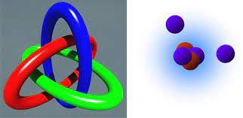
²⁹F: heaviest two-neutron halo nucleus (so far)
N=20
⁶He (N=4)
¹¹Li, ¹⁴Be (4n) (N=8)
¹⁷B, ²²C (N=16)
Matter radius ~ A^{1/3}
Halo nuclei: loosely-bound nucleon(s)
Profound test of modern reaction and structure theories:
* effective shell model interactions: good reproduction of cross section and matter radius increase in ²⁹F
* ab-initio interactions with CC: no increase in matter radius of ²⁹F
Bagchi et al., PRL124, 222504 (2020)

Slide 25

Alfa-particle charge radius measured using muonic ⁴He
Precision improved by almost factor of 5
In agreement with results from electron-He scattering experiments
In agreement with recent determinations of the proton charge radius
Leads to x10 improvement in the ⁶He and ⁸He halo nuclei radii
➔ Established light muonic atoms and ions as precision tools for nuclear structure
J.J. Krauth et al., Nature 589 (2021) 527

Slide 26
A new limit on the neutron-EDM
New limit: |d_{n}| < 1.8 10⁻²⁶ e.cm (90% C.L.)
Improvement of almost a factor 2 compared to the previous best value (PRD92, 092003 (2015)
|d_{n}| < 3.0 10⁻²⁶ e.cm
systematic error improved by factor of 5
With more statistics (n2-EDM) the n-EDM value can reach the 10⁻²⁷ e.cm sensitivity
C. Abel et al., n-EDM collaboration PSI, PRL 124, 081803 (2020)

Slide 27



Laser-cooling of anti-hydrogen atoms
and
Sympathetic cooling of antiprotons using laser-cooled Be⁺
Towards precision anti-matter research
Anti-hydrogen laser cooling using 121.6 nm laser to excite 1S-2P
- red detuned for cooling → transverse energy < 6 μeV
- bleu detuned for heating
Linewidth of the 1S-2S transition reduced by factor 4 ➔ opens possibilities for high-precision laser spectroscopy on anti-H
Sympathetic cooling of a single proton using laser-cooled Be+ ions in spatially separated Penning traps
➔ Towards improved precision in matter–antimatter comparisons and dark matter searches
ALPHA collaboration, Nature 592 (2021) 35 BASE collaboration, Nature 596 (2021) 514

Slide 28
Improved precision on the e/m ratio for antiprotons compared to protons
Testing the Standard Model at the 1.96 × 10⁻²⁷ GeV
4 measurements campaigns in 1.5 years
different measurement techniques
The result: −(q/m)p/(q/m)p = 1.000000000003(16)
(16 parts in a trillion)
The result is consistent with the fundamental charge–parity–time reversal (CPT) invariance and improves the precision of their previous best measurement by a factor of 4.3.
BASE collaboration, Nature 601 (2022) 53

Slide 29
Outlook and perspectives (very limited selection)
Radioactive molecules as probes for new physics ?
Hypernuclei as new probes to test nuclear models ?
^{229m}Th: a new standard for time / a new probe for fundamental constants?
Not covered:
Link to neutrinoless double beta-decay
Search for CP violation and new weak currents in precision beta-decay
Link to neutron-star mergers and gravitational waves

Slide 30
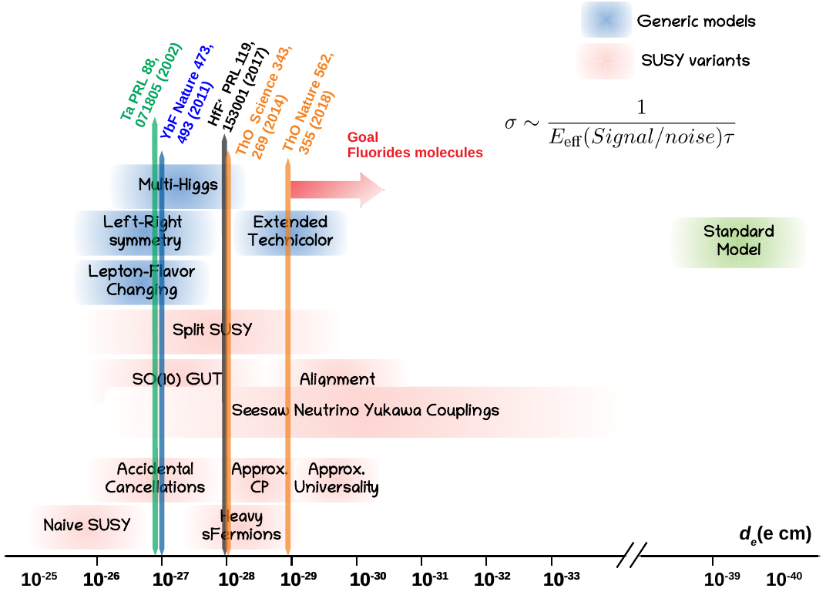
Molecules: most sensitive probes to an eEDM
Electric Dipole Moment
atoms
molecules
SM value is extremely small
GOAL for Radioactive molecules (RaF)
sensitivity to EDM increases with Z (Z=86)
highest sensitivity in pear shaped nuclei
100 TeV
Courtesy R.F. Garcia Ruiz

Slide 31


Pear-shaped nuclei: many are radioactive !
Experimental evidence: ^{222–226}Ra are pear shaped
²²⁸Ra and ²¹⁸⁻²²⁴Rn are vibrating pears
Octupole deformation
λ=2
➔ RaF molecules are ideal probes to search for eEDM
λ=2
P.A. Butler, L.P. Gaffney et al., PRL 124, 042503 (2020)
Nature Communications 10 (2019) 2473
31

Slide 32
RaF radioactive molecules: first spectroscopy
established suitability for laser cooling
allows for ultra-precise measurements of nuclear-spin-dependent PV effects (e.g. nuclear anapole moment or Shiff moment)
²²³RaF
²²⁸RaF
Conditions for efficient laser cooling ➔ Towards eEDM
decay back into ground state
(feeding into the other vibrational level is < 5%)
lifetime of first excited state is < 50 ns (fast for cooling)
other electronic levels appear > 2000 cm⁻¹ higher in energy
➔ closed cycle
Experimentally established level scheme
R.F. Garcia Ruiz, R. Berger et al., Nature 581 (2020) 396
32

Slide 33
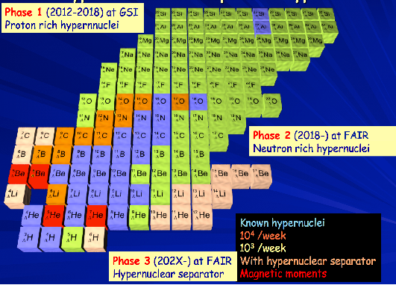

Exotic n-rich hypernuclei: stringent tests for (nuclear) theories
Hyperon puzzle appearance of hyperons in neutron stars
Λnn puzzle existence of a neutral hyper nucleus
Hypertriton puzzle low binding energy ↔ short lifetime
Pilot experiment at GSI (HypHI) ➔ evidence of ³ΛΗ, ⁴ΛΗ, 3_{Λ}n
The lifetimes have also been determined
Next goals: binding energies via invariant mass spectroscopy; using the high resolution of FRS will lead to δE~1MeV
now: WASA coupled to FRS
C.Rappold et al., Phys. Rev. C 88(2013)041001
A.Botvina et al., Phys Rev C 88(2013)054605
Courtesy C. Scheidenberger, N. Kalantar

Slide 34

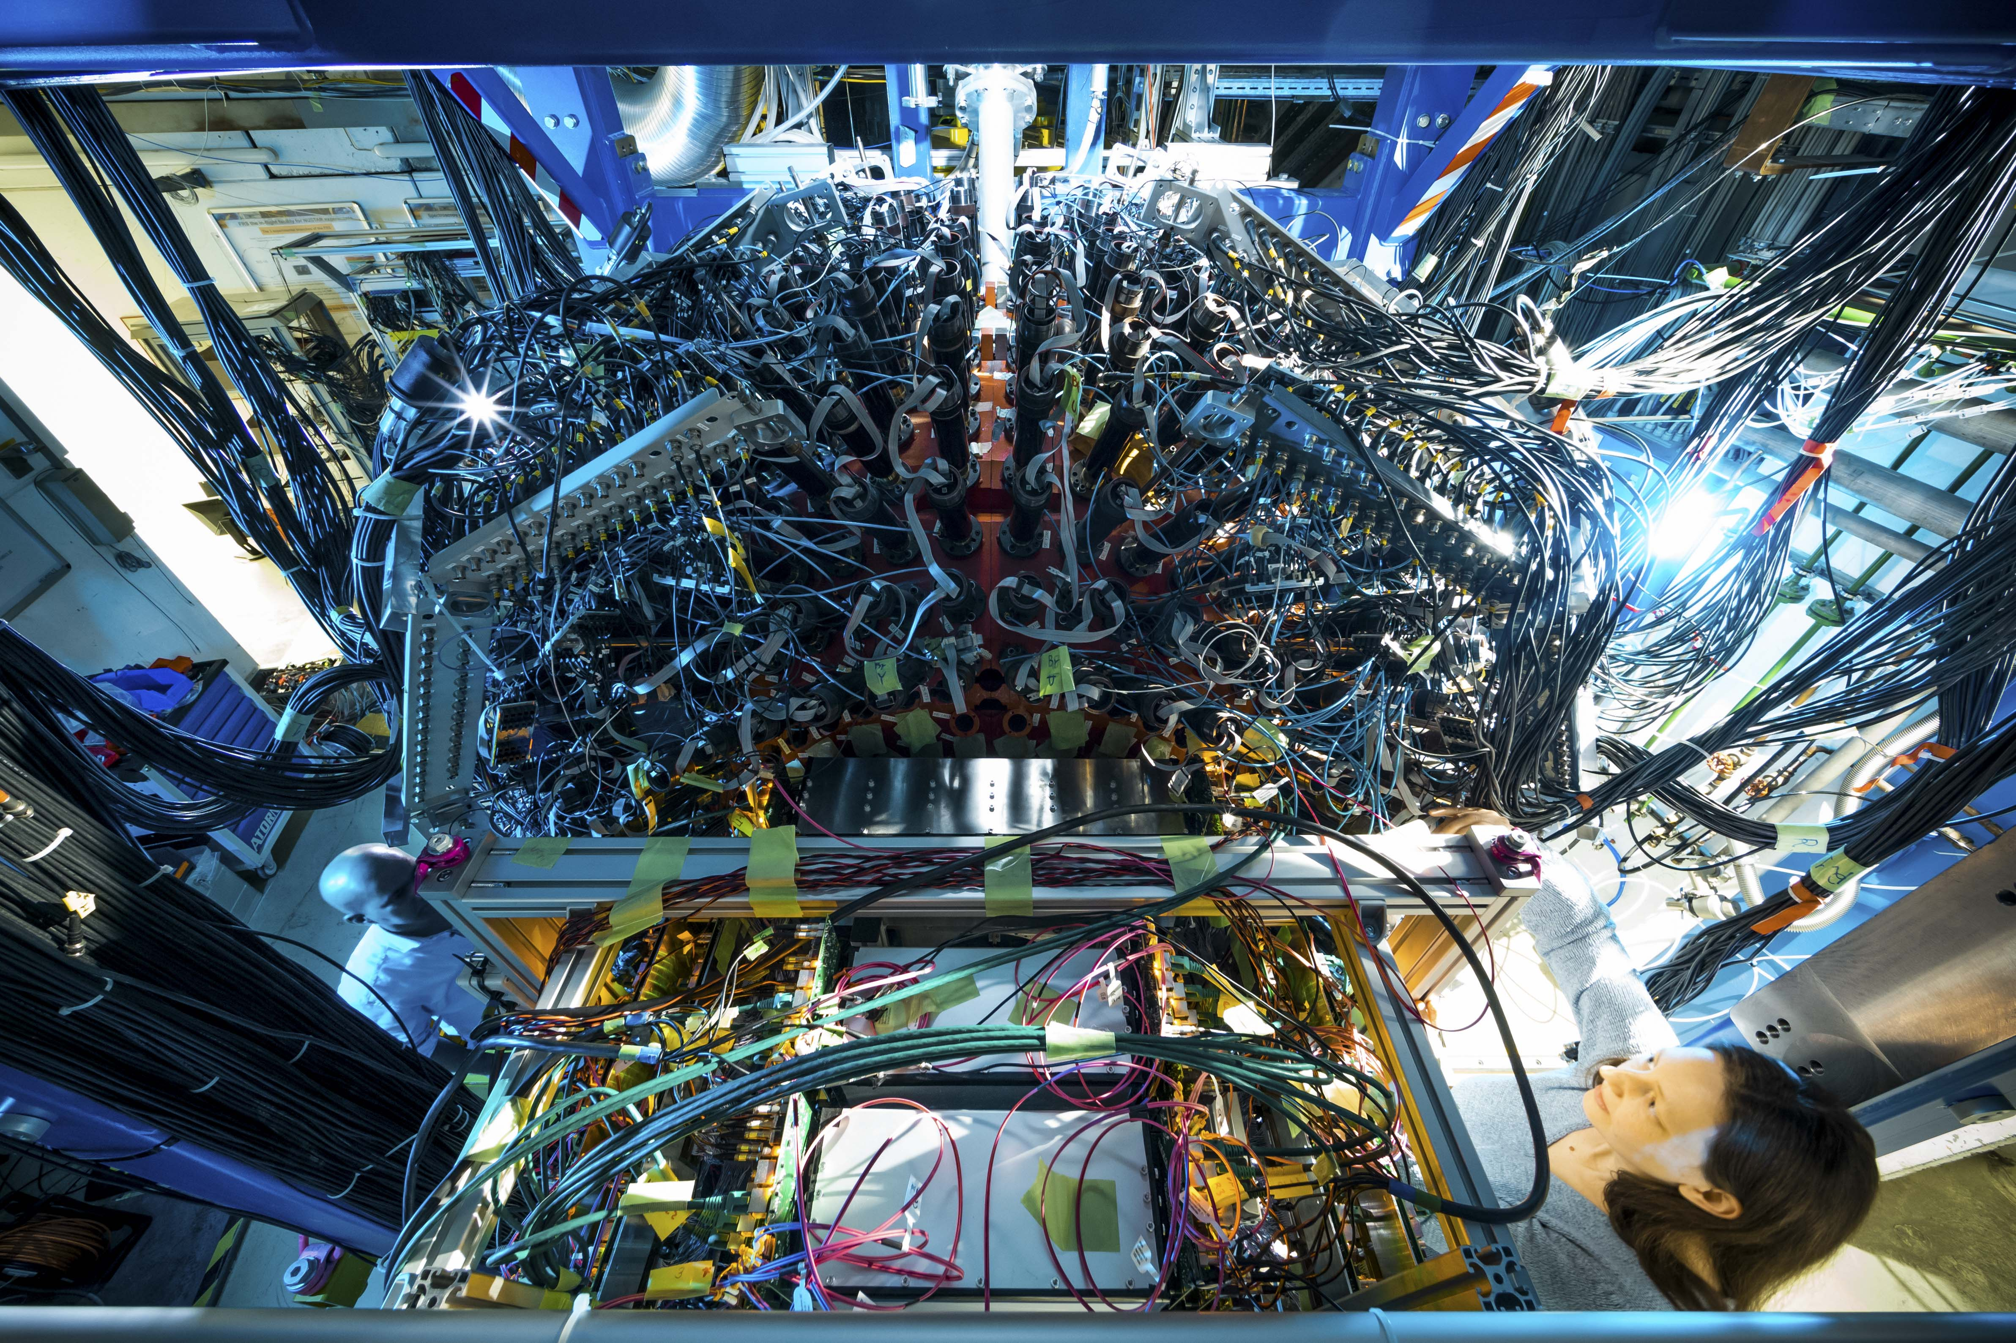
WASA@FRS 2022
Pilot experiments for Super-FRS
Search for eta’-mesic nuclei (S490, K.Itahashi et al., 22.-28.2.2022)
Hypernuclei spectroscopy (S447, T.Saito et al., 10.-19.3.2022)
photo credit: © J. Hosan/GSI/FAIR
Novel spectroscopic techniques are explored to study exotic nuclei and exotic atoms
For the first time a calorimeter is coupled to a high-resolution spectrometer for relativistic beams
W. Korten - ECE16 & ECSG07 Meeting
Courtesy: W. Korten, C. Scheidenberger

Slide 35
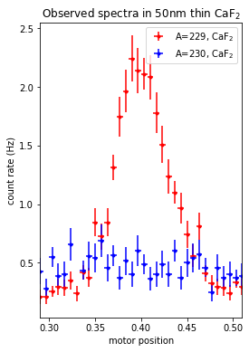
The ^{229m}Th Isomer: progress since 2019
towards a Nuclear Clock and a new probe for precision physics
Bridge between nuclear physics / atomic physics / laser physics/ metrology / solid state physics
²²⁹Th isomer state
ΔE/E ~ 10⁻²⁰: extremely stable nuclear
frequency standard: ‘nuclear clock’
M1 transition
E* ≈ 8.28(17) eV / 8.10(17) eV
λ = 149.7(31) nm / 153.1 (32) nm
τ ≈ min. – h.
Need better precision on the excitation energy/wavelength to allow for optical excitation with deep UV laser light.
(all indirect determinations so far)
Newest: T. Sikorsky et al., PRL 125, 142503 (2020)
²²⁹Th ground state
Newest approach:
Produce isomer via the beta-decay of ²²⁹Ac (62 min) at ISOLDE
Implant in CaF₂ or MgF₂ to block internal conversion.
Observe the radiative UV photon decay for first time !
Precision improved by factor 5-10 !
This will make search for resonant laser excitation for the first time feasible (1 year → 30-40 days)!
S. Kramer, P. Van Duppen, L. Pereira et al., in preparation

Slide 36
CONCLUSIONS
Ab-initio models as well as density functional theories are progressing fast and will have a strong impact on the predictability of nuclear properties (important for neutrinoless double-beta decay, astrophysics, …).
Upcoming facilities (and upgrades) like e.g. FAIR, SPIRAL2, HIE-ISOLDE, SPES, ISOL@MYRRHA, … and developments/improvements of instrumentation is boosting the field (see M. Lewitowicz, I. Shipsey, J. D’Hondt)
Nuclear-physics research is a multi-facetted research area reaching out to many different fields of science and applications
Precision measurements become more and more important and make the link towards particle physics and fundamental symmetry studies (see talk K. Jakobs)
Thanks to P. Van Duppen, N. Kalantar, C. Scheidenberger, P. Greenlees, Y. Leifels, P. Roussel Chomaz, W. Korten, … for input

Slide 37


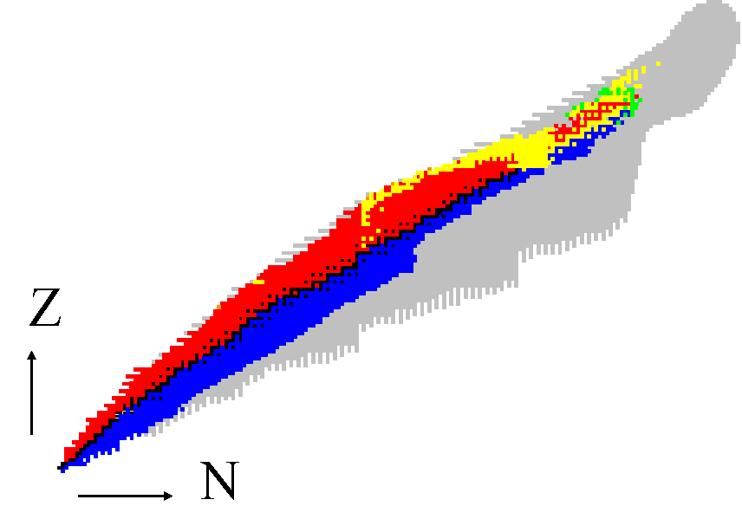





Coordinated action between different Radioactive Ion Beams Facilities

Slide 38
BACKUP

Slide 39
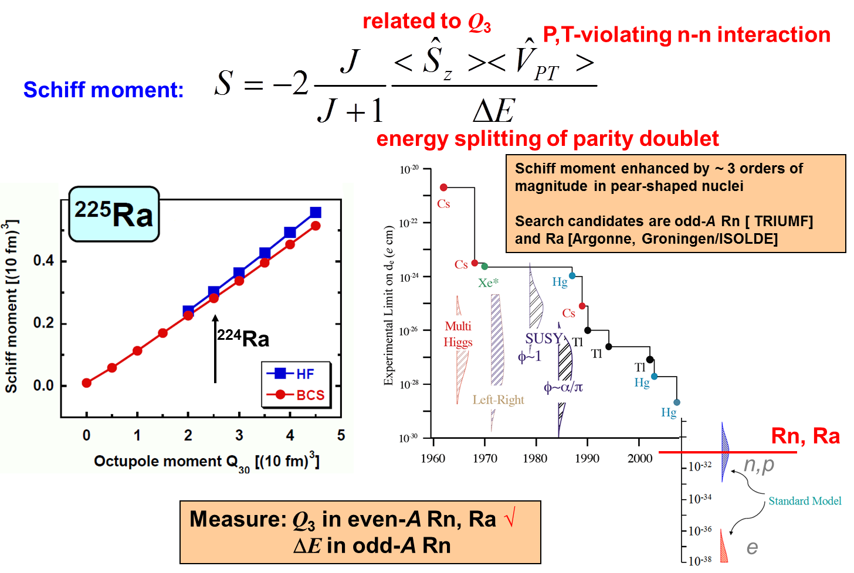
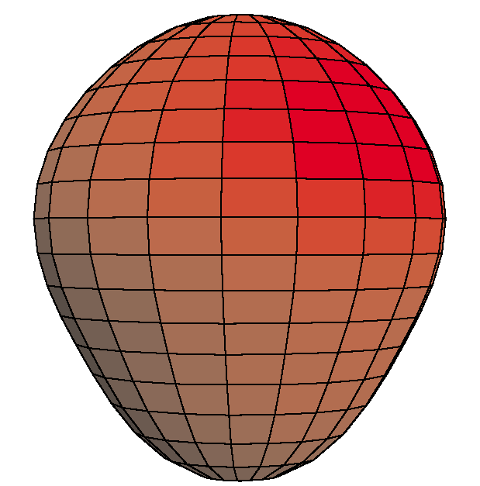
2
Octupole enhanced atomic EDM
I = ½
t_{1/2} = 15 d
Parity doublet
|α⟩
|β⟩
Ψ⁻ = (|α⟩ − |β⟩)/√2
Ψ⁺ = (|α⟩ + |β⟩)/√2
55 keV
Shiff moment enhanced by ~ 3 orders of
magnitude in pear-shaped nucleir
Dobaczewski,- Phys. Rev. Lett. (2018)

Slide 40
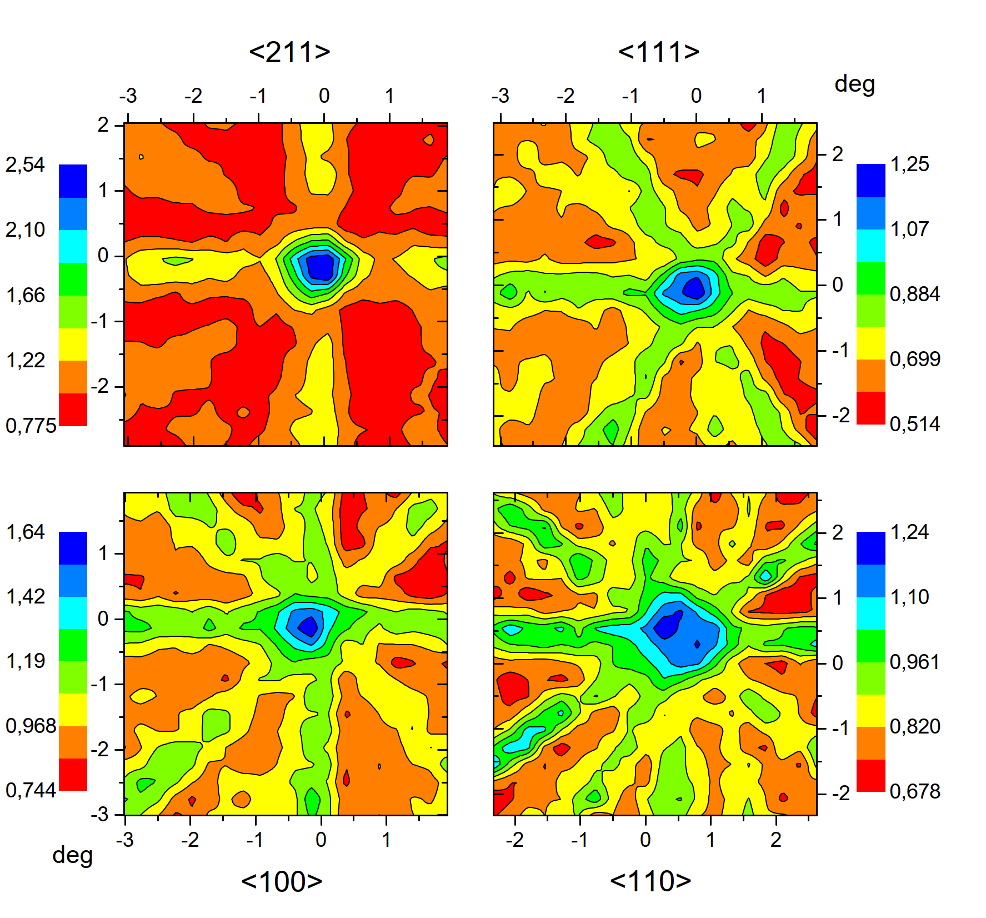
^{229m}Th in CaF crystal - block internal conversion decay
M. Verlinde et al., PRC 100, 024315 (2019)
Exp. Nov 2018
Requirement: 229Ac should take substitutional site in CaF
Idea to measure radiative decay energy:
Produce intense beam of 229Ac (RILIS)
229Ac decays into the 229mTh isomer (~13%)
To block Internal Conversion decay
➔ implantation in wide bandgap material CaF (12 eV)
→ radiative decay dominates !
* Measure the radiative decay energy (VUV)
CaF is transparent for VUV radiation
Method: Emission Channeling
229Ac
β (∼13%)
3/2⁺
E ~ 8.3(1) eV
(IC, 7 μs)
λ~150(3) nm (VUV)
(t_{1/2} ~ hours)
5/2⁺
229Th
Courtesy P. Van Duppen, L. Pereira et al., KU Leuven

Slide 41
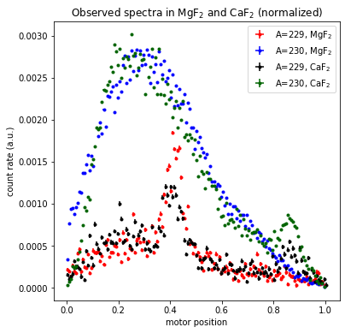


Observation of VUV photon decay from ^{229m}Th
$$≈120nm$$
$$≈200nm$$
3mm slit, raw count rate
3mm slit, normalized to total LaBr₃ count rate
Courtesy S. Cramer, P. Van Duppen
Notes:
Isolde offers a lot of different radionuclides, why not taking one without isomer
230Ac

