Slide 1
ERL Prospects for High Energy Colliders
Introduction: Luminosity limitations in ‘conventional’ Colliders
The Energy Recovery concept
LHeC; FCCeh, FCC-ee und ERLC (ILC) as show case applications of the ERL concept in HEP:
Push-Pull; Recirculating Linac and Circular ERL configurations
Key aspects that need to be validated and demonstrated

Slide 2
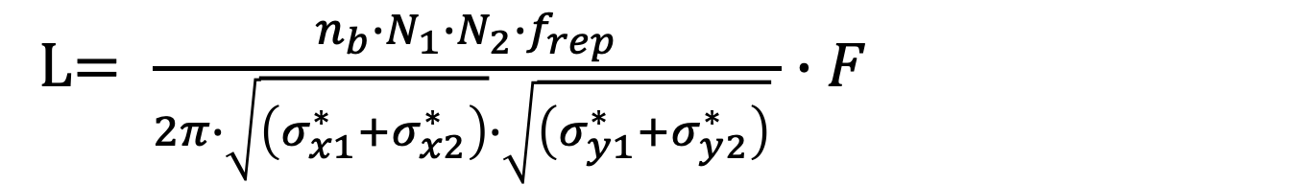
Circular Collider: Peak Luminosity
Luminosity recipe (round beams):
  1) maximize bunch intensities
  2) minimize the beam emittance
3) minimize beam size @ IP (constant beam power);
4) maximize number of bunches;
5) Optimize and potentially compensate for geometric form factor‘F’; Hourglass, X-ing etc
6) Improve machine ‘Efficiency’
Limited by beam-beam interaction
Injector complex / Synchrotron radiation
Optics & beam stability @ IP
Beam Power & Synchrotron Radiation
Assumptions for a HEP collider:
Equal number of bunches and matched beam sizes
in the 2 colliding beams
L$= \frac{n_{b}{∙N}_{1}{∙N}_{2}{∙f}_{rep}}{2π∙\sqrt{\left(σ_{x1}^{∗}+σ_{x2}^{∗}\right)}∙\sqrt{\left(σ_{y1}^{∗}+σ_{y2}^{∗}\right)} }∙F$

Slide 3
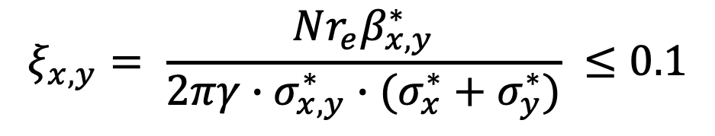
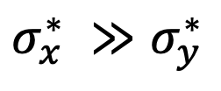
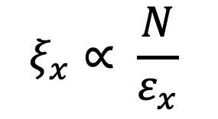
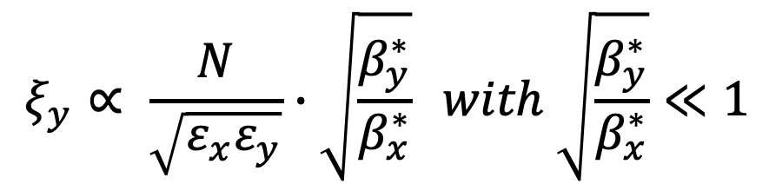
Performance limitation of circular colliders
Beam-Beam Interaction:
Imposes a limit to the maximum acceptable bunch intensity
Limits the luminosity reach of a circular collider
$$ξ_{x,y}= \frac{Nr_{e}β_{x,y}^{∗}}{2πγ∙σ_{x,y}^{∗}∙(σ_{x}^{∗}+σ_{y}^{∗})} ≤0.1$$
Circular machine ➔ Synchrotron Radiation in arcs:
Beam size increases in horizontal and shrinks in vertical plane ➔ flat beams!
$$ξ_{y}^{ }∝ \frac{N}{\sqrt{ε_{x}ε_{y}}}∙\sqrt{\frac{β_{y}^{∗}}{β_{x}^{∗}}} with \sqrt{\frac{β_{y}^{∗}}{β_{x}^{∗}}}≪1$$
$$ξ_{x}∝ \frac{N}{ε_{x}}$$
$σ_{x}^{∗} ≫$ $σ_{y}^{∗}$
➔
and
➔ minimize β_{y}* and increase N until ξ_{x} reaches the beam-beam limit

Slide 4
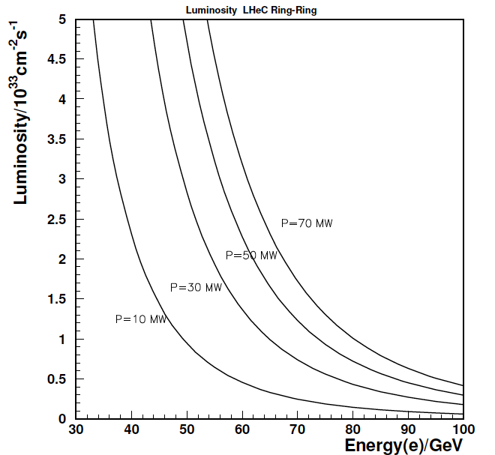
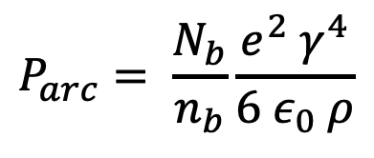
Performance limitation of circular colliders
Synchrotron Radiation in arcs:
Beam size increases in hor and shrinks in vert
LHeC CDR; arXiv:1206.2913
Circular lepton collide performance is limited by:
Beam-beam ➔ bunch intensity
Synchrotron Radiation power ➔ total beam current
Power Scales with E⁴ and ρ⁻¹
$$P_{arc}= \frac{N_{b}}{n_{b}}\frac{e^{2} γ^{4}}{6 ε_{0} ρ}$$
Reduced performance reach for higher beam energies
@ fixed power footprint ➔ limits total beam current!
If bunch intensity is limited by beam-beam, then
SR limits the number of bunches

Slide 5
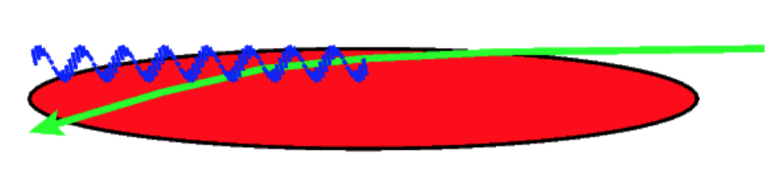
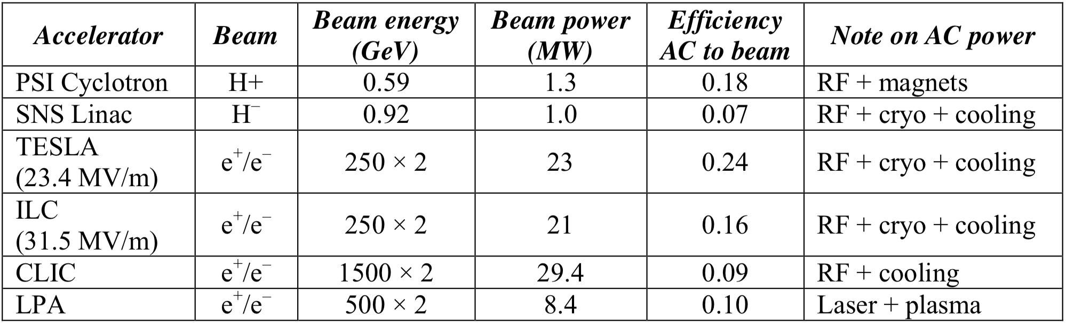
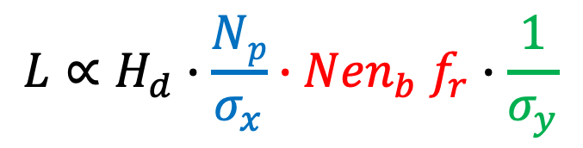
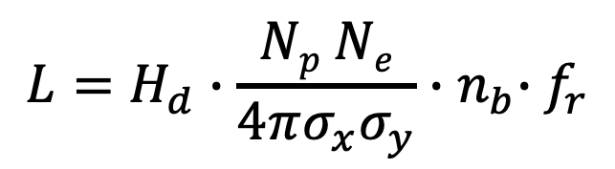
Linac Luminosity
$$L=H_{d}∙\frac{Np Ne}{4πσ_{x}σ_{y}}{∙n}_{b}∙f_{r}$$
A linear Collider overcomes the beam-beam limit of a circular collider
[as the beam does not need to remain to be stable over many passages]
and even utilizes it for performance enhancement [pinch factor]
and minimizes the power losses through Synchrotron Radiation [no bends]
But it does so at the price of power requirements for luminosity production
and that the particles have only once the chance to collide!!!
Luminosity proportional to beam power [Beam Current x Energy]
And e⁺ production might be challenging!
D. Schulte @ 9th International School for Linear Colliders
Bunches are squeezed for
Maximum Luminosity
$$L∝H_{d}∙\frac{Np}{σ_{x}}{∙Nen}_{b}f_{r}∙\frac{1}{σ_{y}}$$
Strong E-M Fields @ IP
L Spectrum
Beam Quality
Particles follow curved trajectory through IP
Linac Beam Power
They emit photons [Synchrotron Radiation] @ the IP
[beamstrahlung]
CM Energy spread
Luminosity reach is directly proportional to beam power, and hence power consumption!
Independent of the underlying linac technology!!!!! What matters is Wall plug Efficiency!!
Markus Roth TU Darmstadt; Accelerators for Medical Applications 2015; Vösendorf, Austria

Slide 6
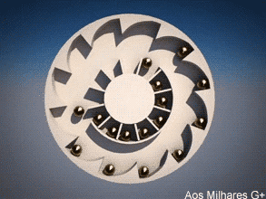
Energy Recovery
Recuperate the energy [and e⁺] from the spend beam after the interaction point
before the beam is dumped
non-linearity of the
beam-beam interaction can
not lead to instabilities and
beam losses if the circulation
of the particles in the machine
is short after the interaction

Slide 7
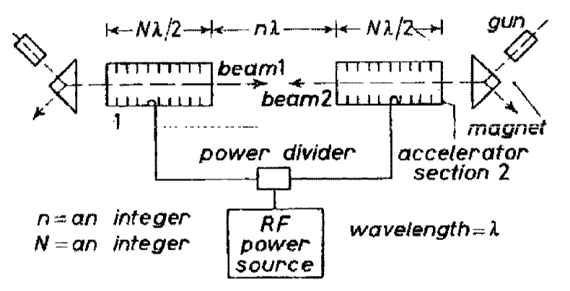
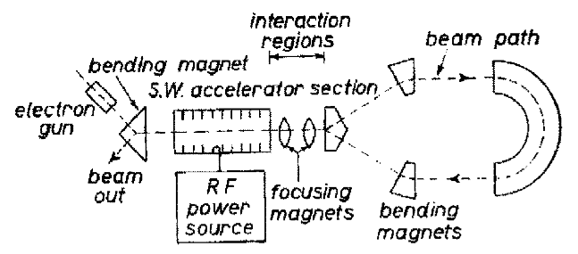
The Best of both Worlds
Energy Recovery Linac concept: First proposal 50 years ago
M. Tigner: “A Possible Apparatus for Electron Clashing-Beam Experiments”,
Il Nuovo Cimento Series 10, Vol. 37, issue 3, pp 1228-1231,1 Giugno 1965
Truly Revolutionary Accelerator design Concept!!!!
With the potential of changing the collider landscape!!!
First Tests: Done at SCA @ Stanford in 1986
Interesting concept for FELs and Compton photon light sources,
and high current electron cooler concepts and colliders!!!
https://images.app.goo.gl/fJPy8BFcnWnzByRY8

Slide 8
Energy Recovery Linac Configurations
Push-Pull Configuration:
2 SC linacs facing each other
Allows only pulsed linac operation
But allows Energy Recovery
Coupled Linac Configuration:
4 SC linacs facing each other
Allows CW linac operation
Allows Energy Recovery
Allows Positron recovery!
Costly implementation as 2 x SRF and SRF is the main cost driver for the ERL

Slide 9
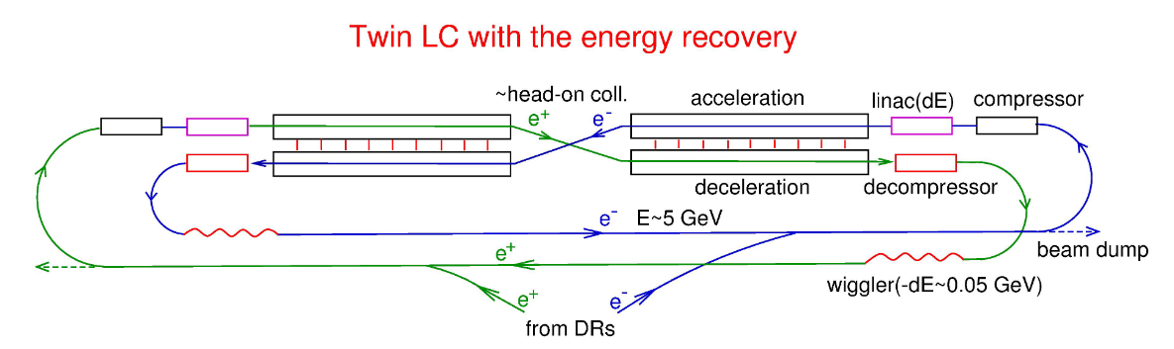
4 Linac ERL Collider Concept:
Valery Telnov BINP
In his proposal the machine is still pulsed and the cycle duration [seconds] is determined by the refrigeration system
Projects peak luminosity of ca 10³⁶ cm⁻²s⁻¹ @ 200MW wall plug power [wiggler 5MW; HOMs 45MW; cryo 110MW]
Luminosity independent of beam energy due to Energy Recovery! But Cryo sclaes with Linac length and HOM with I!
250GeV machine with 0.16A @ 1/3rd duty cycle ➔ > 10GW beam power!!!
➔ https://indico.cern.ch/event/995633/contributions/4275159/attachments/2208757/3755756/telnov-lcws21.pdf

Slide 10
4 Linac ERL Collider Concept:
Valery Telnov BINP
SRF taken from LCLS-II:
Q₀ = 3 10¹⁰ @ 1.8K with E = 20MeV/m ➔ heat of about 1kW/GeV
1/3rd duty factor with 3m bunch spacing ➔ L = 0.5 10³⁶ cm⁻²s⁻¹ @ 160MW
and N= 10¹⁰, d = 3m, I = 0.16A and 250GeV CME

Slide 11
Energy Recovery Linac Configurations
Recirculating Linac Configuration:
SC linac(s) that are connected through return arcs
Still implies some synchrotron radiation (depending on design ca. ½ of ring)
More cost efficient installation as the SC linac is passed more than once
Allows true CW SRF operation [beam loading only as transients during ramp-up]
Still avoids limits through beam-beam interaction!!!
Implies some beam size blow-up through arcs ➔ return-arcs lattice design!
Multiple passes of beams with different energies through same SC linac implies
high beam current in SRF cavities
Effective ERL applications require
SRF technology with Q₀ > 10¹⁰ and
Cost effectiveness requires peak fields of
V > 15MV/m

Slide 12

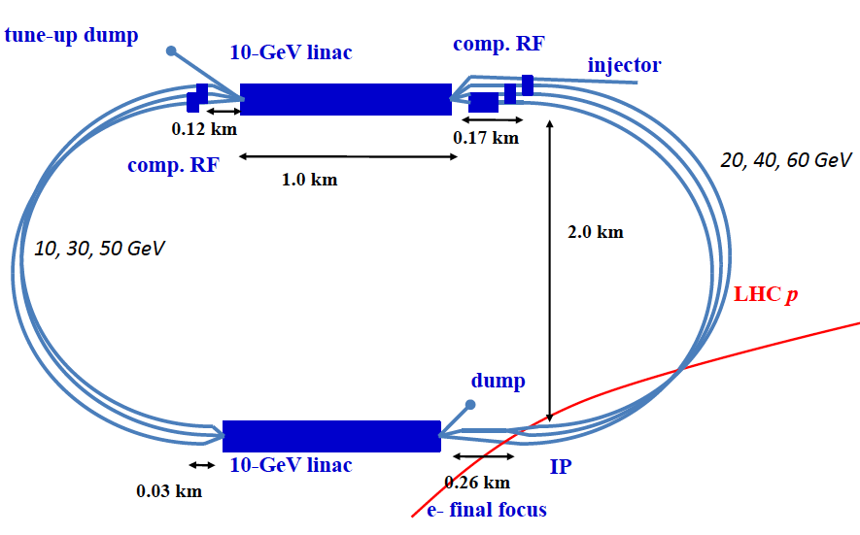
LHeC / FCC-eh Racetrack ERL Collider configuration:
* LHeC CDR, arXiv:2007.14491
Example LHeC: 3-turn Recirculating SRF Linac and ERL operation
Operation in parallel with LHC/HE-LHC/FCC-hh
TeV scale collisions ➔ 50-60 GeV e-beam energy
power consumption < 100 MW
Arc 1
Arc 3
2 1km long SRF linacs
3 separate return arcs at each end of the linac,
matched for the beam energies
Each beam passes 6 times through the SRF:
3 passes with acceleration and 3 with passes deceleration ➔ 6 times I_{e} in SRF!
Arc 5

Slide 13
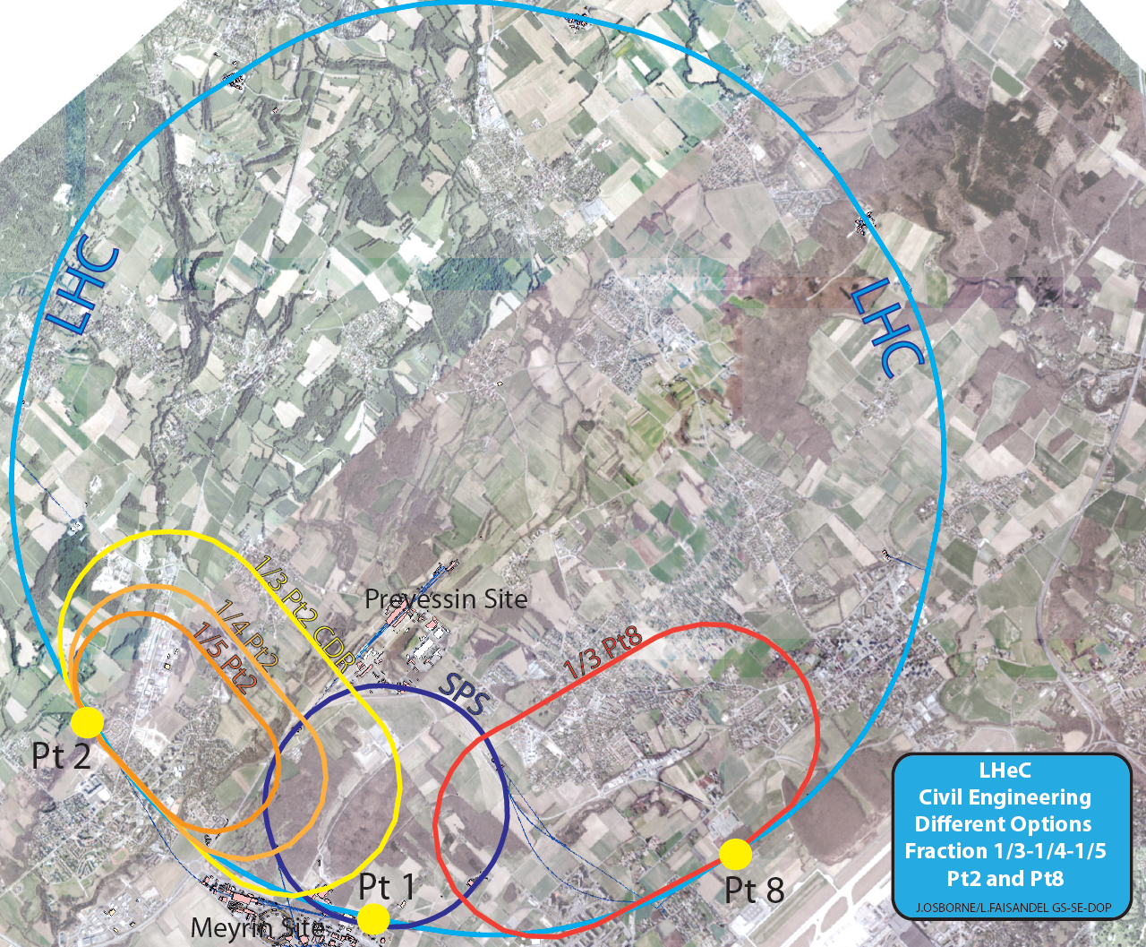
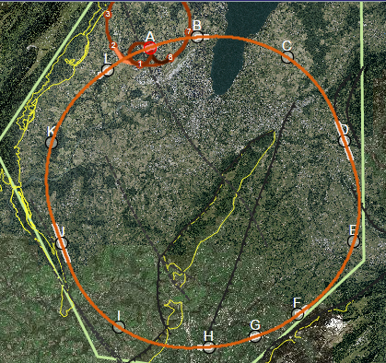
LHeC / FCC-eh ERL Configuration: Layout Options & Scaling
Configurations:
FCC-he considers Point ‘L’ since FCC Week in Berlin
LHeC
arXIV:2007.14491

Slide 14
LHeC: Recirculating Linac with ERL Operation as Baseline
Performance with 100MW Wall Plug Power limit:
arXIV:2007.14491
10³⁴ cm⁻² s⁻¹ Luminosity reach | PROTONS | ELECTRONS
Beam Energy [GeV] | 7000 | 60
Luminosity [10³³cm⁻²s⁻¹] | 16 | 16
Normalized emittance γε_{x,y} [μm] | 2.5 | 20
Beta Function β∗_{x,y} [m] | 0.05 | 0.10
rms Beam size σ∗_{x,y} [μm] | 4 | 4
rms Beam divergence σ’∗_{x,y} [μrad] | 80 | 40
Beam Current @ IP[mA] | 1112 | 15
Bunch Spacing [ns] | 25 | 25
Bunch Population | 2.2*10¹¹ | 2.3*10⁹
Bunch charge [nC] | 35 | 0.64
25 ⬅
➔ 10³⁴cm⁻²s⁻¹ Luminosity can be reached in ep at HL-LHC [and FCC-pp]

Slide 15
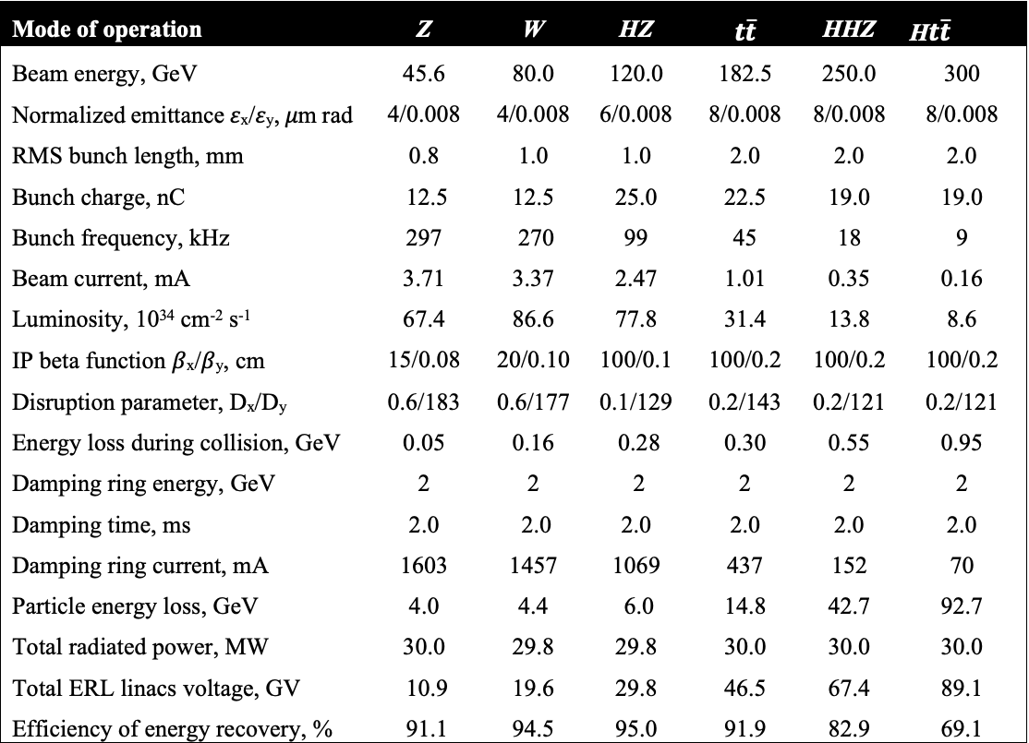
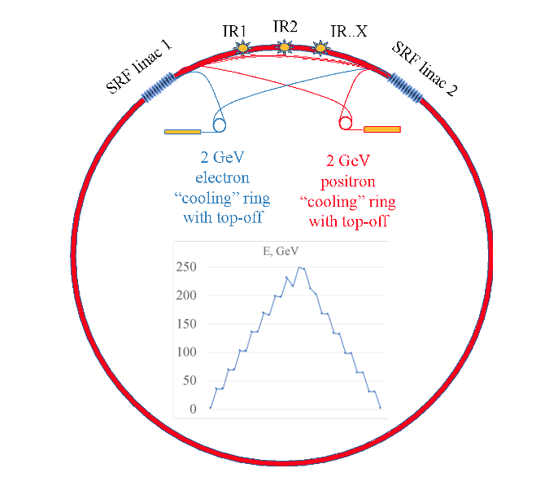
Circular Energy Recovery Collider Concept: CERC proposal
Two 11 to 90 GeV SRF linacs in 4 pass configuration
1/3rd of power consumption as compared to circular collider
CM Energy reach of 600GeV in 100km circumference tunnel
https://arxiv.org/abs/1909.04437
Physics Letters B, 804 (2020) 135394
Maximum Power of 300MW per beam @ 120 GeV and 2.47mA
V. Litvinenko BNL and Stony Brook University; T. Roser BNL; C. Llatas BNL

Slide 16
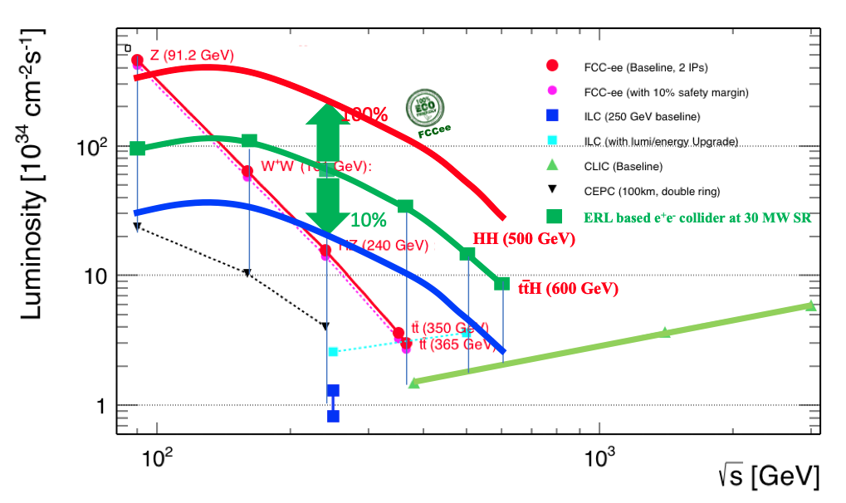
Circular ER Collider Concept:
Vladimir Litvinenko; BNL and Stony Brook University
10MW RF power
30MW RF power
100MW RF power

Slide 17
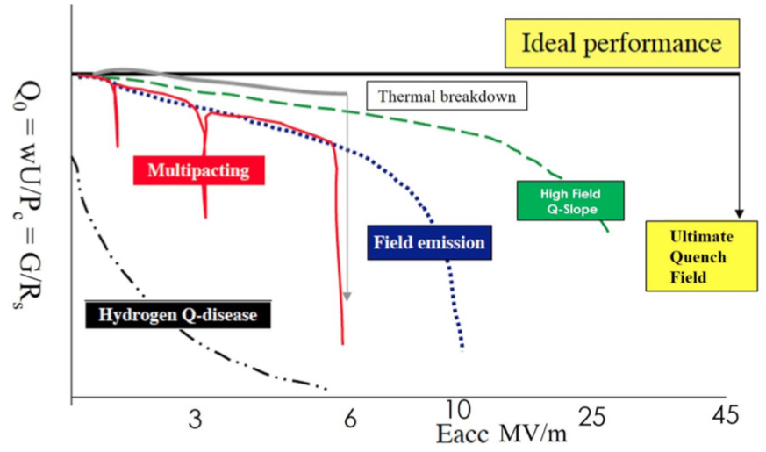
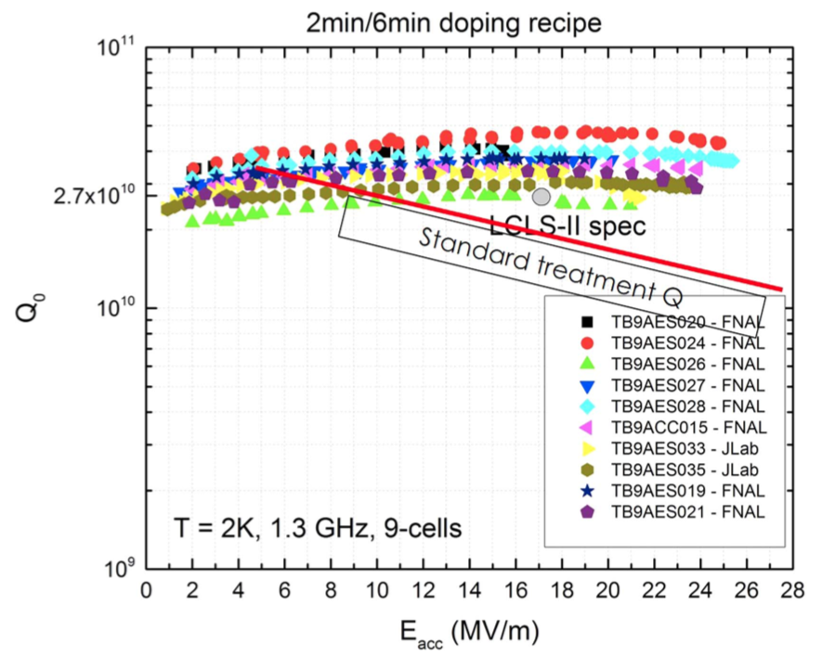
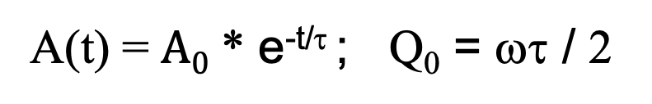
ERL: SRF Challenge
Q₀ versus accelerating voltage:
A(t) = $A0$ * e^{-t/τ} ; Q₀ = ωτ / 2
➔ impressive progress over the last 10 years!!!
➔ Q₀ directly linked to required cryogenics power!!
Hasan Padamse: ‘50 years of success for SRF accelerators’
Superconducting Sci. Technol. 30 (2017) 053003
See talk by Bob Rimmer at this Symposium for more details!

Slide 18
Performance Optimization for ERL Configurations
Need to demonstrate total beam intensity limit for stability in SRF
➔ how many re-circulations and beam currents are possible?!
and need to demonstrate
Limits for beam perturbation with beam-beam interaction and SR in ERL configuration
What level of non-linearity and beam size are acceptable!!!
Acceptance of deceleration path!
Synchrotron Radiation Power:
Can not be avoided for the racetrack configuration ➔ requires scaling of the
return arcs with beam energy! But can reduce SRP by about 50% wrt ring
Beam-Beam interaction:
Not a limit - similar to linear colliders ➔ can increase I_{bunch}
Beam size defined by source [like in a LC] and thus can be optimized
But beam size can not be pushed as extreme as in LC as the beam still needs
to pass through the SRF without losses during the deceleration phase
➔ Can recuperate positrons after collisions
Lattice and Optics design of return arcs:
Novel lattice design requirements for return-arcs!!! Optics and FFAGs.

Slide 19
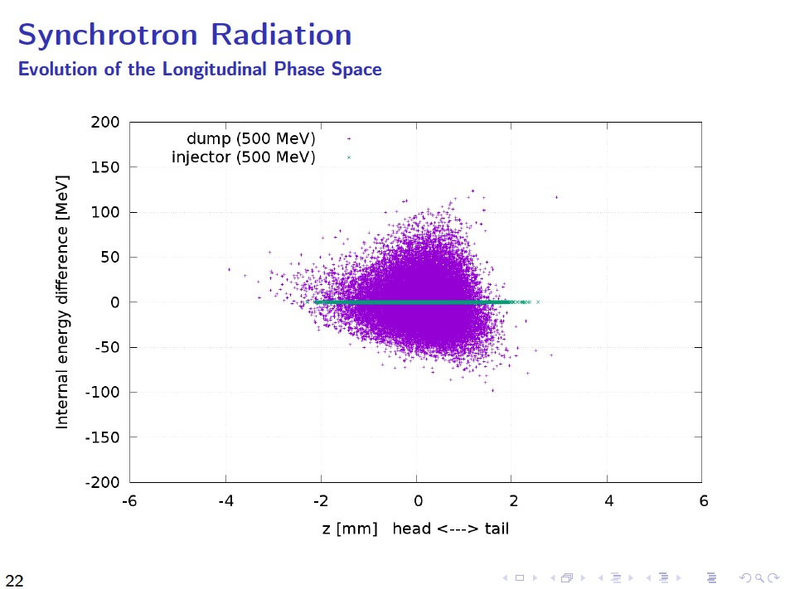
D. Pellegrini (EPFL/CERN) @ ERL’15
The momentum acceptance of the beam dump channel defines in the end the injection energy for the ERL [and thus the ERL efficiency]!!!
ERL2015, Stony Brook University, June 9, 2015

Slide 20
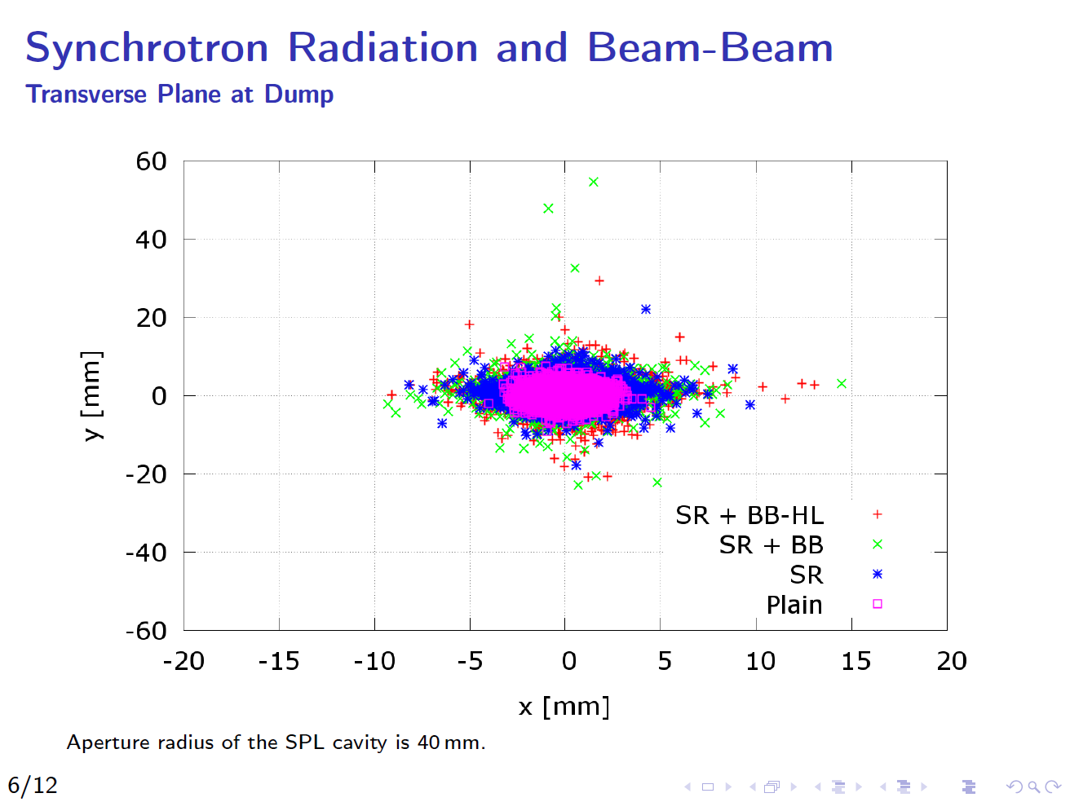
D. Pellegrini (EPFL/CERN) @ ERL’15
ERL2015, Stony Brook University, June 9, 2015

Slide 21
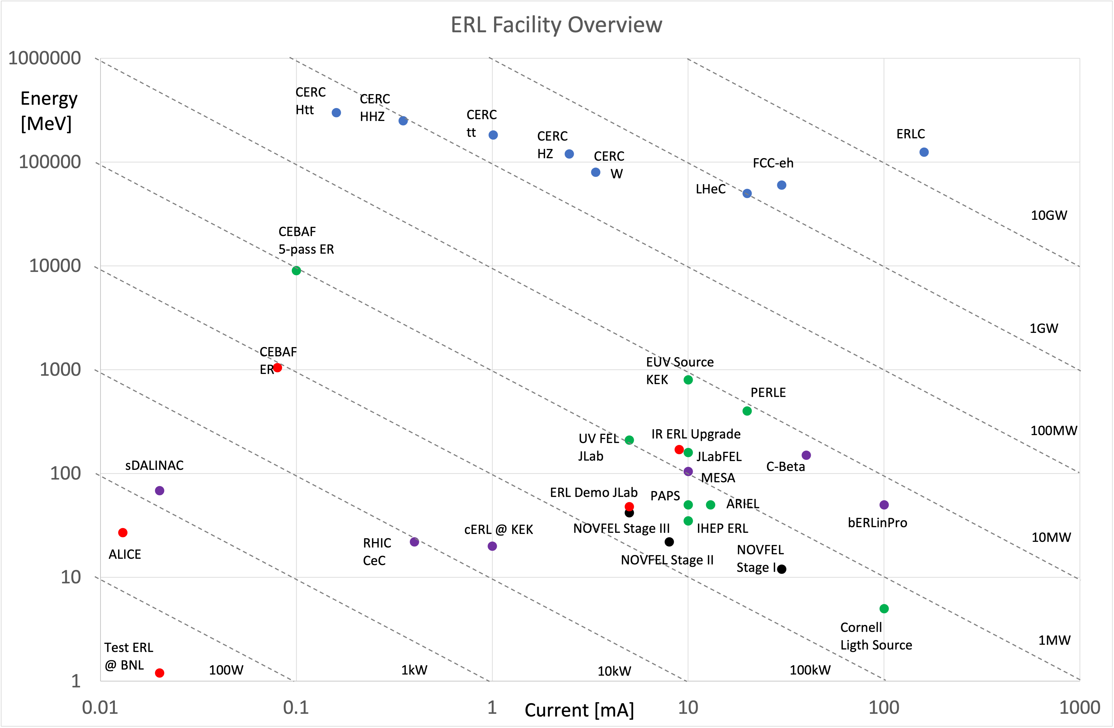
ERL
Facilities
Overview:
e.g.
ERL2017 workshop
@ CERN and
Updated 2019 & 2021
Legacy ERLs no longer in operation
Operational & upcoming ERLs
Planned ERL facilities
Normal Conducting ERLs
HEP ERL based studies

Slide 22
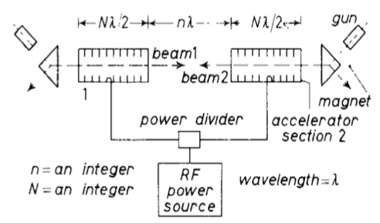
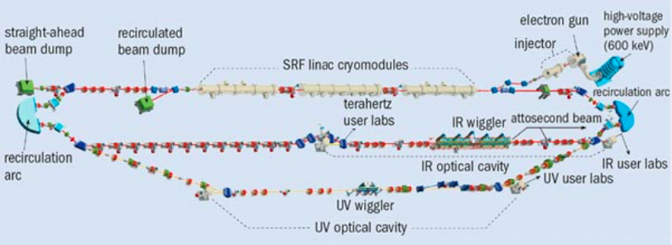
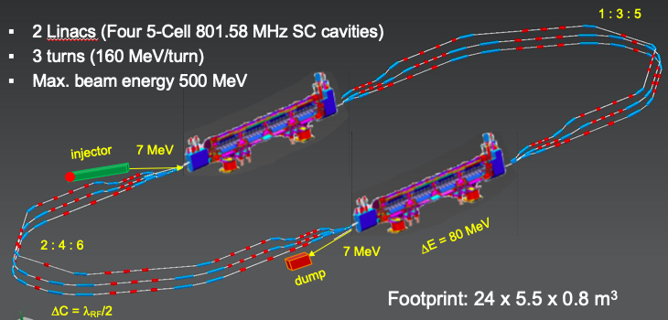
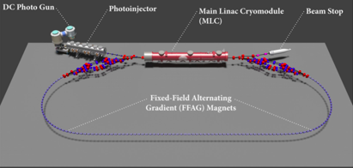
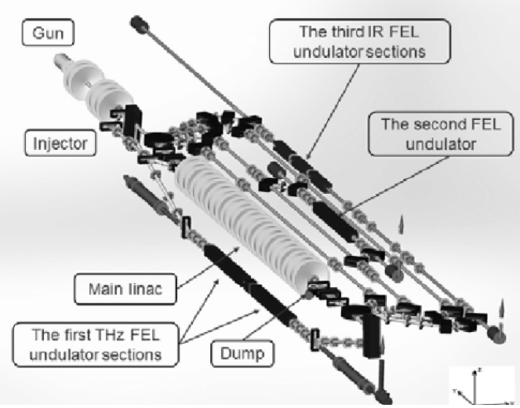
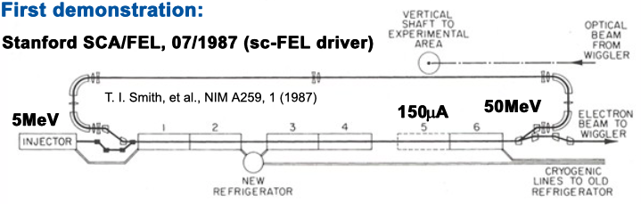
ERL Evolution:
First Idea:
M. Tigner 1965
JLab First MW beam power operation
FEL Demo [1999] & Upgrade [2000]
Multi-turn SRF
C-Beta 2019-2020
Multi-turn SRF, multi-MW
PERLE@Orsay 2025
PERLE can validate the next 10-fold step in beam power
and provide the remaining demonstrations
[multi-turn ERL efficiency at high beam power]
➔
HEP is ready for implementing a truly green accelerator concept!
ALICE
JEARI ERL
1960
1970
1980
1990
2000
2010
2020
2030
2040
First Demonstration
SLAC SCA / FEL 1987
Multi-turn Operation
BINP FEL 2004 [NC]
Multi-MW Operation
bERLin-Pro 2020
HEP / NP ERL application
LHeC/FCC-eh; FCC-ee; ILC;

Slide 23
End

Slide 24
Variations in the ERL Configuration:
Super Conducting 3-turn Recirculating Linac with Energy Recovery operation
Operation in parallel with
LHC/HE-LHC/FCC-hh
TeV scale collision energy
➔ 50-60 GeV electron beam energy
power consumption < 100 MW
CDR option with
9.3km [1/3rd of LHC];
60 GeV
Smaller version with
5km [1/5th of LHC];
50 GeV
O. Brüning, M. Klein and LHeC and PERLE Collaboration
Topical Review Exploring the energy frontier with deep inelastic scattering at the LHC
Journal of Physics G: Nuclear and Particle Physics, Volume 46 #2; November 2019

Slide 25
ERL Validation Needs and Experience
Proposed Collider Projects [e.g. LHeC / FCC-eh and FCC-ee and ILC-ERL] extrapolate demonstrated virtual beam power far beyond the achieved 1.5MW operation!!!
Operational experience up to 1MW virtual beam power:
ERL Test Facilities
ERL Collider Projects
JLab pioneering
eRHIC [6]
LHeC [3]
C-Beta [4]
EUV KEK [1]
IR-ERL JLab [1]
bERLpro [1]
PERLE [3]
cERL @KEK [1]
MESA [2]
Demonstration of multi-turn, multi MW ERL
Operation is on its way!!!
C-Beta and PERLE
ERL demo [1]
ARIEL TRIUMF [1]
CBAF-ER [1]
ERL@CBAF [5]
CeC@RHIC [1]
1.5MW Highest
demonstrated
Virtual beam
power
Test ERL@BNL [1]
ALICE [1]
sDALINAC [2]
ERL Applications

Slide 26
Arc Optics: Emittance preserving FMC cells
Emittance dilution due to
quantum excitations:
Bogacz (JLab) @ ERL2015, Stony Brook University, June 9, 2015 and LHeC at HL-LHC", to be published
[Flexible Momentum Compaction]
Scaling with beam energy and radius of curvature!
Arc 1 , Arc 2
Arc 3, Arc 4
Arc 5, Arc 6
500
Imaginary γ_{t} Optics
0.5
500
DBA-like Optics
0.5
500
TME-like Optics
0.5
[Double Bend Achromat]
[Theoretical Minimum Emittance]
BETA_X&Y[m]
DISP_X&Y[m]
BETA_X&Y[m]
BETA_X&Y[m]
DISP_X&Y[m]
DISP_X&Y[m]
0
-0.5
0
-0.5
0
-0.5
0
BETA_X
BETA_Y
DISP_X
52.3599
DISP_Y
0
BETA_X
BETA_Y
DISP_X
DISP_Y
0
BETA_X
BETA_Y
DISP_X
52.3599
52.3599
DISP_Y
total emittance increase in Arc 1- 5: Δε_{x}^{N} = 4.9 μm rad
factor of 20 smaller than FODO

