Slide 1
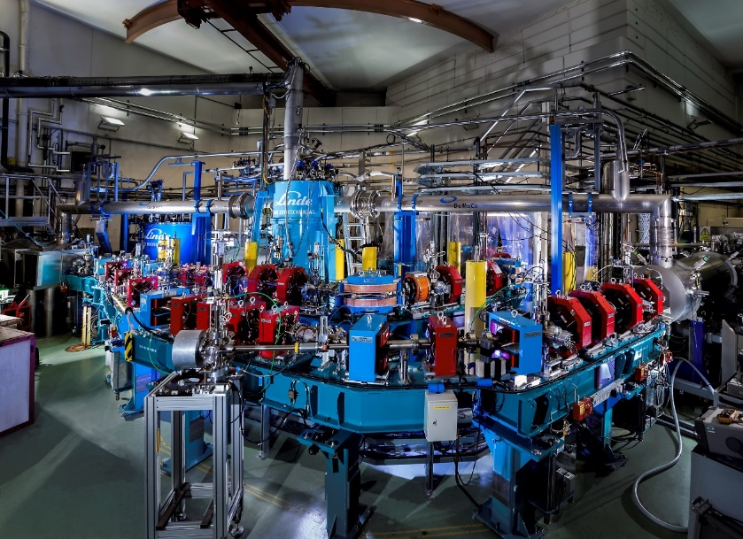

Industrial / Societal Applications of Energy Recovery Linacs
Peter Williams
Daresbury Laboratory & Cockcroft Institute
ECFA LDG Symposium on Energy Recovery Linacs
4th June 2021
ALICE ERL at Daresbury, pictured in 2014, driving IR-FEL for investigations in cancer diagnostics

Slide 2
ERLs Widen the Applications of Accelerators Because…
  Provide (nearly) linac quality/brightness beam at (nearly) storage ring beam powers:
    P_{beam} >> P_{RF}
    beam quality source limited: e_{beam} < e_{ring equilibrium}
  Radiation control: allows us to dump beam at low energy
    can mitigate intractable (i.e. expensive) environmental/safety concerns
  High power beam with reduced RF drive ⇒ allows us to consider higher power applications than would otherwise be unaffordable = GW class beams
  ERLs Apply Wherever You Need A Beam With Simultaneous High Quality AND High Average Power:
      Following examples in Free Electron Lasers & Inverse Compton Sources

Slide 3
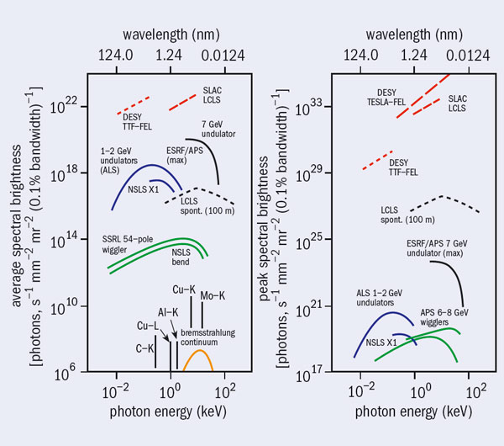
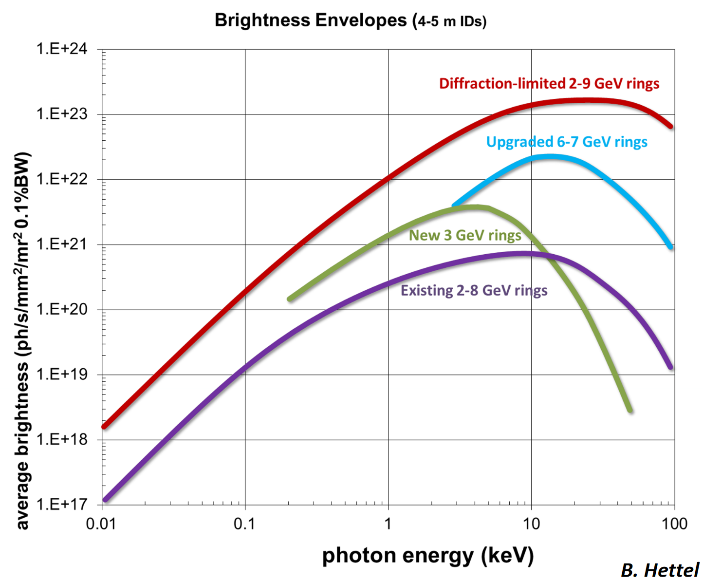
Why ERLs for Free Electron Lasers?
Free electron lasers offer simultaneous transverse and longitudinal coherence and peak brightness approaching 10 orders of magnitude improved with respect to spontaneous SR sources = VERY attractive for chemistry, biology, drug development, materials development etc etc. Hence the new generation of XFEL facilities: LCLS-1 & 2, Eu-XFEL, SHINE
To date however, FELs limited in AVERAGE brightness with respect to “4th generation” spontaneous SR sources e.g. ESRF-EBS. Why? The lasing process is too good at extracting power from the electron beam and putting it into the radiation, so the spent beam is too “screwed up” to store in a storage ring. Answer: don’t store it, throw it away = single use of bunches = repetition rate of radiation limited to repetition rate of linac and beam power can only equal RF drive power. Eg to reproduce a typical storage ring (Spring-8): 8 GeV and 500 mA current = 4 GW RF drive power required!
ERLs free us from that constraint: Don’t store the beam, instead recover it’s energy and pass it to the next bunch.
11 year old comparisons of average (left) and peak (right) brightness of XFELS (red) and 3rd generation SR sources (blue, black, green) and table top sources (bottom left only) – from CERN Courier, November 2010
The upgraded “4th generation” SR sources like ESRF-EBS recapture the crown in terms of average brightness (blue)… but now nearly physics limited (red)

Slide 4
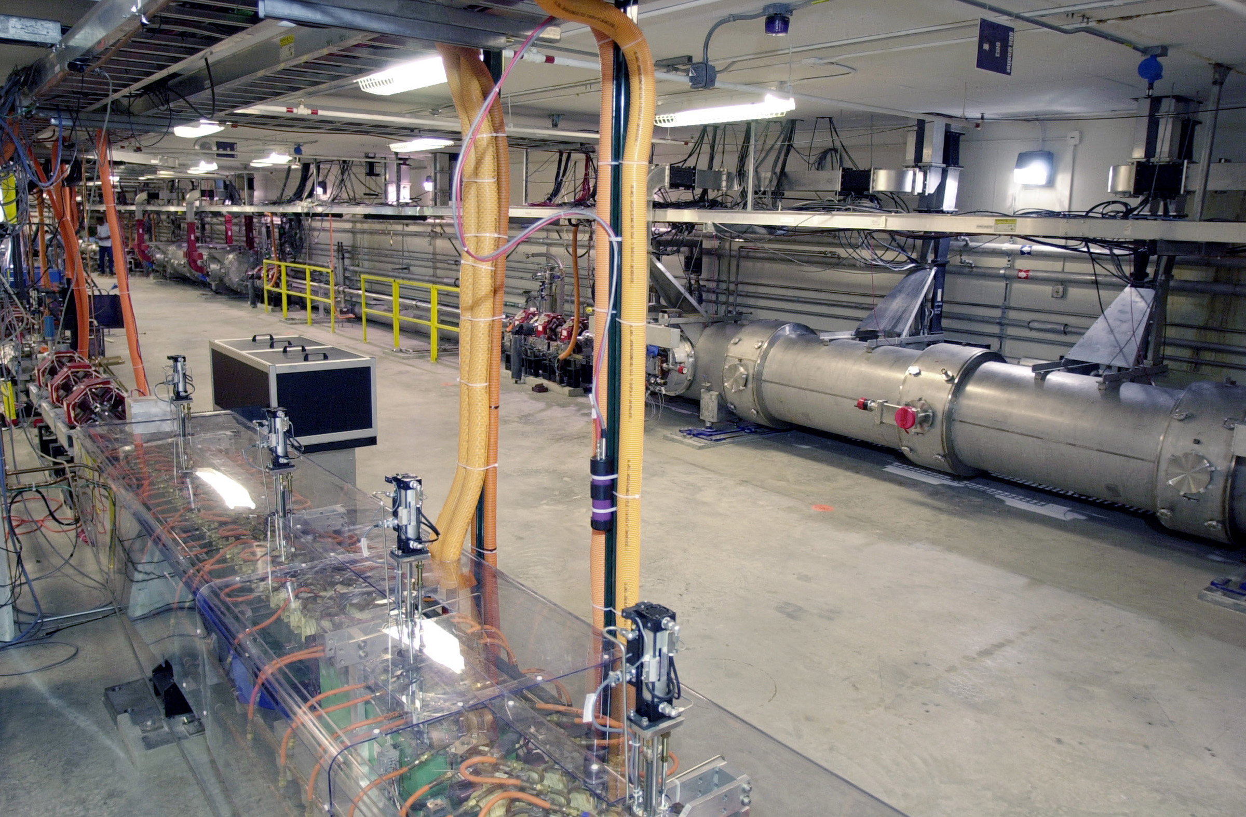
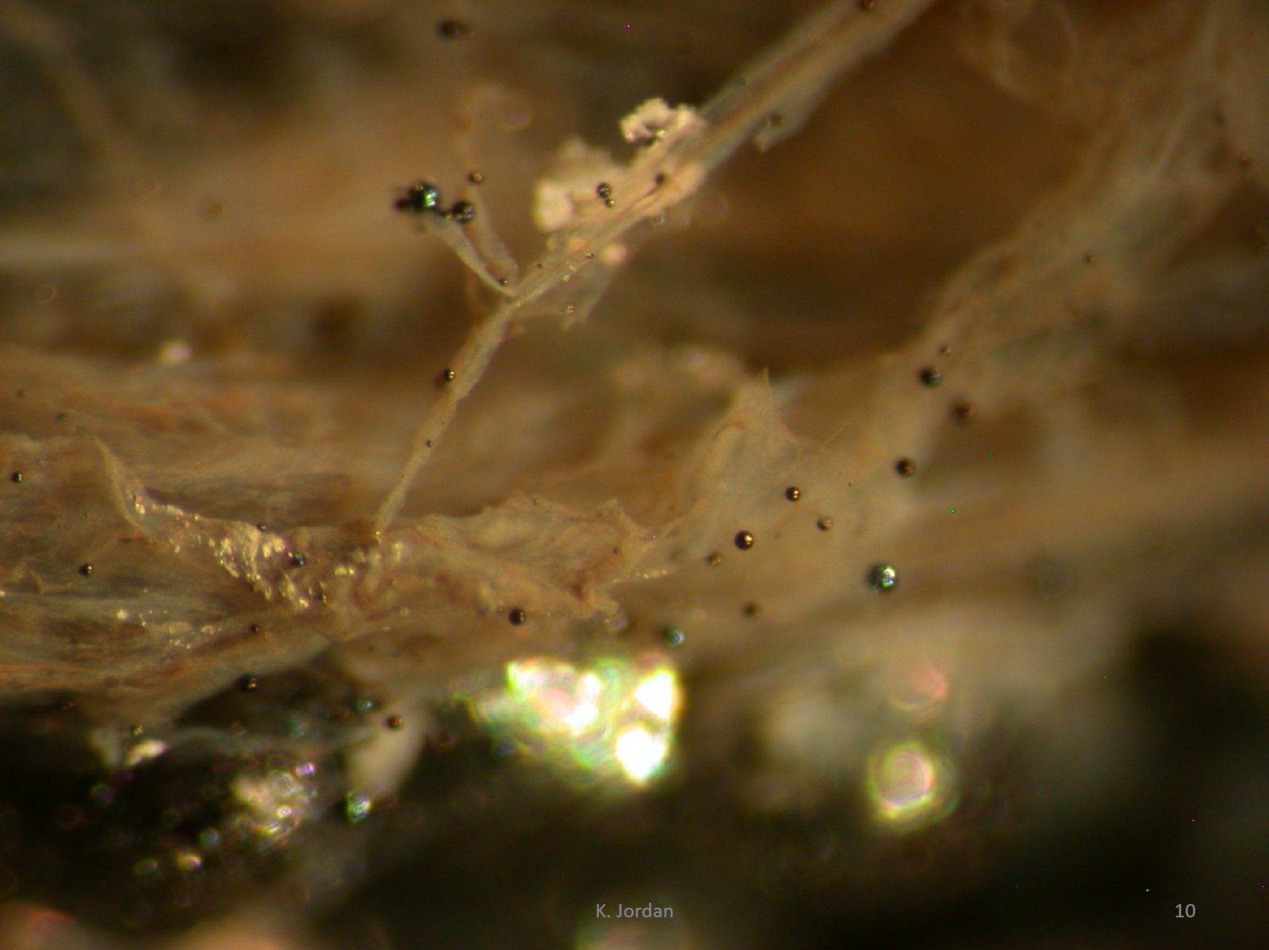
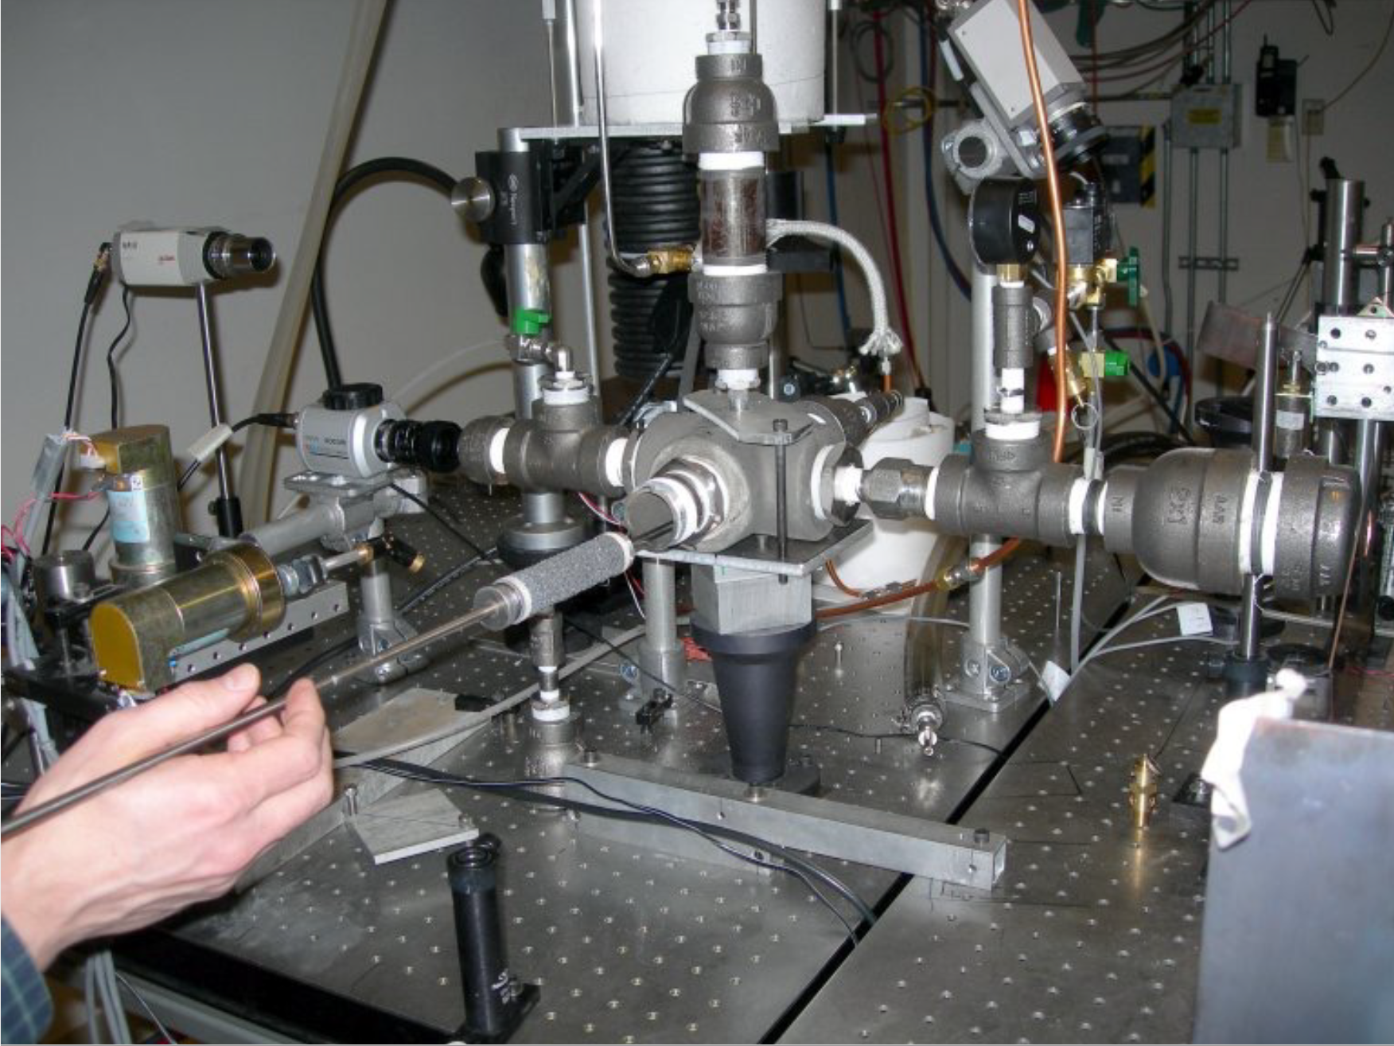
ERLs for FELs – Where we are now
The application of ERL-FELs to “the real world” is in its infancy… some examples
JLab FELs (1995 – 2013): 10kW IR-FEL, 1kW UV-FEL, broadband THz
Discoveries in material synthesis using the FEL has led to the founding BNNT LLC in 2010, which specializes in Boron Nitride Nanotube synthesis.
Initial discoveries made on JLab FEL
First BNNT synthesis in 2007
BNNT materials particularly useful for aerospace construction where enhanced radiation shielding needed – e.g. interplanetary spacecraft.

Slide 5
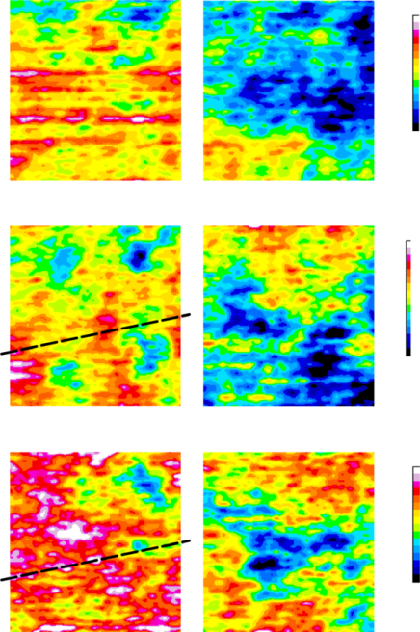
ERLs for FELs – Where we are now
The application of ERL-FELs to “the real world” is in its infancy… some examples
Daresbury ALICE (2005 – 2017)
Multiyear user program on Oesophageal cancer diagnosis technique
Oesophageal adenocarcinoma often progresses from Barrett's oesophagus: lining of the oesophagus is damaged by stomach acid and changed to a lining similar to that of the stomach.
The challenge is to identify patients with Barrett’s oesophagus who will develop oesophageal cancer – present diagnosis method subjective – leads to false positives
High intensity and ease of wavelength tune-ability key here – scan across tissue samples at 3 precisely chosen wavelengths – replicating DNA fluoresces differently to benign – differential image analysis identifies which samples are cancerous
Since discontinuation of ALICE work continues at slower pace at FELIX
Cancer
Barretts
7.0μm
7.3μm
(protein)
8.05μm
(DNA)
reflected IR light
Fibre tip
IR light
Sample
Scanning Platform

Slide 6
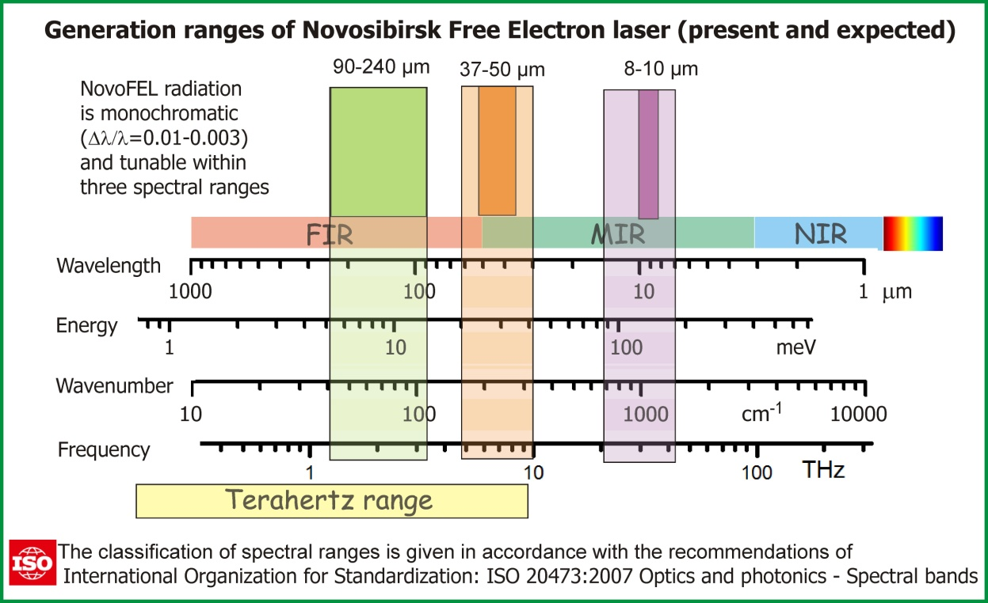
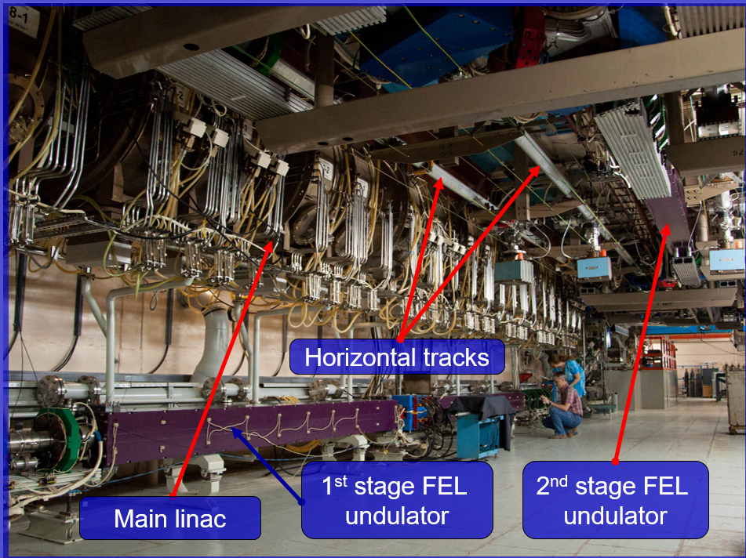
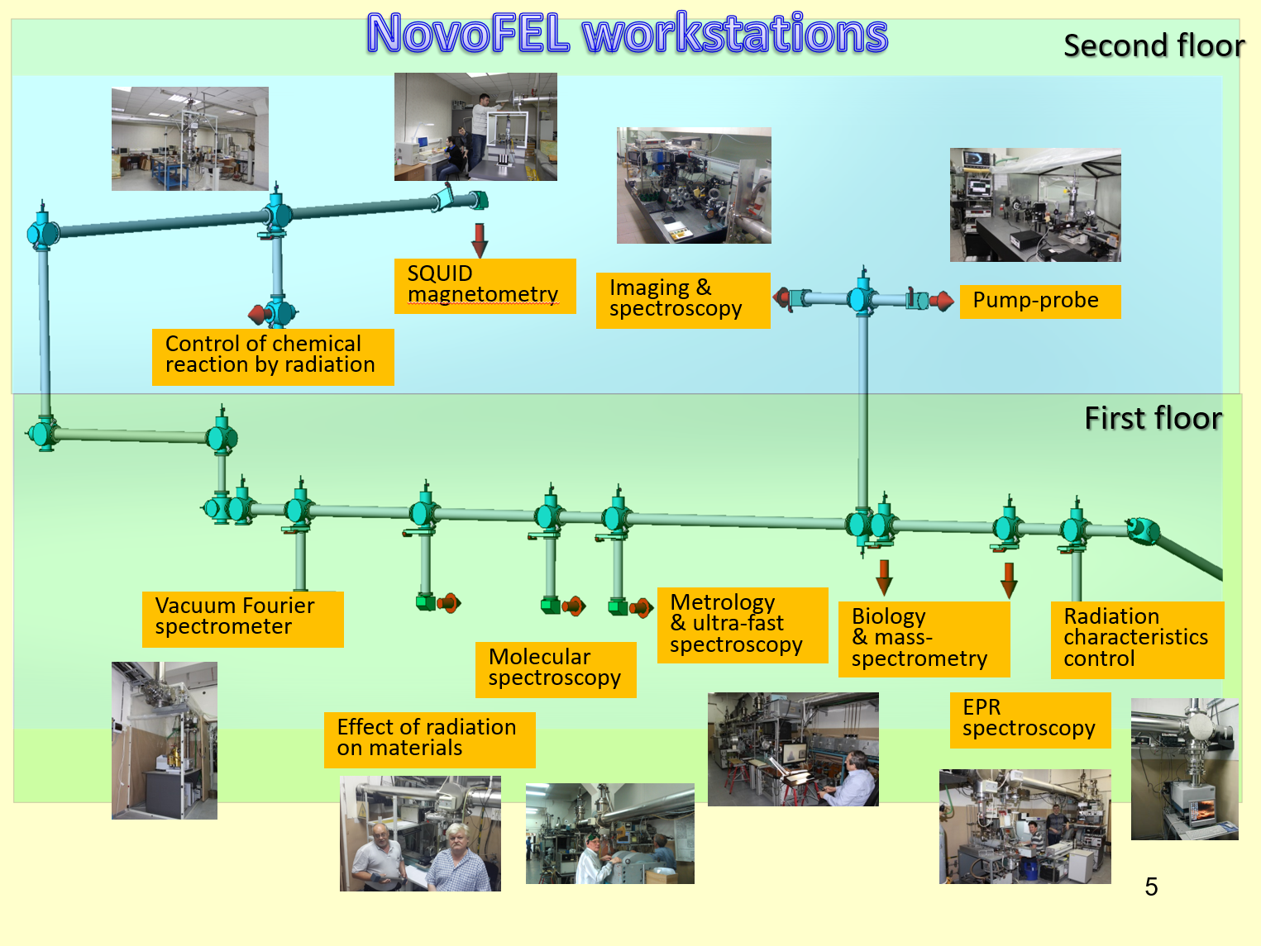
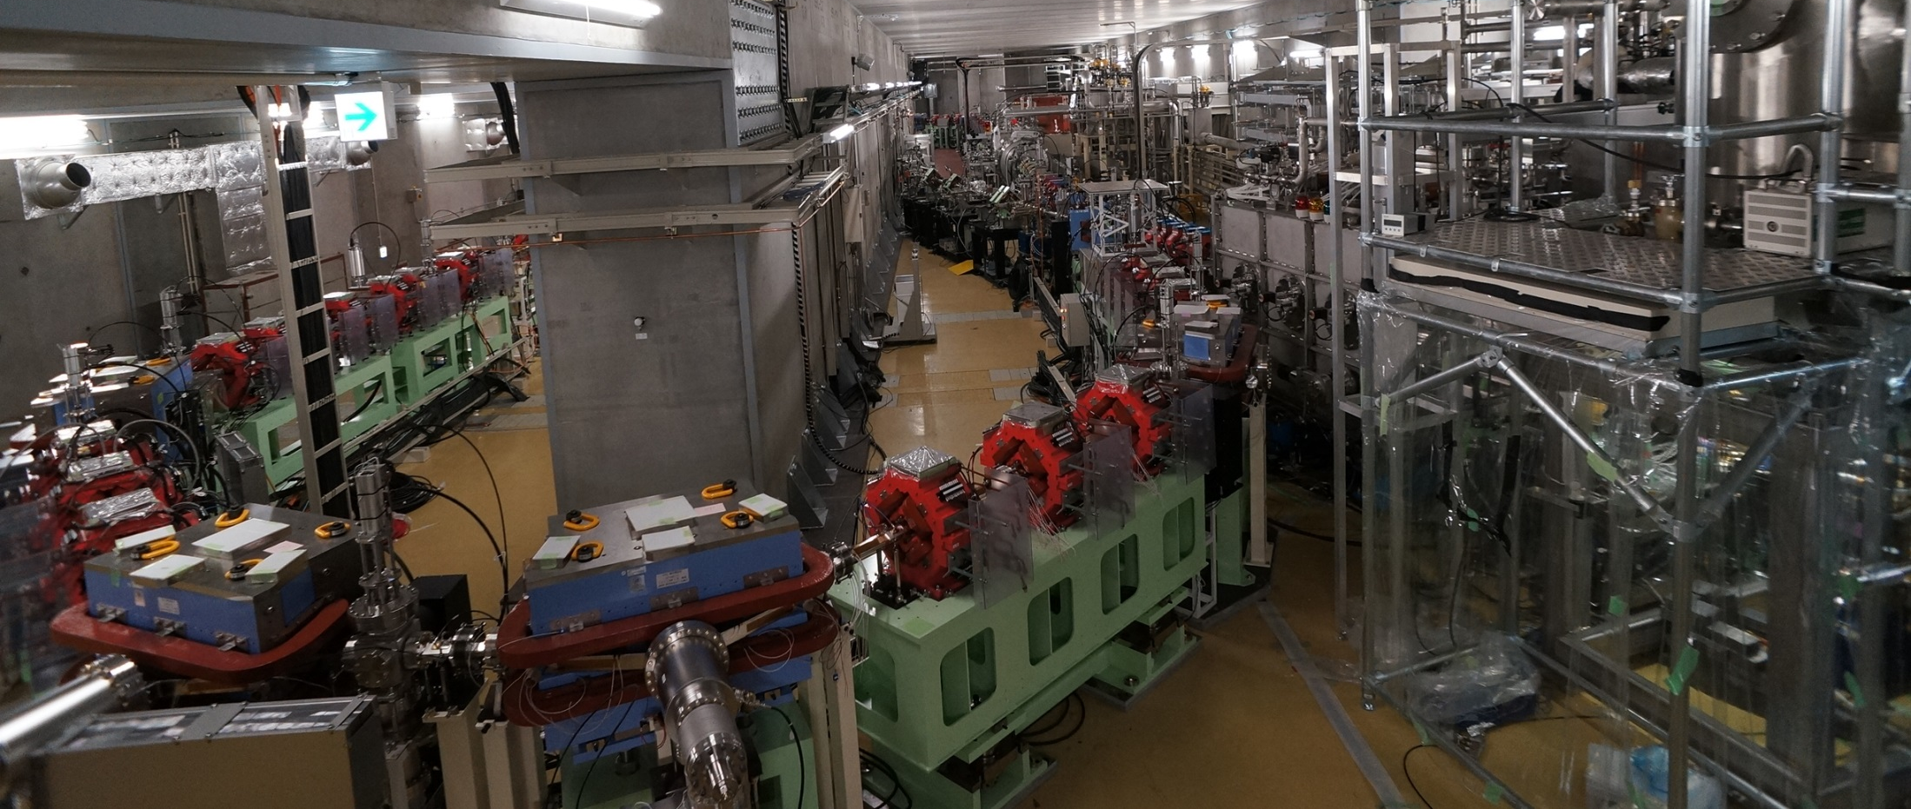
ERLs for FELs – Where we are now
The application of ERL-FELs to “the real world” is in its infancy… some examples
NovoFEL (2003 – present)
THz & IR for biological research
KEK CERL (2010 – present)
In process of converting to FEL research for lithography industry (see later)

Slide 7
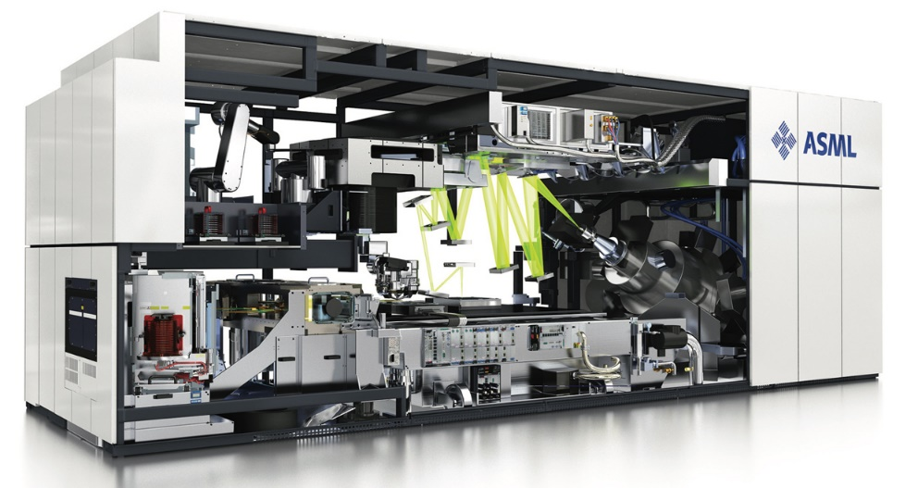
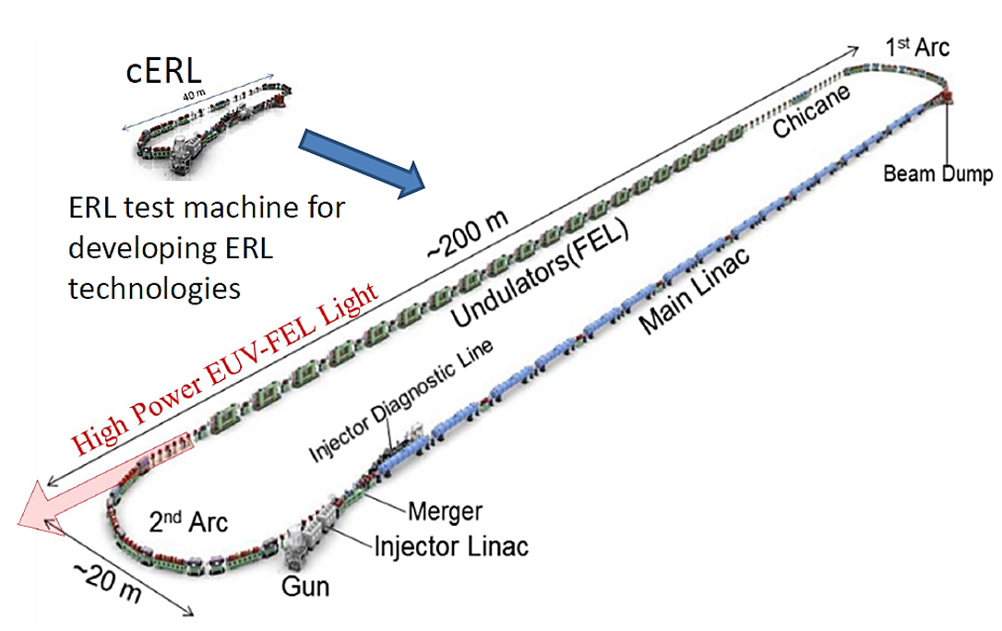

ERLs for FELs – Where we are going
EUV-FEL for semiconductor lithography
In order to keep pace with Moore’s Law (doubling of CPU power every 18 months), industry moving from 193 nm light source to 13.5 nm – enables finer pattern etching. Potentially shorter wavelengths in future…
A major limitation is the power of the EUV light source. Existing technology is ionization of tin droplets = dirty, inefficient, physics limitation going to shorter wavelengths → use an FEL? Need high average power → drive FEL with ERL.
From leading manufacturer of lithography apparatus, ASML Netherlands BV:
  “FEL is an interesting potential solution to generating multi-kW powers of EUV radiation. Energy recovery is a necessary condition to make such a light source economically viable”
A move from existing laser-plasma sources to FELs will be a big commitment from industry as it will mean reconfiguration of chip fabrication plants from 1 source / scanner to source sharing. CAPEX for FEL ~200M EUR, for FAB ~10B EUR. In 2020 semiconductor market size is ~400B EUR
A number of accelerator laboratories have worked with semiconductor industry to develop ERL based EUV-FEL concepts in the 2010s. One concept, from KEK pictured right
IP developed by ASML, although not applied to FEL yet, is being exploited for medical isotope production by IRE Belgium https://www.ire.eu/en/our-activity/ire/smart and Research Instruments https://research-instruments.de/news-events/news-detail/10
Industry continues to interact with accelerator laboratories, Eg. https://conference-indico.kek.jp/event/125/ and publish on relevant topics (see report for references)

Slide 8
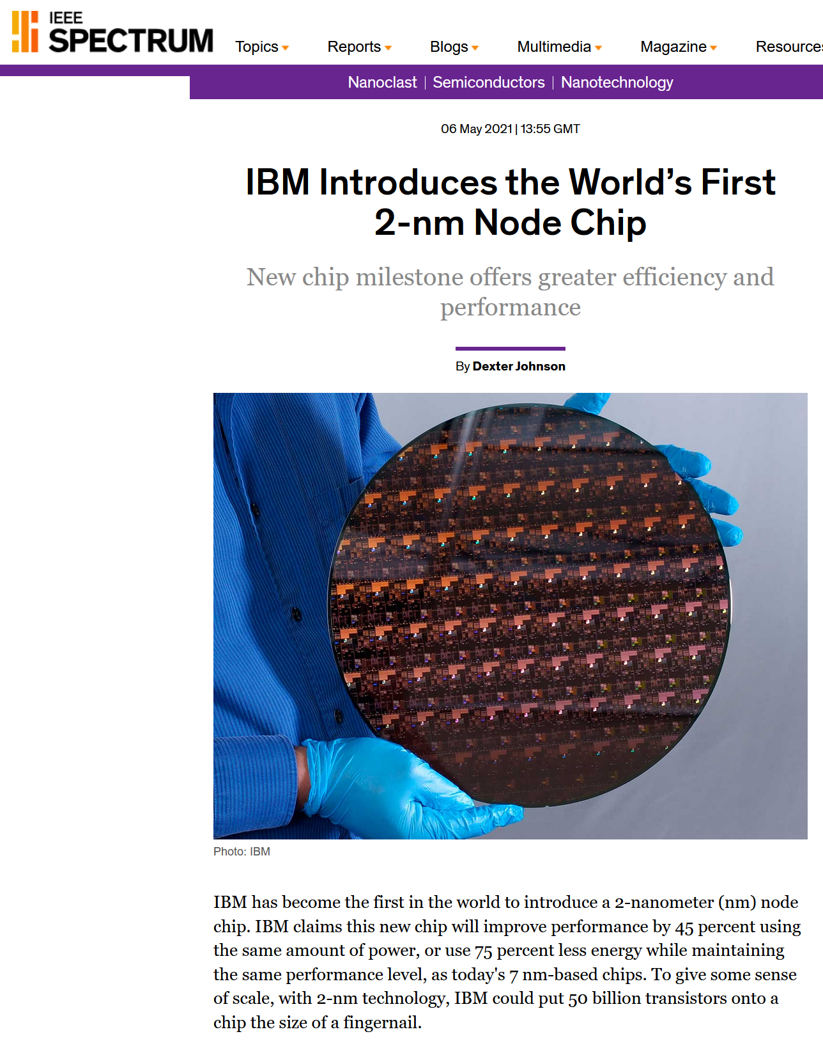
ERLs for FELs – Where we are going
EUV-FEL for semiconductor lithography
Example of potential impact…From IEEE Spectrum May 2021:
“Another first for these chips was IBM’s application of extreme-ultraviolet lithography (EUV) patterning to the front-end-of-line (FEOL) where the individual devices (transistors, capacitors, resistors, etc.) are patterned in the semiconductor. After a decade of hand-wringing over whether EUV would ever deliver on its promises, it has in the last few years become a keystone for enabling 7-nm chips. Now, in this latest step in its evolution, EUV patterning has made it possible for IBM to produce variable nanosheet widths from 15 nm to 70 nm.
The company anticipates that that 2-nm node could potentially reduce the carbon footprint of data centers. It estimates that if every data center changed their servers to 2-nm-based processors, it could save enough energy to power 43 million homes.
Closer to most of us is what IBM expects this to do our laptops and portable devices’ functions—including quicker processing in applications, easier language translation, and faster 5G or 6G connections.
For those who find daily phone charging annoying, 2-nm node chips will quadruple cell phone battery life vs. 7-nm node chips, which the company says could require users to charge their devices only every third or fourth day, rather than every night.”

Slide 9

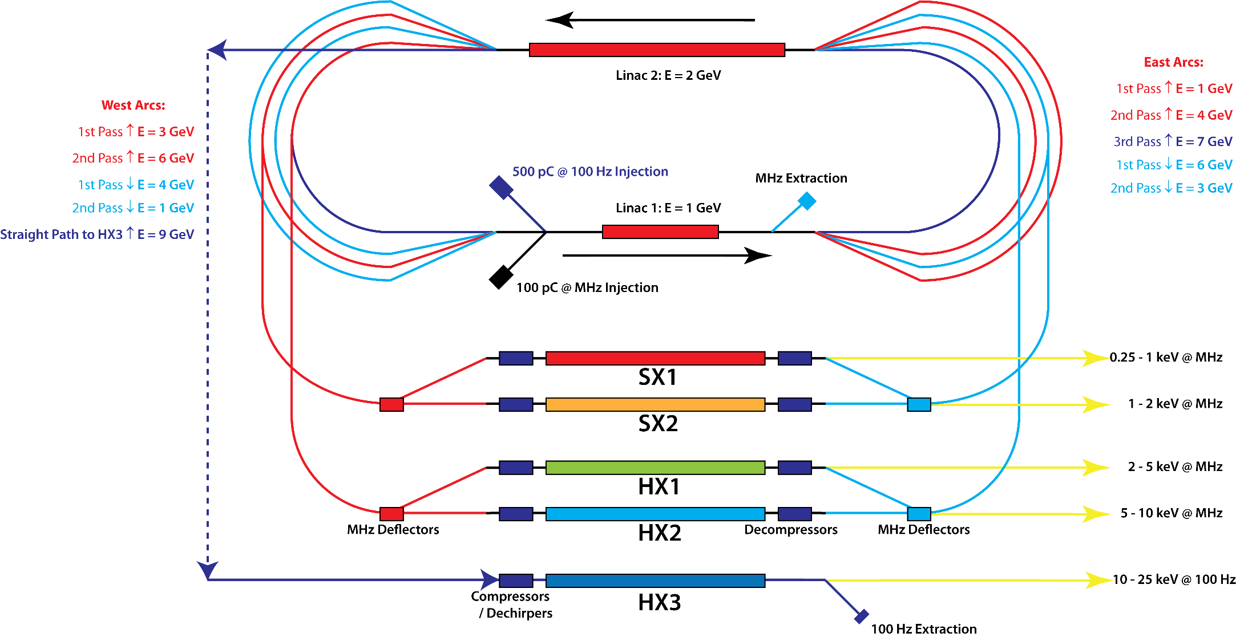
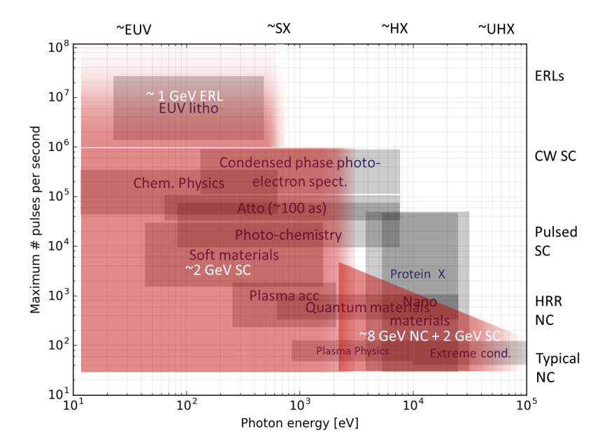
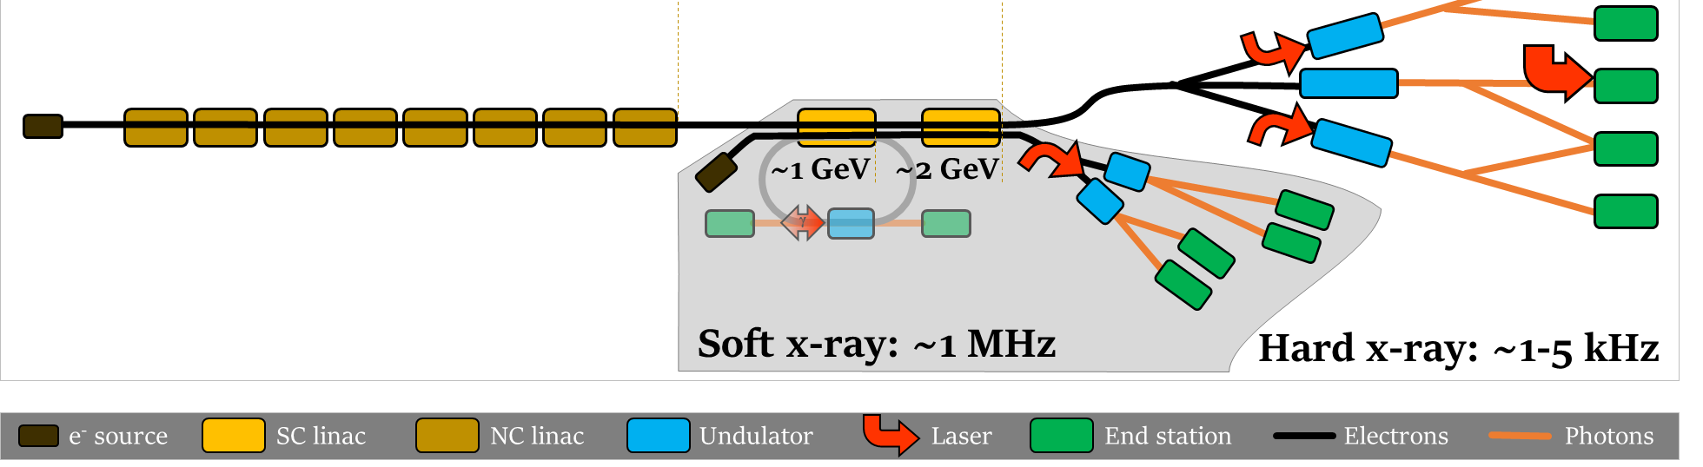
ERLs for FELs – Where we are going
Nm scale EUV radiation likely to be the most important application of ERL-FEL’s, but not the only. This has been recently explored in the context of the UK-XFEL facility proposal, and also at SHINE – Shanghai XFEL project… and also for LHeC
UK-XFEL:
Inspired by CEBAF-X concept, initial proposals to drive hard X-ray FELs with ERL directly – enables type of oscillator FEL termed XFELO – capable of producing transform limited pulses = single cycle X-rays, also large harmonic powers – potentially extending FEL pulses to MeV photon scales. Deemed too ambitious in the context of the proposal! …
…Published 2020 Science Case https://www.clf.stfc.ac.uk/Pages/UK-XFEL-science-case.aspx includes science that could be addressed by incorporating a ~1 GeV ERL into a larger UK-XFEL facility. ERL drives soft X-ray FEL at high average power, enabling lithography & seeding of the hard X-FELs… providing a high power seed pulse results in superior output compared to the SASE lasing seen in Eu-XFEL and LCLS-2 by introducing longitudinal coherence = eliminating noisy pulses. A seeded XFEL can therefore be considered the second generation of XFEL.
Left: Plot of photon energy vs pulse repetition rate shows potential application areas – ERLs sit at the top
Concept UK-XFEL facility incorporates ERL for soft X-ray & ICS gammas

Slide 10
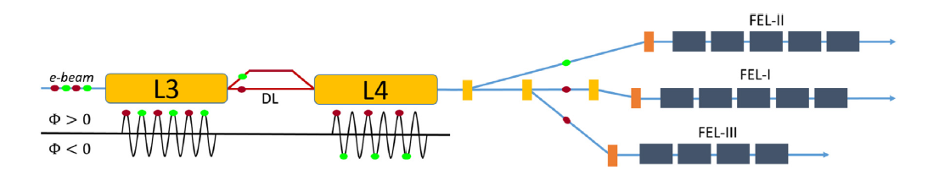
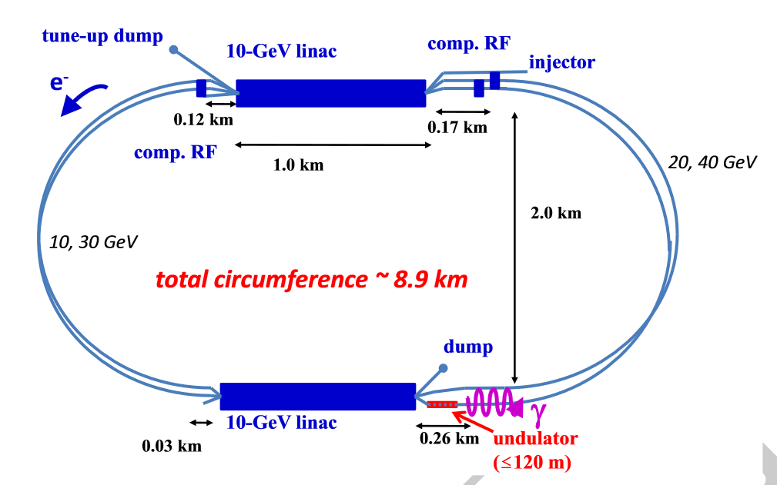
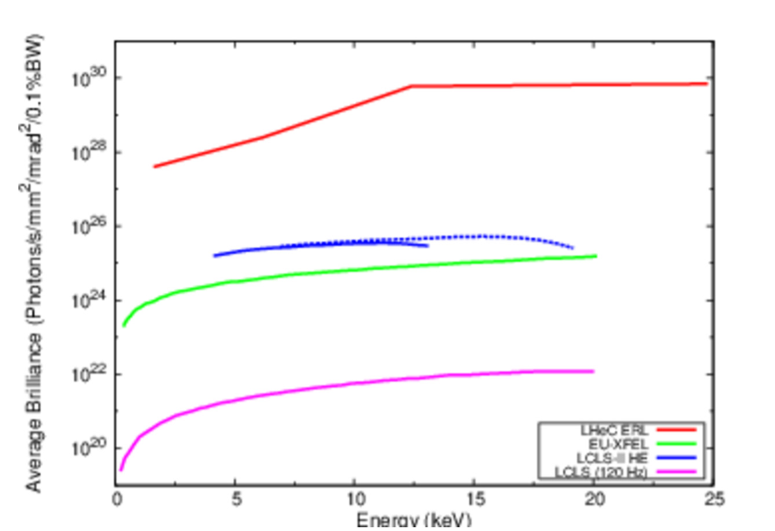
ERLs for FELs – Where we are going
Nm scale EUV radiation likely to be the most important application of ERL-FEL’s, but not the only. This has been recently explored in the context of the UK-XFEL facility proposal, and also at SHINE – Shanghai XFEL project… and also for LHeC
SHINE:
Different approach - Considering ERL mode in part of their linac to enable greater final energy range – allows them to drive widely different wavelength XFELs by assigning different energies to each pulse within a single linac
LHeC:
Using the LHeC to drive a SASE FEL requires a reduction of the energy to 40 GeV in order to limit the SR driven emittance growth
Choosing to match photon energies of Eu-XFEL, LCLS-II etc again shows the ERL advantage in terms of average brilliance – 4 orders of magnitude more.

Slide 11
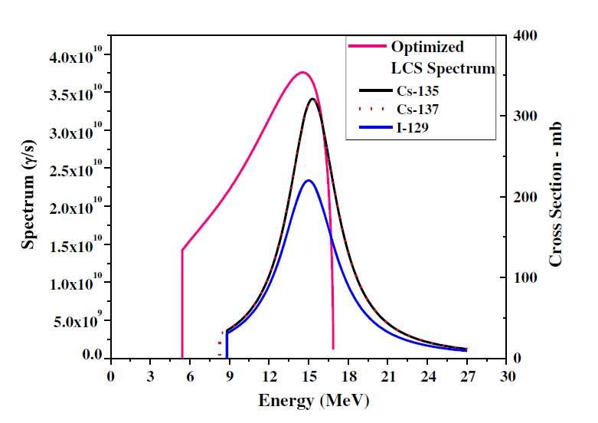
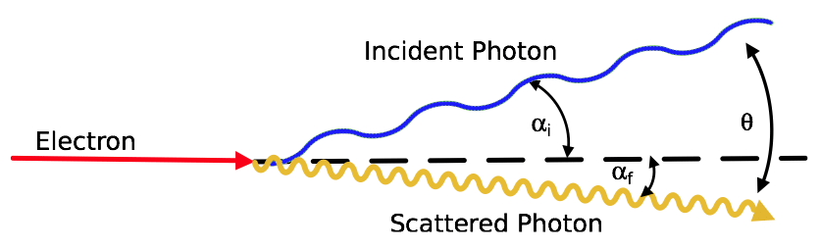
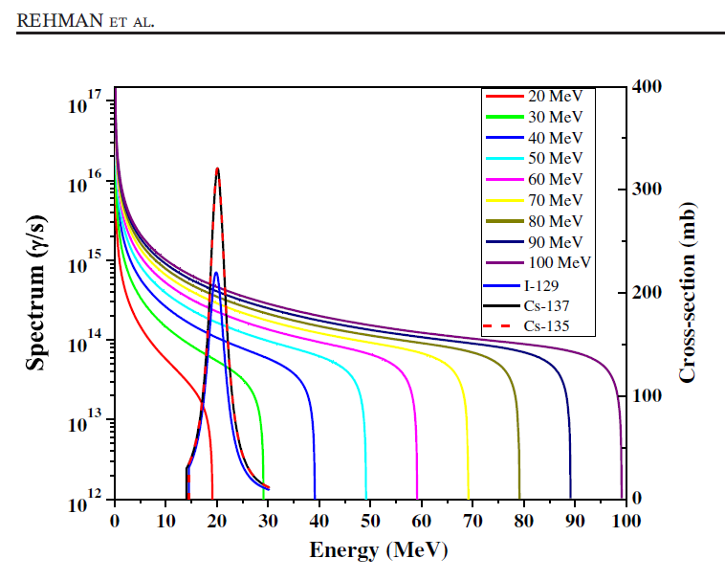
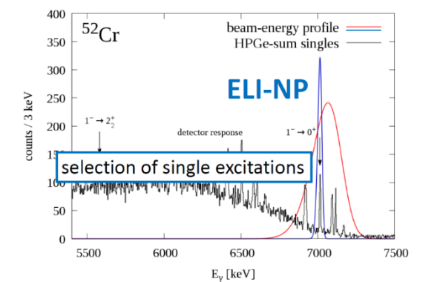
Why ERLs for Inverse Compton Scattering Gamma Sources?
MeV photons predominantly produced by linac accelerated electrons impinging on target – Bremsstrahlung = white source, broadband dominated by low energy photons with high energy cutoff.
A tune-able and monochromatic / monoenergetic / narrowband source of MeV photons with high flux would allow the “photonics” paradigm of atomic physics enabled by solid state lasers from 1960s to be translated to the nuclear regime → “nuclear photonics”.
Inverse Compton scattering of electrons on external (laser) photons capable of achieving this due to energy-angle correlation combined with collimation. Existing sources are low flux equilibrium storage rings – NewSUBARU (Spring-8 Campus, Japan) and HIγS (Duke U, USA). As with FELs, limitation is disruption to stored beam.
Example of potential: broad photonuclear “dipole resonances” of nuclear structure are not well matched to brem energy spectrum
Raw, loosely collimated ICS gamma bandwidth well matched to dipole resonance, and flux enabled by ERL compensates for lower cross section of ICS vs brem = more efficient isotopic transmutation
Brem spectra compared to dipole resonances of I-129 and Cs-135/137
ICS spectrum compared to dipole resonances of I-129 and Cs-135/137
Most exciting implications however when can narrow bandwidth below typical nuclear excitation spacings of 10 – 100 keV → selective excitations of single nuclear modes

Slide 12
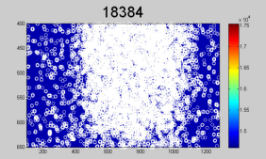
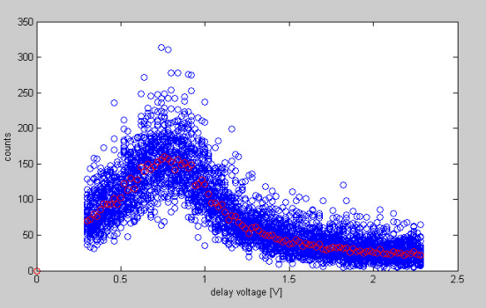
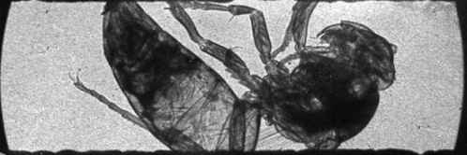
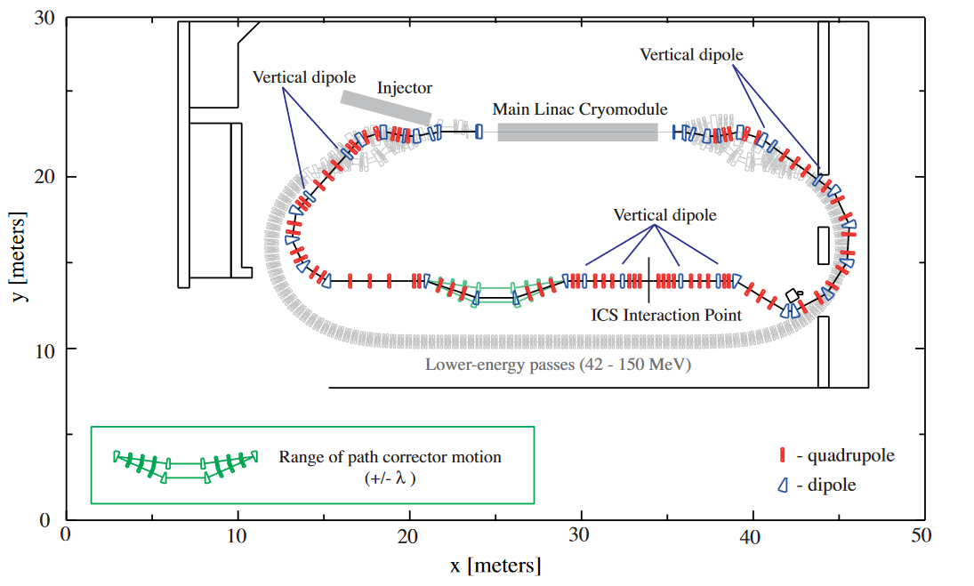
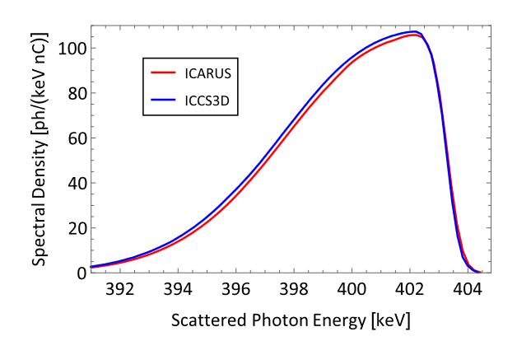
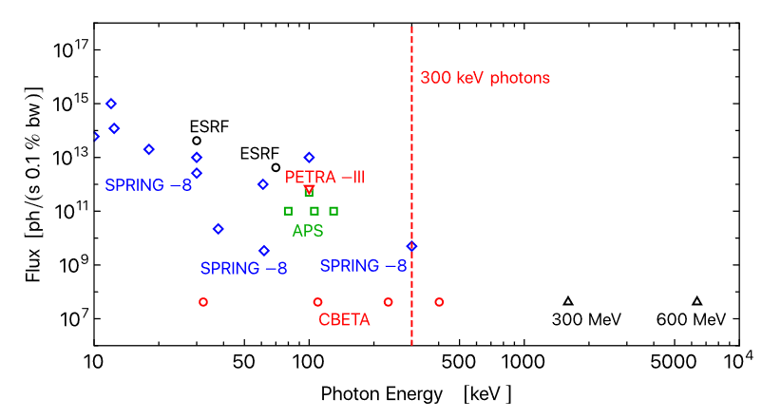
ERLs in Inverse Compton Scattering Sources – Where we are now
Test experiments carried out on Daresbury ALICE (2009) … & KEK cERL (2015)
Design for ICS source on CBETA ERL published last week https://doi.org/10.1103/PhysRevAccelBeams.24.050701
Flux and brilliance at largest SR sources (Spring-8, ESRF, APS, PETRA-III) fall off rapidly above 100 keV such that CBETA (much smaller machine!) outperforms them above 300 keV. The independence with energy implies a step change in capability for higher energies (black triangles show examples at 300 and 600 MeV electron beam energy)

Slide 13
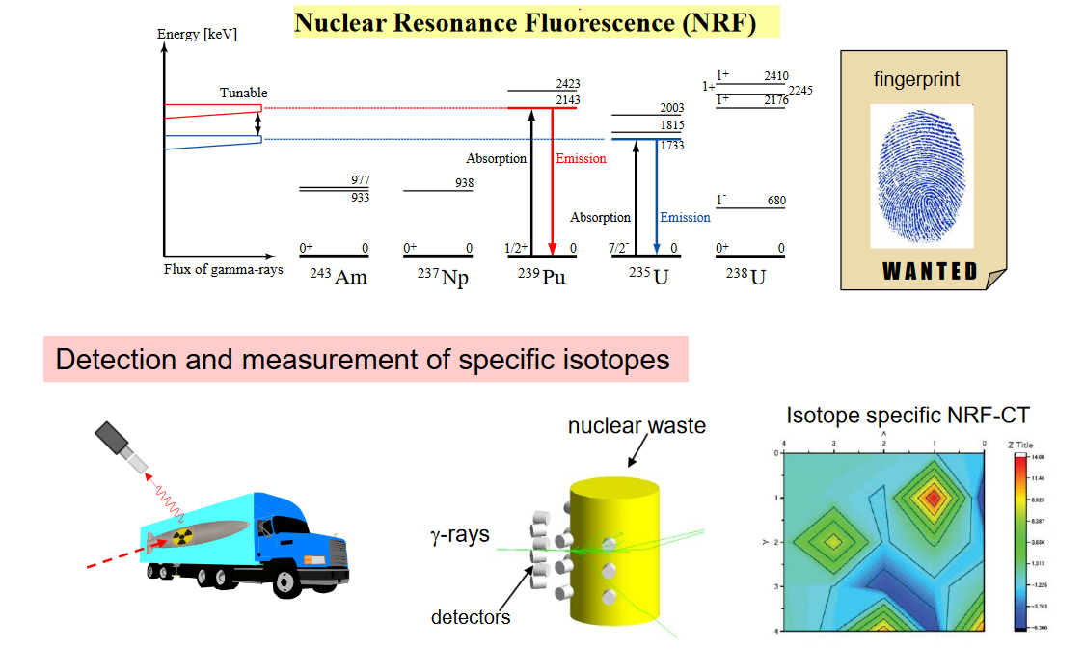



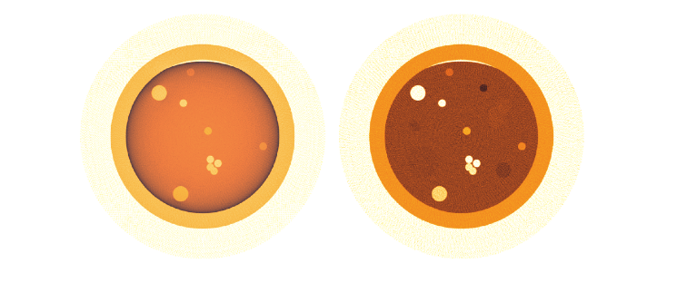
ERLs in Inverse Compton Scattering Sources – Where we are going
Next generation ERLs considering ICS sources: PERLE, UK-XFEL / DIANA, MESA
For photons in 1-3 MeV range: Nuclear Resonance Fluorescence (γ, γ’), pencil beam of ICS source ideal for Computed Tomography of: e.g. detection of clandestine nuclear materials, defects in fuel assemblies, assay of spent fuels, unknown legacy wastes (particular UK problem), …
AWE (UK body responsible for nuclear security) funding study applying ERL driven ICS source to displace brem sources in threat reduction
NNL (UK body responsible for nuclear power research), Sellafield and Dalton Institute approached to join study of applying ERL driven ICS source to nuclear decommissioning
Simulated nuclear fuel rod containing isotopic defects: image from 2 MeV Brem (left)
and 1733 keV ICS (right) shows superior differentiation

Slide 14
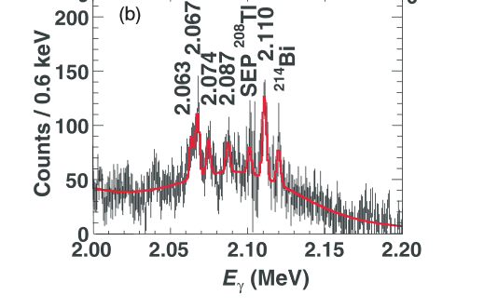
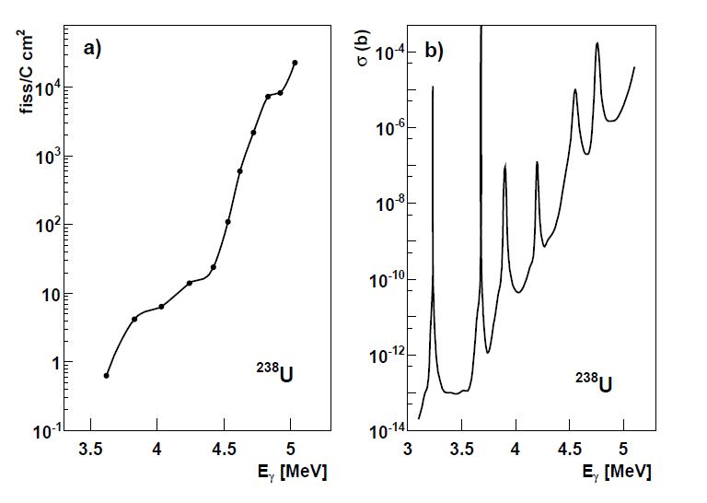
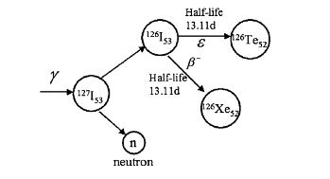
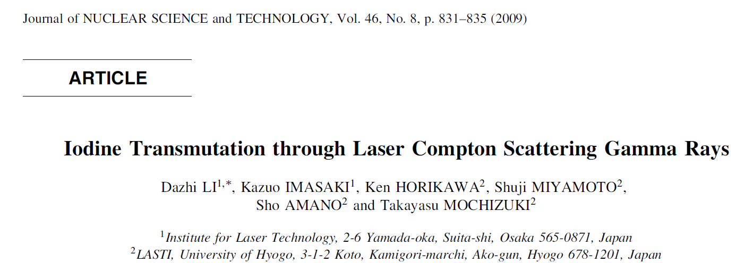
ERLs in Inverse Compton Scattering Sources – Where we are going
For photons in 3-100 MeV range: Transmutation / Photofission (γ,n), (γ,p), (γ,f). The observed broad “dipole resonances” of nuclear structure predicted to actually be composed of multiple sharp resonances, storage ring ICS starting to provide evidence.
Strong angular collimation and small emittance / energy spread from an ERL to minimise bandwidth to narrower than resonance separations: tune to particular resonance, thereby choosing the desired decay chain of a particular isotope – leading to the potential of selective isotopic transmutation at industrially relevant quantities without need for chemical partition
The dream is to reduce / change profile, (even eliminate) burden of long-lived actinides and fission products on future waste repositories, impact public acceptance of waste
Additional potential for industrial production of non-standard medical isotopes (i.e. not Te-99m) at high specific activity to enable new treatments
Study on HIγS:
“In addition to the nine previously reported transitions for U-235, 13 more were observed for the first time”
Predicted “hidden” resonances in photofission cross sections
Demonstration on NewSUBARU storage ring ICS (2009)
“Perspectives for photofission studies with highly brilliant, monochromatic γ-ray beams” P. G. Thirolf et. al., EPJ Web of Conferences 38, 08001 (2012)
Selective transmutation of I-127 using ICS (a stand-in stable isotope to prove the principal for problematic I-129 (half-life 16 million years, high chemical activity)

Slide 15
Conclusions
  ERLs promise a step change in the capabilities of electron accelerators by providing high quality linac-like beams with storage ring-like average powers
  In addition to the benefits for high energy physics there are exciting applications in other scientific fields, and promising industrial / societal applications
  In this talk I highlighted those enabled by ERL driven Free Electron Lasers and Inverse Compton Sources
  Thanks to the other members of the ERL panel, special contributions from Hiroshi Kawata, George Neil, Andrew Hutton, Kevin Jordan, Dave Douglas, Nikolay Vinokurov

