Slide 1
“Relative positioning - considerations
from optics and beam dynamics”
Masamitsu Aiba, Katsunobu Oide, Frank Zimmermann
FCC technologies meeting #3, 27 May 2021

Slide 2
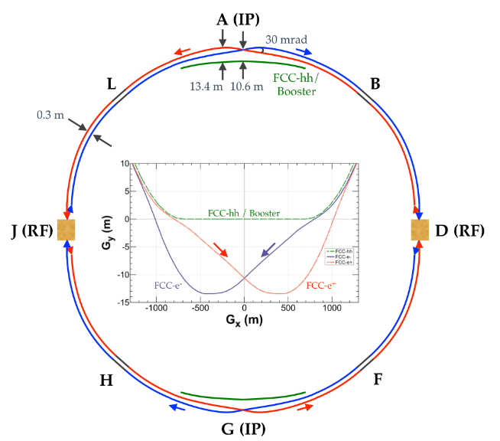
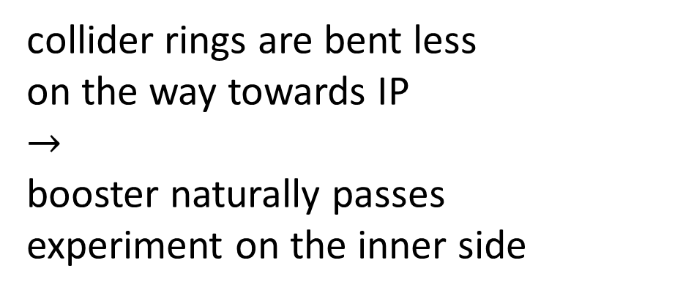
1. general consideration
collider rings are bent less
on the way towards IP
$$→$$
booster naturally passes
experiment on the inner side
in the arc:
booster would naturally be inside the collider (as in the CDR)
positioning above or underneath also possibly
outer side of collider would require several crossings – probably not an option
K. Oide et al., “Design of beam optics for the future circular collider e⁺e⁻ collider rings,”
Phys. Rev. Accel. Beams 19, 11100 (2016)

Slide 3
2. extraction from booster & injection into the collider
injection will be horizontally or longitudinally
(physically also in the horizontal plane)
beam jitter at injection of up to 1σ_{x} acceptable
vertical injection has been discarded (too tight tolerances)
M. Aiba et al, “Top-up injection schemes for future circular lepton collider” NIM A 880 (2018) 98-106
M. Aiba

Slide 4
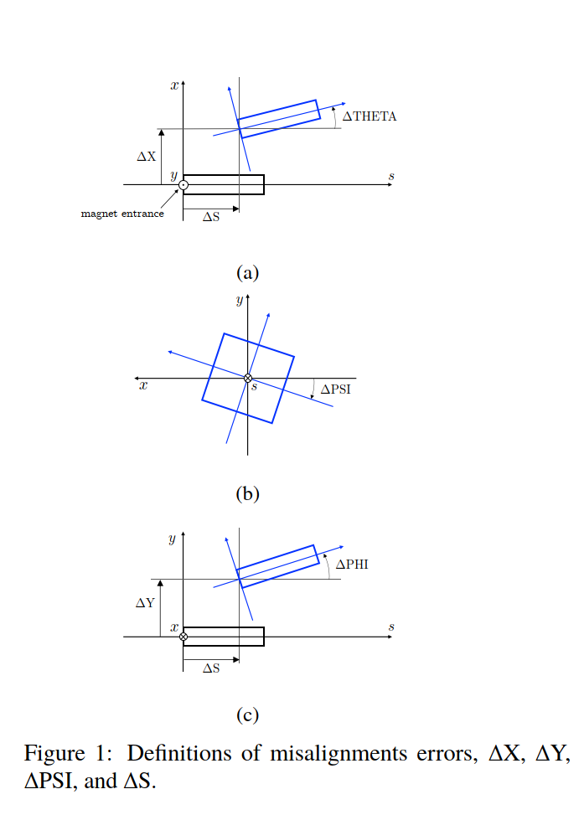
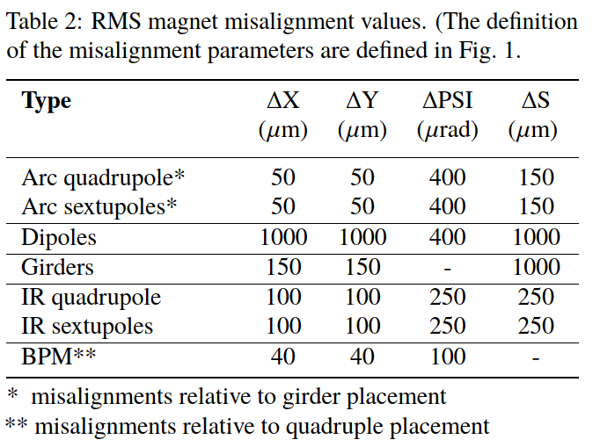
3. alignment tolerances - collider
alignment for booster more relaxed, factor 1.5 or 2
T.K. Charles et al., “Update on the Low Emittance Tuning
Of the e+/e- Future Circular Collider,” IPAC’21 (this week)

Slide 5
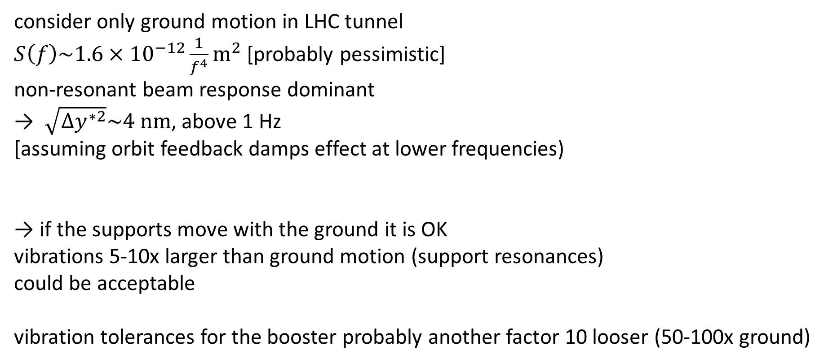
4. vibration tolerances
K. Oide, FCC-ee optics meeting (next week)
consider only ground motion in LHC tunnel
$S\left(f\right)\sim 1.6×{10}^{−12}\frac{1}{f^{4}}{\text{m}}^{2}$ [probably pessimistic]
non-resonant beam response dominant
→ $\sqrt{{Δy}^{∗2}}\sim 4 \text{nm}$, above 1 Hz
[assuming orbit feedback damps effect at lower frequencies)
→ if the supports move with the ground it is OK
vibrations 5-10x larger than ground motion (support resonances)
could be acceptable
vibration tolerances for the booster probably another factor 10 looser (50-100x ground)

Slide 6
5. beam loss measurements
discussions with Manfred Wendt
and with the “BLM gurus”
Belen Maria Salvachua Ferrando, Kay Wittenburg, Christos Zamantzas, Gero Kube
“…at the LHC [it] is already difficult to disentangle the beam loss from B1 and B2, for example, in places close to the collimators the particle showers are so mixed… but in these cases having the beam pipes one on top of each other would not improve it. What we do is to check many consecutive BLM devices to understand the direction of the shower.”
configuration 1
e±
e⁻
e⁺
configuration 2
e⁻
e⁺
e±

Slide 7
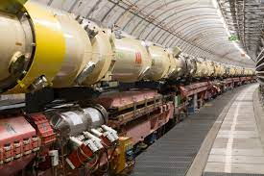
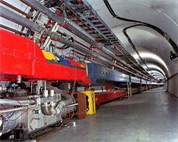
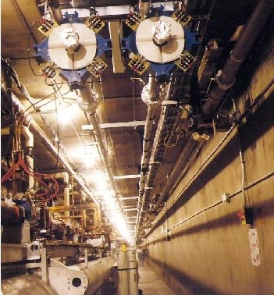
6. AOB
a few examples of beam lines in the same tunnel
HERA-p
HERA-e
Main Ring
PEP-II
injection
lines
e+
Tevatron
e-
SLAC linac

