Slide 1









Position of main and booster rings in FCC-ee cross section
(as introduction)
V. Mertens
FCC-ee R&D and Technology Meeting, 27.5.2021
LHC
FCC
PS
SPS
http://cern.ch/fcc
Work supported by the European Commission under the HORIZON 2020 projects EuroCirCol, grant agreement 654305; EASITrain, grant agreement no. 764879; ARIES, grant agreement 730871, FCCIS, grant agreement 951754, and E-JADE, contract no. 645479
Photo: J. Wenninger

Slide 2

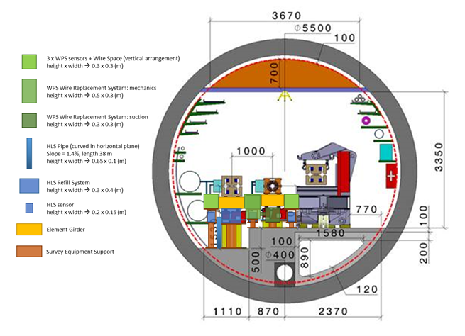
FCC-ee baseline cross section in regular arc
Elements and space reservations
Main drawback:
little (to no) space to access to left of main ring and in between main and booster ring during installation, maintenance etc. for pipe connection, cable connection, alignment, ...; need to climb over or crawl under magnets.
Still missing here 2nd cooling circuit (Cu/Al)
All graphs: F. Valchkova-Georgieva

Slide 3
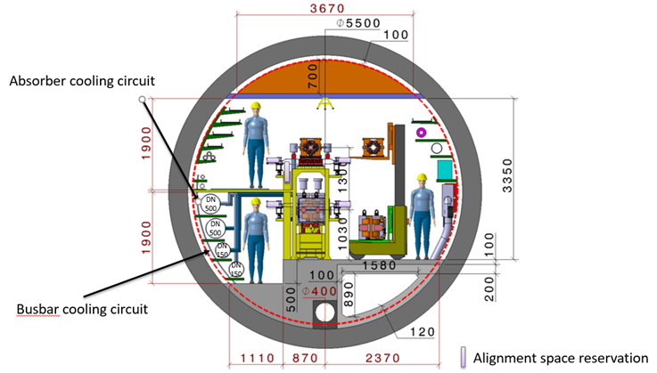
FCC-ee alternative cross section in regular arc
Main (potential) drawbacks:
Additional metallic structures
Stability of booster ring (?)
Deformations (?)
Magnet replacement
Other SR pattern (+ or - ?)

Slide 4
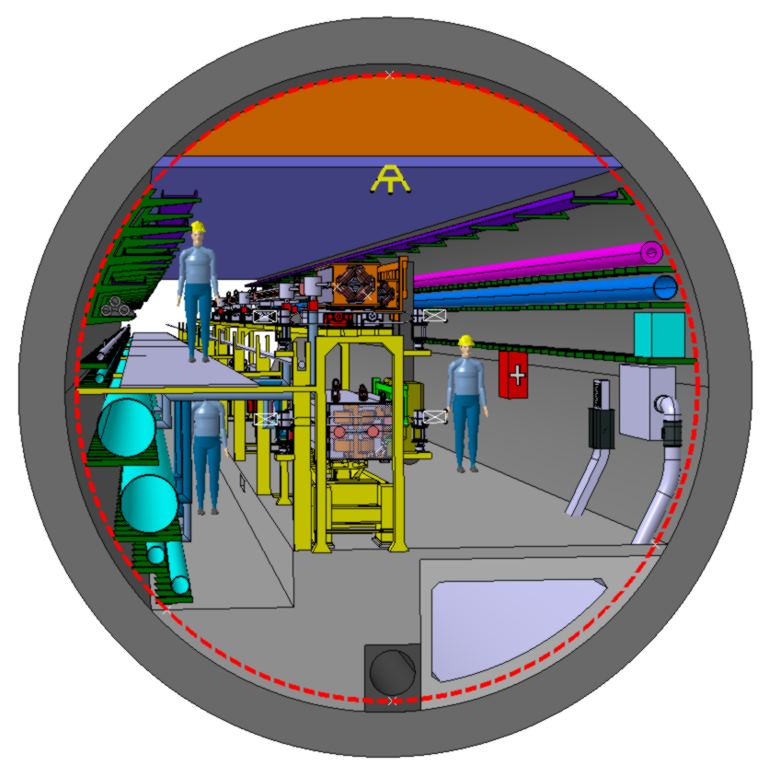
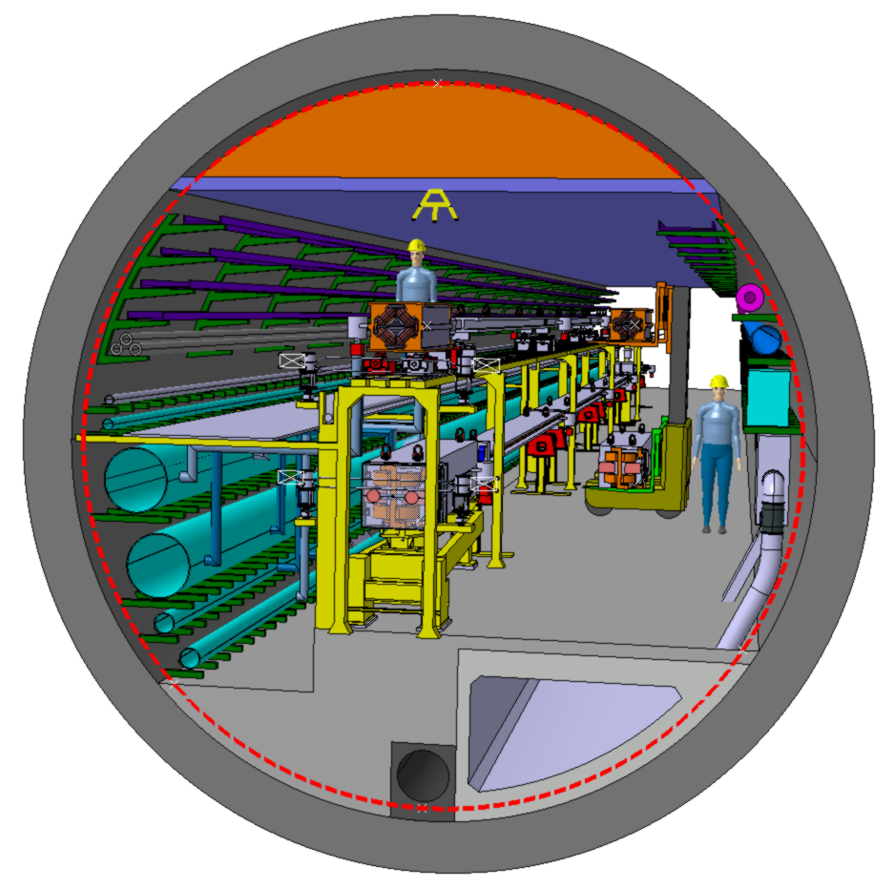
FCC-ee alternative cross section in regular arc

Slide 5
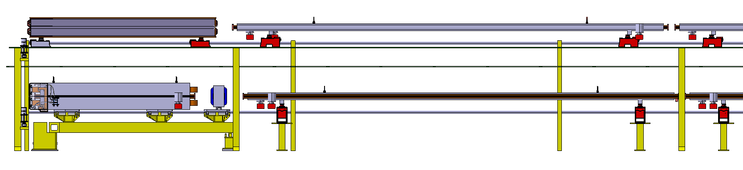
Aspects of longitudinal integration

Slide 6
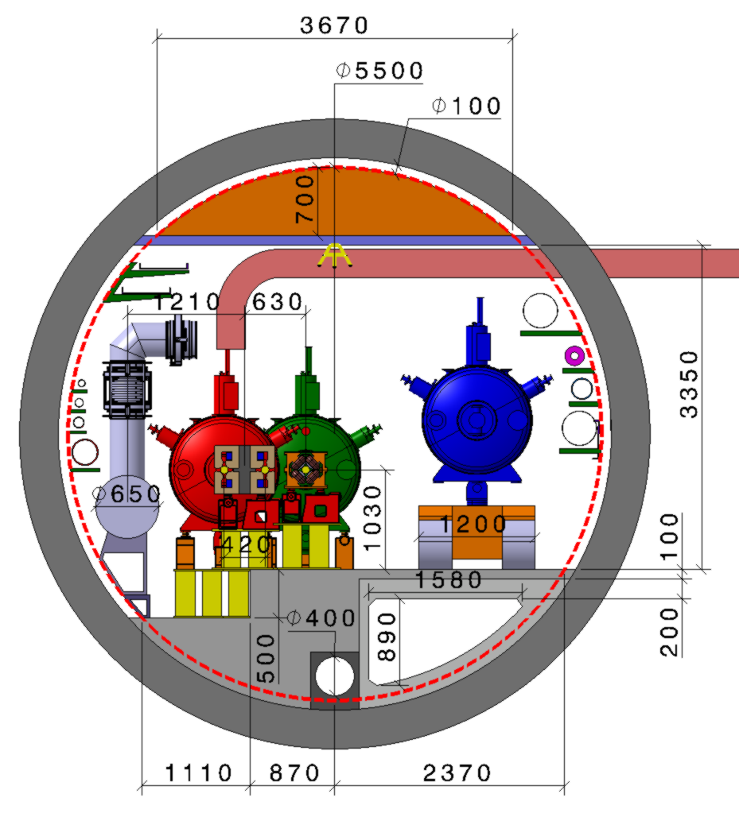
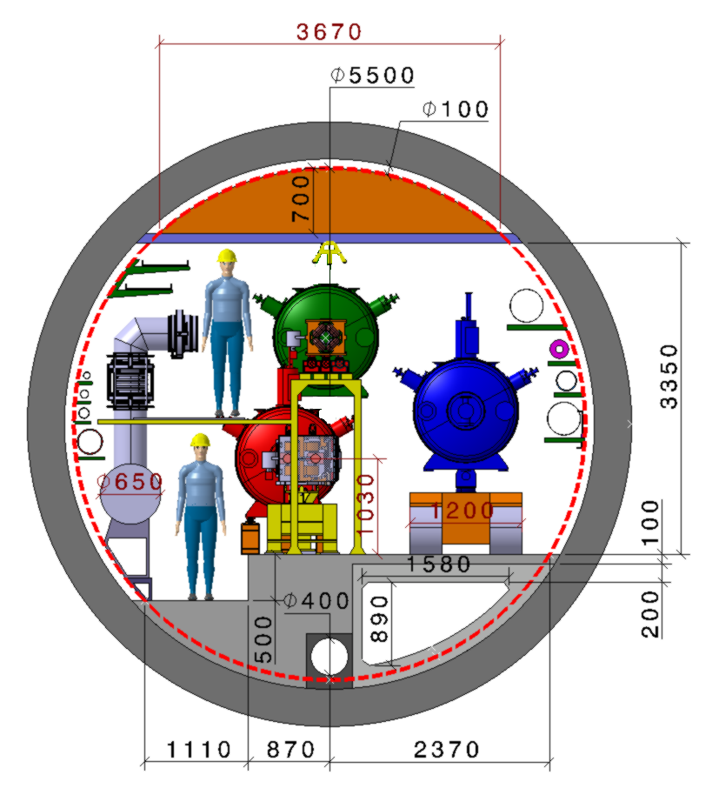
FCC-ee alternative cross section in RF section
Bulky cryostats
Design in that area not worked out to greater detail, pending further considerations and evolving equipment de-sign
Maybe interesting:
A possible FCC layout with 8 access points (as currently discussed) may require to stack the transfer lines on top of the FCC-hh over several kilometres, until the beam reaches the next straight injection section.

Slide 7

THANK YOU FOR YOUR ATTENTION !

