Slide 1

Integration of FCC-ee main and booster rings
F. Valchkova-Georgieva
FCC-ee R&D and Technology Meeting, 27.5.2021

Slide 2
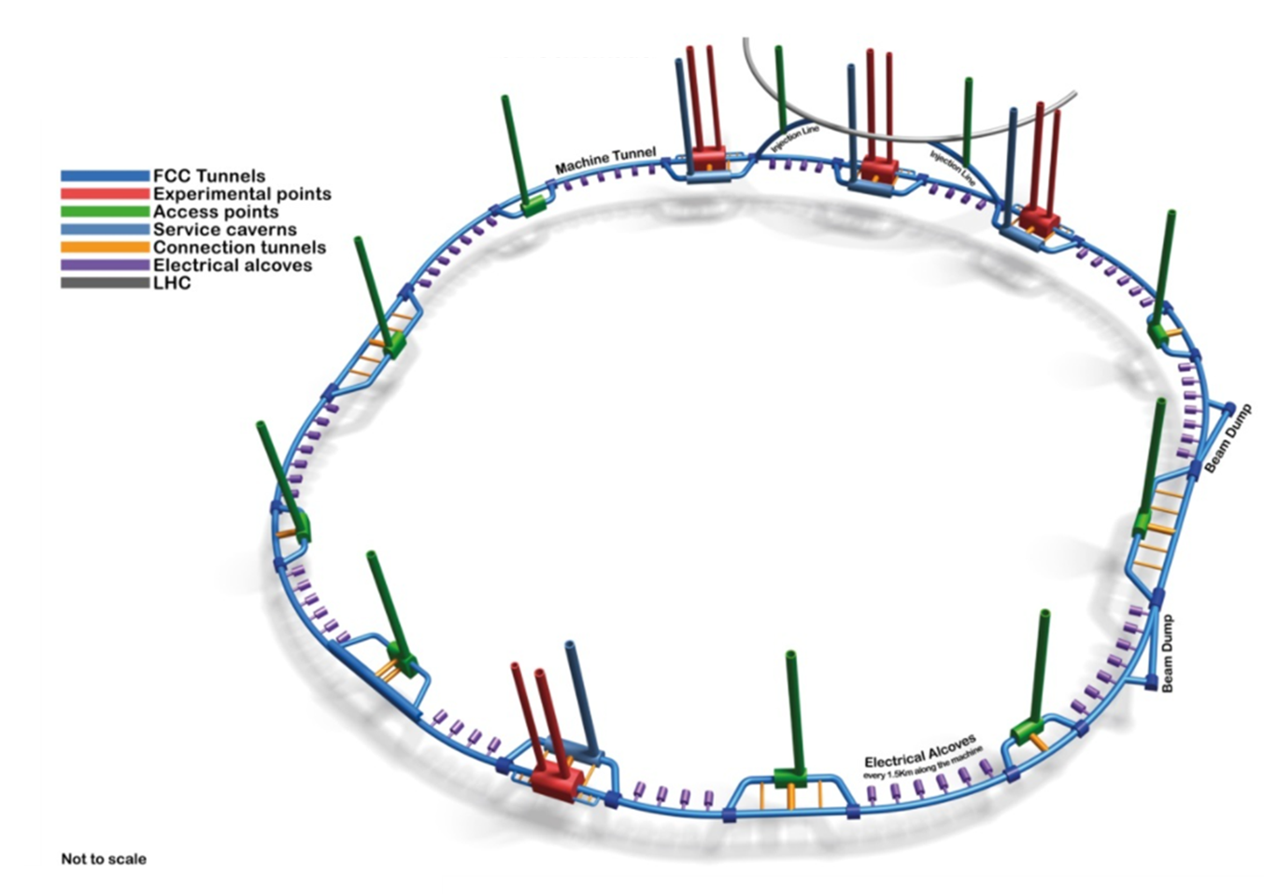
Future Circular Collider (FCC) - 3D Schematic
Collider Centre
Courtesy SMB-SE

Slide 3
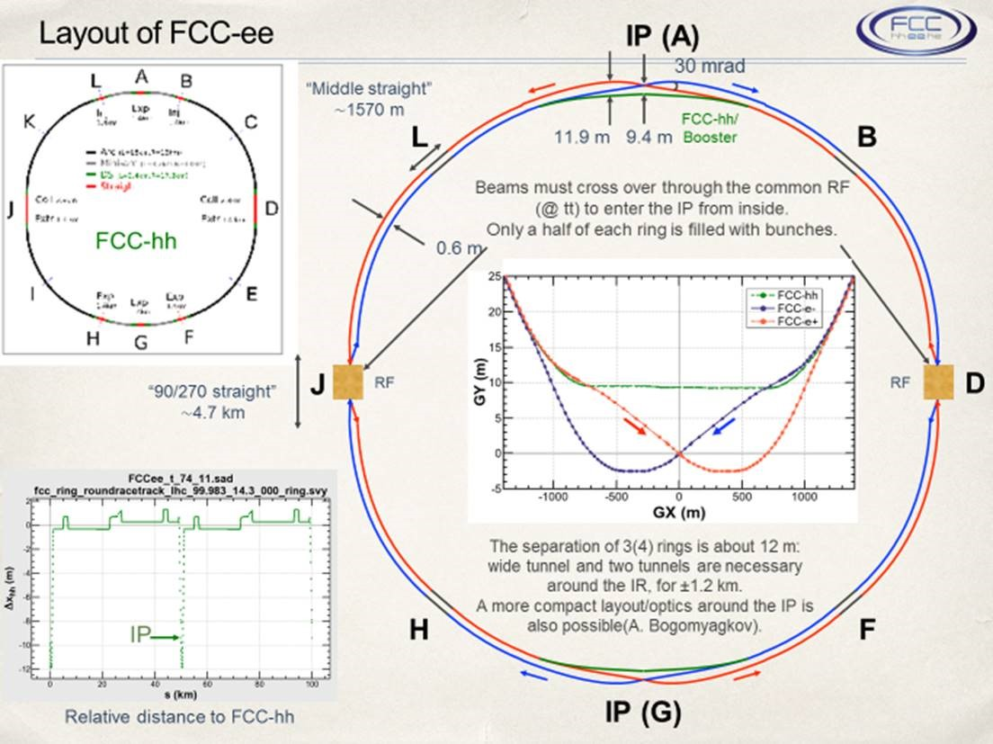
FCC - ee main and booster rings layout
Collider Centre
Courtesy K. Oide

Slide 4
Integration of FCC-ee machine elements at point A

Slide 5
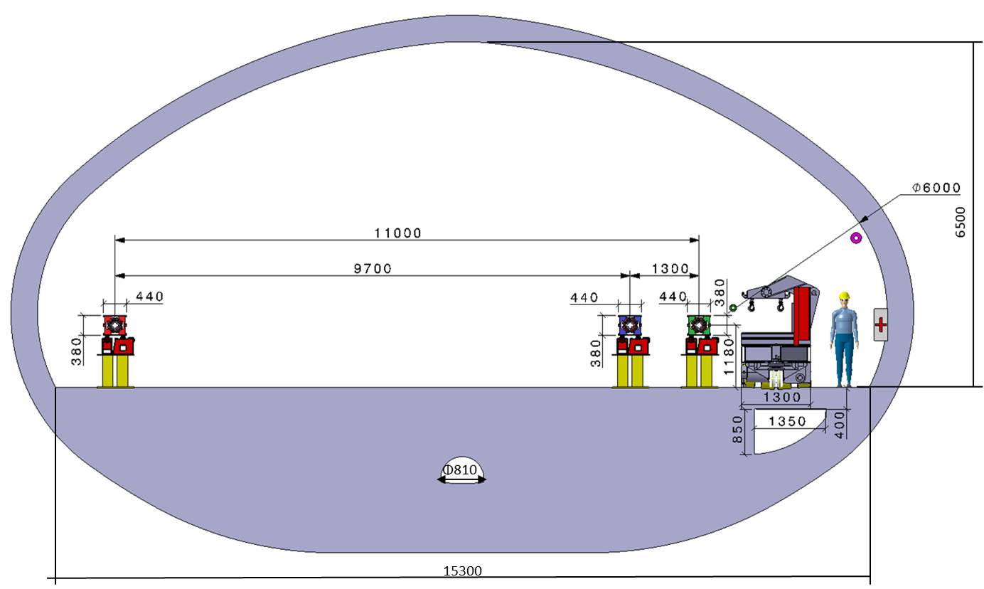
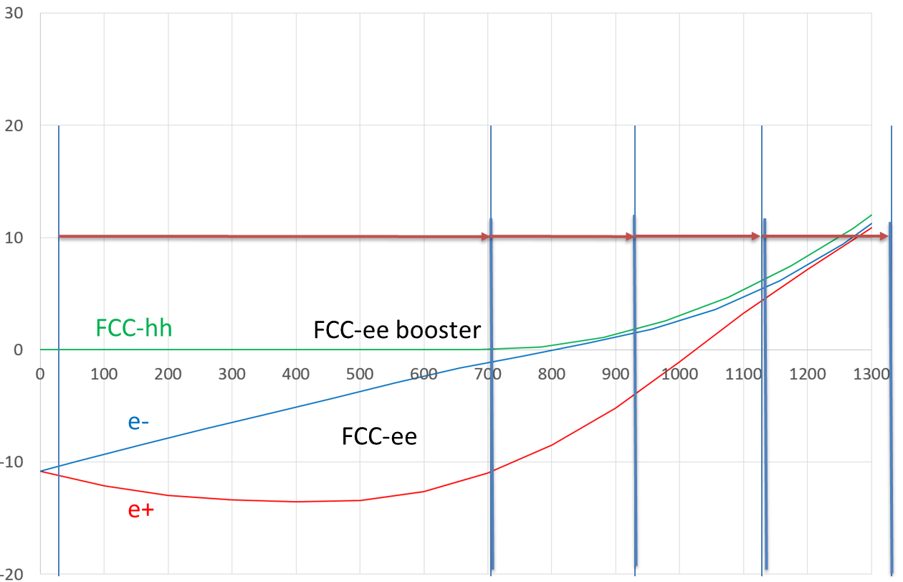
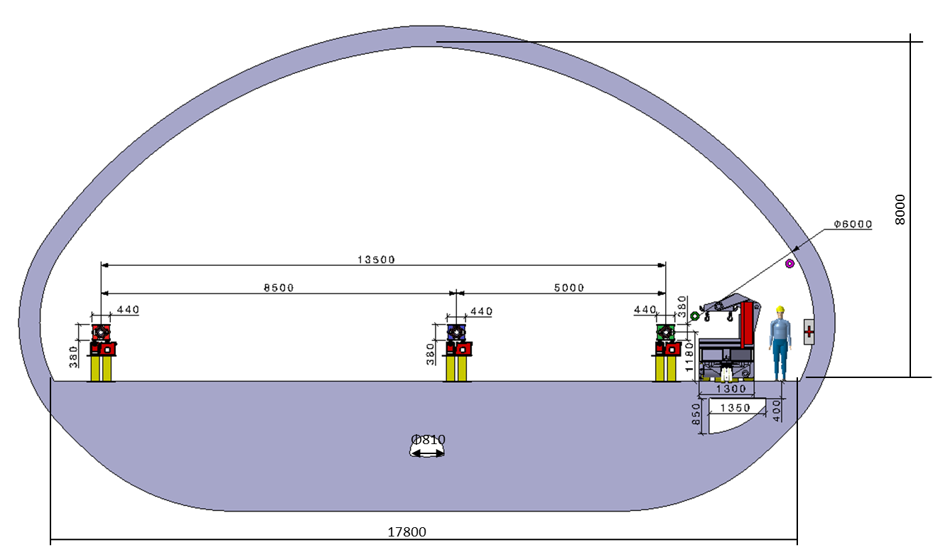
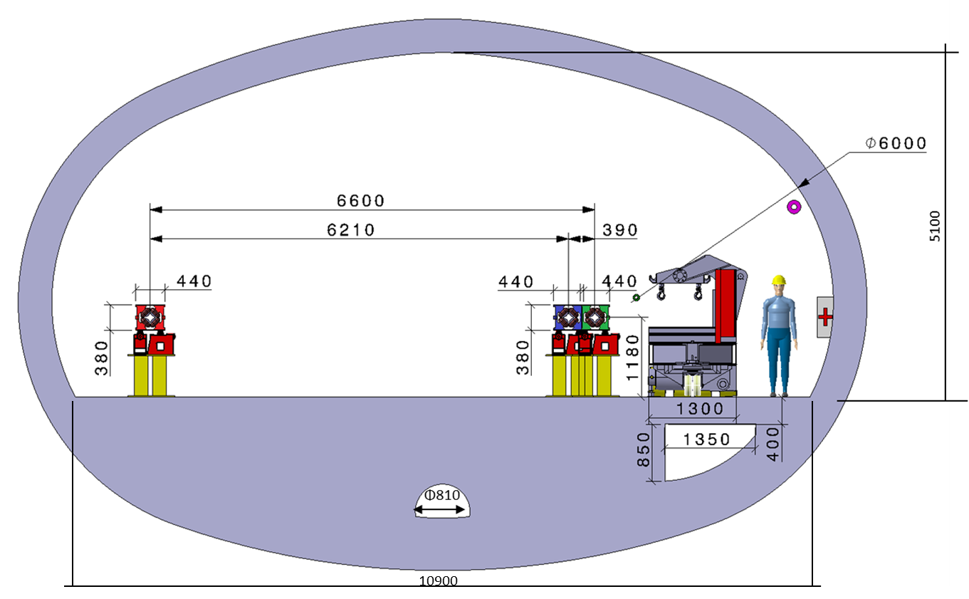
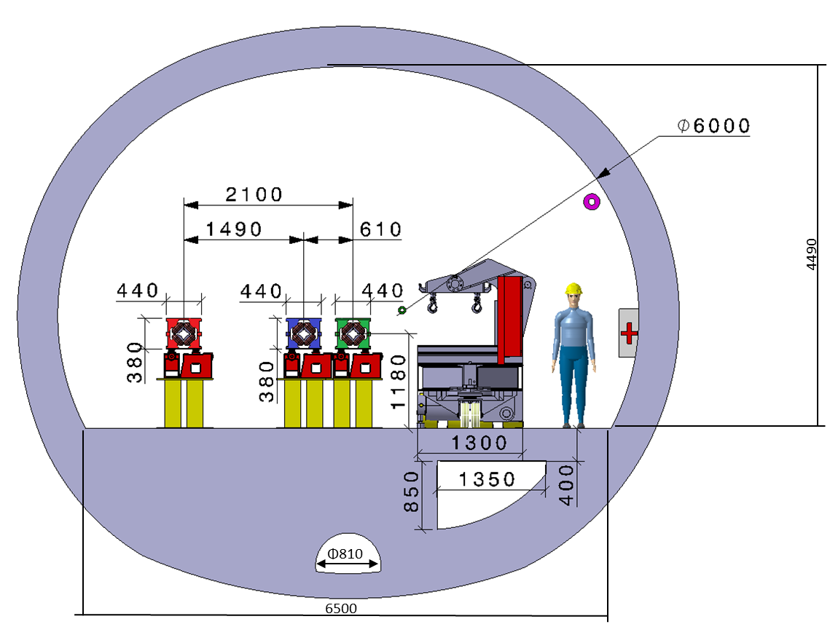
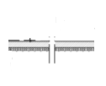
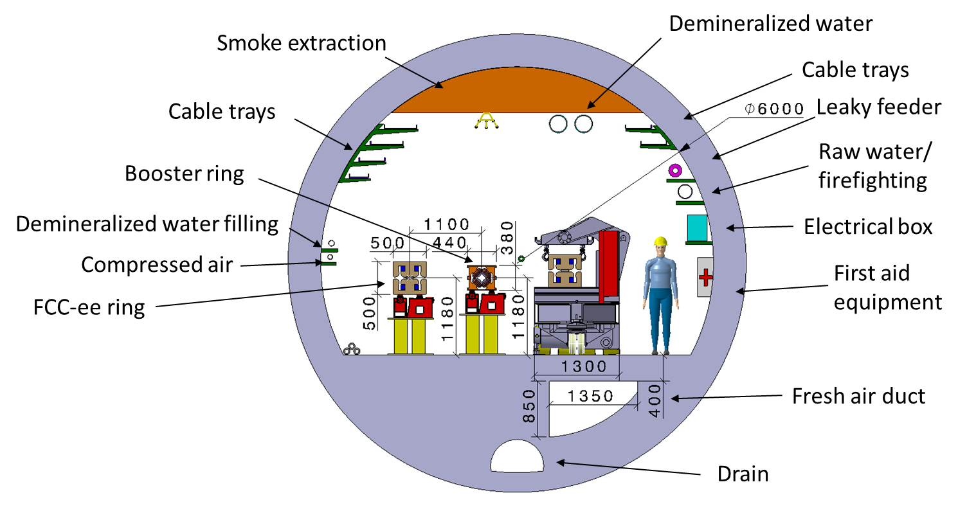

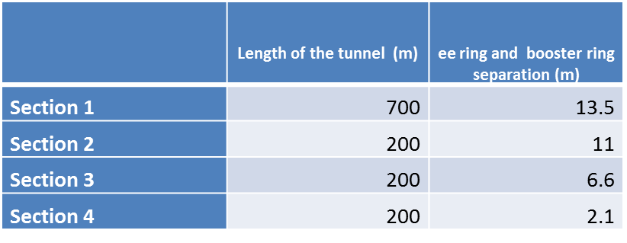
FCC-ee enlargement
Collider Centre
4500
6500
5100
[m]
6500
10900
Cross sec 4
Experiment Cavern
8000
15300
Cross sec 3
Cross sec 2
17800
Cross sec 1
Regular arc
Section 1
700 m
Section 2
200 m
Section 3
200 m
Section 4
200 m
arc
interaction point
Data: K. Oide (FCC-ee), A. Langner (FCC-hh = FCC-ee booster); enlargement steps: M. J. Stuart

Slide 6
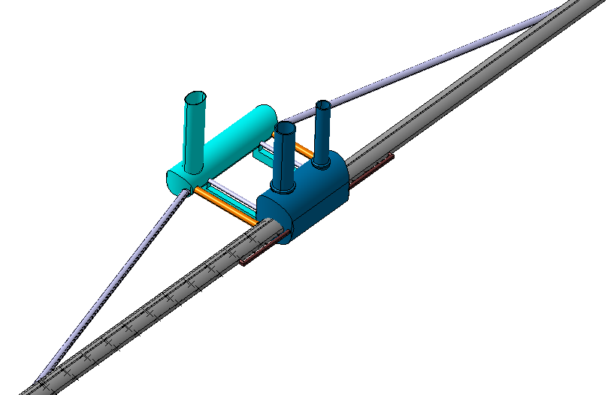
FCC-ee Underground Structure at Point A
Collider Centre
Transport Tunnel
Service Cavern
Machine Tunnel
Connection Tunnel
Transport Tunnel
Survey Gallery
Experiment Cavern
Survey Gallery
Machine Tunnel

Slide 7
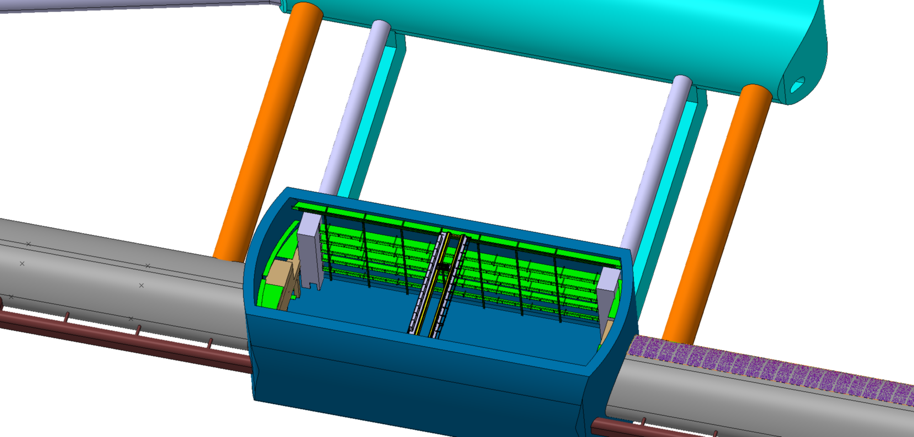
FCC-ee Experiment Cavern at Point A
EL Gallery
Safe Passage
Safe Area

Slide 8
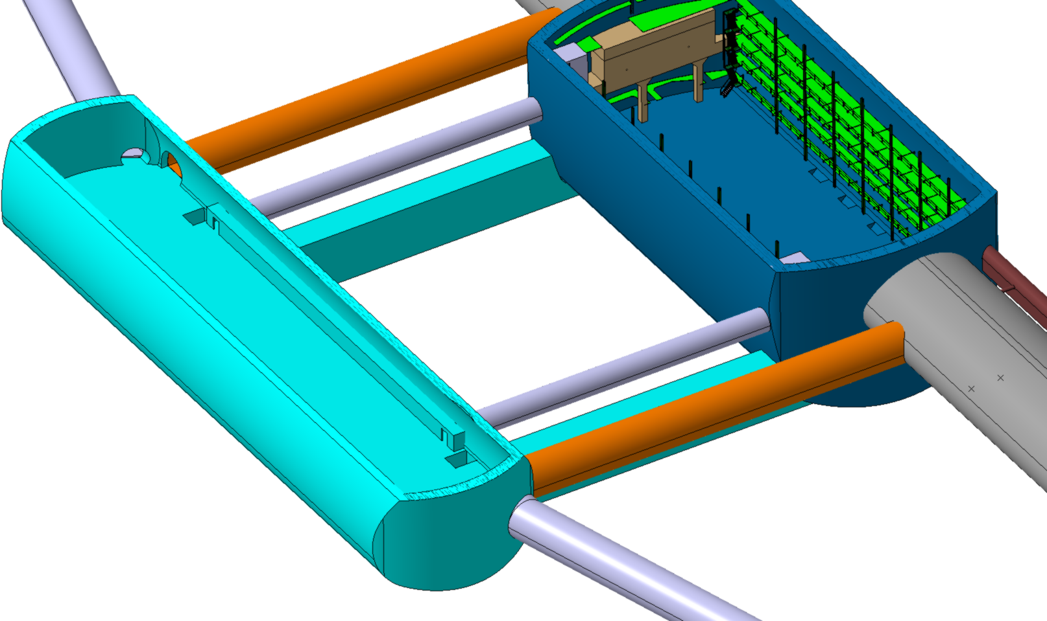

FCC-ee Service Cavern at Point A
Safe Area

Slide 9
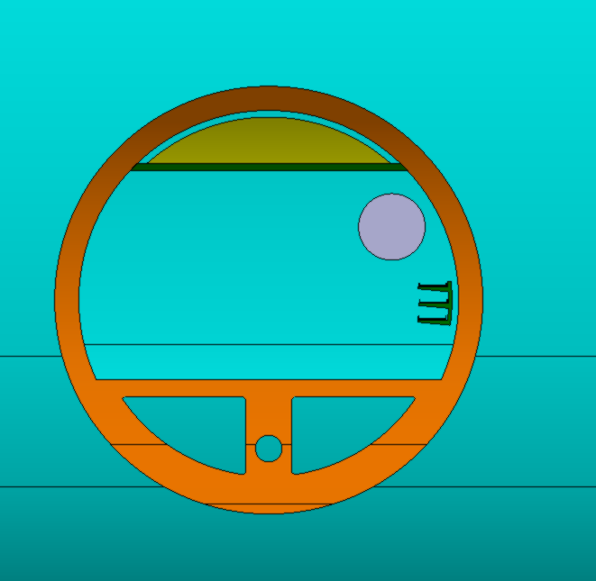
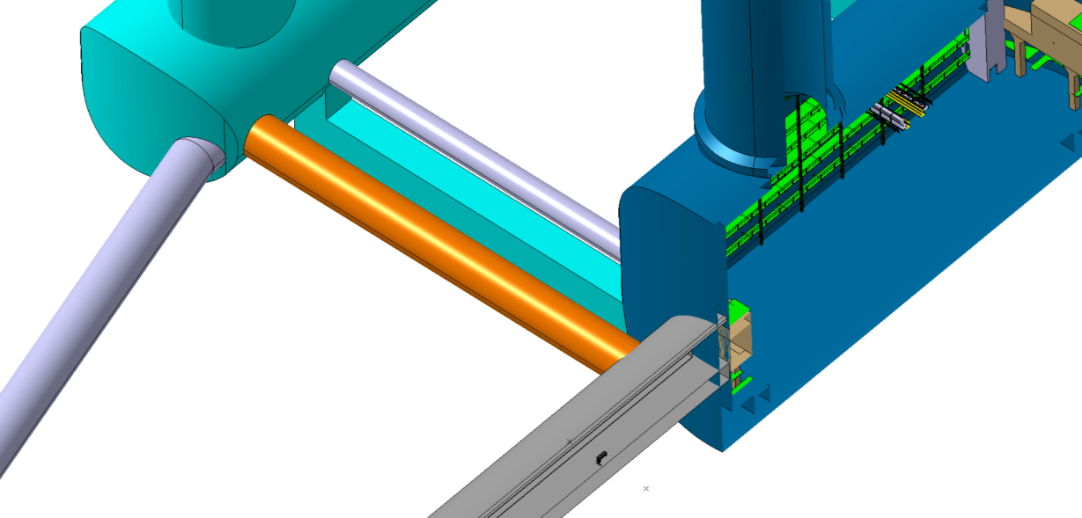
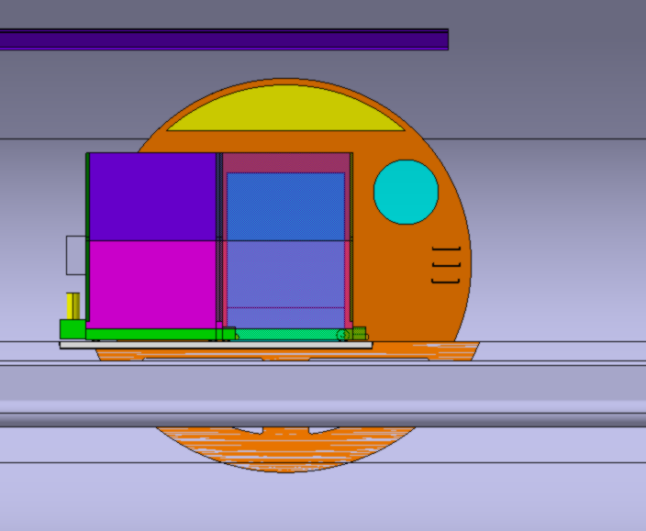
FCC-ee/hh Connection Tunnel at Point A
Smoke/He extraction
Tunnel Ø5500
QRL Ø1000
Cable trays
Ventilation machine area supply
Ventilation machine area extraction
Drain
Ø300
Mobile Wall

Slide 10
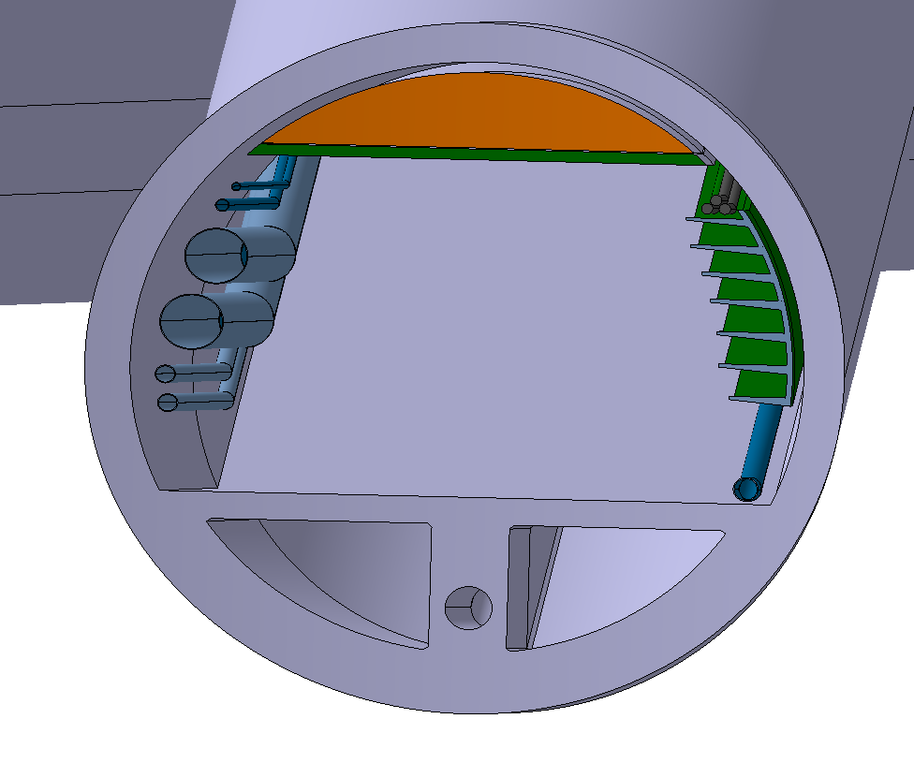
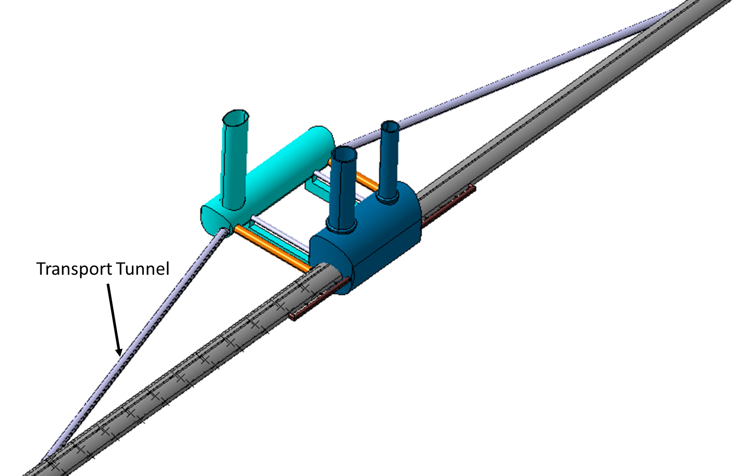
FCC-ee Transport Tunnel at point A
Smoke/He extraction
Transport Tunnel Ø 5.5m
Water filling DN65
Compressed air DN80
Electrical HV power transmission
Cable trays
Absorber cooling circuit
DN500
Busbar cooling circuit
DN250
Firefighting DN200
Ventilation machine area extraction
Ventilation machine area supply
Drain
Ø300

Slide 11
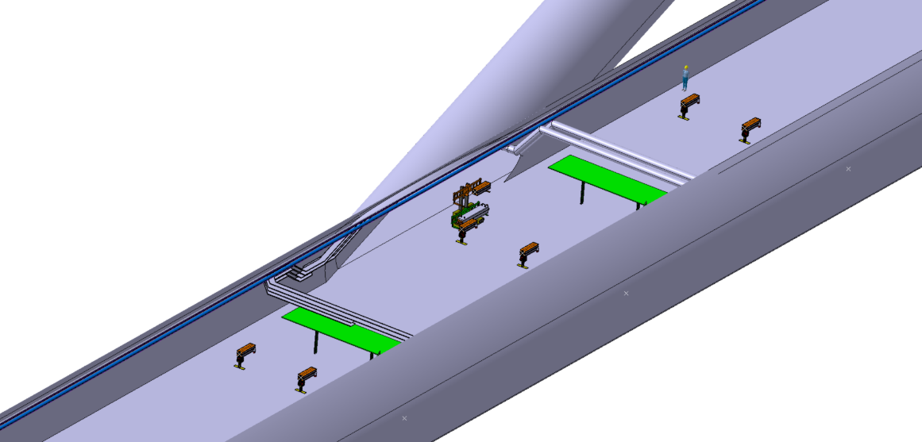
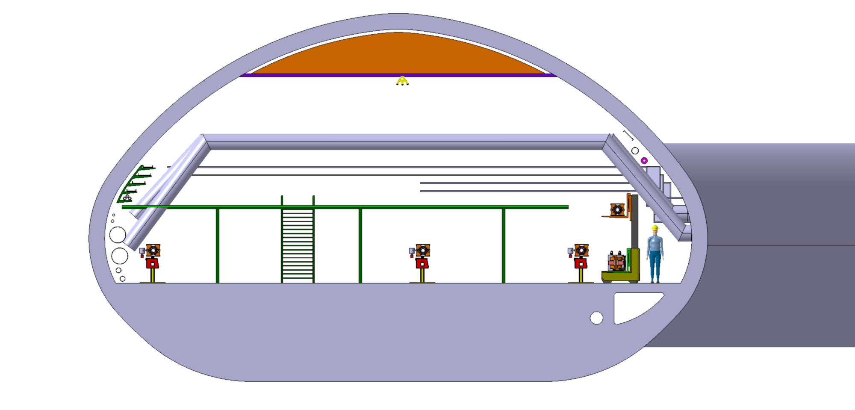
FCC-ee Machine Tunnel Section 1 at Point A
Collider Centre
1700
ee+ ring
2300
ee- ring
booster ring
Collider Centre
Collider Centre
1200
8500
5000
3100
17800

Slide 12
Integration of FCC-ee machine elements in SSS (Short Straight Section)

Slide 13
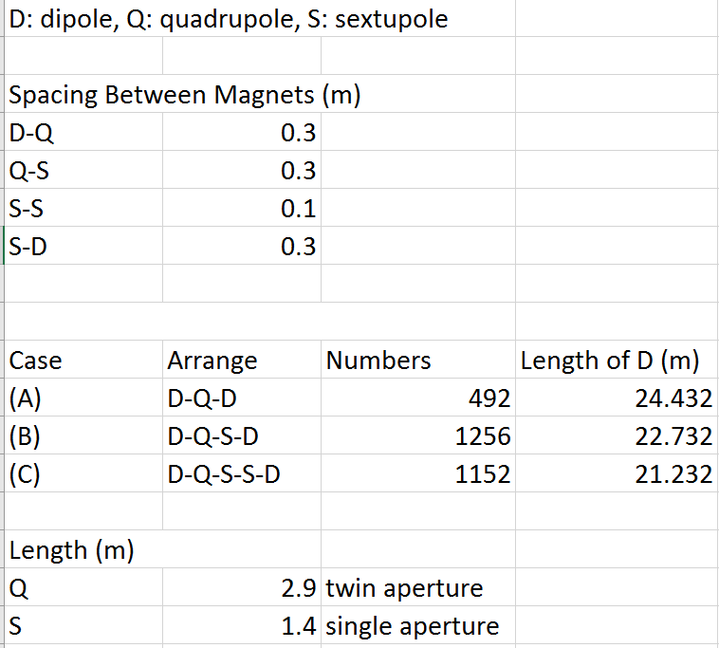
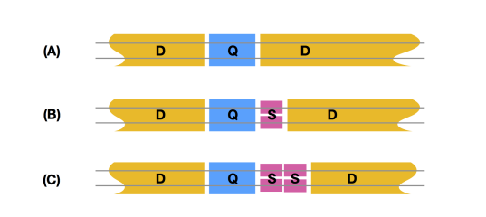
Integration of FCC-ee machine elements
FCC-ee main ring
Table provided by Katsunobu Oide on 24.7.2018

Slide 14
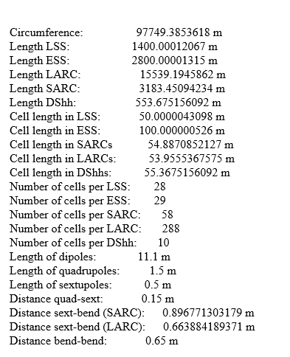
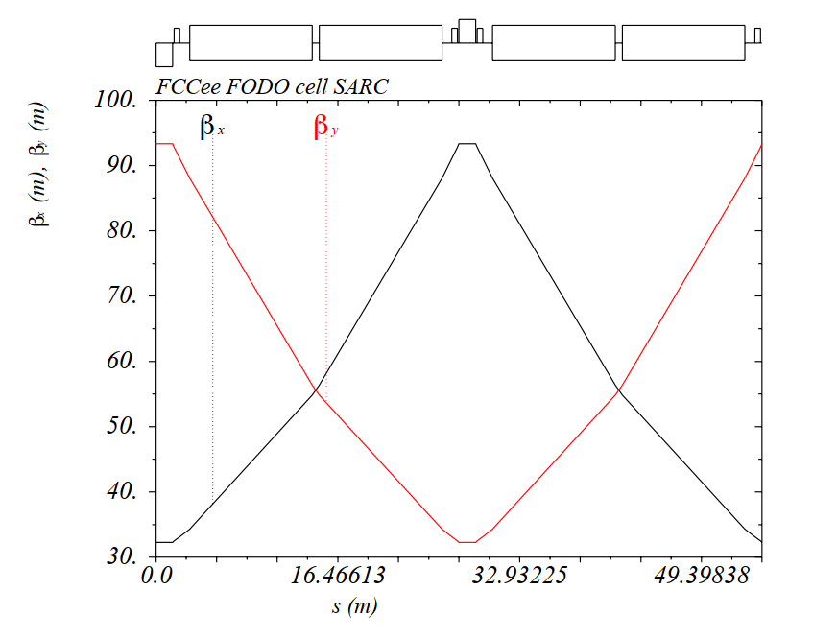
Integration of FCC-ee machine elements
FCC-ee booster ring
Data and diagram provided by Bastian Harer on 27.7.2018

Slide 15
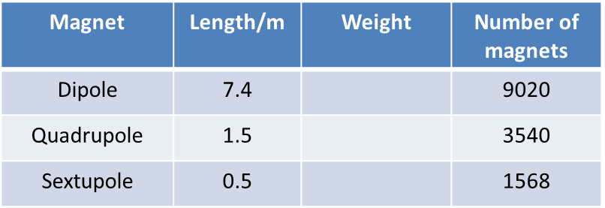
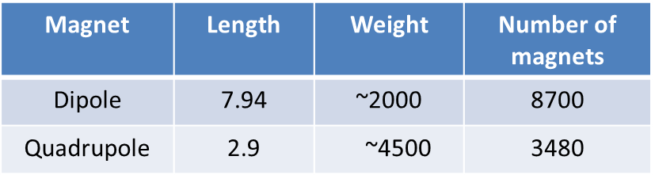
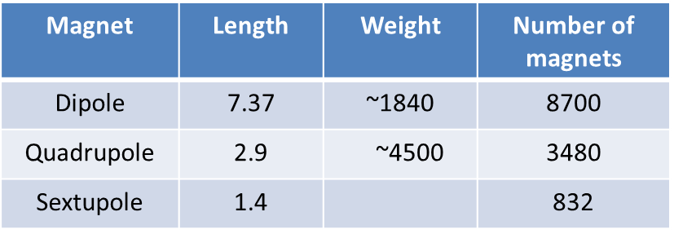
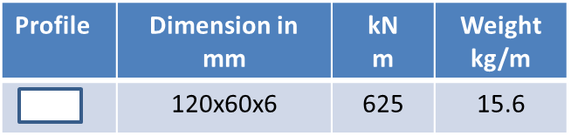
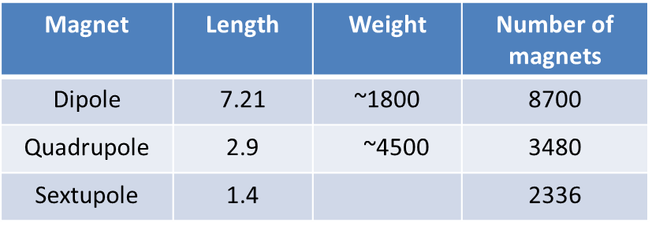
Integration of FCC-ee machine elements
Main ring magnet information
(if half-cell length reserved for a single – long – dipole
is distributed over 3 – shorter – dipoles):
Booster magnet information
(if half-cell length reserved for 2 dipoles
is distributed over 3 dipoles):
Case A:
Case B:
Metallic structure:
Case C :

Slide 16
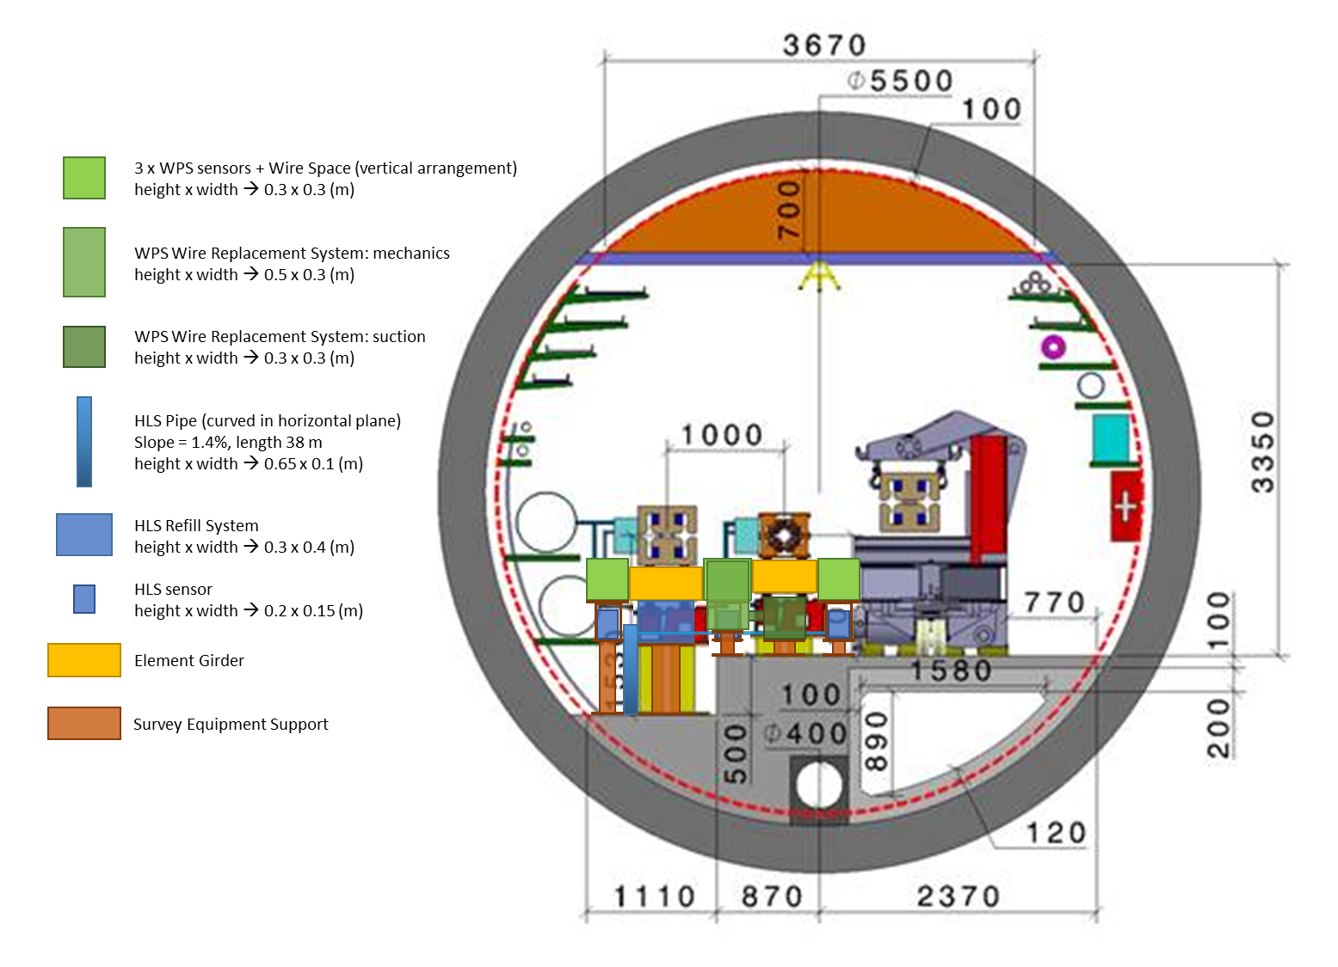
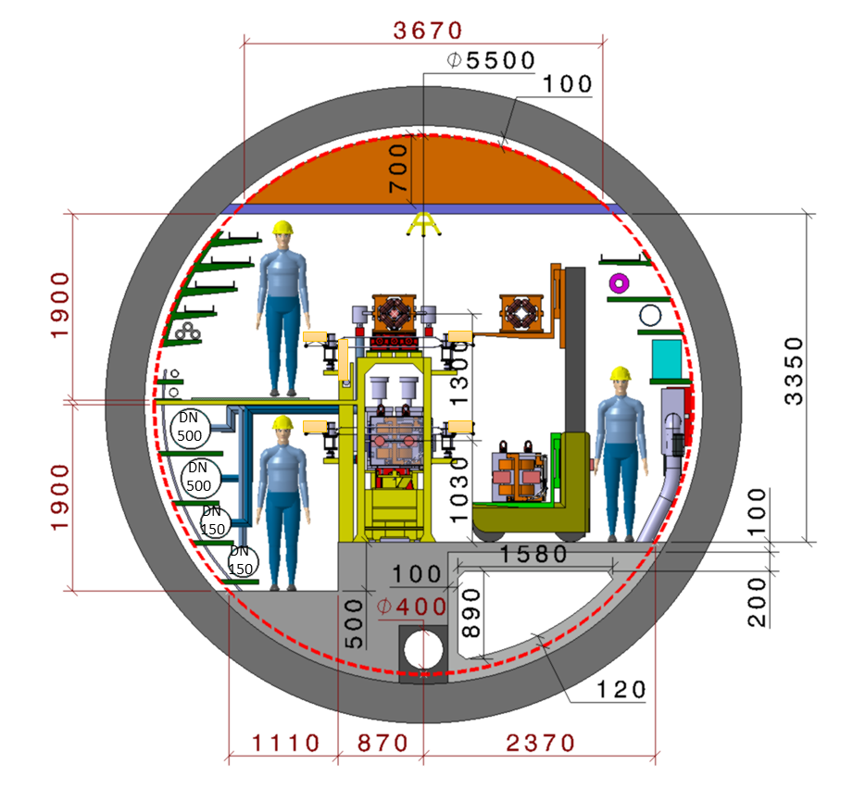
Integration of FCC-ee machine elements in SSS
Layout cross section:
Alternative cross section
Space reservations for Survey elements
Collider Centre
Absorber cooling circuit
ee+ ring
ee- ring
booster ring
Busbar cooling circuit
Alignment space reservation

Slide 17
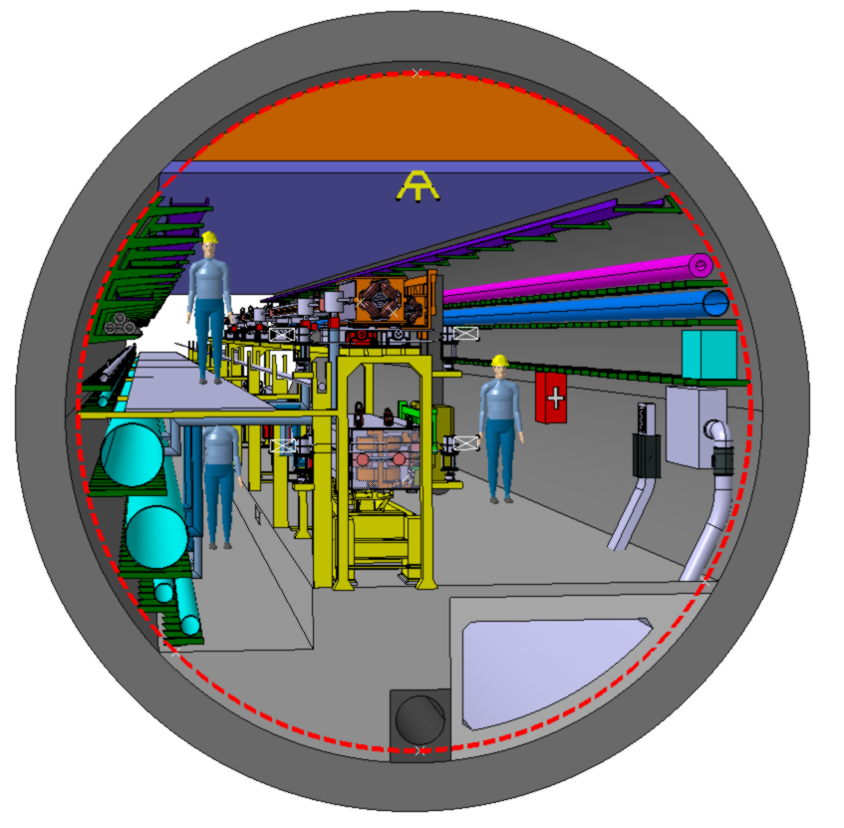
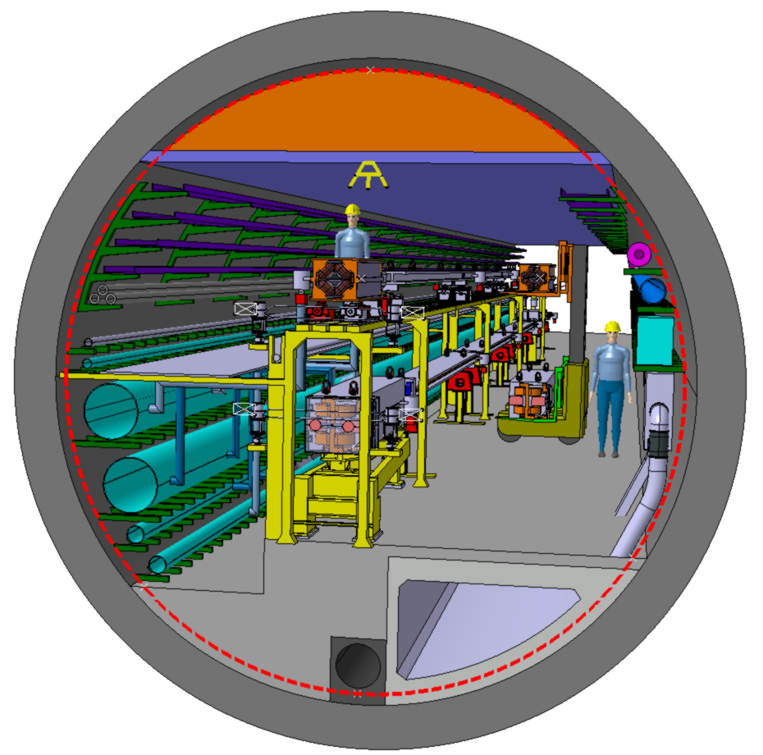
Alternative integration of FCC-ee machine elements
Isometric view

Slide 18
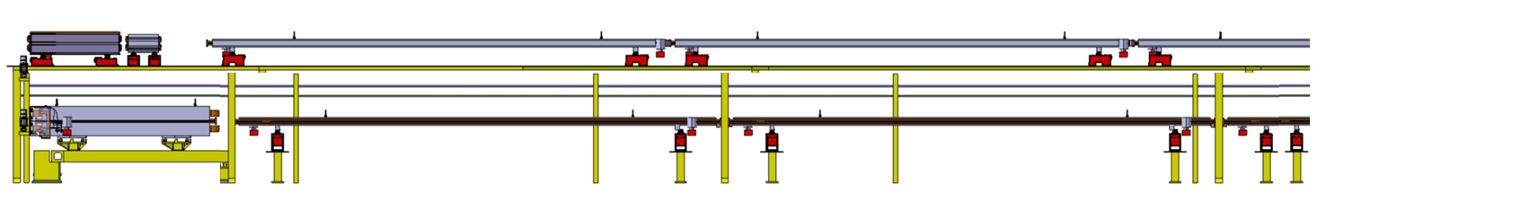
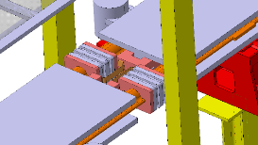
Integration of FCC-ee machine elements
“Case A”: main ring SSS without sextupole; followed by 24.432 m for dipole(s)
Side view
0.15 m
0.89 m
0.32 m
0.32 m
1.5 m
0.5 m
7.4 m
7.4 m
2.9 m
7.94 m
7.94 m
0.3 m
0.3 m
0.3 m

Slide 19
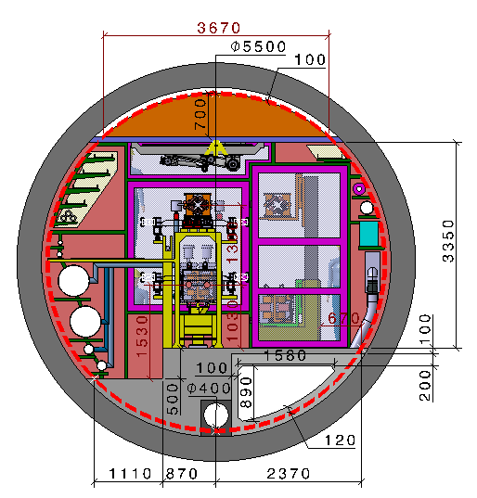
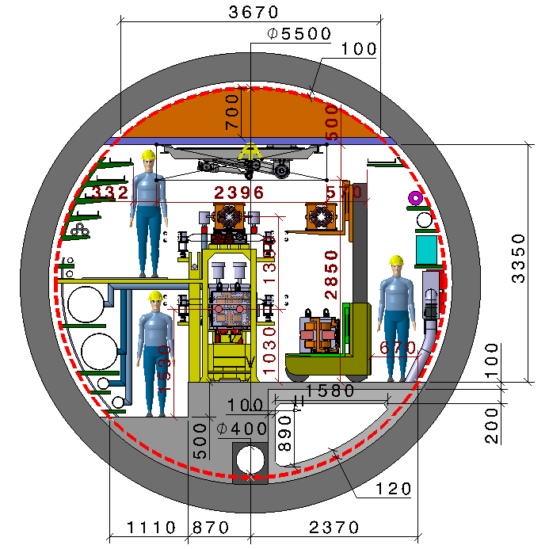
Robot in FCC-ee Regular tunnel
Collider Centre
Robot position in the middle of the tunnel

Slide 20
Integration of FCC-ee RF machine elements at point D

Slide 21
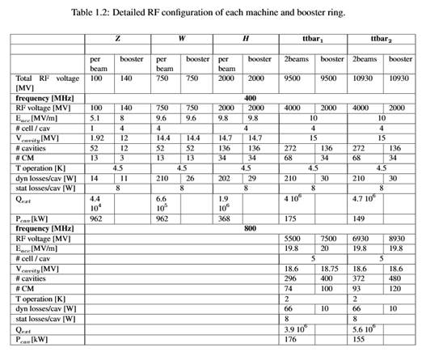

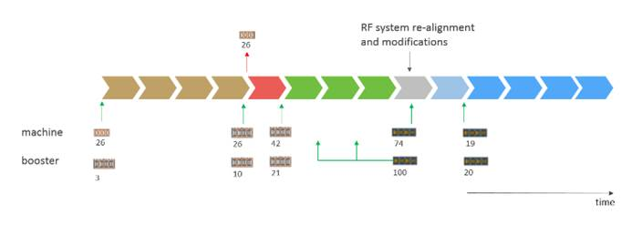

RF layout and installation/modification works
Courtesy O. Brunner
400 MHz
800 MHz

Slide 22
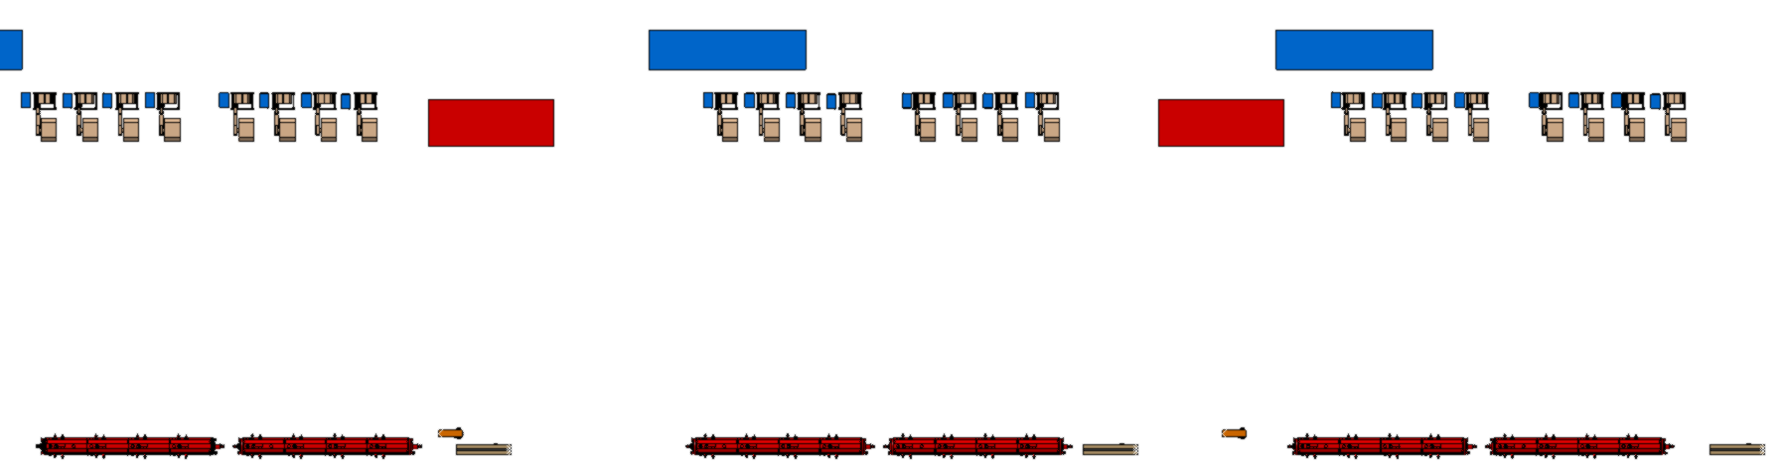
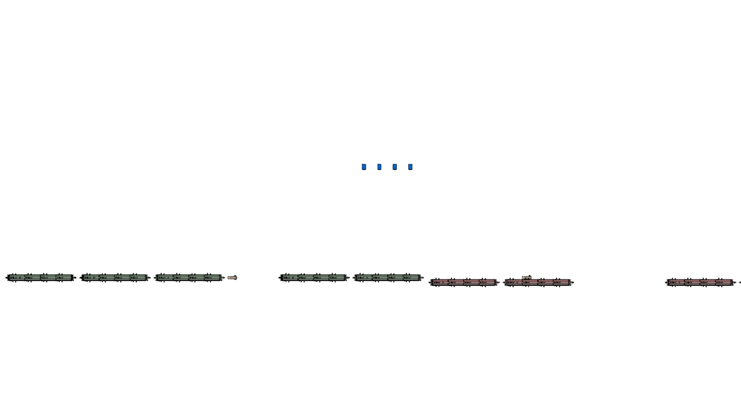
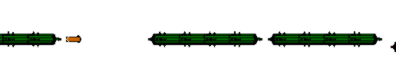
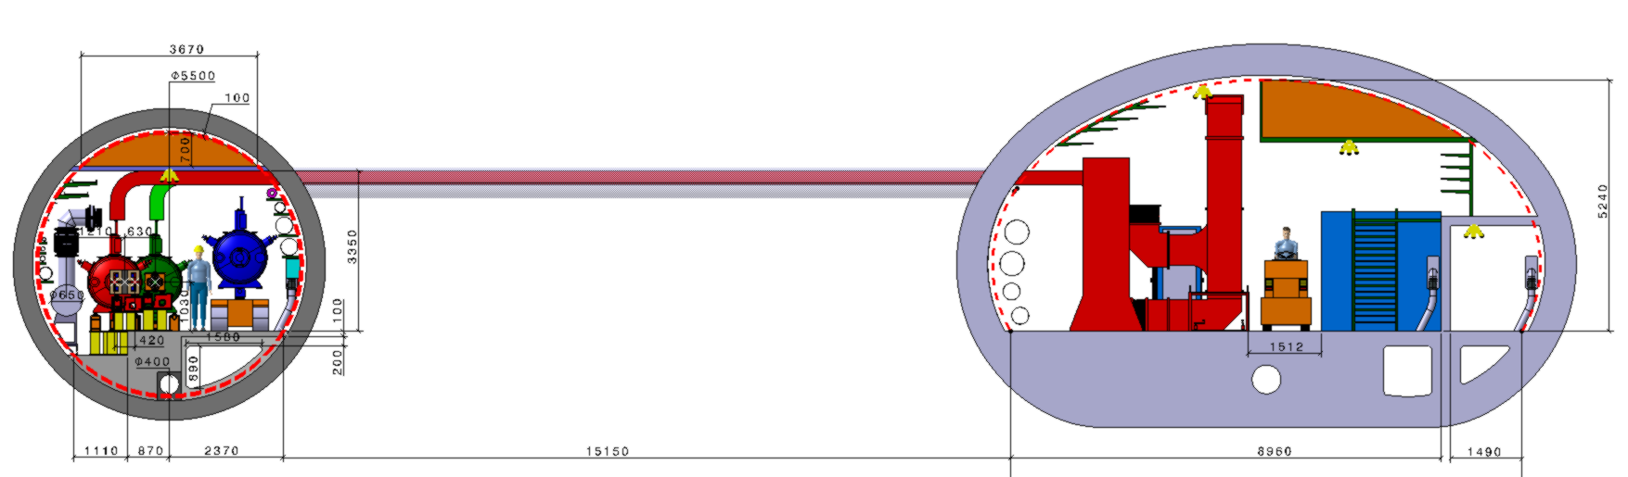
FCC-ee RF machine elements (H)
400 MHz cryomodules (ø 1.14 m x 12 m), half LSS
17 e⁺e⁻ CM + 9 booster CM = 26 CM (476.2 m)
68 klystrons
Bunker
(LxWxH=8x3x3 m)
Faraday cage
(LxWxH=10x2x2.5m)
Klystron, circulator&rack
Booster rack
booster ring
е⁻ ring
12
12
3.5
12
12
3.5
1.5
12
12
3.5
e⁺ ring
Machine tunnel
0.6
2.2
11.2
0.6
0.3
5.4
2.7
0.6
2.3
Transport vehicle
Waveguide
Transport/klystron gallery
Collider Centre
Safety passage
Klystron, circulator & rack
Faraday cage

Slide 23
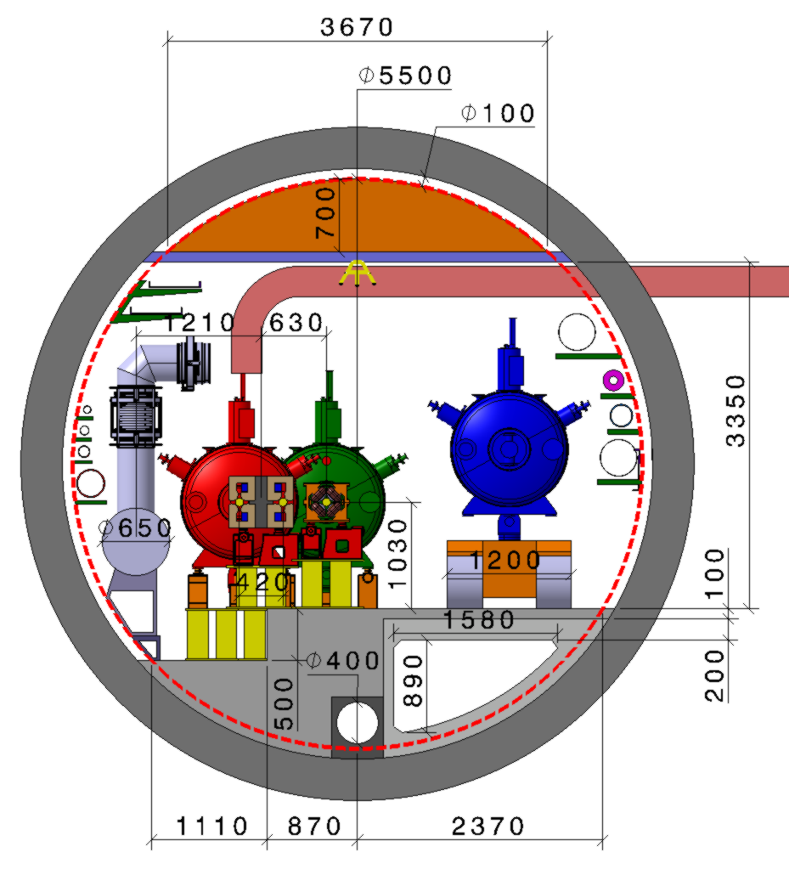
FCC-ee RF cross section (H)
QRL Ø along 400 MHz section 0.65 m.
Preliminary length of half LSS 400 MHz 476.2 m (H machine)
(nota: inner 2 x 645.7 m left empty for later ttbar installation)
Distance between e⁺e⁻ quadrupoles 40 m, length 3.5 m.
Distance between booster quadrupoles 50 m, length 1.5 m.
Collider Centre

Slide 24
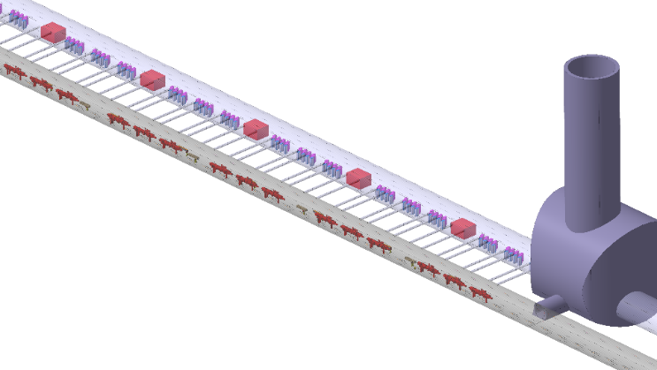
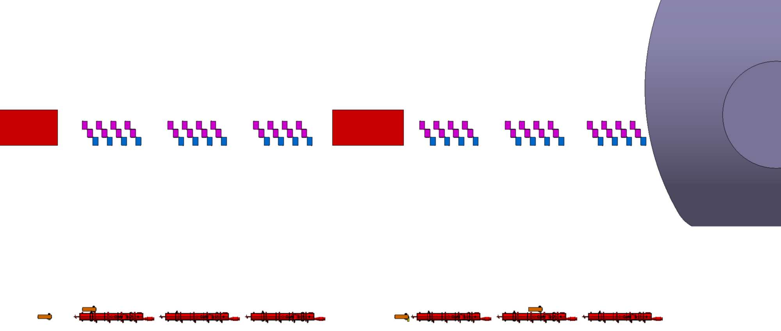
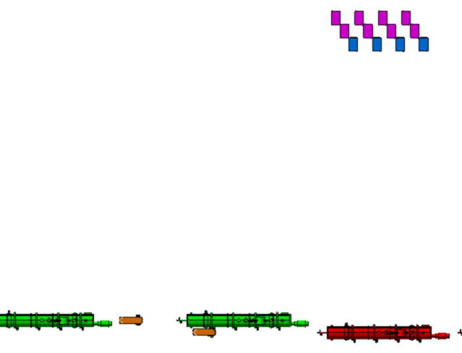
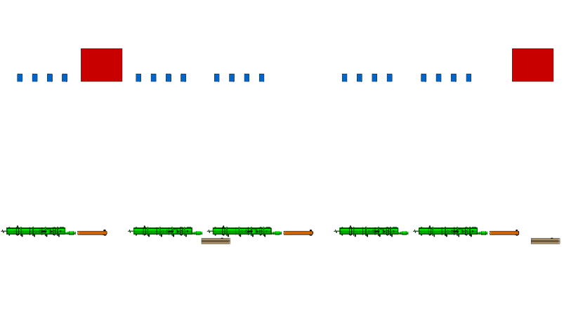
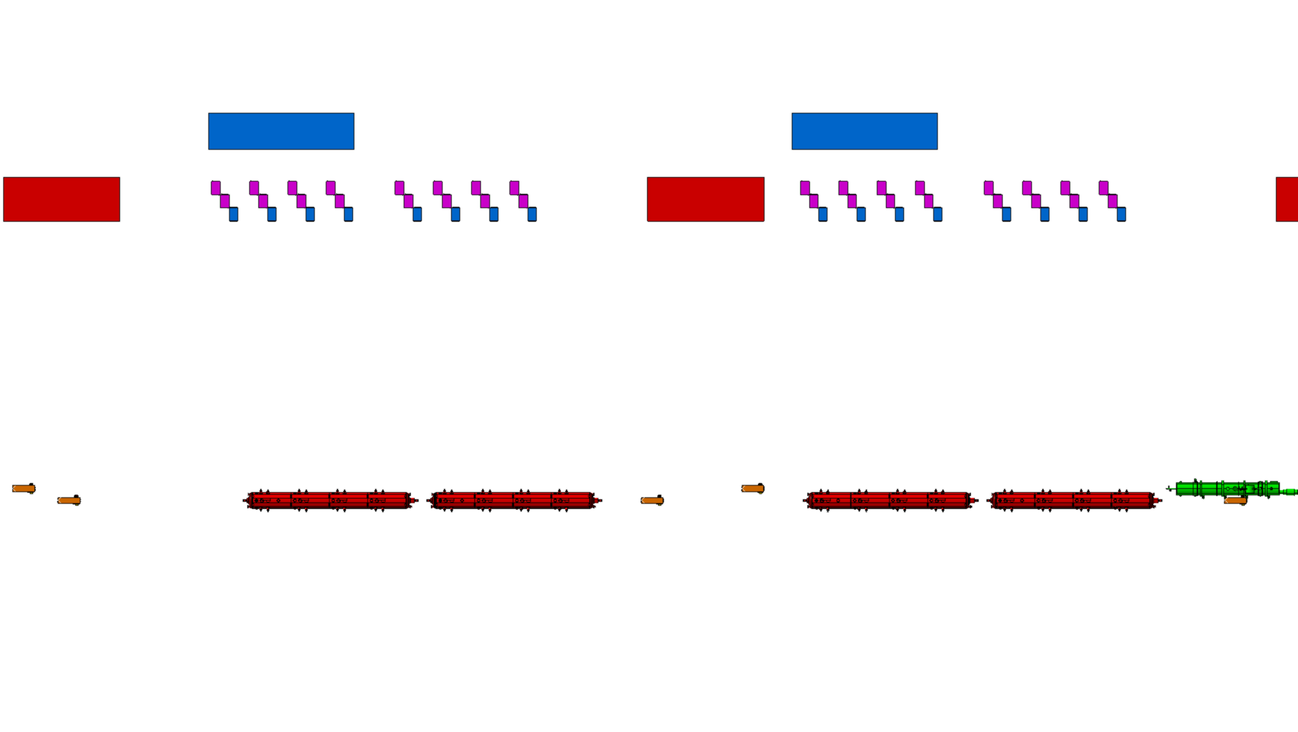
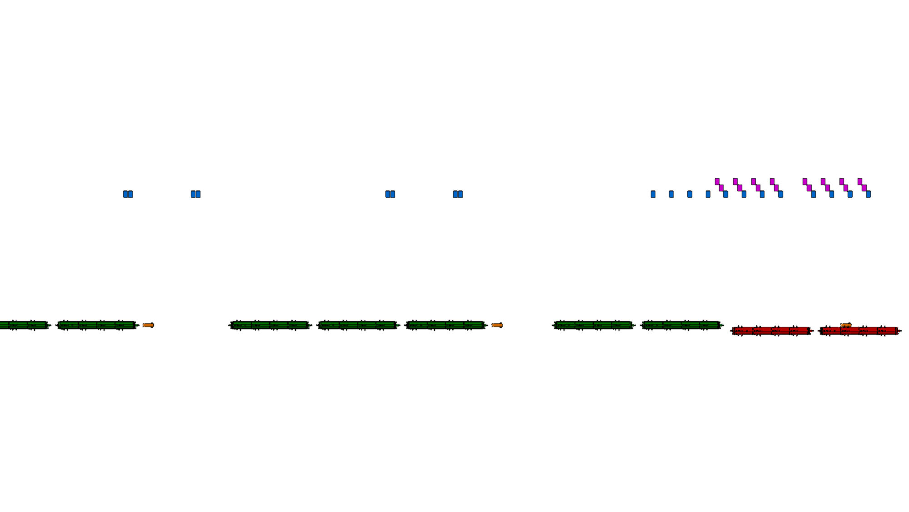
FCC-ee RF cross section (ttbar2)
800 MHz cryomodule (ø 1.09 m x 9 m), half LSS
24 e⁺e⁻ CM + 30 booster CM = 54 CM (645.7 m)
Transport/klystron gallery
Shaft ø 12 m
Bunker
(LxWxH=8x3x3 m)
Machine tunnel
IP
e⁺e⁻ ring
booster ring
9.3
9
9
9
0.3
0.6
0.6
9.8
Service cavern
(LxWxH=15x25x15 m)
400 MHz cryomodules (ø 1.14 m x 12 m), half LSS
17 e⁺e⁻ CM + 9 booster CM = 26 CM (476.2 m)
Bunker
(LxWxH=8x3x3 m)
RF Power
Racks
booster ring
e⁺e⁻ ring
12
0.6
12
11.1
2.7
12
0.6
12

Slide 25


FCC-ee RF cross section (ttbar2, 400 MHz)
QRL Ø along 400 MHz section 0.65 m.
Preliminary length of 400 MHz section 476.2 m.
Distance between e⁺e⁻ quadrupoles 40 m, length 3.5 m.
Distance between booster quadrupoles 50 m, length 1.5 m.
Collider Centre

Slide 26


FCC-ee RF cross section (ttbar2, 800 MHz)
QRL Ø along 800 MHz section 0.85 m.
Preliminary length of 800 MHz section 645.7 m.
Distance between e⁺e⁻ quadrupoles 40 m, length 3.5 m.
Distance between booster quadrupoles 50 m, length 1.5 m.
Collider Centre

Slide 27

FCC-ee RF/cryogenic layout (points D, J)
L. Tavian
17 CMs
17 CMs
332.4 m
332.4 m
8 CMs
9 CMs
143.8 m
121.9m
334.4 m
311.3 m
301.7 m
334.4 m
Total length without kickers:
2212.3 m
30 CMs
24 CMs
23 CMs
30 CMs

Slide 28

THANK YOU FOR YOUR ATTENTION !

