Slide 1
Position of the Booster and the collider in the FCC-ee tunnel
Alignment considerations
H. Mainaud Durand
27 May 2021

Slide 2
General constraints
  Access (installation, alignment, maintenance)
  Space
  Radiation level
  Thermal stability
  Stability of the tunnel floor, ground motion
Component & support design
  Impact of vibrations
  Eigen frequencies
  Rigidity of component & support
  Weight
Alignment of a component inside a tunnel
Beam requirements
  Fiducialisation requirements
  Component assembly on girder
  Girder alignment in the tunnel
  Relative / absolute alignment requirements
Project constraints
  Cost
  Manpower available
  Operation / maintenance time
Alignment methods & instrumentation available

Slide 3
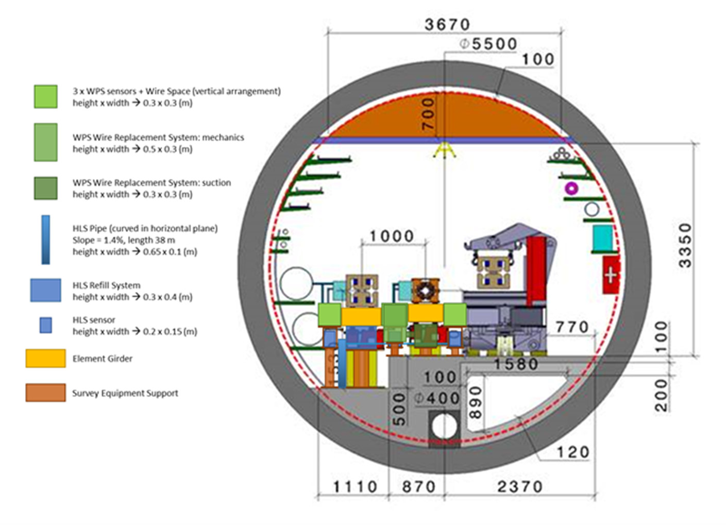
Alignment considerations
A solution similar to the HL-LHC Full Remote Alignment System (FRAS) solution was integrated in the cross section. This solution developed for linear collider or LSS is not applicable for circular collider as all the available space is booked by alignment systems.
Access very difficult towards the non-transport area
Position determination should be performed from the top (monorail?), more difficult to use robots?
Better configuration than second option from the vibrations and thermal stability point of view
The only place for the references of the underground geodetic network is on the tunnel floor (the transport area), but slab not very thick.

Slide 4
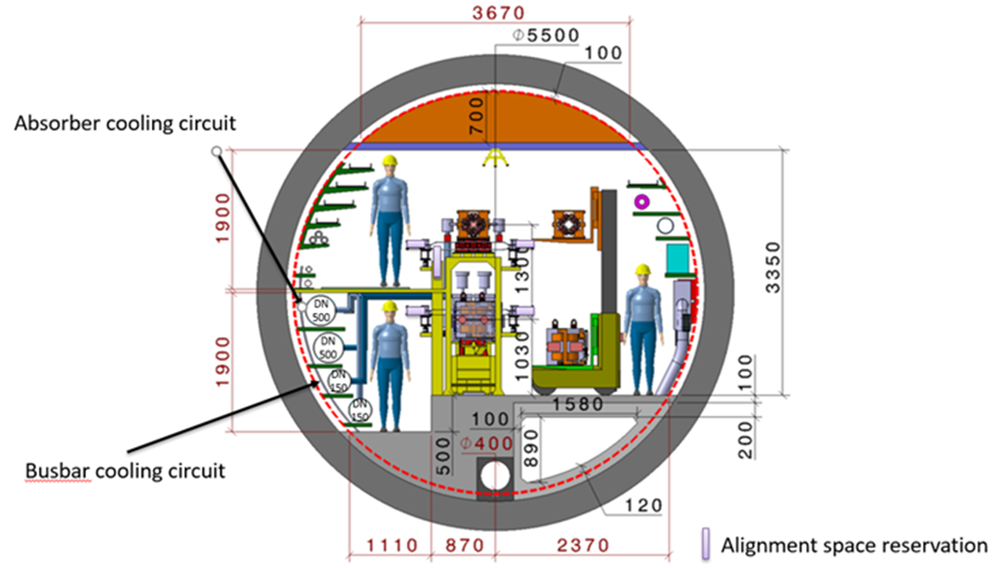
Alignment considerations
One of the drawback of the second option: long-term alignment stability of w.r.t. variation of temperature (between installation and operation), according to the longitudinal position of the component, with a higher risk of lack of rigidity of the support and of the component, amplification of vibrations and lower eigen frequencies for the support and component.
Tight alignment requirements → all budget error impacted by thermal drifts. 1 additional reason to install a FRAS system to correct.
Once cables, alignment systems and other services or systems will be integrated: far less space to circulate around.
Only 1 side to perform standard alignment measurements
Limited space for the adjustment system on top.

