Slide 1
Assisting detector design with machine learning
Tobias Golling, University of Geneva
FCC Zurich workshop, August 25-26, 2022

Slide 2
The detector design challenge
Very high-dimensional
Many trade-offs not obvious at detector level
But dictated by downstream physics goals
Slow design cycles, hard to automate (non-differentiable)
Paradigm-based, no guarantee of optimality

Slide 3
Many challenges !
Optimal design needs to include ALL aspects of the simulation-reconstruction chain
  Making software like GEANT differentiable: colossal task !
  Also tracking, clustering, P-flow, object ID,…
What to optimize for?
  Factorization approach: particle resolution, classification,…
  Vs. final physics goals: Higgs coupling, NP discovery potential,..
  Unconventional signatures
  Cost, redundancy, robustness, “general-purpose”, buildability,…
Multi-objective optimisation (Pareto optimality)
  Optimal sub-manifolds (see ATLAS & CMS)
  Future-proof: new tech, new AI, new reco (boosted-object tagging @LHC)

Slide 4
A superhuman task !

Slide 5
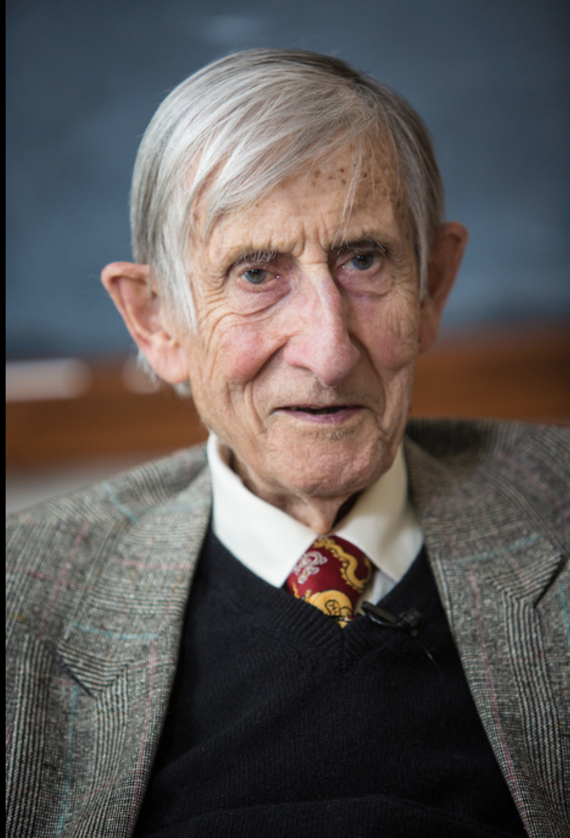
“New directions in science are launched by new tools much more often than by new concepts.”
- Freeman Dyson
Notes:
Let’s start with some quotes, first by a theoretical physicist, Freeman Dyson.
The particular tool, we are all here today to discuss, AI, has far reaching consequences, as bluntly put by Demis…

Slide 6
The pitch: ML to assist in designing better detectors
Machine learning* to assist in end-to-end optimisation
  ML is differentiable
  Evaluation is fast (function call)
Facilitates automation:
  (Stochastic) gradient descent
  Generative surrogate models to replace (locally) Sim+Reco
  Reinforcement learning (explore vs. exploit)
  From “hits-to-Higgs” (graph-based models)
*Rise of deep learning in HEP in last 10 years going beyond classification and regression [LivingReview]

Slide 7
Growing area of active research
Recent success on Chip design [Nature], sensor design etc.
Overview on surrogate models in HEP [2203.08806]
Proofs of concept in HEP [2002.04632, MODE]
TG: plan for magnet design with Carmine Senatore (new PI@DPNC-UNIGE-CHIPP)
Keen to hear about your interest / brainstorm / benchmarks / collaborate
Reminder:
  Intended to assist detector design not to replace experts
  Goal: guidelines for design, novelty, symbiosis: AI-empowered HEP
Notes:
Opportunity for young generation: “Design from scratch” (Guenther, Florencia)

