Slide 1
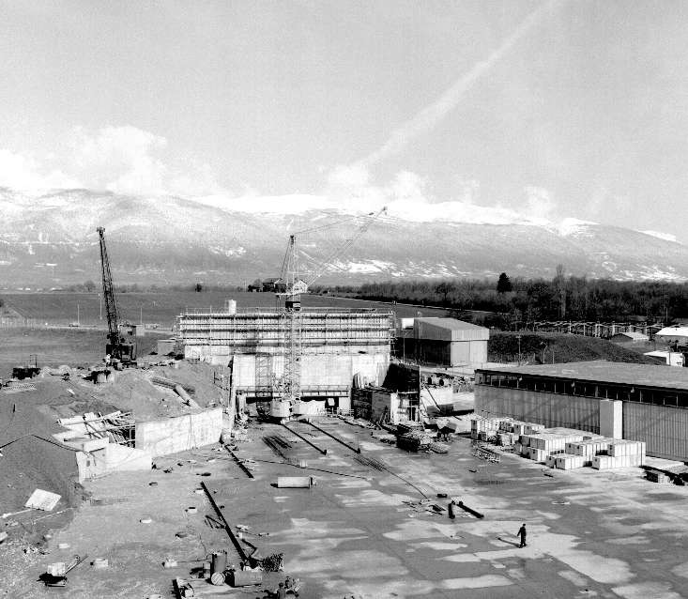
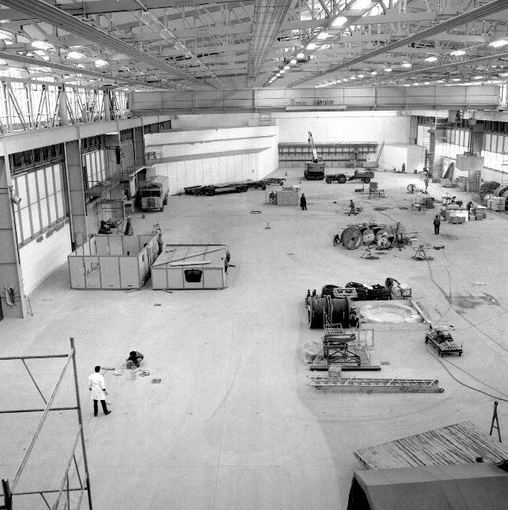
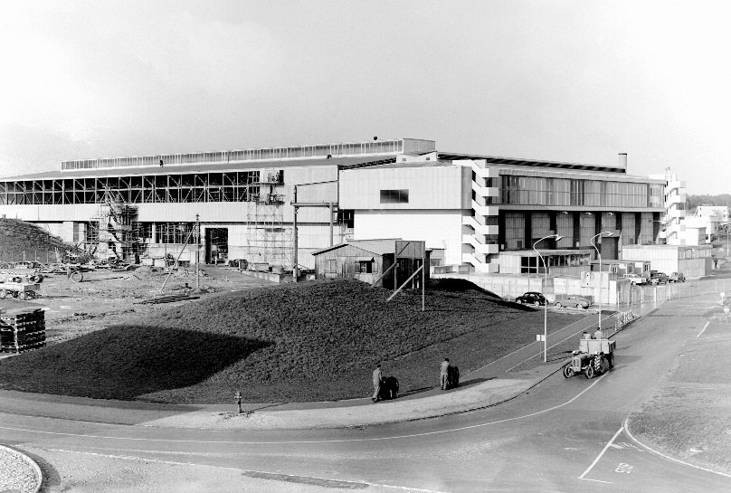




Individual System Tests (ISTs)
East Hall under construction - 1962
Filipa Carvalho (BE-EA)
East Area Renovation

Slide 2
Weekly Coordination Meetings
Taking place every Tuesday @ 11 AM
Follow up on all activities happening in B.157
  Identify & mitigate problems – Electrical Inspection
  Coordinate activities of the groups that own equipment that interface with each other
Quickly act on pressing issues and ensure a good flow of communication between all parts involved
Minutes will be sent out after every meeting

Slide 3
So far…
Magnet IST in T08
CV IST almost completed
Currently: HW power converters/magnets
Electrical Inspection of the mixed area planned for 18 June – magnet group to confirm if the magnet covers will be ready in time (confirm until the 11th)
At least 1st document draft available in EDMS for each equipment (CERN-0000211059)

Slide 4
T08 Schedule
Task Name | Groups | Duration | Start | Finish
Beam To target and T8 tasks (Draft) | TE-EPC | 77 days | Mon 31/05/21 | Thu 16/09/21
Power Converters T8 and Target Area HW | TE-EPC | 15 days | Mon 31/05/21 | Fri 18/06/21
Magnets Tests in T8 and Target Area | TE-MSC | 15 days | Mon 31/05/21 | Fri 18/06/21
Test Primary Area Ventilation (1day without access zones) | EN-CV | 2 wks | Mon 07/06/21 | Fri 18/06/21
Commission the Beam stoppers | EN-STI | 2 days | Mon 21/06/21 | Tue 22/06/21
Test access EA1 | EN-AA | 2 days | Wed 23/06/21 | Thu 24/06/21
Test access EA2 | EN-AA | 1 day | Fri 25/06/21 | Fri 25/06/21
Power Converters Mixed Area HW Part 1 | TE-EPC | 15 days | Mon 21/06/21 | Fri 09/07/21
Magnets Tests in Mixed Area | TE-MSC | 15 days | Mon 21/06/21 | Fri 09/07/21
Shielding Roof completed | EN-HE | 0 days | Fri 09/07/21 | Fri 09/07/21
Smoothing Measurement (all zones) | BE-GM | 2 wks | Mon 12/07/21 | Fri 23/07/21
Smoothing Correction (T8, Target Area, and secondary only) | BE-GM | 5 days | Mon 26/07/21 | Fri 30/07/21
Smoothing Correction (all zones) | BE-GM | 10 days | Mon 02/08/21 | Fri 13/08/21
Power Converters Mixed Area HW Part 2 | TE-EPC | 5 days | Mon 26/07/21 | Fri 30/07/21
Install and Commissioning RP Monitor on the Primary Roof | HSE-RP | 3 wks | Mon 05/07/21 | Fri 23/07/21

Slide 5
East Area Renovation
Thank you!

