Slide 1
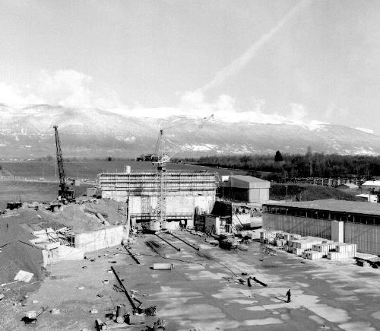
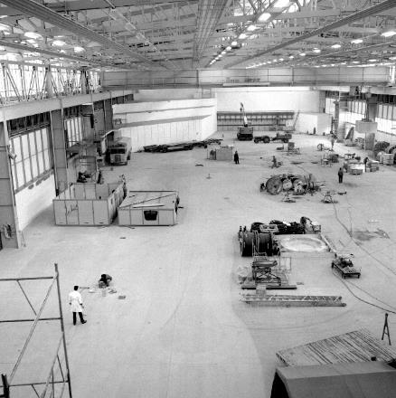
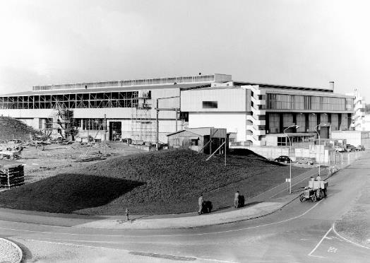

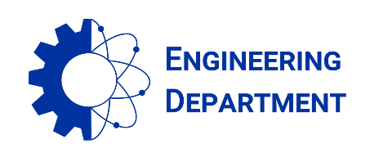
East Area Renovation - News and CSR4 feedbacks
Project Team #45 on 04.06.2021
East Hall under construction - 1962
S. EVRARD (EN-EA), on behalf of the project team

Slide 2
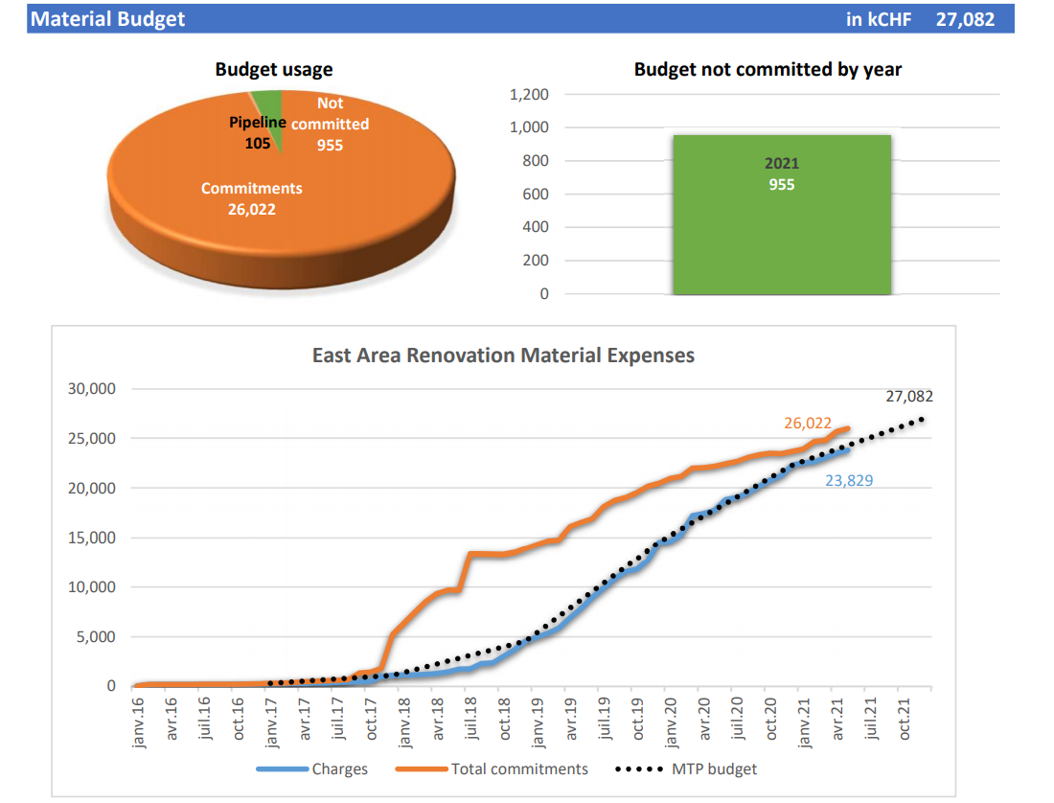
Budget situation on June 1st
Overall material budget: 27.1 MCHF
On June 1st: 96 % committed and 88 % charged
Less than 1 MCHF to commit in 2021
Main changes since last meeting:
  250 kCHF transferred to SCE–CONS for B.251 renovation, hence the reduction in M budget
Big orders to come
  RP monitoring systems (> 100kCHF)
CtC overrun for some WPs
  BC being closed by FAP to avoid even bigger overruns

Slide 3
Initial electrical inspection (Apave for HSE)
MEY_CH_157_LIGNE FAISCEAU T8
MEY_CH_157_INSTALLATIONS EL
MEY_CH_157_ZONE MIXTE
MEY_CH_157_ZONE F63
MEY_CH_157_ZONE T09-T10
MEY_CH_157_ZONE T09
MEY_CH_157_ZONE T10
MEY_CH_157_ZONE T11 CLOUD
Limited to T08 beamline and Target area
2 kinds of remarks: Earthing of Alarm panels and IP2X of magnet covers (only a few number)
PSO and Commissioning Engineer to organise the next initial safety inspections →

Slide 4
Project Quality check
A first inspection has been carried out by the project quality team on the T08 beamline on May 31st
The remaining beamlines will be inspected in due time but before IST’s
 | Visual Inspection |  |  |  |  |  | Mechanical Inspection |  |  |  |  | Picture
 | INFOR Label | Gas Connection | Compressed Air | Survey | Cabled | Earthing | Lifting Points | Screws | Vacuum Sealing | Vacuum Supports | Comments
T08.MBXHD005 |  |  |  |  |  |  |  |  |  |  | Located in B.352
T08.HMBAD005 |  |  |  |  |  |  |  |  |  |  | Located in B.352
T08.BLM006 |  |  |  |  |  |  |  |  |  |  | Located in B.352
T08.BTV020 | OK | N/A | N/A | OK | NOK | OK | NOK | OK | OK | N/A | Camera and its support not fixed, not cabled | Link
T08.HBTV020 | OK | N/A | N/A | OK | N/A | OK | NOK | OK | N/A | N/A |  | Link
T08.MQNEF021 | OK | N/A | N/A | OK | OK | OK | OK | OK | OK | N/A |  | Link
T08.HMQAM021 | OK | N/A | N/A | OK | N/A | OK | OK | OK | N/A | N/A |  | Link
T08.MQNEF023 | OK | N/A | N/A | OK | OK | OK | OK | NOK | OK | N/A | one screw missing on the downstream cover | Link
T08.HMQAM023 | OK | N/A | N/A | OK | N/A | OK | OK | OK | N/A | N/A |  | Link
T08.MCXCF025 | OK | N/A | N/A | OK | OK | OK | OK | OK | OK | N/A |  | Link
T08.MCXCF026 | OK | N/A | N/A | OK | OK | OK | OK | OK | OK | N/A |  | Link
T08.HLMAA025 | OK | N/A | N/A | OK | N/A | OK | OK | OK | N/A | NOK | Downstream vacuum support not fixed | Link

Slide 5
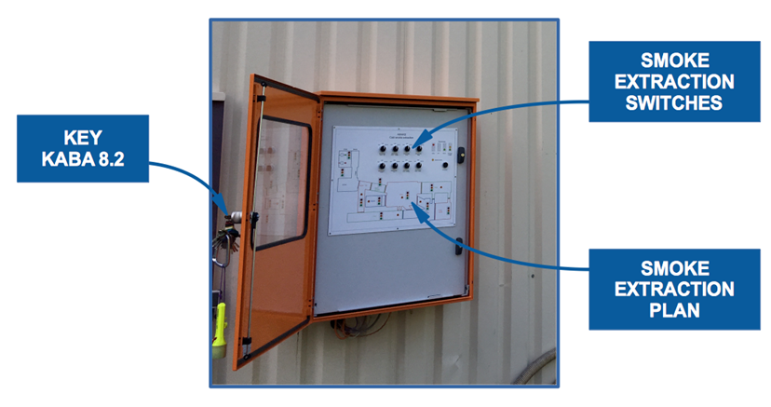
Firemen cubicle
functional schematic
HSE requirements EDMS 1854596
The operation panel shall provide for each smoke extraction zone an individual switch featuring 3 switch positions (AUTO/OFF/DESENFUMAGE) and status signals to account for operation mode and malfunction.
Specific requirements
FRS manual control of 5 ventilations systems:
  Primary area,
  Mixed area,
  ATEX ventilation
  Destratification
  IRRAD/CHARM primary ventilation
Visit on site with SCE Contractor, in operation: deadline end of July
Fire detection
Fire cubicle
Two sectional doors
5 ventilations
Action
Skydomes
Status

Slide 6

Thanks for your attention !

