Slide 1

Personnel Protection Systems in the framework of East Area Renovation
D. Chapuis, B. Morand, E. Sanchez-Corral EN-AA
04/06/2021

Slide 2
Installation work

Slide 3
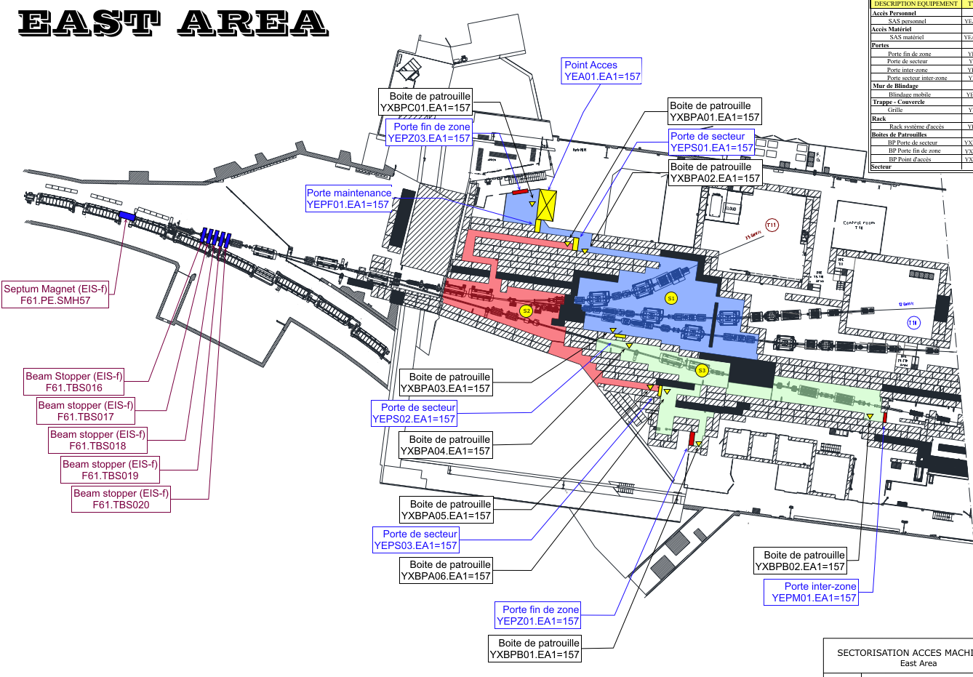
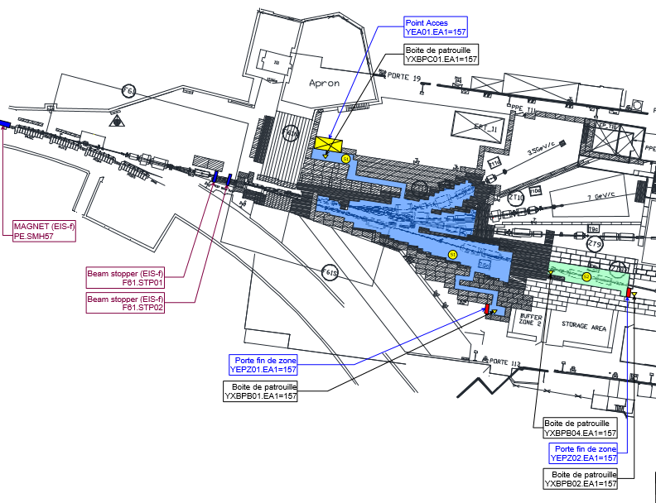
EA1 sectorisation update
Before East Area renovation
Current sectorisation

Slide 4
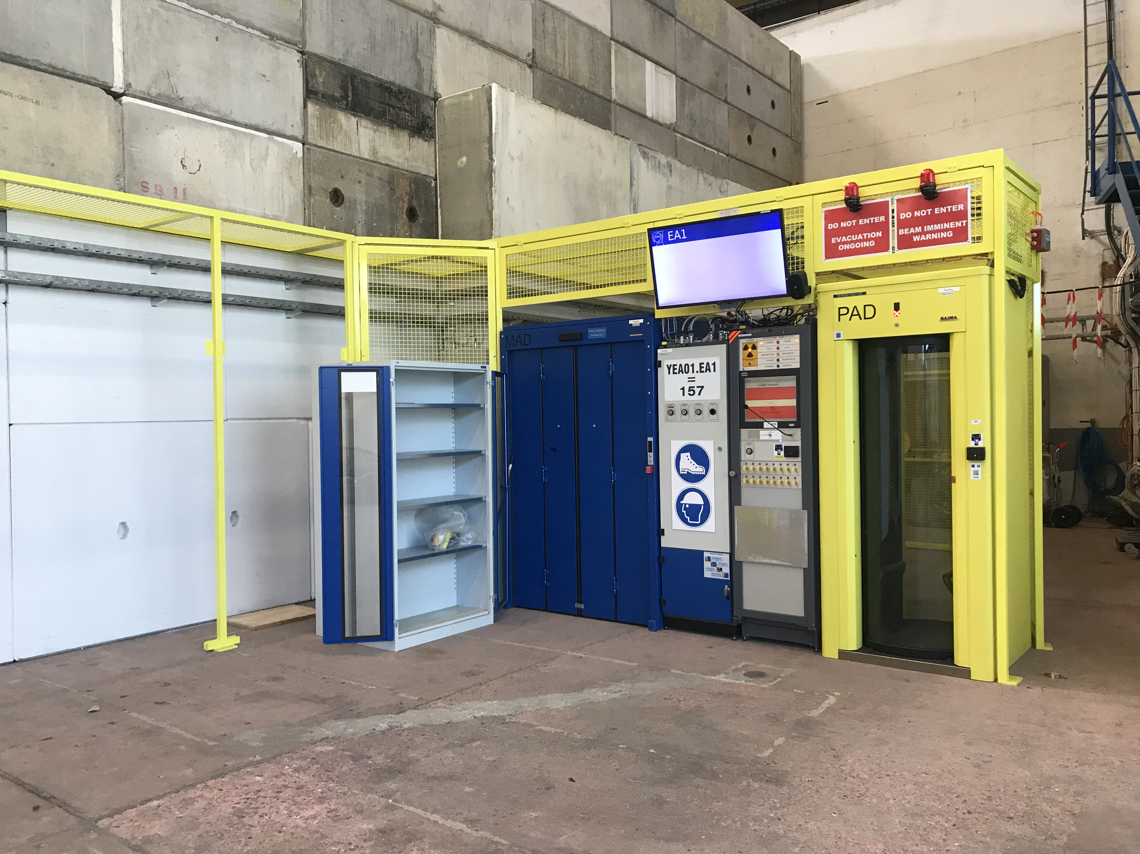
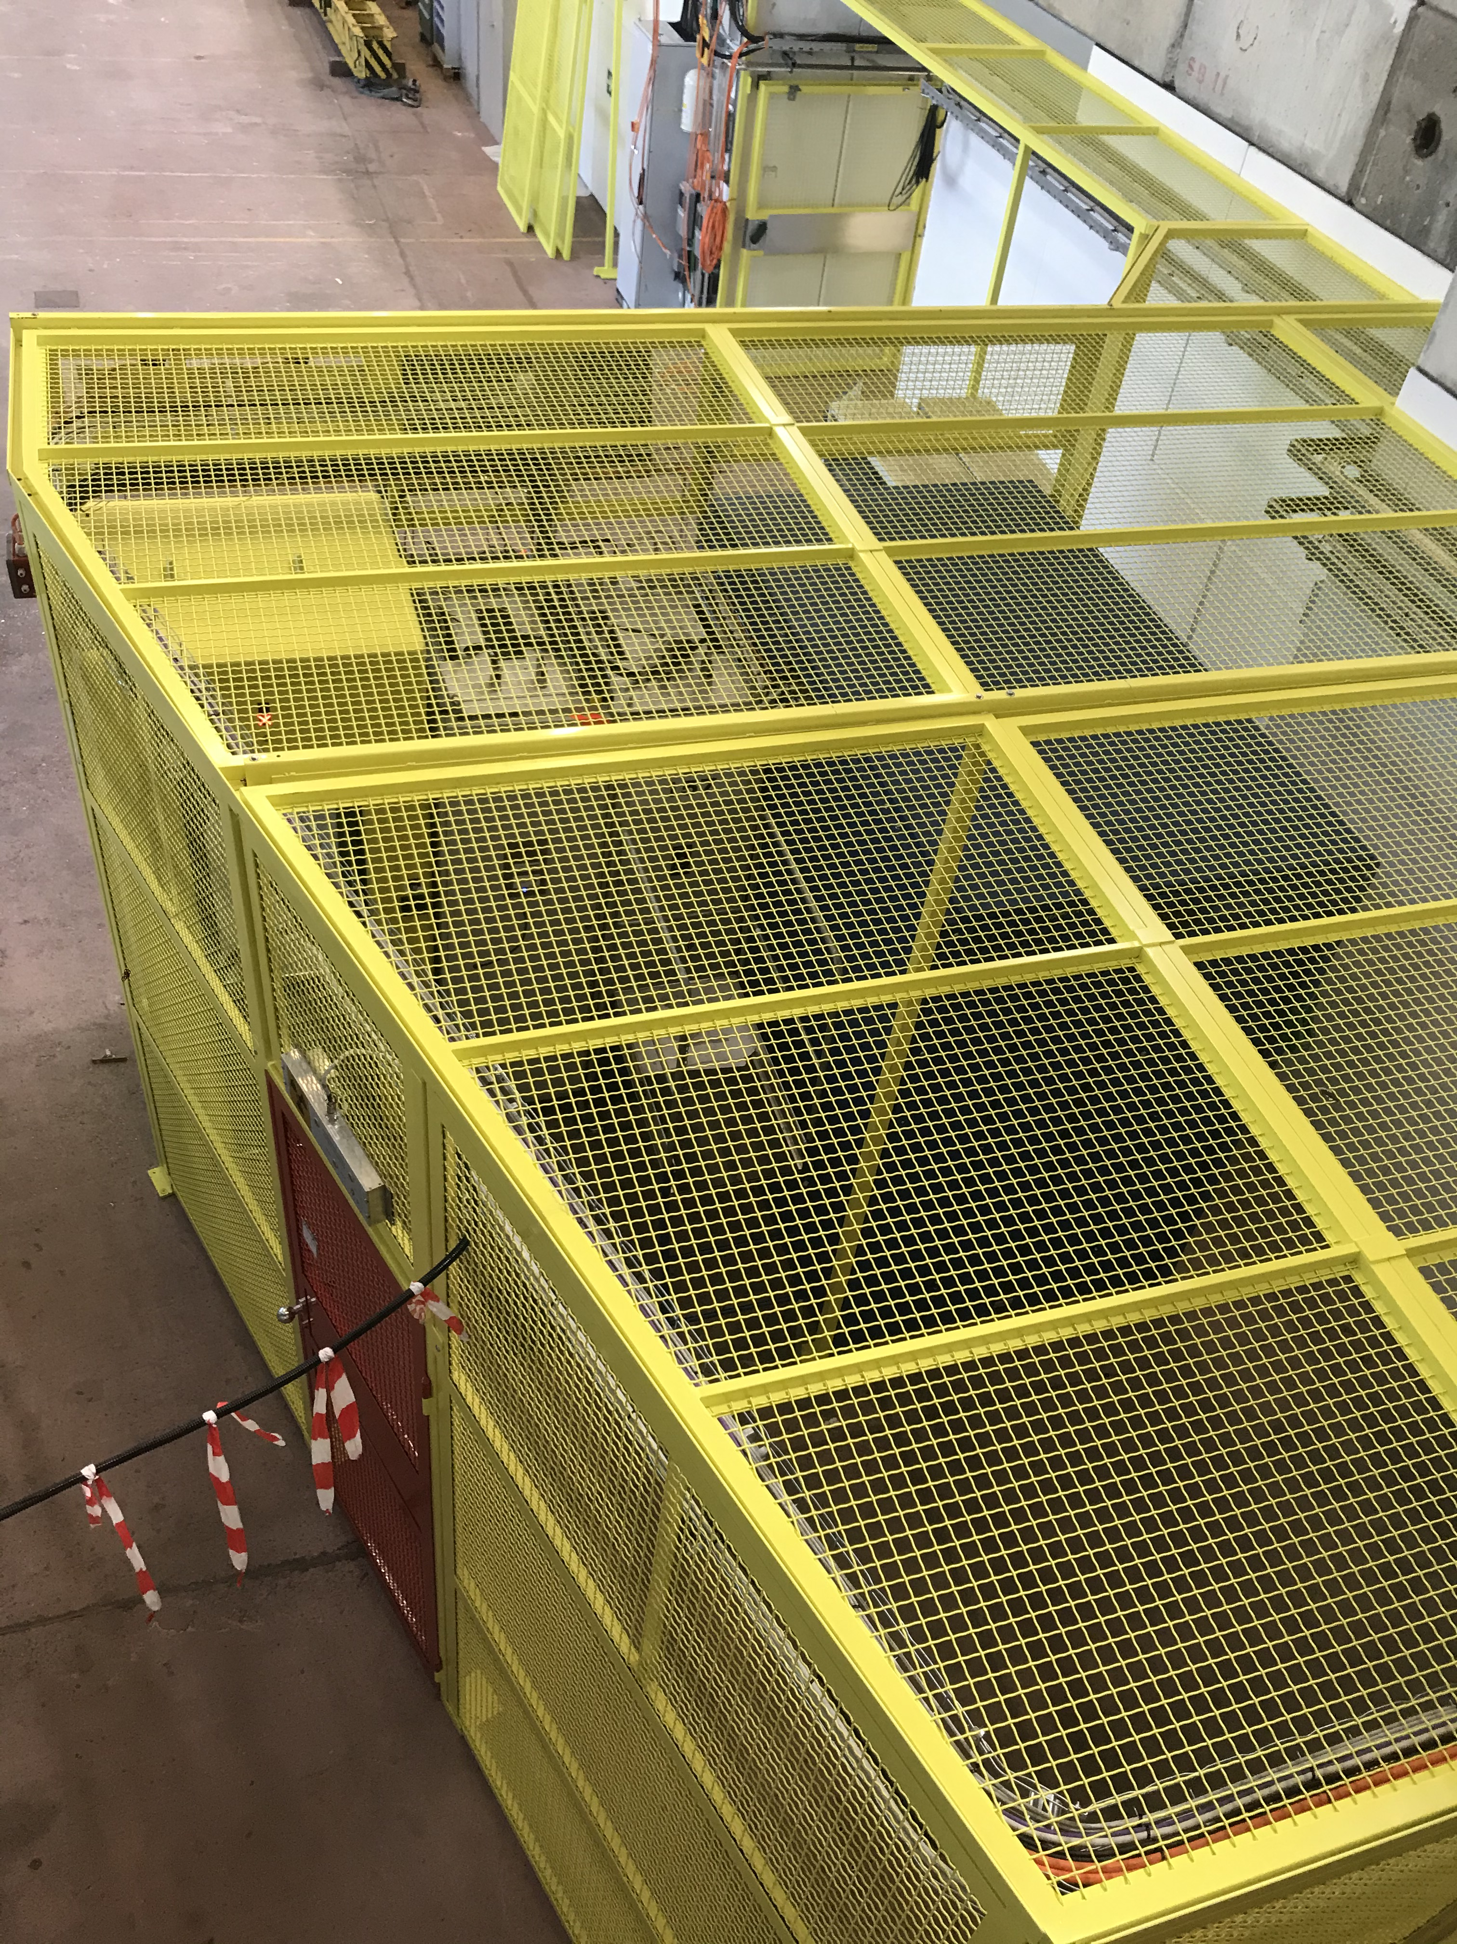
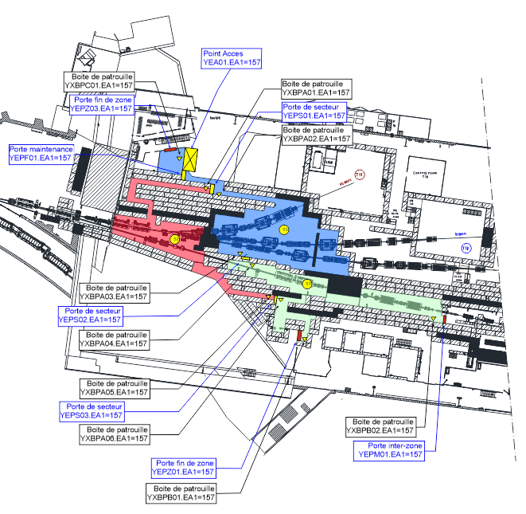
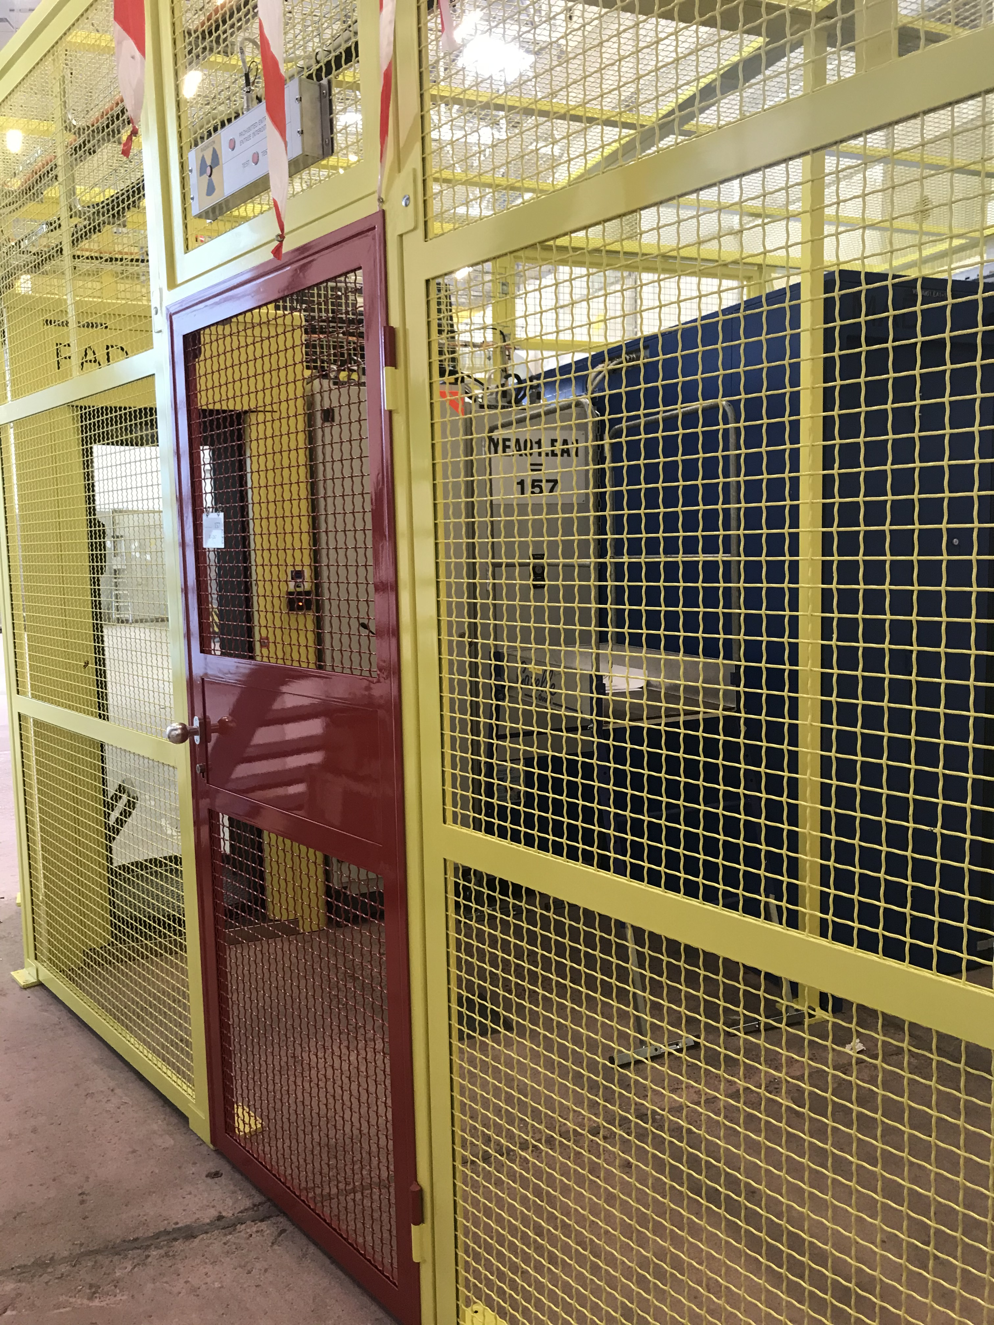
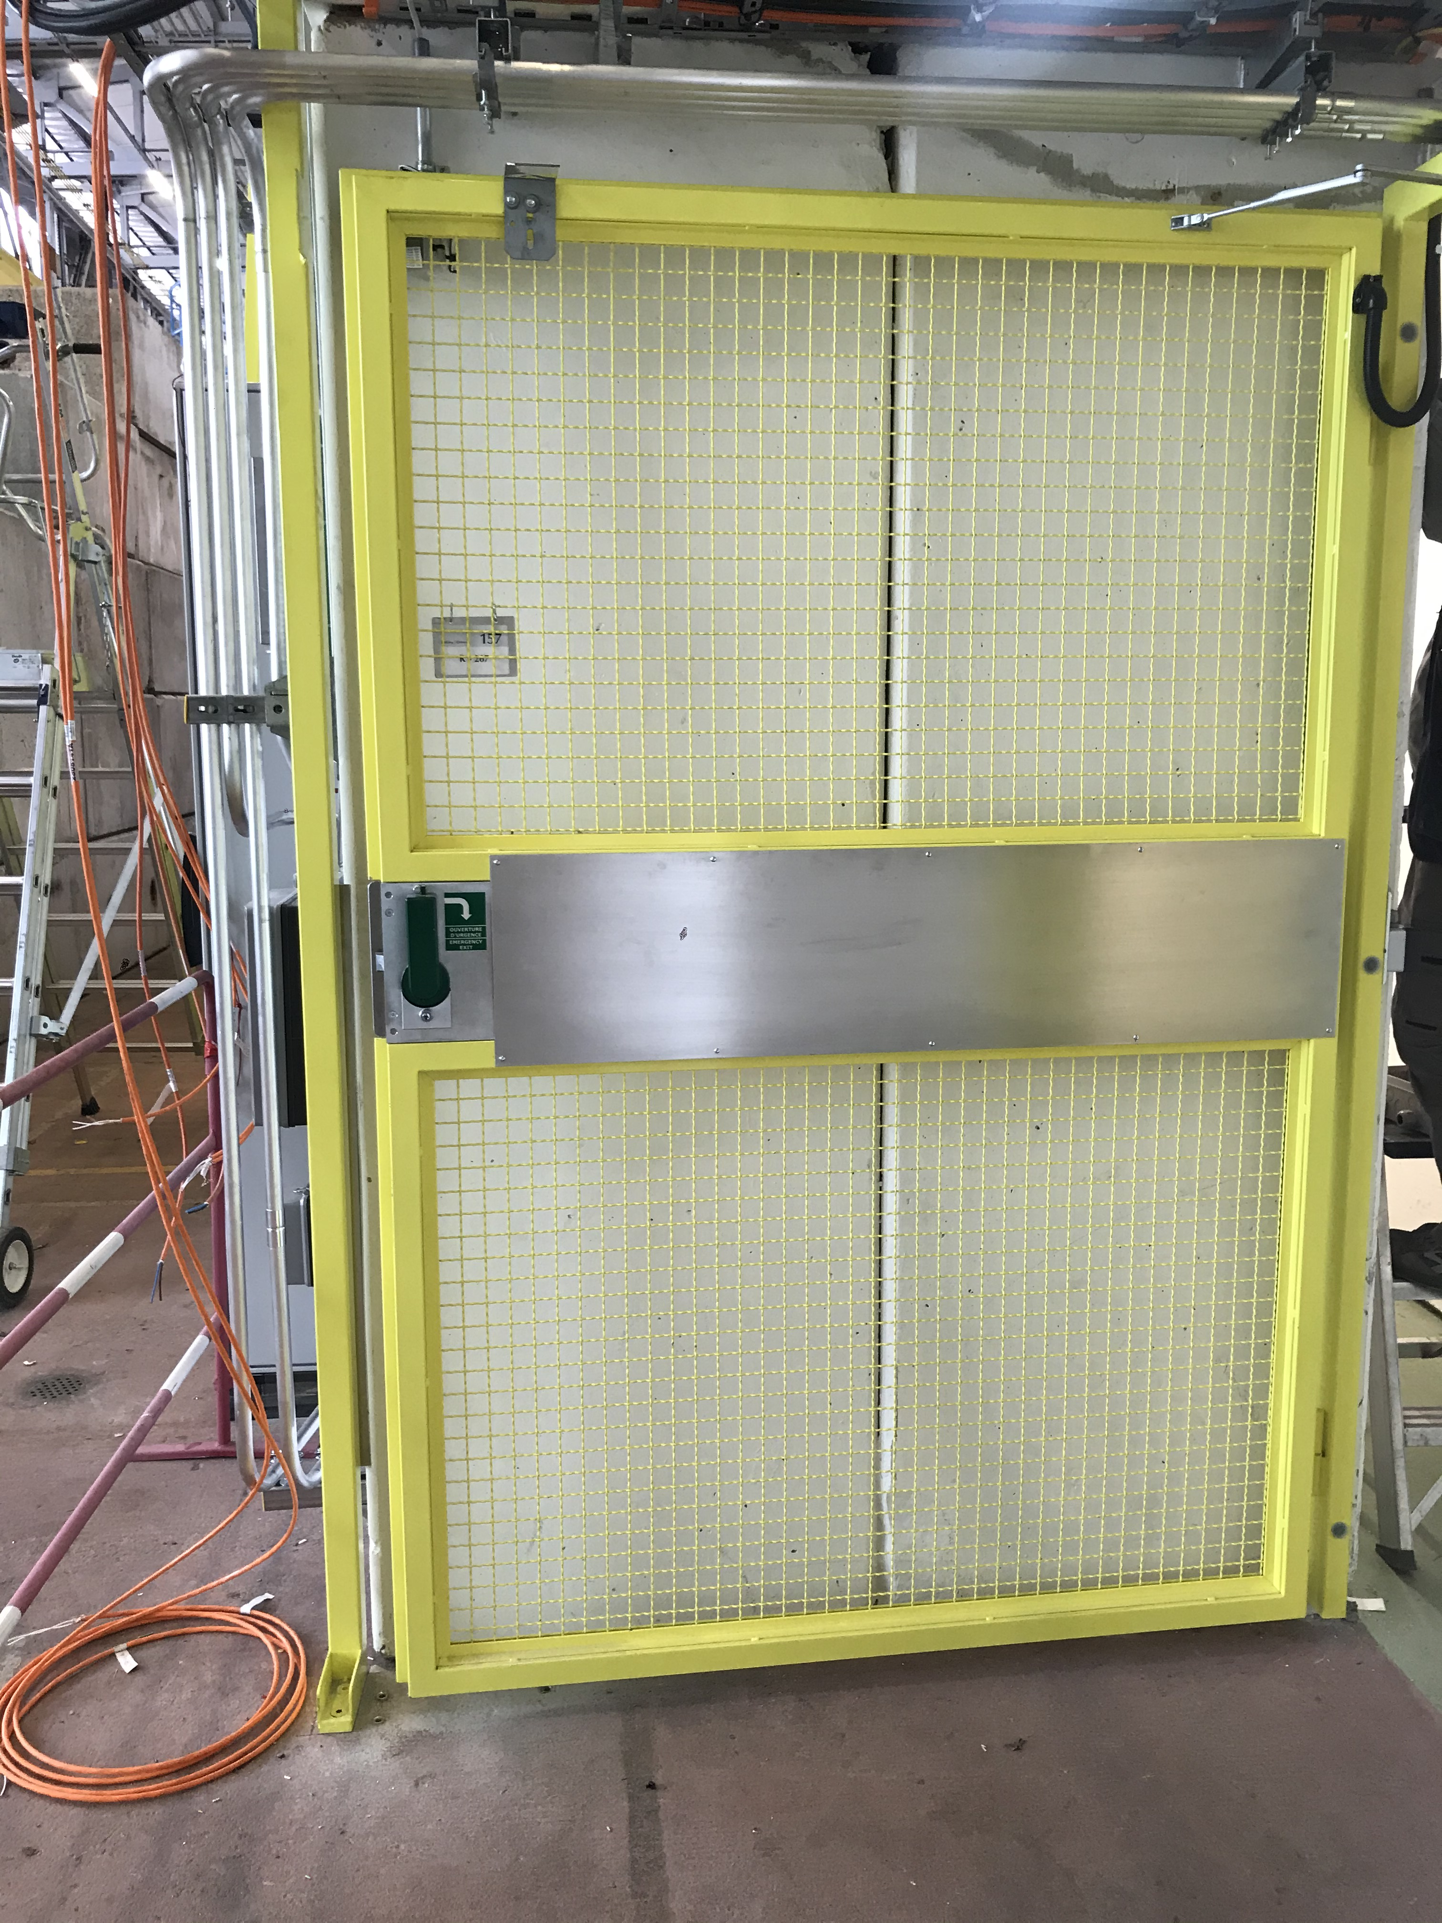
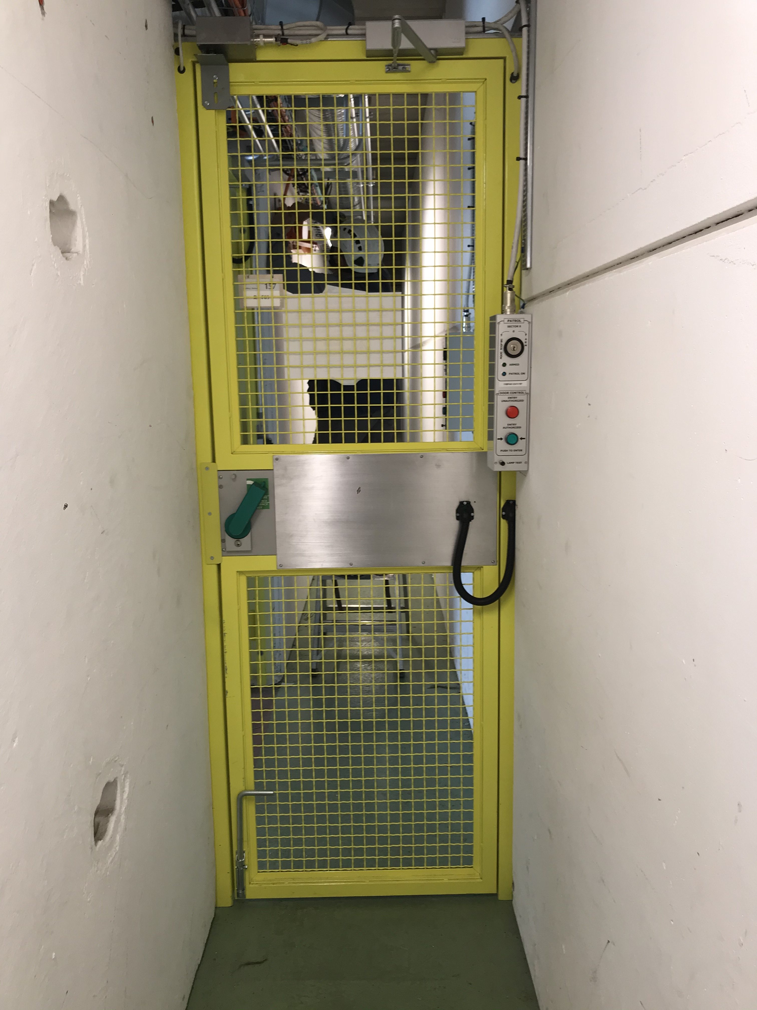
EA1 sectorisation update
Réinstallation du point d’accès YEA01.EA1.157 et reconstruction de grilles.
Réinstallation de la porte YEPZ03.EA1=157
Construction et installation de nouvelles portes de maintenance et secteur YEPF01.EA1=157 et YEPS01.EA1=157

Slide 5
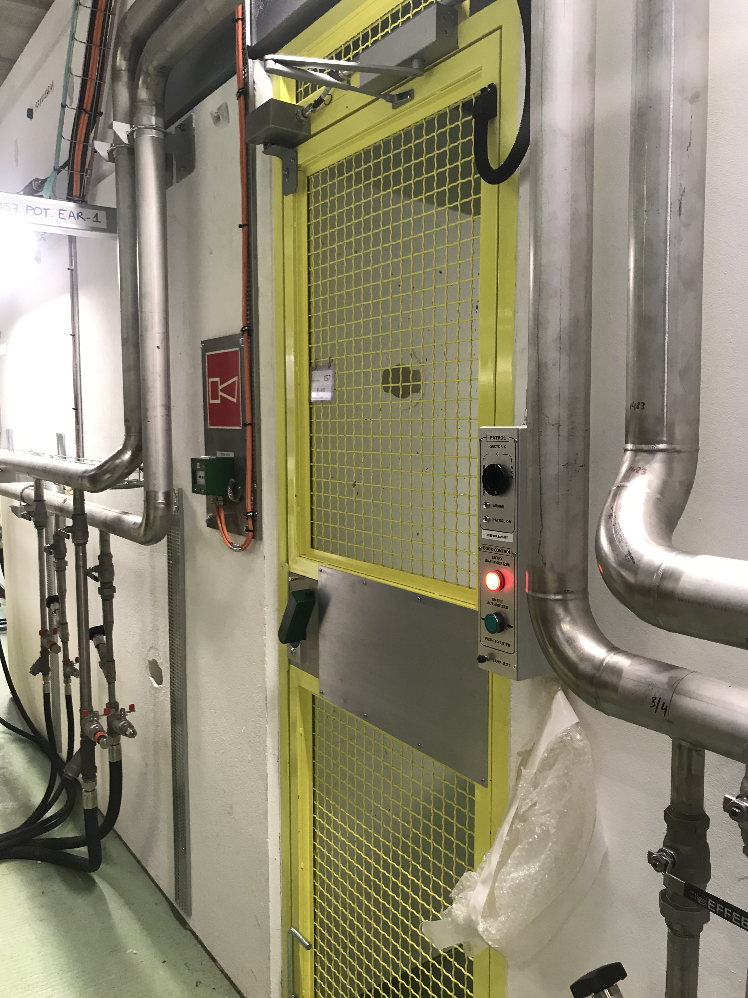
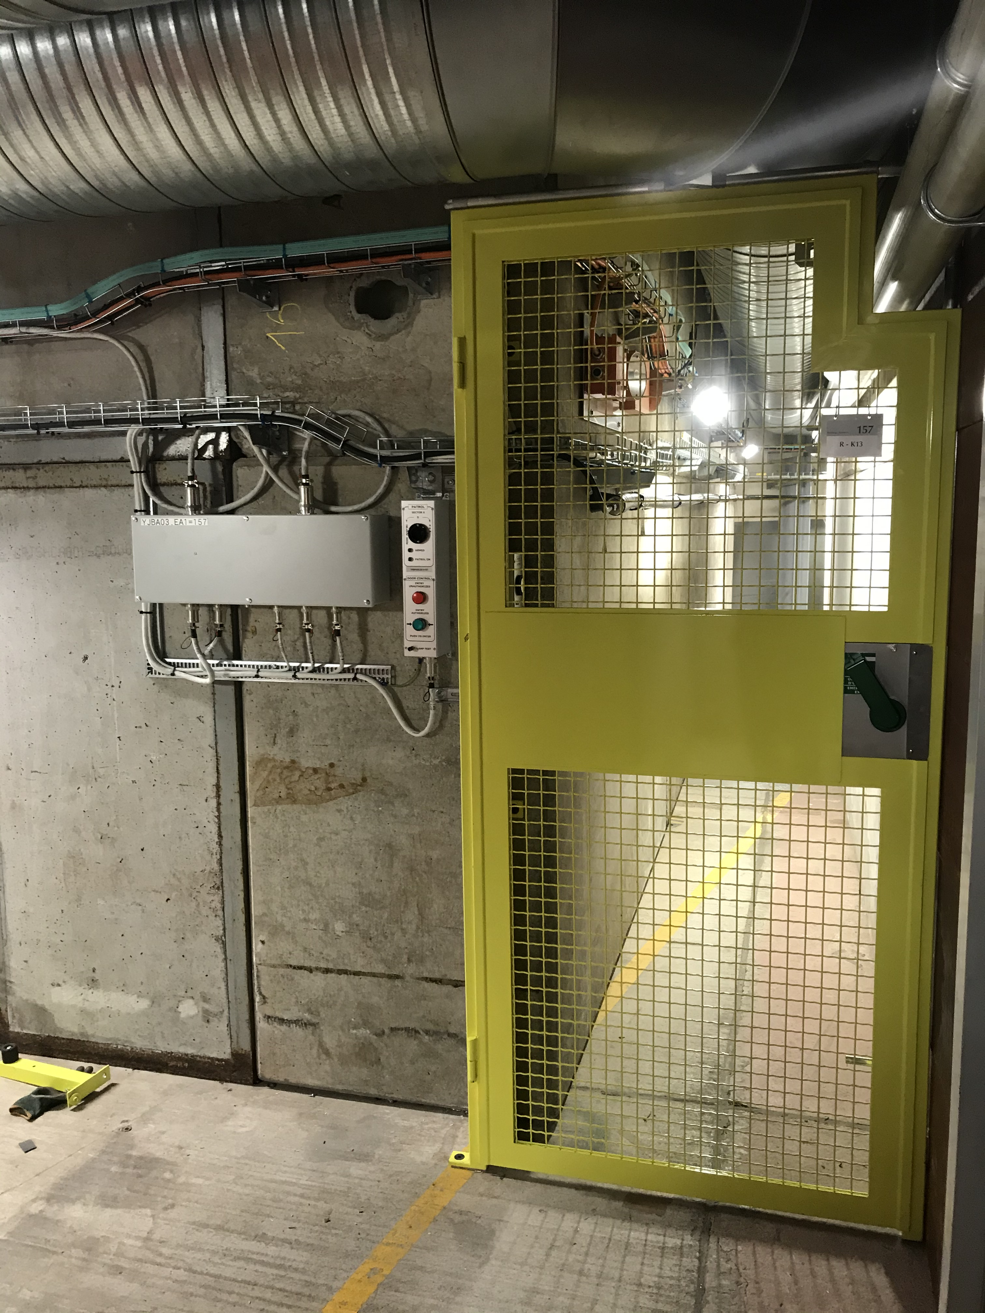
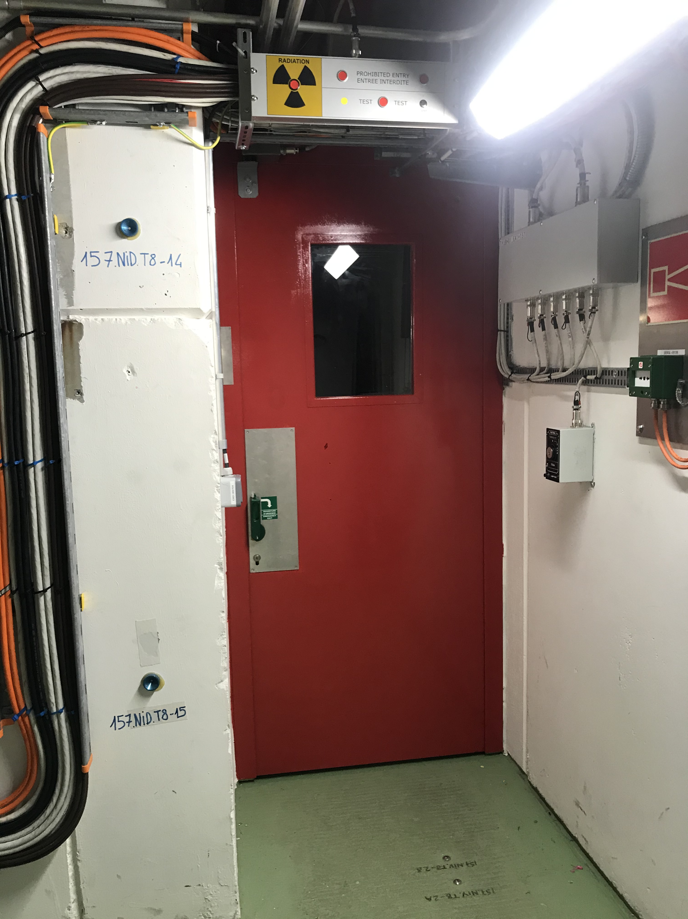
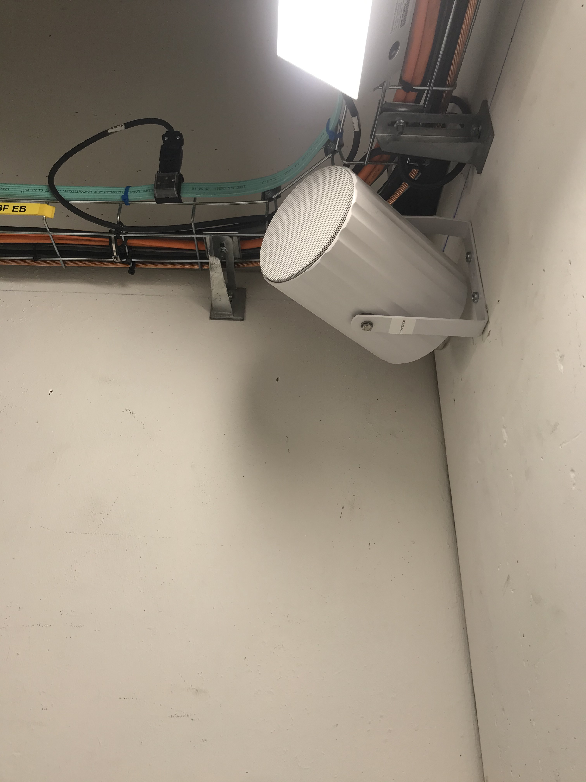
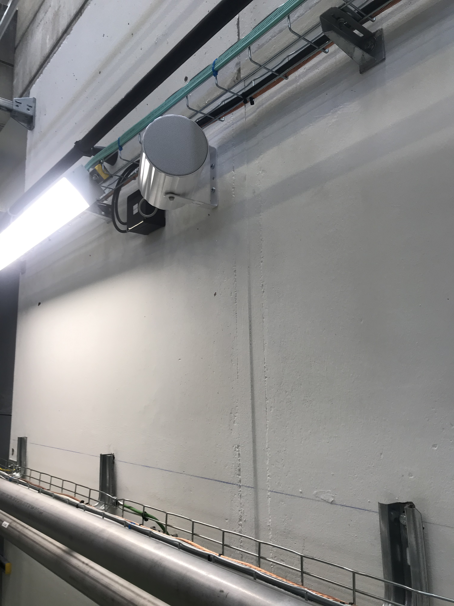
EA1 sectorisation update
Construction et installation des nouvelles portes de secteur YEPS02.EA1=157 et YEPS03.EA1=157
Réaménagement de la porte inter zone YEPM01.EA1=157 (EA1 et EA2)
Public address: Réinstallation à neuf de tous les haut parleur dans les secteurs S1, S2 et S3.

Slide 6
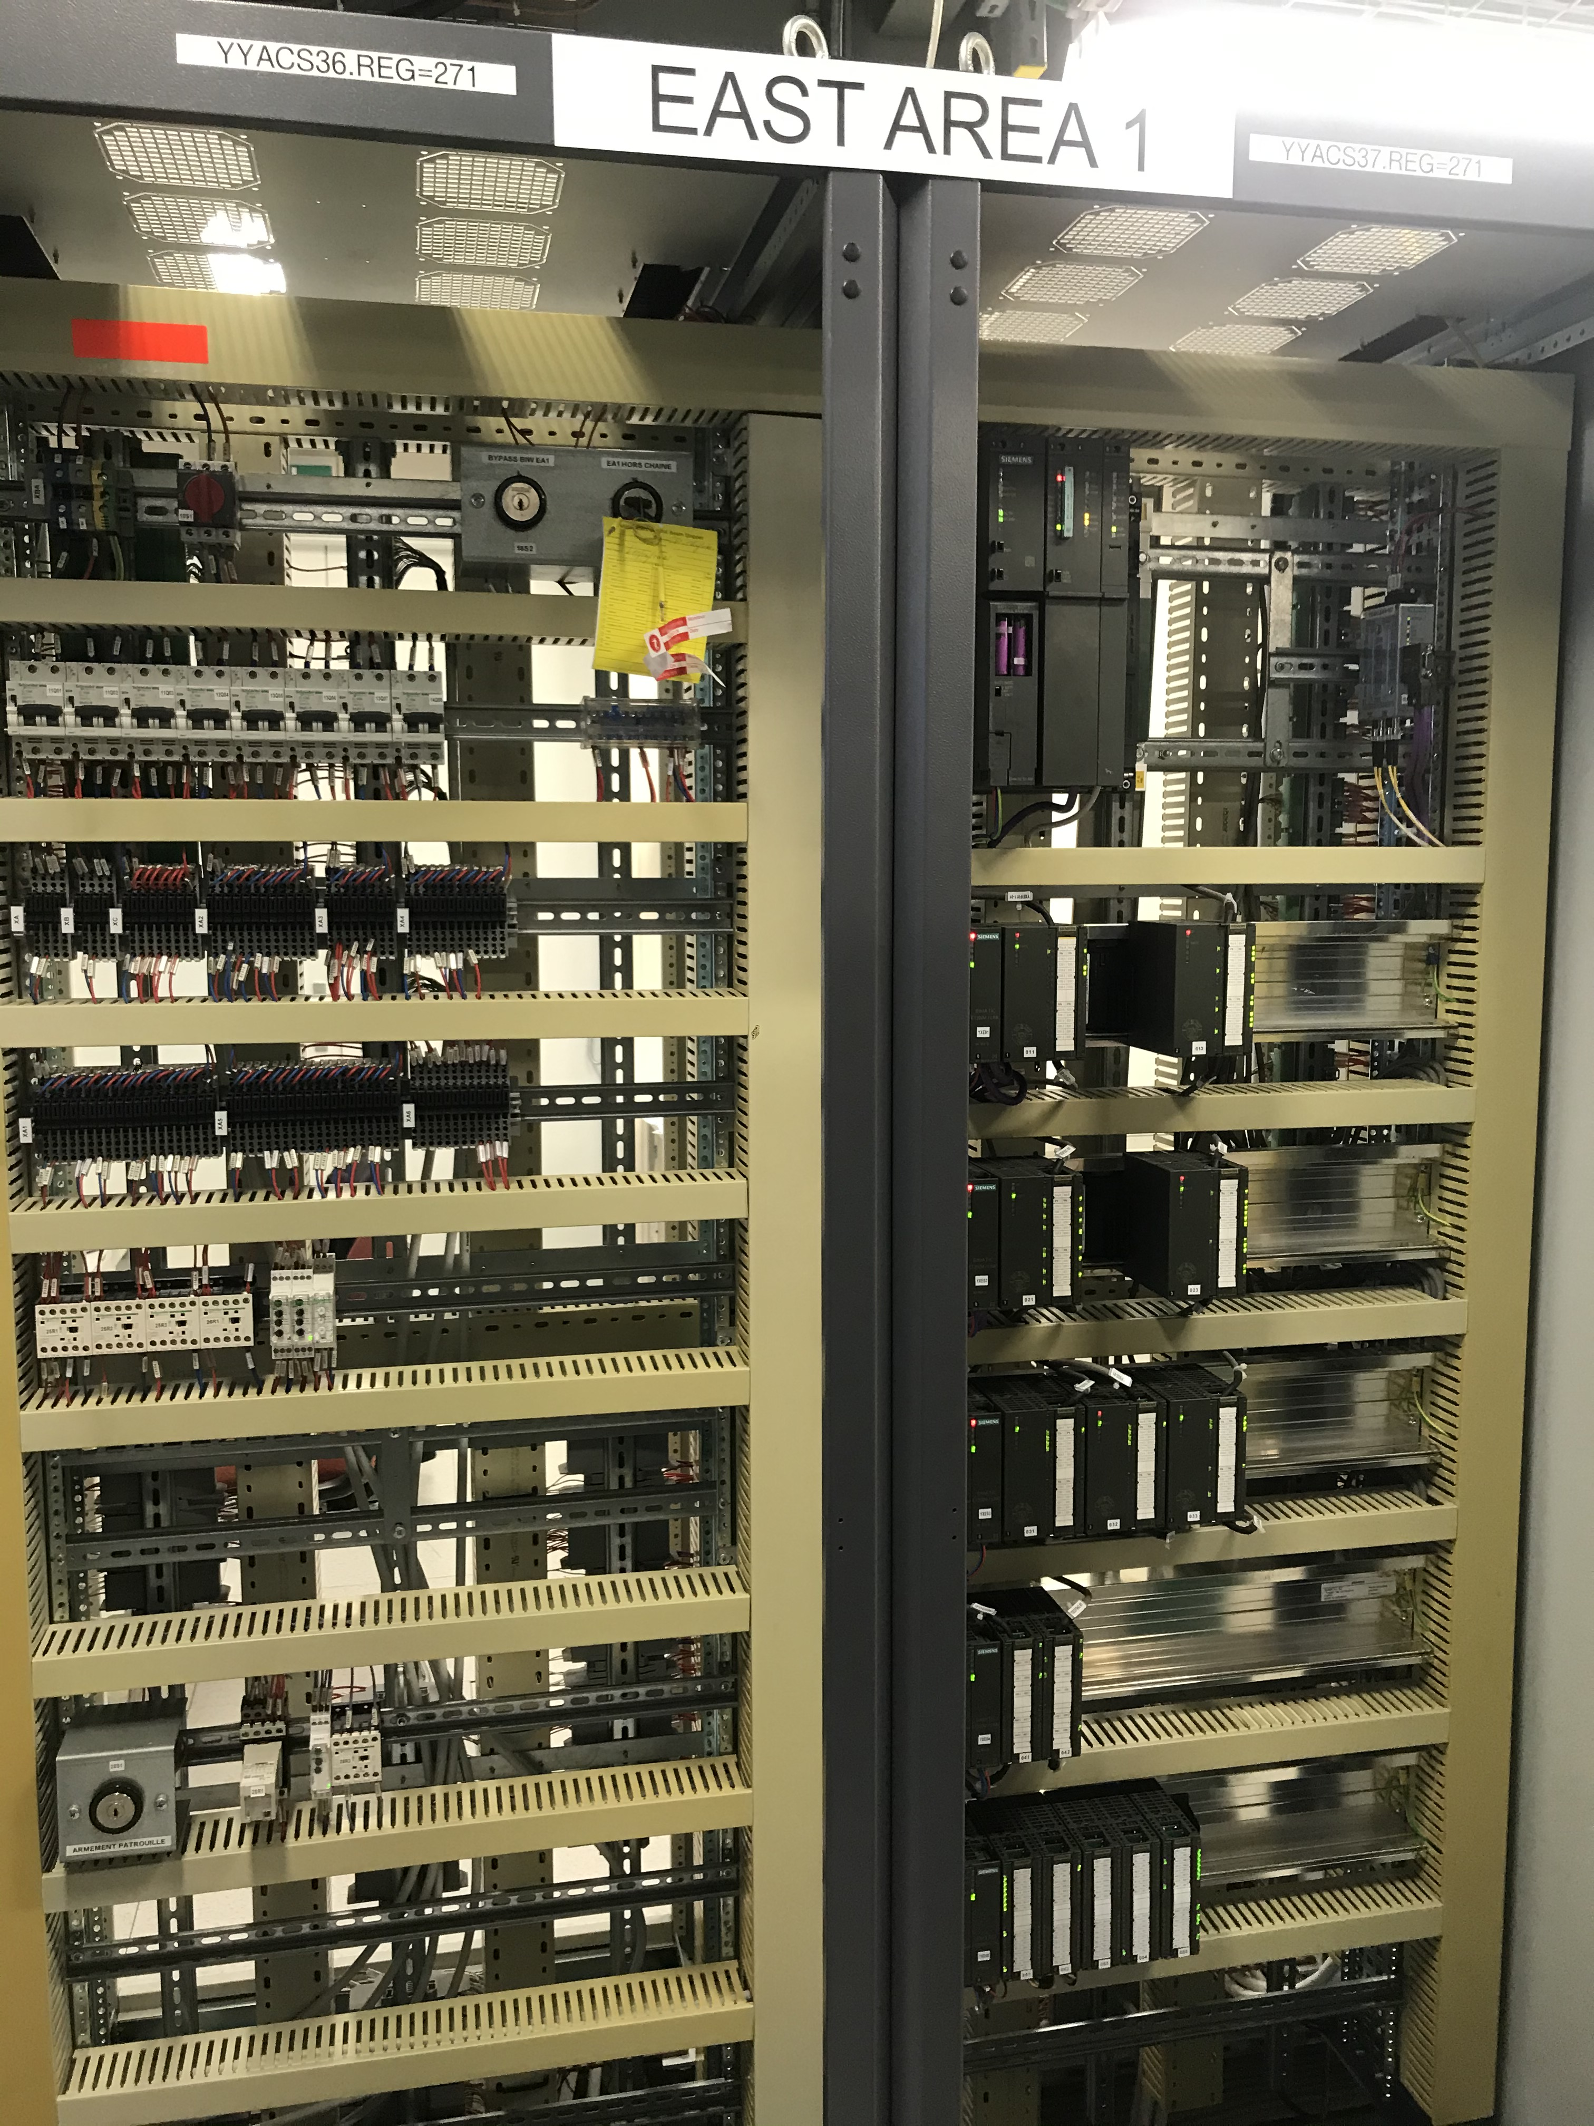
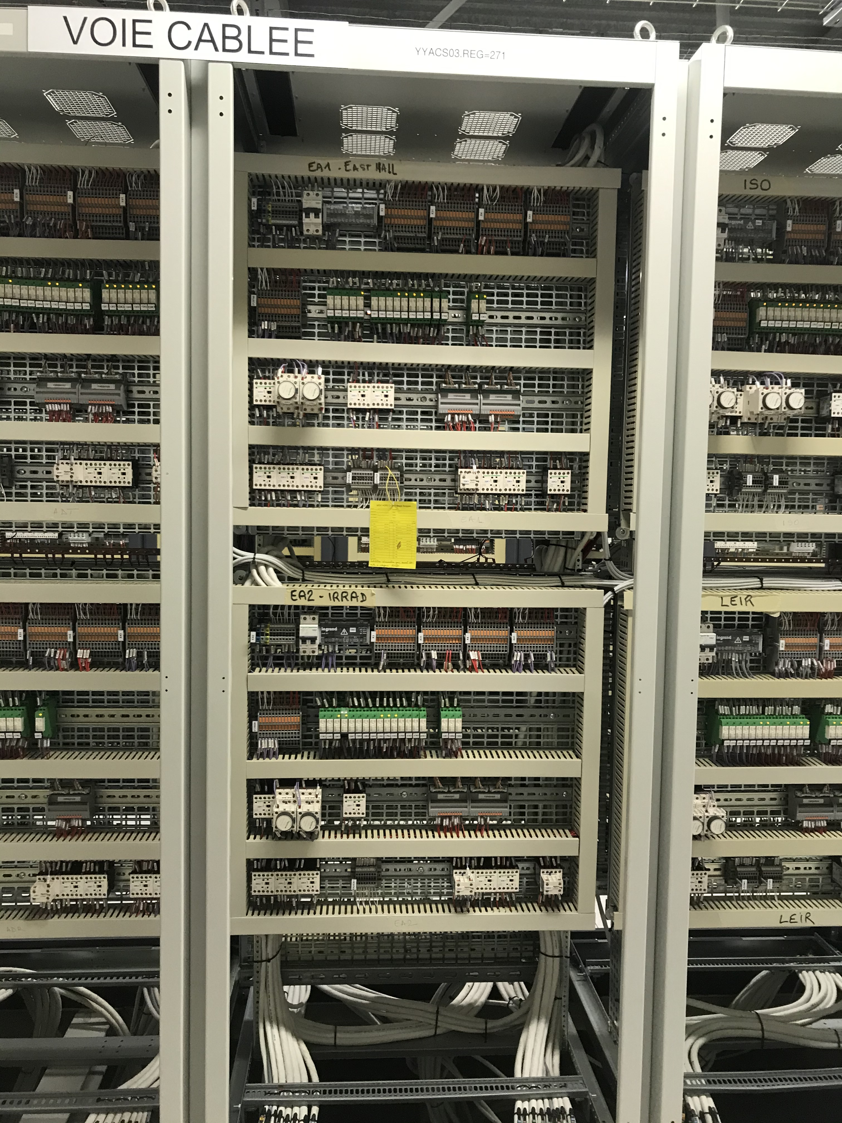
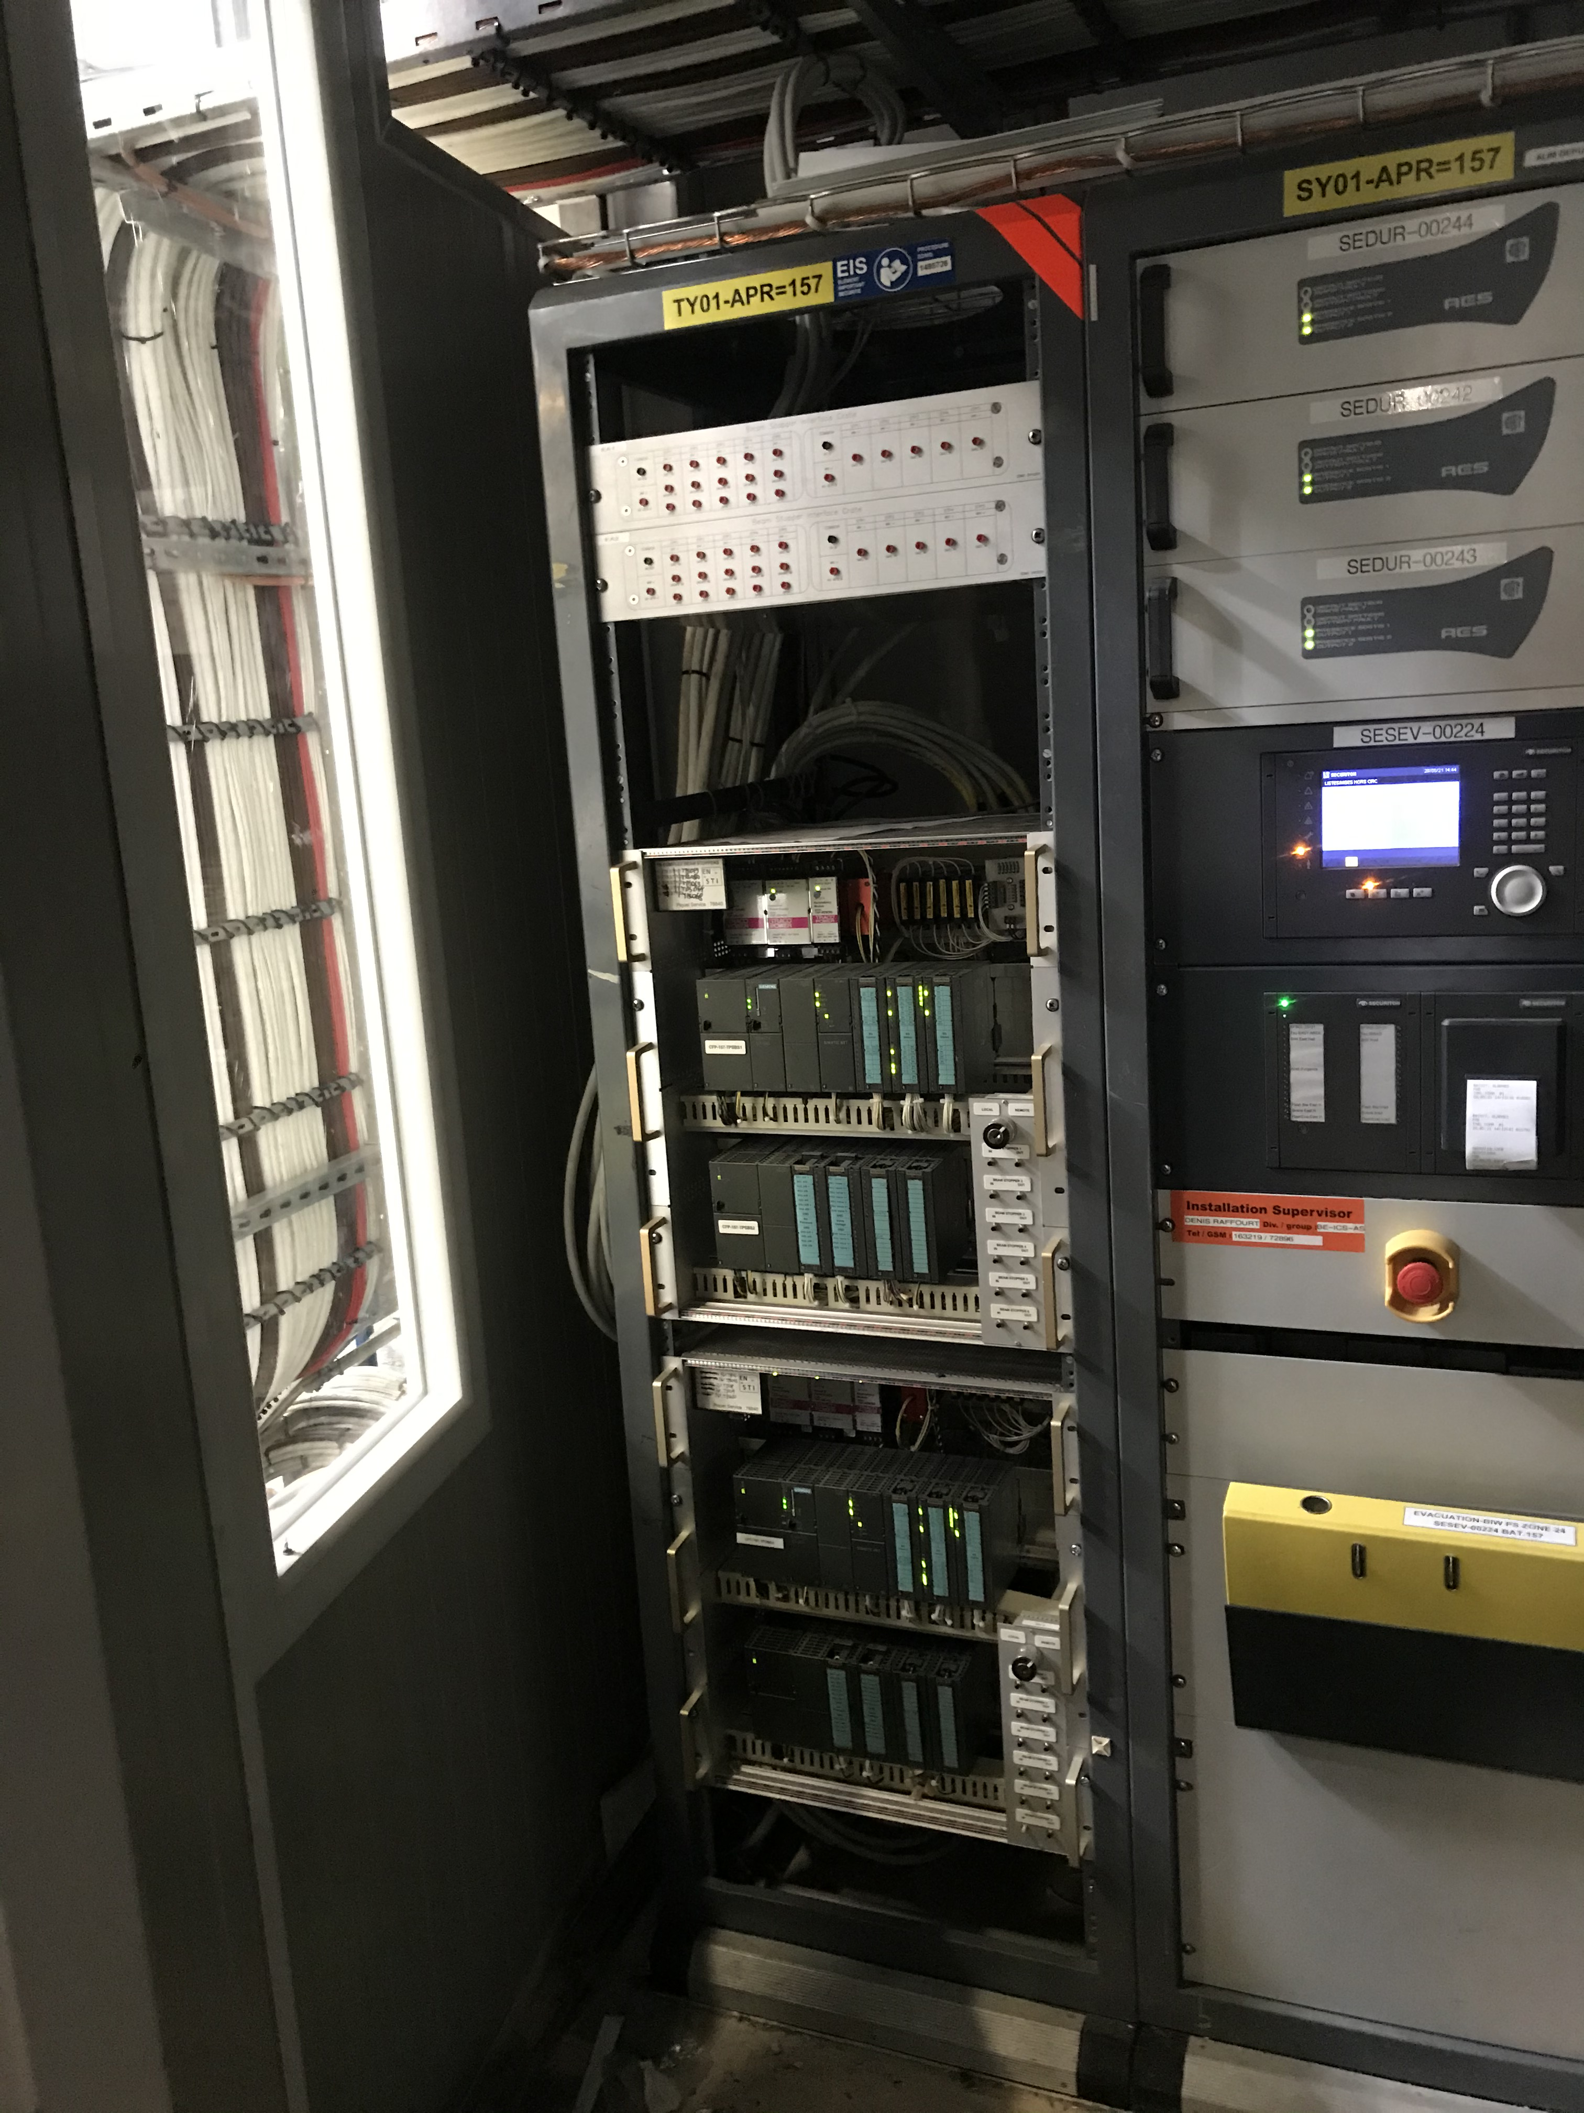
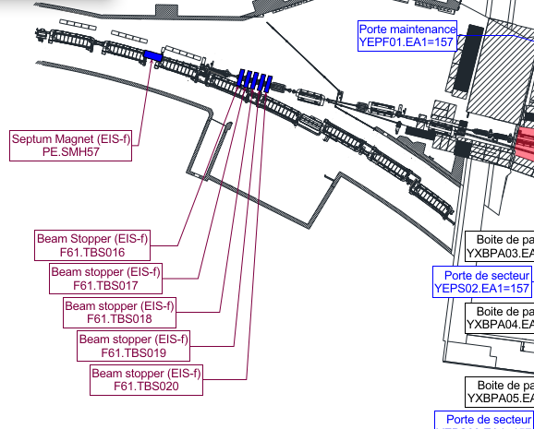
EA1 sectorisation update
Bat.271: Modification de câblage automate de zone EA1 et voie redondante (nouvelles portes de secteurs).
Bat.157 Apron: Intégration d’un nouveau châssis interface Beam Stopper zone EA1 (résultante de 5 Beam Stopper)

Slide 7
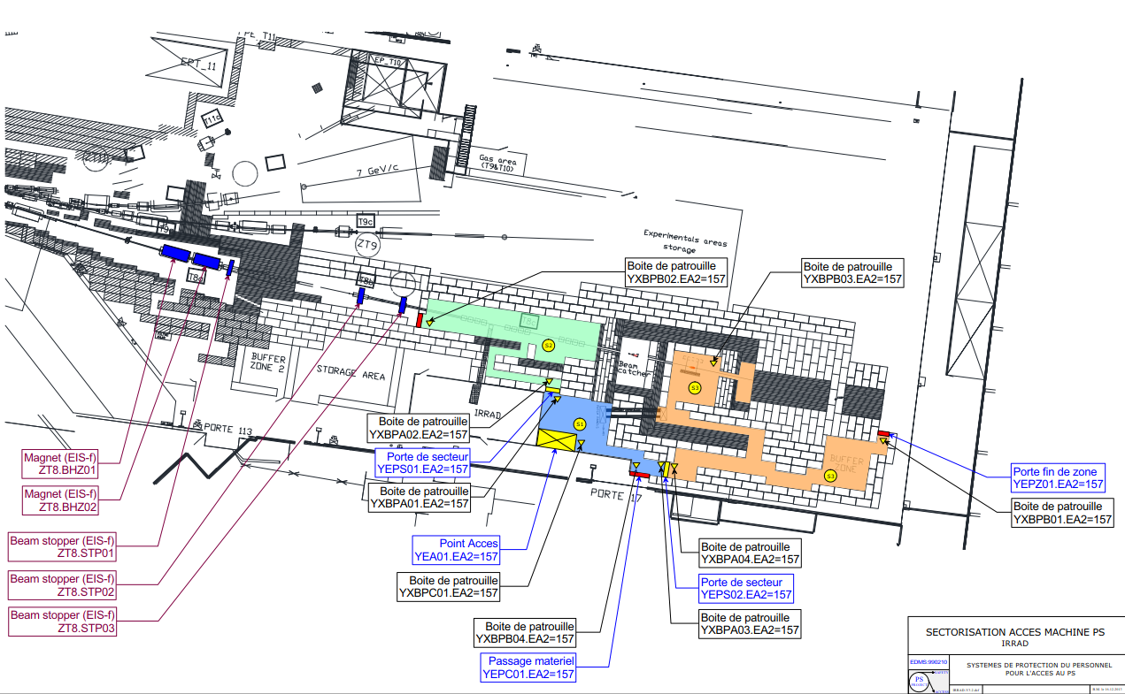
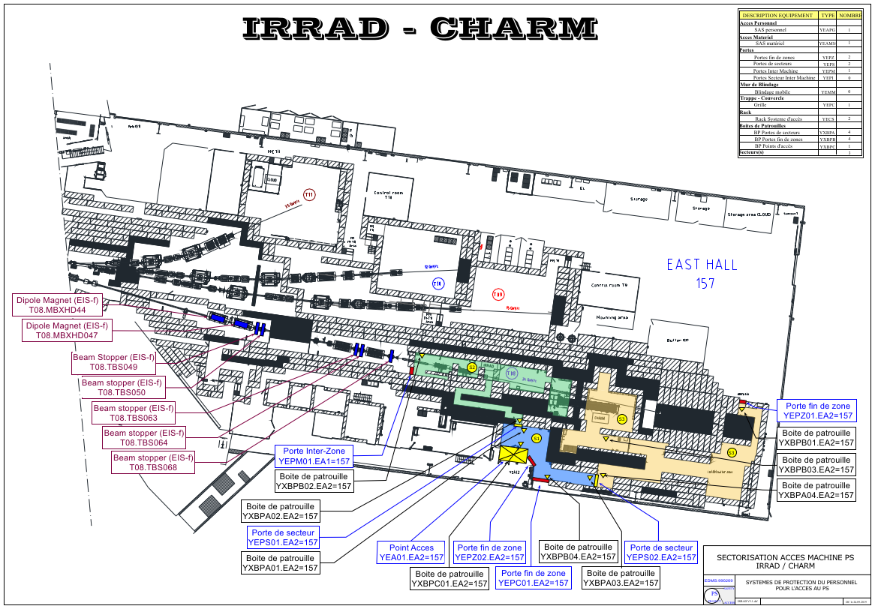
EA2 sectorisation update
Before East Area renovation
Current sectorisation

Slide 8
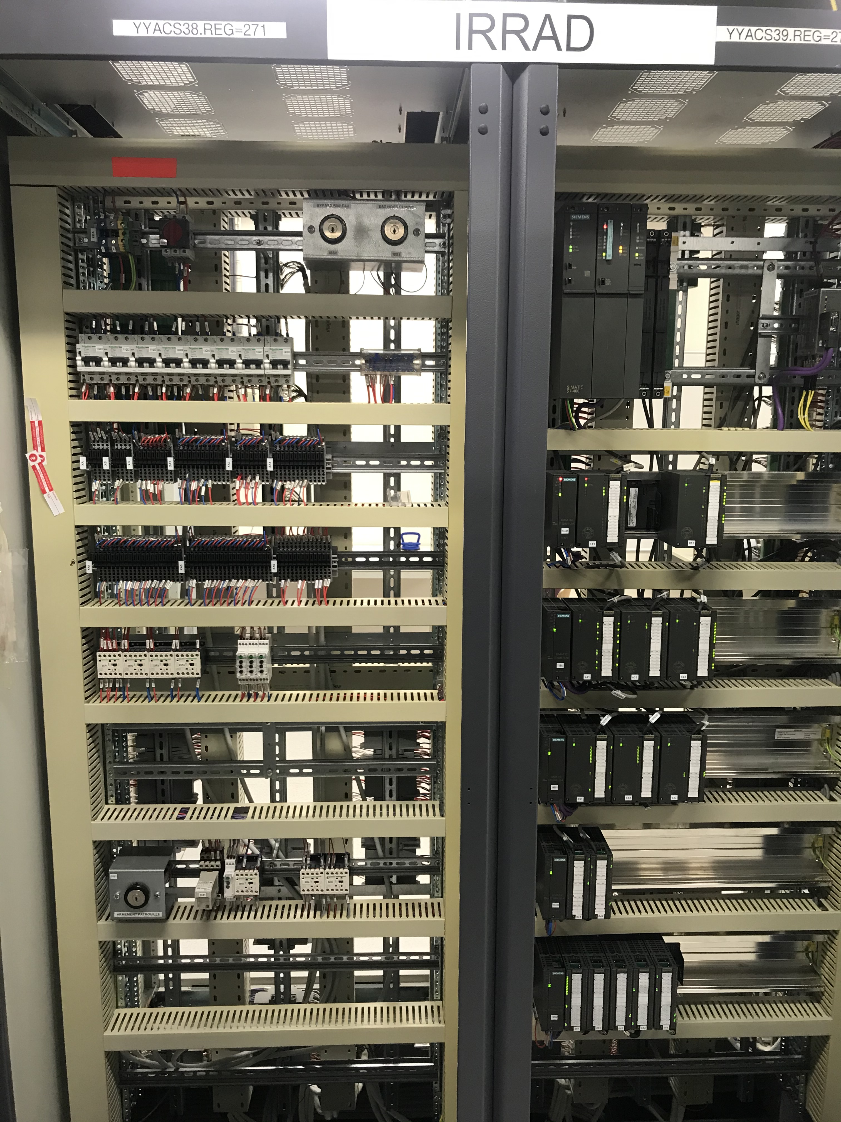
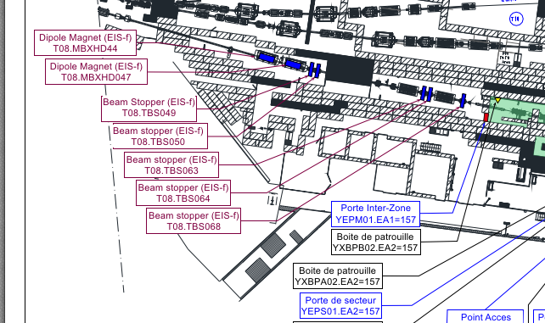
EA2 sectorisation update
Bat.271: Modification câblage automate de zone EA2 et voie redondante
Bat.157 Apron: Intégration d’un nouveau châssis interface Beam Stopper zone EA2 (résultante de 5 Beam Stopper)

Slide 9
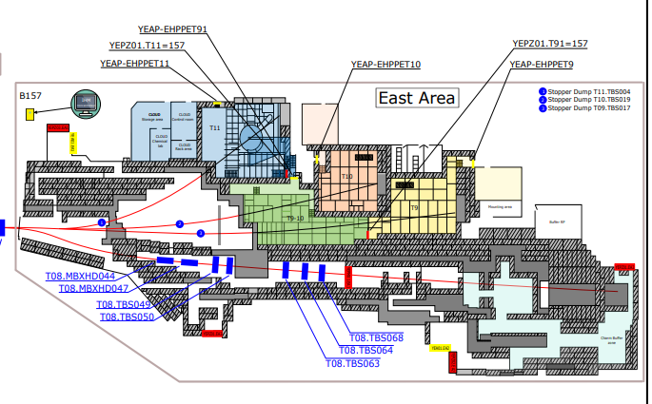
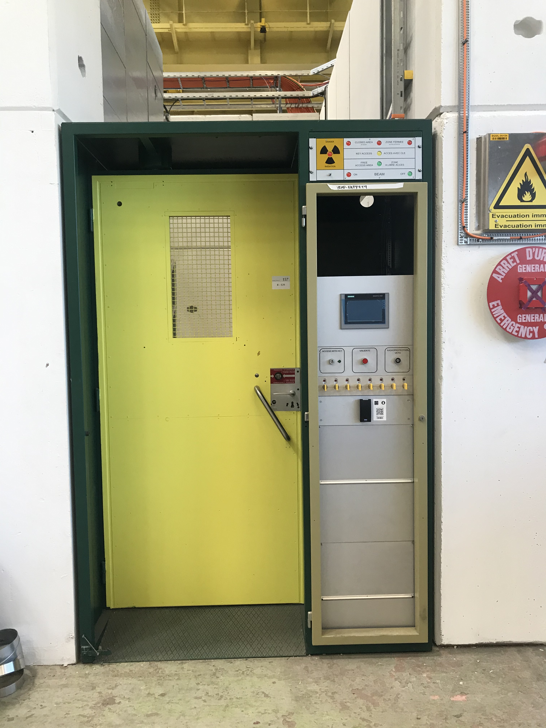
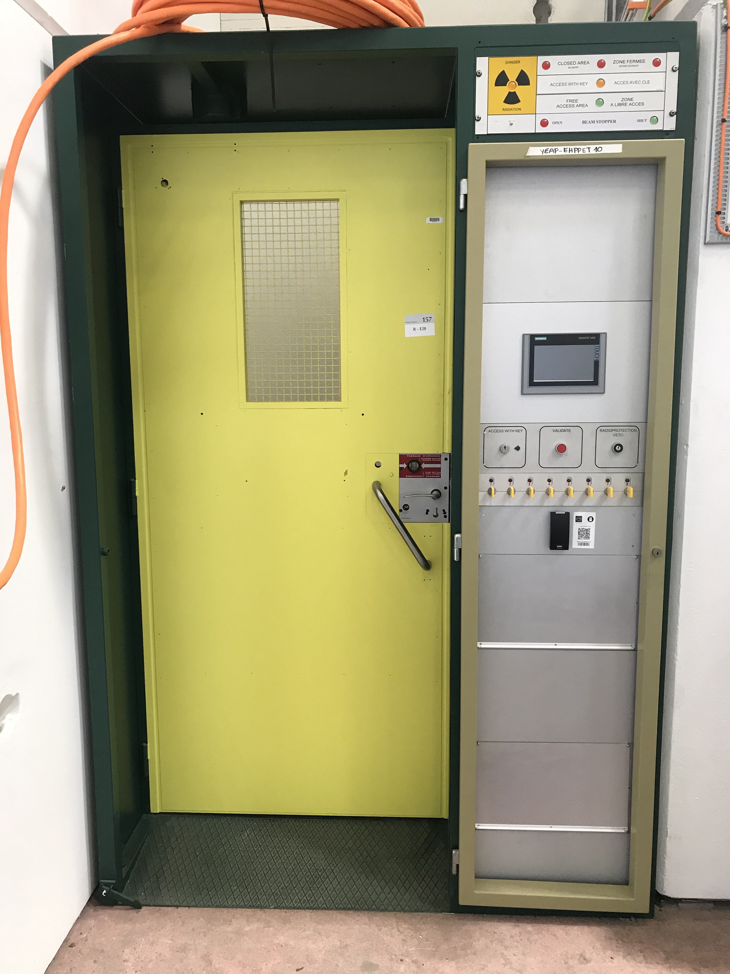
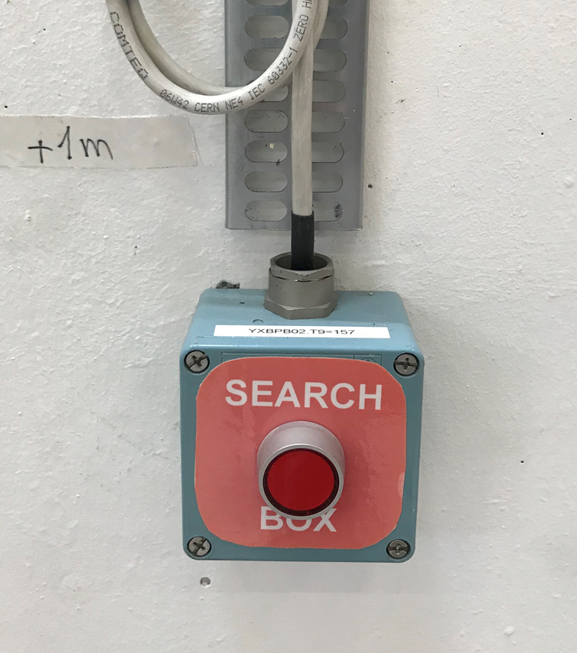
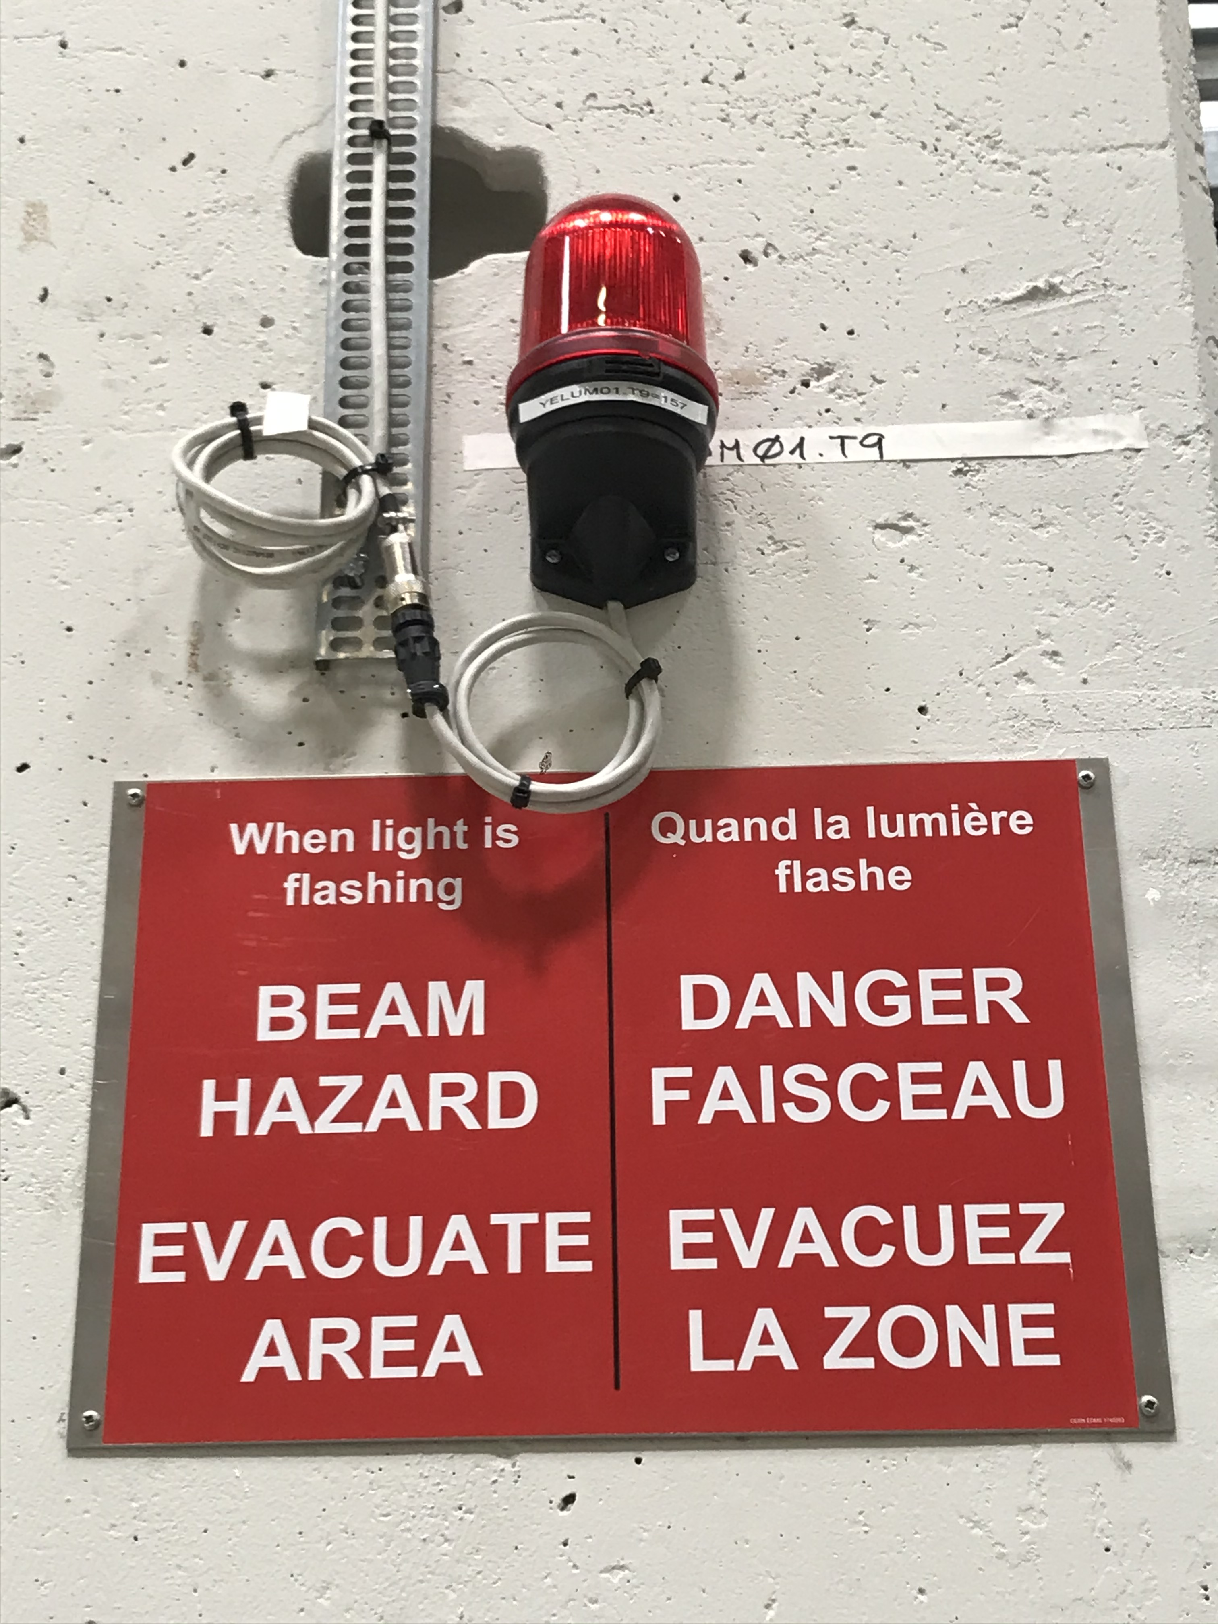
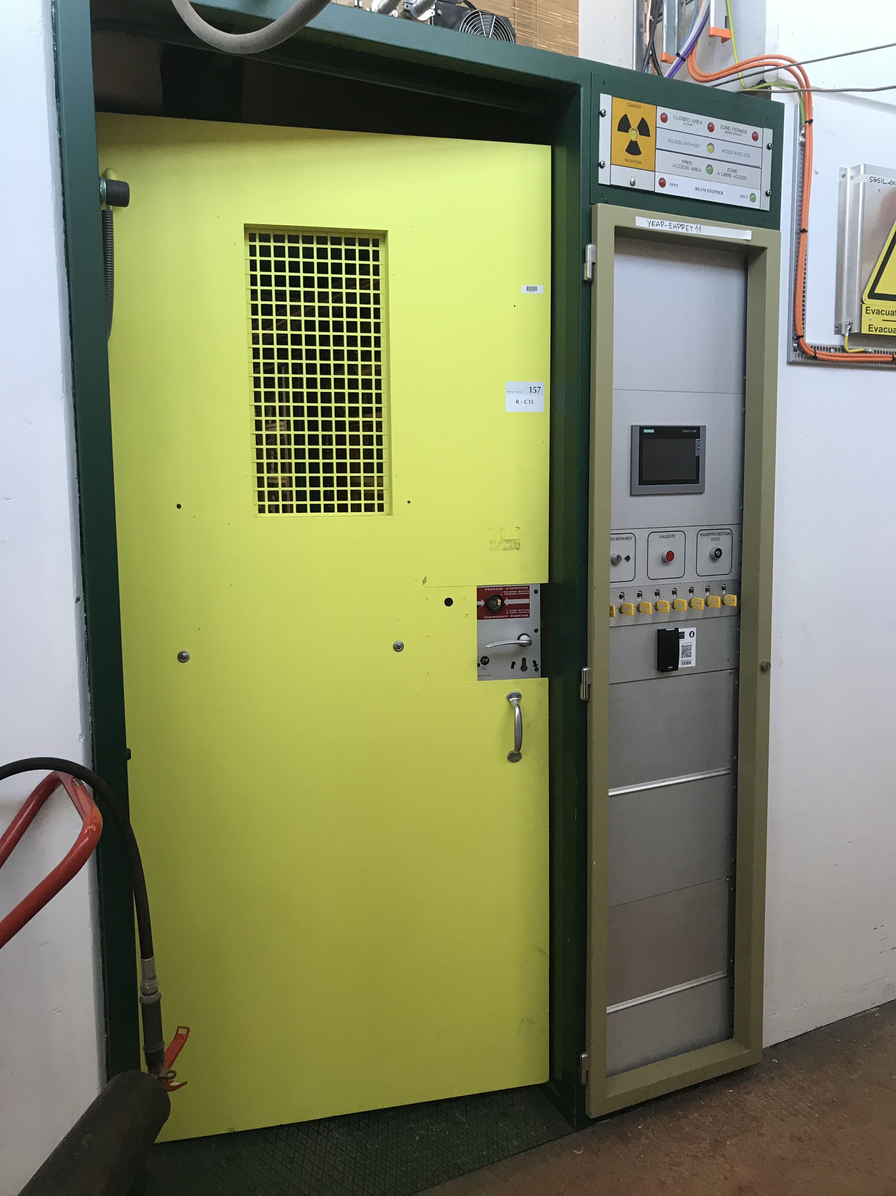
Experimental areas update
T9-T10-T11 Rénovation mécanique et update des PLC point d’accès. Nouvelles balises et search box.
Exemple de balise et de search box dans les zones expérimentales

Slide 10
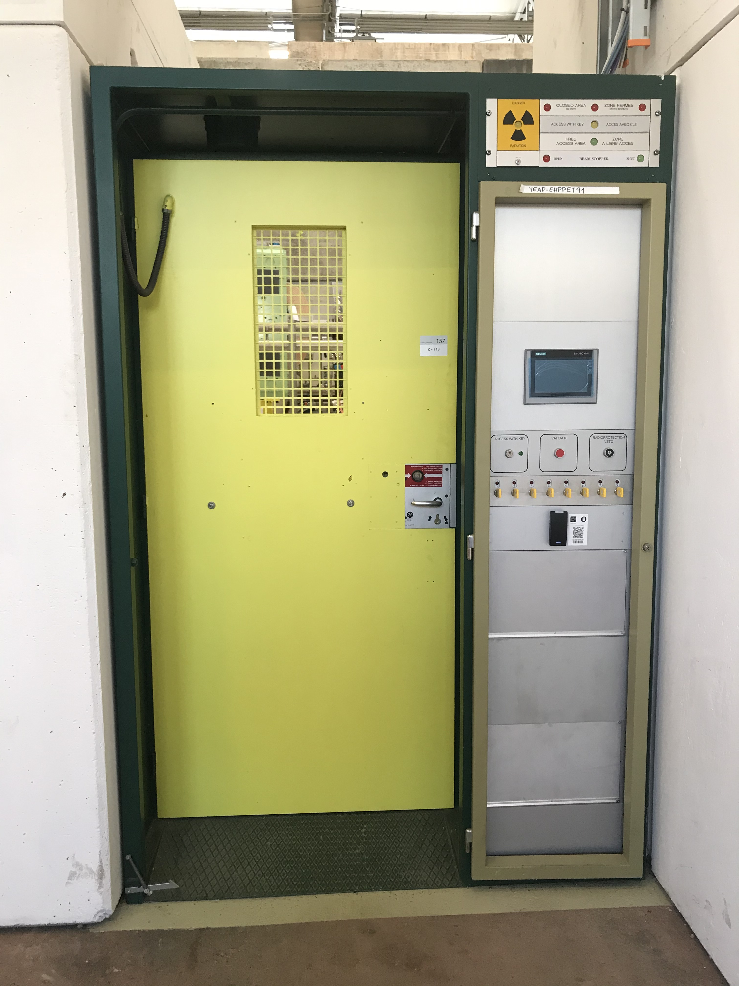
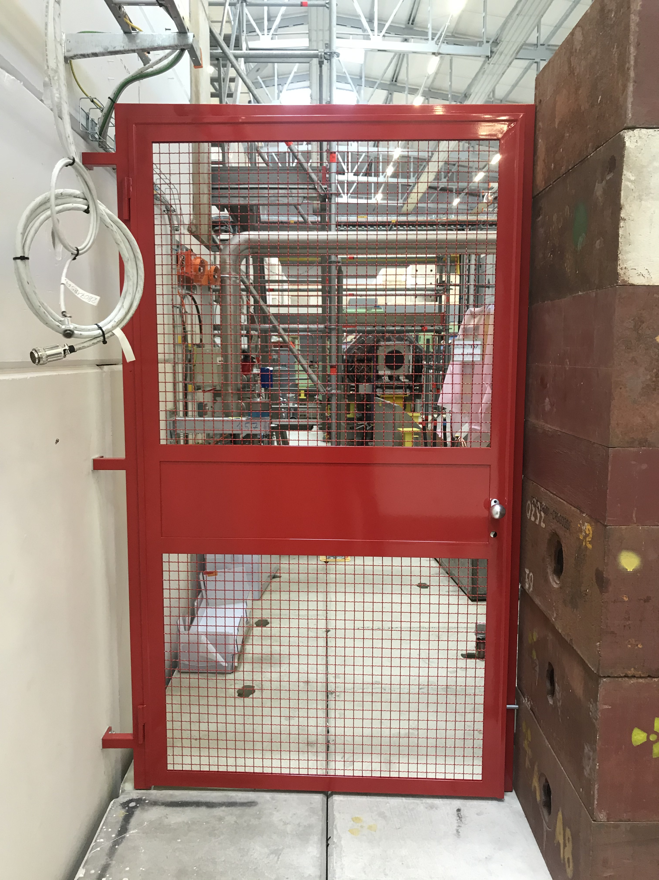
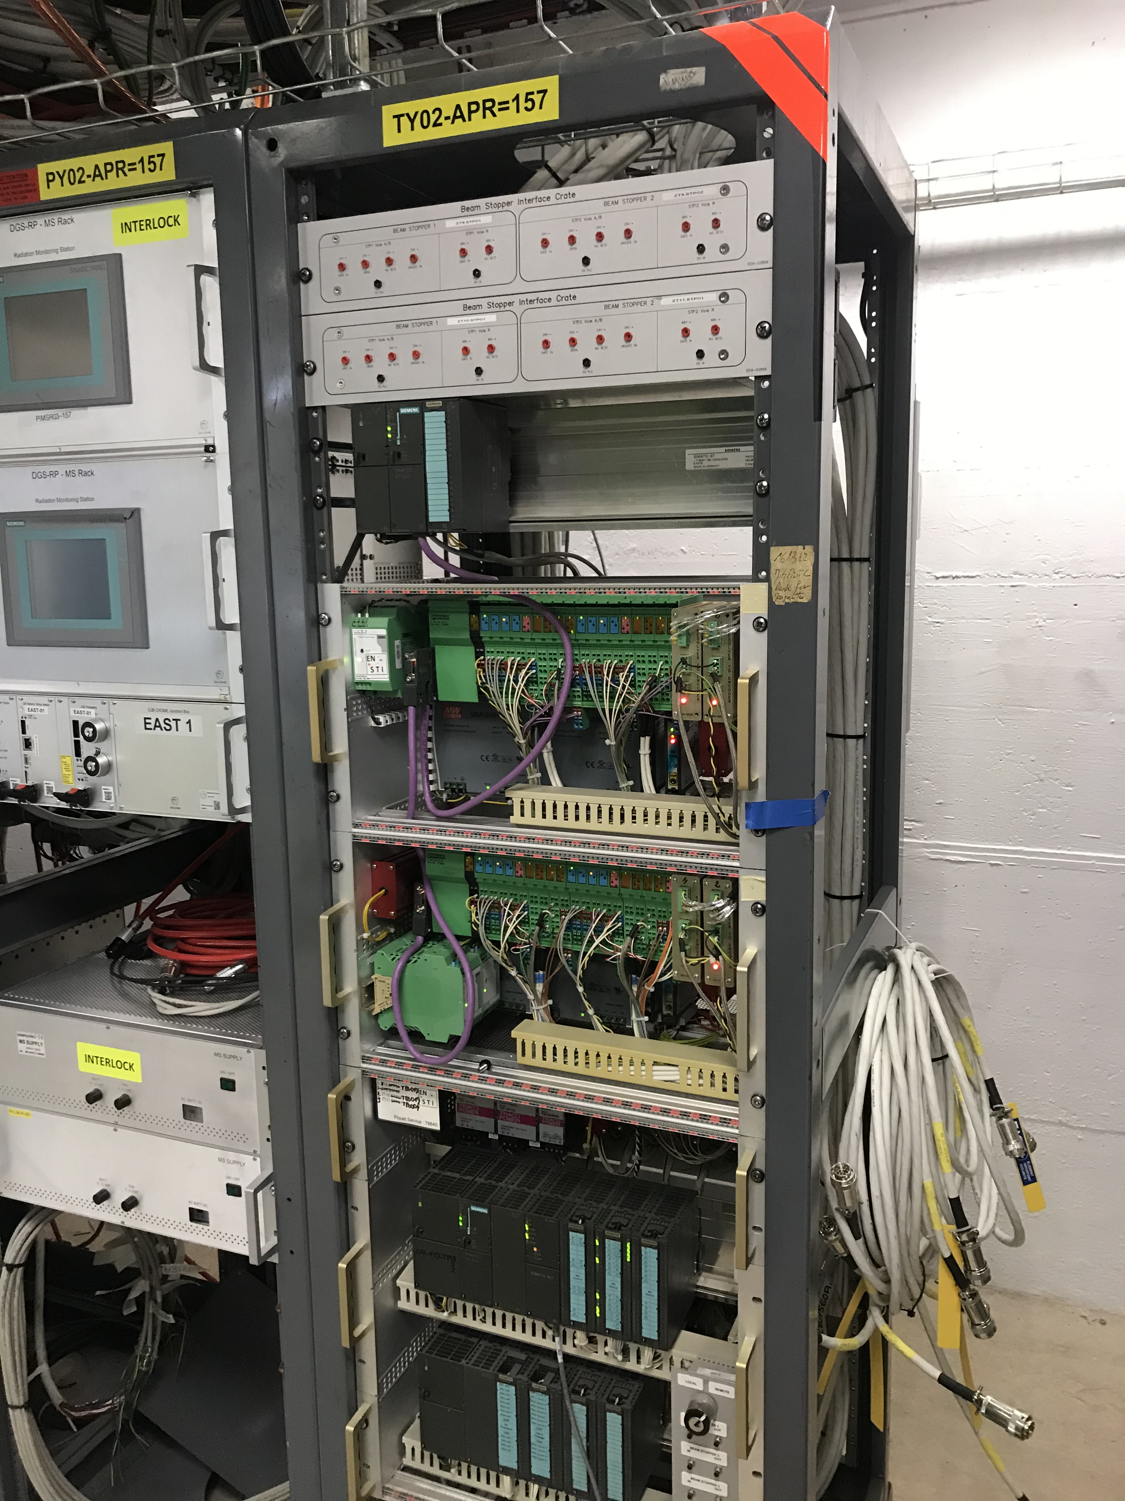
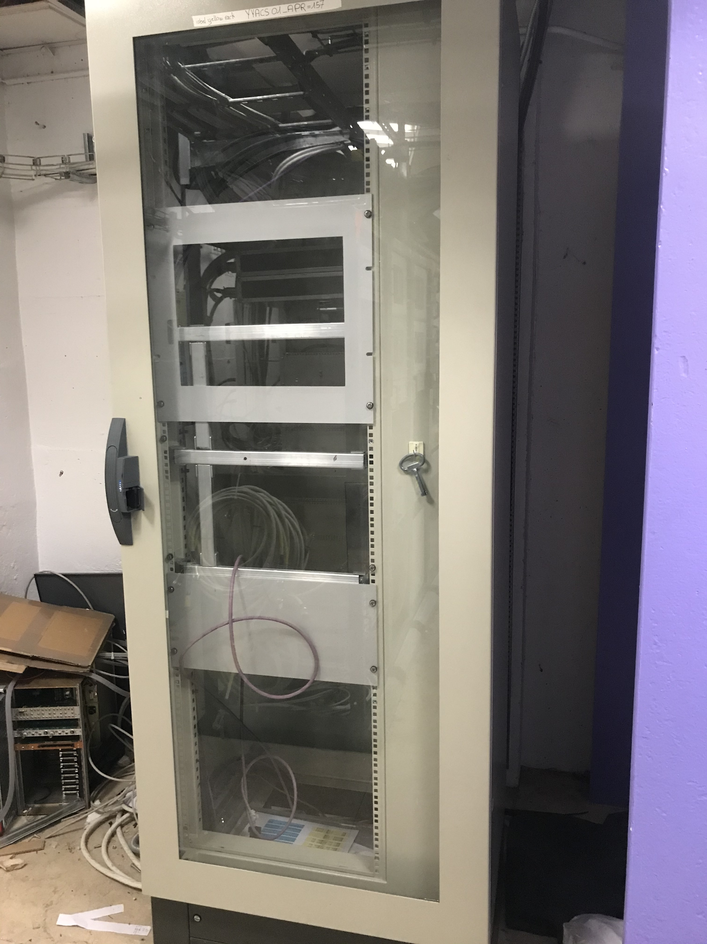
Experimental areas update
T9-10 nouvelle zone: monobloc PPE et une porte fin de zone
Bat.157 Apron: Châssis interface Beam stopper déplacés.
Bat.157 Apron: Rack automate concentrateur à intégrer.

Slide 11
Commissioning tests for EA1 & EA2

Slide 12
Commissioning tests phases
EN-AA synchro tests with EIS-a
Week 22
Electrical tests with external equipments
Week 23
Functional tests for EA1 & EA2
Week 24 (or 25)
IST document: https://edms.cern.ch/document/2426479
Planning: https://oss-coordination.web.cern.ch/gantt/latest

Slide 13
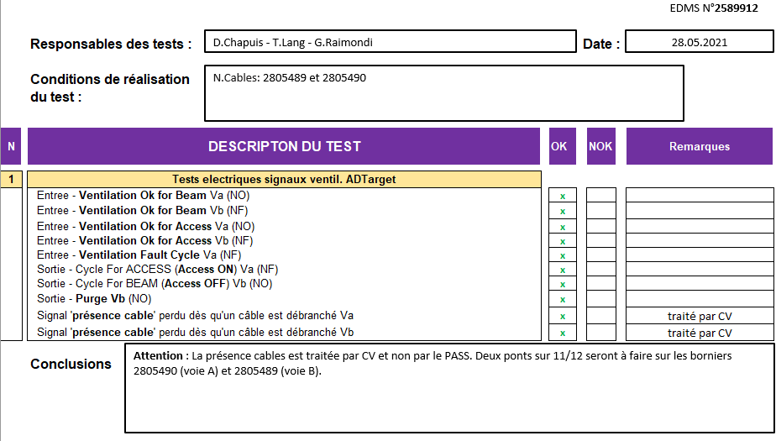
Interface tests status
Interface with ventilation: OK
Interface with beam stoppers: On going
Interface with SY-EPC: On going
Interface with BIW: should be ready end of next week

Slide 14
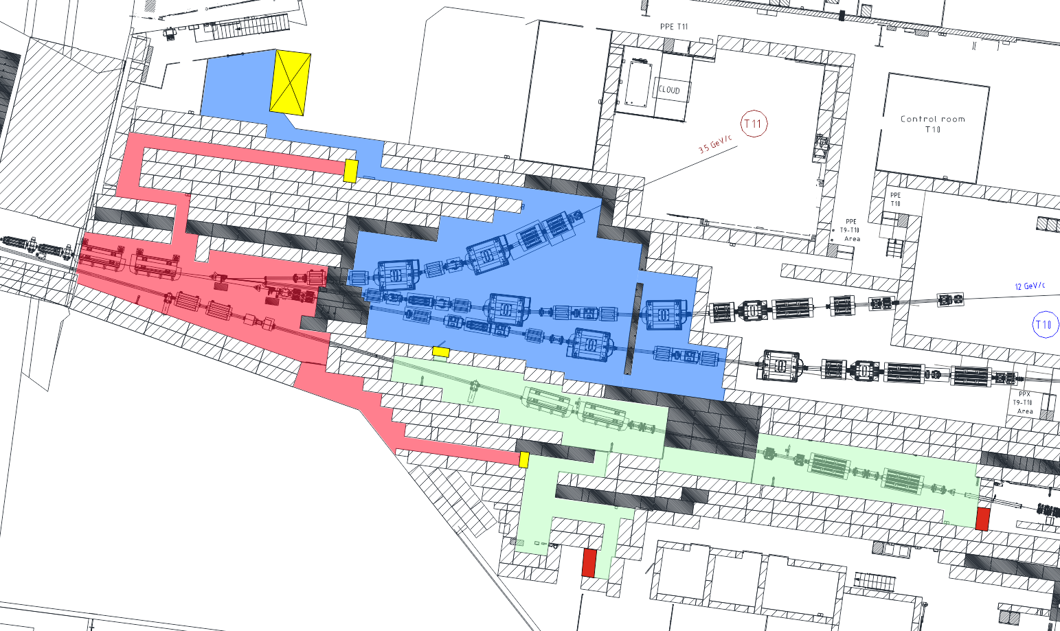

Functional tests EA1 & EA2
We would like to profit of the absence of activity during the hardware tests to perform our functional tests
To be confirmed by EAR project.
No impact on the PS beam operation since the upstream securisation is bypassed and will only be tested during the DSO tests
SMH57 will only be tested during the DSO tests as well because it is locked out as a compensatory measure of the absence of personnel protection system

Slide 15

Summary
No show stopper identified regarding the technical aspects. We just need to organise ourself according to our ressources and EAR activities.
Functional tests of EA1 & EA2 should be done in June
  If not, it should be postponed to the end of August
Commissioning of the experimental areas scheduled for the end of August.

