Slide 1
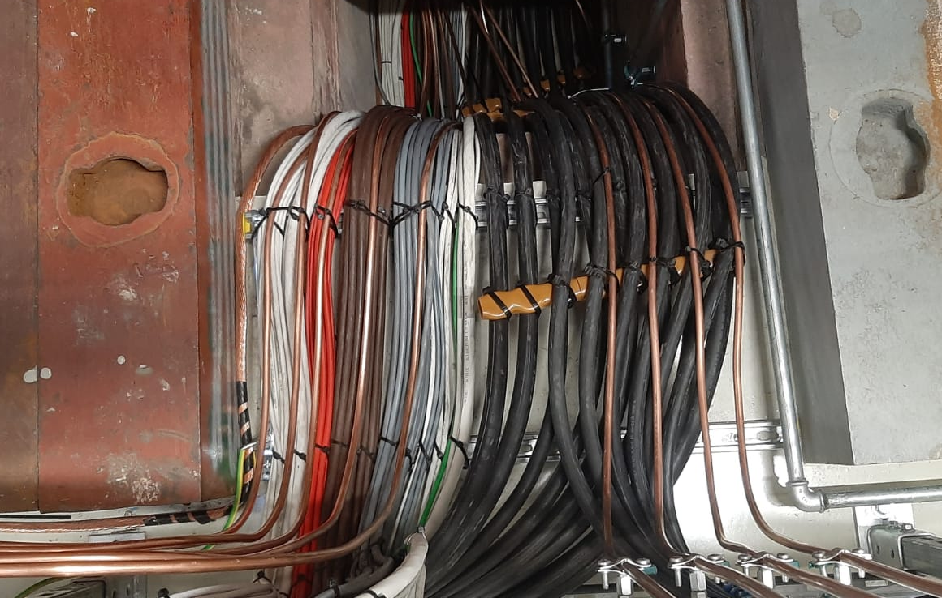
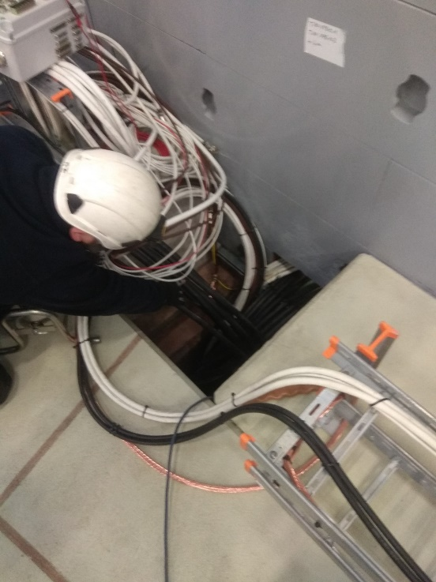
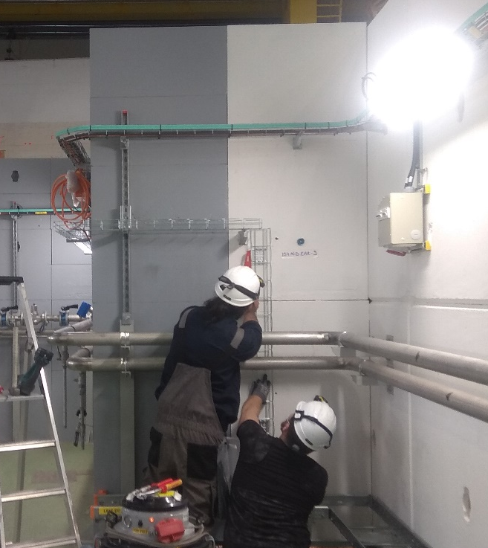


East Area Renovation – Cabling campaign
11th EN-EA East Area Equipment Review 04.06.2021
A. ALONSO (BE-EA)

Slide 2
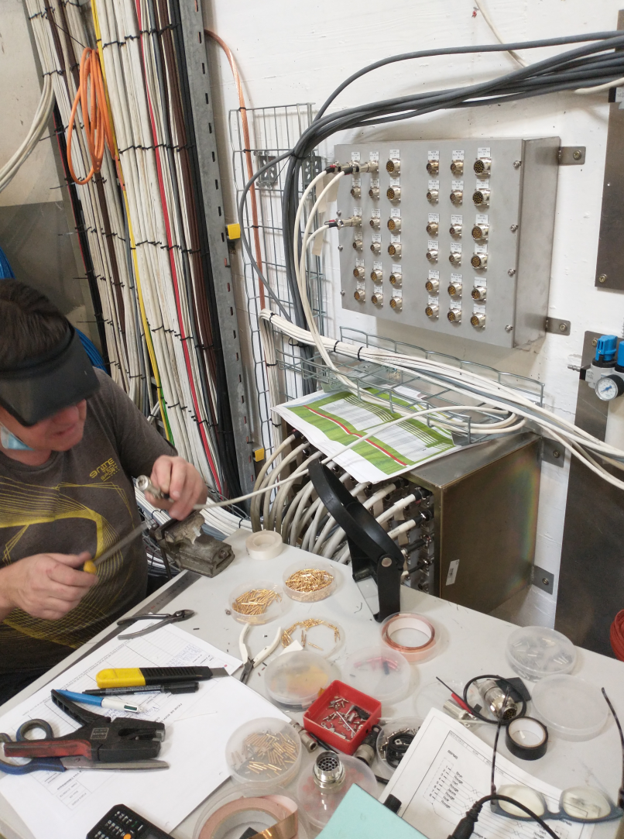

Cabling campaign
Control cables
Old control cables removal
DC cables
Old DC cables removal
Earthing
Worker installing connectors

Slide 3
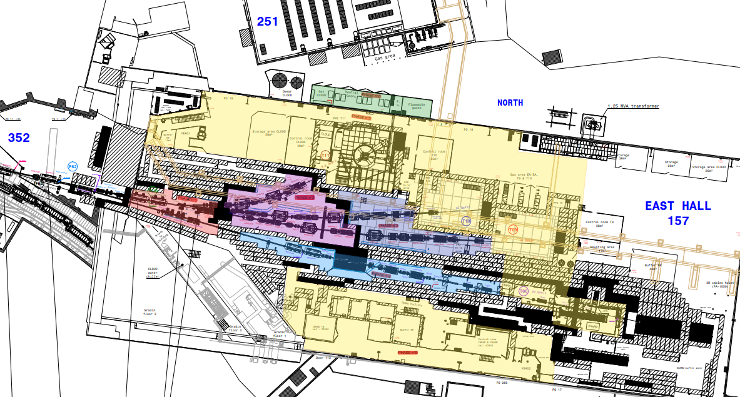
Phases of the Project
PHASE 7
Various
PHASE 6
PHASE 5
PHASE 2
PHASE 1
PHASE 3
PHASE 4
04/06/2021

Slide 4
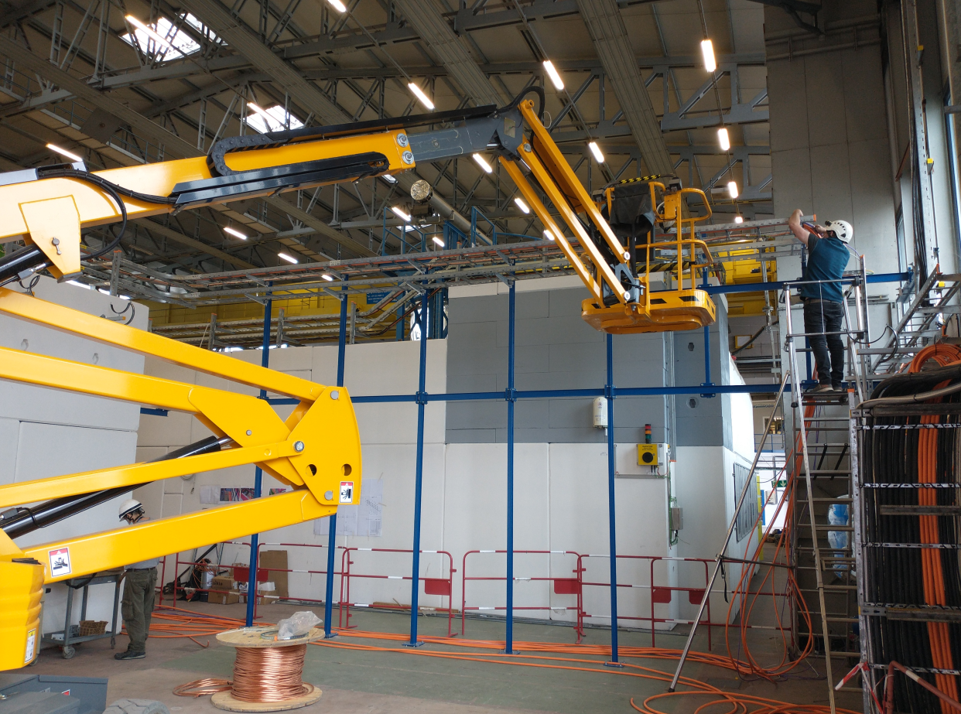
Control cabling
96% Completion
652 Cables on the original planning
  30 Removed
  244 Modified
  21 Modified twice
860 Connectors
728 Cables at the moment
50,5 Km of cables
More cables are expected to be added during construction, commisioning or even operation
Cable bridge created to pass cables to the exterior of the building

Slide 5
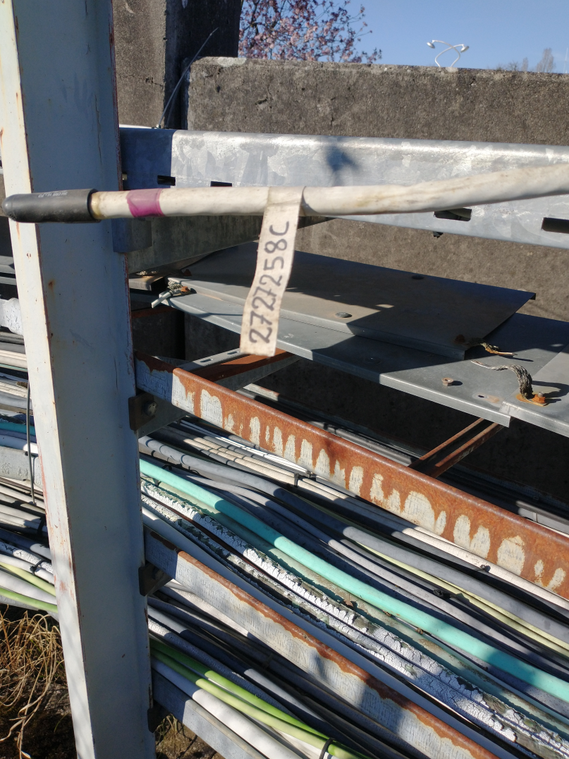
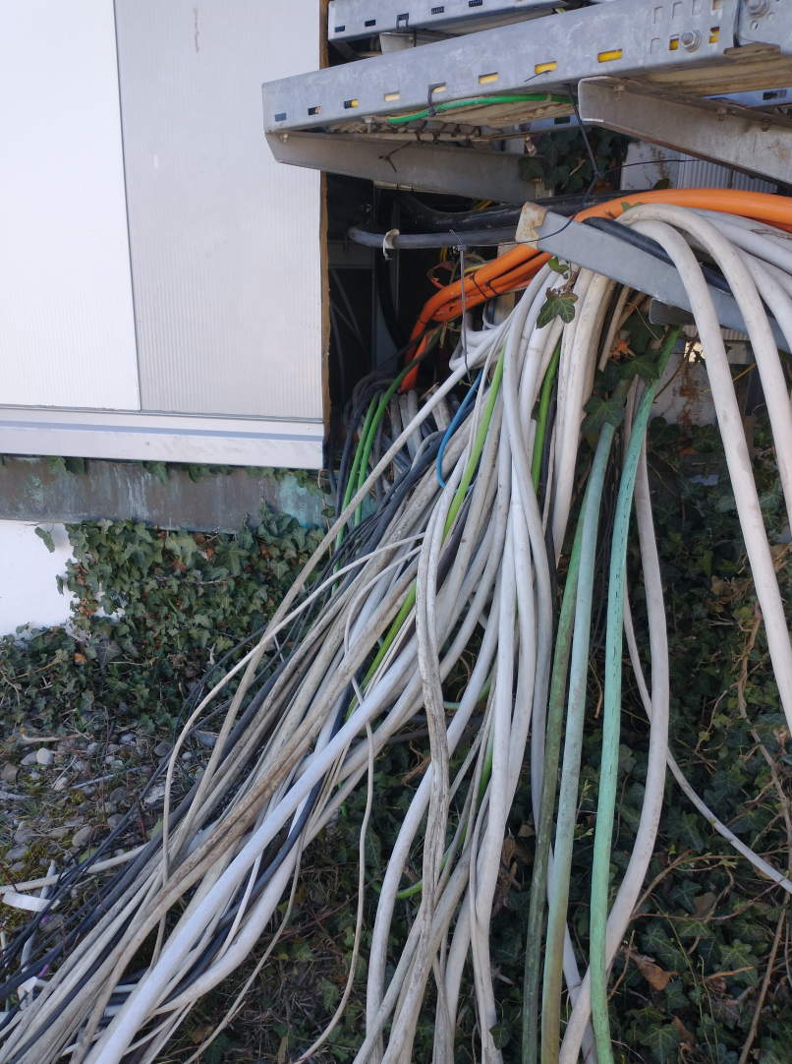
Old control cable removal
A few cables remaining
4,5 Km of cables removed
Pink label mark a cable to be removed
Cables to be removed at exterior of the building

Slide 6
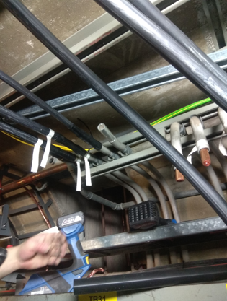
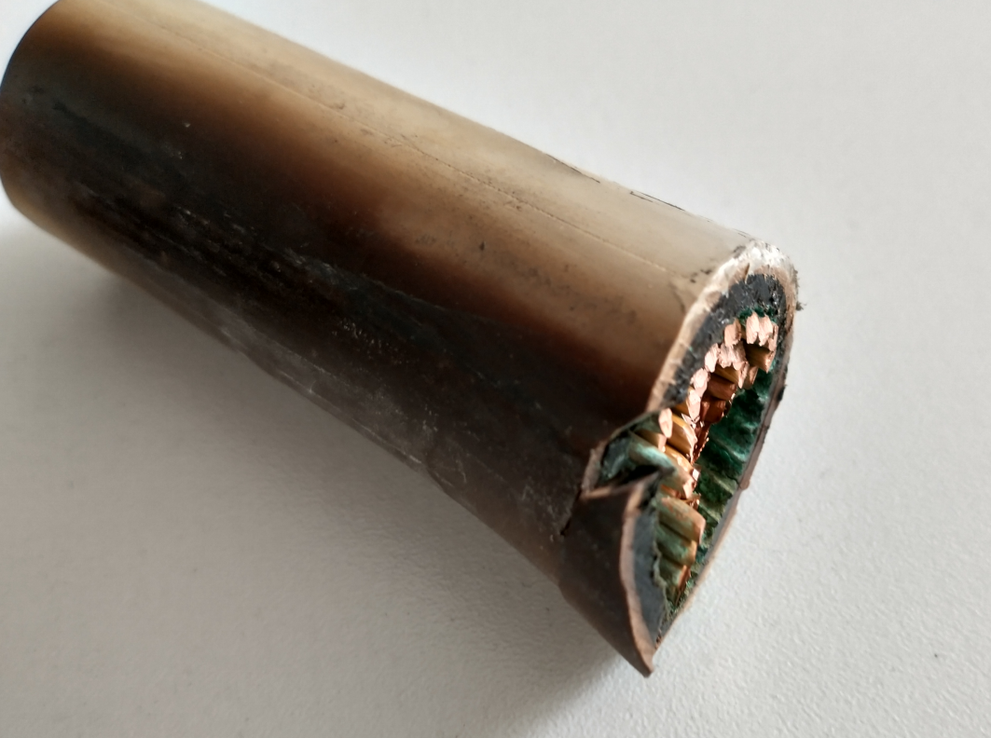
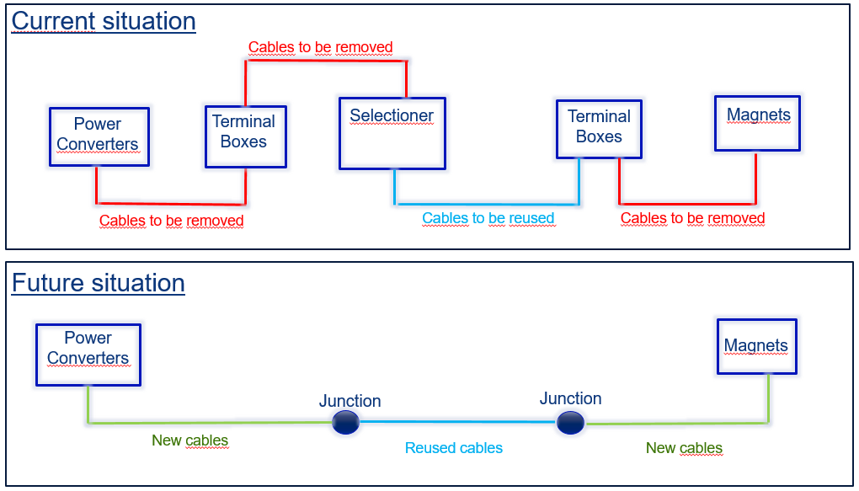
DC cabling
Last 2 magnets to be installed
128 DC cables
  36 cables of 120 mm2
  92 cables of 240 mm2
Old situation
Example of cable rusted and burned in the gallery
New situation
The external surface in some remaining cables is not in perfect conditions.
Possible manipulation or movement could cause damage of insulation
Joining the old cables with the new ones at the gallery
40 m

Slide 7
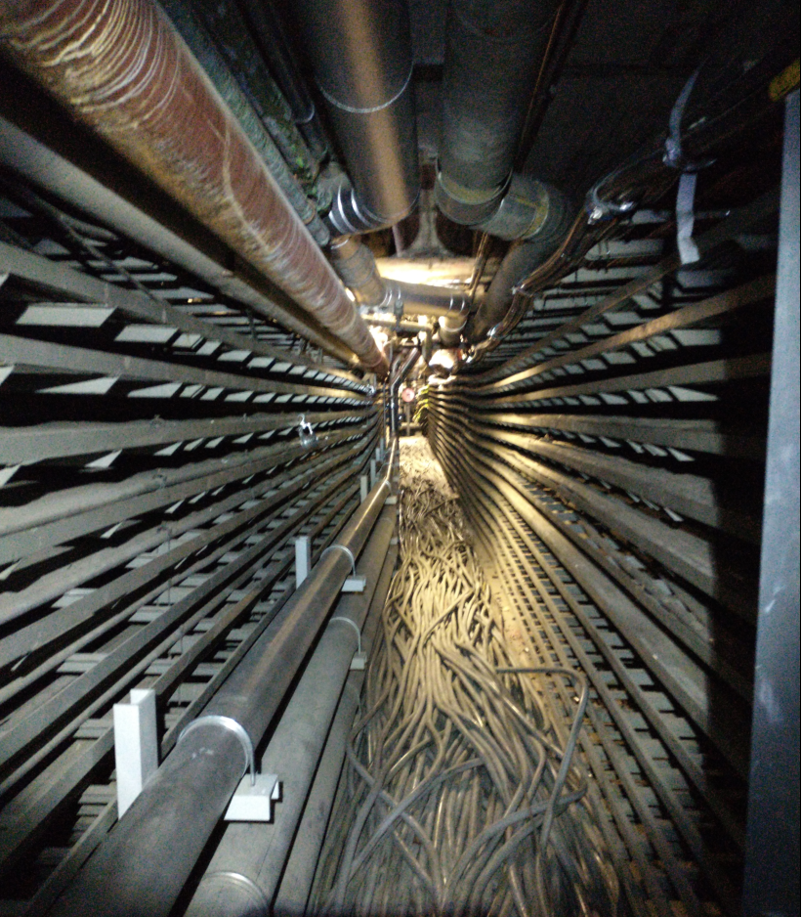
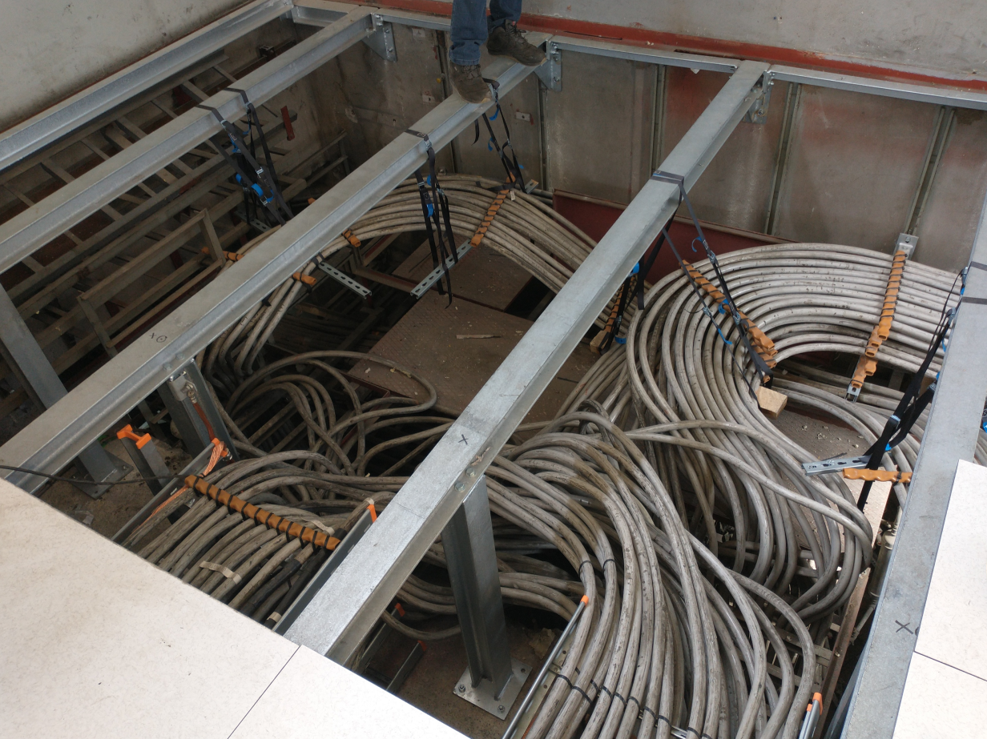
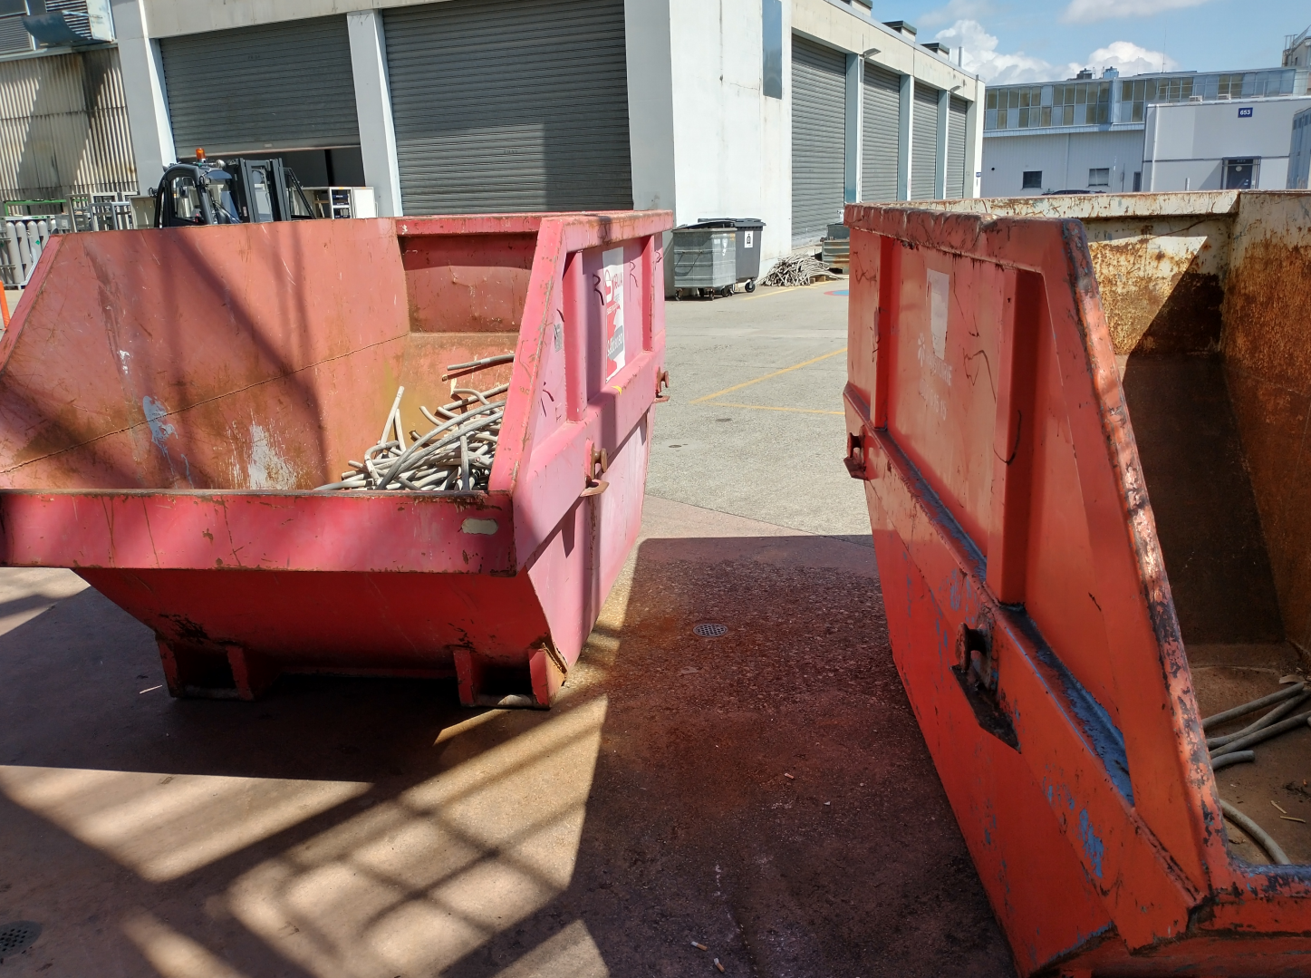
Old DC cable removal
3 more weeks of work remaining
120 cables removed
7,2 Km of cables
The extracted cables will be sold and the money will cover the extraction job and more
Old DC cables to be kept at Building 251
Old DC cables to be removed at the gallery
Removed cables waiting to be sold to recycle

Slide 8
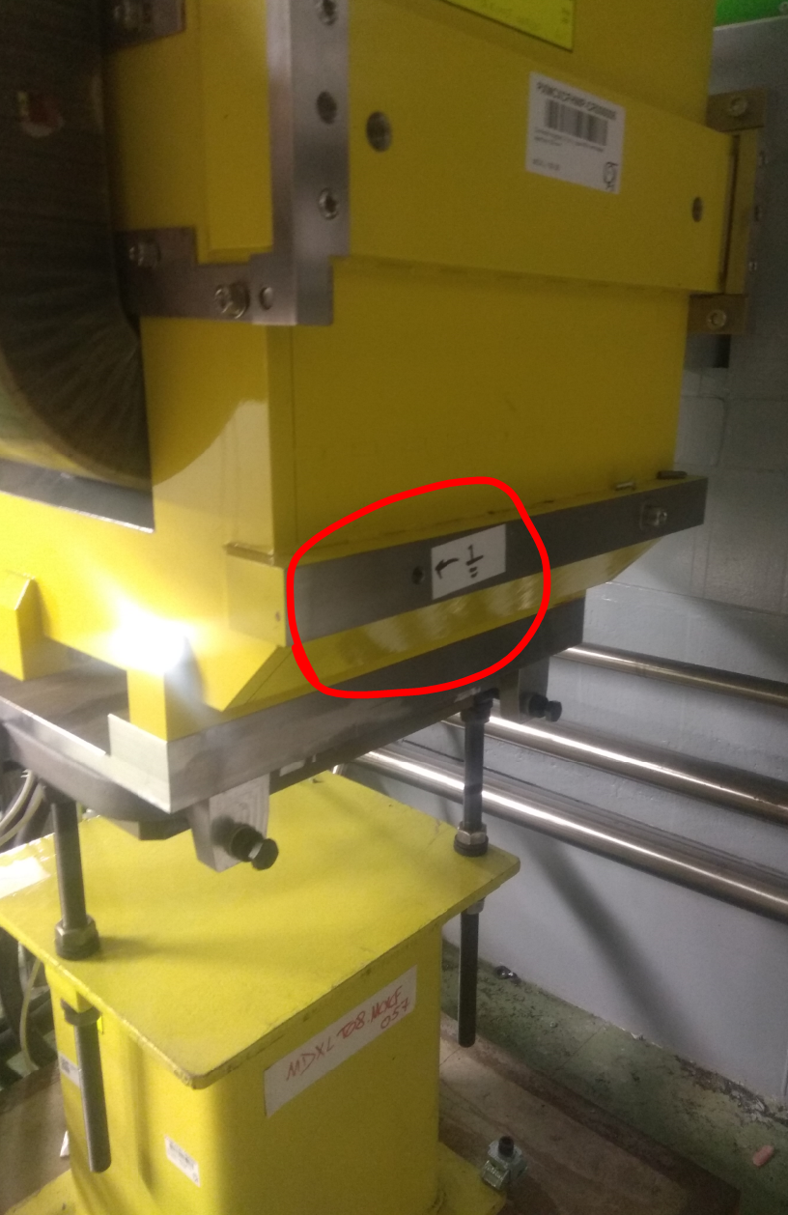
Earthing
20% equipment missing
Around 100 elements to be grounded
80% Completed
20% Elements not at place yet
CERN orders a minimum of 16 mm2 of earthing
For the equipment connected to DC cables 35 mm2 and 50 mm2 of earthing cable were used for extra safety

Slide 9

Thanks for your attention !
04/06/2021

