Slide 1



n_TOF Physics Report
67th INTC Meeting
Javier Praena
Universidad de Granada (Spain)
CERN Scientific Associate (EP/SME) n_TOF Physics Coordinator
1

Slide 2



INTC recommendation Nov 2020
In the committee’s view, the commissioning part is unavoidable for reliable and safe operation of the facility. In addition, experience by the collaboration with the planning and interpretation of experiments has shown that the characterisation of flux, spatial profile, resolution function and background are essential for any physics campaign. Therefore, the requested protons should be allocated. Optimization of beam time in 2021 will be called upon by those with approved experiments. It is however, strongly recommended that these optimizations are not allowed to compromise good commissioning and a high quality characterisation of the experimental conditions.
The INTC recommends 1.78e19 protons for approval by the Research Board.
2
Javier Praena – U. Granada – CERN (EP/SME)
Isolde Neutron Time-of-Flight Committee, 23/06/2021

Slide 3
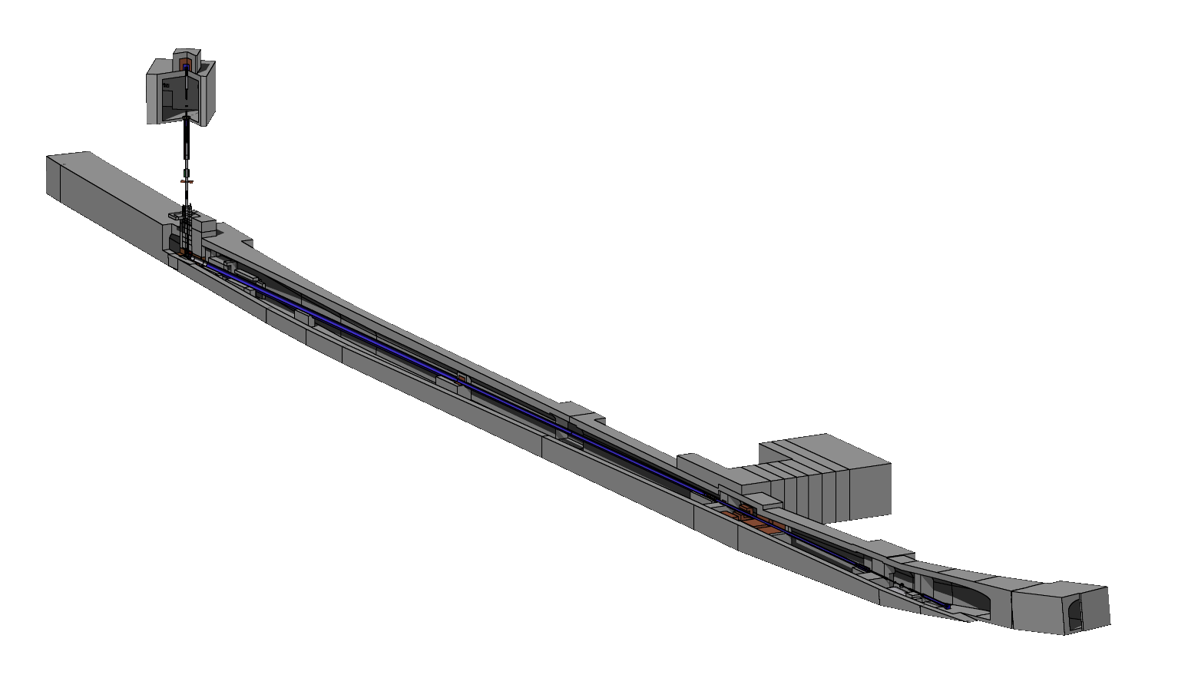
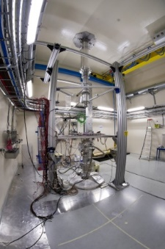
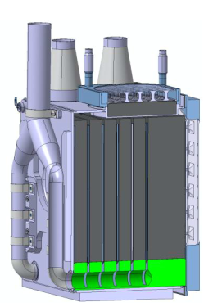
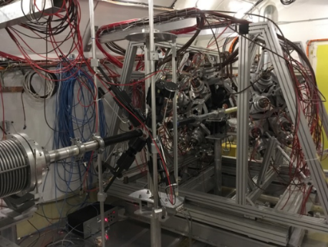
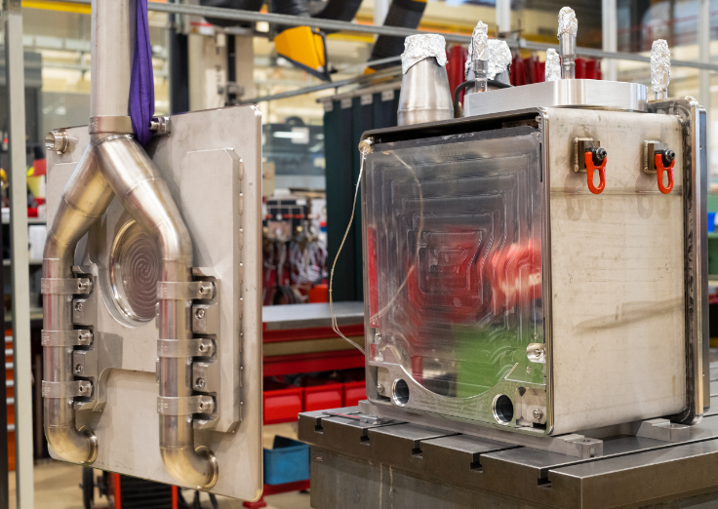
Commissioning. In red what is planned in 2021 (YETS on 15th Nov)
65·10¹⁷ protons
20 GeV
Protons
Pulsed
EAR2 (2014)
EAR2 small collimator + Demineralized Water.
EAR2 big collimator + Demineralized Water.
EAR2 small collimator + Borated Water.
Neutrons
L₂=20 m
21·10¹⁷ protons
24/09-31/10
Neutrons
53·10¹⁷ protons
Pb target
25·10¹⁷ protons
19/07-23/09
L₁=185 m
EAR1 (2001)
38·10¹⁷ protons
24/09-15/11
Monitoring target & neutron flux at EARs
RP for NEAR.
Characterization of NEAR neutron flux
4. EAR1 small collimator + Borated Water.
5. EAR1 big collimator + Borated Water.
3
Javier Praena – U. Granada – CERN (EP/SME)
Isolde Neutron Time-of-Flight Committee, 23/06/2021

Slide 4
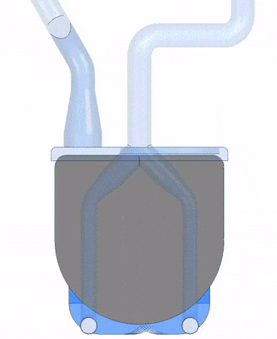
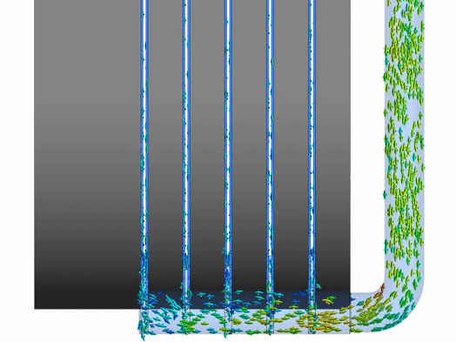
Target Commissioning
19th July – 23rd September 2021
Al-6082-T6 supporting structure
(anti-creep and N₂ cooling channels)
N₂-cooled Pb neutron spallation target for the CERN’s n_TOF facility
R. Esposito, M. Calviani
ICANS XXIII – International Collaboration on Advanced Neutron Sources – October 2019
Javier Praena – U. Granada – CERN (EP/SME)
Isolde Neutron Time-of-Flight Committee, 23/06/2021

Slide 5
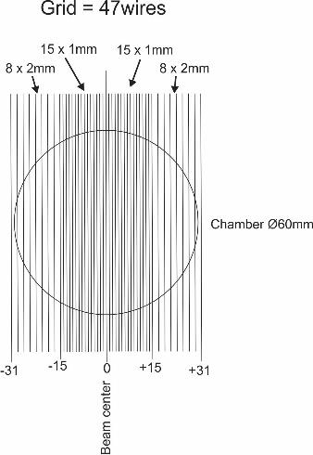
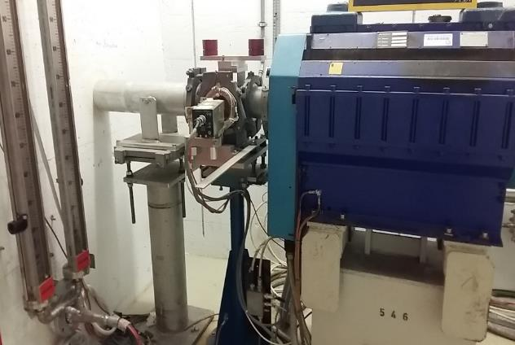
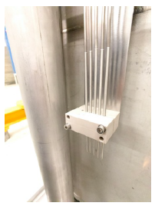
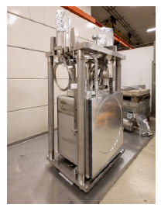
Proton beam size and position & neutron flux
Secondary Electron Monitor (SEM) will act as monitoring for the positioning and size of the proton beam. SEM was installed on the Week 5 2021 in the proton transfer line to the target (FTN).
Correlated to neutron detectors at EARs.
Temperature & proton intensity
K-thermocouples located between the Pb slices for monitoring the temperature versus proton intensity.
Neutron fluence with SPND
Self Powered Neutron Detectors (SPND) will be used for determining the neutron fluence in a possition close to the target.
Cross-check with FLUKA and EARs data.
IFMIF-DONES (collaboration with fusion material irriadition facility).
SPND are already at CERN (2nd Installation coordination meeting).
5
Javier Praena – U. Granada – CERN (EP/SME)
Isolde Neutron Time-of-Flight Committee, 23/06/2021

Slide 6
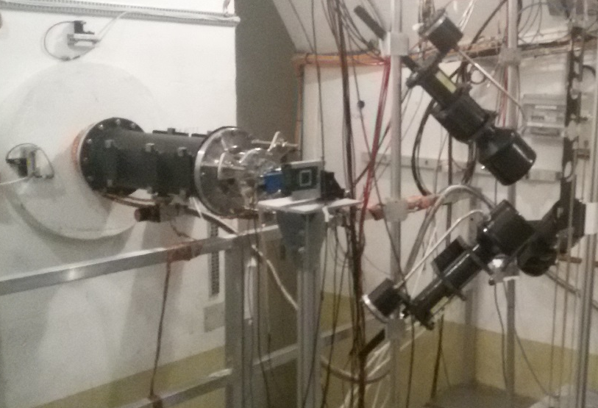
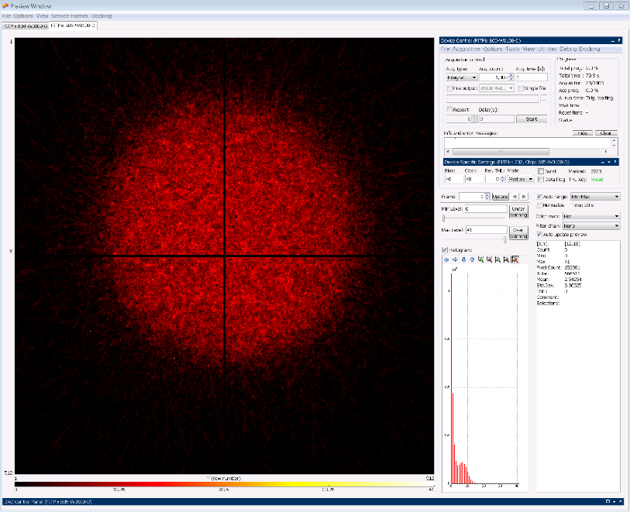
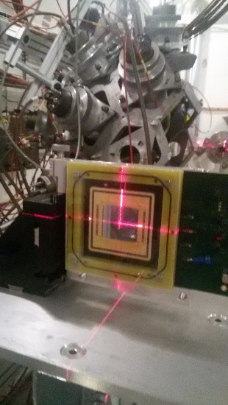
19th July - 22nd July: timepix for alignment
Two Timepixes (4 sensors 15x15 mm², as used in 2018 for beam alignment)
EAR1 and EAR2. For EAR2 the support are on construction.
More detectors will be already installed downstream Timepix.
Neutrons
2018
Fabrizio Murtas, Michael Bacak
Javier Praena – U. Granada – CERN (EP/SME)
Isolde Neutron Time-of-Flight Committee, 23/06/2021

Slide 7
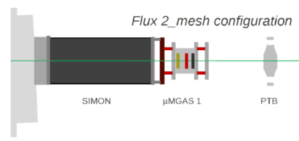
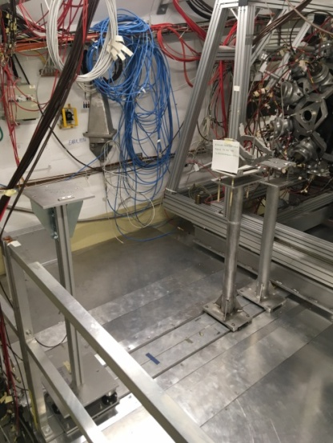

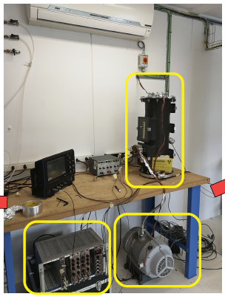
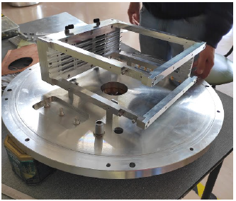
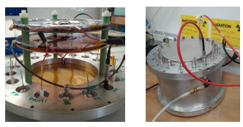
EAR1 during Target Commissioning: 25·10¹⁷ protons
PPAC1
SiMon1
MGAS1
All the chambers and samples are already at CERN except PPAC1 (at CERN on 7th July).
Neutrons
⁶Li
¹⁰B, ²³⁵U
^{235,235}U
Works and several tests have been done at CERN and other laboratories
MGAS1
Simon1
PPAC1
Javier Praena – U. Granada – CERN (EP/SME)
Isolde Neutron Time-of-Flight Committee, 23/06/2021

Slide 8
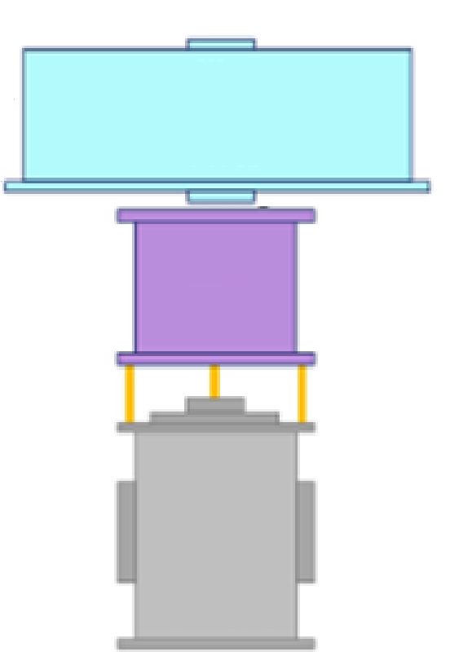
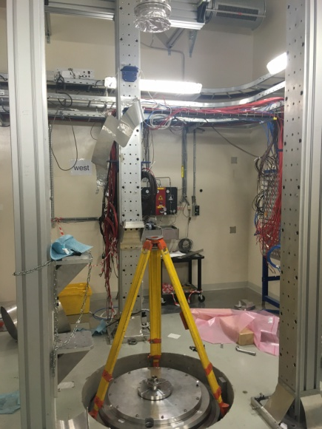
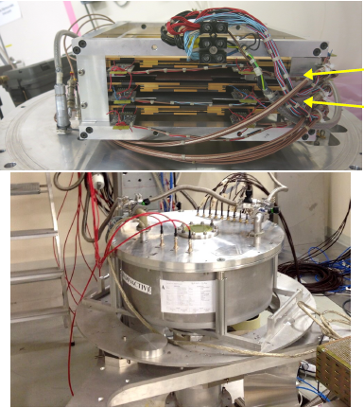
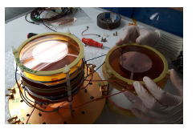
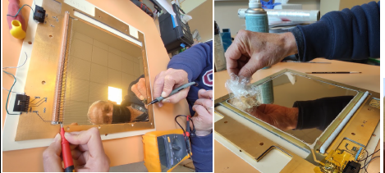
EAR2 during Target Commissioning: 25·10¹⁷ protons
PPAC2
^{235,238}U
All the chambers and samples are already at CERN.
MGAS2
¹⁰B, ²³⁵U
Neutrons
SiMon2
⁶Li
Works and several tests have been done at CERN and other laboratories
PPAC2
MGAS2
Alice Manna, Diego Tarrío, Laurent Tassan-Got
Javier Praena – U. Granada – CERN (EP/SME)
Isolde Neutron Time-of-Flight Committee, 23/06/2021

Slide 9
Summary of Planning for Target Commissioning 2021
Dates (Protons) | Task | Thermocouples | SPND | SEM | EAR1 EAR2
19/07 (3·10¹⁶) | First Proton Beam on target (max 1E12 ppp) | Yes | Yes | Yes | Timepix
20/07- 04/08 (10¹⁷+2·10¹⁷) | FTN optics cross-check (max 1E12 ppp) |  |  | Yes | Timepix
28/07 - 04/08 | Low intensity (max 2E12 ppp), stable operation | Yes | Yes | Yes | PPACs PTB SiMoNs MGASs
12/08 - 17/08 (10¹⁷) | FTN optics cross-check (max 1E12 ppp). |  |  | Yes
12/08 - 27/08 (8·10¹⁷) | Medium intensity (3.5E12 ppp) | Yes | Yes | Yes | PPACs PTB SiMoNs MGASs
23/08 - 30/08 (10¹⁷) | Moving beam on target |  |  | Yes | PPACs PTB SiMoNs MGASs
07/09 - 10/09 (10¹⁷) | FTN optics cross-check |  |  | Yes
07/09 - 23/09 (12·10¹⁷) | High intensity (8.5E12 ppp) | Yes | Yes | Yes | PPACs PTB SiMoNs MGASs
23/09/2021 25·10¹⁷
9
Javier Praena – U. Granada – CERN (EP/SME)
Isolde Neutron Time-of-Flight Committee, 23/06/2021

Slide 10
Neutron Beam Commissioning
24th September – 15th November (EAR1)
24th September – 31st October (EAR2)
Javier Praena – U. Granada – CERN (EP/SME)
Isolde Neutron Time-of-Flight Committee, 23/06/2021

Slide 11
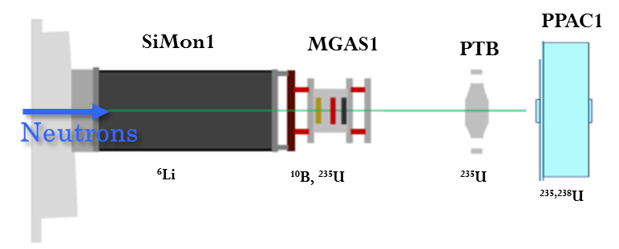
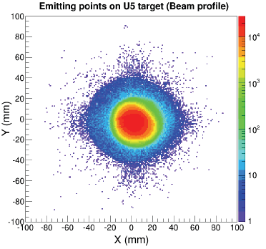
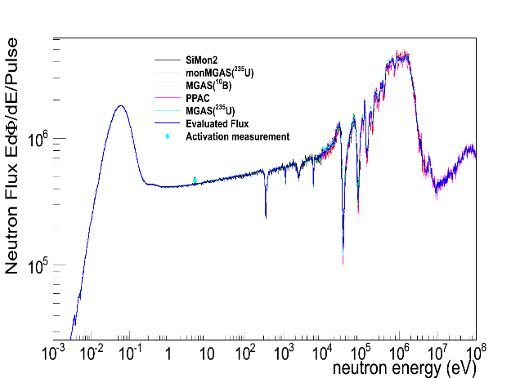
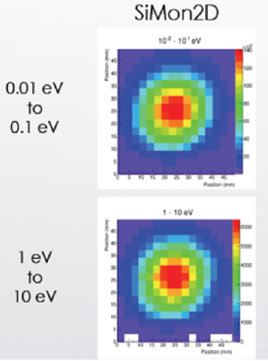
Neutron Flux and Beam Profile at EAR1: 12·10¹⁷ protons (24/09-06/10)
All the chambers and samples are already at CERN except PPAC1 (to be delivered at begining of July 7th).
Michael Bacak
Simon1: Simone Amaducci, José Antonio Pavón.
MGAS1: Nikola Patronis, Elisso Stamati, Veatriki Michalopoulu
PPAC1: Alice Manna, Diego Tarrío.
PTB: Elisa Pirovano, Mirko Dietz
Neutron Flux and Beam Profile at EAR2: 7·10¹⁷ protons (24/09-03/10)
All the chambers and samples are already at CERN.
PPAC2
^{235,238}U
MGAS2
¹⁰B, ²³⁵U
Neutrons
Michael Bacak
Simon2: Simone Amaducci, José Antonio Pavón.
MGAS2: Marta Sabaté, José Antonio Pavón
PPAC2: Alice Manna, Diego Tarrío.
SiMon2
⁶Li
Javier Praena – U. Granada – CERN (EP/SME)
Isolde Neutron Time-of-Flight Committee, 23/06/2021

Slide 12
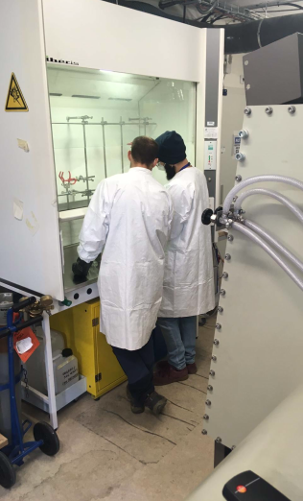
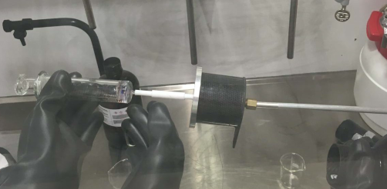
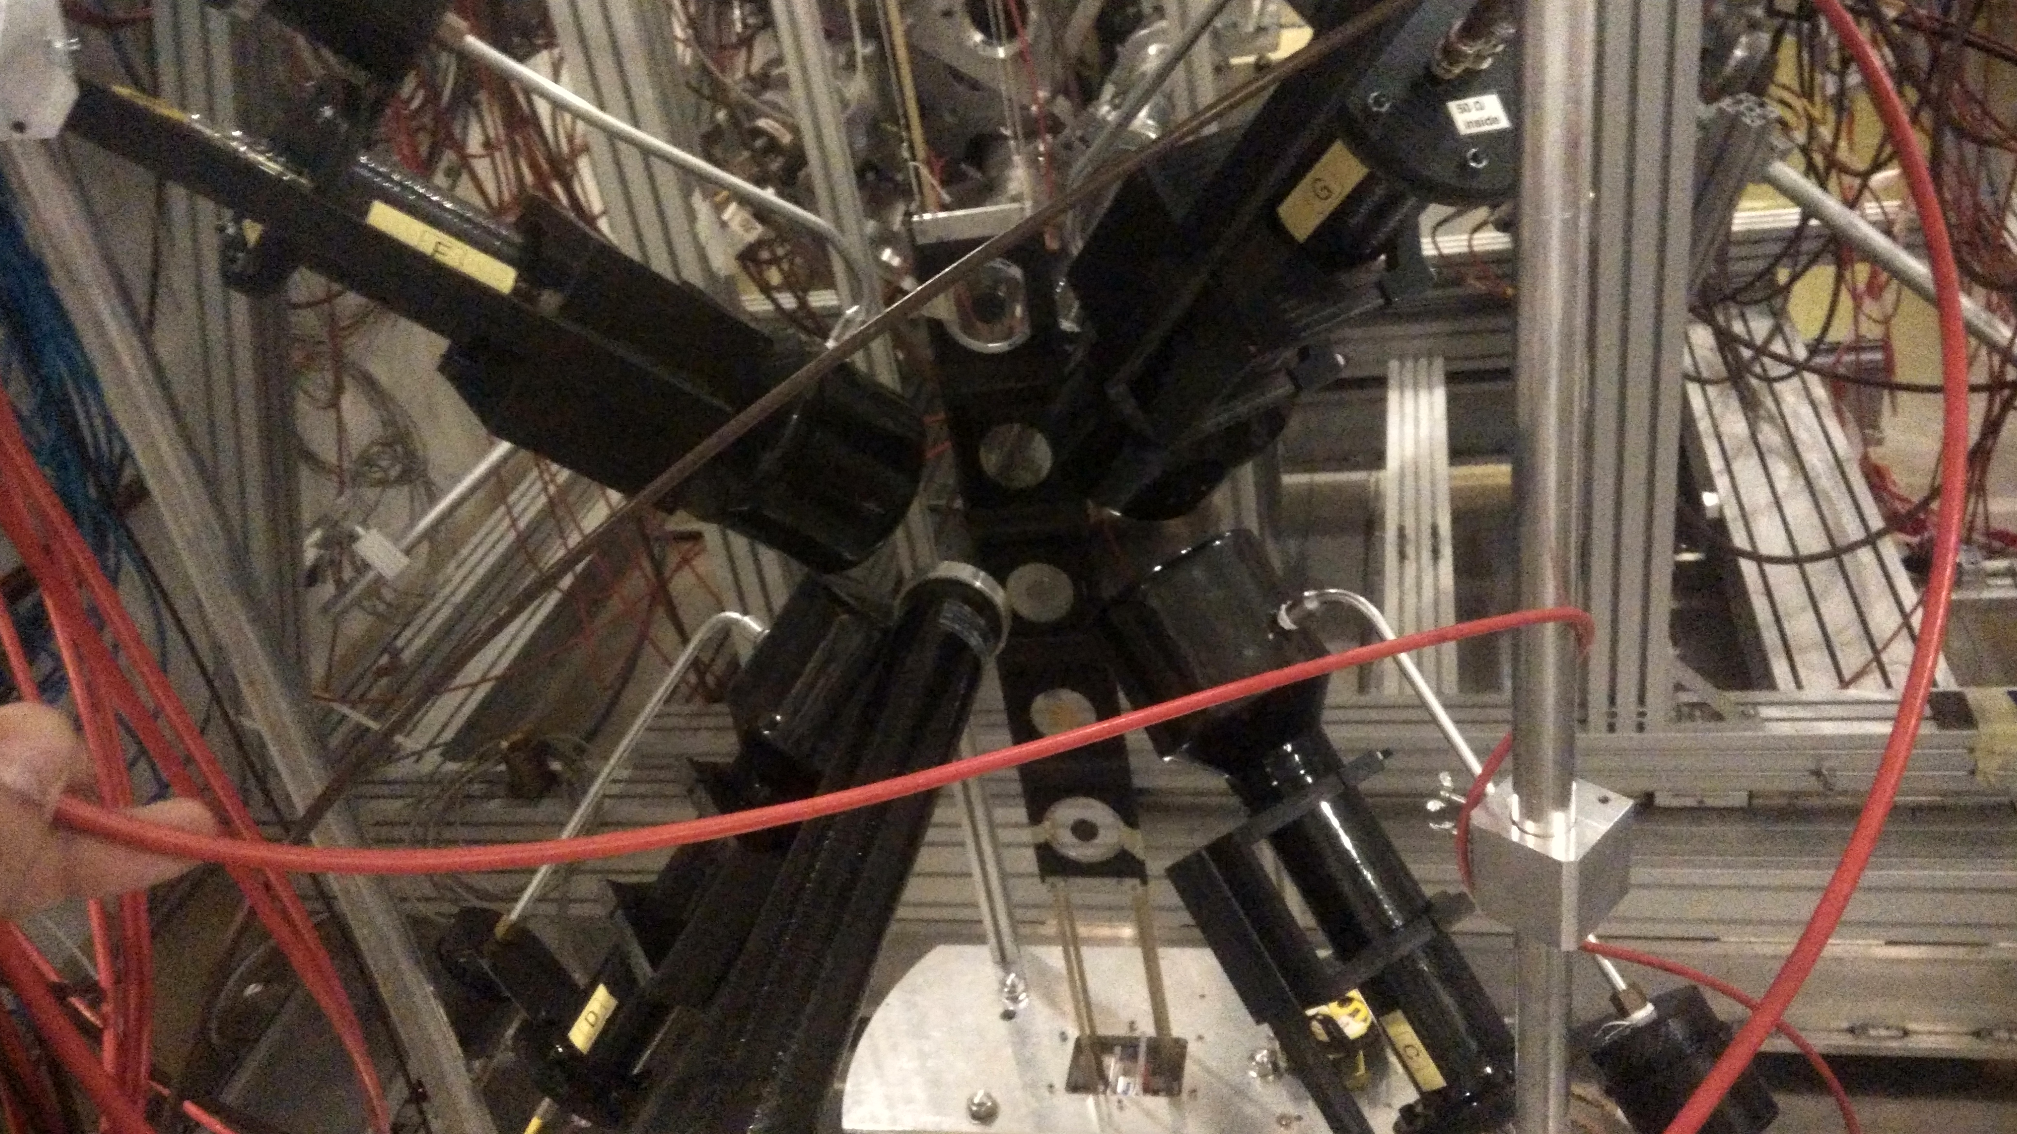
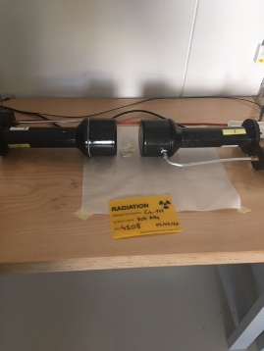
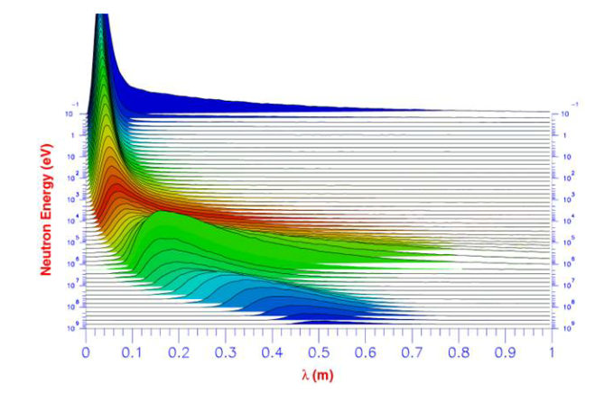
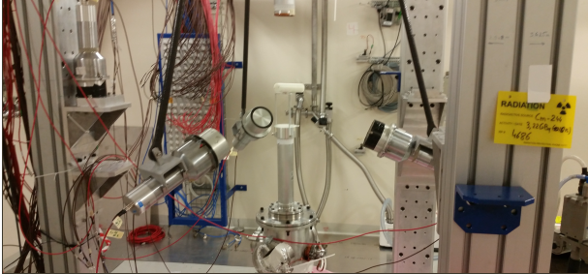
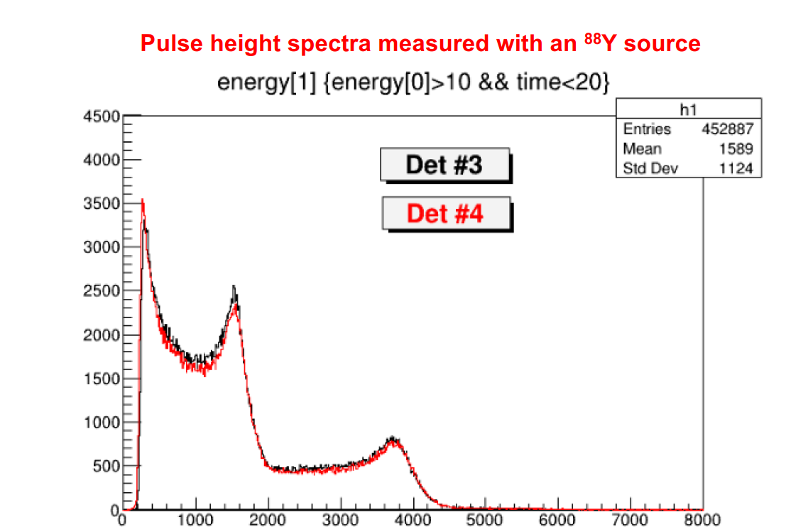
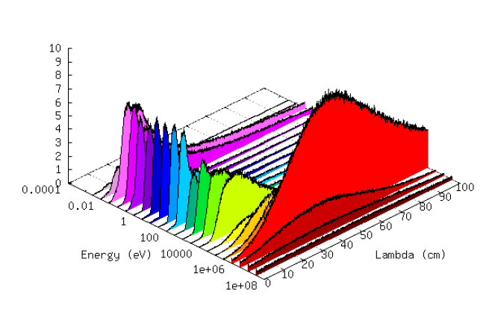
Time-to-Energy at EAR1: 14·10¹⁷ protons (07/10 – 31/10)
C6D6 were already filled with benzene at ISOLDE vented cup.
Laboratory test have been already performed.
Adriá Casanovas, Francisco García Infantes, Jose Antonio Pavón.
Neutrons
Combination of measurements of neutron capture reactions and FLUKA simulations. Vasilis Vlachoulis, Marta Sabaté, Francisco García Infantes and José Antonio Pavón.
Time-to-Energy at EAR2: 7·10¹⁷ protons (05/10 – 15/10)
C6D6 Bicron were already tested at CIEMAT.
Víctor Alcayne, Jorge Lerendegui
Neutrons
Combination of measurements of neutron capture reactions and FLUKA simulations. Vasilis Vlachoulis, Marta Sabaté, Francisco García Infantes and José Antonio Pavón.
12
Javier Praena – U. Granada – CERN (EP/SME)
Isolde Neutron Time-of-Flight Committee, 23/06/2021

Slide 13
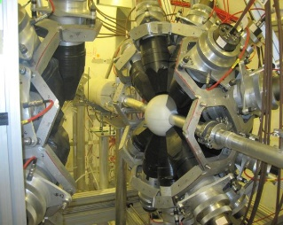
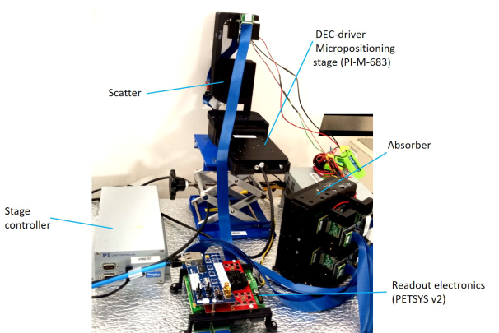
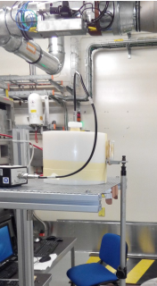
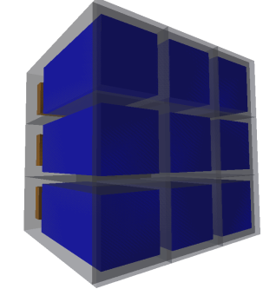
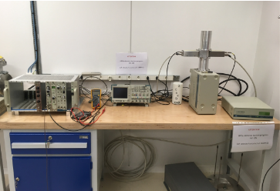
Background and Tests at EAR1: 12·10¹⁷protons (01/11 - 15/11)
TAC
iTED
He3
Adriá Casanovas, César Domingo, Emilio Mendoza, Víctor Alcayne, Adriá Sánchez Caballero, Jorge Lerendegui, Ariel Tarifeño, Cristian Massimi, Nikolas Patronis, Aagatino Musumarra, P. Mastinu.
HPGe
sTED
Background and Tests at EAR2: 7·10¹⁷protons (16/10 - 31/10)
iTED
sTED
He3
Adriá Casanovas, César Domingo, Emilio Mendoza, Víctor Alcayne, Adriá Sánchez Caballero, Jorge Lerendegui, Ariel Tarifeño
Cristian Massimi, Nikolas Patronis, P. Mastinu.
13
Javier Praena – U. Granada – CERN (EP/SME)
Isolde Neutron Time-of-Flight Committee, 23/06/2021

Slide 14
NEAR (new experimental area)
Javier Praena – U. Granada – CERN (EP/SME)
Isolde Neutron Time-of-Flight Committee, 23/06/2021

Slide 15
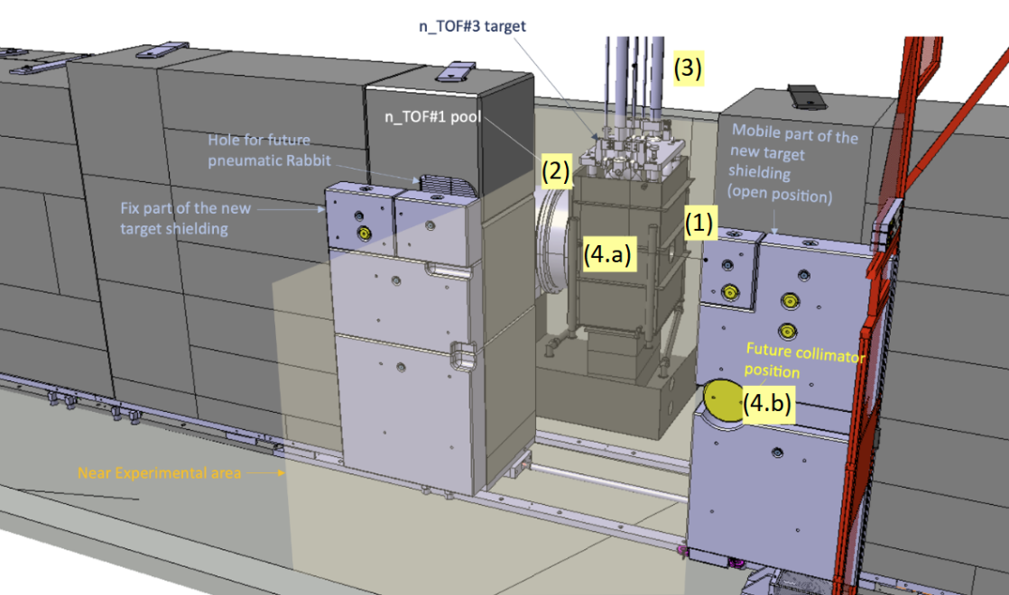
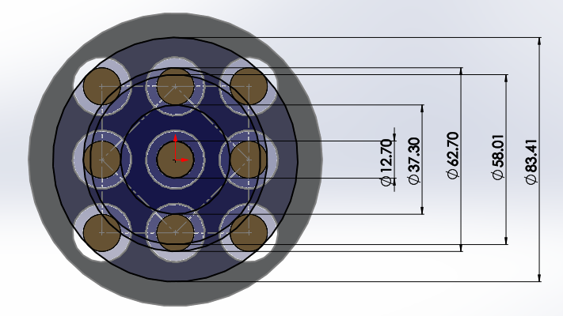
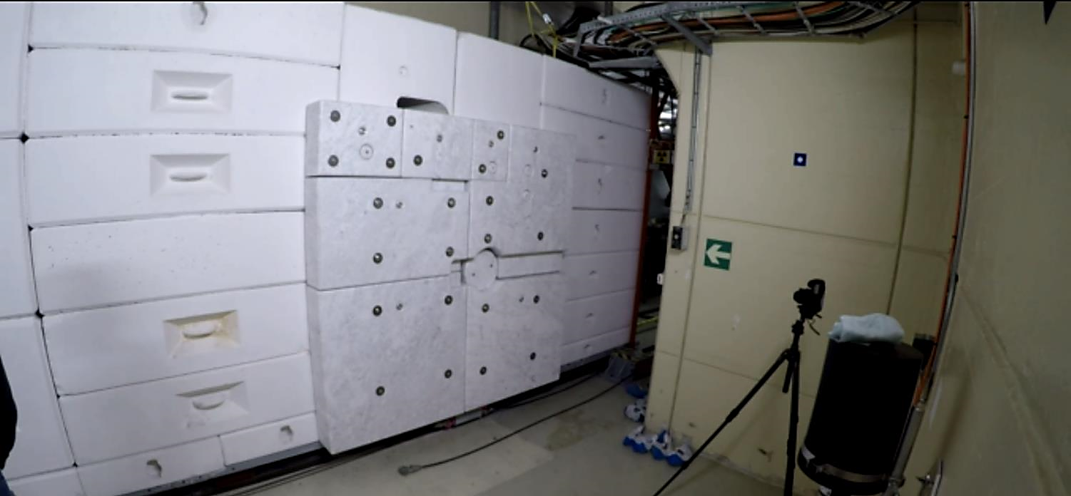
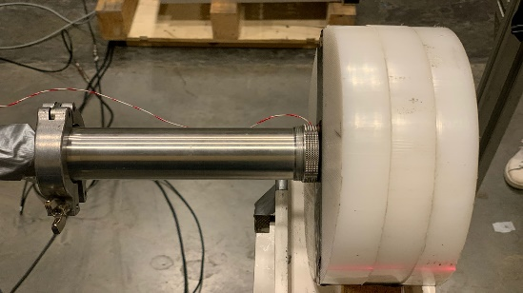
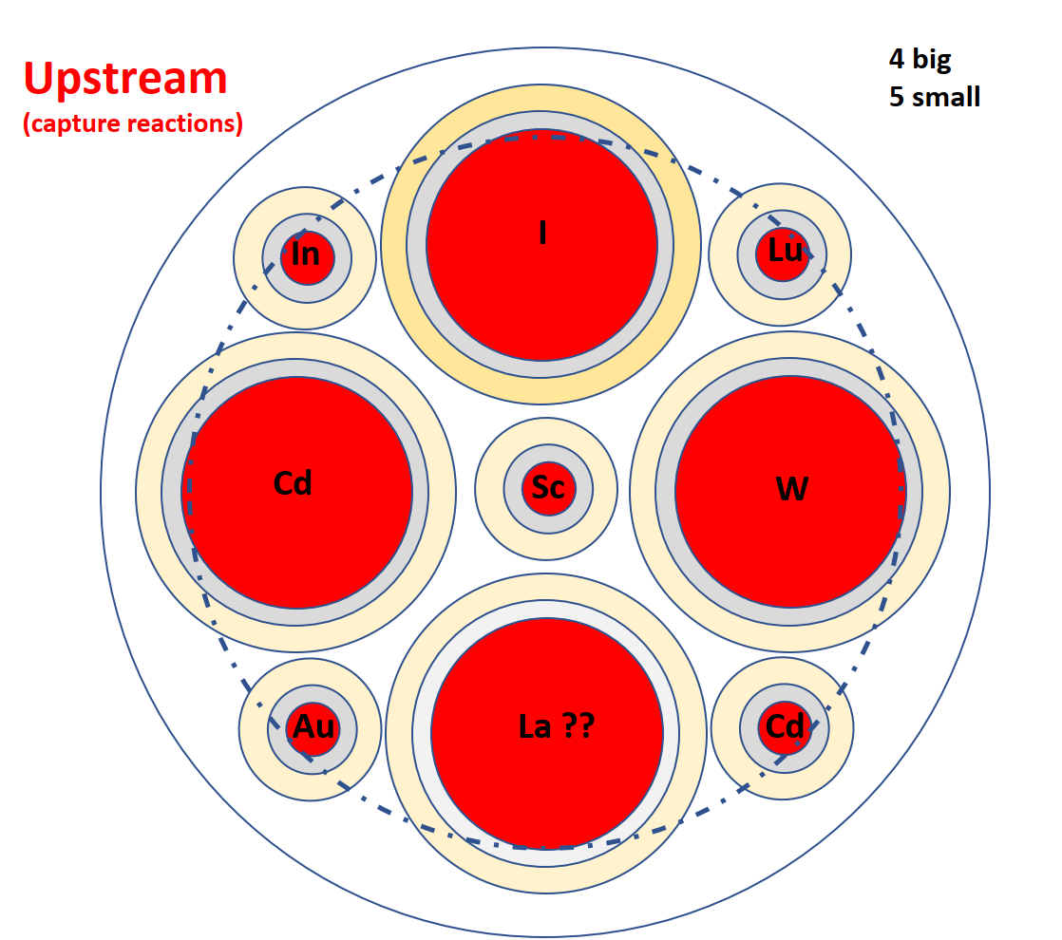
NEAR: multiactivation characterizations of the neutron flux.
Few slots are already planned for accessing NEAR for the characterization of the neutron flux and the RP conditions.
Position for multiactivation
Ana-Paula Bernardes
15
Javier Praena – U. Granada – CERN (EP/SME)
Isolde Neutron Time-of-Flight Committee, 23/06/2021

Slide 16
COVID measures
Javier Praena – U. Granada – CERN (EP/SME)
Isolde Neutron Time-of-Flight Committee, 23/06/2021

Slide 17
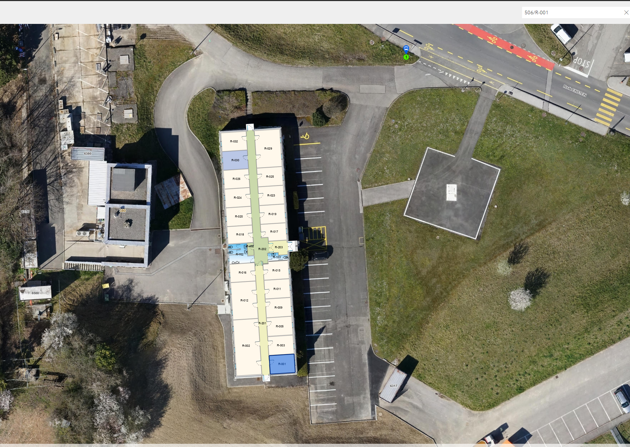
506 n_TOF Building.
17
Javier Praena – U. Granada – CERN (EP/SME)
Isolde Neutron Time-of-Flight Committee, 23/06/2021

Slide 18
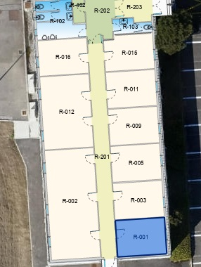
506 n_TOF Building.
Kitchen
1 person
Office 2 persons
2m with masks
COVID measures in control room are organized.
At present in the offices we have only two free tables.
We are already quite full!!!
COVID measures in experimental areas are ongoing.
Office 2 persons
2m with masks
Office 2 persons
2m with masks
Meeting Room
4 persons
masks
Office 2 persons
2m with masks
Office 2 persons
2m with masks
Control Room
6 persons
FFP2
18
Javier Praena – U. Granada – CERN (EP/SME)
Isolde Neutron Time-of-Flight Committee, 23/06/2021

Slide 19
Summary
Target Commissioning will run from 19th July to 23rd of September.
New elements across the lines, new elements for monitoring the target, proton beam optics, possible variations of the neutron flux at the Experimental Areas will be checked and carefully studied. Data for the neutron flux will be acquired in the last two weeks.
Commissioning of the Neutron Beam at the EARs will run from 23rd of September to the YETS (15th of November).
It should be possible to have two weeks for Physics Measurements at EAR2.
  Several actions and tests have been carried out for each detector setup. Everything on schedule.
  We have already at CERN an expertise team for setting up the detectors and to analyze the data. DAQ upgrade and commissioning ongoing.
Javier Praena – U. Granada – CERN (EP/SME)
Isolde Neutron Time-of-Flight Committee, 23/06/2021

Slide 20

Javier Praena
Universidad de Granada (Spain)
CERN Scientific Associate (EP/SME) n_TOF Physics Coordinator
Thank you on behalf
n_TOF Collaboration
20

Slide 21
Time line Commissioning
Javier Praena – U. Granada – CERN (EP/SME)
Collaboration Board Meeting, 16/03/2021

Slide 22
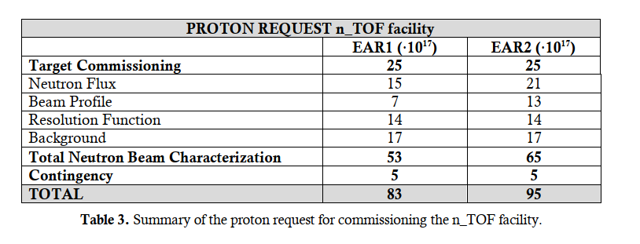
Outlook of the proton request
22
Javier Praena – University of Granada - CERN
65th INTC, Online, 3-4 November 2020

Slide 23


Detectors status overview: Timepix
Two Quad Timepixes (4 sensors 15x15 mm² each) fully operational already at CERN (as used in 2018 for beam alignment)
In order to perform alignment in EAR2 as well, funds for two more requested by INFN-LNF
Integration mechanic for EAR2 beam line needed
M. Barbagallo, n_TOF Collaboration (Zoom) Meeting, September2020

Slide 24
Target Commissioning: 19th July – 23rd September
Neutron Flux: several detectors at EARs (neutrons/(cm²proton))
Neutron Beam Profile: PPACs (transversal distribution of the fluence as a function of the energy) .
Background: possible several detectors at EARs compatible with the CM Planning.
Temperature & proton intensity: K-type thermocouples.
Neutron fluence close to the target: SPND.
Neutron Flux & proton beam size and position: SEM.
Radioprotection conditions in the area around the target.
Multiactivation technique for characterizating the NEAR spectrum.
24
Javier Praena – U. Granada – CERN (EP/SME)
Collaboration Board Meeting, 16/03/2021

Slide 25
Working Groups and Meetings
Document of the Commissioning presented at the INTC (November 2020):
  CERN-INTC-2020-072 ; INTC-P-587.
  https://cds.cern.ch/record/2737307.
Facility Operation Meetings (weekly). R. Steerenberg, K. Hanke.
n_TOF Facility Commissioning Working Group (2-3 weeks). M. Calviani, J. Praena.
n_TOF NEAR Technical Meetings (2 weeks). A. Bernardes
n_TOF Target Installation Coordination (weekly). R. Franqueira Ximenes.
NEAR Working Group (monthly). N. Colonna, A. Mengoni.
Local Team Meetings (two weeks). A. Mengoni, J. Praena.
Javier Praena – U. Granada – CERN (EP/SME)
Collaboration Board Meeting, 16/03/2021

Slide 26
Summary
Target Commissioning requires of a cross-check with monitoring in EAR1 and EAR2 (Simon, MGAS, PPAC)
  During the Target Commissioning several postdoc with expertise and PhD students will be involved in the analysis for a “prompt” response. See talk of Alberto.
Commissioning of the Neutron Beam at the EARs
  The 3 PhD at CERN will be involved in the CM. Several postdocs and more students will join the Local Team.
  Work on going
    Simon1 and Simon2 on schedule. Test at Lab in April. Both ready at the middle of May.
    MGAS1 and MGAS2 on schedule. Test at Lab finished. Test at EARs during April-May. Part DAQ Commissioning.
    PPAC1 and PPAC2. On schedule. Test and mounting at CEA. Shipping to CERN at the end of May. Laurent Tassan Got and Diego Tarrío can provide more details if needed.
    PTB. On schedule. Ralf Nolte can provide more details.
    L6D6. Filling with no bubbles. Test at EAR1 with source end of March. Part DAQ Commissioning.
    Bicron. A test in Spain was planned (April). Shipping to CERN schedule at beginning of May/end April.
    Local Team from April: S. Amaducci, A. Casanovas, F. García Infantes, J. A. Pavón, E. Stamati, M. Barbagallo.
Javier Praena – U. Granada – CERN (EP/SME)
Collaboration Board Meeting, 16/03/2021

Slide 27
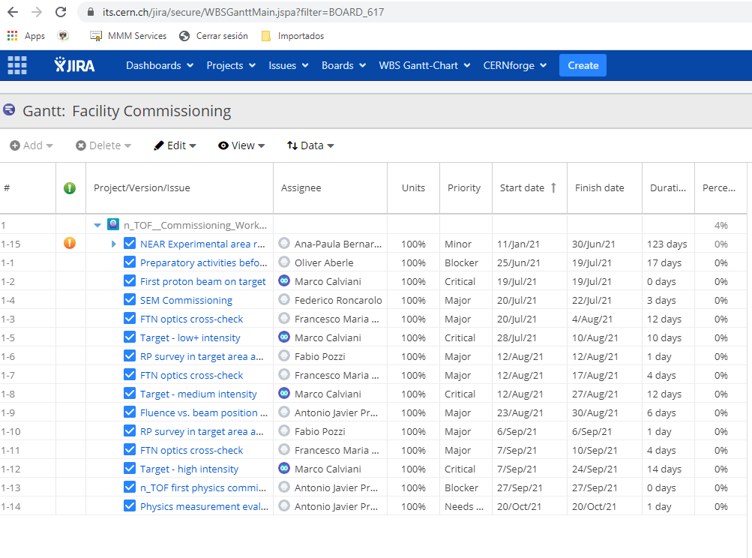
Commissioning Gantt-Chart in JIRA
Javier Praena – U. Granada – CERN (EP/SME)
Collaboration Board Meeting, 16/03/2021

Slide 28

Commissioning Gantt-Chart in JIRA
Javier Praena – U. Granada – CERN (EP/SME)
Collaboration Board Meeting, 16/03/2021

