Slide 1
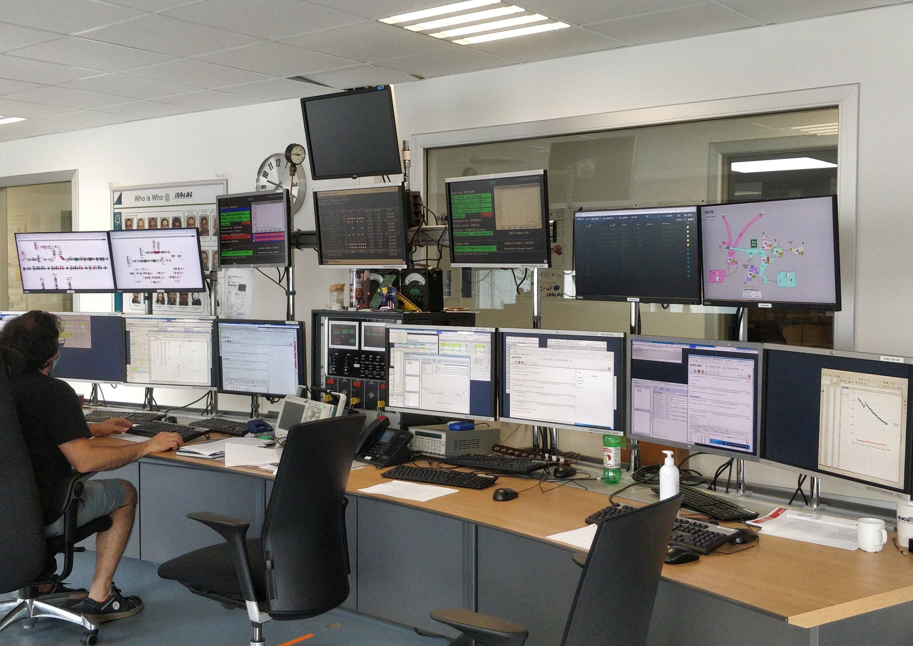
INTC 67 June 2021 ISOLDE Physics update
Schedule/INTC
Access to cern
Around the hall
Training

Slide 2
Beam requests and schedule
Row Labels | Count of Experiment | Sum of Requested shifts
Actar | 2 | 12
COLLAPS | 2 | 40
Corset/XT03 | 1 | 12
CRIS | 5 | 72
IDS | 7 | 44
IDS | 5 | 50,5
IDS fast timing | 6 | 25,001
IDS Vandle | 1 | 15
IDS/TISD | 1 | 2
ISOLTRAP | 3 | 36
ISS | 7 | 117
LA1 Bordeaux | 1 | 12
Magnetic moments | 2 | 8
MIRACLS | 1 | 7
SSP | 20 | 53
TAS | 3 | 19
Thorium clock | 2 | 11
TISD/ISOLTRAP | 4 | 60
VITO | 4 | 17
VITO | 1 | 0
Wisard | 1 | 24
Edinbugh setup | 1 | 21
Gandalph | 1 | 6
TISD | 1 | 6
GLM | 2 | 6
Grand Total | 84 | 675,501
~676 shifts requested
Low energy Physics 21 June
HIE ISOLDE: stable July 7; physics in W30
Lack of ventilation in Class A labs, UC units were “predicted in 2020”
Combine with some used targets from 2018
Travel still very difficult for many countries (see access section later)
Inevitable bias to local groups (or those able to run remotely)

Slide 3
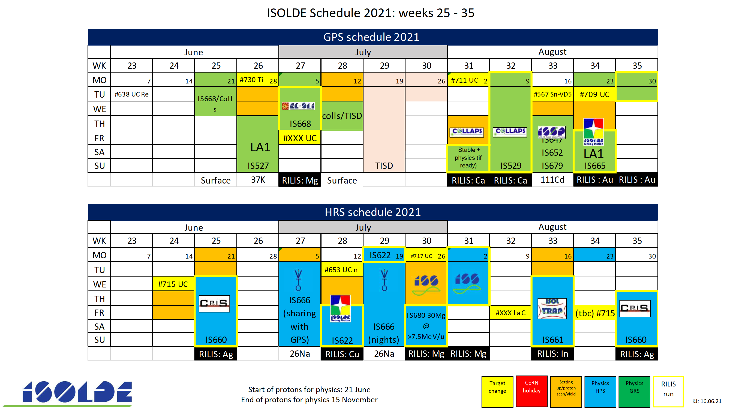
Published schedule till W35
145.5 scheduled shifts

Slide 4
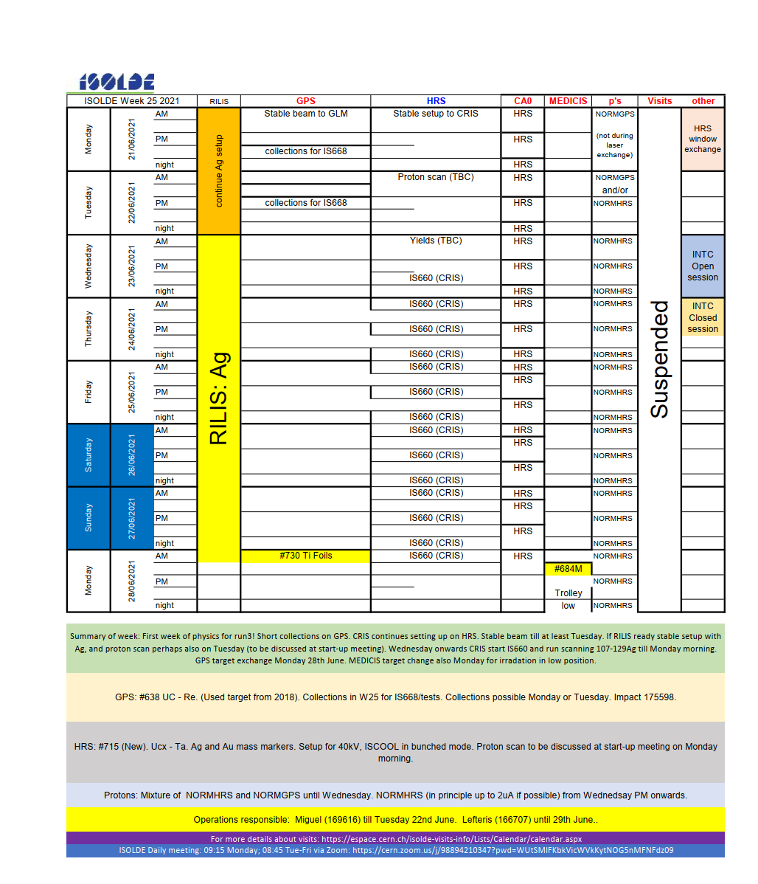
Schedule for W25: first week of physics
GPS: collections for solid state
HRS: Laser spectroscopy of Ag isotopes from the CRIS experiment.
Schedule till November almost ready….to be published in the coming weeks
Difficult year for e.g. solid state and groups without local support
Some groups prefer to be ready in Spring
Winter physics for LE should be possible.
Beginning of a Marathon with physics from March 2022

Slide 5
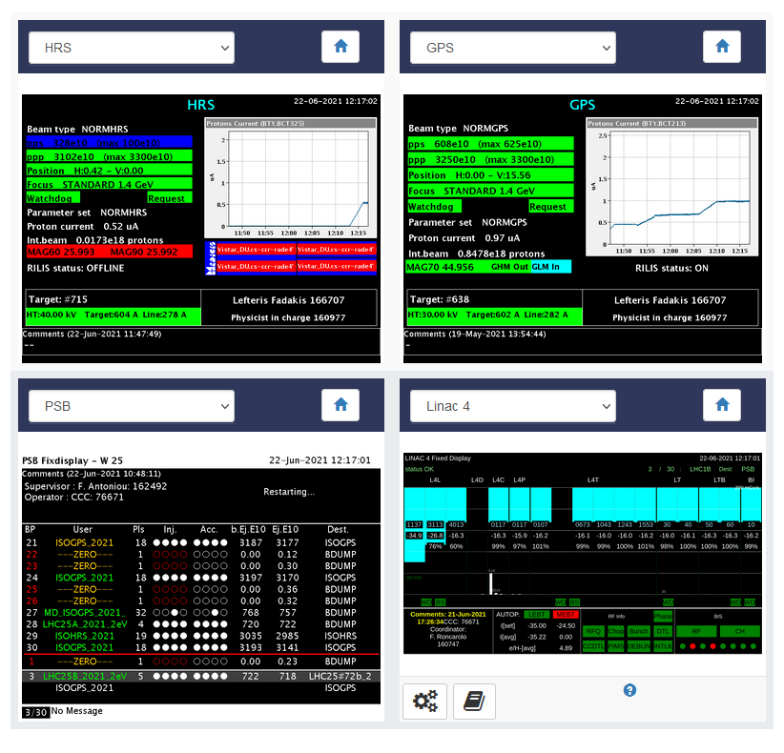
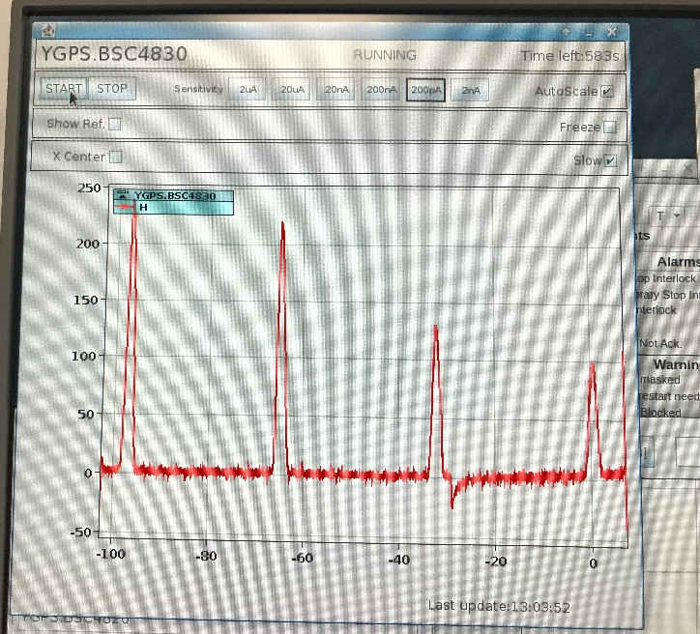
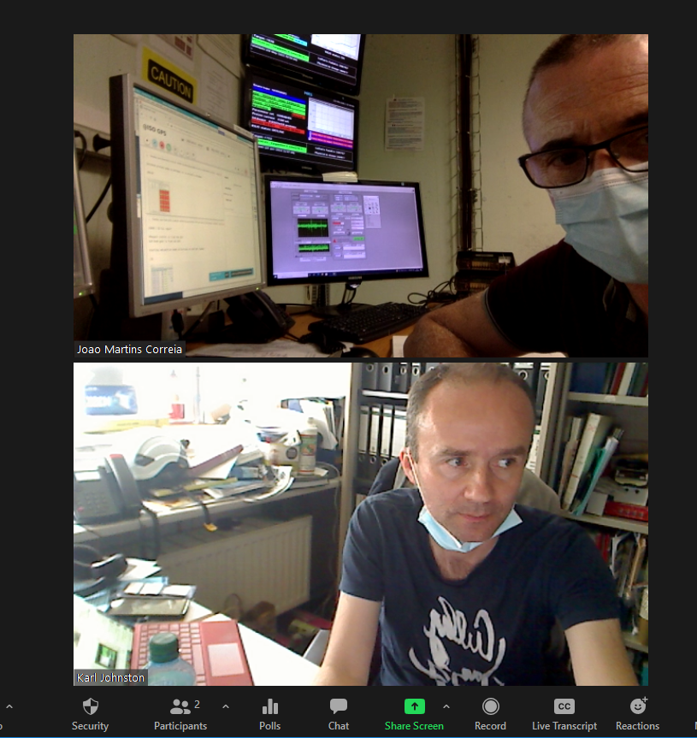
Frist physics of run3 has begun! GPS yesterday and HRS today!

Slide 6
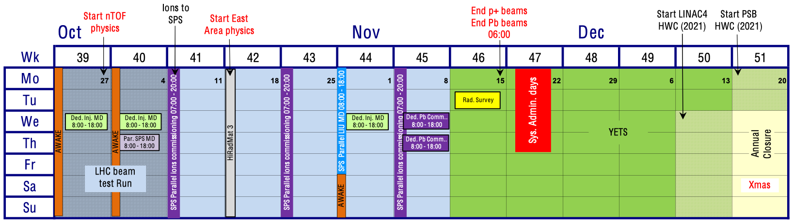
The LHC beam test will be delayed by 3 weeks to weeks 42 and 43
The Closure of the LHC tunnel and Cavern for commissioning will also be delayed by 3 weeks to 21 February
  The YETS 2021-2022 will be extended by 3 weeks for all machines and facilities
An update of the YETS and injectors schedules has been presented at the IEFC last Friday.
2022
Beam requests for 2022 (probably only low energy) to go out end of September
Expect protons mid March
HIE ISOLDE in the Summer: not possible to run cryo plant over winter stop.
HIE ISOLDE demand expected to be very high in 2022!

Slide 7
 | Count of Exp. no. | Sum of Shifts remaining for Run3
CRIS | 5 | 99,5
IDS | 10 | 107
IDS/ISOLTRAP | 1 | 6
TISD | 4 | 20
TISD/IDS | 1 | 9
HIE | 26 | 452
Gandalph/CRIS | 1 | 6
Windmill/IDS | 1 | 22,5
Travelling Setup | 2 | 24
COLLAPS | 2 | 35
ISOLTRAP | 4 | 42
Collections: 163Ho | 1 | 6
biophysics | 1 | 9,5
SSP | 9 | 116
Gandalph | 1 | 8
Travelling Setup; ECSLI | 1 | 11
IDS/VANDLE | 1 | 18
in-source / IDS | 1 | 10
VITO | 1 | 29
TAS | 3 | 39
MIRACLS | 1 | 17
Collections: 108Ag | 1 | 30
PAC nuclear moments | 1 | 12
WISARD | 1 | 24
Medical physics | 2 | 16
Grand Total | 82 | 1168,5
Shift backlog before this INTC
 | Count of Exp. no. | Sum of Shifts remaining for Run3
INTC 63 | 34 | 485
INTC 64 | 18 | 285,5
INTC 65 | 14 | 245
INTC 66 | 16 | 153
Grand Total | 82 | 1168,5

Slide 8
Documents submitted for INTC 67
Summary of documents discussed at INTC 67 | Sum of Shifts requested | Count of Facility
Letter of intent | 41 | 6
COLLAPS | 8 | 1
HIE ISOLDE | 30 | 2
TISD | 3 | 1
(blank) | 0 | 2
Letter of clarification | 59 | 3
HIE ISOLDE | 59 | 3
Proposal | 240 | 15
COLLAPS | 17 | 1
CRIS | 16 | 1
HIE ISOLDE | 191 | 10
Nuclear masses | 8 | 1
Quadrupole moments | 8 | 1
Grand Total | 340 | 24

Slide 9
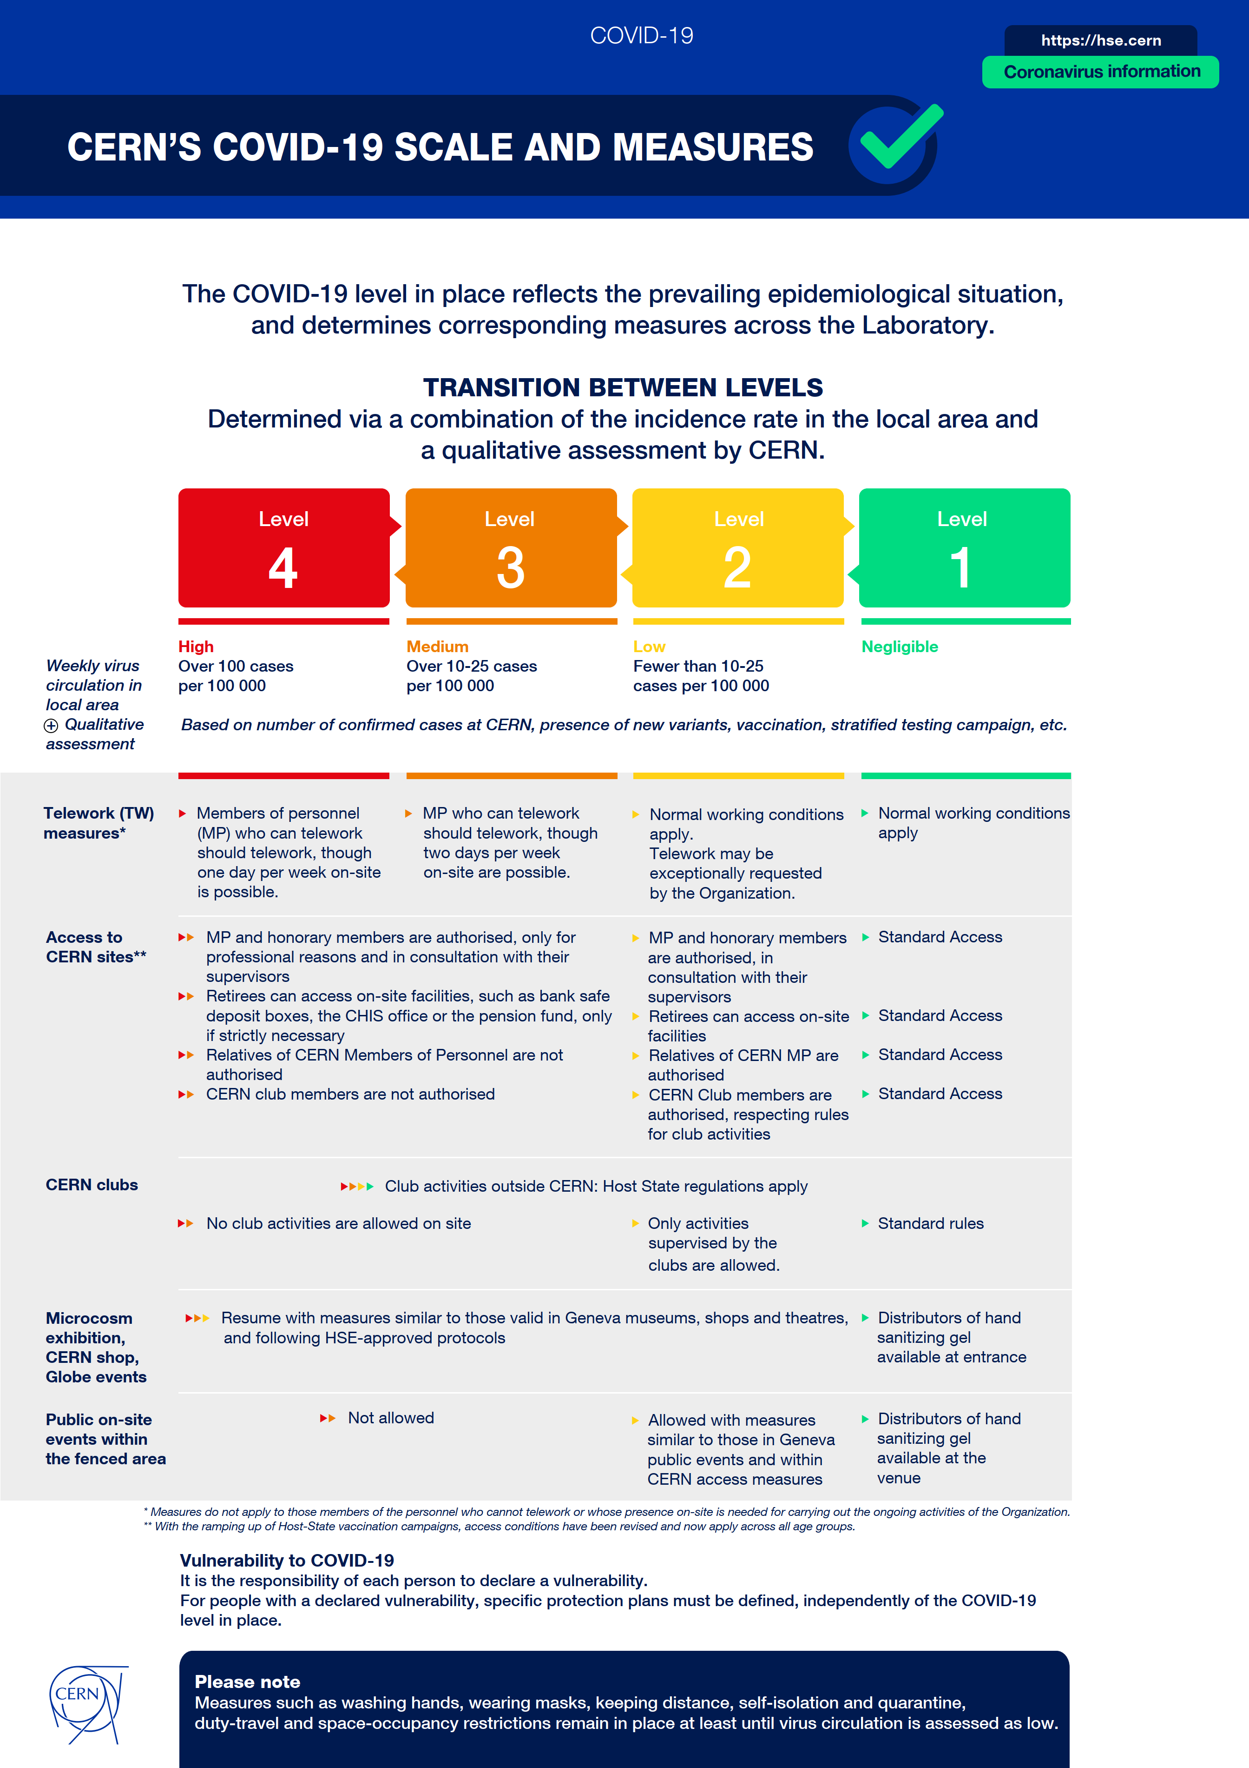
CERN currently in level orange
Hse.cern

Slide 10
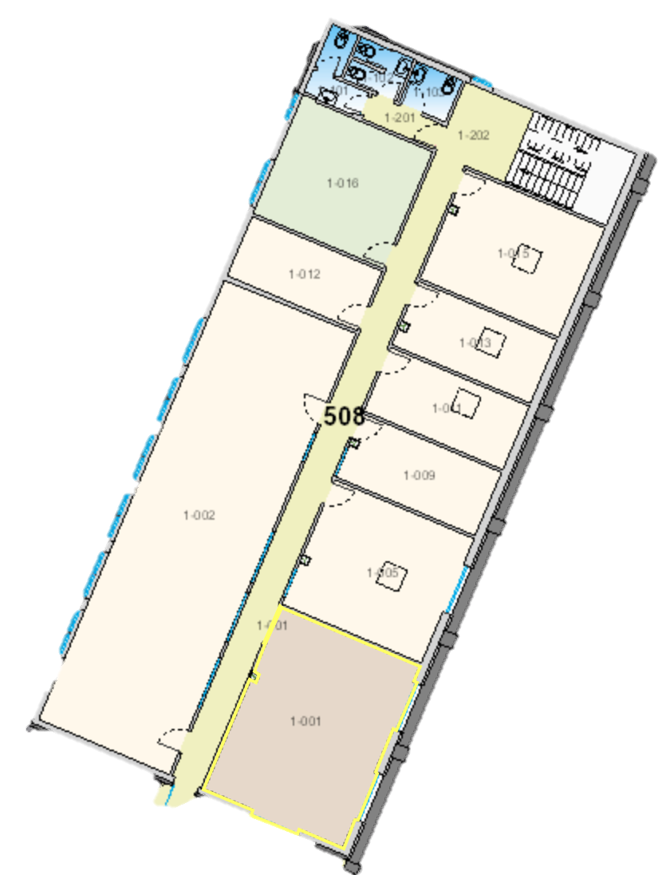
Restrictions on number of people remain
1-002 → Control room (291 m³)
170 m³/h
6 people
1-016 → Kitchen (77 m³)
Vent?
4 people
1-001 → Visitors room (130 m³)
310 m³/
6 people
1-015 → RILIS DAQ (76 m³)
196 m³/h
4 people
1-005 → ISOLDE DAQ (87 m³)
232 m³/h
4 people
1-009 → ISOLTRAP DAQ (44 m³)
176 m³/h
2 people
1-011 → xx (44 m³)
Vent?
4 people
1-013 → xx (42 m³)
Vent?
2 people

Slide 11
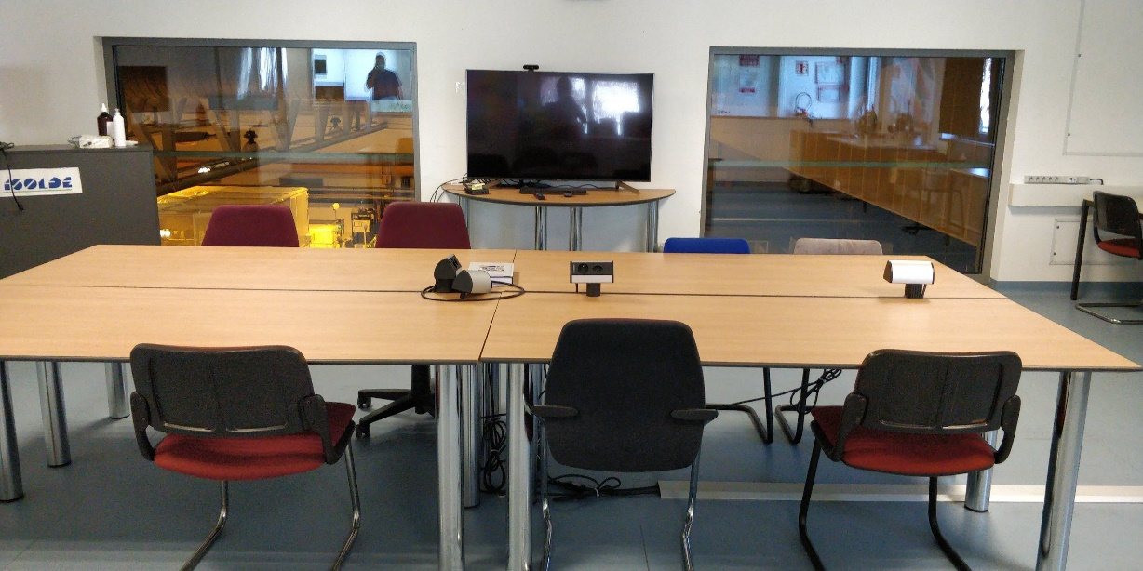
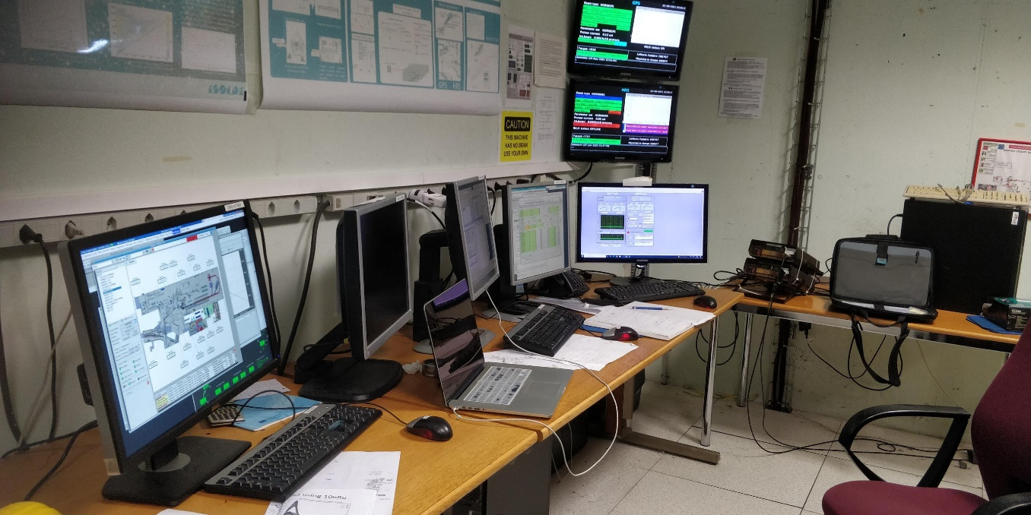
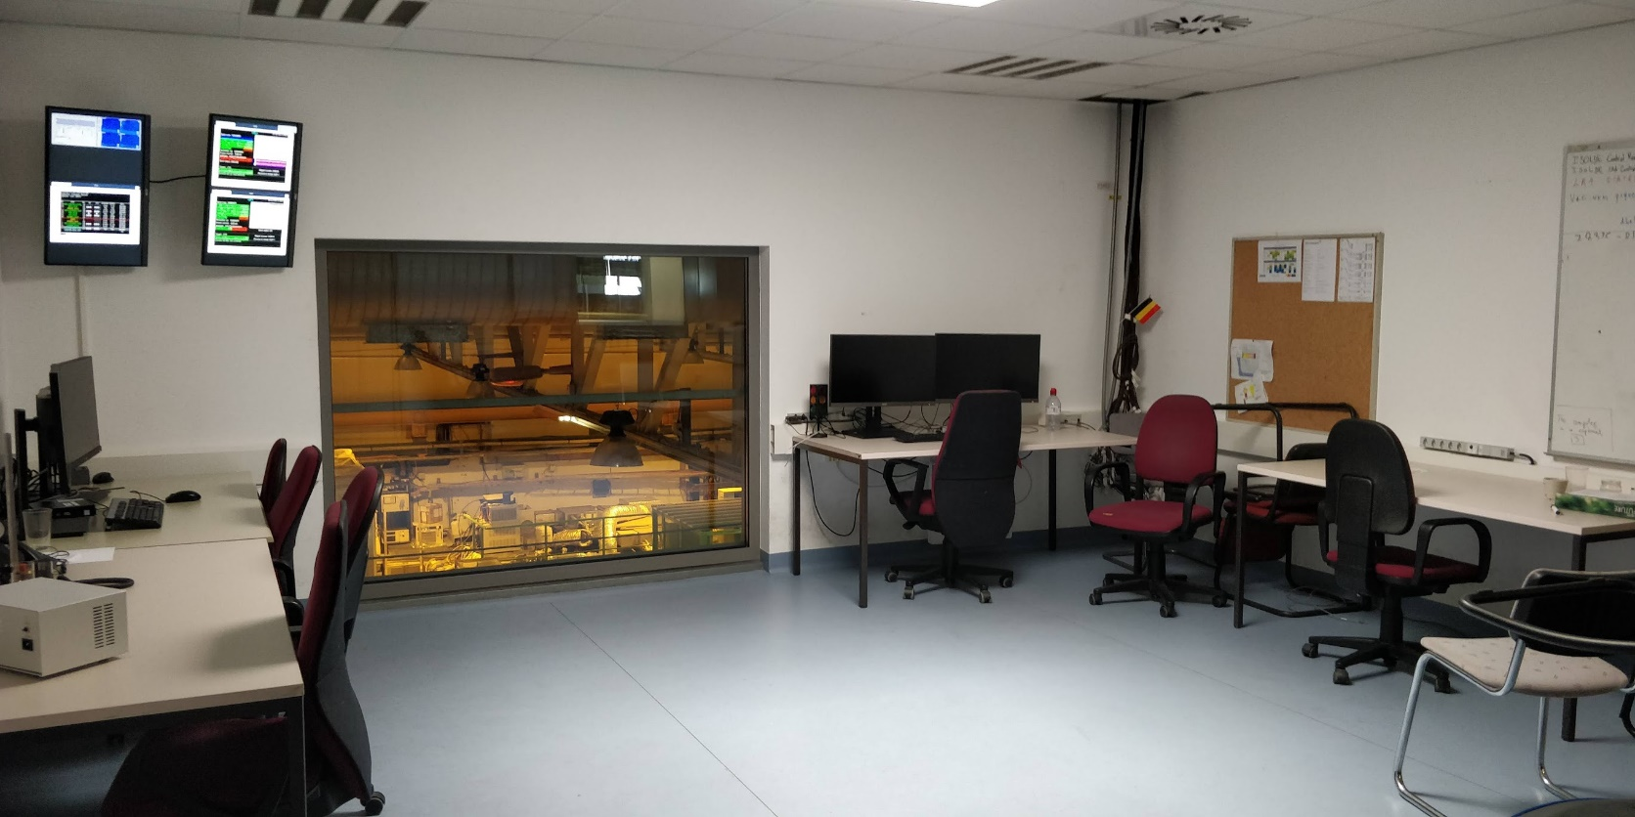
Use old control room, DAQ and visitors space more optimally to allow for more distancing/zoom conferencing
With OP, additional control terminals…OP working on means to allow monitoring e.g. for advanced users at home/office

Slide 12
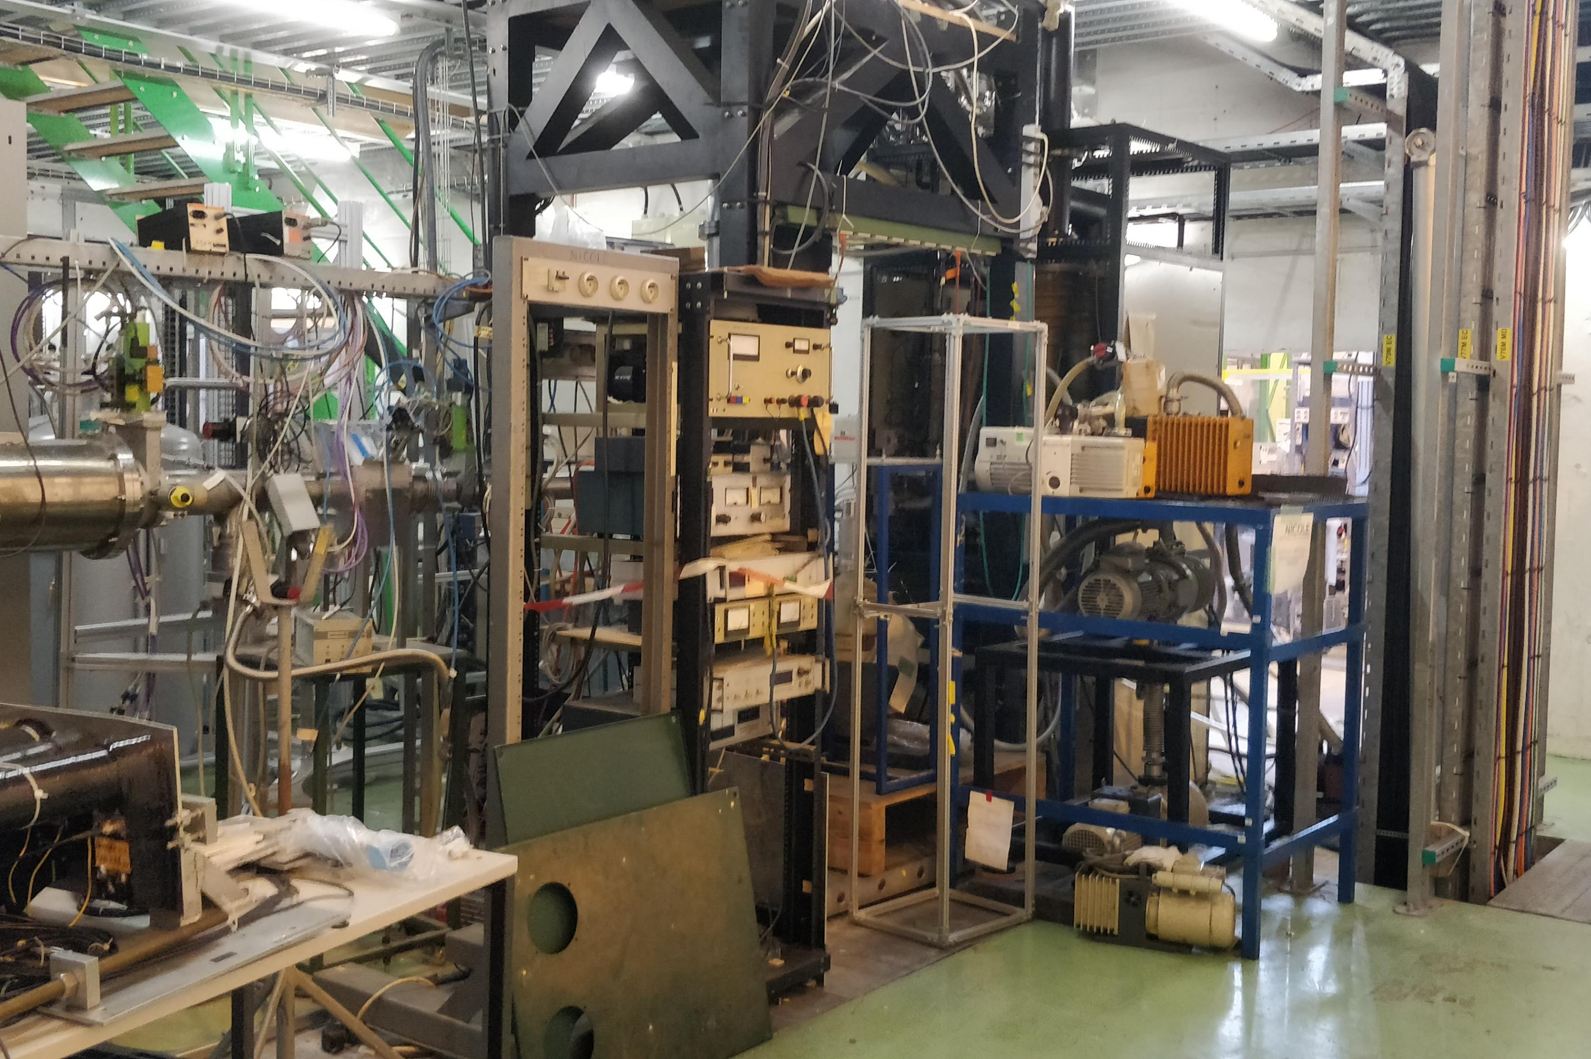
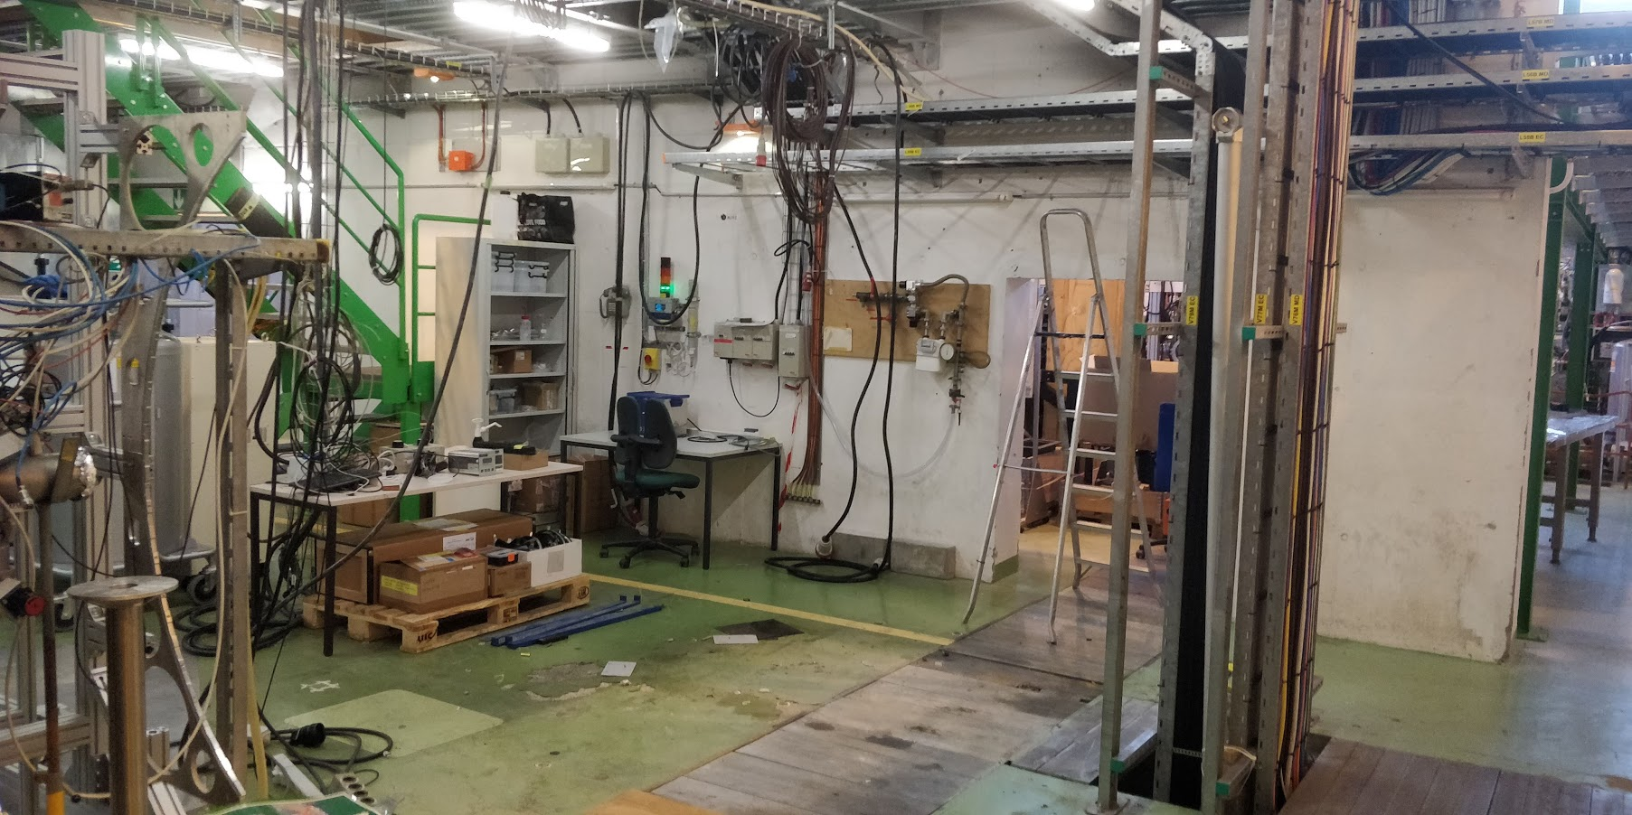
Removal of NICOLE: finally some progress

Slide 13
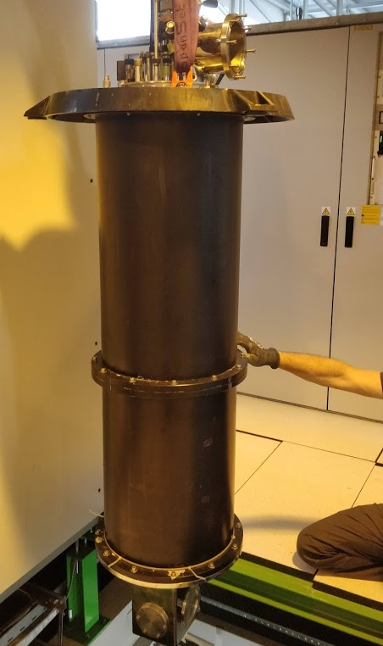
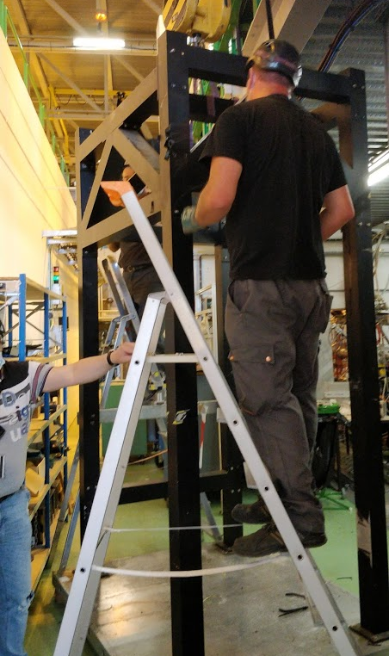
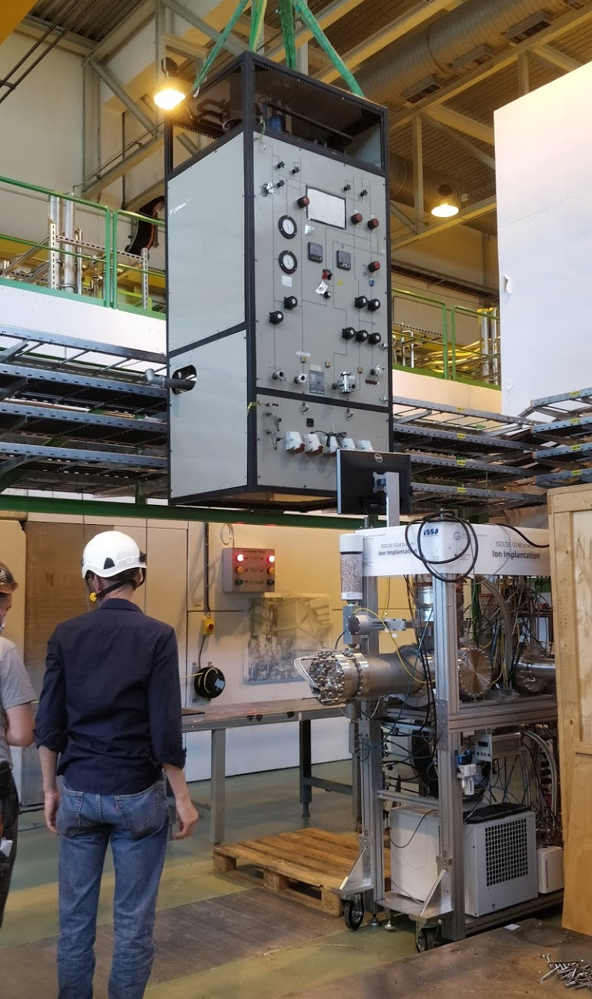
Many thanks for Simon Mataguez for a lot of help

Slide 14
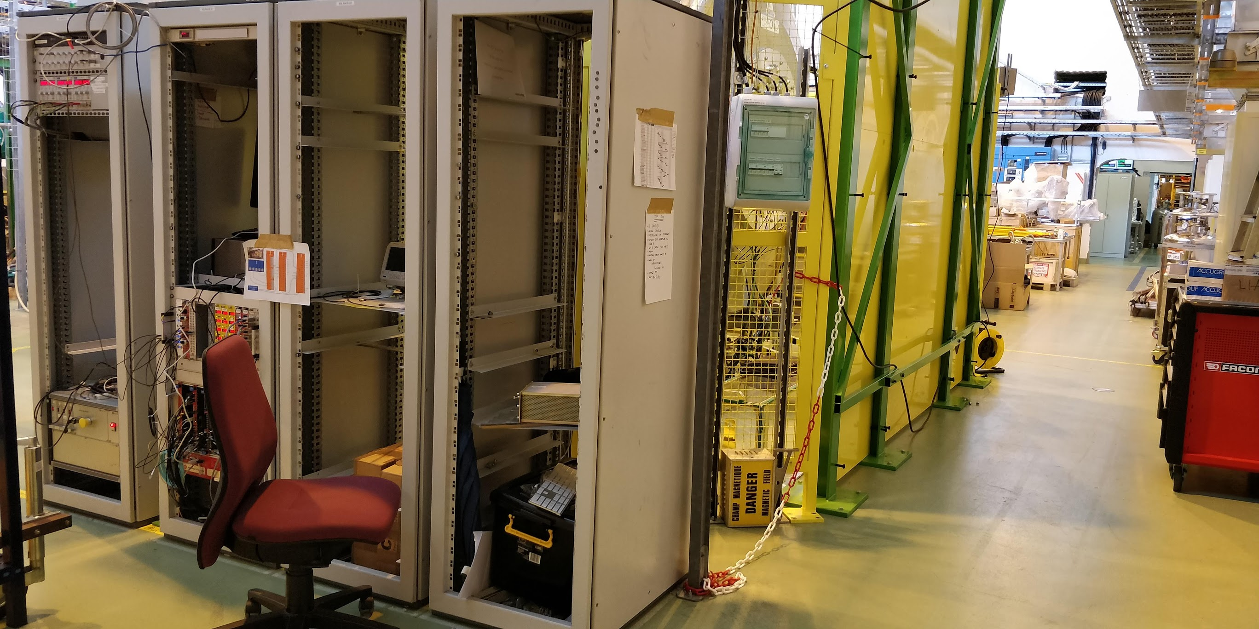
ISS closed up and ready for stable beam from July 7

Slide 15
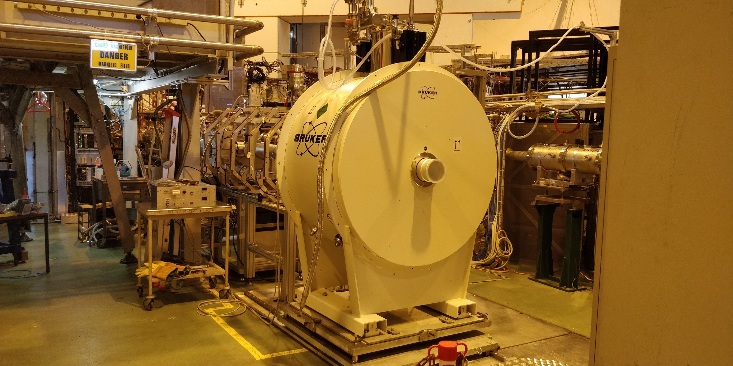
Vito beamline almost ready
Since March new SC magnet is in place

Slide 16
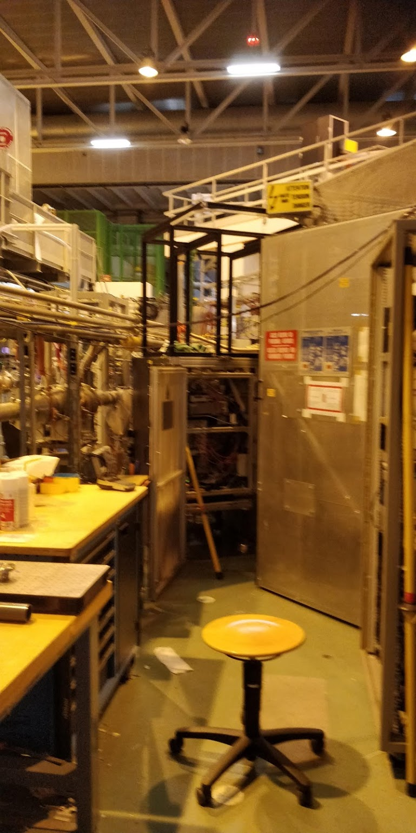
A lot of work has taken place at ISOLTRAP, including the new HV cage which now been approved by safety.
First successful run with the MR-TOF last week for LISA tests.

Slide 17
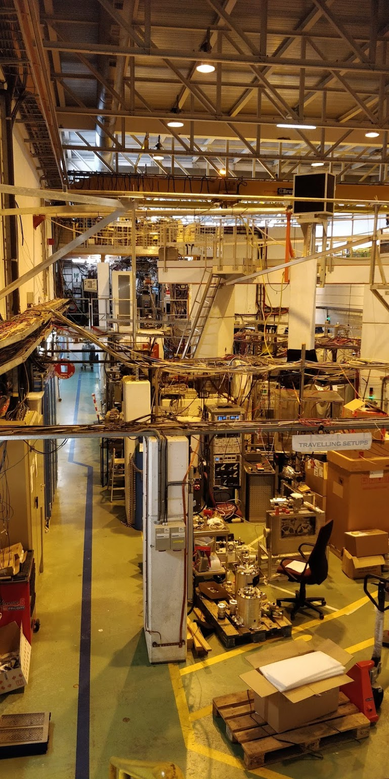
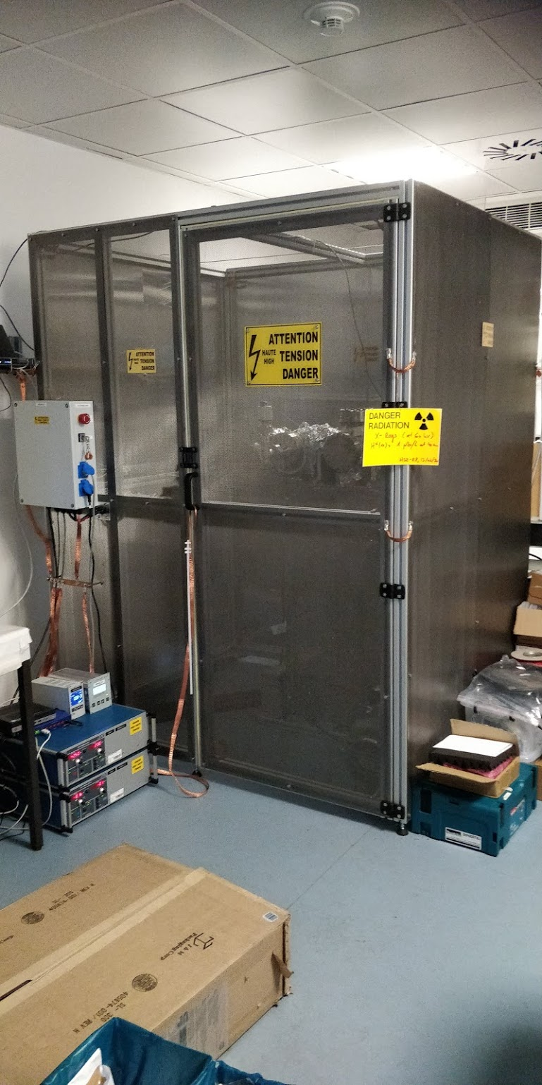
MIRACLS:
Work ongoing at LA2 for the reduced setup.
HV cage in 508 will be moved to the old NICOLE area
Assembly of Paul trap starting soon

Slide 18
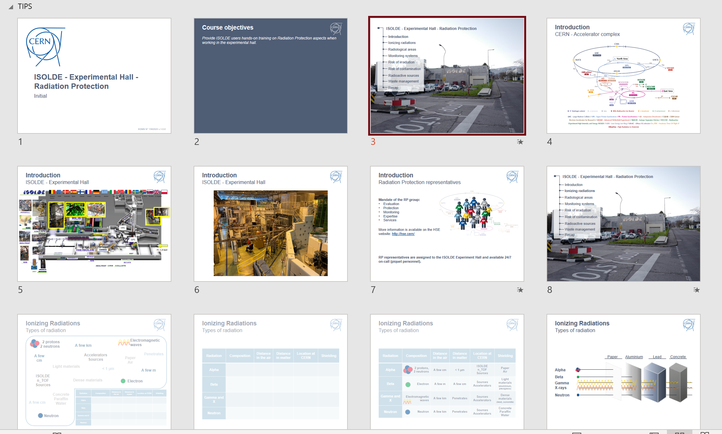
Training
In addition to the (ever-growing) number of online courses…
Hands-on RP and Electrical training
New from next week:
dedicated weekly sessions of RP hands-on course. Local trainer (!) so scheduling should be easier for this course.
New EP-wide electrical course for all users/staff who need to work in an experimental area.
Both will take place on Tuesday but time has increased:
  EP course 0830 till 1230
  RP course 1400 till 1630
In LMS:
ISOLDE - Experimental Hall - Radiation Protection - Handling (Covid-19)
Electrical Safety - Working in EP experiments

Slide 19
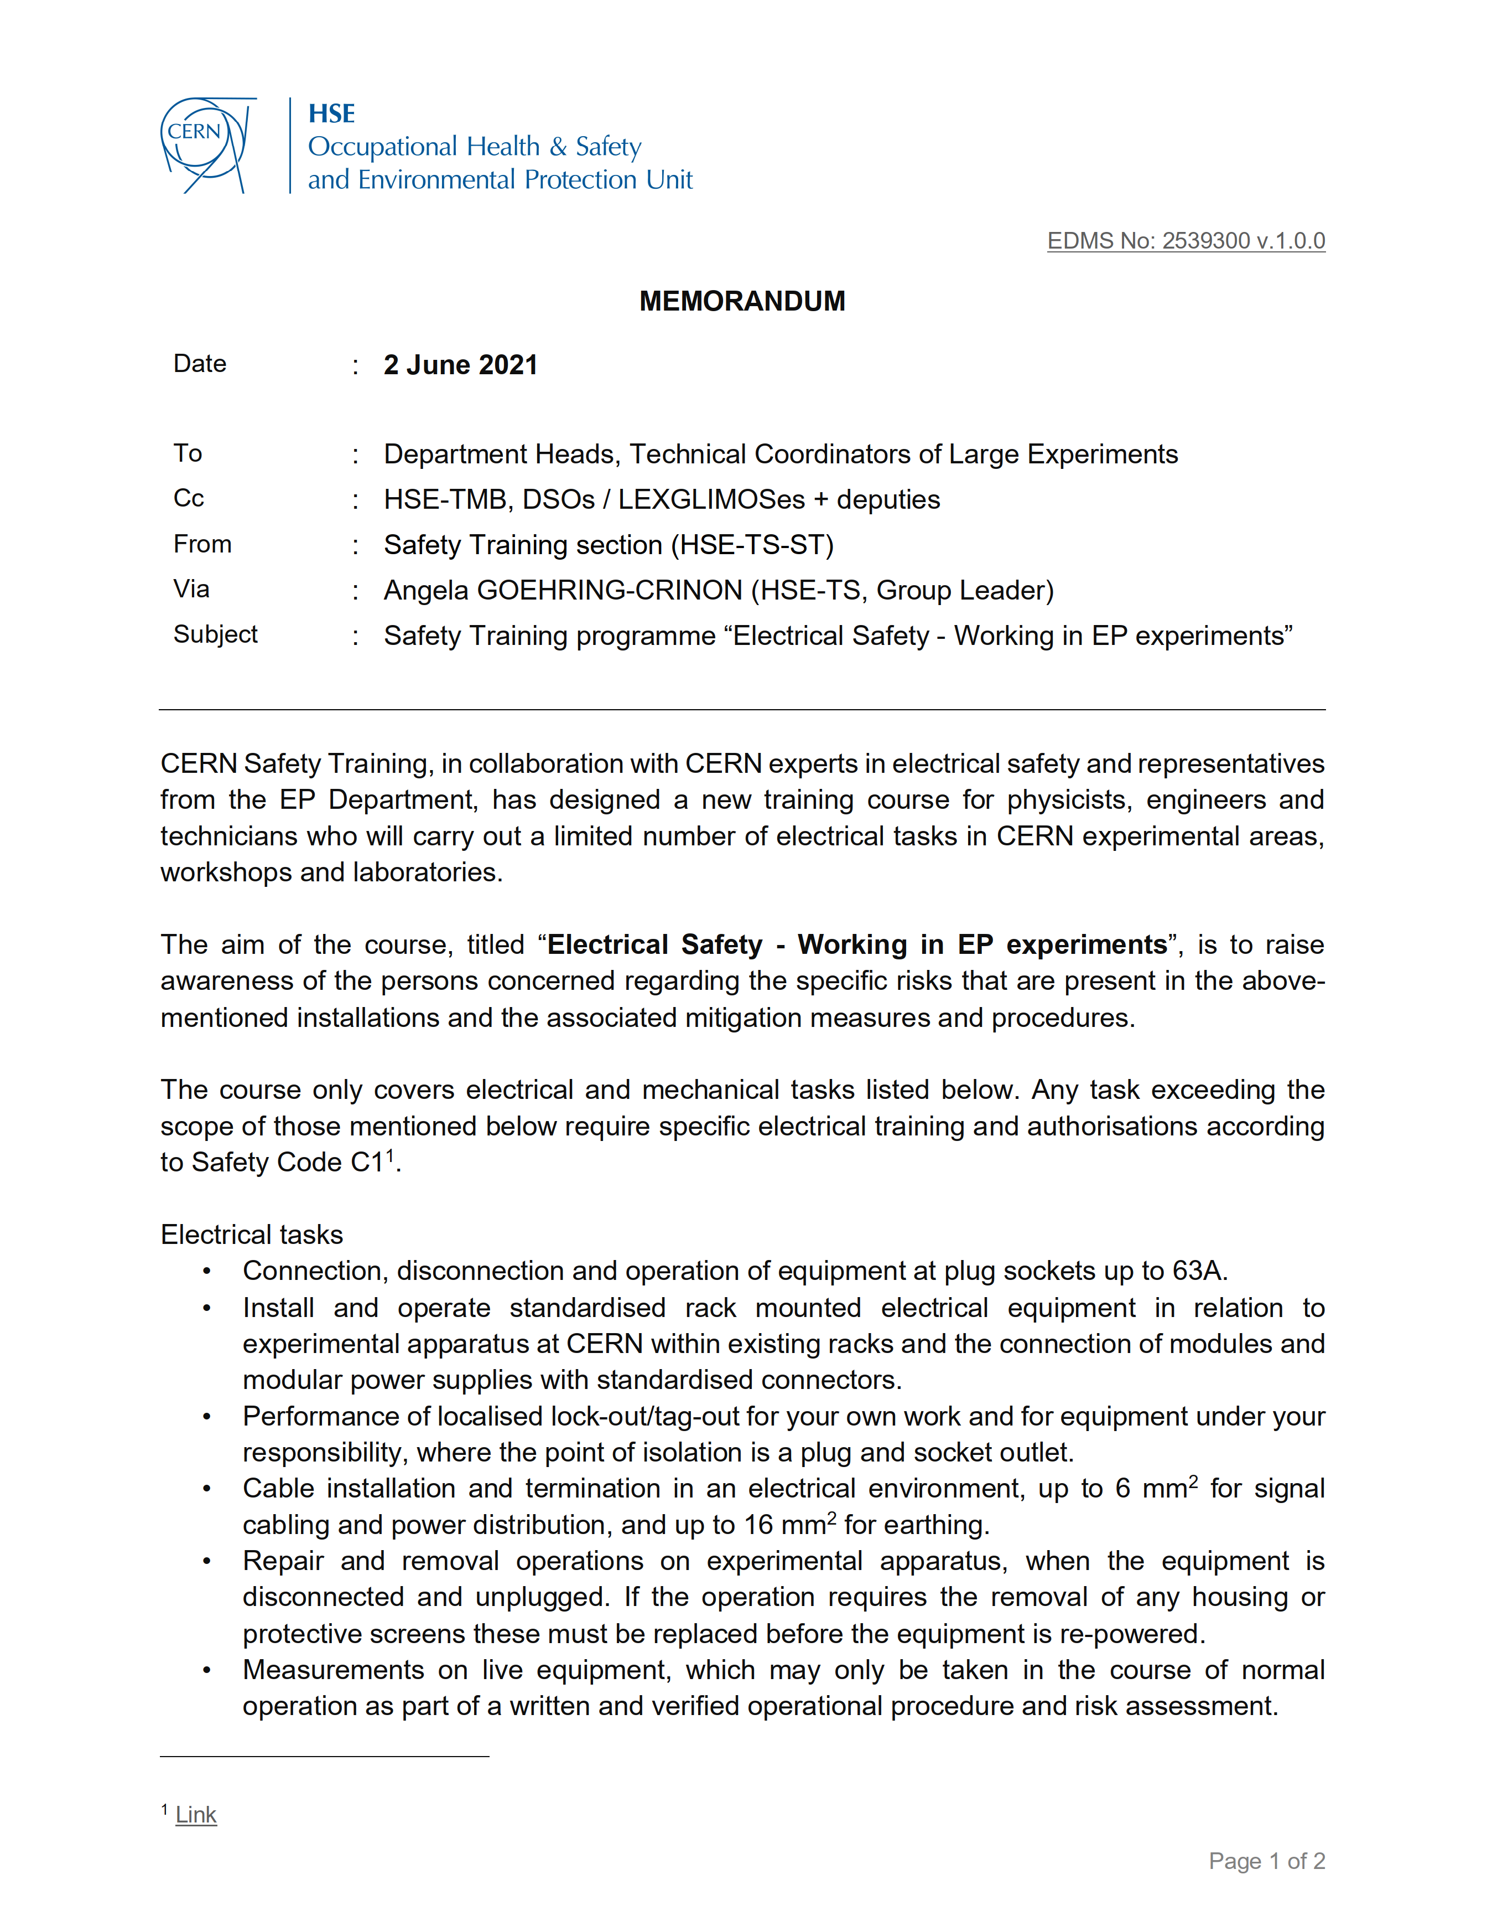
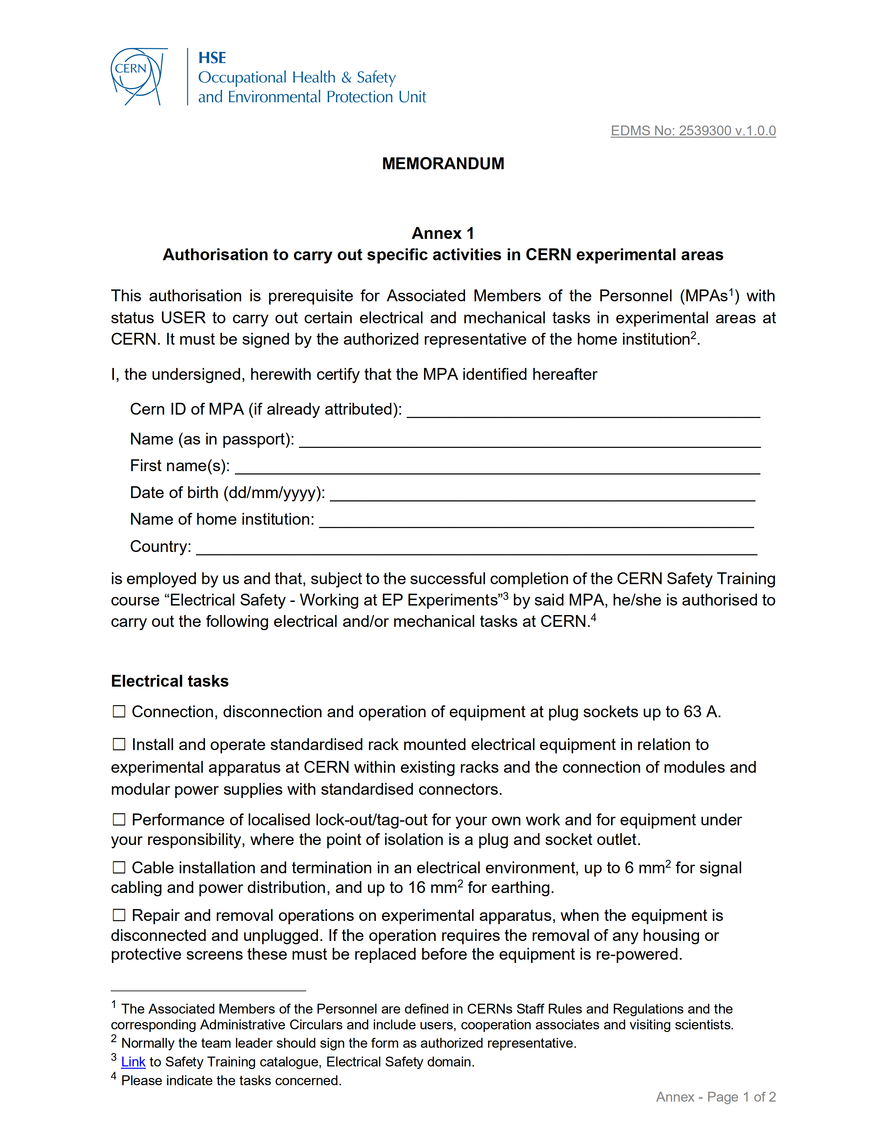
EDMS No: 2539300 v.1.0.0

