Slide 1
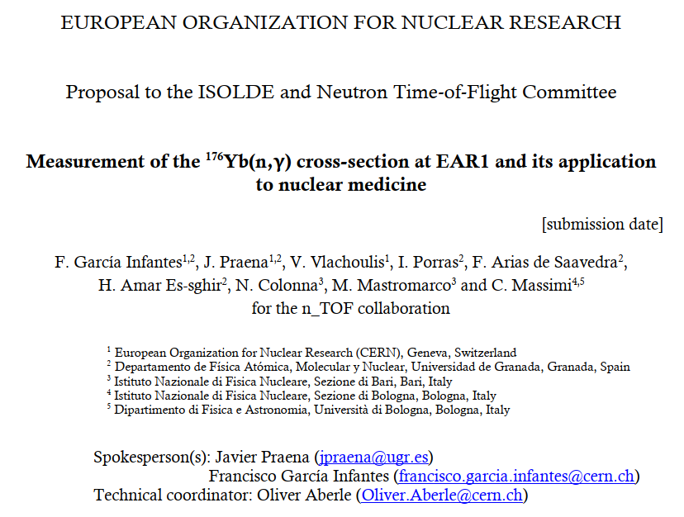



1

Slide 2



Outlook
Scientific motivations.
  ¹⁷⁷Lu in nuclear medicine. Complementary production in new facilities.
  Data needs of the ¹⁷⁶Yb(n,γ)¹⁷⁷Yb (→ ¹⁷⁷Lu).
Status ¹⁷⁶Yb(n,γ) experimental data and evaluations.
  No data in the 1/v region (meV-keV).
  No resolved resonances.
Proton beam request at EAR1.
  1.5e18
2
Javier Praena – U. Granada – CERN (EP/SME)
¹⁷⁶Yb(n,γ) proposal, INTC-P-607, 23/06/2021

Slide 3
Scientific motivations
Javier Praena – U. Granada – CERN (EP/SME)
¹⁷⁶Yb(n,γ) proposal, INTC-P-607, 23/06/2021

Slide 4
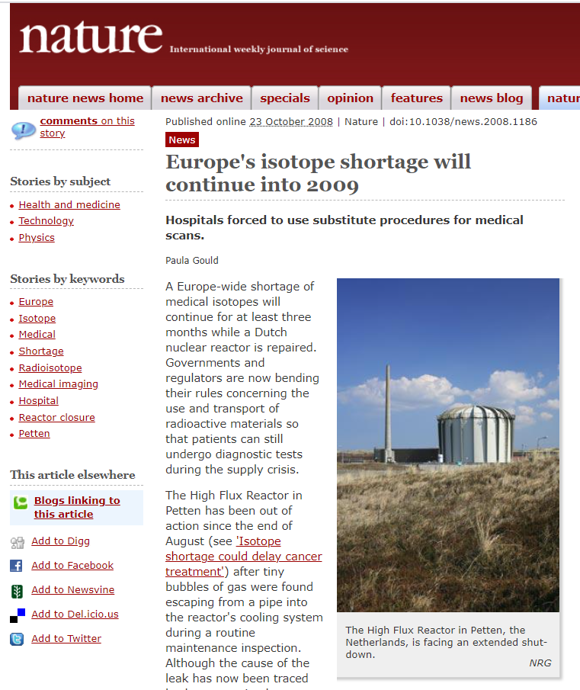
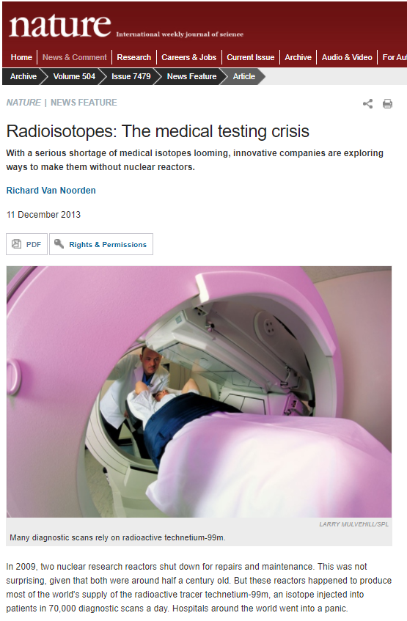
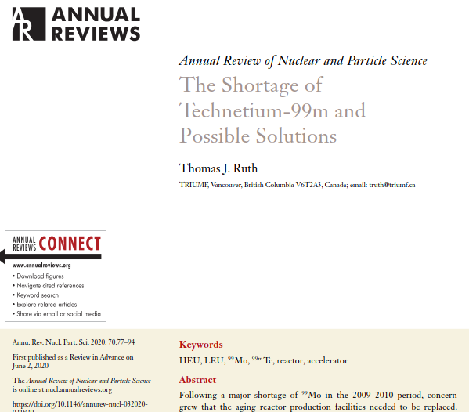
New facilities for complementary radioisotope production
There is a trend since a decade to use existing and new nuclear facilities for producing radioisotopes (Medicis-Isolde).
The Technetium world crisis in 2009-2010 was an alarm about the way to supply radioisotopes for nuclear medicine. Few reactors world wide.
2009
2013
2020
4
Javier Praena – U. Granada – CERN (EP/SME)
¹⁷⁶Yb(n,γ) proposal, INTC-P-607, 23/06/2021

Slide 5
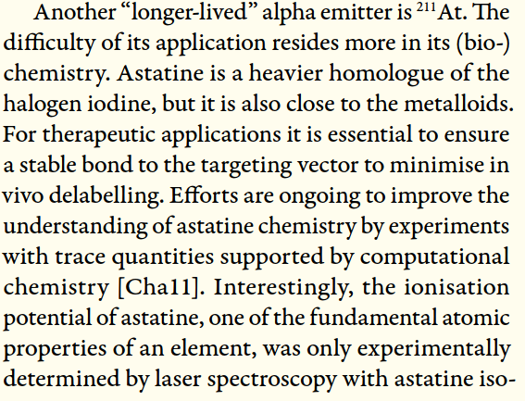

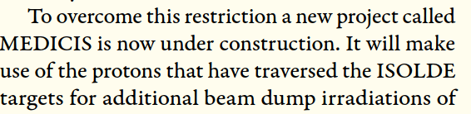
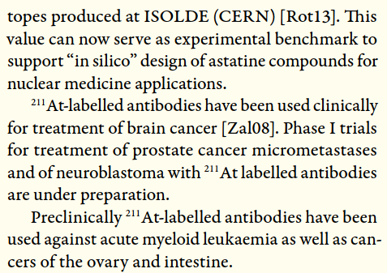
New facilities for complementary radioisotope production
Many working groups and international agencies have pushed for the use of nuclear facilities for radioisotope production with application to nuclear medicine (therapy and diagnosis). Not only “industrial” production is needed…
R&D activities in nuclear facilities as ISOLDE provided a better understanding in nuclear medicine
2014
5
Javier Praena – U. Granada – CERN (EP/SME)
¹⁷⁶Yb(n,γ) proposal, INTC-P-607, 23/06/2021

Slide 6
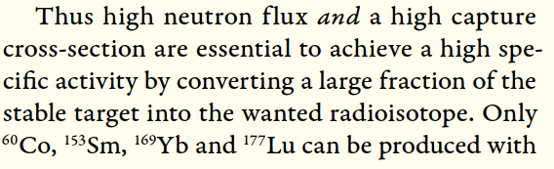
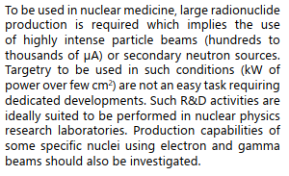

New facilities for complementary radioisotope production
Also, accelerator-based neutron facilities has been considered for the production of radioisotopes for nuclear medicine.
2014
6
Javier Praena – U. Granada – CERN (EP/SME)
¹⁷⁶Yb(n,γ) proposal, INTC-P-607, 23/06/2021

Slide 7
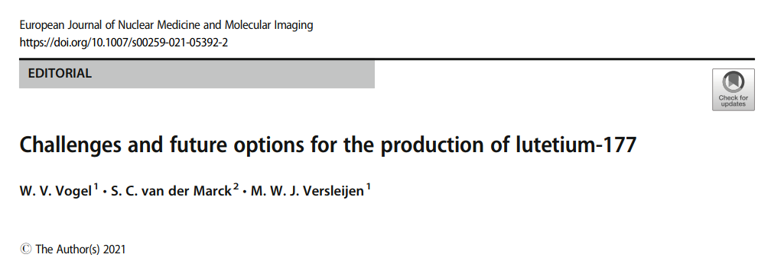
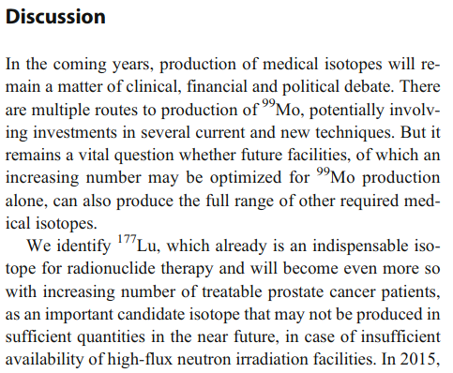
New facilities for complementary radioisotope production
7
Javier Praena – U. Granada – CERN (EP/SME)
¹⁷⁶Yb(n,γ) proposal, INTC-P-607, 23/06/2021

Slide 8
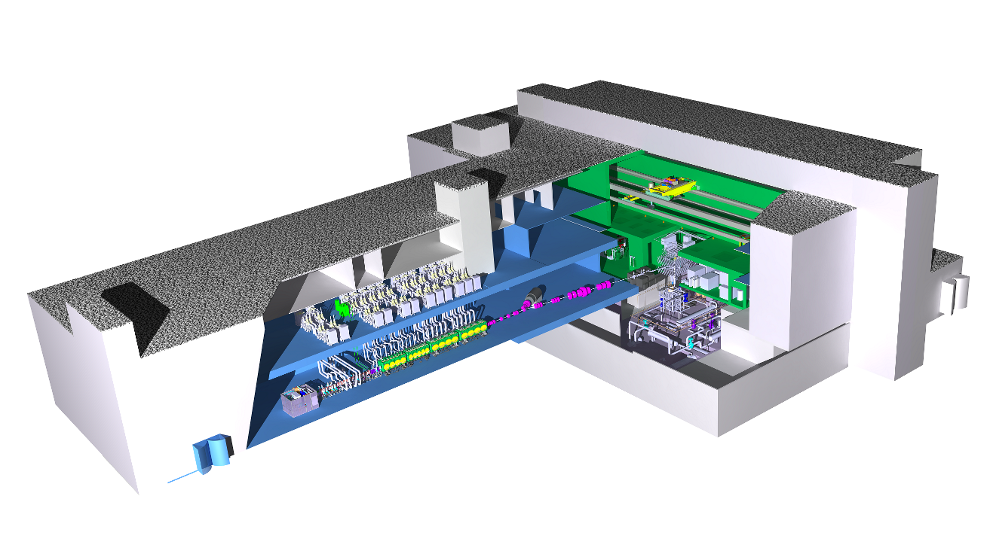
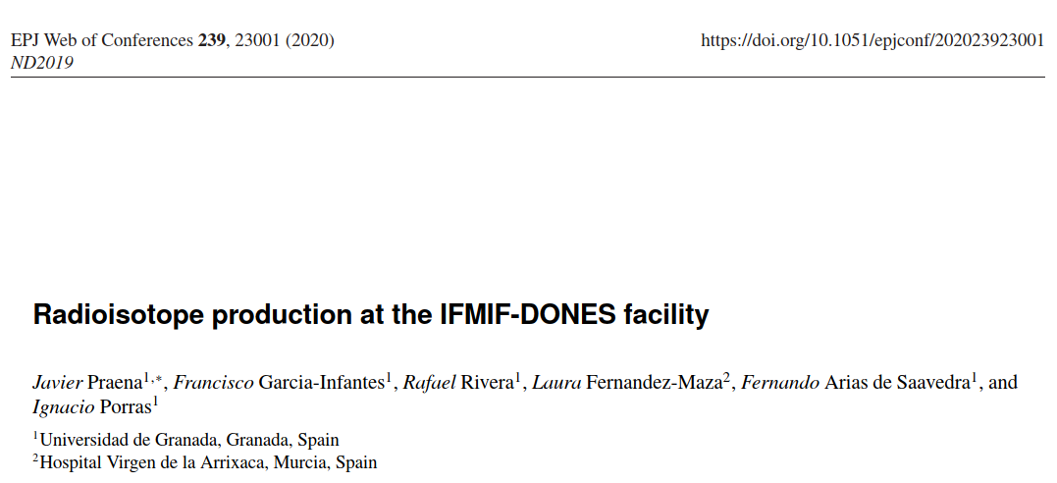
New facilities for complementary radioisotope production
Facilities under designed and construction as IFMIF-DONES (Granada, Spain) considers the production of radioisotopes for medicine as an complementary application.
MEDICIS-ISOLDE-CERN is an excellent successful example.
Nuclear data are needed to calculate the specific activity of the most adequate radioisotopes.
IFMIF-DONES
Accelerator
Lithium Loop
8
Javier Praena – U. Granada – CERN (EP/SME)
¹⁷⁶Yb(n,γ) proposal, INTC-P-607, 23/06/2021

Slide 9
¹⁷⁷Lutetium in medicine
Javier Praena – U. Granada – CERN (EP/SME)
¹⁷⁶Yb(n,γ) proposal, INTC-P-607, 23/06/2021

Slide 10
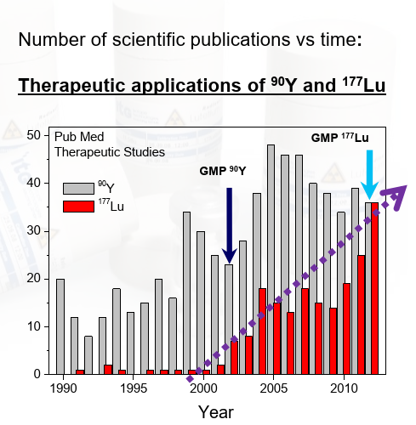
¹⁷⁷Lu, rising demand
Theragnostic = diagnosis and therapy.
Versatile radioisotope and one the most important emergent radioisotopes.
Good good success in gastroentero-pancreatic neuroendocrine tumours [11].
Currently, Lu177 is under study for several other tumours with good results [12].
At present, it is produced in nuclear reactors.
Rising demand radioisotope.
10
Javier Praena – U. Granada – CERN (EP/SME)
¹⁷⁶Yb(n,γ) proposal, INTC-P-607, 23/06/2021

Slide 11
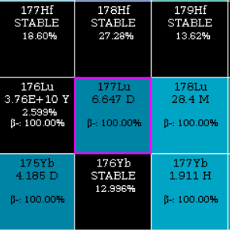
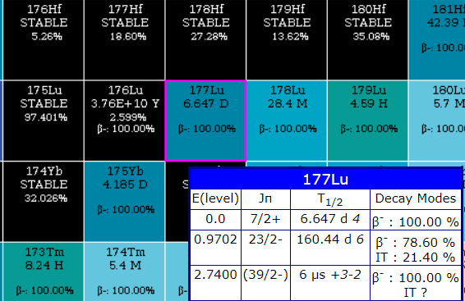
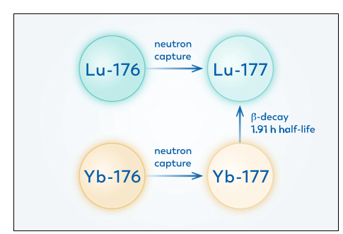
¹⁷⁷Lu production routes
“Carrier Added”
¹⁷⁶Lu(n,γ) → ¹⁷⁷Lu + ^{177m}Lu
Higher production. Lower specific activity.
^{177m}Lu is produced (0.05%), 160 days.
“Non Carrier Added”
¹⁷⁶Yb(n,γ)¹⁷⁷Yb (→ ¹⁷⁷Lu)
Lower production. Higher specific activity.
^{177m}Lu is negligible (<0.0001%)
11
Javier Praena – U. Granada – CERN (EP/SME)
¹⁷⁶Yb(n,γ) proposal, INTC-P-607, 23/06/2021

Slide 12
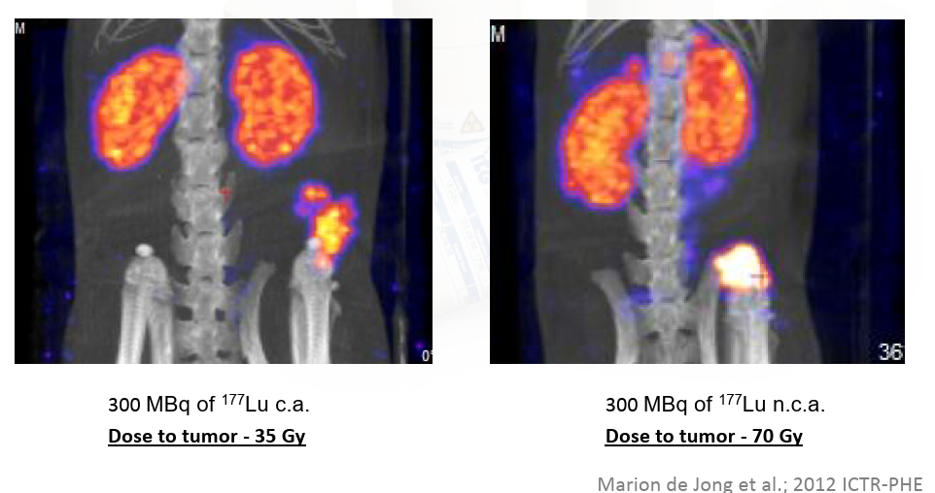
Specific activity: impact on tumor uptake
“Carrier Added”
“Non Carrier Added”
12
Javier Praena – U. Granada – CERN (EP/SME)
¹⁷⁶Yb(n,γ) proposal, INTC-P-607, 23/06/2021

Slide 13
¹⁷⁶Yb(n,γ)¹⁷⁷Yb
Data status. Proton request.
Javier Praena – U. Granada – CERN (EP/SME)
¹⁷⁶Yb(n,γ) proposal, INTC-P-607, 23/06/2021

Slide 14
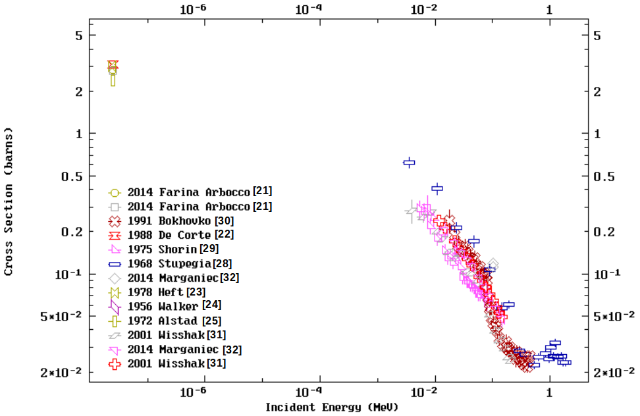
Experimental data ¹⁷⁶Yb(n,γ)
No data in the 1/v region
No resolved resonances. Resonances detected in transmission experiments.
Resolved Resonance Region
14
Javier Praena – U. Granada – CERN (EP/SME)
¹⁷⁶Yb(n,γ) proposal, INTC-P-607, 23/06/2021

Slide 15
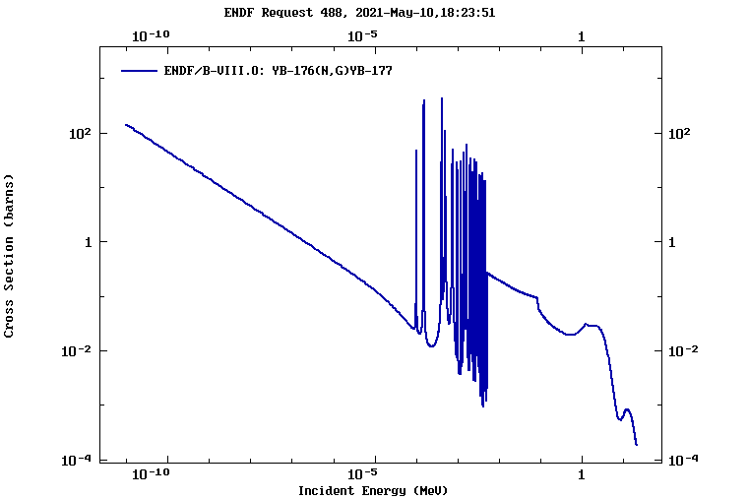
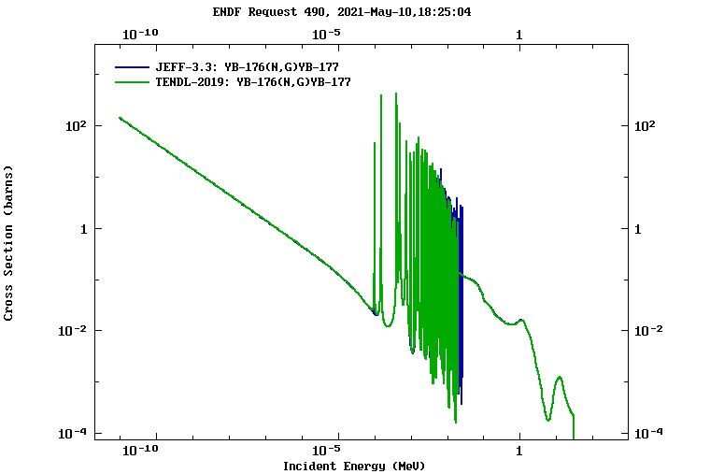
Evaluations ¹⁷⁶Yb(n,γ)¹⁷⁷Yb
Evaluations foreseen resonances in the ¹⁷⁶Yb(n,γ) due to the results of transmission experiments. However, (n,γ) have not been detected
RRR up to 5 keV
RRR up to 25 keV
15
Javier Praena – U. Granada – CERN (EP/SME)
¹⁷⁶Yb(n,γ) proposal, INTC-P-607, 23/06/2021

Slide 16
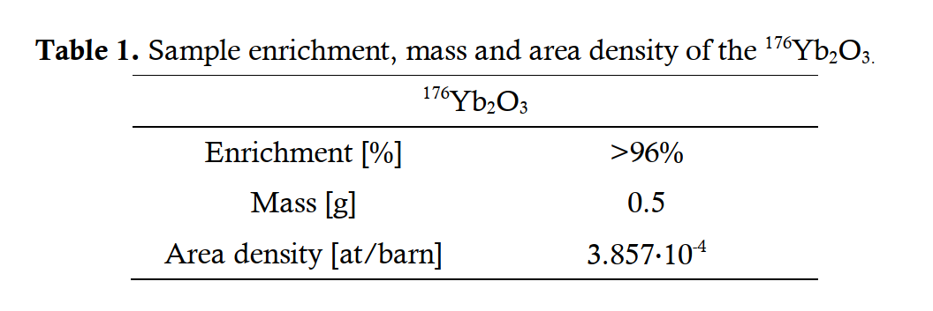
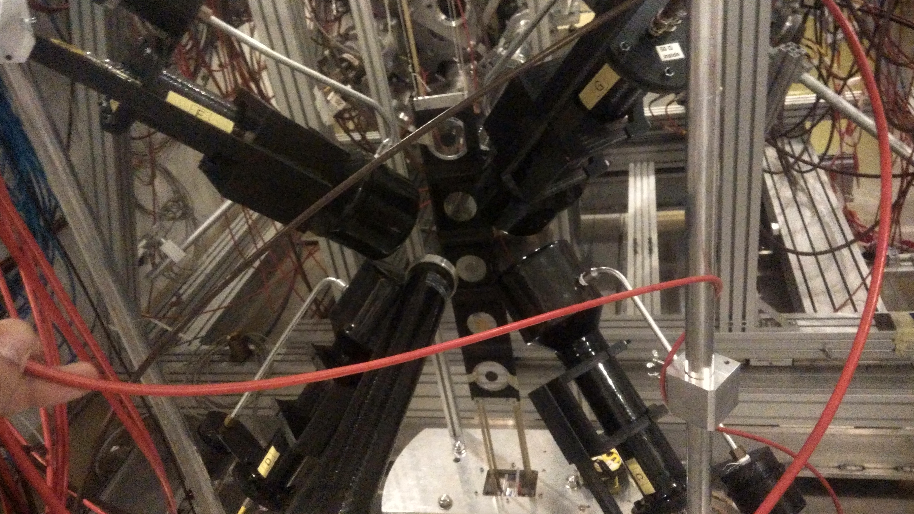
Sample and setup at EAR1
For the sample we will follow the method of Wisshak et al. [31], powder in Al can container.
Trace Science Inter. provides the material with a higher enrichment than Wisshak et al. [31].
Contaminations of ¹⁶⁸Yb and ¹⁷⁶Lu are not expected, private communication Trace Science.
Four C₆D₆ detectors
Neutrons
16
Javier Praena – U. Granada – CERN (EP/SME)
¹⁷⁶Yb(n,γ) proposal, INTC-P-607, 23/06/2021

Slide 17
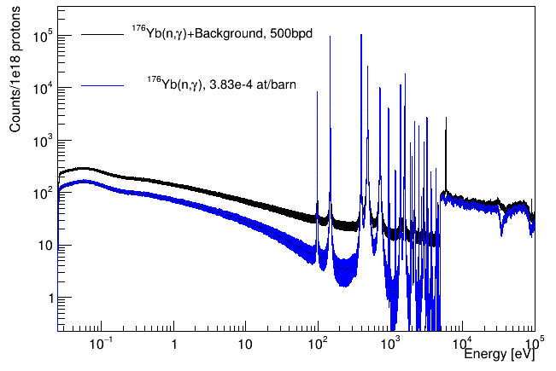
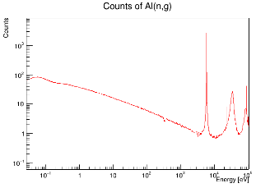
Counts for 1e18 protons at EAR1: 500 bpd
Considering the setup with 4 C₆D₆, ENDF and the sample 3.8e-4 at/b.
Most important background is expected from the Al can.
Background can be substrate
Energy [eV] | Average Statistical uncertainty
1 - 70 | 10 - 30 %
1st and 2nd at WHM | 5 %
Valleys 1st and 2nd | 30 %
17
Javier Praena – U. Granada – CERN (EP/SME)
¹⁷⁶Yb(n,γ) proposal, INTC-P-607, 23/06/2021

Slide 18
Sample by TRACE SCIENCE: no ¹⁶⁸Yb
¹⁷⁶Lu and ¹⁶⁸Yb are the most undesirable isotopes in the sample. Both will not be present in the sample.
Isotopes | Abundance
¹⁷¹Yb | 0.41 %
¹⁷²Yb | 0.69 %
¹⁷³Yb | 0.51 %
¹⁷⁴Yb | 1.99 %
¹⁷⁶Yb | 96.4 %
 | 100 %
However, let us consider that the ¹⁶⁸Yb isotope would be present in the sample of TRACE.
18
Javier Praena – U. Granada – CERN (EP/SME)
¹⁷⁶Yb(n,γ) proposal, INTC-P-607, 23/06/2021

Slide 19
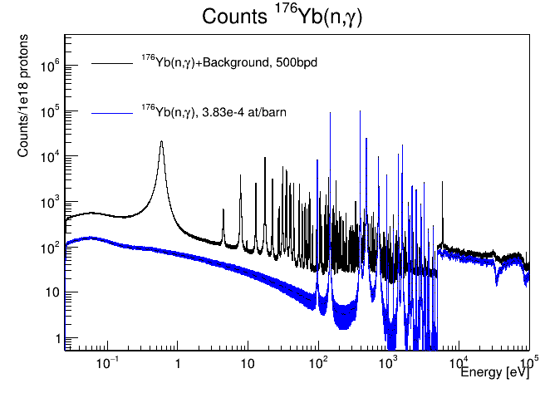
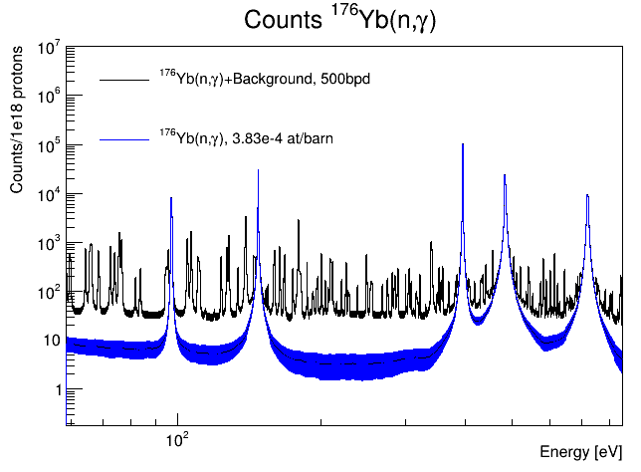
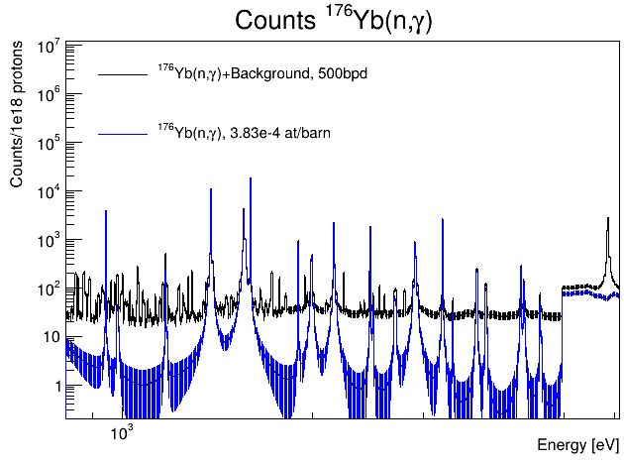
Most unfavorable sample for background
Sample for the experiment considering an artificial contamination of 0.12% of the ¹⁶⁸Yb isotope.
Sample of Trace with artificial 0.12% ¹⁶⁸Yb
Sample of Trace with artificial 0.12% ¹⁶⁸Yb
>99% is ¹⁷⁶Yb
Sample of Trace with artificial 0.12% ¹⁶⁸Yb
Even in this artificial less favorable situation the background can be substrate
19
Javier Praena – U. Granada – CERN (EP/SME)
¹⁷⁶Yb(n,γ) proposal, INTC-P-607, 23/06/2021

Slide 20
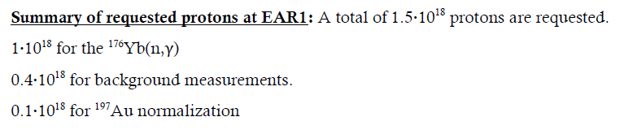
Conclusions and proton request
¹⁷⁷Lu is an important theragnostic radioisotope in nuclear medicine.
It is considered for its production in accelerator-based neutron sources by means of the ¹⁷⁶Yb(n,γ) reaction as complementary to the production at nuclear reactors.
A complete lack of data of the ¹⁷⁶Yb(n,γ) cross-section in the 1/v region (meV-keV).
Important ¹⁷⁶Yb(n,γ) resonances, never detected, are expected because they have been detected in transmission experiments.
At n_TOF, we will provide data in 1/v and will resolve the resonances for the first time, in a reasonable beam time.
At present, it is not an objective of n_TOF to produce radioisotopes.
20
Javier Praena – U. Granada – CERN (EP/SME)
¹⁷⁶Yb(n,γ) proposal, INTC-P-607, 23/06/2021

Slide 21

Javier Praena
Universidad de Granada (Spain)
CERN Scientific Associate (EP-SME-62) n_TOF Physics Coordinator
Thank you
21

Slide 22
Sample by TRACE SCIENCE: no ¹⁶⁸Yb
¹⁷⁶Lu is not present in the sample. ¹⁶⁸Yb is the other isotope that could give noticeable background.
Contaminations of ^{168,170}Yb are not expected.
Isotopes | Experimental Enrichment *Kappeler
¹⁷⁰Yb | 0.10 %
¹⁷¹Yb | 0.53 %
¹⁷²Yb | 0.87 %
¹⁷³Yb | 0.73 %
¹⁷⁴Yb | 2.47 %
¹⁷⁶Yb | 95.3 %
 | 100 %
Isotopes | Abudance
¹⁷¹Yb | 0.41 %
¹⁷²Yb | 0.69 %
¹⁷³Yb | 0.51 %
¹⁷⁴Yb | 1.99 %
¹⁷⁶Yb | 96.4 %
 | 100 %
22
Javier Praena – U. Granada – CERN (EP/SME-)
Coll. Board Meeting, 11/05/2021

Slide 23
IFMIF-DONES
Javier Praena – U. Granada – CERN (EP/SME-)
Coll. Board Meeting, 11/05/2021

Slide 24

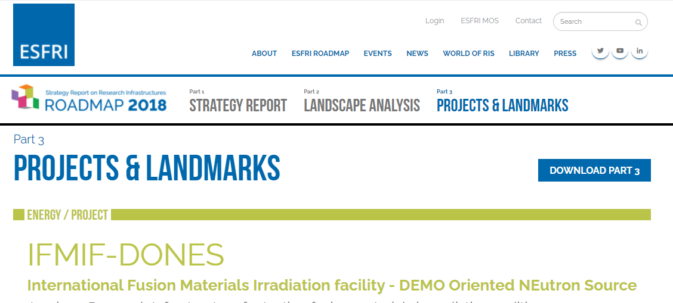
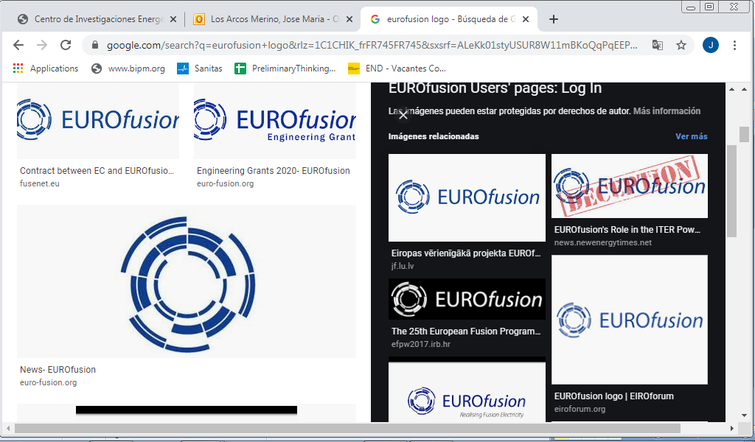





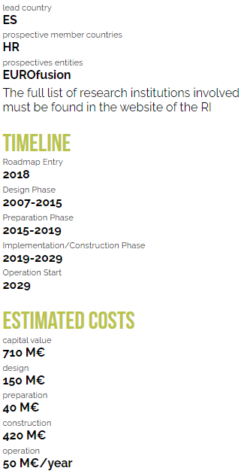
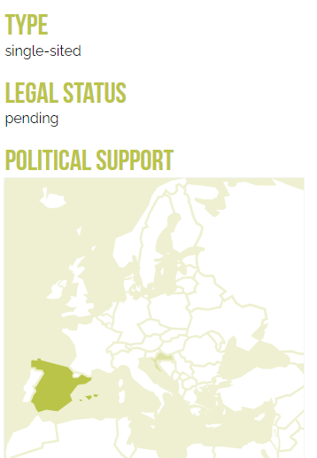






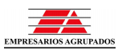


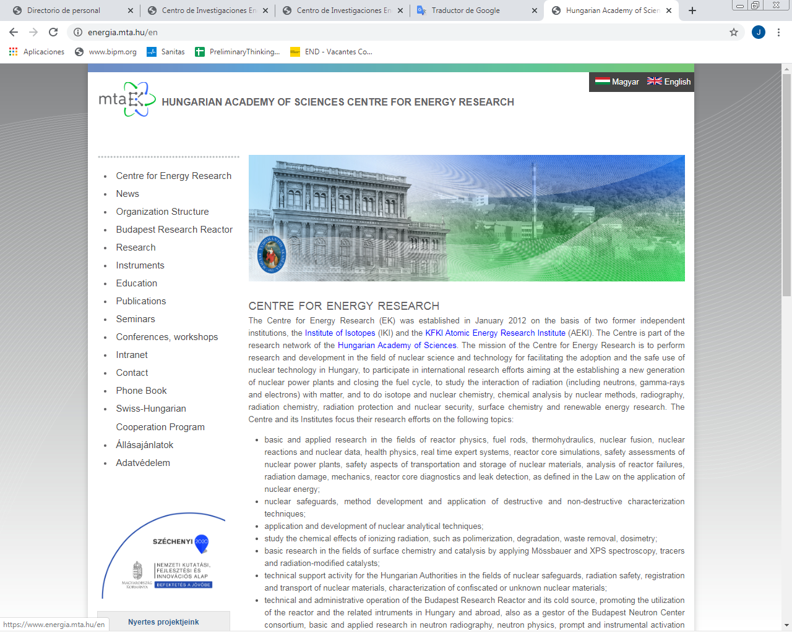



ESFRI facility. City host: Granada
24
Javier Praena – U. Granada – CERN (EP/SME-)
Coll. Board Meeting, 11/05/2021

Slide 25
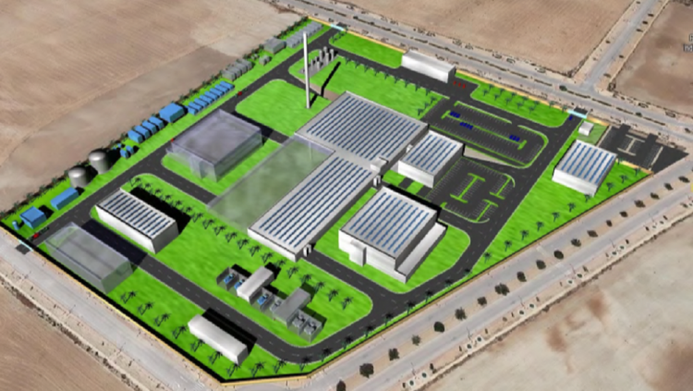
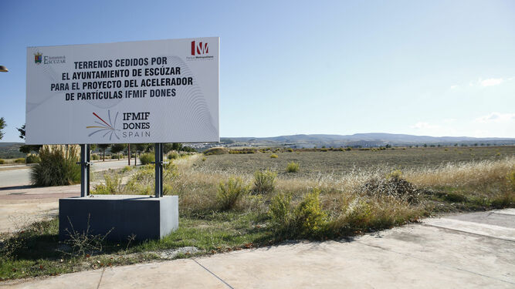
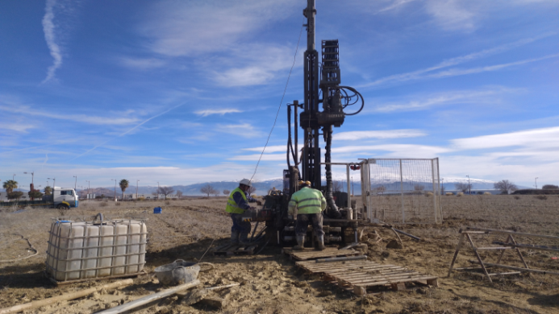
Spain-Croatia. City host: Granada
25
Javier Praena – U. Granada – CERN (EP/SME-)
Coll. Board Meeting, 11/05/2021

Slide 26
The facility goal: produce neutrons
Accelerator
Lithium Loop
26
Javier Praena – U. Granada – CERN (EP/SME-)
Coll. Board Meeting, 11/05/2021

Slide 27
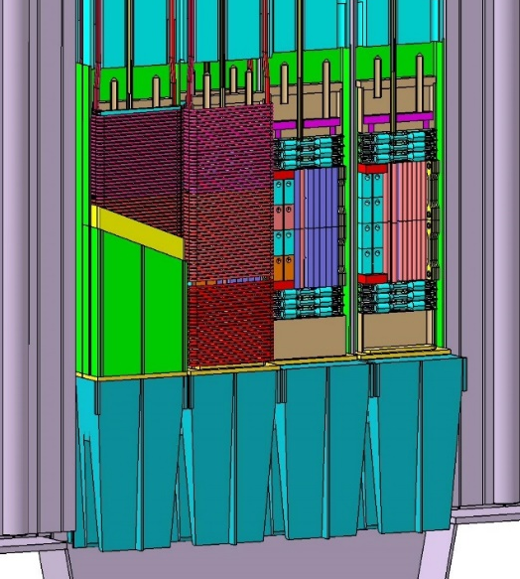
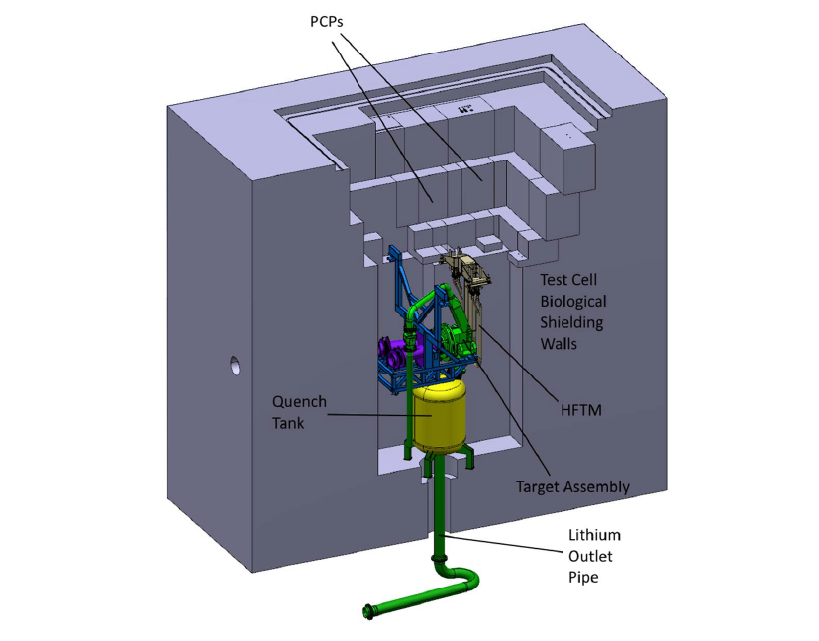
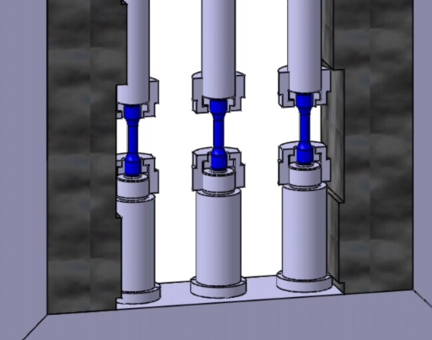
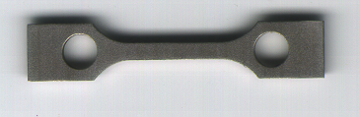
Neutron damage in key pieces of fusion reactors
The goal of IFMIF-DONES is to produce neutrons-like DEMO fusion reactor.
Study the behaviour of several key pieces of DEMO.
Irradiations will last several months.
27
Javier Praena – U. Granada – CERN (EP/SME-)
Coll. Board Meeting, 11/05/2021

Slide 28
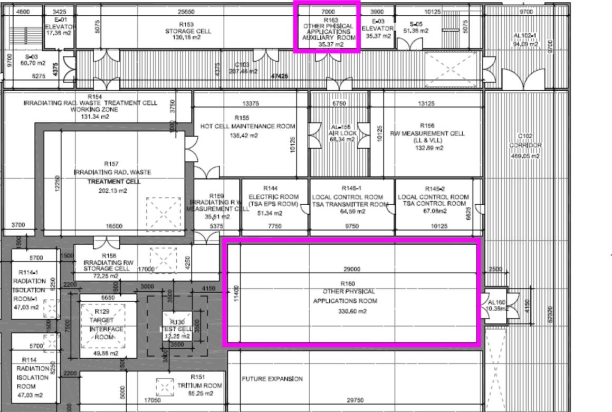
Other applications: in and out the bunker.
The design of the building of IFMIF-DONES has already included an experimental hall (R160) next to the bunker where the neutrons are produced.
28
Javier Praena – U. Granada – CERN (EP/SME-)
Coll. Board Meeting, 11/05/2021

Slide 29
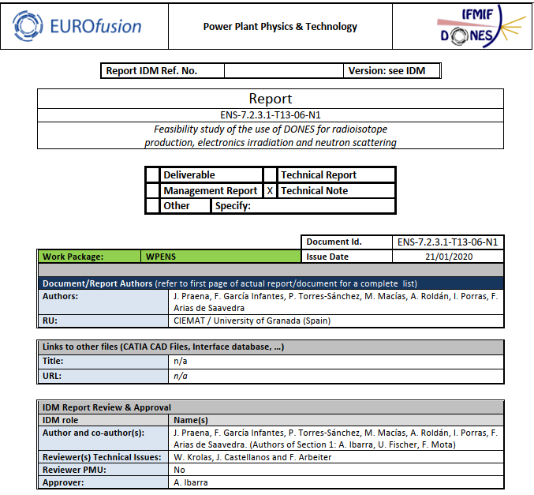
UGR and the other applications.
29
Javier Praena – U. Granada – CERN (EP/SME-)
Coll. Board Meeting, 11/05/2021

Slide 30
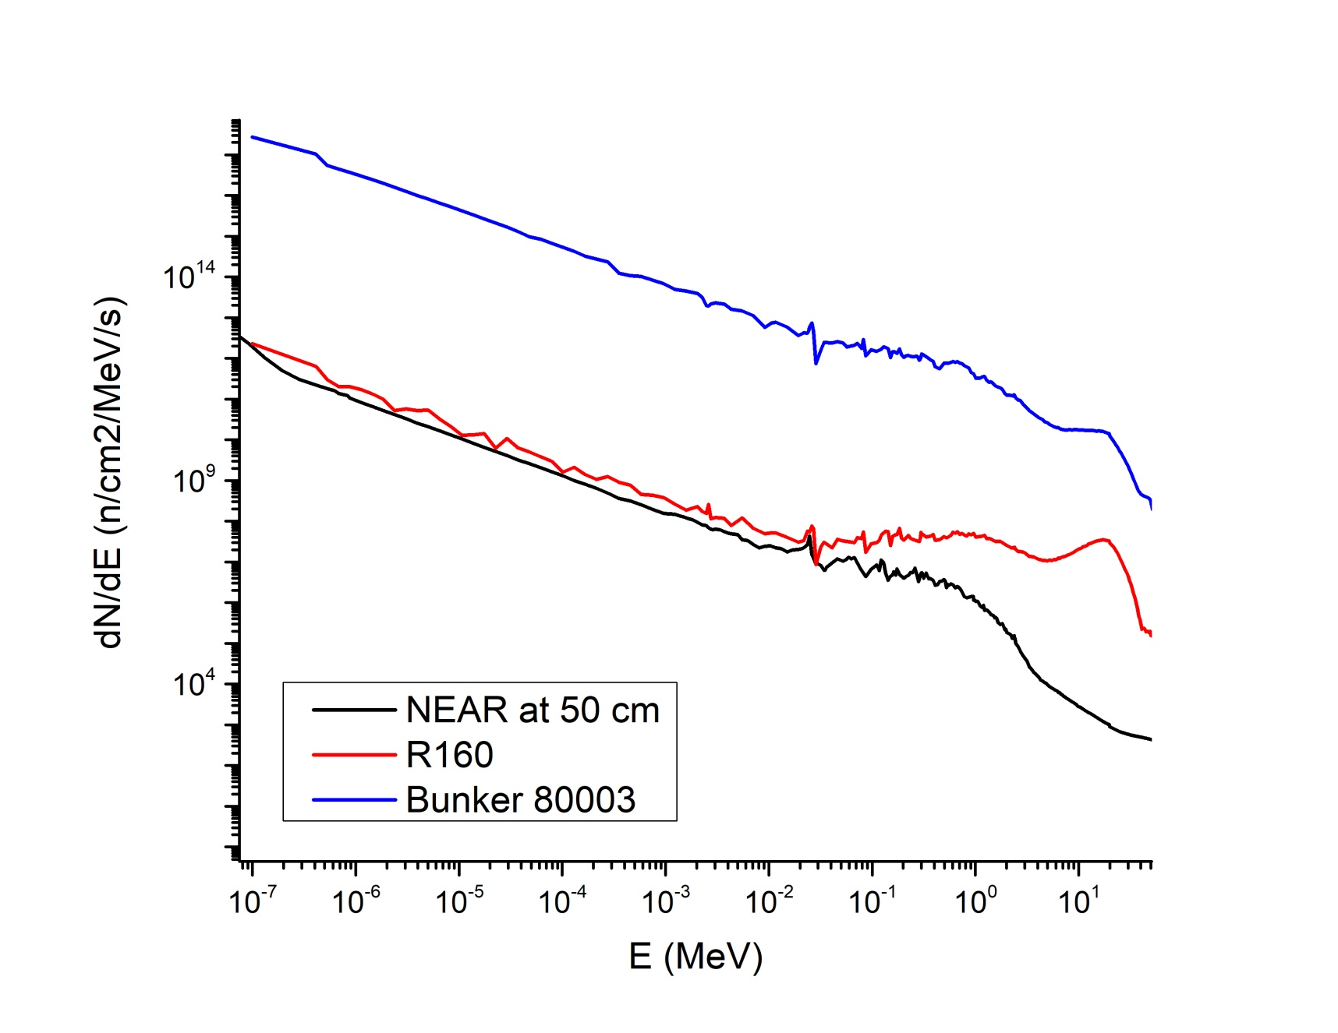
N_TOF versus DONES
30
Javier Praena – U. Granada – CERN (EP/SME-)
Coll. Board Meeting, 11/05/2021

Slide 31
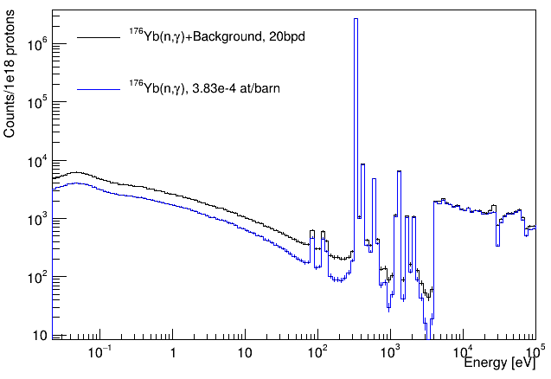
Counts for 1e18 protons at EAR1: 20 bpd
The low statistics in the 1/v could be improved with a smaller number of bpd
However, the low statistic of the valleys will remain.
31
Javier Praena – U. Granada – CERN (EP/SME-)
Coll. Board Meeting, 11/05/2021

Slide 32
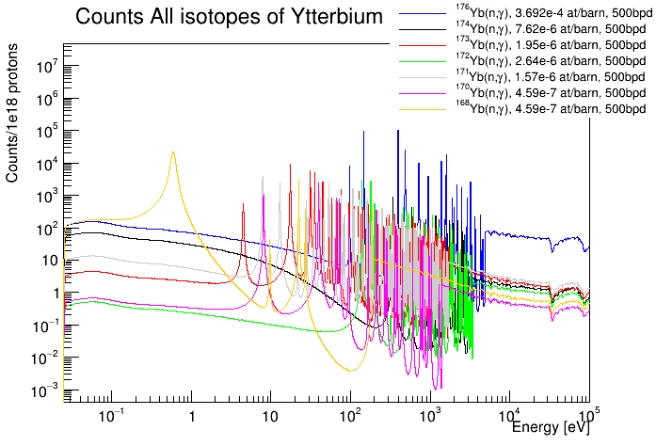
Counts for natural enrichment of ytterbium
23

