Slide 1
Single-particle structure, effective proton charge, and emerging collectivity around ¹³²Sn
G. Georgiev¹, A.E. Stuchbery², J.M. Allmond³, A. Andreyev⁴, D.L. Balabanski⁵, L. Barber⁶, M.J.G. Borge⁷, M.P. Carpenter⁸,
J. Cederkall⁹, K. Chipps³, K. Chrysalidis¹⁰, D. Clarke⁶, D. Cullen⁶, N. Erduran¹¹, M. Febbraro³, L.M. Fraile¹², S. Franchoo¹,
V. Fedosseev¹⁰, S. Freeman⁶, L. Gaffney¹³, A. Galindo-Uribarri³, J. Gerl¹⁴, K. Gladnishki¹⁵, M. Gorska¹⁴, T. Grahn¹⁶, T. J. Gray³,
K. Hadyńska-Klęk¹⁷, R. Heinke¹⁰, C. Henrich¹⁸, A. Illana¹⁶, E. Ince¹⁹, K. Johnston¹⁰, T. Kibédi², D. Kocheva¹⁵, M. Komorowska¹⁷,
A. Kusoglu²⁰, G.J. Lane², A.-C. Larsen²¹, J. Ljungvall¹, R. Lozeva¹, B. Marsh¹⁰, I. Matea¹, A.J. Mitchell², P.J. Napiorkowski¹⁷,
D.R. Napoli²², G. Neyens^{10,23}, R.D. Page²⁴, S.D. Pain³, P. Papadakis²⁵, G. Pasqualato¹, D.C. Radford³, G. Rainovski¹⁵, C. Rasco³,
J.A. Rodriguez¹⁰, S. Rothe¹⁰, M. Scheck²⁶, J. Smallcombe²⁴, C. Sotty²⁷, K. Stoychev¹, O. Tengblad⁷, N. Warr²⁸, S. Wilkins¹⁰,
K. Wimmer⁷, K. Wrzosek-Lipska¹⁷, J.L. Wood²⁹, D.T. Yordanov¹, C.-H. Yu³
¹ IJCLab, Orsay, France; ² The ANU, Canberra, Australia; ³ ORNL, Oak Ridge, USA; ⁴ Uni. York, UK; ⁵ ELI-NP, Bucharest, Romania;
⁶ Uni. Manchester,UK; ⁷ IEM, CSIC, Spain; ⁸ ANL, Argonne, USA; ⁹ Lund Uni., Sweden; ¹⁰ ISOLDE, CERN, Switzerland; ¹¹ Istanbul Sabahattin Zaim Uni., Turkey; ¹²Uni. Complutense, Madrid, Spain; ¹³ Uni. Liverpool, UK; ¹⁴ GSI, Darmstadt, Germany; ¹⁵ Uni. Sofia, Bulgaria; ¹⁶ Uni. Jyväskylä, Finland; ¹⁷ HIL, Uni. Warsaw, Poland; ¹⁸ TU Darmstadt, Germany; ¹⁹ Istanbul Uni.-Cerrahpasa, Turkey; ²⁰ Istanbul Uni, Turkey; ²¹ Uni. Oslo, Norway; ²² LNL-INFN, Legnaro, Italy; ²³ IKS, KU Leuven, Belgium; ²⁴ Uni. Liverpool, UK; ²⁵ STFC Daresbury, UK; ²⁶ Uni. West of Scotland, Paisley, UK;
²⁷ NIPNE, Bucharest, Romania; ²⁸ IKP, Uni. Cologne, Germany; ²⁹ Georgia Institute of Technology, Atlanta, USA

Slide 2
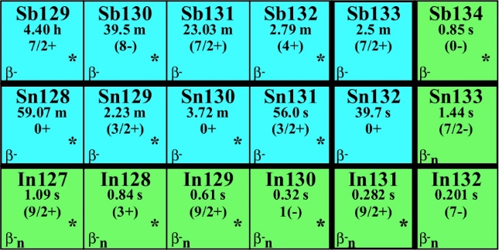
E2 Strength (Coulex) of Odd-Z Nuclei Near ¹³²Sn: Effective charges and pn Interactions
Recently Published;
40% E2 enhancement
Beyond
particle-core
s.p. eff.
charges
Proton +
neutron hole pairs
Proton hole +
neutron hole pairs
Beyond
particle-core

Slide 3
Sn B(E2) Systematics – moving to odd-proton neighbours
Total electric quadrupole strength of ¹²⁹Sb is enhanced compared to the Sn systematics
¹²⁹Sb PRL 124, 032502 (2020)
¹²⁸Sn
E2 sum as a tool & a measure of developing collectivity:
Empirical comparison of E2 strengths
Detailed shell-model comparisons
¹³⁰Sn

Slide 4
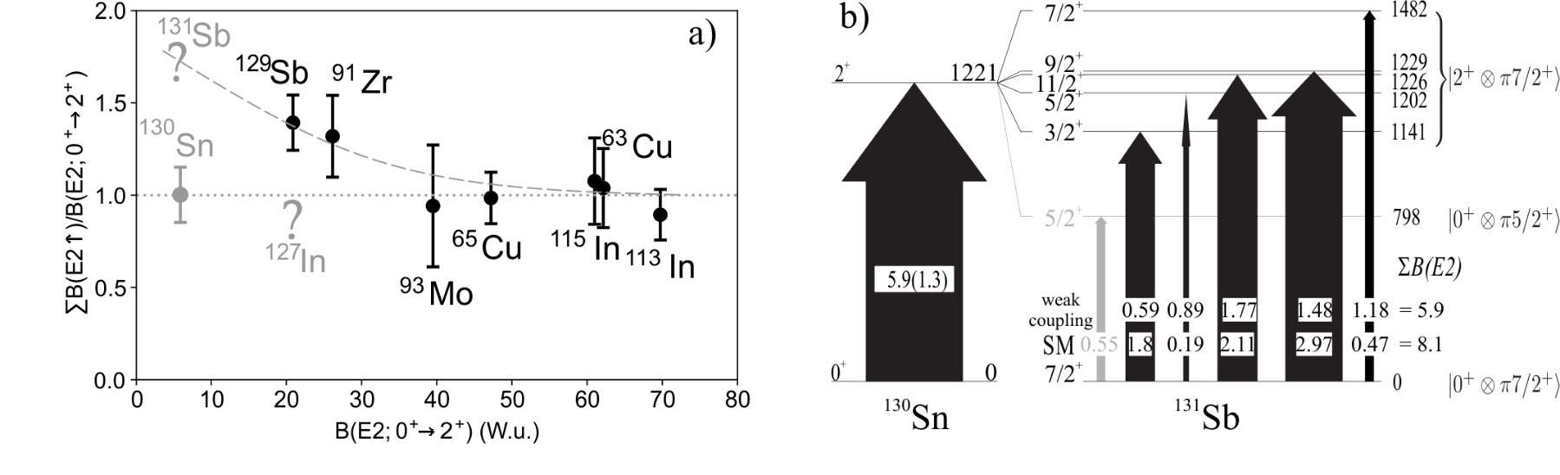
Core vs Particle-Core (fragmented) E2 Strength
E2 Sum is invariant in particle-core model for all coupling strengths
Breakdown of particle-core observed for B(E2) < 40 W.u. [Gray et al., PRL (2021)]
Shell-model calculations predict different breakdowns for particles and holes; breakdown not understood, limited data
Breakdown pattern may not be monotonic
Shell model: NushellX. Full 50 < Z,N < 82 major shell. Interactions: sn100 (PRC 71, 044317) and GCN50:82 (PRC82, 064304)

Slide 5
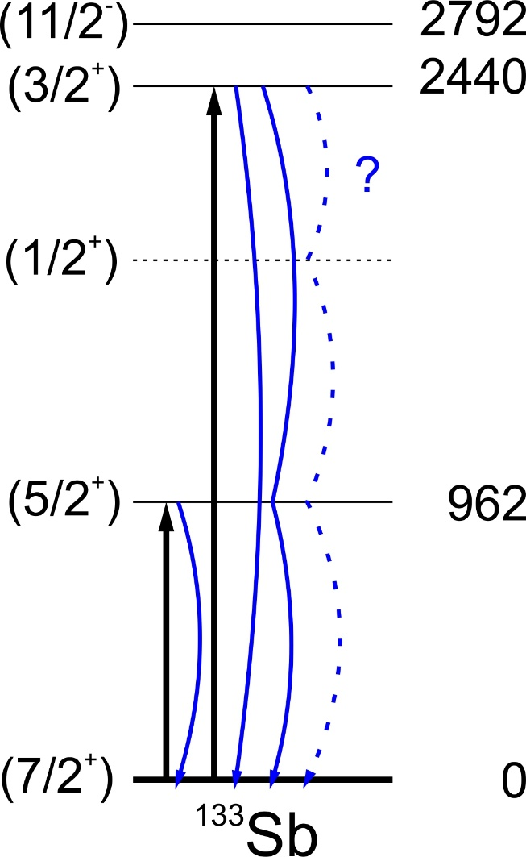
¹³³Sb: Effective charges next to ¹³²Sn
s.p. eff.
charges

Slide 6
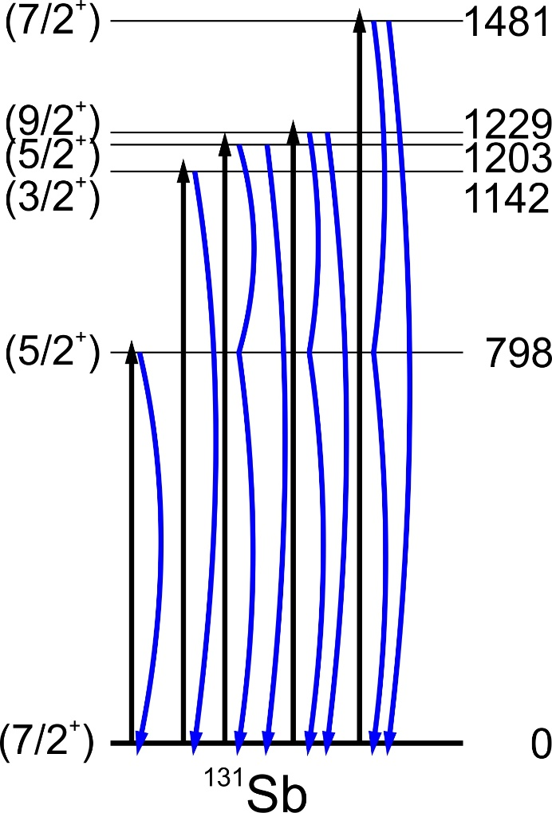
¹³¹Sb: particle-core structure, pn interactions, developing collectivity
Beyond
particle-core

Slide 7
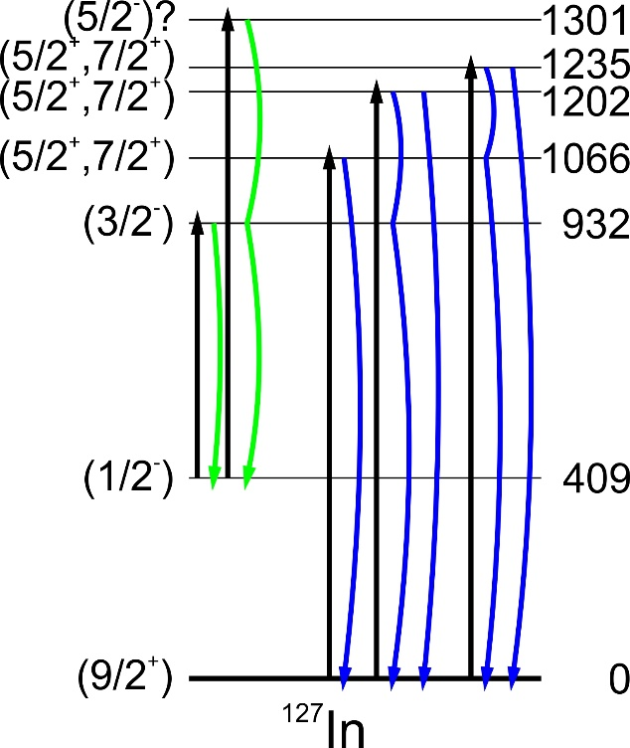
¹²⁷In: particle-core structure, p⁻¹n interactions, developing collectivity
9/2⁺ g.s. beam
½⁻ isomer beam
Beyond
particle-core

Slide 8
What we aim for and what the experiment will provide?
¹³³Sb
transition probabilities; purity of single-particle states; proton effective charge; single particle energies around ¹³²Sn
¹³¹Sb
probe the sum rule at ¹³⁰Sn - very sensitive test case; stringent test of shell model calculations; emergence of collectivity around shell closures; distinguish between core modification and proton-neutron correlations
¹²⁷In (1/2⁻ isomer and 9/2⁺ g.s. beams accelerated)
measure B(E2) strengths
excitation on ½⁻ isomer should give B(E2)s and angular correlations
spins and configuration assignment of the ‘known’ candidate multiplet states and search for other strongly Coulomb-excited states, which might be missing multiplet members
identify other low-lying states (possibly with both positive and negative parities, when structures on top of the two isomeric states are excited) to be compared to shell-model calculations and E2 sum rule.

Slide 9
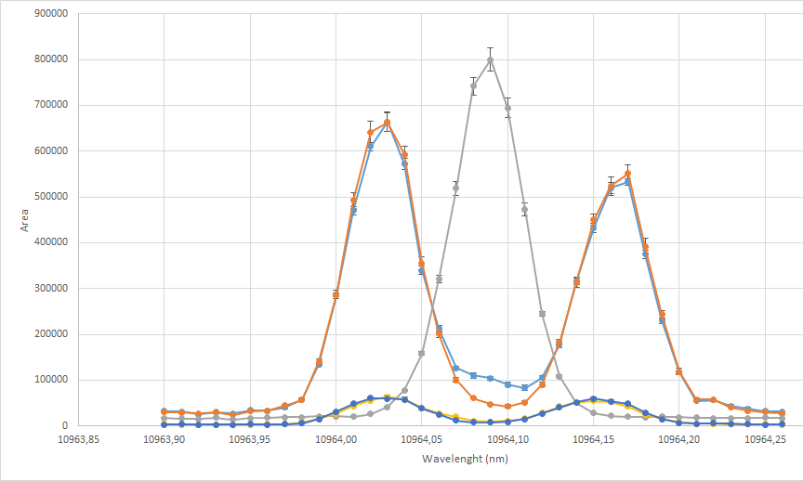
RIB production from ISOLDE and experimental details
Use of a neutron-converter for reducing the surface-ionized spallation products (Cs, Ba etc.)
Narrow-band RILIS for isomer selection in ¹²⁷In
(½⁻ isomer)
(9/2⁺ ground state)
isotopes | yield [p/µC] | surface contamination | rate @ Miniball [pps]
¹³¹Sb | 7.2 x 10⁷ | 25% | 3 x 10⁶
¹³³Sb | 4.7 x 10⁷ | 50% | 2 x 10⁶
¹²⁷In | 5.5 x 10⁶ | 25% | 2.5 x 10⁵
Coulomb excitation measurement at Miniball (CD-only configuration)
Beams – ¹³³Sb, ¹³¹Sb; ^{127g}In, ^{127m}In
Energy – 4 MeV/u
Targets – ¹⁹⁶Pt: 1 mg/cm² for ¹³³Sb and ¹³¹Sb; 2 mg/cm² for ¹²⁷In
Standard Miniball Coulex configuration
  beam energy and the target (composition and thickness) were optimized aiming at:
  safe (single-step) Coulomb excitation (within the angular coverage of the CD detector)
  precise B(E2) values - considering the influence of the Q moment on the B(E2)

Slide 10
Beam-time request
3 shifts of beam on target with ¹³¹Sb beam;
3 shifts of beam on target with ¹³³Sb beam;
3 shifts of beam on target with ¹²⁷In (9/2⁺) using a narrow-band RILIS ionization;
3 shifts of beam on target with ¹²⁷In (1/2⁻) using a narrow-band RILIS ionization.
2 shifts for changes between isotopes/isomers
A total of 14 shifts requested.
(Technical Advisory Committee has OK’ed proposal: “The yields in the proposal are properly discussed and have been recently measured. “ etc.)

Slide 11
What we aim for and what the experiment will provide?
¹³³Sb
transition probabilities; purity of single-particle states; proton effective charge; single particle energies around ¹³²Sn
¹³¹Sb
probe the sum rule at ¹³⁰Sn - very sensitive test case; stringent test of shell model calculations; emergence of collectivity around shell closures; distinguish between core modification and proton-neutron correlations
¹²⁷In (1/2⁻ isomer and 9/2⁺ g.s. beams accelerated)
measure B(E2) strengths
excitation on ½⁻ isomer should give B(E2)s and angular correlations
spins and configuration assignment of the ‘known’ candidate multiplet states and search for other strongly Coulomb-excited states, which might be missing multiplet members
identify other low-lying states (possibly with both positive and negative parities, when structures on top of the two isomeric states are excited) to be compared to shell-model calculations and E2 sum rule.

Slide 12
End

Slide 13
Particle-Core Coupling
The weak-coupling limit yields equivalent B(E2)↓ values; strong coupling would repartition strength
7/2⁺
2⁺
11/2⁺
9/2⁺
| 7/2⁺ ⨂ 2⁺ >
5/2⁺
3/2⁺
B(E2)↓ = 10
10
10
10
10
10
0⁺
7/2⁺

Slide 14

Particle-Core Coupling
All particle-core coupling schemes (e.g., weak and strong) preserve the total strength up, <Q²>_{core =} Σ B(E2)↑
7/2⁺
2⁺
11/2⁺
9/2⁺
| 7/2⁺ ⨂ 2⁺ >
5/2⁺
3/2⁺
B(E2)↑ = 50
10
15
Σ B(E2)↑ = 50
12.5
7.5
5
0⁺
7/2⁺

Slide 15
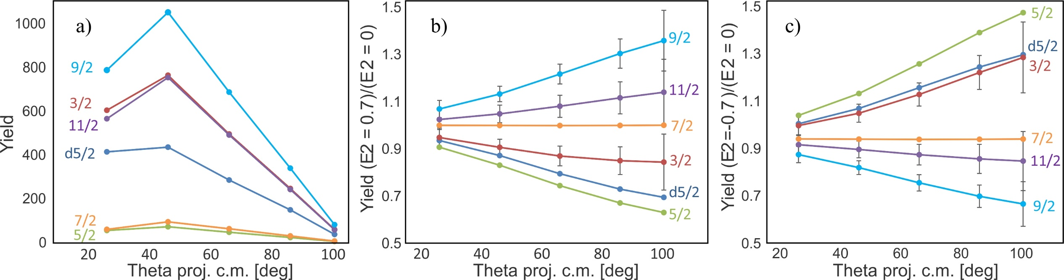
High-accuracy B(E2)’s from Coulex – the pitfalls

Slide 16
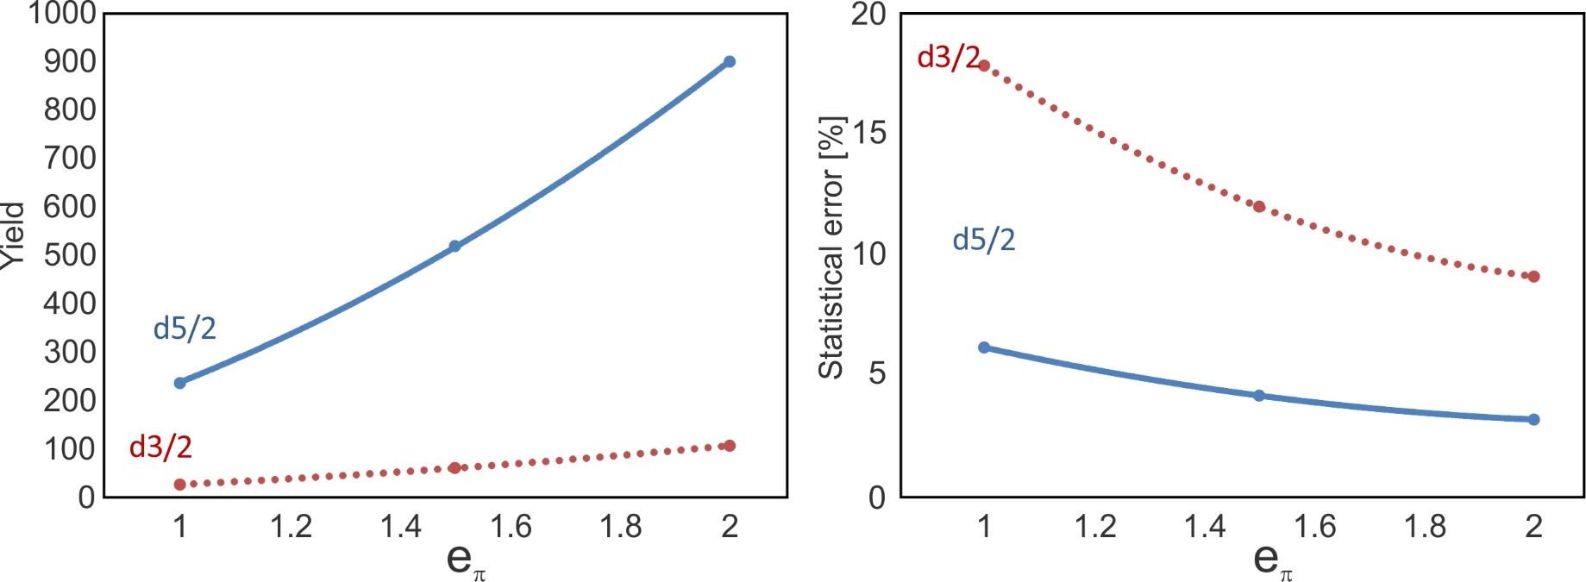
Proton effective charges from ¹³³Sb

Slide 17
Expected γ-yields at Miniball
isotope | I_{i} | I_{f} | E_{x} [MeV] | B(E2­) [W.u.] | p-g yields | B(E2) stat. err. [W.u.] | stat. err. [%]
¹³¹Sb | 7/2 | 5/2_{d5/2} | 0.798 | 0.55 | 1325 | 0.015 | 2.7
 |  | 3/2 | 1.141 | 1.8 | 2174 | 0.039 | 2.1
 |  | 5/2 | 1.202 | 0.19 | 205 | 0.014 | 7.0
 |  | 11/2 | 1.226 | 2.11 | 2114 | 0.046 | 2.2
 |  | 9/2 | 1.229 | 2.97 | 2951 | 0.055 | 1.8
 |  | 7/2 | 1.482 | 0.47 | 257 | 0.029 | 6.2
¹³³Sb | 7/2 | 5/2_{d5/2} | 0.962 | 0.31 | 520 | 0.014 | 4.4
 |  | 3/2_{d3/2} | 2.439 | 2.79 | 62 | 0.35 | 13
¹²⁷In | 9/2 | 11/2 | 1.066 | 7.1 | 921 | 0.20 | 3.3
 |  | 13/2 | 1.235 | 7.2 | 458 | 0.34 | 4.7
 |  | 5/2 | ~1.1 | 3.8 | 658 | 0.15 | 3.9
 |  | 7/2 | ~1.6 | 0.34 | 14 | 0.09 | 27
 |  | 9/2 | ~1.6 | 0.2 | 8 | 0.07 | 35
¹²⁷In | 1/2 | 3/2 | 0.524 | 2.5 | 2948 | 0.04 | 4.0
 |  | 5/2 | ~1 | 1.5 | 1905 | 0.03 | 2.8

