Slide 1
n_TOF Technical Report
at the 67th INTC Meeting
Oliver Aberle, SY-STI-TCD

Slide 2
Outlook LS2
Main activities for LS2 - Facility
  Work in FTN line (PS closure 23rd October)
  Spallation target exchange
    Water cooling station
    Target shielding modification
    Perspective for NEAR-target experimental station
  Horizontal beam line
    Sweeping magnet replacement
    New collimator Nº2
    NEAR

Slide 3
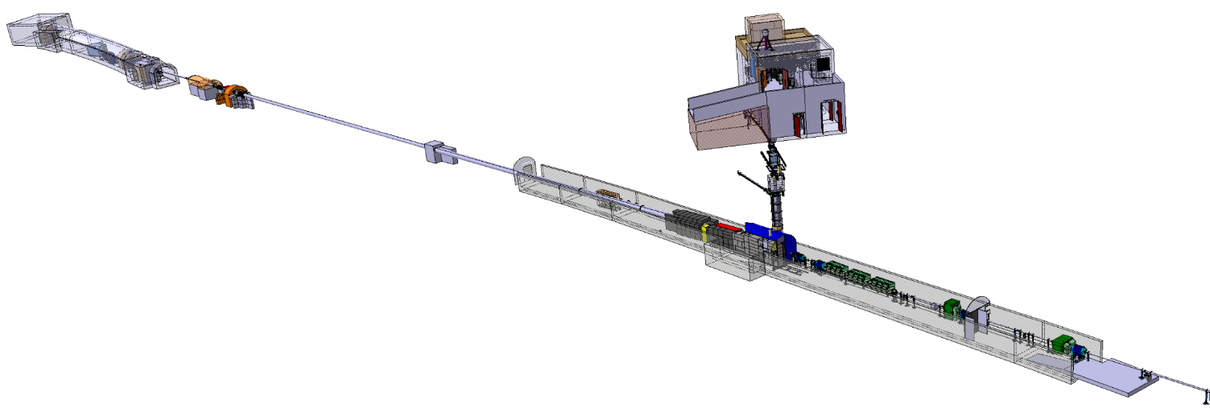
FTN line
Completed
Magnet renovation done
New mobile shielding installed
SEM Grid tank installation done, instrument and
Be window installation in January 2021
Alignment completed, line closed und under vacuum
Cabling completed
Access last week to check ventilation door tightness

Slide 4
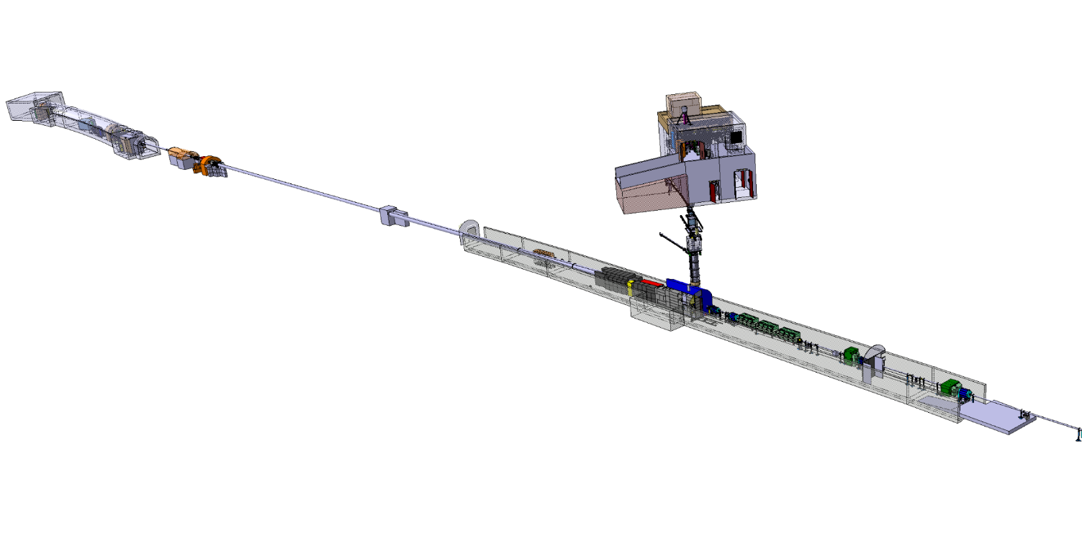
n_TOF target and mobile shielding

Slide 5
n_TOF spallation target #3
Engineering Design Report EDMS TOF-TAR-ES-0003
Target #3 construction and assembly completed
Target #3 cold tests w/ nitrogen cooling station operational – February 2021
Target #3 Installation Review (TIR) – end of February 2021 (https://indico.cern.ch/event/984553/)
Target #3 installation in the pit and vertical beam line installation – March/June 2021 completed
n_TOF readiness for beam mid-July 2021
Beam on target planned for 19th July 2021 (see
ACC-PM-MS-0002 (v.4.0) MASTER SCHEDULE OF THE LONG SHUTDOWN 2 (2019-2020))

Slide 6
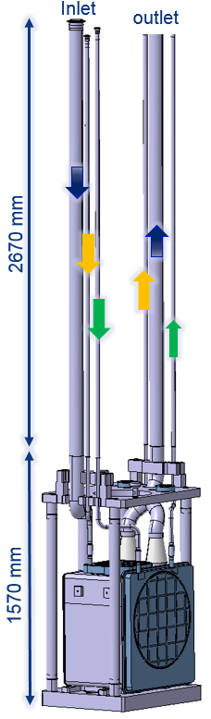
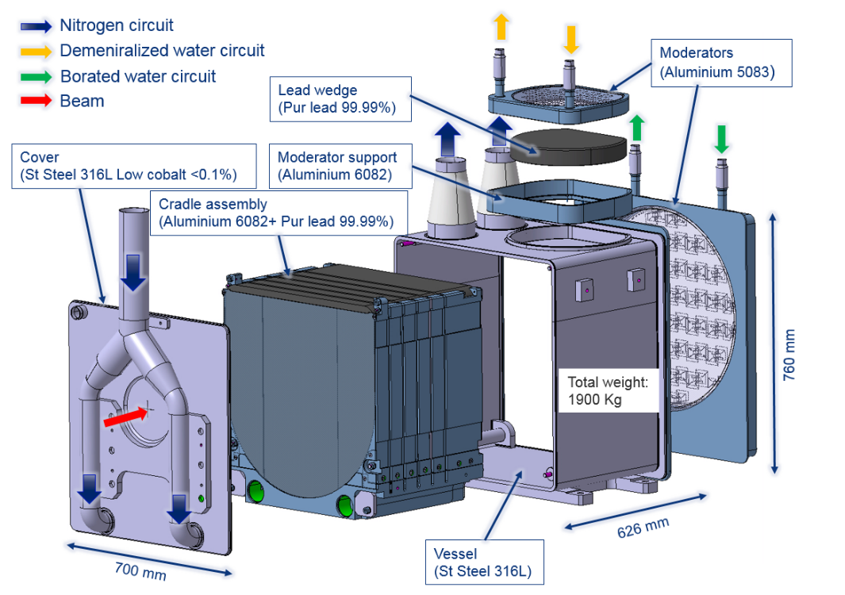
n_TOF target #3
Production completed

Slide 7
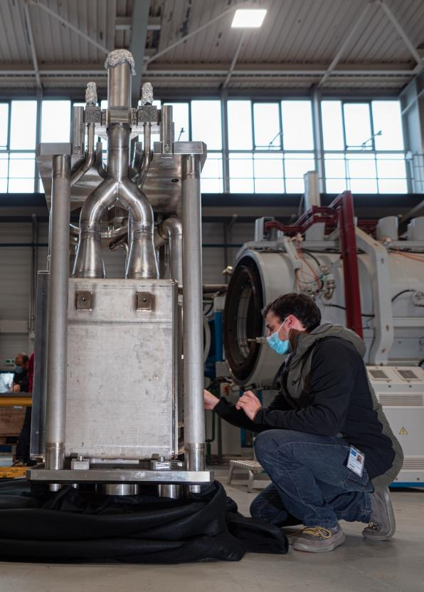
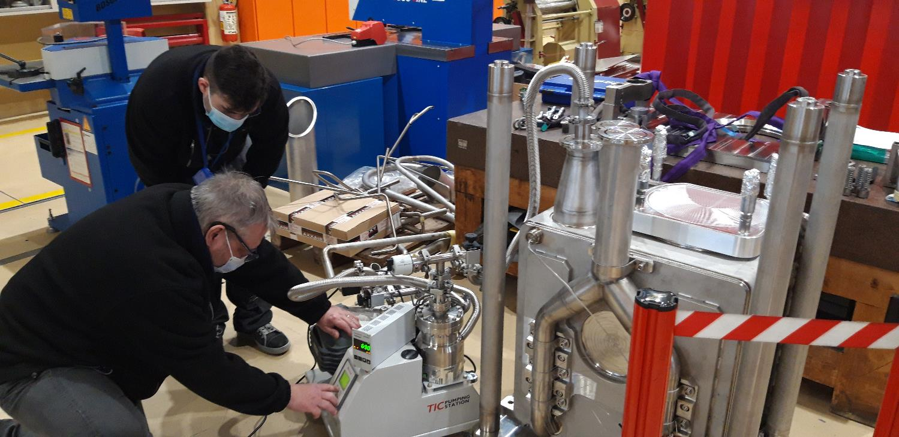
n_TOF target #3
Completed

Slide 8
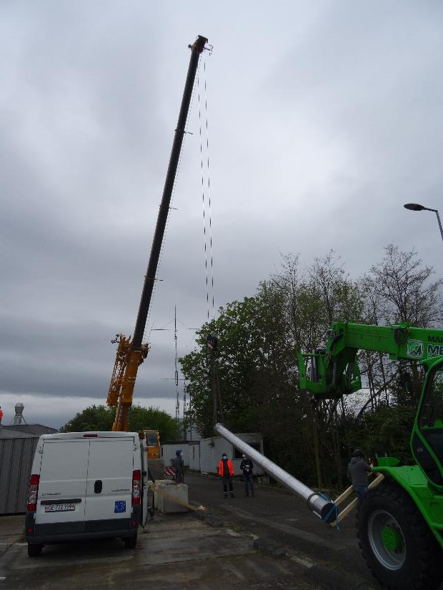
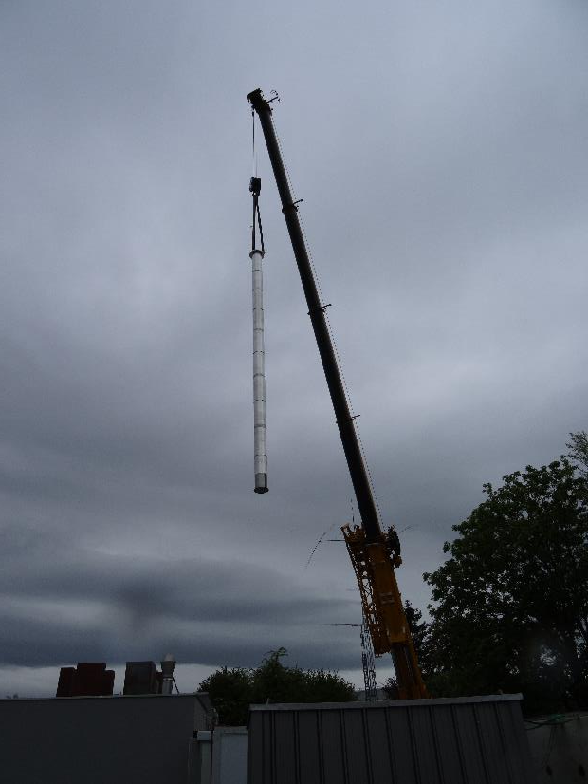
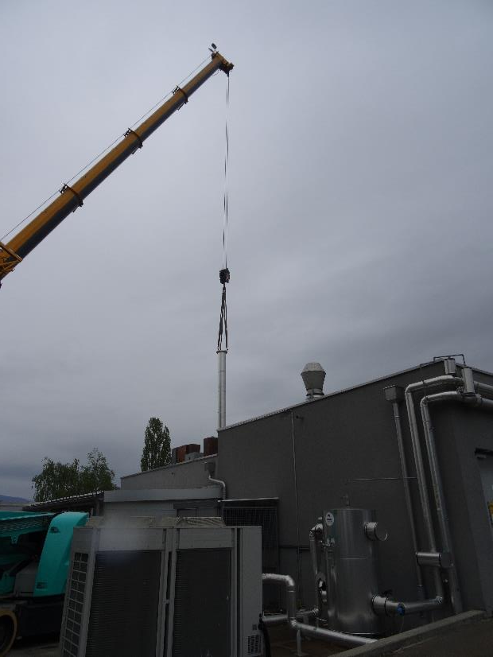
Target and vertical beam line installation

Slide 9
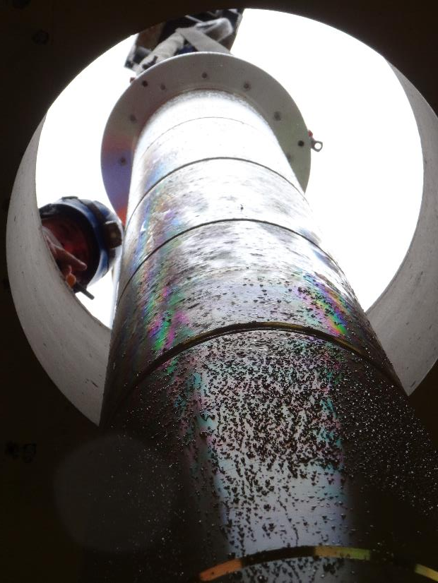
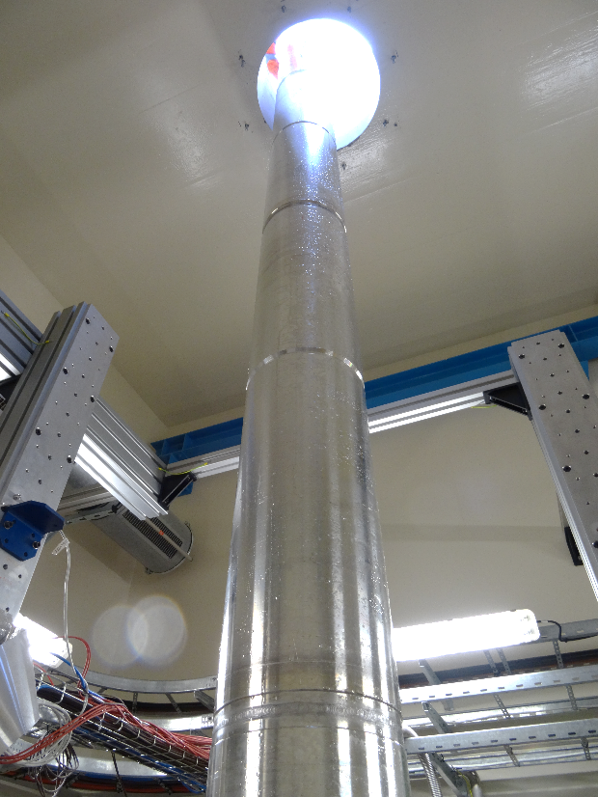
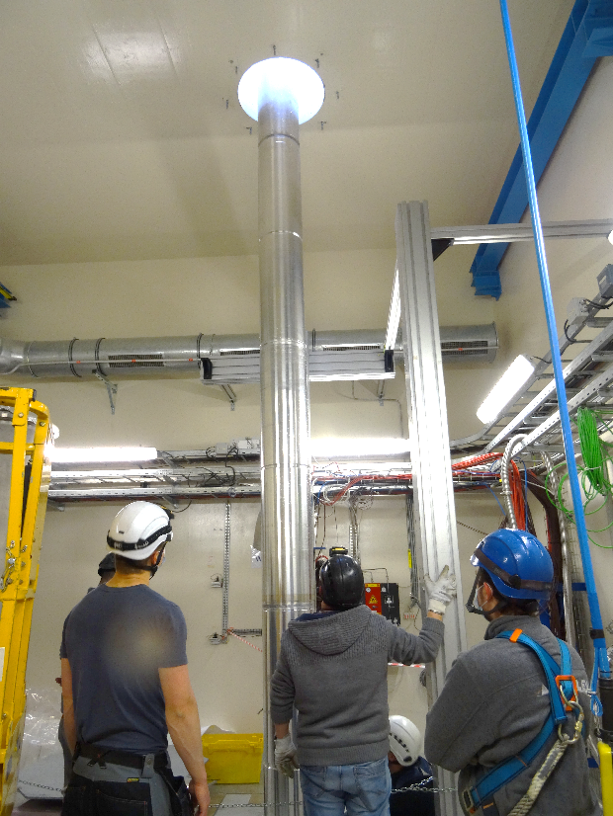
Target and vertical beam line installation

Slide 10
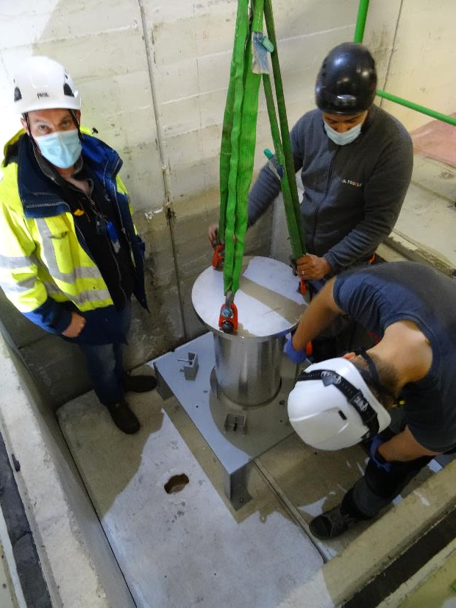
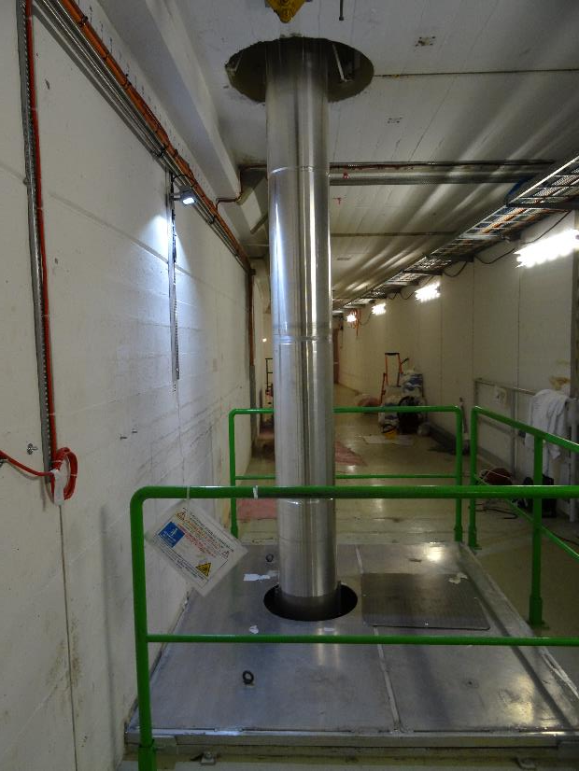
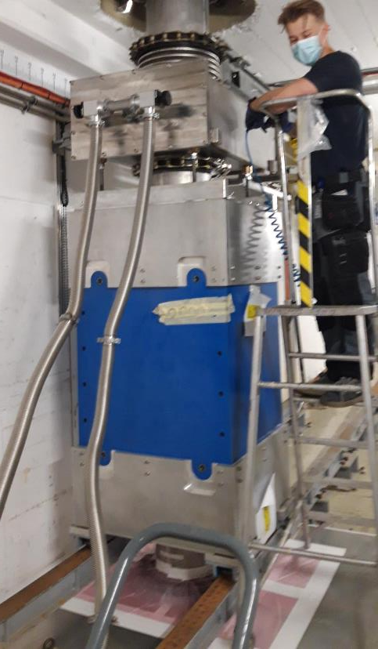
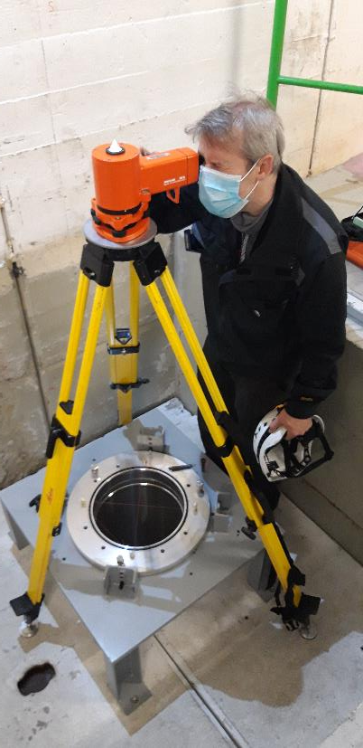
Target and vertical beam line installation
Completed

Slide 11
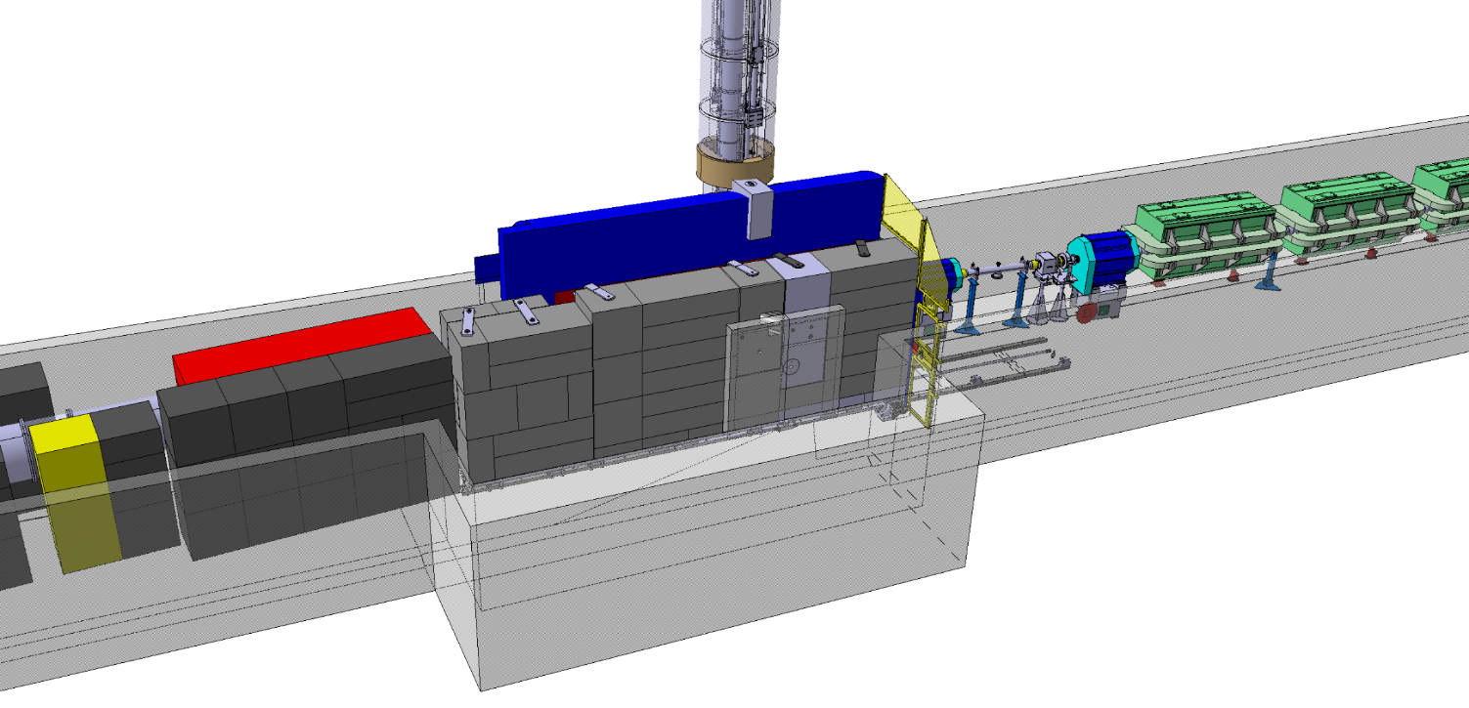
n_TOF target shielding
Third Generation n_TOF Spallation Target and Vertical Neutron Beam Line
EDMS TOF-TAR-EC-0001
Mobile part
Reconfiguration of the (fixed) shielding around the spallation target
Access door modification

Slide 12
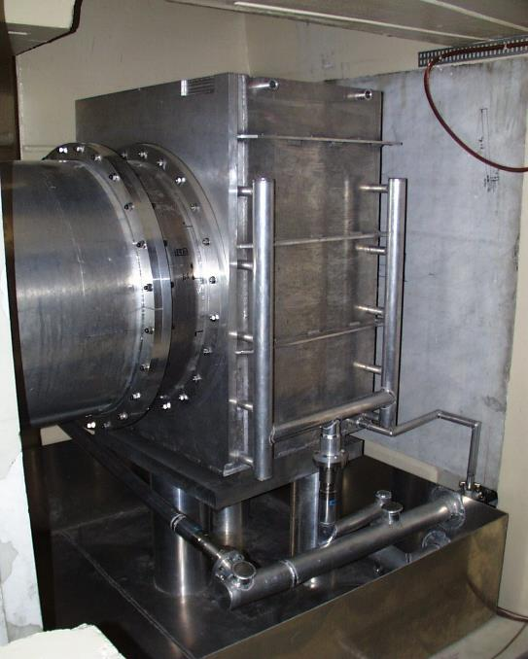
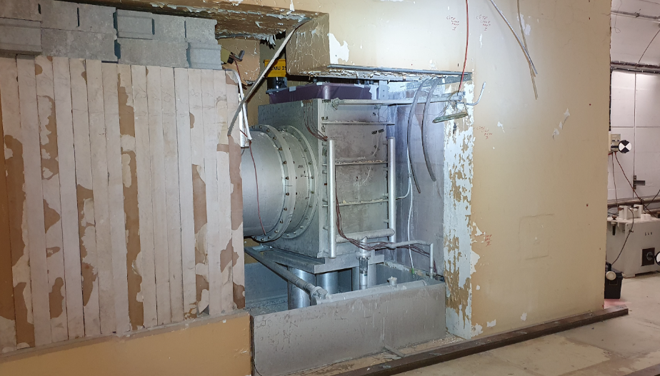
n_TOF – original pit (April 2020)
20 years
Target pit ±1999
Target pit April 2020

Slide 13
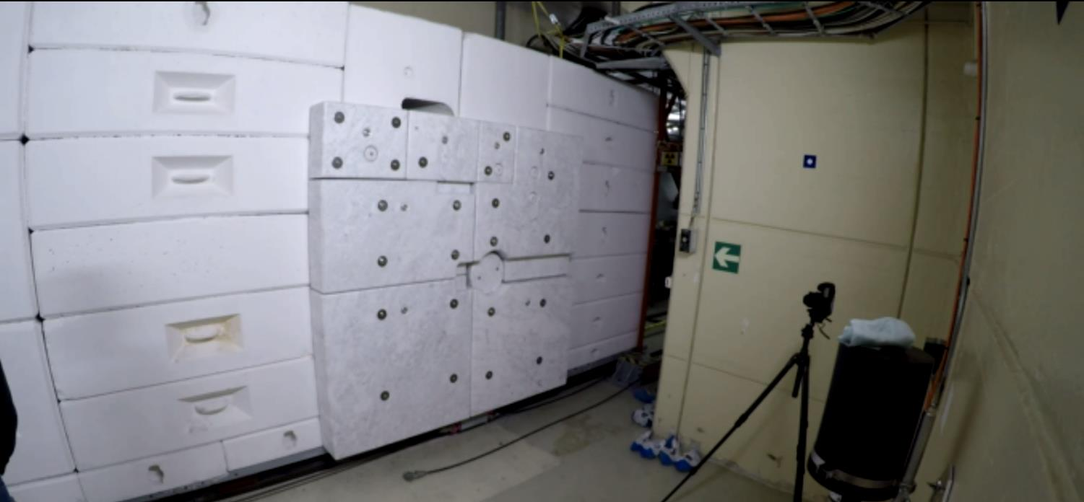
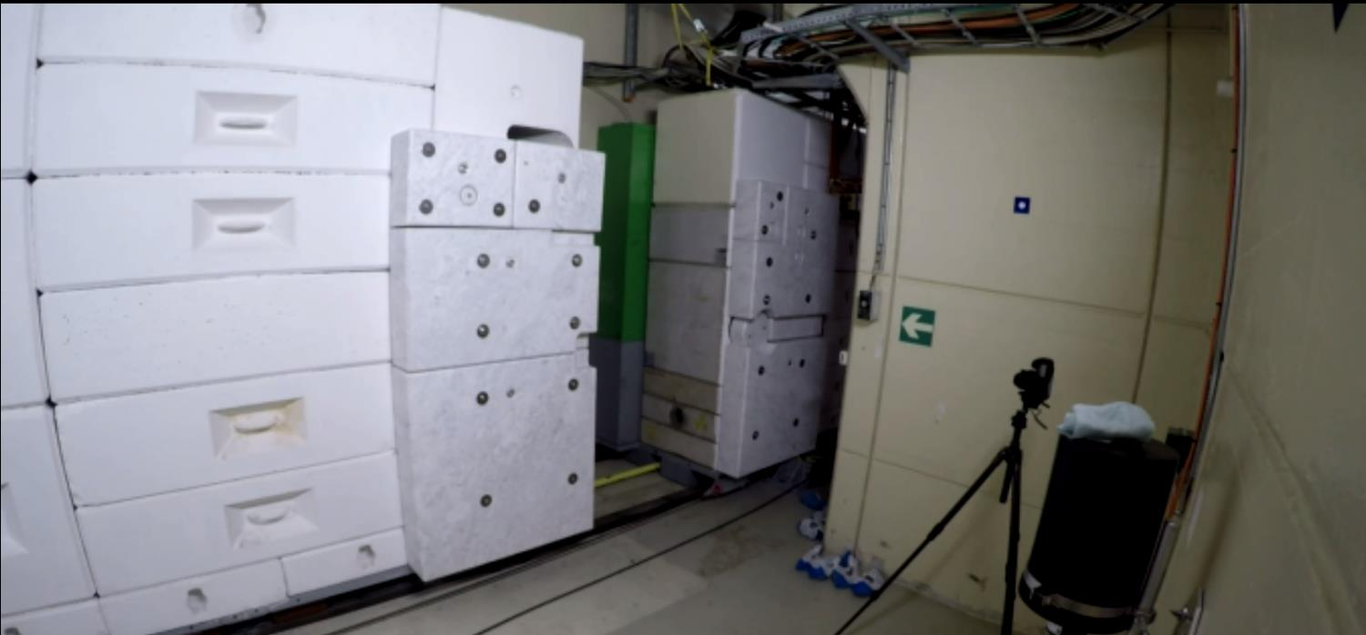
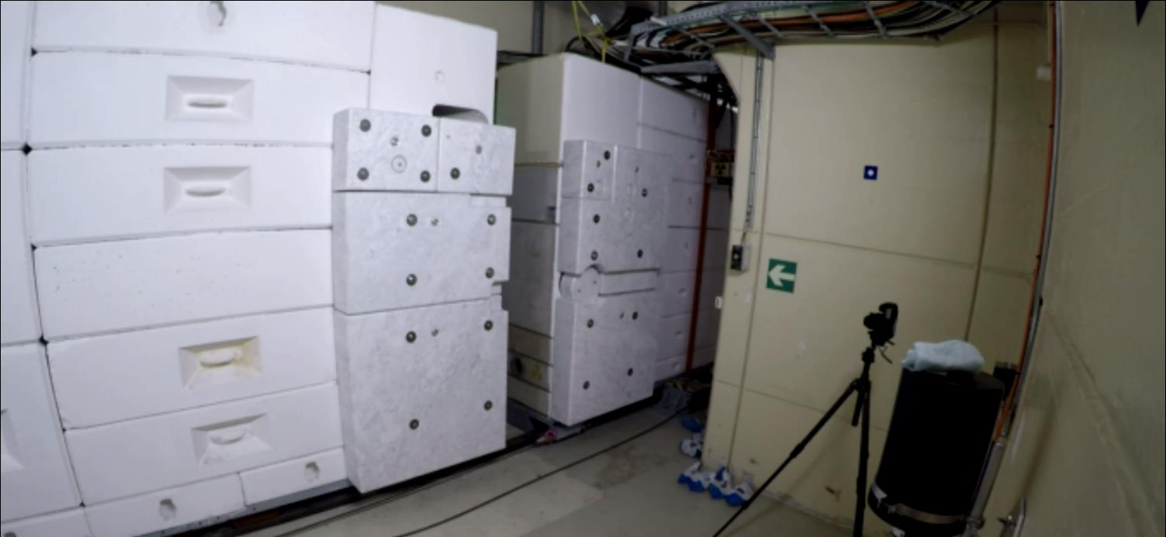
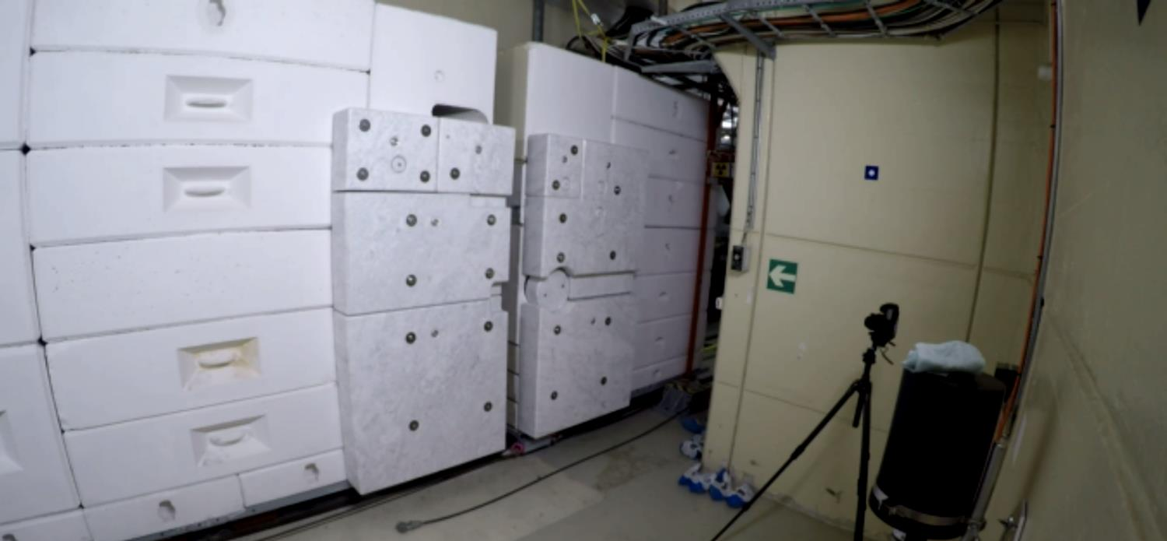
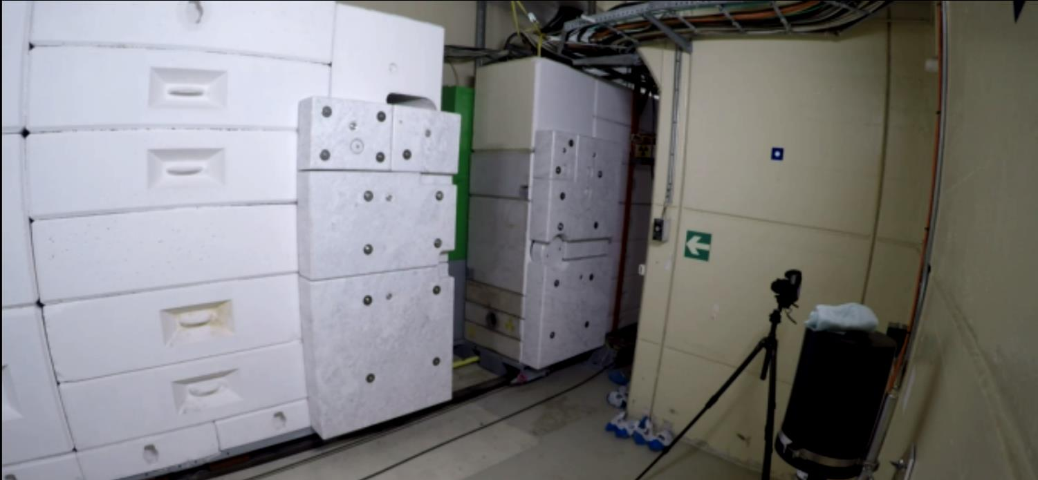
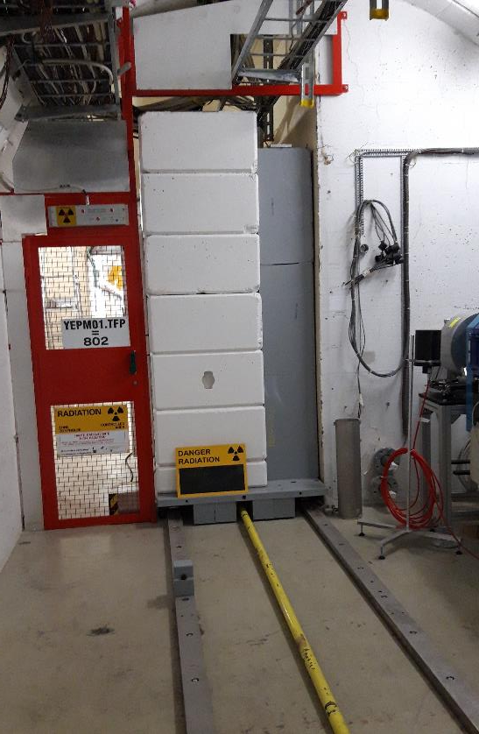
n_TOF target mobile shielding
Completed

Slide 14
Perspectives on ”NEAR-target” station
Discussions and details in TOF-PM-WD-0001
Priority is to get facility running post-LS2, meaning target, shielding & neutron beam line components – funded in a resource-loaded schedule (phase 1)
Study for physics-driven NEAR station currently ongoing, with implementation post LS2 under evaluation (phase 2)
  Dedicated movable/exchangeable moderator on the shaping collimator aperture
  Full size plug under construction for handling tests
  → post LS2 possible

Slide 15
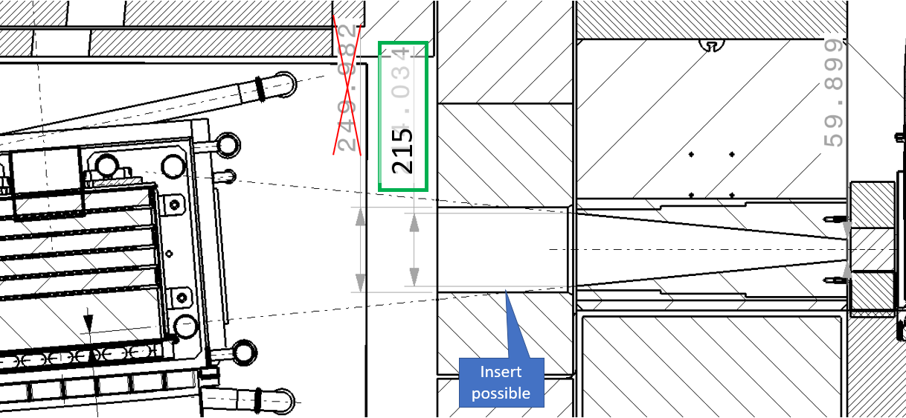
Shielding details for “NEAR”
In-shielding with collimator insert, space for moderator and samples

Slide 16
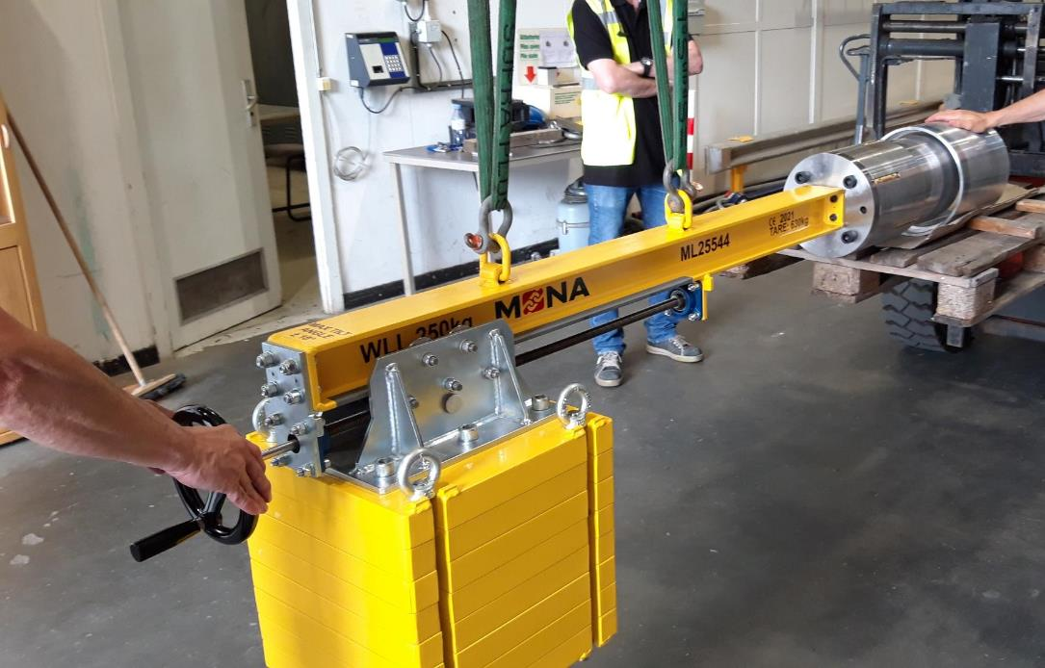
Shielding details for “NEAR”
Collimator insert and lifting spreader test

Slide 17
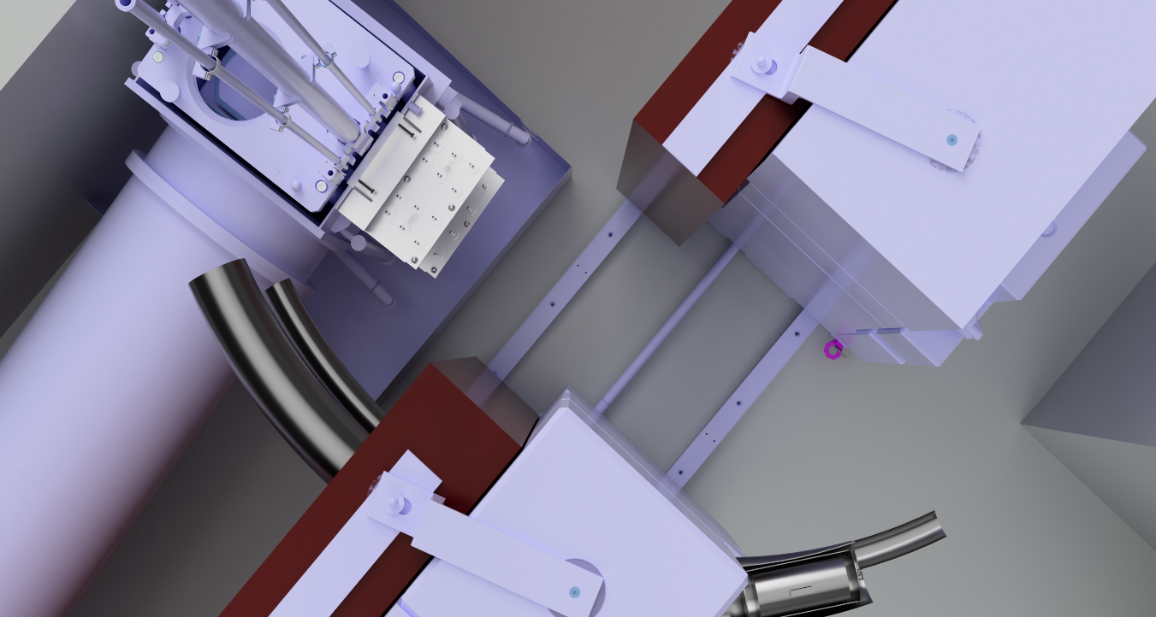
Shielding details for NEAR
Investigate on possibilities and interest for irradiation for R2E, R2M and physics

Slide 18

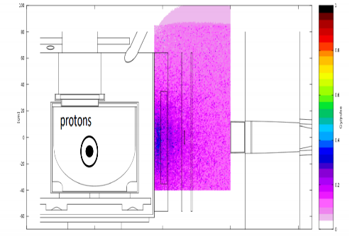
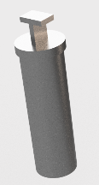
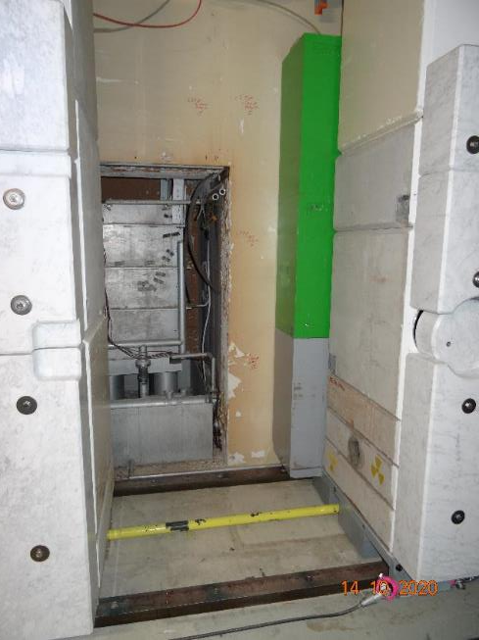
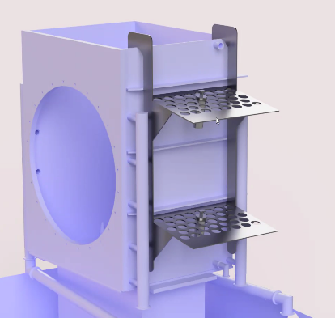
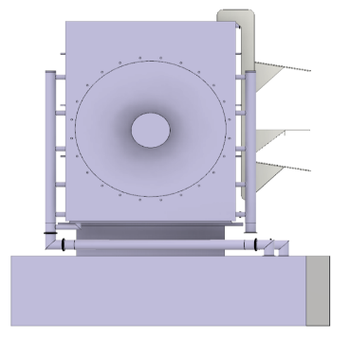
Perspectives for NEAR target station
Synergistic irradiation of materials for acc. complex (R2M) in mixed-field conditions at unprecedented levels at CERN
0.3-0.5 Gy/pulse (~1 MGy/y), homogeneous over “large” volumes
AP. Bernardes, M. Maeder, M. Ferrari, D. Senajova, M. Barbagallo

Slide 19
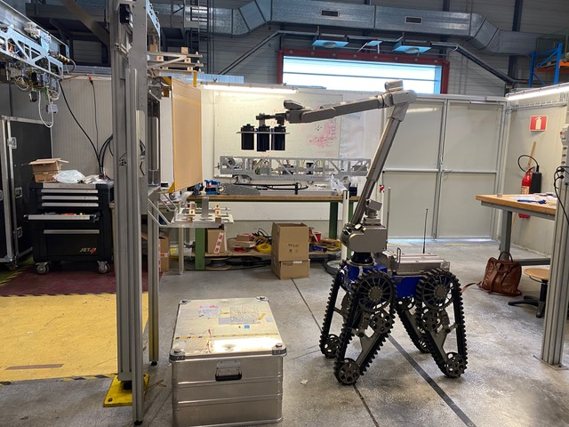
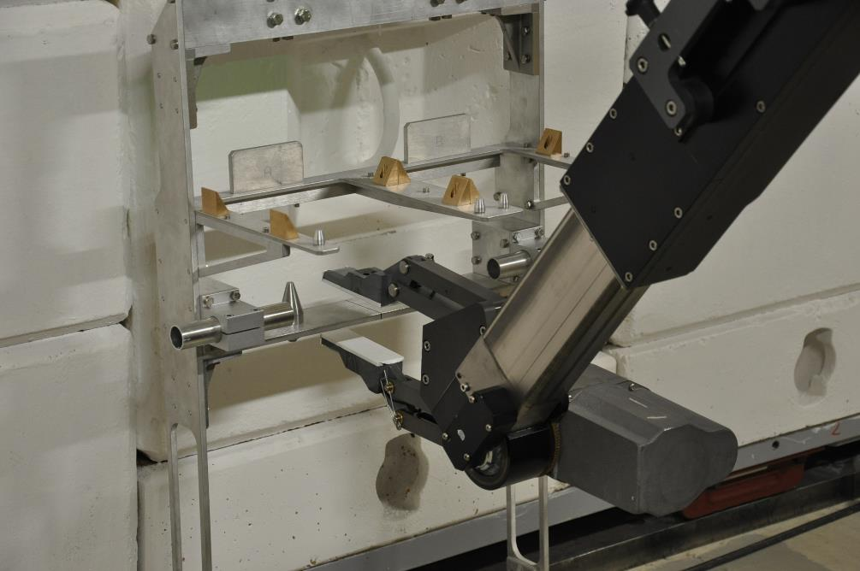
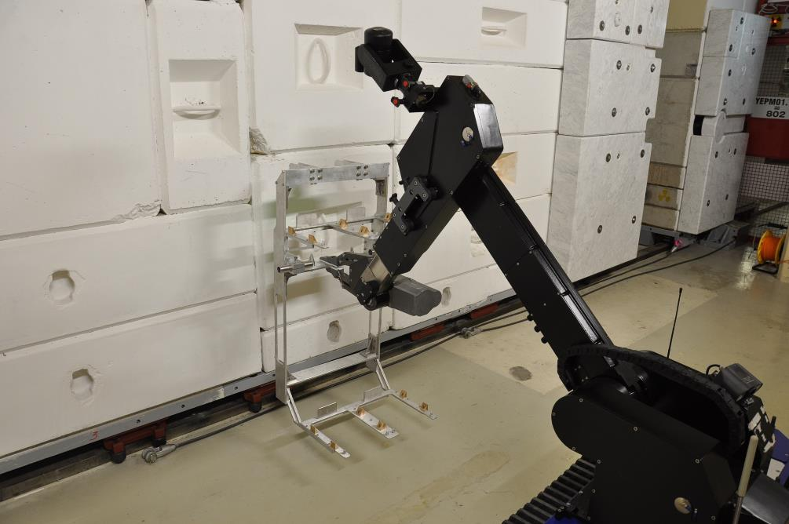
NEAR
  Test for accessibility done
  Shelf installed last week
Courtesy D. Senajova

Slide 20
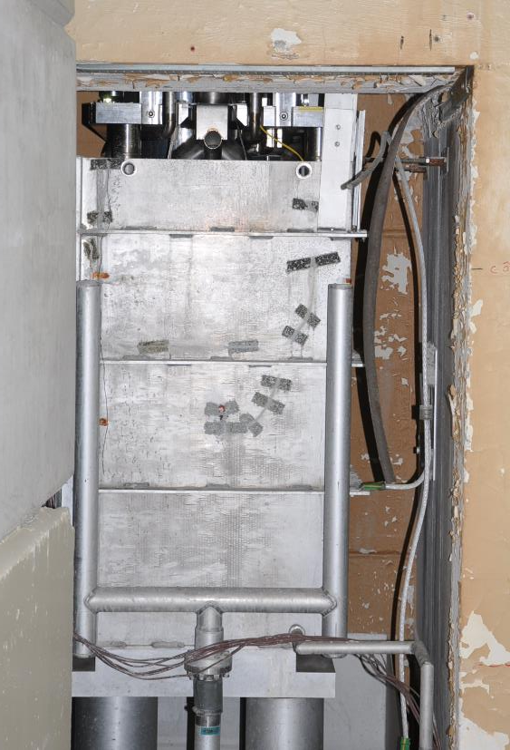
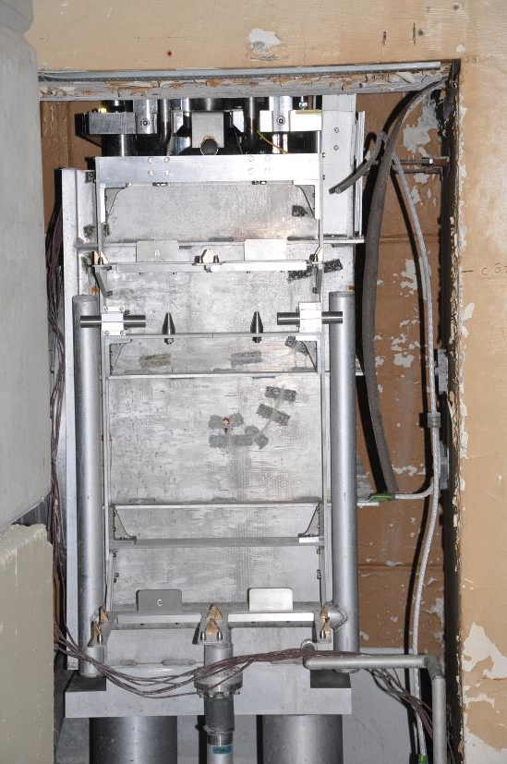
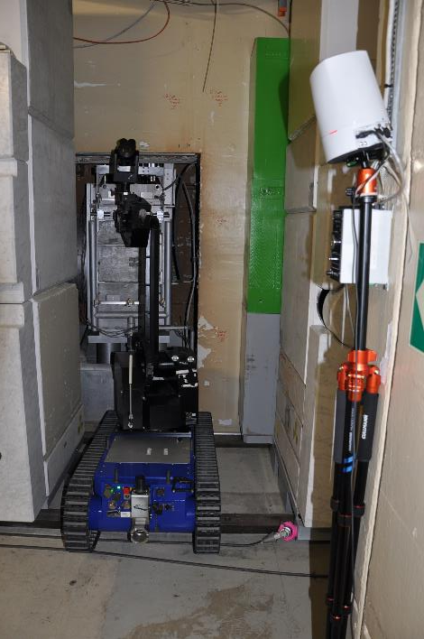
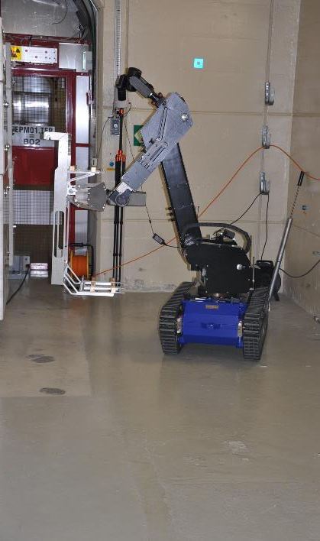
NEAR
  Test for accessibility done
  Shelf installed last week

Slide 21
n_TOF water cooling station

Slide 22
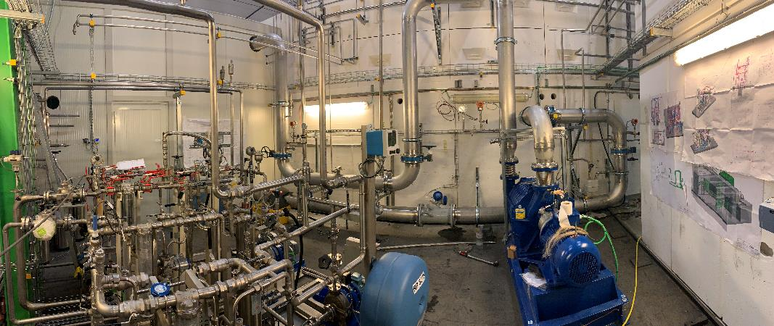
Target #3 cooling and moderator station
Target nitrogen cooling required the full replacement of the target cooling and moderator circuits
Major efforts from CV to develop the technology to match the specifications and RP requests (EDMS 2068336)
F. Dragoni
Under pressure room for filters (RP)
Moderators (2x)
Charcoal + HEPA filters
N₂ compressor
This Photo by Unknown Author is licensed under CC BY-NC

Slide 23
n_TOF horizontal beam line (TT2A)

Slide 24
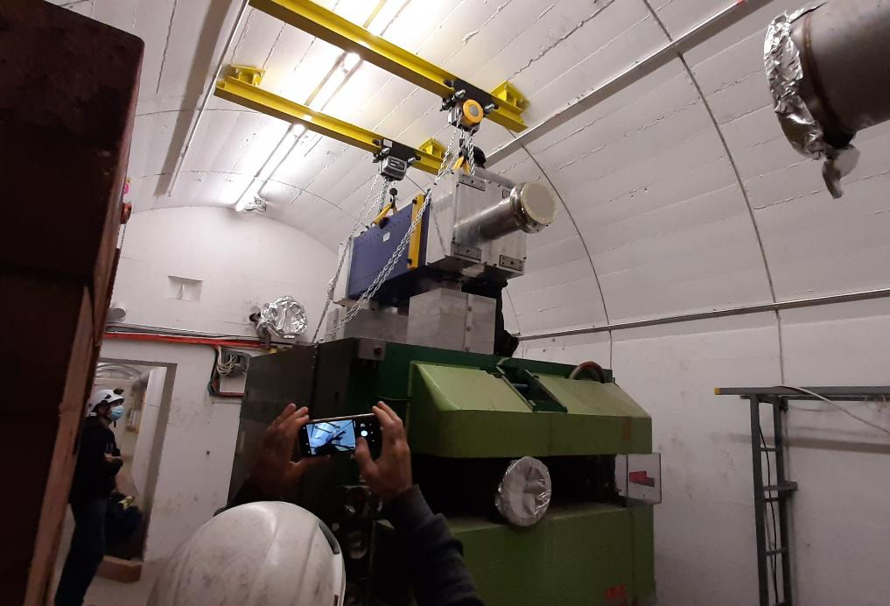
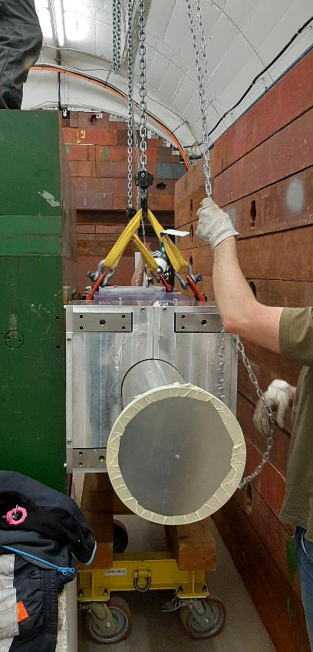
New sweeping magnet
Vacuum chamber inserted and welded
Alignment today

Slide 25
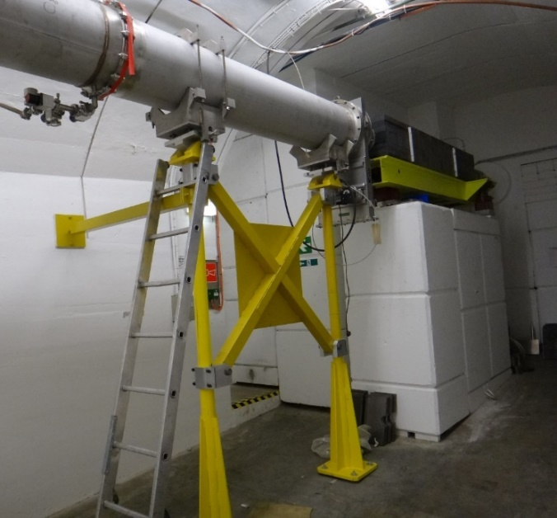
Original second EAR 1 collimator
Consolidation of collimator Nº2
Functional specification TOF-T-ES-0001 (v.0.1) New Second Collimator in the Horizontal n_TOF Neutron Beam Line

Slide 26
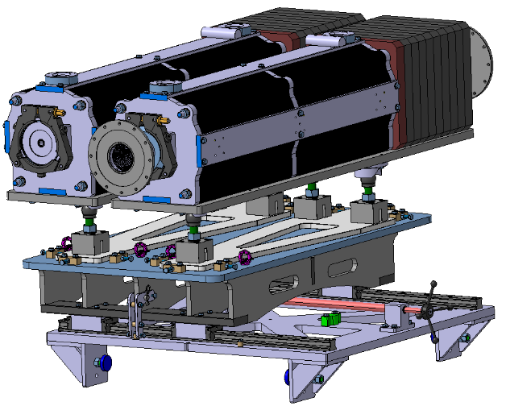
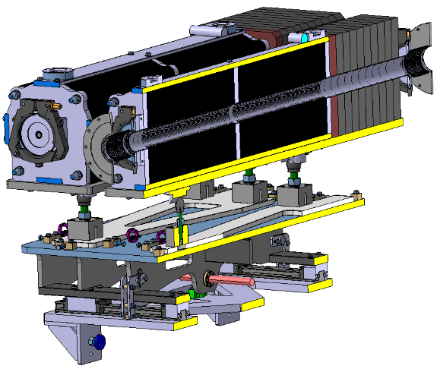
New collimator #2 EAR1
Carbon steel sheets, laser cut
Borated PE
Two different collimators, swap during run to different diameter
Avoid long procedure for collimator exchange
Green light for design given after a review with n_TOF
Detailed design completed, fabrication launched
Ø 20mm
Vacuum chambers
Structure: Profils, water jet cut
Ø 80mm
Manual drive + linear rails
Movement
Mechanical end stops
Assembly ongoing, installation planned week 27

Slide 27
n_TOF Experiment LS2 activities
Cabling campaign in EAR1 (remove the old sweeping magnet cables, replace the detector cables in the rack/bunker area) - Completed
Implementation of the ASN-OFSP safety recommendations in EAR2
Consolidation of the gas system in EAR2 - ongoing
Consolidation of the alignment system – after beamline remounting
Upgrade of the n_TOF electronics laboratory - completed
Control room and offices ready
DAQ upgrade
Consolidation and R&D program for detectors - ongoing

Slide 28
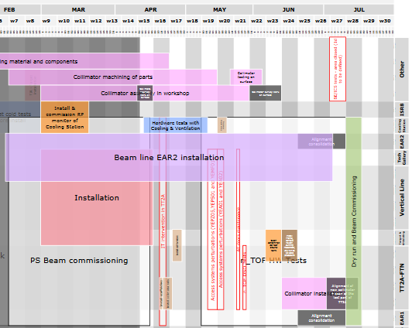
Schedule and coordination
n_TOF Facility Refurbishment Project Schedule: EDMS 2001626
Ready for beam
Target and vertical beam line installation
Horizontal beam line installation

Slide 29
Conclusions
Target installed
Cooling and moderator stations up and running
Vertical beam line completed
  Horizontal neutron beam – collimator to finalize and to install
  Upgrades and consolidation in both Class A laboratories
First beam on target 19th July 2021

