Slide 1
PAC studies of isolated small molecules:
The Pb nuclear quadrupole moments and further cases
H. Haas^{1,2}, J. Röder^{1,2}, L. Hemmingsen³, S.P.A. Sauer³, J.G. Correia^{2,4},
J. Schell^{2,5}, V. Amaral¹, D.C. Lupascu⁵, R. Vianden⁶, V. Kellö⁷
¹ Department of Physics and CICECO, University of Aveiro, 3810-193 Aveiro, Portugal
² EP Division CERN, 1211Geneve-23, Switzerland
³ Department of Chemistry, University of Copenhagen, 2100 Copenhagen, Denmark
² C2TN, DECN, Instituto Superior Técnico, Universidade de Lisboa, Portugal
⁵ Institute for Materials Science and Center for Nanointegration, Duisburg-Essen (CENIDE), University of Duisburg-Essen, 45141 Essen, Germany
⁶ Helmholz-Institut für Strahlen- und Kernphysik, Universität Bonn, Nussallee 14-16, Bonn, Germany
⁷ Department of Physical and Theoretical Chemistry, Comenius University, 84215 Bratislava, Slovakia
Follow-up of project IS640

Slide 2

Determination of nuclear quadrupole moments
Methods for long-lived (stable) nuclei:
Atomic spectroscopy
Molecular spectroscopy
Muonic / pionic spectroscopy
Methods for short-lived (excited) states:
PAC / PAD spectroscopy in solids
Moessbauer spectroscopy in solids
Level mixing spectroscopy in solids
$$ν_{Q}=eQV_{zz}/h$$
Experimentally measured: Problem:
V_{zz} (EFG) has to come from theory!
1-2% Theoretical accuracy 10-20%
Link via NMR to get V_{zz} in solids (for stable isotopes with I > 1/2)
but
impossible for several elements:
«missing link peoblem»

Slide 3
The “missing link” cases of nuclear quadrupole moments
H
He
Li
Be
B
C
N
O
F
Ne
Na
Mg
Al
Si
P
S
Cl
Ar
K
Ca
Sr
Ti
V
Cr
Mn
Fe
Co
Ni
Cu
Zn
Ga
Ge
As
Se
Br
Kr
Rb
Sr
Y
Zr
Nb
Mo
Tc
Ru
Rh
Pd
Ag
Cd
In
Sn
Sb
Te
I
Xe
Cs
Ba
La
Hf
Ta
W
Re
Os
Ir
Pt
Au
Hg
Tl
Pb
Bi
Po
At
Rn
Fr
Ra
Ac
Ce
Pr
Nd
Pm
Sm
Eu
Gd
Tb
Dy
Ho
Er
Tm
Yb
Lu
Th
Pa
U
Np
Pu
Am
Cm
Bk
Cf
Es
Fm
Md
No
Lr

Slide 4
What we have done in IS640:
Measure the quadrupole interaction in some free Cd (and Hg) molecules in the gas state by PAC
Basic idea: In a linear molecule the EFG (V_{zz}^{mol}) is along the molecular axis
The rotation axis J is always perpendicular to the molecular axis
The EFG along J is then, independent of J:
V_{zz}^{rot} = -1/2 V_{zz}^{mol}
For large J the quantization should be fully along J, leading to a splitting frequency independent of J !

Slide 5

Quantum mechanics
No J: $\text{Ĥ}=eQVzz \{\frac{3Iz2−I\left(I+1\right)}{4I\left(2I−1\right)}$}
$R\left(t\right)=a0+\text{a}\text{1}\cos{(w0t)}+\text{a}\text{2}\cos{(2w0t)}+\text{a}\text{3}\cos{(3w0t)}$
$w0= \frac{6}{4I\left(2I−1\right)}$ $\frac{eQVzz}{h}$

Slide 6
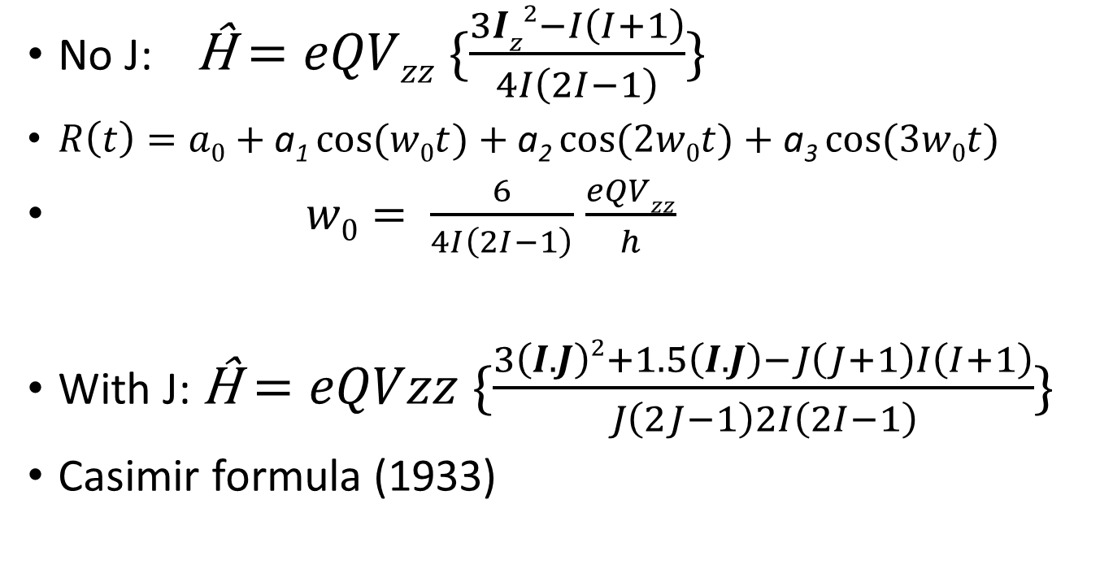
Quantum mechanics
No J: $\text{Ĥ}=eQVzz \{\frac{3Iz2−I\left(I+1\right)}{4I\left(2I−1\right)}$}
$R\left(t\right)=a0+\text{a}\text{1}\cos{(w0t)}+\text{a}\text{2}\cos{(2w0t)}+\text{a}\text{3}\cos{(3w0t)}$
$w0= \frac{6}{4I\left(2I−1\right)}$ $\frac{eQVzz}{h}$
With J: $\text{Ĥ}=eQVzz \{\frac{3\left(I.J\right)2+1.5\left(I.J\right)−J\left(J+1\right)I\left(I+1\right)}{J\left(2J−1\right)2I\left(2I−1\right)}$}
Casimir formula (1933)

Slide 7
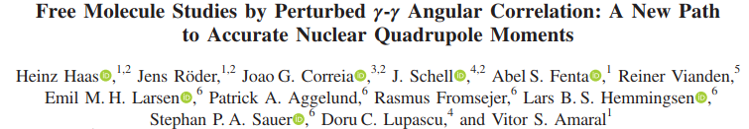
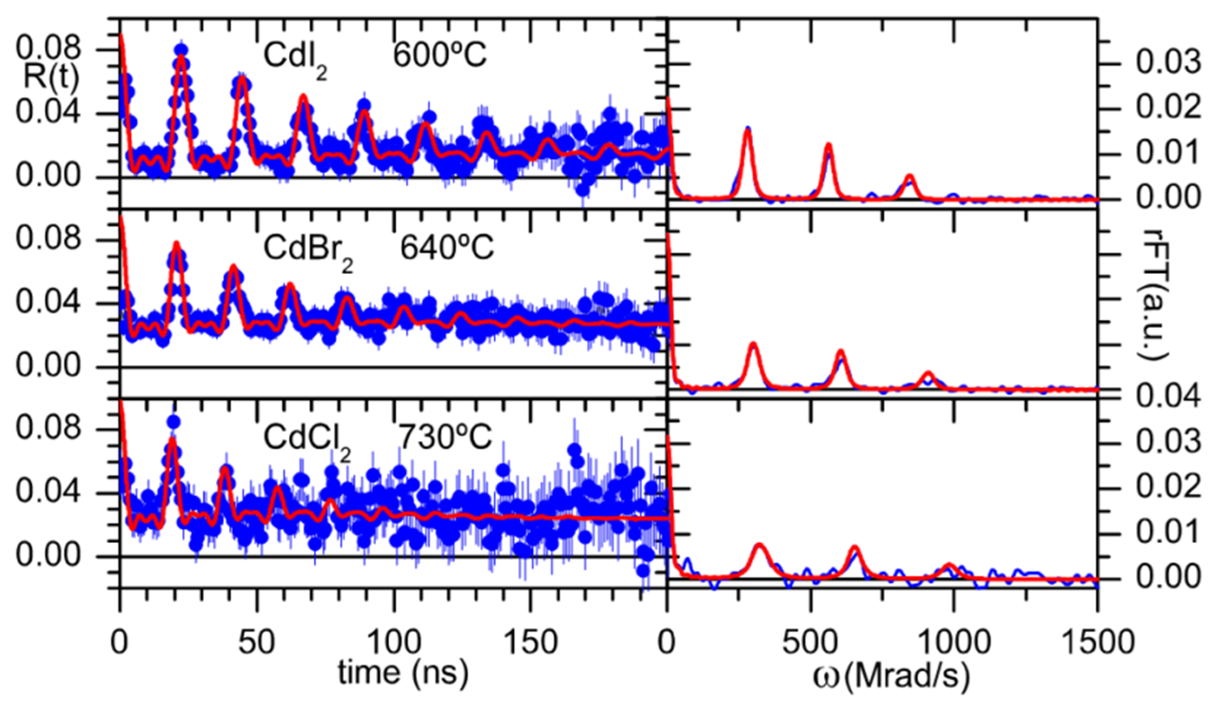

Slide 8
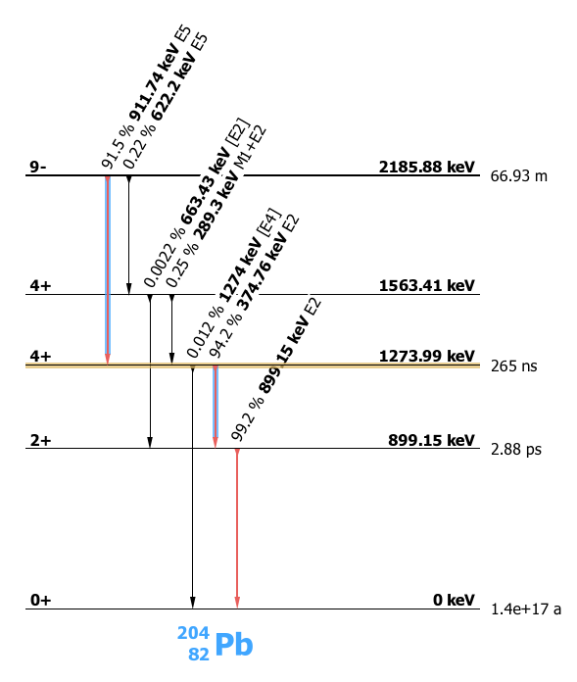
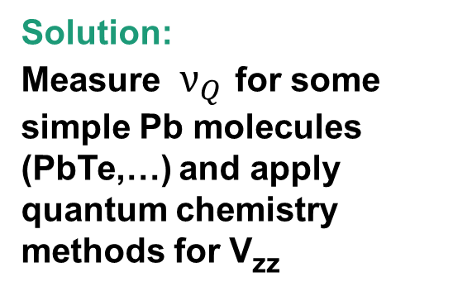
Calibrating the Pb quadrupole moments
Present status:
Q from some 20 PAD / LEMS experiments and
V_{zz} from some 25 PAC measurements in solids
Q of PAC state
tied to
Solution:
Measure $ν_{Q}$ for some simple Pb molecules (PbTe,…) and apply quantum chemistry methods for V_{zz}
Problems:
high temperatures needed
sample production
counting statistics
higher state spin

Slide 9
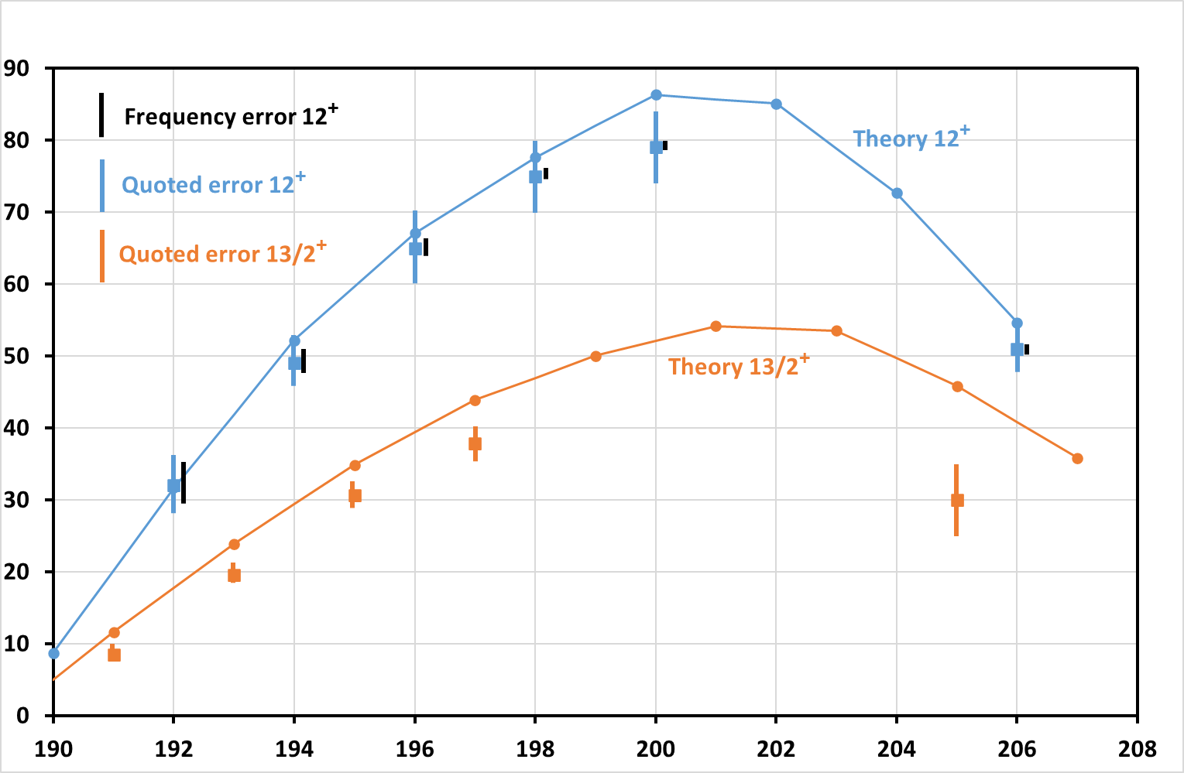
Typical example demonstrating need for accurate Q calibration
The i_{13/2}^{-n} states in Pb isotopes
Q
[efm²]
Shell model
Chong Qi 2016

Slide 10
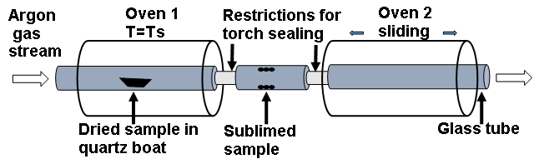
The proven technique
The new high temperature technique
Restriction for
torch sealing
Sliding oven for
outgassing
ISOLDE
beam
Pushing rod
50nm sample (PbTe,…) on
minute (2x6mm) quartz slide
Quartz tube

Slide 11
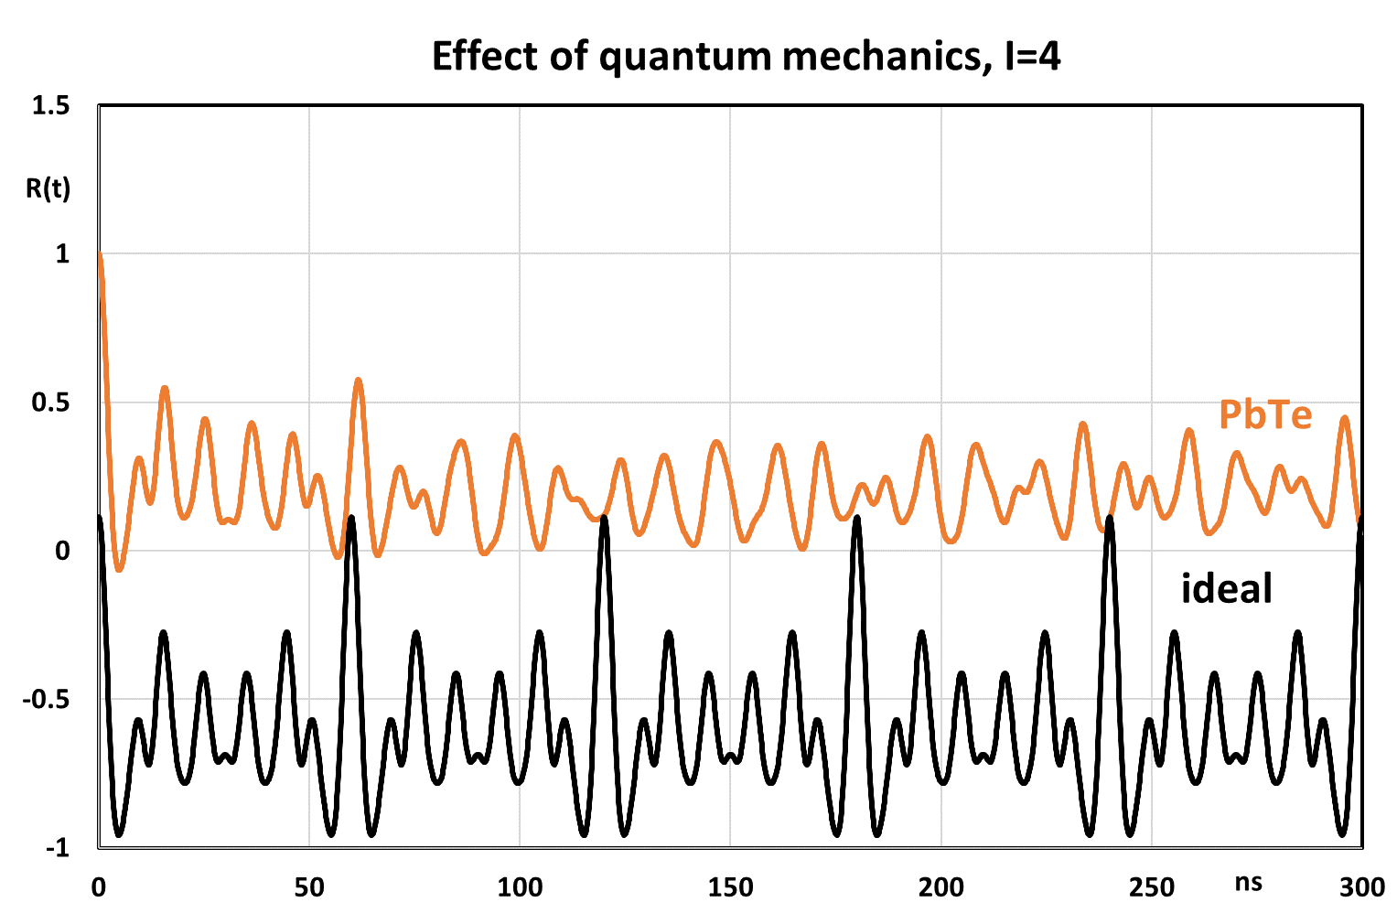

Slide 12
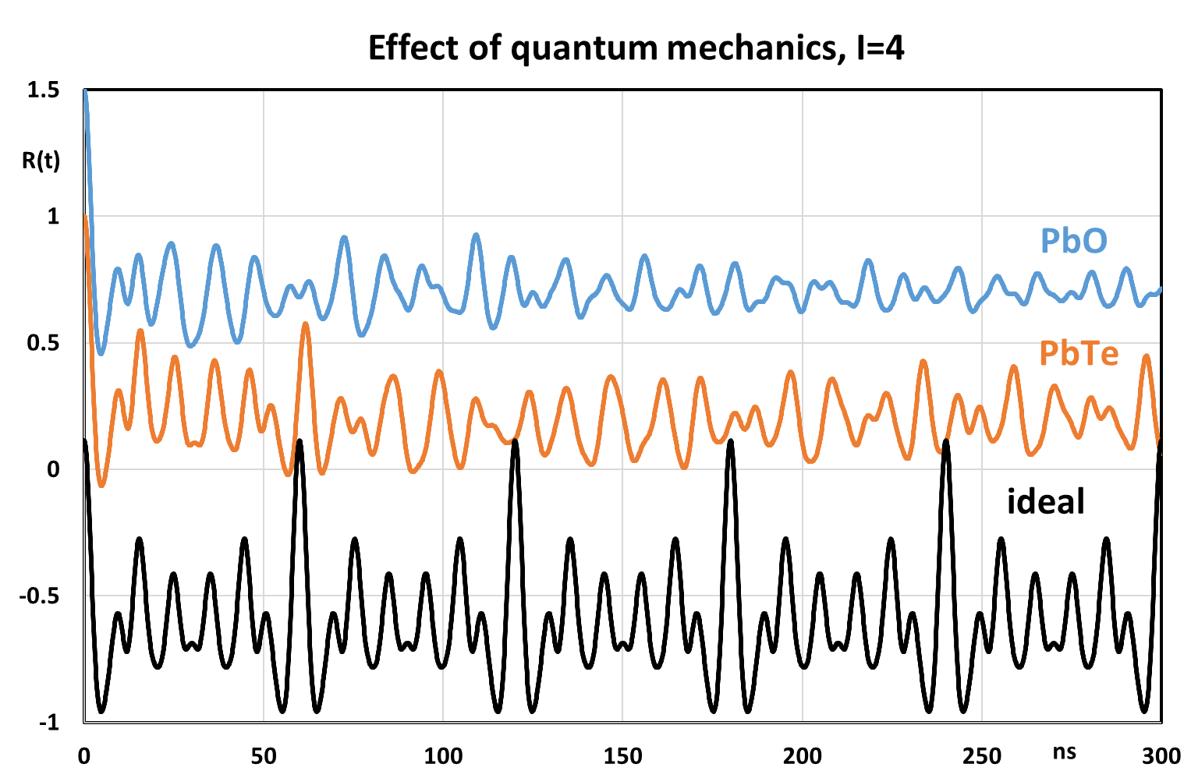

Slide 13
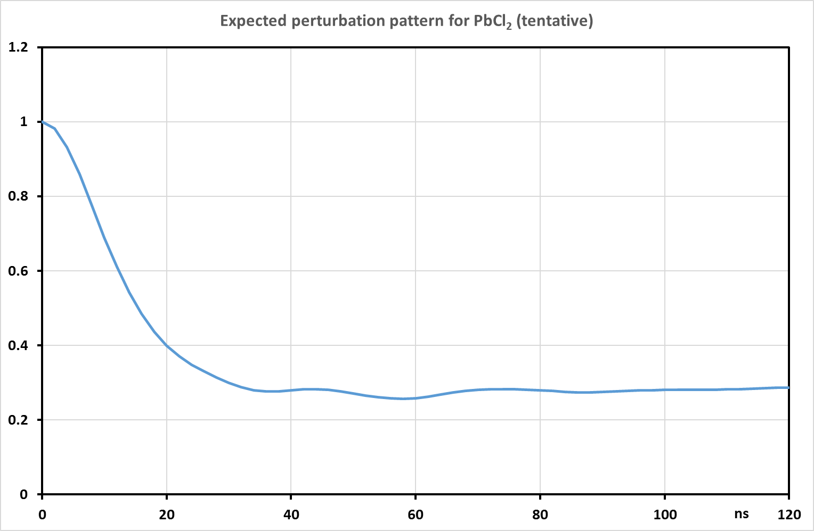
Test case 1: Non-linear molecule ²⁰⁴PbCl₂
Special interest: Testing possible application to more cases,
Checking complex treatment of perturbation function
Difficulty: Absence of periodic structure,
Obtaining sufficient statistical accuracy

Slide 14
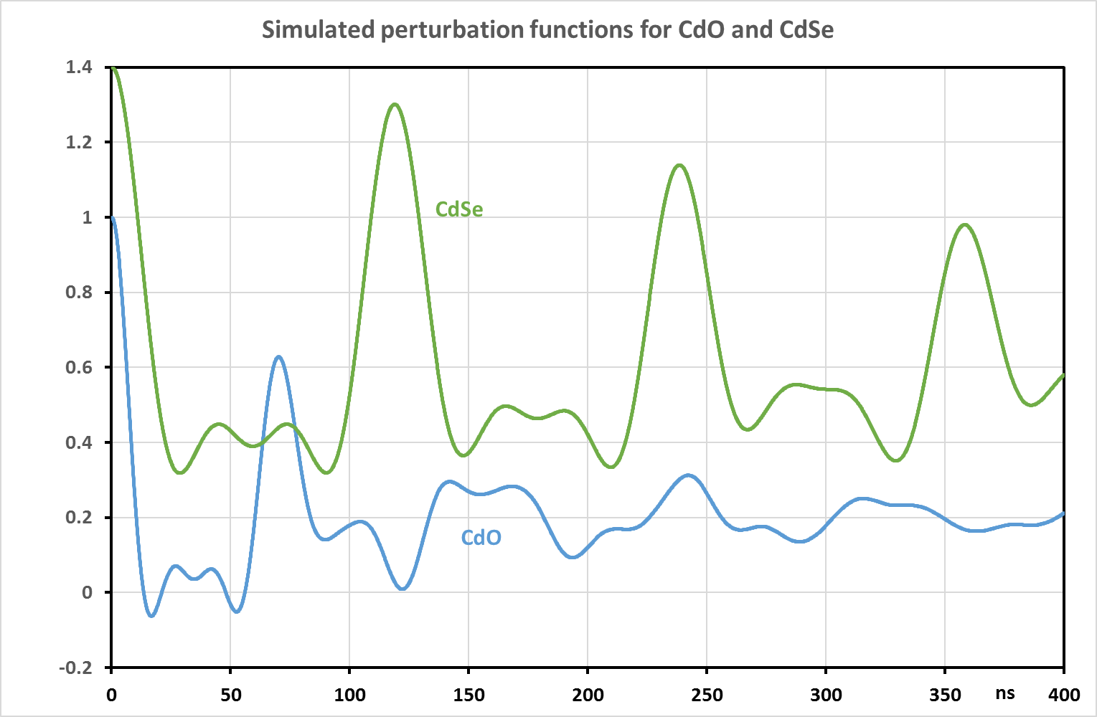
Test case 2: Weakly bound molecule ¹¹¹CdSe
Special interest: Checking quantum chemistry calculation for small EFG,
Testing new sample production method
Difficulty: High measuring temperature, low molecule stability

Slide 15
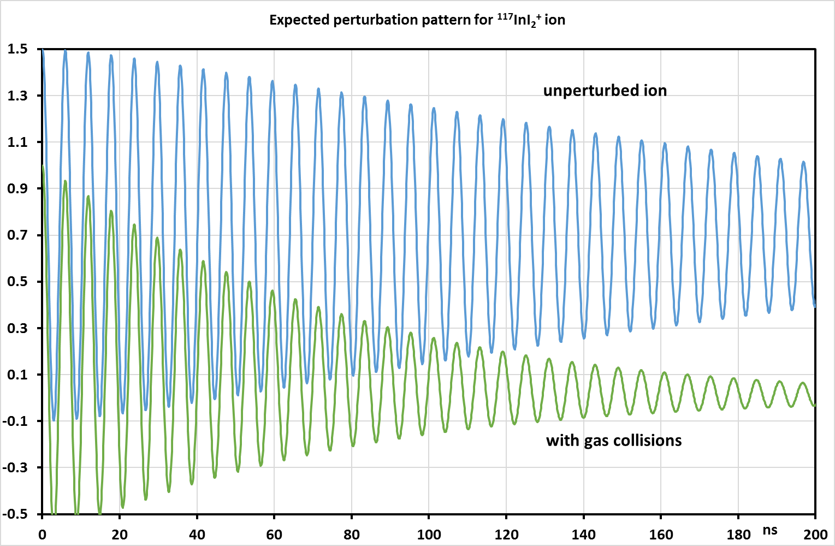
Test case 3: Molecular ion ¹¹⁷InI₂⁺
Special interest: Checking use for β⁻ produced ionized molecules,
Extending applications to further cases (Sn «missing link»?)
Difficulty: High expected interaction frequency,
Treatment of beta-recoil in analysis

Slide 16
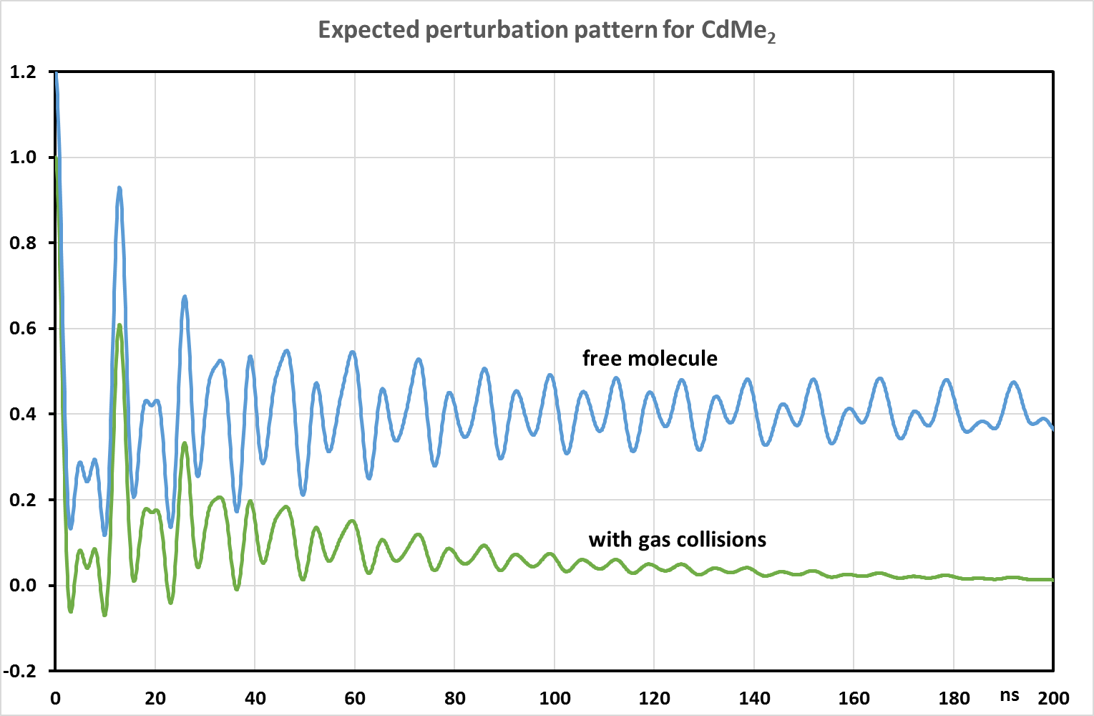
IS640 completion 1: Measuring ¹¹¹Cd-dimethyl molecule
Special interest: Measuring EFG shift for weakly interacting molecules in solid, checking our published estimate
Measuring quasi-linear molecule
Difficulty: Sample production via chemistry, high interaction frequency

Slide 17
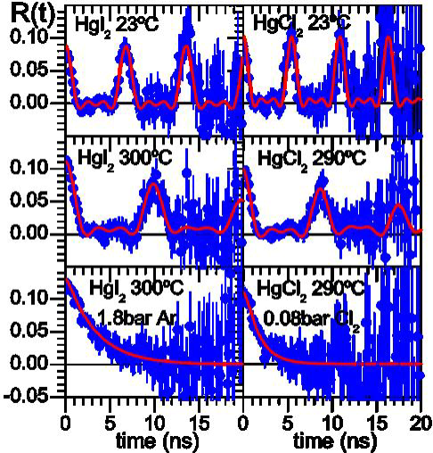
IS640 completion 2: Measuring ¹⁹⁹Hg-dibromide molecule
Special interest:
Obtain 2nd case (after HgCl₂)
for shift of EFG in molecular
solid
Testing DFT calculations
Difficulty:
Sample production for volatile molecule by first formation of metal deposit and then reaction with Br₂

Slide 18
Summary
We plan further PAC experiments on free molecules
Primary goal: A precision value for Q of the 4⁺ state in ²⁰⁴Pb
Test of novel applications of the technique:
to non-linear molecules (²⁰⁴PbCl₂)
to unstable molecules (¹¹¹CdSe)
to charged molecules (¹¹⁷InI₂⁺)
Complete IS640 studies of Cd and Hg cases:
Cd-dimethyl
Hg-dibromide

Slide 19
Beam Time Request
Required isotope | Implanted beam | Probe element | Type of experiment | Intensity [at/μC] | Target / Ion source | Atoms per sample | nº of shifts
^{204m}Pb (67 min) | ^{204m}Pb | ²⁰⁴Pb | γ-γ PAC | 10⁸ | UCx/ RILIS | 2 x 10¹⁰ | 1 x 4
^{111m}Cd (48 min) | ^{111m}Cd | ¹¹¹Cd | γ-γ PAC | 10⁹ | Molten Sn/ VADIS | 2 x 10¹⁰ | 2 x 1
¹¹⁷Cd (150 min) | ¹¹⁷Ag | ¹¹⁷In | γ-γ PAC | 10⁸ | UCx/ RILIS | 5 x 10¹⁰ | 1 x 1
^{199m}Hg (43 min) | ^{199m}Hg | ¹⁹⁹Hg | γ-γ PAC | 10⁹ | Molten Pb/ VADIS | 2 x 10¹⁰ | 1 x 1

Slide 20
Slides for discussion

Slide 21
Problems with previous calibration of Q via B(E2)
Assuming pure wavefunctions for 12⁺ and 10⁺
Accuracy of t_{1/2}
Correction for branch feeding

Slide 22
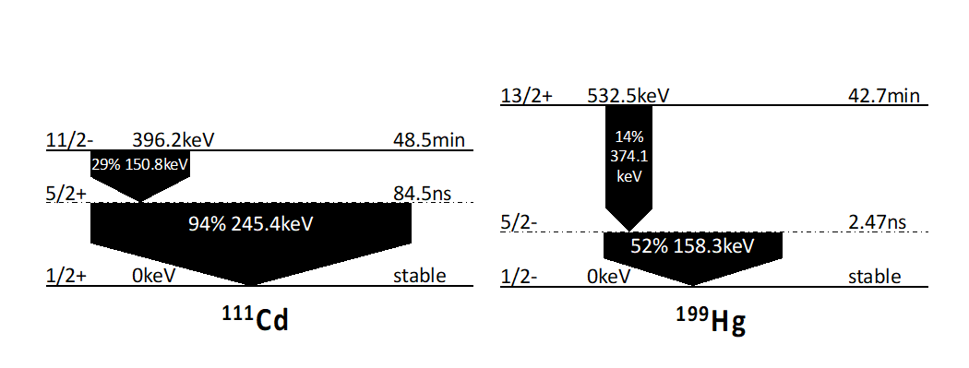

Slide 23
