Slide 1
Task 7 :
11T Cable Stacks Stiffness Characterization at RT and 77K
Ó. Sacristán, M. Guinchard
Mechanical Measurement Laboratory
Courtesy of Felix Wolf for the stacks production
5/26/2021

Slide 2
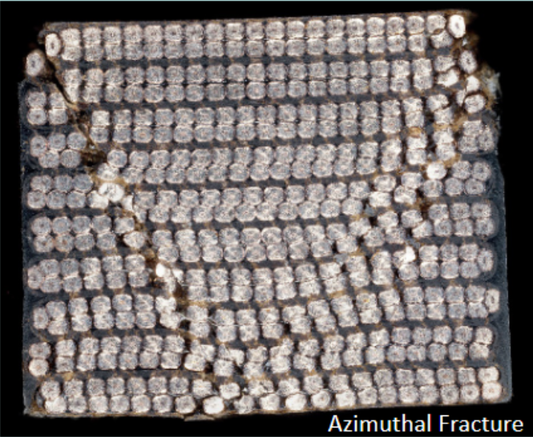
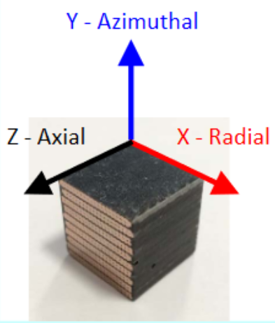
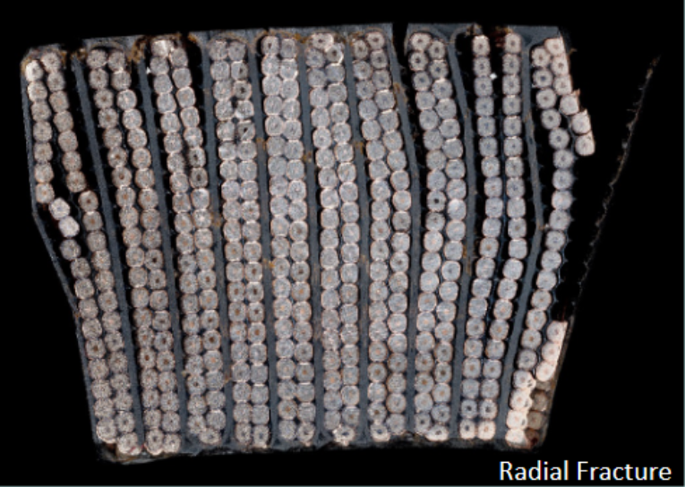
Outline
      History
      Test Set-Up
      Test matrix
      Results
      Conclusions

Slide 3
History
2017
  Test fixture development and validation campaign
  Study with C. Fichera (cofunded TE-MSC/EN-MME fellow) on MQXF mechanical behaviour modelization (EDMS 1828060)
2018
  CEA MQYYM cables campaign for benchmarking purposes (EDMS 1856393)
  11T cable campaign considering other constituent materials (EDMS 1962338)
2019
  11T cable campaign azimuthal direction. Focused on 77K behaviour of the cables
  (EDMS 2208499)
  11T cable campaign focused on impregnation issues. (EDMS 2271688)

Slide 4
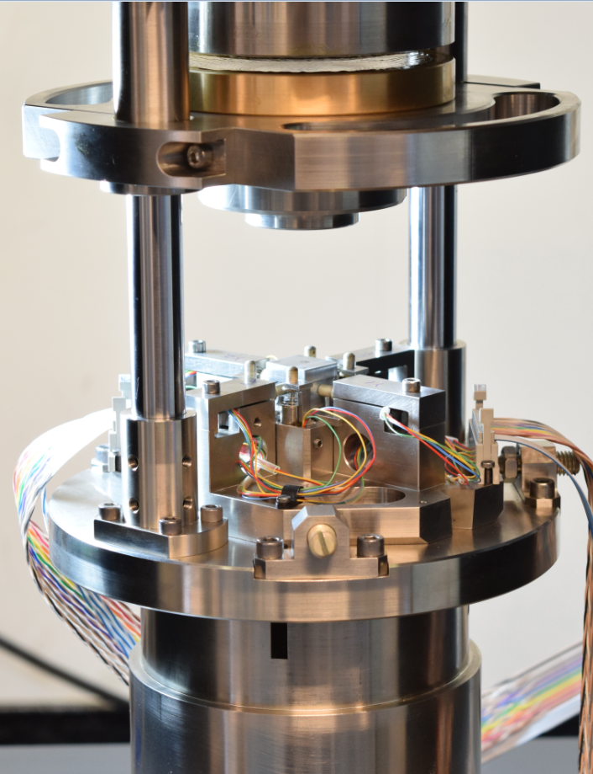
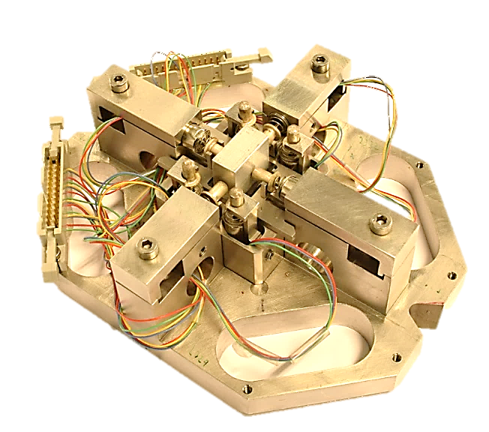
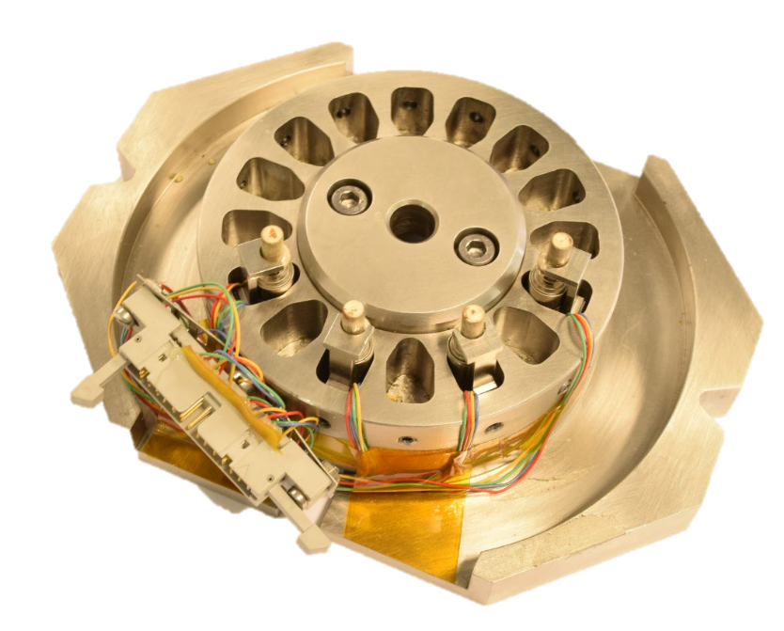
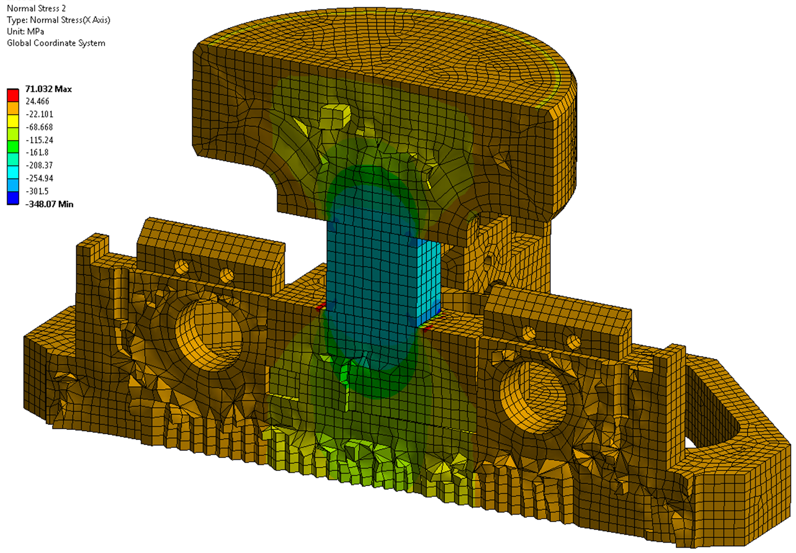
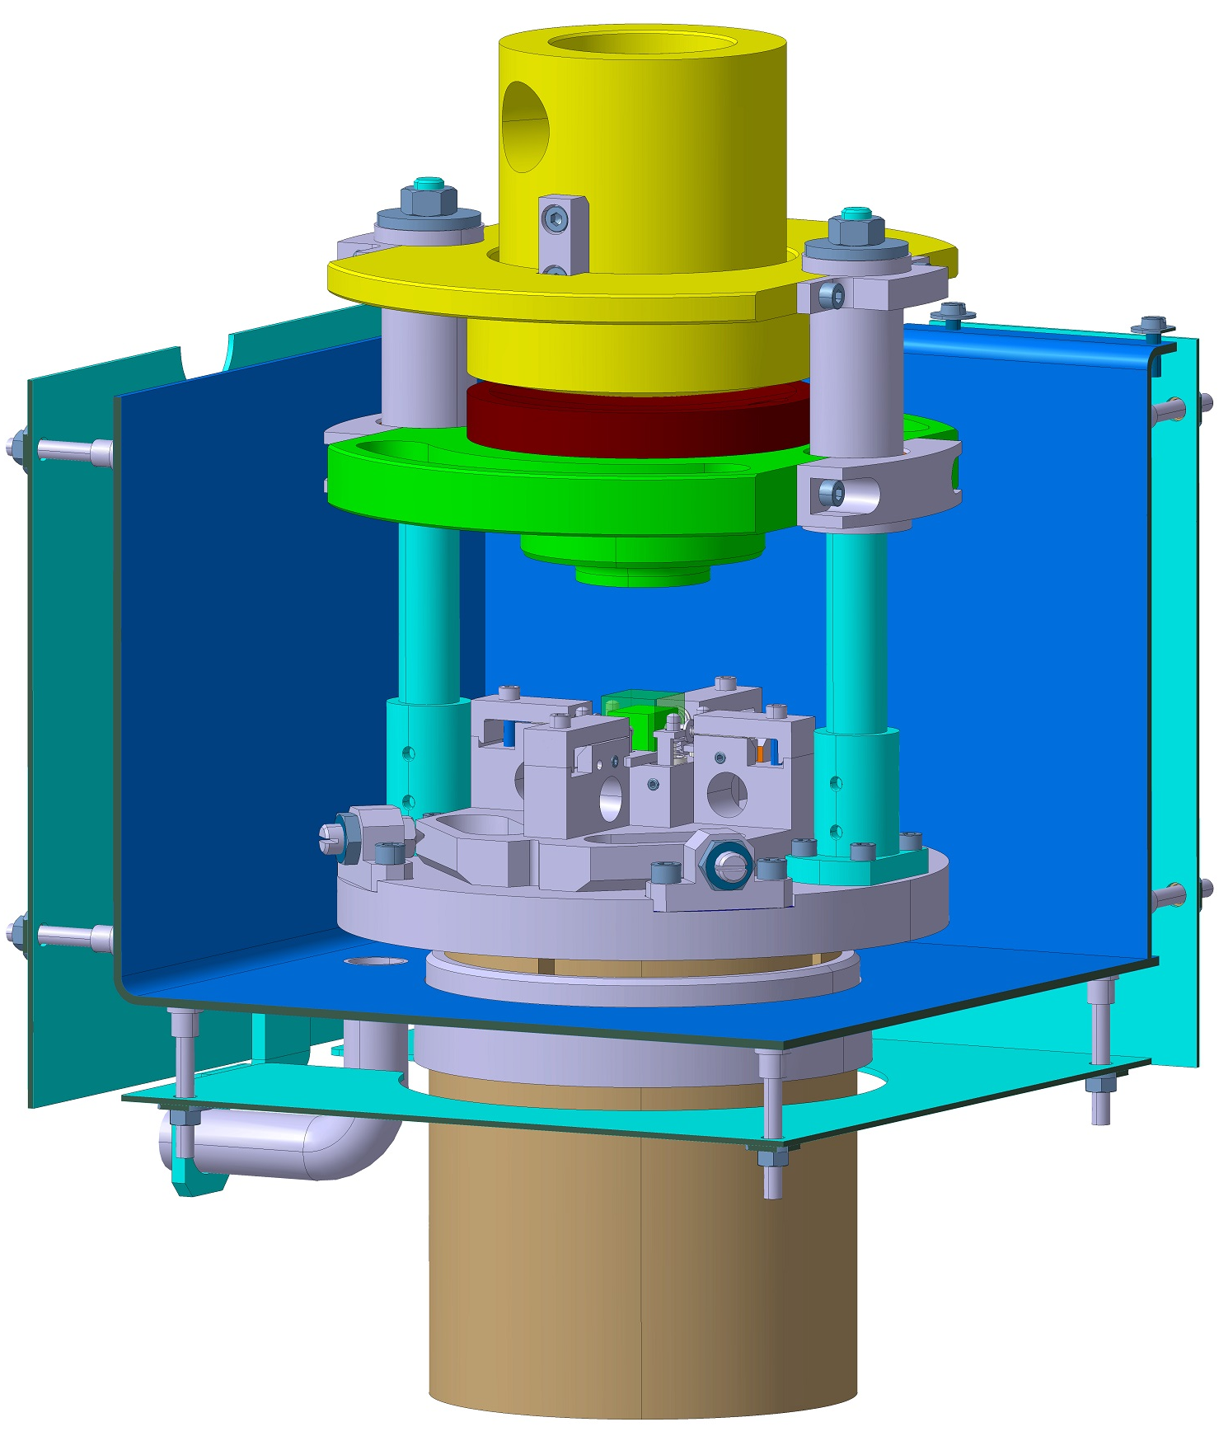
Test Set-up
FEA Model
Measuring Insert
Calibration Insert
      Test Fixture: According to EDMS 1700440;
      Integrated in a ZWICK Z400 universal testing machine;
      Equipped with 8 displacement sensors;
      Deformation measurements in the 3 directions simultaneously

Slide 5
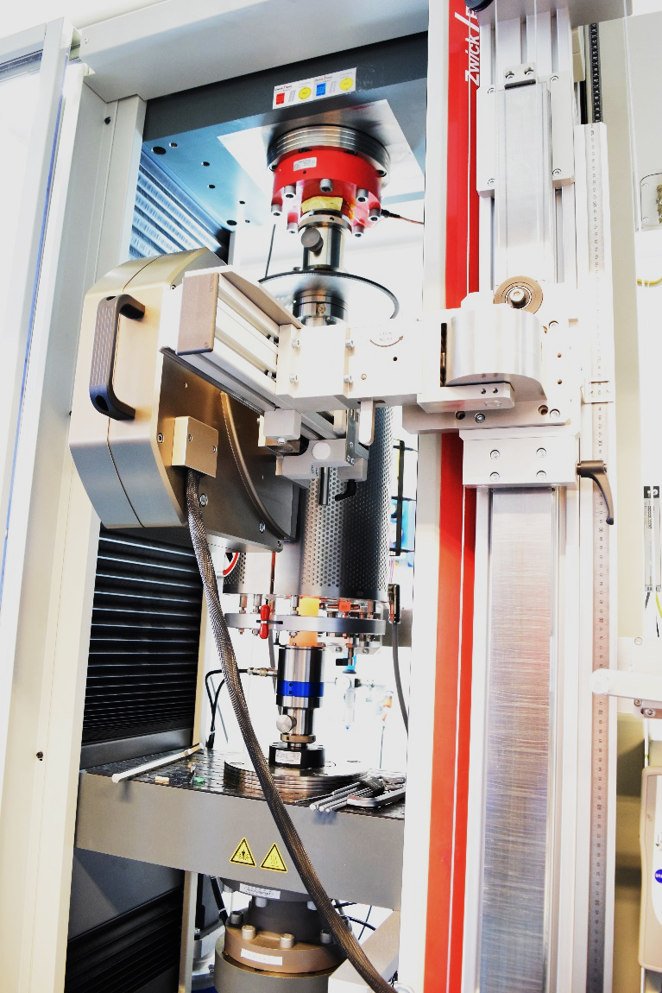
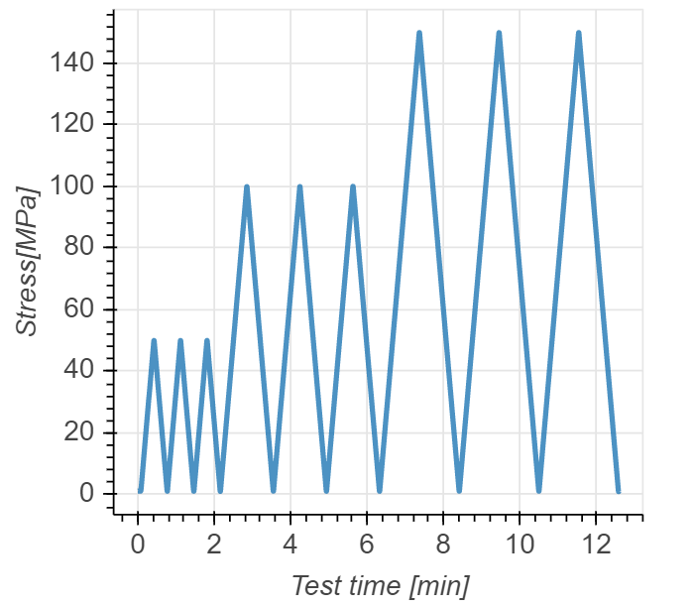
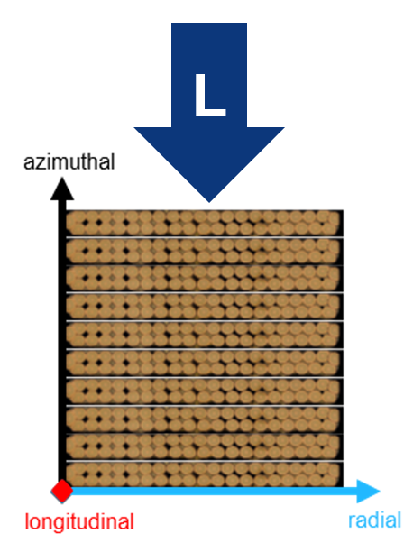
Test Matrix
Specimen Material : 18 cable stacks according to EDMS 2570525
Specimen Dimensions [mm] : Metrology report : EDMS 2570466
Test directions : Azimuthal, longitudinal and radial directions
Test temperature : 293 K and 77 K
Testing Program: 3 loading/unloading cycles to 50, 100 and 150 MPa.
Loading Speed : 3 MPa/s
Testing Campaign Workflow
RT Calibration
77K Calibration
RT
Compliance
RT
Testing
RT
Compliance
77K
Compliance
77K
Testing
77K
Compliance

Slide 6
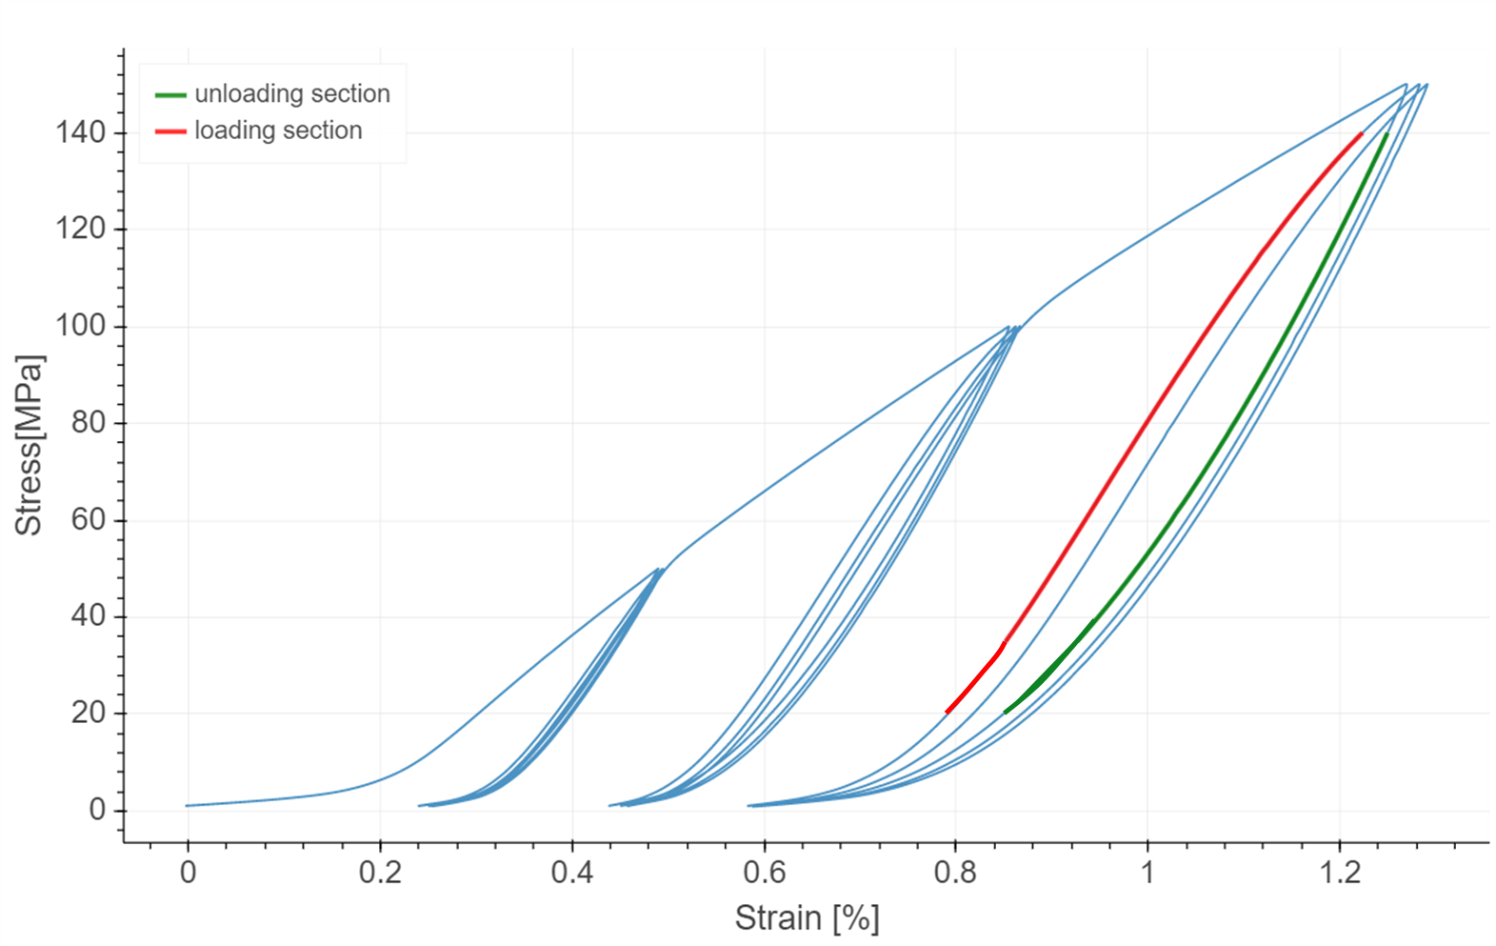
Stiffness analysis
10-stack campaigns consistently show a characteristic nonlinear mechanical behavior with 3 distinct phases: primary loading, unloading, reloading;
Observed characteristics are similar to a hyper elastic constitutive material law (stress softening after load exceeds its prior all-time maximum value);
Post-processing was define as the best fit (linear regression) from 20 to 140 MPa (when possible) calculated on the three loading and unloading phases up to 150 MPa;
All results presented in this document were proceeded with this method.
Reference
Point
Loading
Reference
Point
Unloading

Slide 7
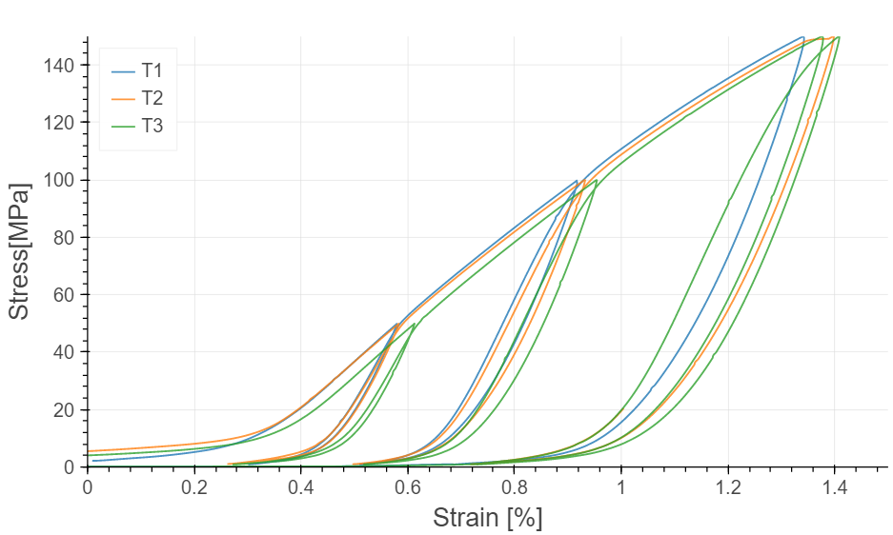
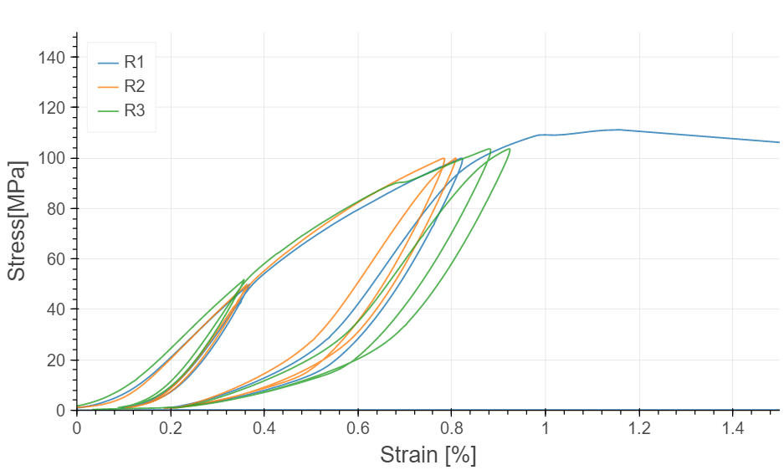
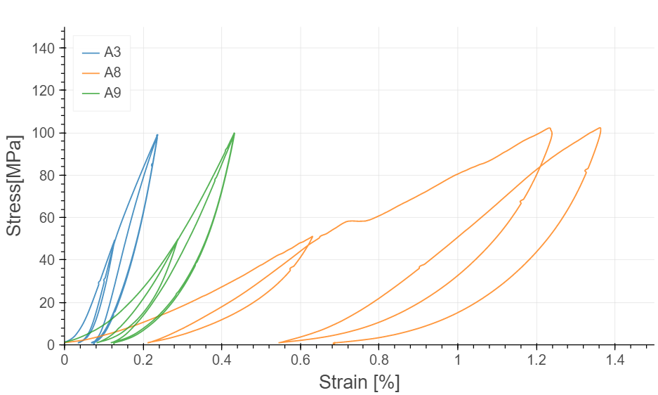
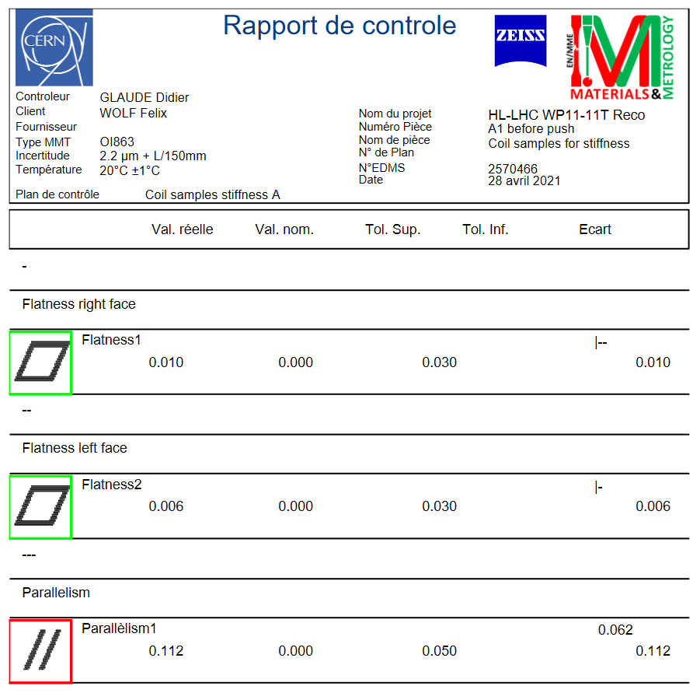
293 K Results Overview
Azimuthal
Radial
Axial
Huge dispersion of mechanical behaviour in axial direction, probably related to the sample shapes.

Slide 8
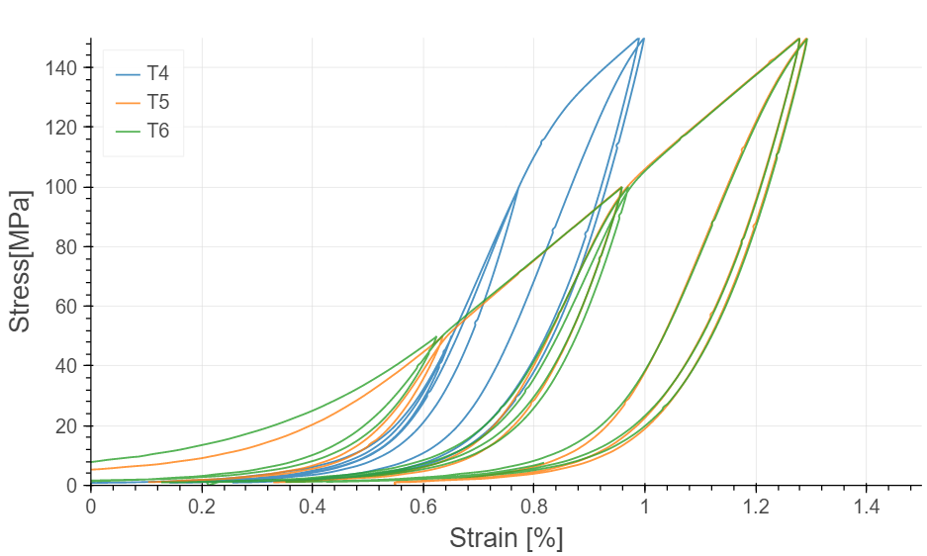
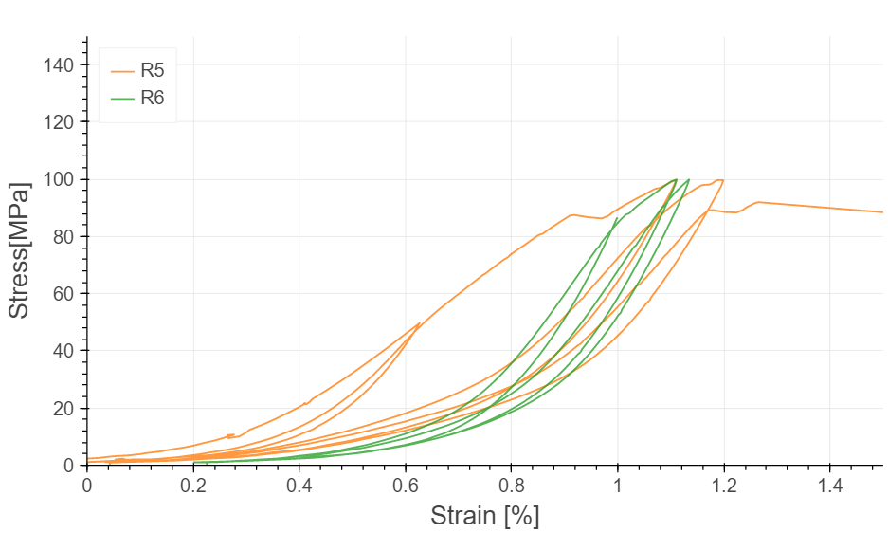
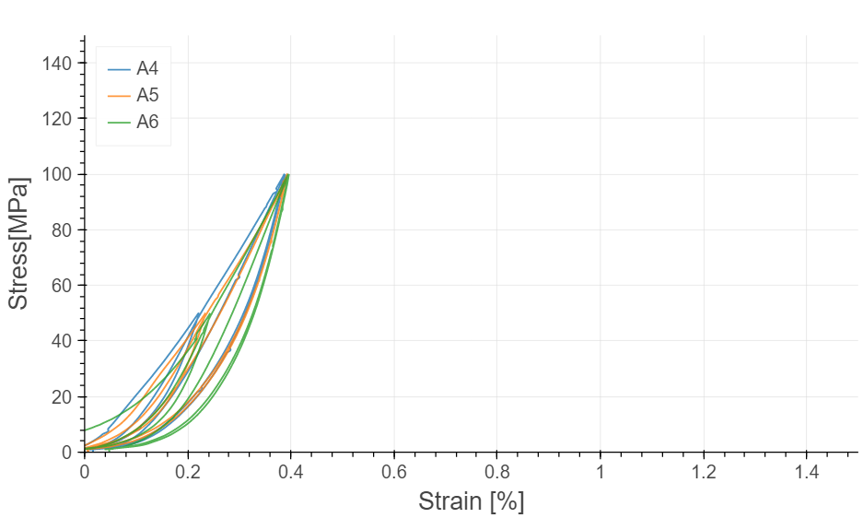
77 K Results Overview
Azimuthal
Radial
Axial
T4 looks as if it had been pre-compressed beforehand. Fastening for cutting operation??

Slide 9
Azimuthal Stiffness Overview

Slide 10
Radial Stiffness Overview

Slide 11
Axial Stiffness Overview

Slide 12
Comparison with previous data : Azimuthal Rigidity
11T Ten Stacks, 2021,
EDMS#22572505
11T Ten Stacks, 2019,
EDMS#2208499
MQXF Ten Stacks, 2017 EDMS#1828060

Slide 13
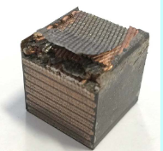
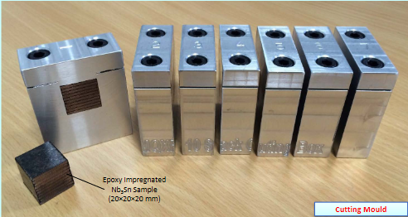
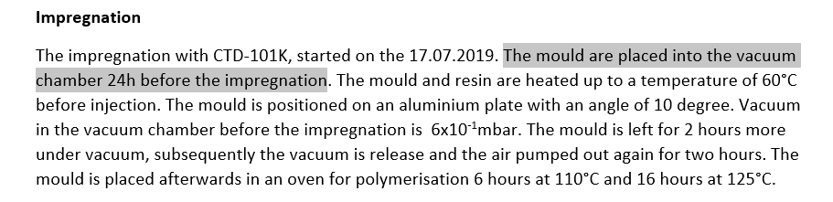
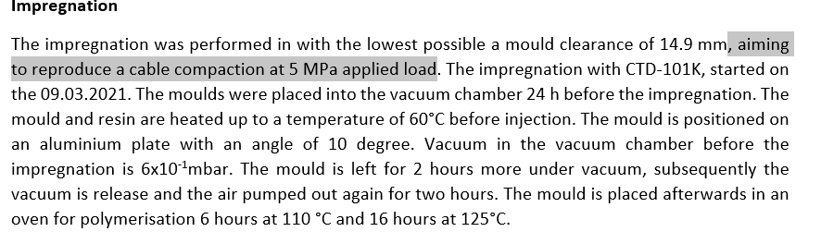
Conclusion
The 11T ten-stack stiffness was successfully measured in the three directions at 293 K and 77 K;
All the results in azimuthal and radial directions are consistent in term of stiffness ;
Some exotic behavior was observed during test in the axial directions, probably related to the preparation of the samples (Cutting effects with diamond disc saw). Due to the brittleness of the Nb3Sn alloy, the10-stack has to be laterally constrained during cutting to prevent the sample delamination (C. Fichera recommendations)
In comparison with the previous 11T test campaign, samples tested in 2021 are stiffer in azimuthal directions (+25 % at 293 K and +10% at 77 K). This variation is probably explained by the difference of manufacturing process : The compaction during reaction and impregnation for the 2021 ten-stacks was different of 2019 ten-stacks.
2019 Report
2021 Report

Slide 14
14

