Slide 1
slides for PEB

Slide 2
Motivation
accurate measurement of proton bunch profile needed:
  to verify streak data used for ChDR BPM design (plot from Eugenio’s thesis)
  to understand connection between hosing at low frequency and bunch structure
RF provides measurement with typical BW at 2 GHz (SPS BQM) – check what the MD scope gives
we propose to measure the proton bunch profile with typical resolution up to 100 GHz single shot

Slide 3
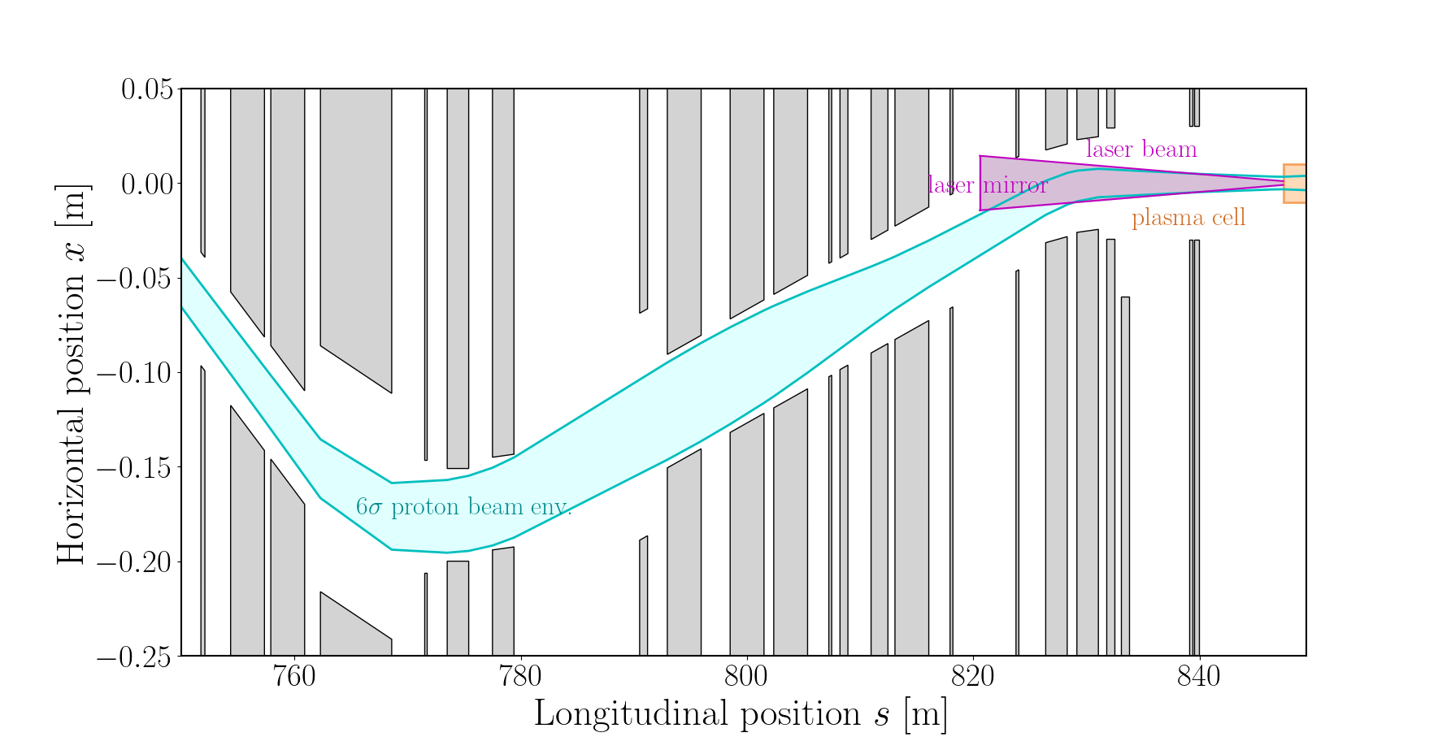
proposal
use electro-optical spectral decoding. (maybe dedicated slide with a plot from the current setup in CLEAR, some basic considerations about intensity of the field, factors limiting resolution etc.;)
Use commercial components as much as possible:
  use AWAKE laser at 780 nm. Stretching / chirping to ns scales achievable with commercial products (TeraXion). An offer for a 780 nm stretcher to 2.4 ns has been requested
  analysis: use Shamrock interferometer at least for proof of principle? Multiple inputs should allow for precise noise subtraction (modulated / unmodulated laser pulse)
Use fibres for propagation of pulse to minimize alignement
Location: ideally before laser injection but this appears

