Slide 1

Proposed measurement of the proton bunch profile
Collette Pakuza
For AWAKE BI
44th AWAKE PEB meeting
02/06/21
Notes:
Emphasize that it’s just a proposal so very conceptual, would like to ask what you think on the idea

Slide 2
Contents
Motivation
Outline of concept
System at CLEAR based on this concept
Proposal for AWAKE
Open questions
Conclusion
Collette Pakuza – 44th AWAKE PEB meeting 02/06/21
2

Slide 3
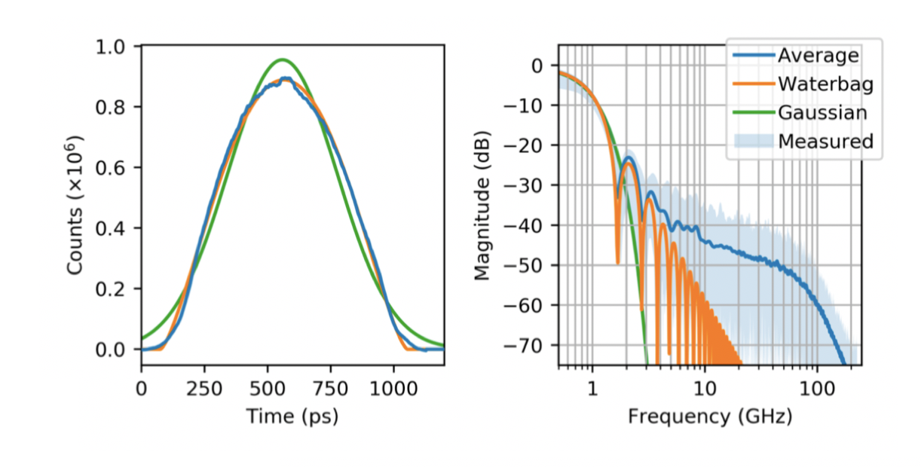
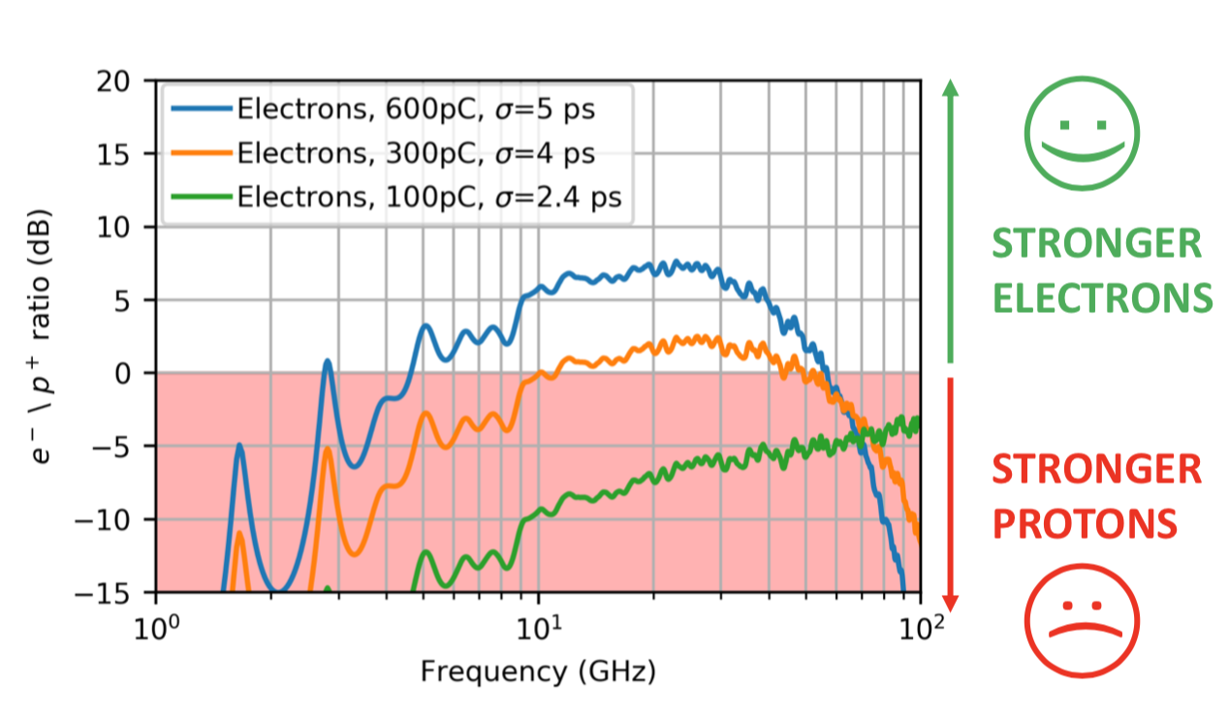
Motivation
Accurate measurement of proton bunch profile needed:
  To verify streak camera data used for ChDR BPM design
  To understand connection between hosing at low frequency and bunch structure
Provides additional information contributing to the landscape of parameters measured at AWAKE
Current RF-based system provides measurement with typical BW of 2 GHz (SPS BQM)
We propose to measure the proton bunch profile with typical resolution up to 100 GHz single shot
Eugenio Senes
Collette Pakuza – 44th AWAKE PEB meeting 02/06/21
3
Notes:
RF measurement doesn’t reach the resolution required for this measurement
10 ps resolution in the EO case

Slide 4
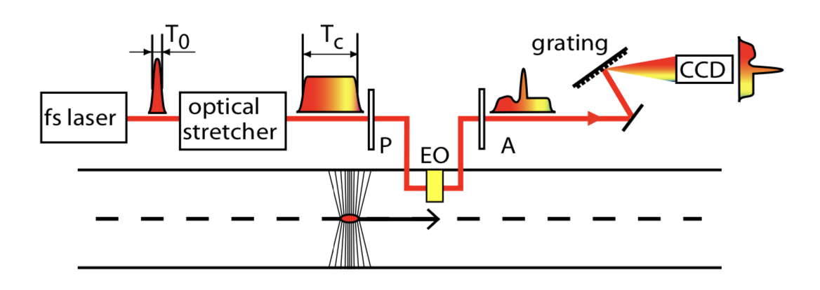
Concept
Use electro-optic spectral decoding
Most suitable EO technique as it provides non-invasive, single shot measurement
Longitudinal bunch profile probed with chirped laser
Temporal overlap of chirped laser with the coulomb field of particle bunch in the EO crystal imprints the longitudinal bunch profile on laser pulse as polarization modulation
Analyser transforms this into spectral intensity modulation
Spectrum of laser pulse measured with spectrometer
Collette Pakuza – 44th AWAKE PEB meeting 02/06/21
4
Notes:
Existing EO techniques:
Simple EO sampling with scanning delay – requires multiple shots
Electro-optic temporal decoding – single-shot but requires complex optical setup and challenging alignment of an optical cross-correlation
Spatially resolved electro-optic detection – invasive technique
Electro-optic spectral decoding – single-shot, non-invasive – most suitable for our application

Slide 5
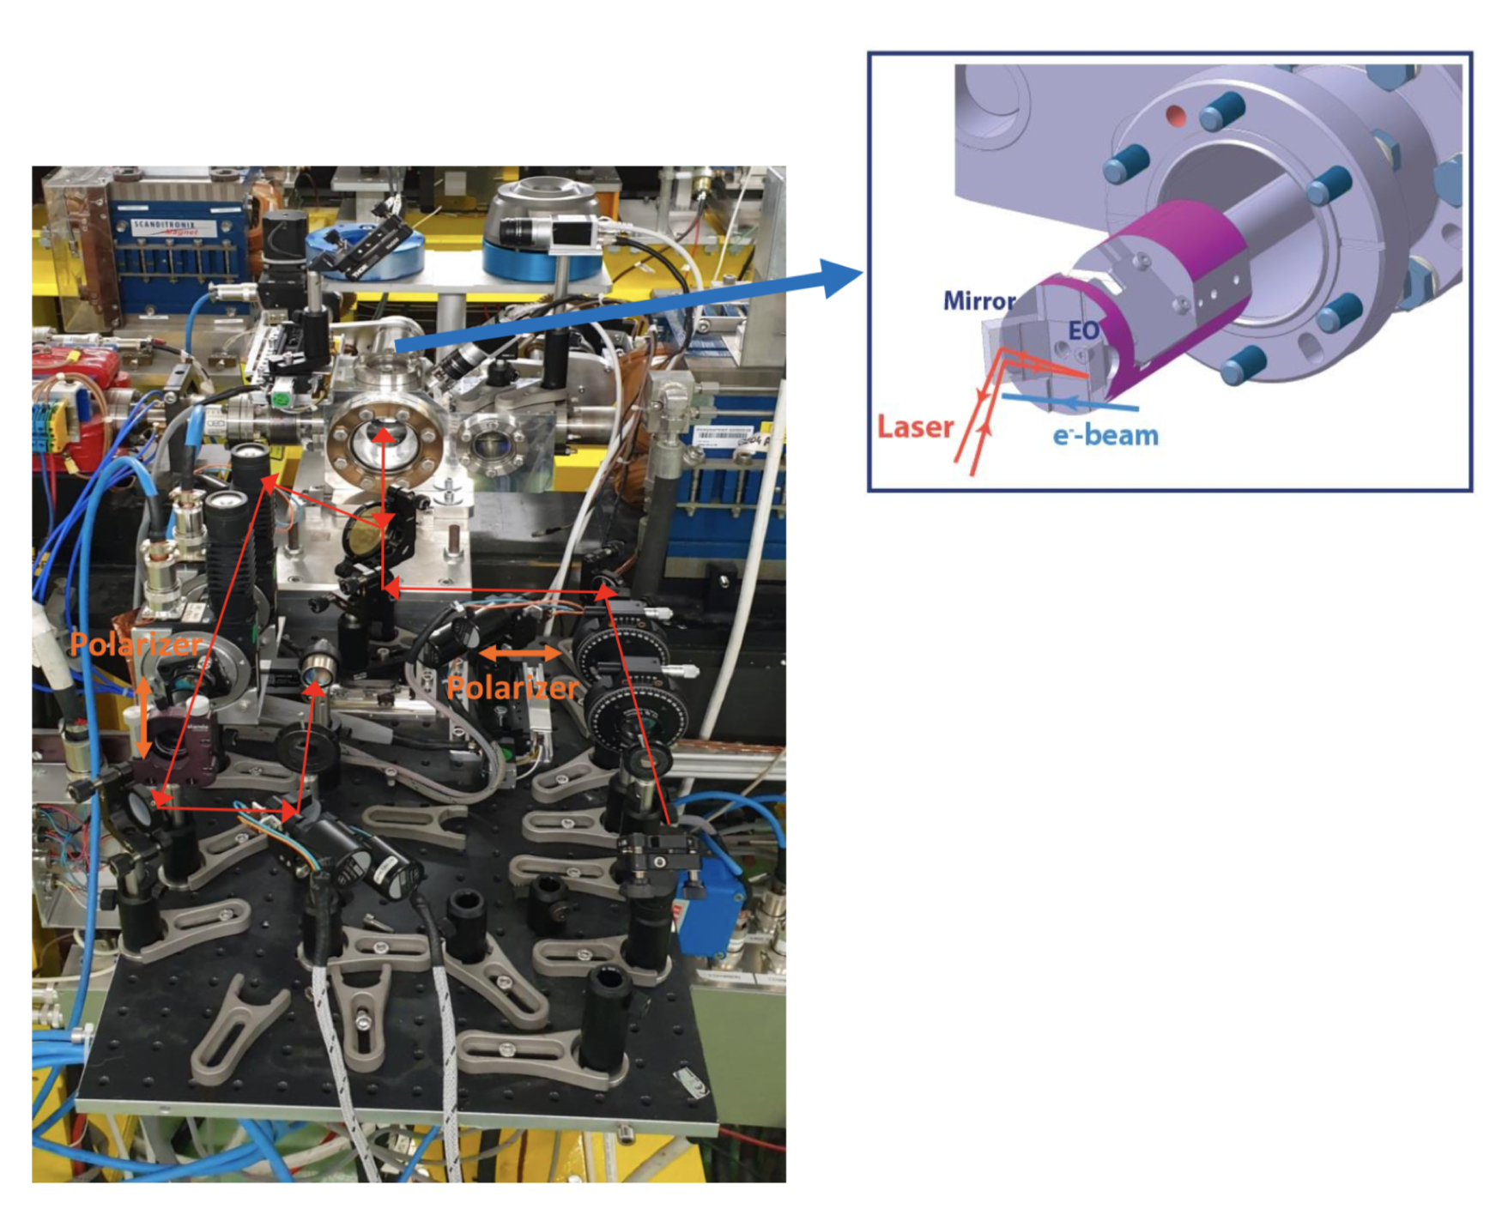
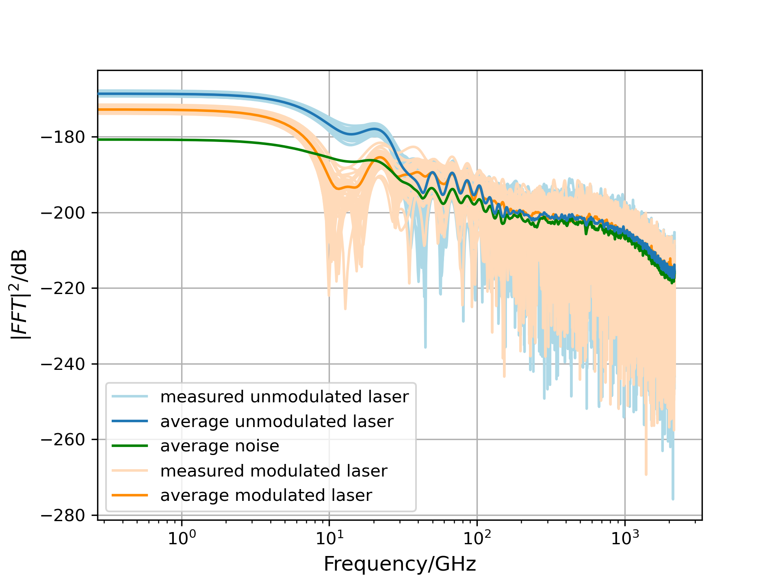
Current system at CLEAR
Current system at CLEAR used for beam position measurements, not designed for spectral measurements
Shows that we can already achieve quite a large BW and precise measurement of the spectrum
However can’t measure modulated and unmodulated profile single shot so need to rely on average noise level
Current system at CLEAR:
Collette Pakuza – 44th AWAKE PEB meeting 02/06/21
5

Slide 6
Proposal for AWAKE
Hope to use as many commercial components as possible:
  Use AWAKE laser at 780 nm
    Stretching/chirping to ns scales achievable with commercial products (TeraXion)
    An offer for a 780 nm stretcher to 2.4 ns has been requested
  Analysis: if possible, use Shamrock interferometer at least for proof-of-principle? Advantage: multiple inputs should allow for precise noise subtraction (modulation/unmodulated laser pulse measured simultaneously)
Collette Pakuza – 44th AWAKE PEB meeting 02/06/21
6

Slide 7
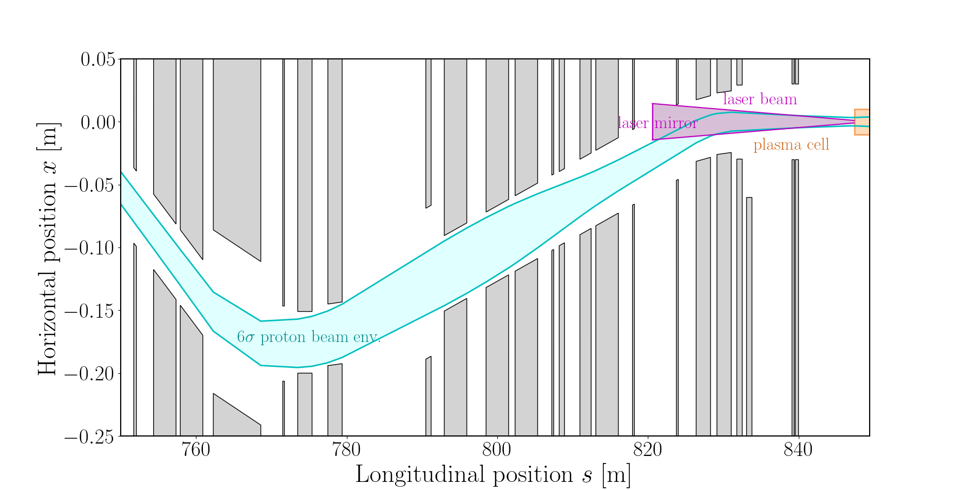
Open questions
Location of instrument
  Prime position would be before the laser merge point where only the proton bunch is present
    However difficult to implement
  Just before mirror
    Proton bunch is quite wide
  After the merge point
    Would need to understand the impact of the presence of the laser on the EO measurements
    May be that the short laser pulse can be identified easily in the modulated chirped laser pulse
Rebecca Ramjiawan
Collette Pakuza – 44th AWAKE PEB meeting 02/06/21
7

Slide 8
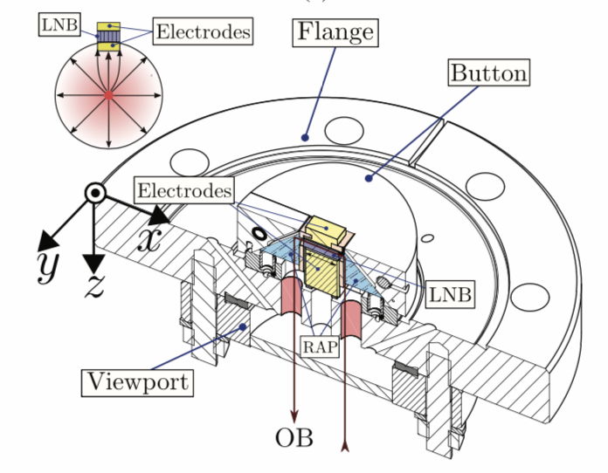
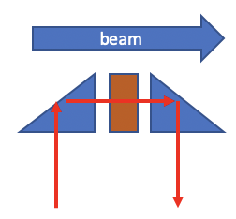
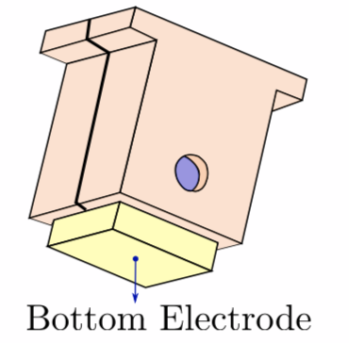
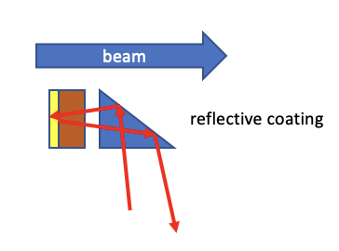
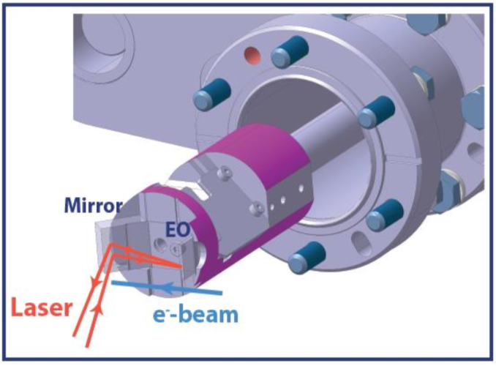
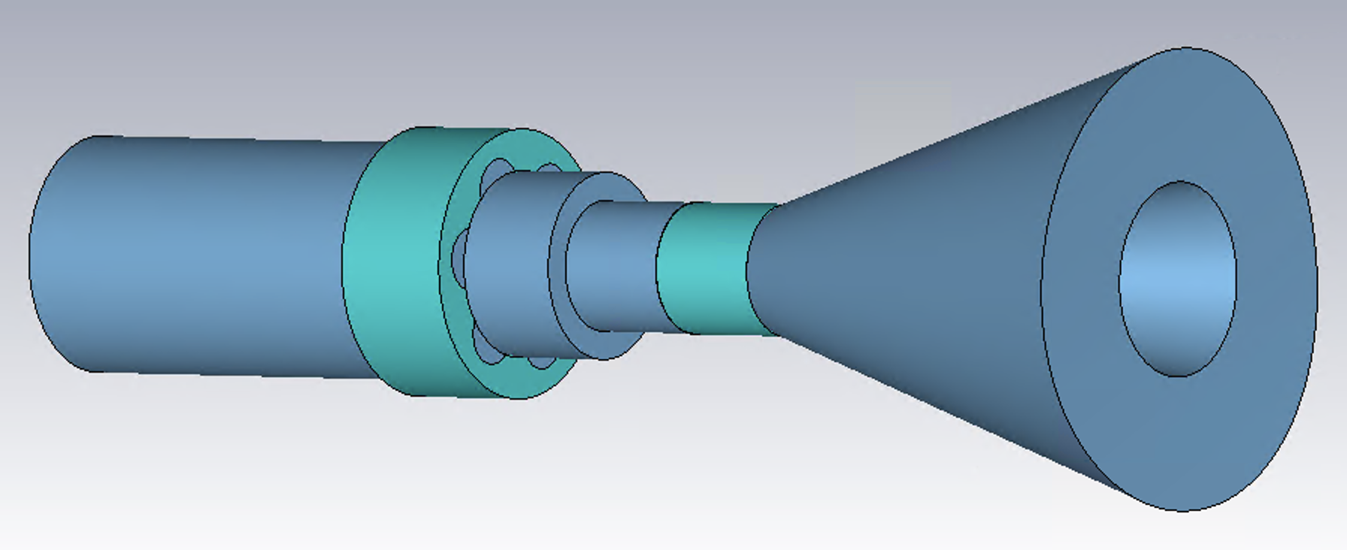
Open questions
Pick-up configuration
  Crystal set-up
  How to inject the laser
Cut crystal to simplify alignment
Combine high-frequency (DESY) or ChDR PU with EO modulator
(BW limited to 20 GHz)
RHUL BPM:
Addition of metal electrode between crystal and beam
Extremely significant shadowing - saw no signal
CLEAR BPM:
Collette Pakuza – 44th AWAKE PEB meeting 02/06/21
8

Slide 9
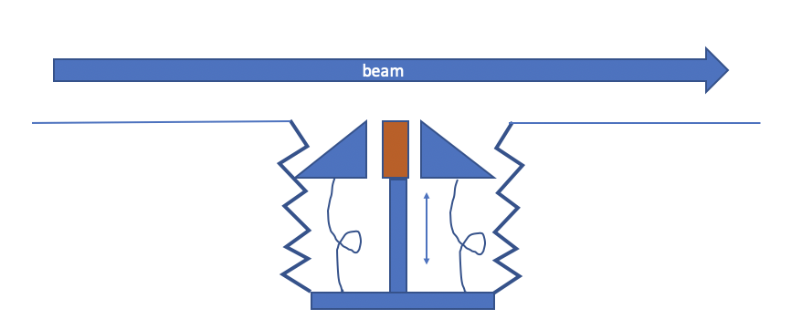
Open questions
Pick-up configuration
  Crystal set-up
  How to inject the laser
Merging PM fibres with crystal
  Vacuum compatible, radiation tolerant?
Or everything in-air fibre coupled and laser mechanically aligned in vacuum in viewport (RHUL BPM)
Needs further discussions with crystal experts and further investigations
Collette Pakuza – 44th AWAKE PEB meeting 02/06/21
9

Slide 10
Conclusions
Good physics premise for measurement of proton bunch profile
Details would need to be studied and decided such as position of instrument and EO crystal set-up
Promising and achievable technique with resources available at AWAKE and BI
Collette Pakuza – 44th AWAKE PEB meeting 02/06/21
10

Slide 11
Thank you for your attention!

