Slide 1
WP8 – Superconducting Magnet Design
Meeting #2
Lucio rossi – wp8 coordinator

Slide 2












This is a HITRI+ meeting (with only-IFAST members as observers)
I.FAST
& I.FAST

Slide 3
MSs & DLVs

Slide 4
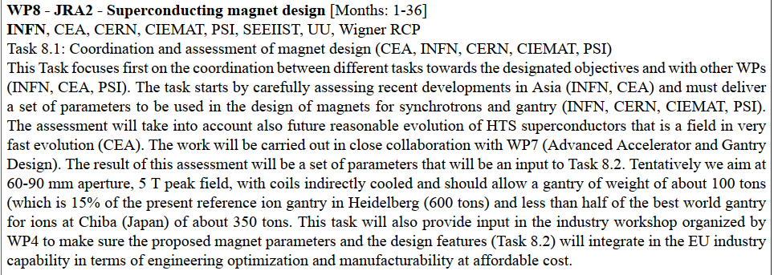
Detailed program – task1

Slide 5
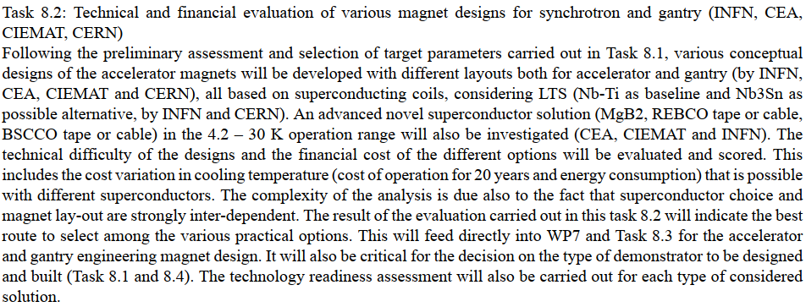
Detailed program – task 2

Slide 6
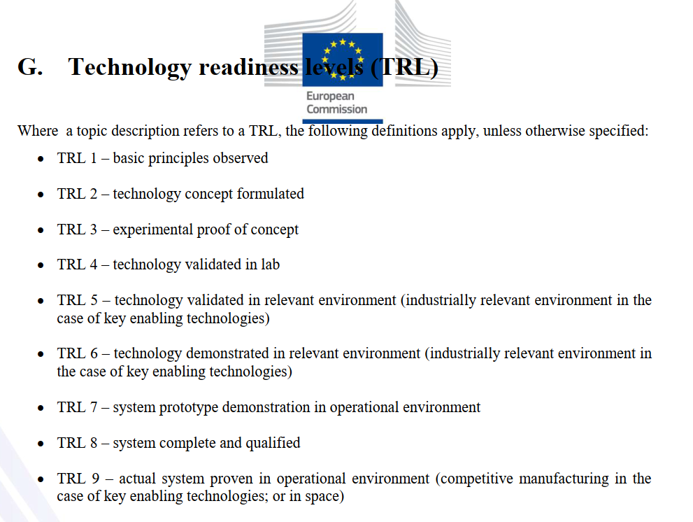
TRL – Technology Readiness Level according to H2020
Technology Readiness Levels (TRLs) are indicators of the maturity level of particular technologies.
This measurement system provides a common understanding of technology status and addresses the entire innovation chain.
There are nine technology readiness levels; TRL 1 being the lowest and TRL 9 the highest.

Slide 7
Rule of the game for task2
(comparison between different design and materials) ; end 2021
Lm= 800 mm
Diam=75 mm
B0= 4.5 T pure dipole field; 20% of margin on load line.
Straight
Considerations for construction of curved magnet with ρ of the order of 1.5 m
Consideration for combined functions (either geometry or nested)
Consideration on extension of field to higher field (5T+)
dB/dt = 0.3 T/s for Gantry (0.9T-Bmax) – Synchrotrons: 1 T/s. (0.3T-Bmax)
T= 5 K (no two-phase he); T = 10 K; T = 20 K

Slide 8
Complete Matrix for design option
Please take the Design Option matrix, see excel file in the same Indico file as this one, and complete
Taking into account the recommendation written in the above slides.
Have in mind that the Institutes that have subscribed to task 1 and 2 are supposed to contribute, at a level proportional to the personnel they receive form EU, to this job…

Slide 9
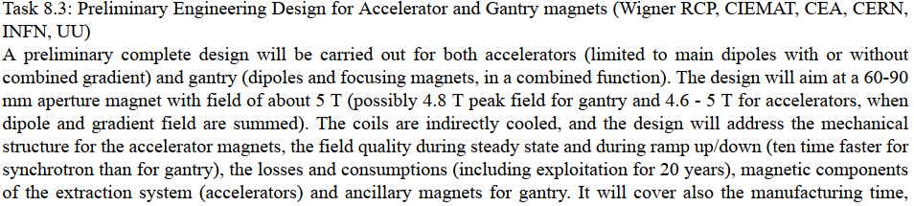
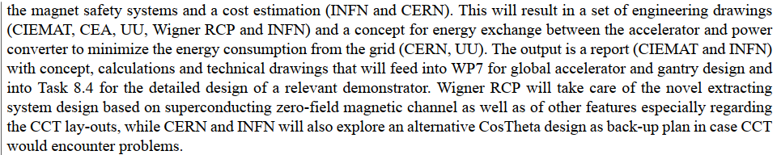
Detailed program – task 3

Slide 10
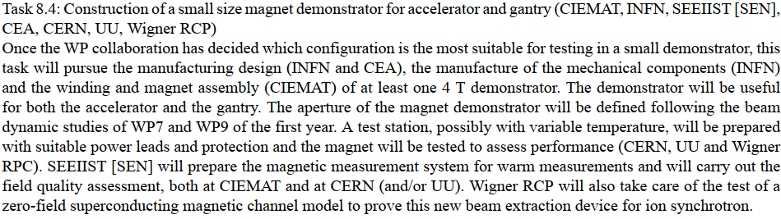
Detailed program – task

Slide 11
Reserve slides

Slide 12
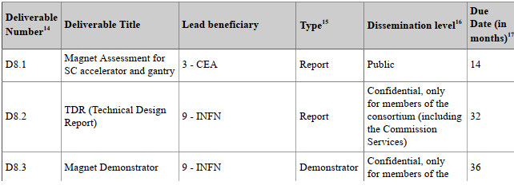
HITRI + WP8 Deliverables

Slide 13
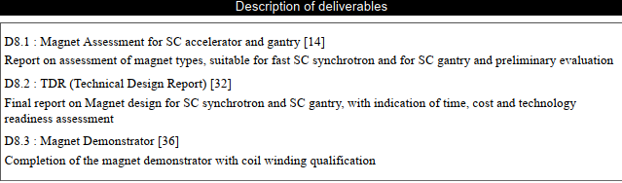
HITRI+ GA – DLV description

Slide 14
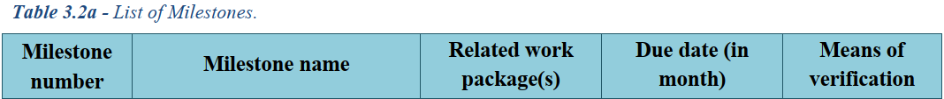
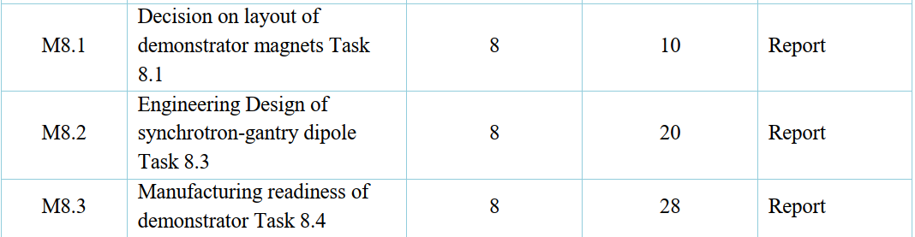
HITRI+ proposal - MS

Slide 15
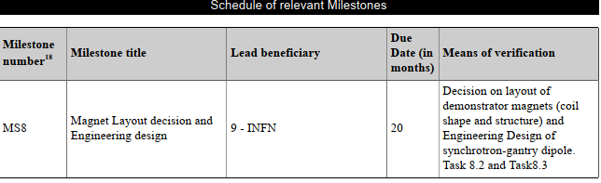
HITRI+ GA - MS

Slide 16
WP8 Listing
INFN-LASA

Slide 17
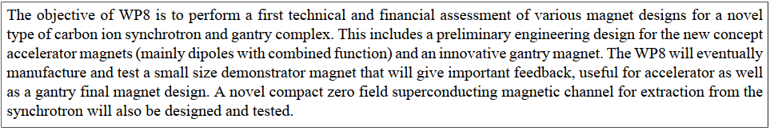

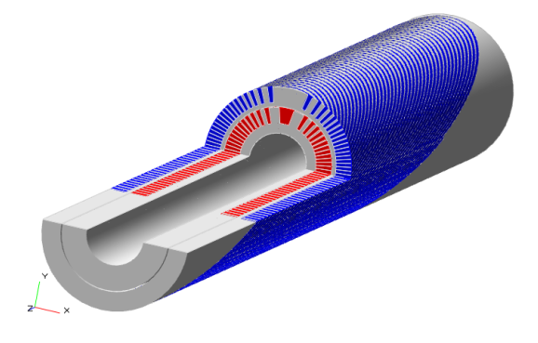

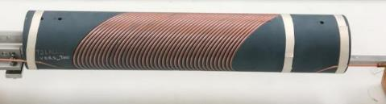
WP8 duration: from M1 to M36 !! (HITRI+ is 48 months)
Scope of our WP8
CCT dipole
4 T operative
5 T target
Ø =60-90 mm
Outer layer

Slide 18
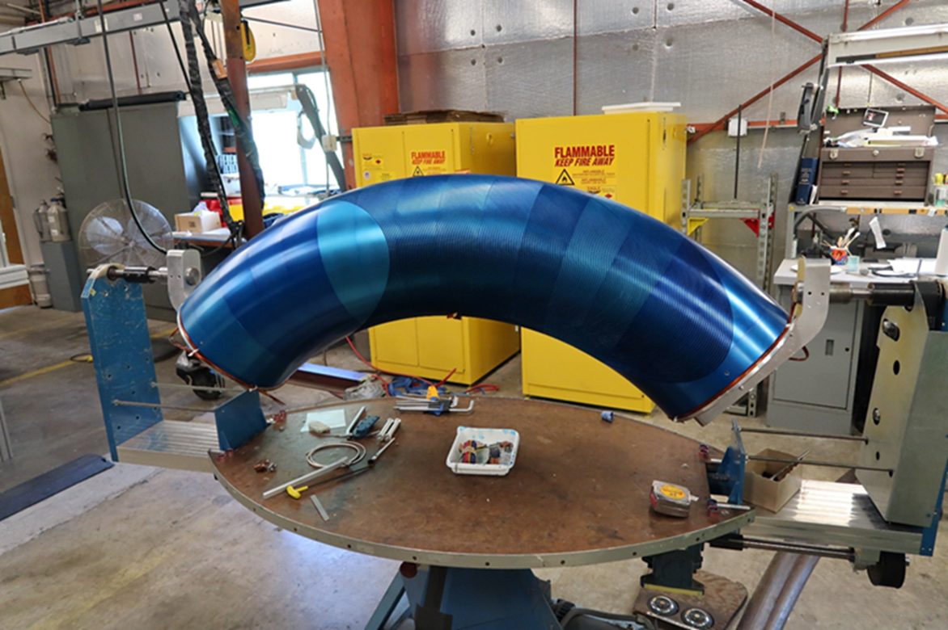
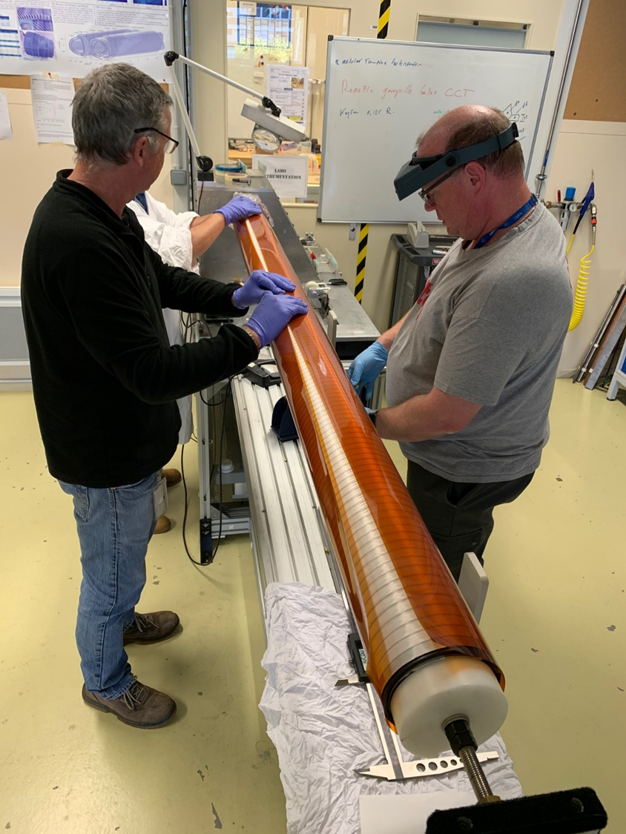
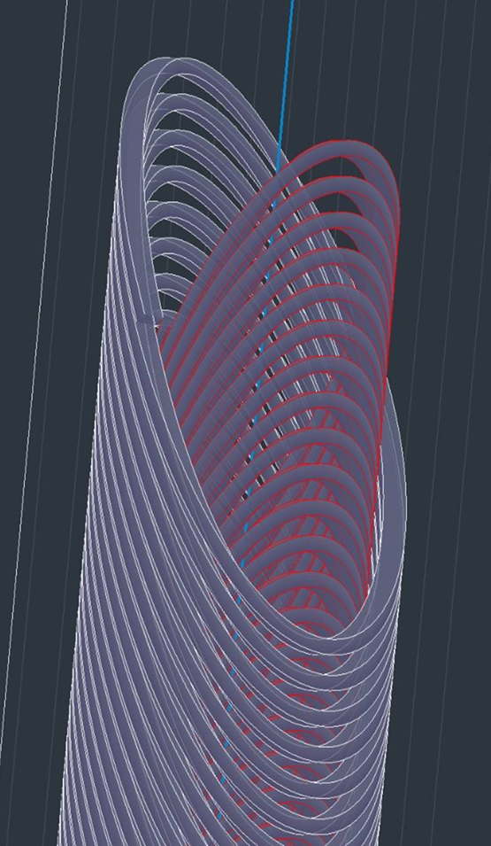
Nb-Ti CCT: p-gantry and HiLumi LHC
LBNL: CCT coil prototype for large acceptance proton gantry ∅ = 400 mm: Successfully tested to 3.5 T; segmented former.
HiLumi LHC: CERN has designed, built and tested a dual 3 T, 2 m long - ∅ = 105 mm, straight CCT. Now IHEP Beijing producing 2x13 units
Short circuit at 3.5T!!
Proto 2m 2.9 T 105 mm very successful at CERN. However, learning and transfer not easy (China…, SE)…

Slide 19
DLV & MS at a glance
HITRI+ Milestones (1 formal and 2 are internal: M1i and M3i
Task8.1
Task8.2
Task8.3
Task8.4

Slide 20
HITRI + WP8 Risk & Mitigation plan

Slide 21
Resources: only Column 3 – EC funds- is reported to EU; column 4 (matching funds) are not to report
However Pr. Coordinator can ask

Slide 22
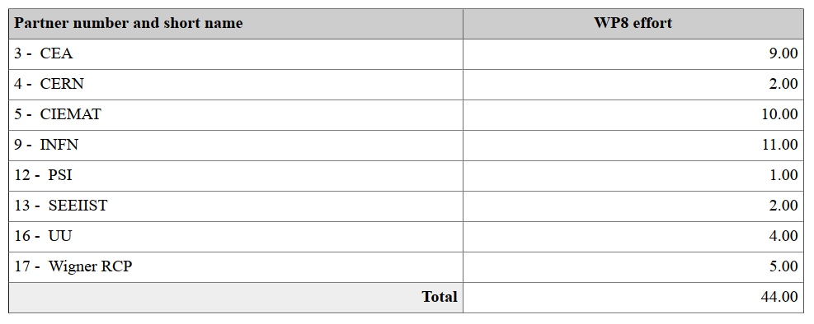
The amount of personnel is outrageously low… To protect ourselves in formal reporting. But we MUST MEET DLV!!

