Slide 1
General information
G. Iadarola
ABP Computing Meeting – 28 May 2021

Slide 2
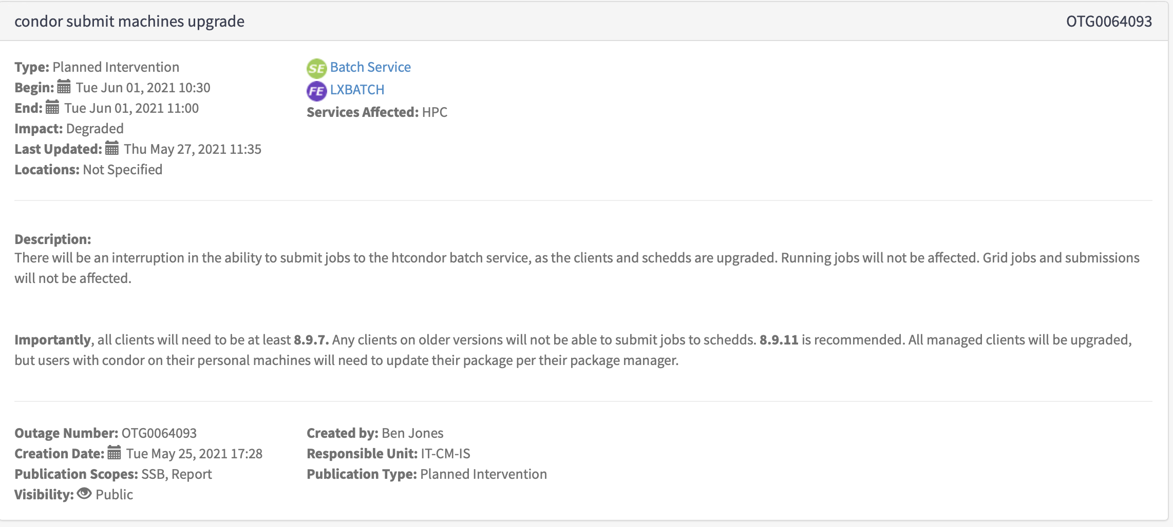
General information
HTCondor version update will take place next week
  No issue expected for users launching jobs on lxplus
  People who have an HTCondor installation on their computer should install the new version to be able to launch jobs
https://cern.service-now.com/service-portal?id=outage&n=OTG0064093
2

Slide 3
Thanks for your attention!

