Slide 1

Office of Nuclear Physics
Science Program including LHC
October 30, 2010
Fermi National Accelerator Laboratory
Gene Henry
Physics Research Division Director
for
Timothy J. Hallman
Associate Director of the Office of Science for Nuclear Physics

Slide 2
Outline
NP Frontiers, Mission, Priorities
User Facilities, and Science Portfolio
Isotopes Program
12 GeV CEBAF Upgrade
FRIB
HI program
  RHIC program
  LHC program
ALICE
CMS

Slide 3
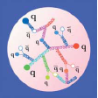
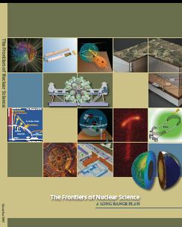

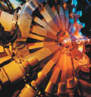
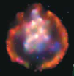

Scientific Opportunities and Priorities
Scientific frontiers and opportunities are identified by the scientific community
  Primary guidance has come from DOE/NSF Nuclear Science Advisory Committee (NSAC)
  Other guidance obtained from National Academy of Science (NAS), Interagency/International studies, facility PACs, etc.
The Frontiers of Nuclear Physics
Quantum Chromodynamics
From the Structure of Hadrons
to the Phases of Nuclear Matter
Nuclei and Nuclear Astrophysics
From Structure to Exploding Stars
In Search of the New Standard Model
Neutrinos - Fundamental Interactions

Slide 4
Nuclear Physics Program Mission
Mission: To discover, explore and understand all forms of nuclear matter; to understand how the fundamental particles, quarks and gluons, fit together and interact to create different types of matter in the universe, including those no longer found naturally
Priorities:
To understand how quarks and gluons assemble into the various forms of matter and to search for yet undiscovered forms of matter
To understand how protons and neutrons combine to form atomic nuclei and how these nuclei have emerged during the 13.7 billion years since the origin of the cosmos
To understand the fundamental properties of the neutron and develop a better understanding of the neutrino
To conceive, plan, design, construct, and operate national scientific user facilities; to develop new detector and accelerator technologies
To provide stewardship of isotope production and technologies to advance important applications, research and tools for the nation
To foster integration of the research with the work of other organizations in DOE

Slide 5
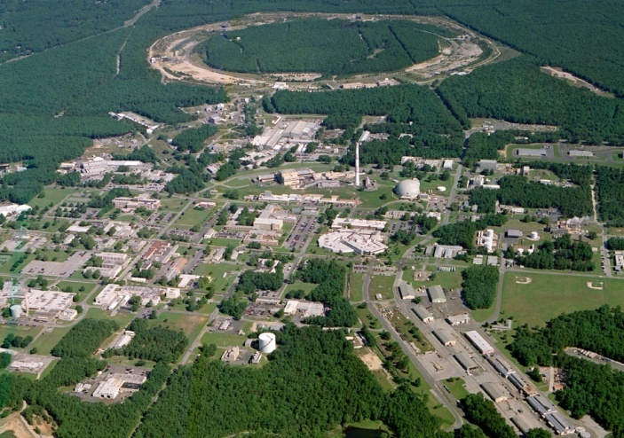
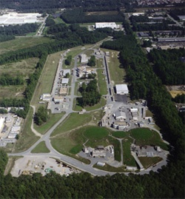
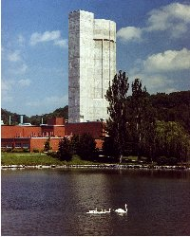
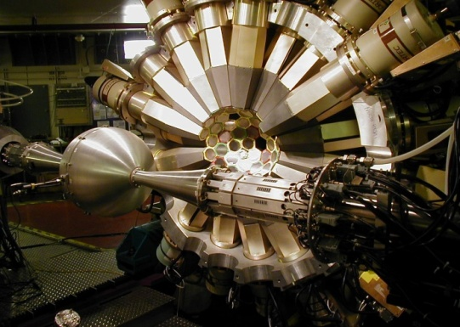
NP Operates Four National User Facilities
“Microscopes” capable of groundbreaking research
ALS 1993
Relativistic Heavy Ion Collider at BNL
Continuous Electron Beam Accelerator Facility at JLab
CEBAF
Holifield Radioactive Ion
Beam Facility at ORNL
Argonne Tandem Linac Accelerator System at ANL

Slide 6
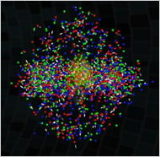
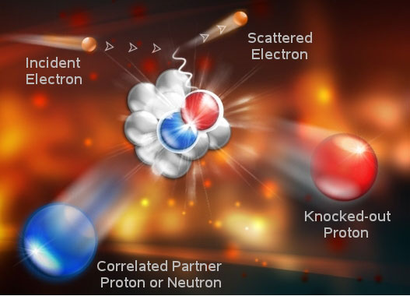
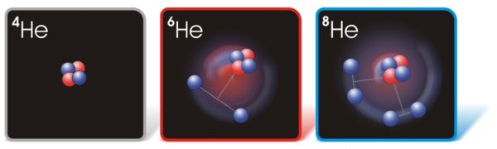
At the NP National User Facilities the Research
Spans a Range of Microscopic Scales:
From Quarks and Gluons
To Protons and Neutrons
Relativistic Heavy Ion Collider
Continuous Electron Beam Accelerator Facility
To Nuclei
CEBAF
Holifield Radioactive Ion
Beam Facility
Argonne Tandem Linac Accelerator System

Slide 7
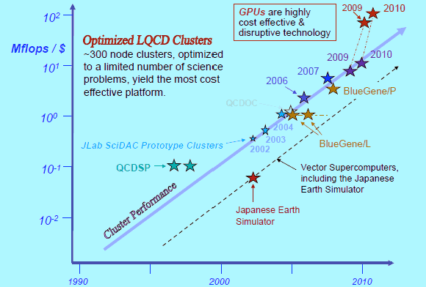
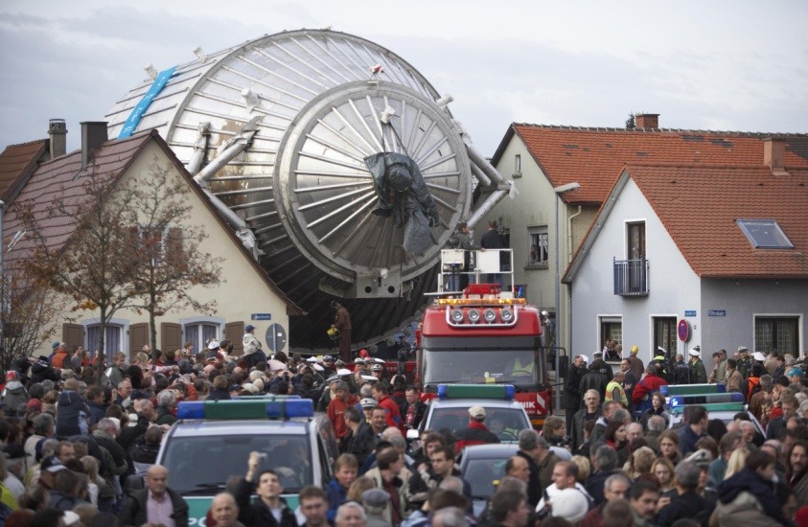
Additional Elements of the
NP Basic Science Portfolio
Nuclear Theory
  Effort in all areas of nuclear physics
  SciDAC, Topical Centers, LQCD
Neutrino Physics-Particle/Antiparticle; Mass
  Cryogenic Underground Observatory for Rare
  Events (CUORE)
  Majorana Demonstrator R&D
  Karlsruhe Tritium Neutrino Experiment
  (KATRIN)
Fundamental Physics with Neutrons
  Fundamental Neutron Physics Beamline at SNS
  Electric Dipole Moment of the neutron (nEDM)
  Neutron beta-decay, reaction asymmetry,
  spin rotation
Heavy Ion Research at the Large Hadron Collider
Graphical Processor Units in LQCD Computing
KATRIN Spectrometer Tank

Slide 8
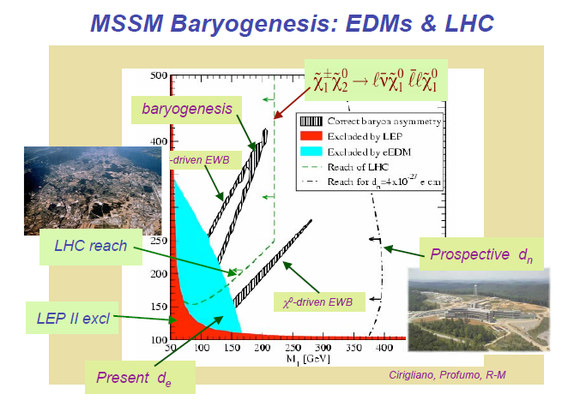
Complementarity of High and Low Energy Approaches to Fundamental Questions

Slide 9
Isotope Program Production and Distribution of Commercial and Research Isotopes
Richland:
Cancer therapy
Brookhaven – BLIP:
PET equipment; Antibody labeling;
Cardiac imaging; Cancer therapy
Idaho – ATR
Sterilization
NIH - Cyclotrons:
Research isotopes
Washington Univ.:
Research isotopes
Oak Ridge – HFIR:
Industrial NDA;
Industrial sources;
Cancer therapy
Stable Isotopes Inventory
UC Davis/McClellan:
Research isotopes
U. of Missouri – MURR:
Research isotopes
Los Alamos – LANSCE/IPF:
Calibration sources for PET
Cardiac imaging; Biomedical tracer
Savannah River Tritium Facility:
He-3: Neutron detectors; Fusion reactors,
Lung testing

Slide 10
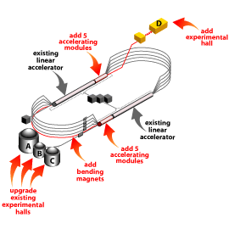
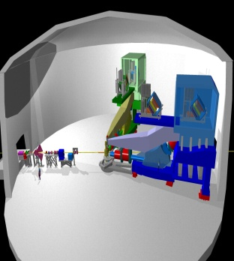
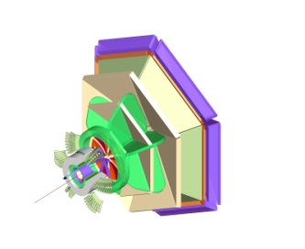
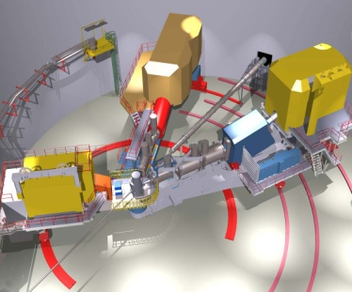
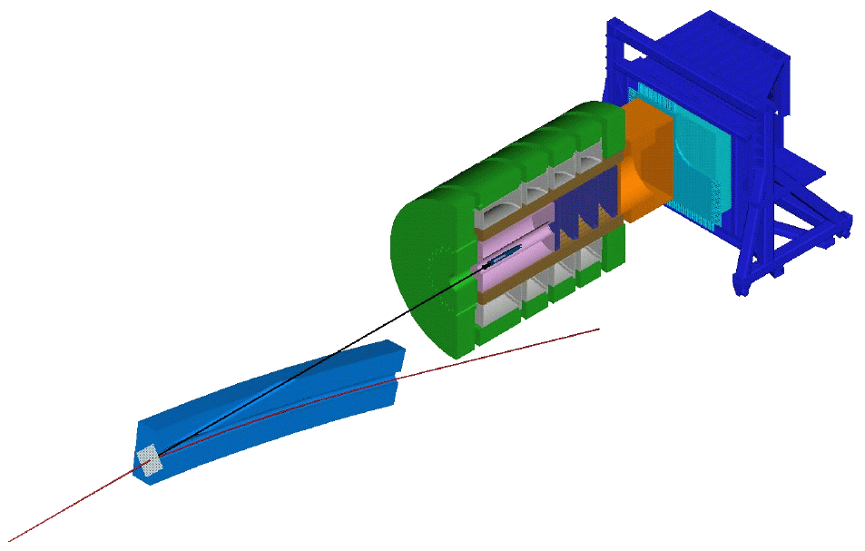
12 GeV CEBAF Upgrade Project at JLab
Unique, world-class facility and scientific program
  New insight into the structure of the nucleon
  Investigate transition between hadronic and
  quark/gluon description
  Address one of great questions of modern
  physics: the mechanism that “confines” quarks
  together
Scope of the project
  Doubling the accelerator beam energy
  New experimental Hall and associated beamlines
  Upgrades to the existing three experimental Halls
TPC: $310 Million
Successful CD-2, CD-3 in FY 2008; operations
anticipated in FY 2015
Recovery Act funding advances project
funding of $65 Million
A
High Resolution Spectrometer (HRS) Pair, and specialized large installation experiments
B
C
D
CLAS upgraded to higher (10³⁵) luminosity and coverage
Super High Momentum Spectrometer (SHMS) at high luminosity and forward angles
9 GeV tagged polarized photons and a 4π hermetic detector

Slide 11
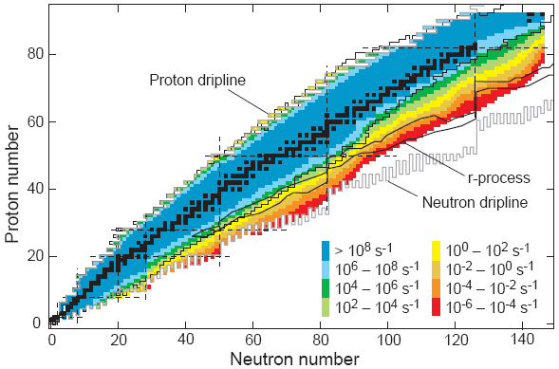
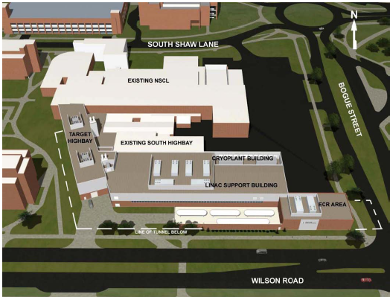
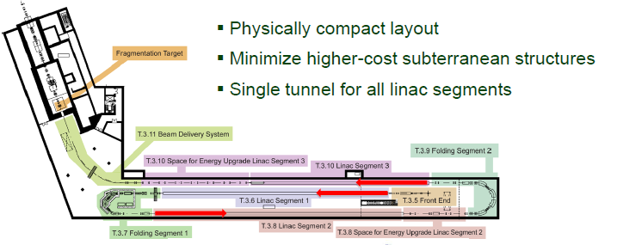
Facility for Rare Isotope Beams (FRIB) at MSU
Production of Rare Isotopes
FRIB at Michigan State University
Science Drivers for FRIB
Nuclear Structure
Nuclear Astrophysics
Fundamental Symmetries
Other Scientific Applications

Slide 12
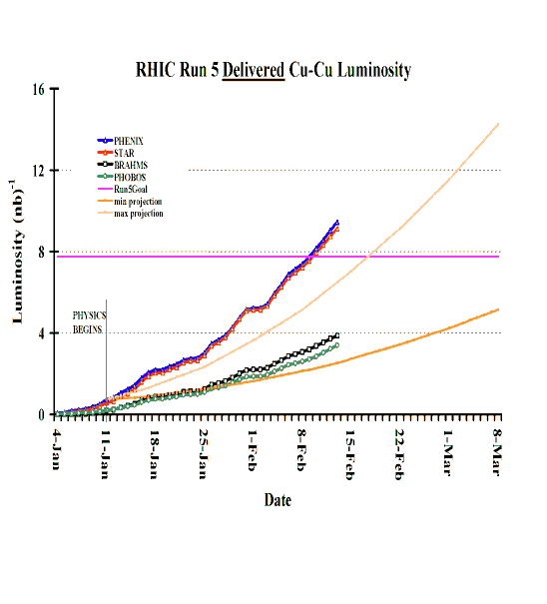
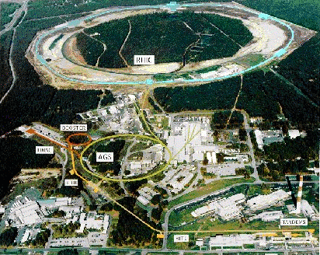
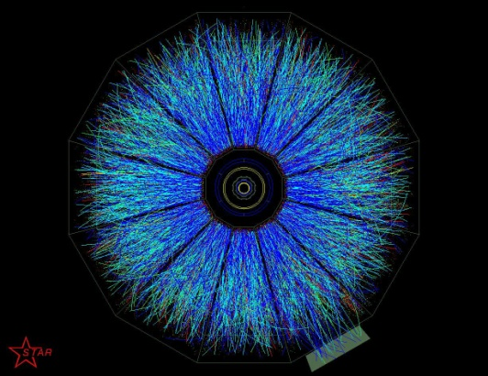
Research at the Relativistic Heavy Ion Collider
Capabilities:
Relativistic Heavy Ion Collider at BNL
RHIC completed in 1999; first physics in 2000
Serves an international community of ~1200
Colliding beams: Gold (to 100 GeV/nucleon)
Protons (to 250 GeV)
EBIS begins commissioning 2010
Scientific Mission:
Study hot, dense Nuclear Matter
- Search for Quark-Gluon Plasma
Study gluon content of proton
- Origin of the spin of the proton
using polarized proton beams

Slide 13
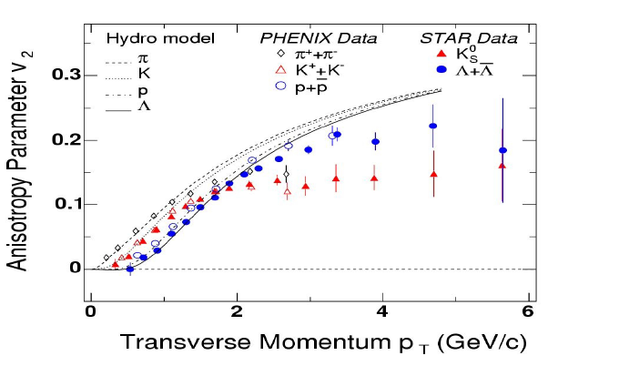
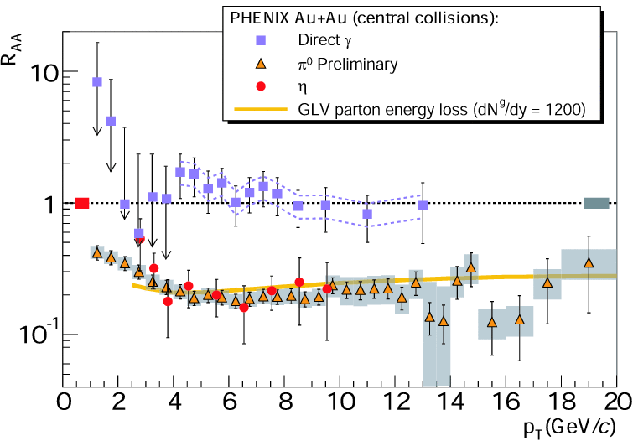
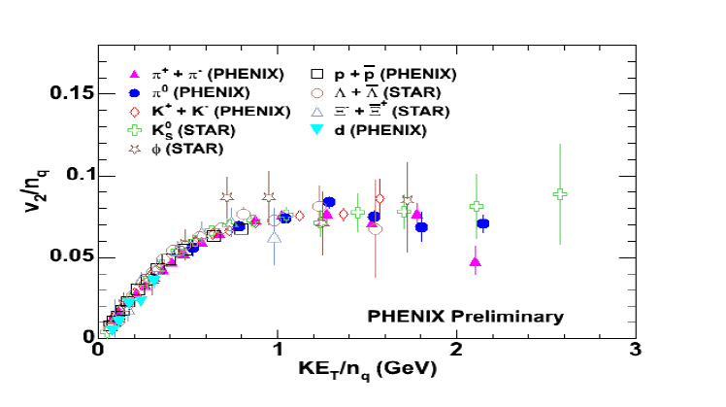
Evidence at RHIC for a Strongly Interacting Quark-Gluon Plasma - “sQGP”
Good agreement of hydro computations with radial and elliptic flow data
Very large energy loss of jets
The evidence is strong that one has made a system of strongly interacting quarks and gluons – sQGP
Many unknowns, e.g. viscosity effects - computation is a theoretical challenge
Quark Coalescence models reproduce elliptic flow data

Slide 14
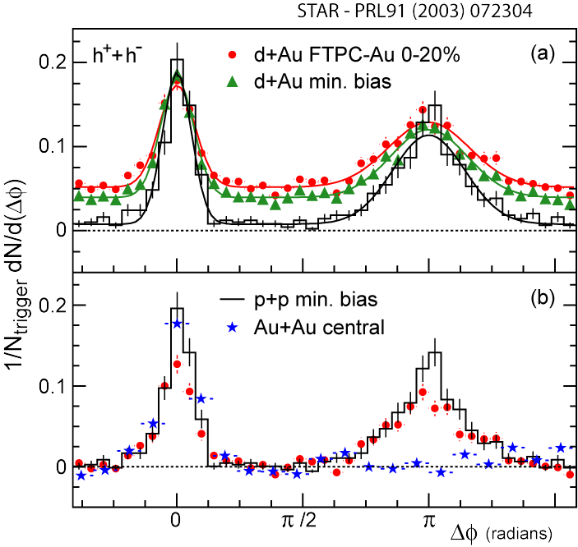
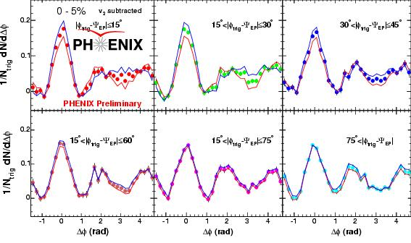
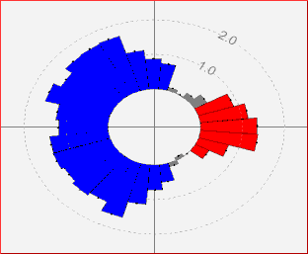
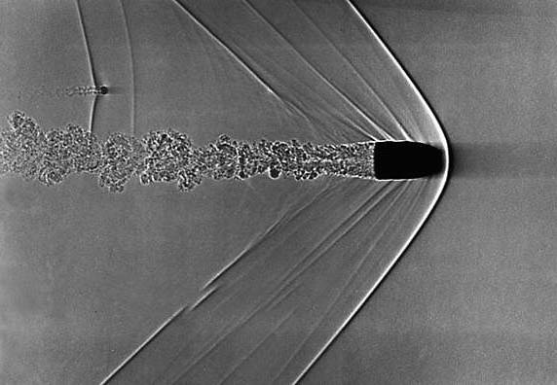
Jet Suppression Studies at RHIC
J. Jia (PHENIX), nucl-ex/0510019.
Hint of stronger double-peak structure out-of-plane than in-plane Mach Cones in Plasma?
Near-side jet unchanged
Away-side nearly disappeared -consistent with “surface emission”
d+Au ~ p+p: final state effect
near-side
trigger
near
Mach cone
versus
Medium
away
deflected jets
away-side jet axis
Mach Cone

Slide 15
Nuclear Physics at the LHC
In 2002, the Nuclear Science Advisory Committee Long Range Plan provided an outlook on new domains of science to be explored, that included the LHC:
In 2004, the NSAC subcommittee reviewed the U.S. Program in Heavy-Ion Physics, noting “the LHC will open up a new regime in relativistic heavy-ion physics with significant opportunities for discoveries” and recommended that:
Participation at the LHC should become a new component of the U.S. Heavy Ion program;
This participation should receive comparable investment priority with each of the two near-term upgrade programs for the large RHIC detectors.
The science of high energy density physics (HEDP) was also highlighted in the NRC report Connecting Quarks with the Cosmos, and the interagency response to this report, which identified HEDP as the most effective way to address one of the eleven compelling science questions: What Are the New States of Matter at Exceedingly High Density and Temperature?
“It would be wise to make a modest investment… so that some U.S. participation is possible. This program should focus on those aspects of relativistic heavy ions not easily addressed at RHIC”.

Slide 16
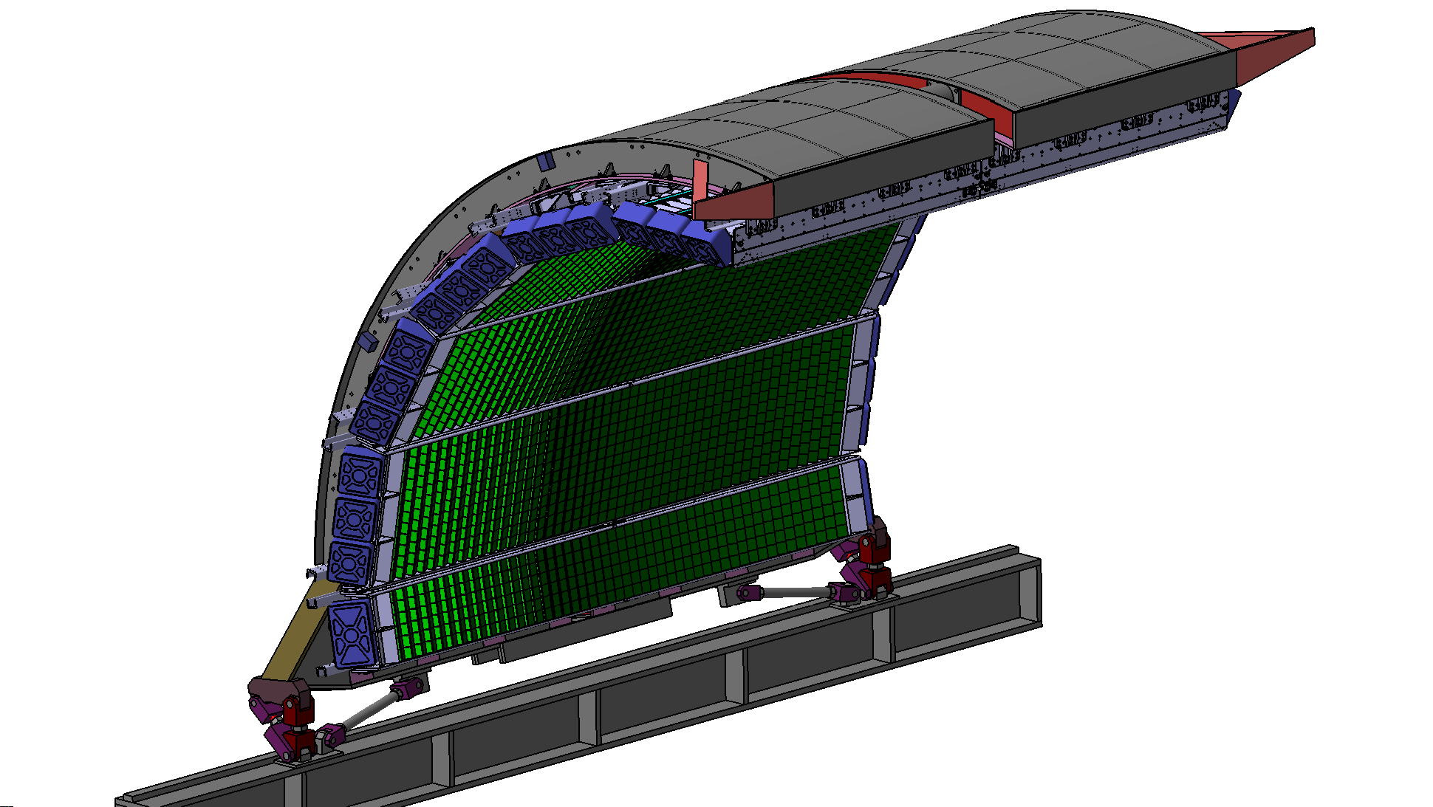
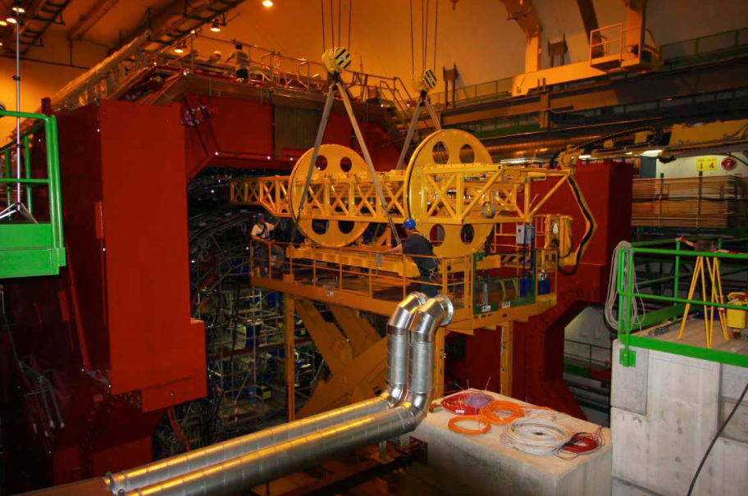
An Electromagnetic Calorimeter for ALICE – A Large Ion Collider Experiment
ALICE/EMCal
DOE TPC: $13.5 Million
FY 2007-FY 2011
CD-2/3 in February 2008
LHC - world’s highest energy facility for particle physics;
heavy ion studies @ ~4 wks/yr
Electromagnetic calorimeter (EMCal) for the ALICE
experiment is a major investment for Nuclear Physics
Joint U.S., French, and Italian project
Project Deliverables:
Seven EMCal supermodules
Three are contributed by European collaborators
Status:
All EMCal supermodules are fabricated
Four supermodules are installed for the present run
EMCal
Insertion of supermodule

Slide 17
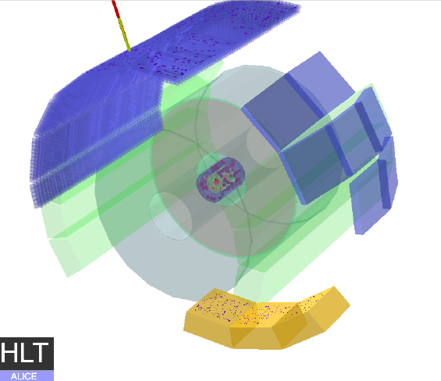
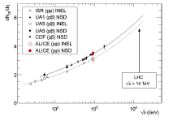
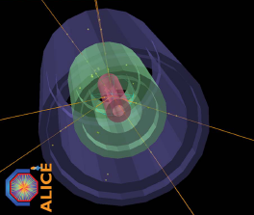
Research with the EMCal and ALICE
Scientific Research with the ALICE EMCal
Triggering on high p_{T} π₀, gammas and electrons to study jet quenching through leading particles
Hard processes modified by the nuclear medium
Jet correlations and jet reconstruction
ALICE-USA Research Collaboration
Seven Universities and three National Laboratories
About 34 PhD scientists
Computing for ALICE
NERSC/PDSF at LBNL; cluster at LLNL
ALICE Event from first LHC Beams
First proton--proton collisions at the LHC as observed with the ALICE detector: measurement of the charged particle pseudo-rapidity density at 900 GeV. Euro. Phys. Jour. C 65, 111 (Jan 2010).

Slide 18
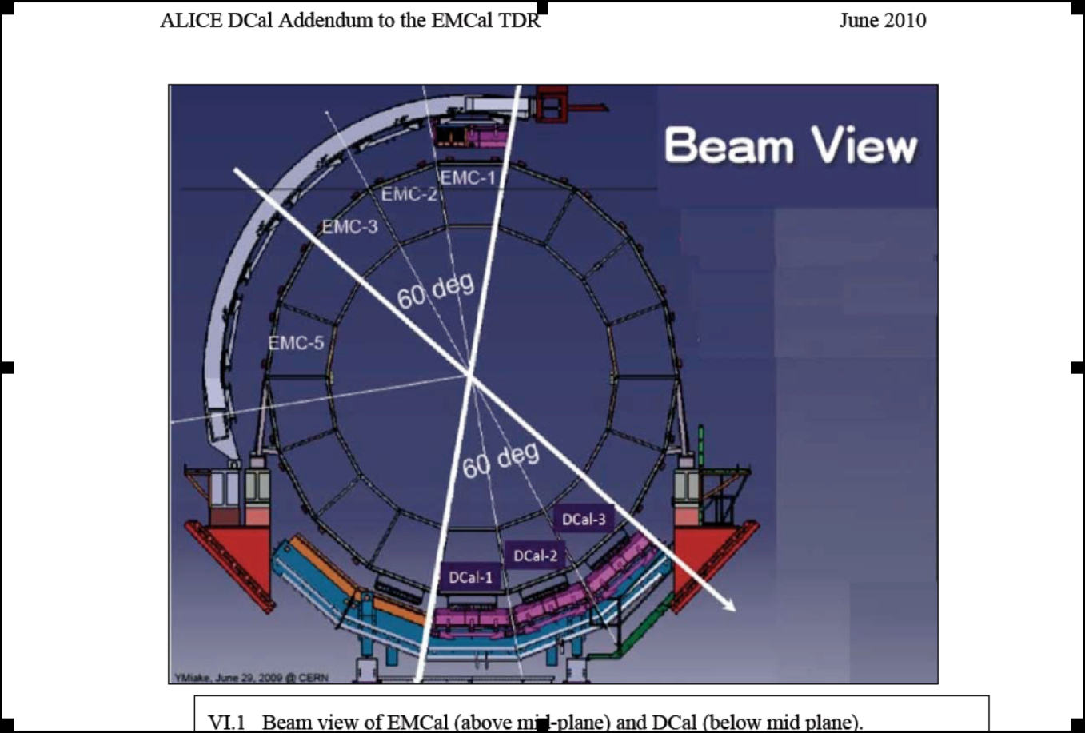
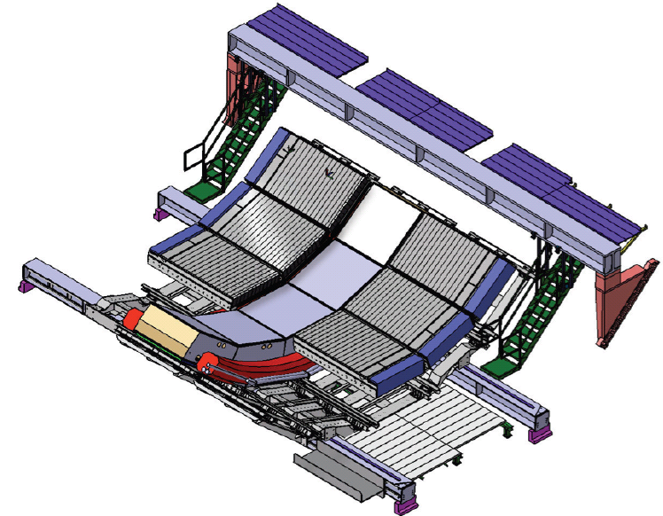
Di-jet Calorimeter (DCal)
Extension to the EMCal
ALICE Di-Jet Calorimeter (DCal)
Extends acceptance of the EMCal
Enables hadron-jet and di-jet correlations
Builds on EMCal technology
Six supermodules with reduced length are planned
US contributes three supermodules
Together EMCal and DCal form a two-arm spectrometer
DCal Collaboration
  France, Italy, US, China, and Japan
DCal Concept

Slide 19
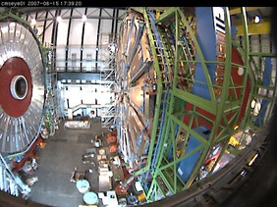
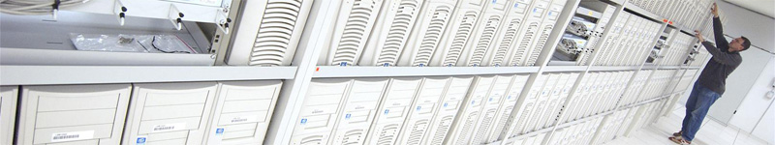
The Compact Muon Solenoid (CMS) Experiment
Heavy Ion Research with the Compact Muon Solenoid
Initial conditions in heavy-ion collisions--the role of the color glass condensate (CGC)
Properties of the near-ideal liquid produced in heavy-ion collisions and its evolution from the initial conditions
Mechanism of jet quenching using highly differential probes
NP Investment in High Level Trigger Computing
Collaboration
MIT is the lead institution
Six Universities and one National Laboratory
About 20 PhDs
Computing
Tier-2 computing center at Vanderbilt University
Simulation cluster at MIT
CMS

Slide 20
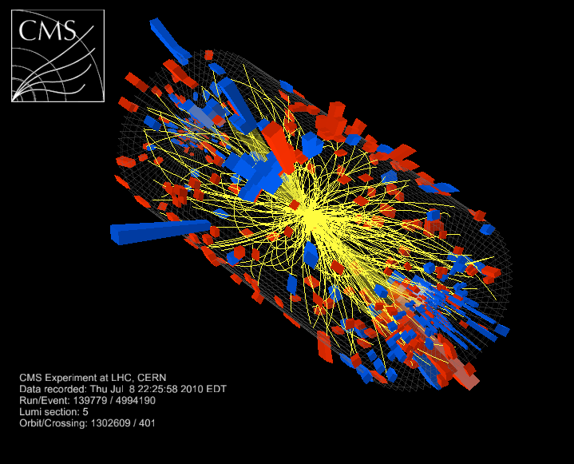
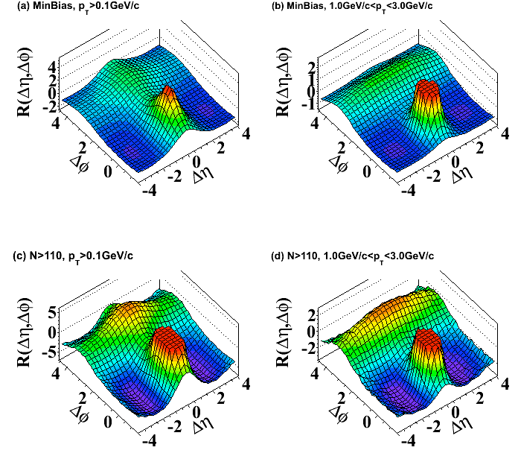
Long-Range Near-Side Angular Correlations in Proton-Proton Interactions in CMS
The CMS Collaboration Results on two-particle angular correlations for charged particles emitted in proton-proton collisions at center of mass energies of 0.9, 2.36 and 7TeV over a broad range of pseudorapidity (η) and azimuthal angle (φ) are presented using data collected with the CMS detector at the LHC. Short-range correlations in ∆η, which are studied in minimum bias events, are characterized using a simple independent cluster parameterization in order to quantify their strength (cluster size) and their extent in η (cluster decay width). Long-range azimuthal correlations are studied more differentially as a function of charged particle multiplicity and particle transverse momentum using a 980nb−1 data set at 7TeV. In high multiplicity events, a pronounced structure emerges in the two-dimensional correlation function for particles in intermediate pT’s of 1-3GeV/c, 2.0< |∆η|<4.8 and ∆φ≈0. This is the ﬁrst observation of such a ridge-like feature in two-particle correlation functions in pp or p-pbar collisions.

