Slide 1
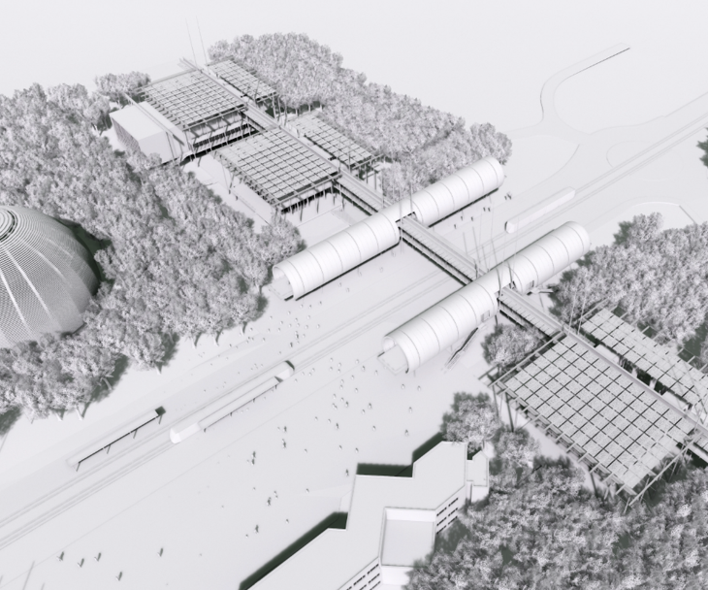
Discover CERN

Slide 2
Discover CERN
83/1-001

Slide 3
Discover CERN: Accelerate

Slide 4
Discover CERN: Accelerate
ELISA

Slide 5
Discover CERN: Accelerate
ELISA

Slide 6
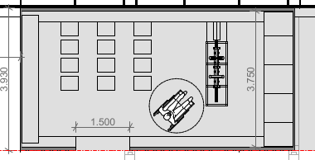
5.500
Visitors
3,75 m
Person giving the demo
7,5 m

