Slide 1
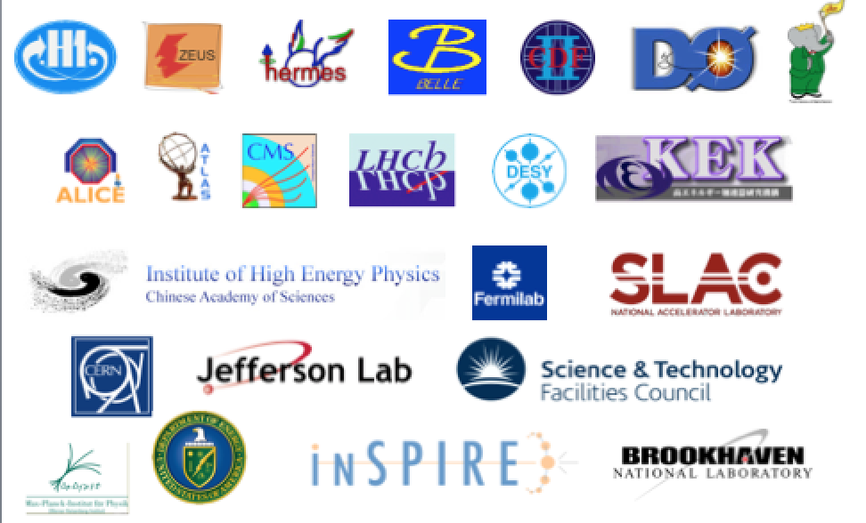



Data Preservation in High Energy Physics
3rd DPHEP Workshop
Cristinel DIACONU
CPPM/CNRS/Aix-Marseille University
http://dphep.org

Slide 2
DPHEP timelines
2018 status
Year | 2007 | 2008 | 2009 | 2010 | 2011 | 2012 | 2013 | 2014 | 2015 | 2016 | 2017
HEP | HERA stops | Babar stops | LHC starts | Belle I stops | Tevatron stops |  |  |  | LHC Run 2
DPHEP Group |  |  | ICFA Panel |  | LHC exp. joined | DPHEP Manger appointed at CERN |  | DPHEP Collaboration Agreements signed | 1st DPHEP Collaboration Meeting |  | 2nd DPHEP Collaboration Meeting
DPHEP Docs |  |  | DPHEP White Paper |  |  | Blueprint Report |  |  | DPHEP Status Report 2020 Vision |  | DPHEP 2017 Status Report
DP Projects within expts. |  | Babar DP starts |  | HERA DP starts | BELLE DP starts | CMS DP Policy CDF/D0 DP starts Babar LTDAP operational | ALICE, LHCb, DP Policies | ATLAS DP Policy H1/ZEUS DP systems operational | CERN/LHC Open Data | CERN/LHC Analysis Preservation Tevatron DP operational
Start-up
Consolidation
DPHEP Collaboration

Slide 3
2009: Study Group
The DPHEP study group identified the following priorities, in order of urgency:
Priority 1: Experiment Level Projects in Data Preservation. Large laboratories should define and establish data preservation projects in order to avoid catastrophic loss of data once major collaborations come to an end. The recent expertise gained during the last three years indicate that an extension of the computing effort within experiments with a person-power of the order of 2-3 FTEs leads to a significant improvement in the ability to move to a long-term data preservation phase. Such initiatives exist already or are being defined in the participating laboratories and are followed attentively by the study group.
Priority 2: International Organisation DPHEP. The efforts are best exploited by a common organisation at the international level. The installation of this body, to be based on the existing ICFA study group, requires a Project Manager (1 FTE) to be employed as soon as possible. The effort is a joint request of the study group and could be assumed by rotation among the participating laboratories.
Priority 3: Common R&D projects. Common requirements on data preservation are likely to evolve into inter-experimental R&D projects (three concrete examples are given above, each involving 1-2 dedicated FTE, across several laboratories). The projects will optimise the development effort and have the potential to improve the degree of standardisation in HEP computing in the longer term. Concrete requests will be formulated in common by the experiments to the funding agencies and the activity of these projects will be steered by the DPHEP organisation.
These priorities could be enacted with a funding model implying synergies from the three regions (Europe, America, Asia) and strong connections with laboratories hosting the data samples.

Slide 4
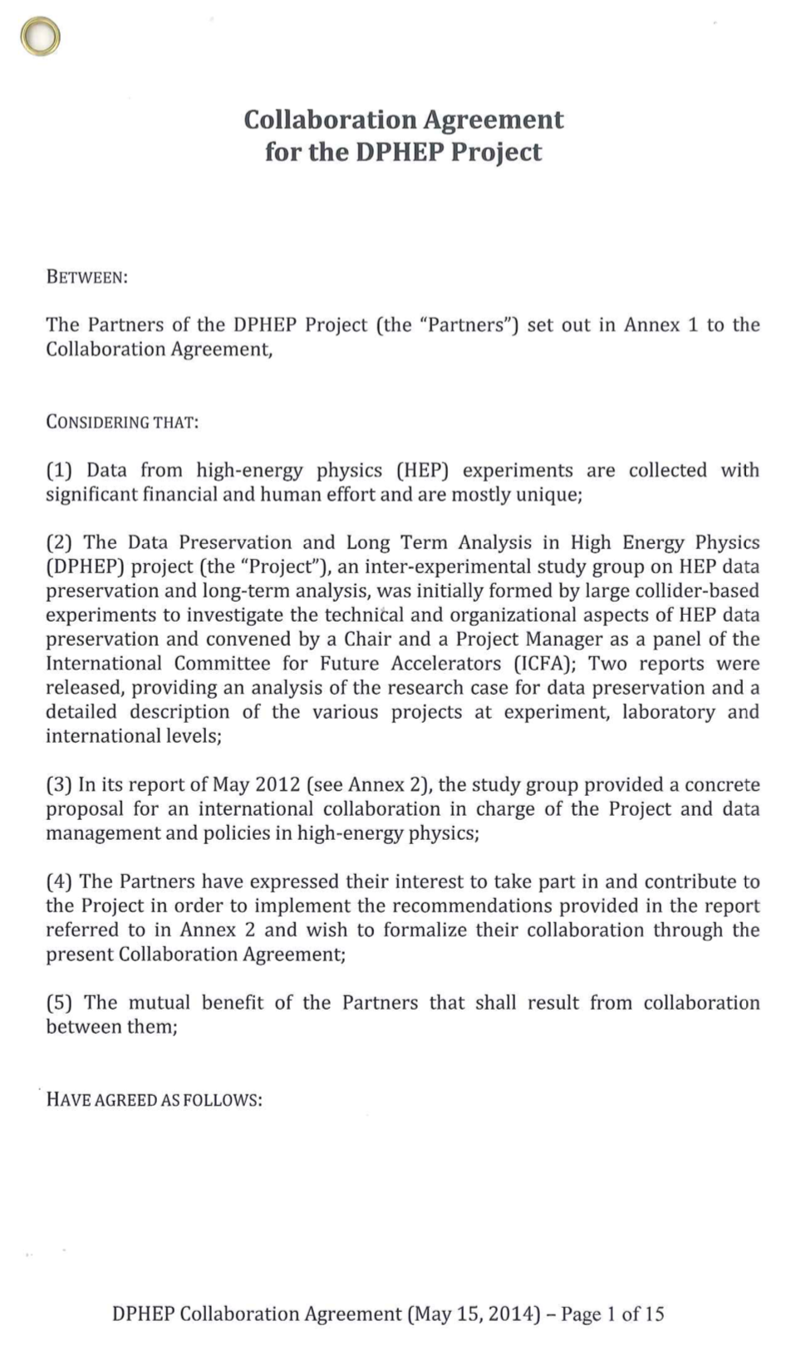
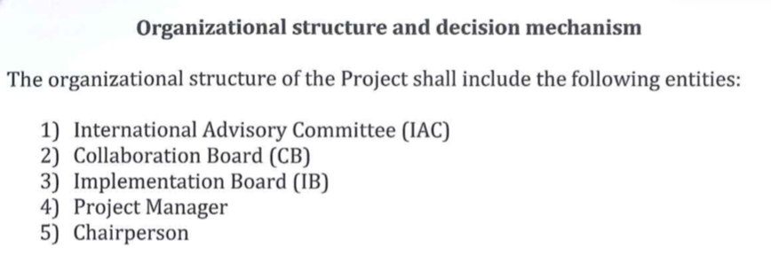
The DPHEP Collaboration
Collaboration Agreement was signed in 2014
  Give a clear sign of the will of labs to collaborate in this common challenge
Members:
  2014: CERN, DESY, HIP, IHEP, IN2P3, KEK, MPP
    2015 IPP/Canada , 2017 UK/STFC
  Active labs from US, Italy
    have not formally joined, but are represented in the Collaboration Board.
The DPHEP collaboration continue to act as an ICFA panel, as indicated in the Collaboration Agreement
  About 60 contact persons FA, Labs, experiments
DPHEP Activity
  Global reports 2009(whitepaper), 2012 (blueprint), 2015, 2017 (global reports)
  Collaboration meetings: 2015, 2017
  Remote panel discussion March 2nd 2021
  Report to ICFA Marc 12, 2021

Slide 5

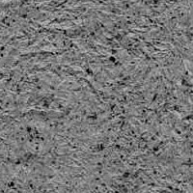
Scientific output from preserved data
Source: web site
Source: web site
DP system
DP system
Source: web site/inspire
LEP
Source: inspirehep.net
R2DP/CDFDP

Slide 6
Situation and trends
Significant/measurable impact of dedicated DP projects @expts./labs
  Production of high quality and unique scientific results at very low (non-zero) cost
    10% output for less than 1% investment: ✓
  Signs of re-vigorating collaborations in the context of new projects
    HERA-EIC; LEP-FCCee
  Case for longer term preservation: data sets parking
    CDF, D0, Babar, LEP, Jade : carefully follow the usability in time
LHC exps. very active in DP and strongly linked to Open Data/Science:
The (DP)HEP future is also considered
  FCC, EIC : transfer of knowledge in DP from LHC/oldies
And more is possible on:
  Education, training, outreach….
    open data projects are an opportunity to reinforce these aspects as well
The panel expresses the need to keep the issue highly visible on the community’s agenda
  ensure an adequate level of endorsement from FA/Labs/Experiments

Slide 7
The DPHEP 2020 Vision
The “vision” for DPHEP – first presented to ICFA in February 2013 – a consists of the following key points:
  By 2020, all archived data – e.g. that described in DPHEP Blueprint, including LHC data – should be easily findable and fully usable by the designated communities with clear (Open) access policies and possibilities to annotate further
  Best practices, tools and services should be well run-in, fully documented and sustainable; built in common with other disciplines, based on standards
  There should be a DPHEP portal, through which data / tools accessed
  Clear targets & metrics to measure the above should be agreed between Funding Agencies, Service Providers and the Experiments (Collaborations).
  Although there is clearly much work still to be done, this vision looks both achievable and the timescale for realizing it has been significantly reduced through interactions with other (non-HEP) projects and communities.

Slide 8
Next steps: proposal presented to ICFA Meeting March 11, 2021
DPHEP as a collaboration
  CERN support needed: focal point of ongoing major experiments/computing standards
  Réinforce Laboratory and FA contacts
  DPHEP 3rd Workshop : july 2021
    Collaboration Board meeting, management evolutions needed
DPHEP as an ICFA panel:
  a mandate prolongation is considered as a very useful asset
DPHEP Panel Objectives for 2021-2024:
  improve the awareness and stimulate improvements on DP
    Scientific motivation, organisation, technologies, standards, outreach and education
    Organise Workshops / issue Global Reports, ensure the link to other communities
  reinforce and support the ongoing laboratory-based projects and their cooperation
    keep alive data sets that (can) still produce science, keep track on parked data sets
  support/develop the DP aspects for future experiments and encourage the ToK
  encourage open data and open science as a way to preserve data and knowledge
  The panel acts as a collaboration hosted at CERN. A Project Manager is appointed to support the Panel.
  The panel will present a plan of activities at the next Panel Review.

Slide 9
Workshop objectives
Provide an update on the changing (or changed) landscape, e.g. FAIR data management (plans), reproducibility, sustainability of data repositories, an update on the status of OAIS and related "standards" and so forth.
  Describe the "new world order" wrt "data stewardship / curation / preservation"
Status reports of the services and ongoing developments in the area of LTDP and their outlook
  Many of these are now are ramping-up as production services
Perform a site-experiment round-table to capture the current situation including common problems & solutions HEP-wide
Start the preparation of two documents:
  Letter to labs/executive summary
  DPHEP status report 2022 (update of 2012/2016 documents)

Slide 10
DPHEP Report 2021
Executive Summary (2 pages)
  Format of a letter to FA/ICFA
Introduction
Data Preservation landscape
  Scientific impact
  A perspective on methodologies and organisational approaches
Experiment/sites reports, DP Technologies and projects
    Workshop contributions + invited
The 202X vision
Timeline:
  Brainstorming for letter/executive summary Wed. afternoon
  Individual contributions by end July
  First draft by mid-september
  Final release October 2021

Slide 11
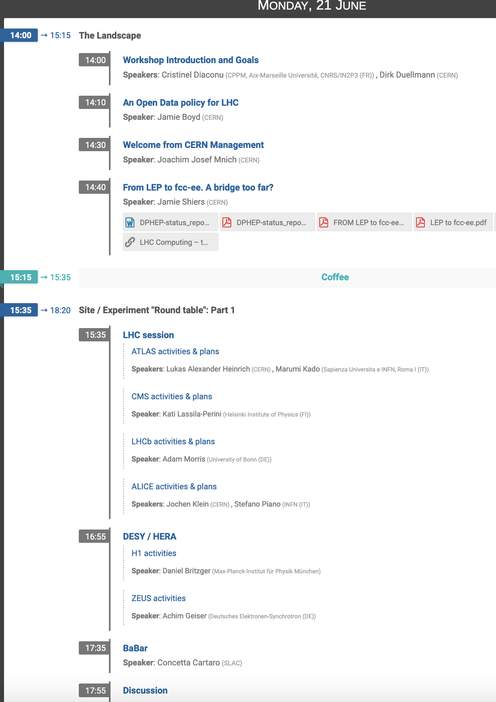
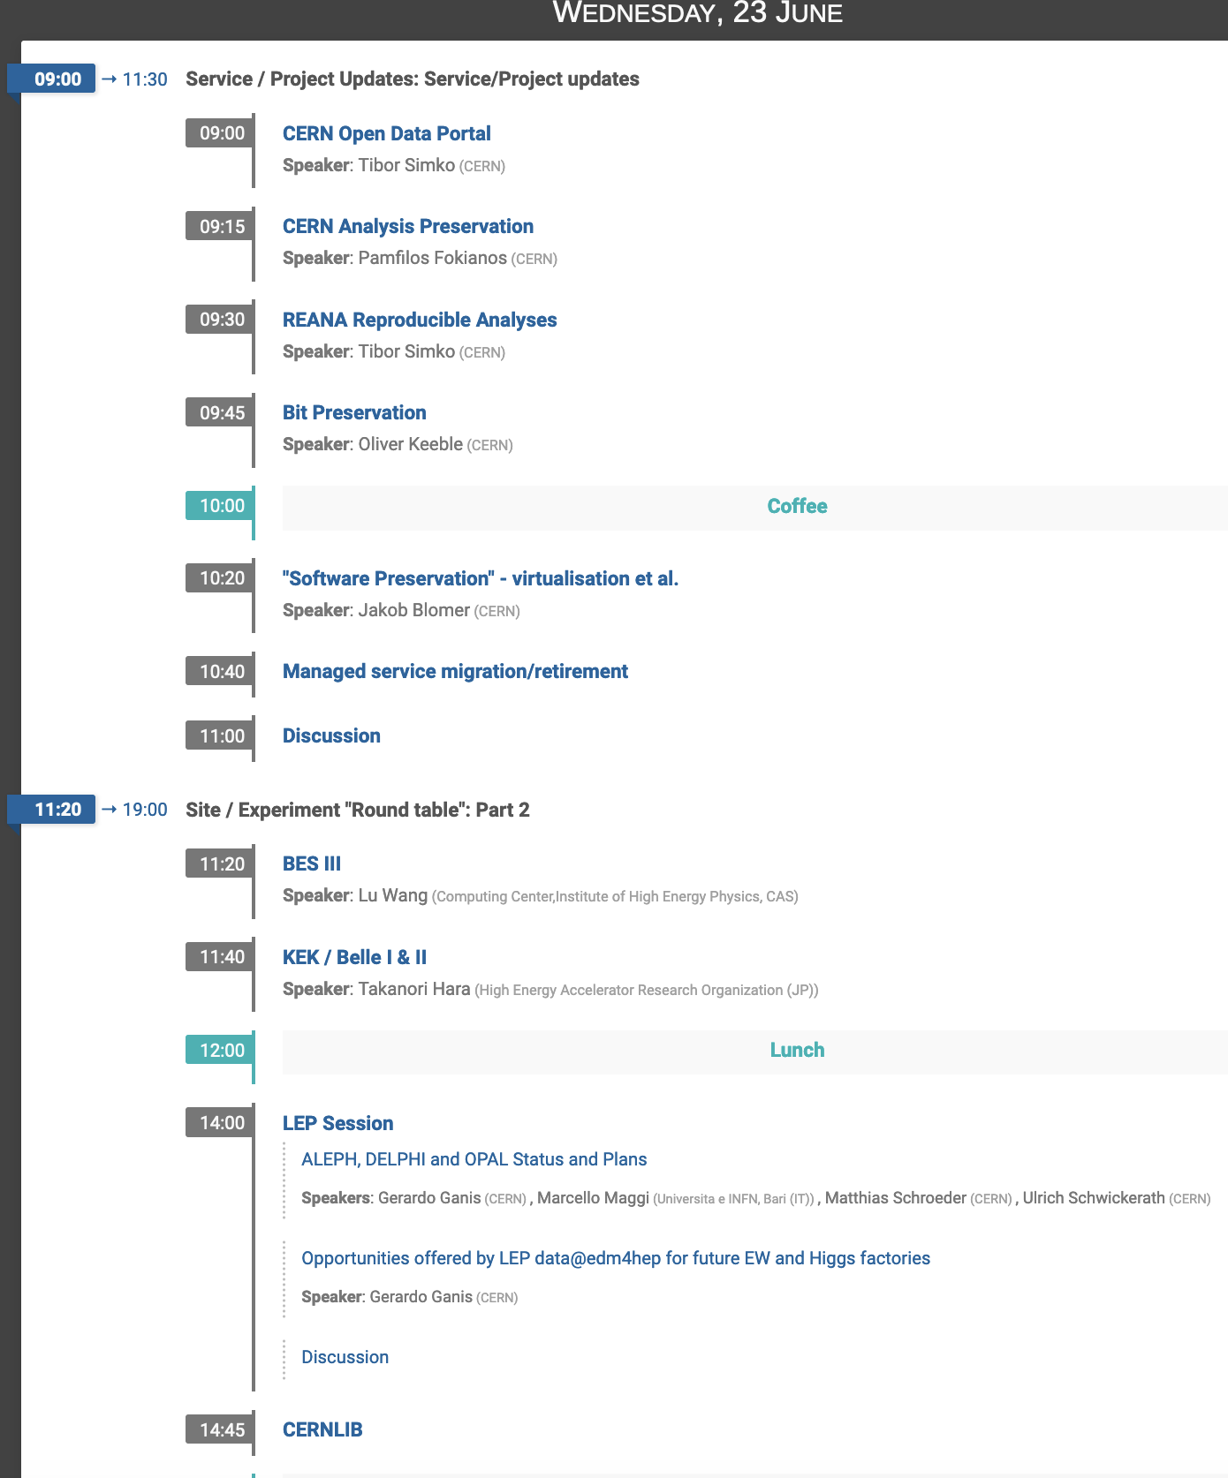
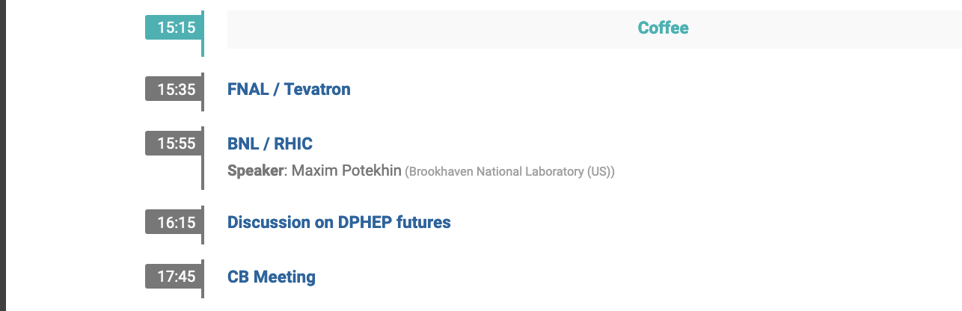

Slide 12
BACKUP

Slide 13
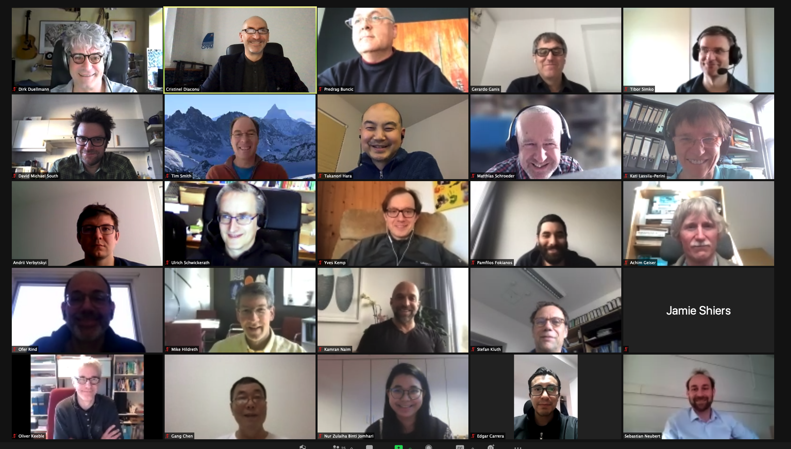
Panel remote discussion: March 2nd
CERN/IT
Me
CERN/EP
CERNVM/Key4HEP
CERN/opendata
DESY/H1
CERN/opendata
KEK/BELLE
OPAL
CMS
MPI/JADE
DESY/IT
CERN/SIS
DESY/ZEUS
CERN/IT DELPHI
BNL
MPI/Jade/Opal
Daspos/ N.Dame
CERN/openscience
CERN/IT/DPHEP
IHEP/BES
LHCb
CERN/IT
CERN/SIS/opendata
https://indico.cern.ch/event/1009487/

Slide 14
Data Preservation projects labs: recent update
@DESY: H1 (migration) and ZEUS (encapsulation) in great shape
  successful transitions to the DP systems, publication plans continues and includes O(10) papers
  objective: alive by 2030; New institutes joining (synergy with EIC)
@CERN: strong LHC activity, LEP data/sw refreshed, OD/OS standards/technologies, DPHEP portal
  Need for the continuation of the central management support
@MPI: multi-experiment framework explored (JADE, HERA, OPAL)
  JADE on a desktop
@KEK: BELLE I data readable in Belle II framework ;
  objective maintain Belle I data by 2023 (when the precision will be exceeded by the new data)
@IHEP/BES3: The experiment is expected to stop data taking by 2022
  Data to be preserved for 15 years
  Strong support to DP national and international activities expressed
@BNL/JLAB: DP activity ongoing (ATLAS, EIC), discussed with NPC
@Babar: LTDA supported analysis since 2012. SLAC support ended in February. Data almost entirely copied to CERN/GridKa.
  Data saved at CERN/GridKa: ~ 1.2 PB+ 0.5 PB ( ongoing), Minimal user infrastructure for ongoing analyses and documentation hosted at U. of Victoria.
@FNAL: (indirect news this time) transition to a DP system for both CDF (CDFDP) and D0 (R2DP)
  Data stored/saved @FNAL+Italy, 500th paper from D0 in 2021

Slide 15
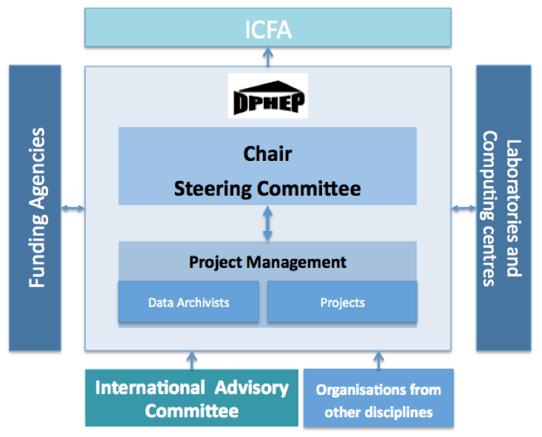
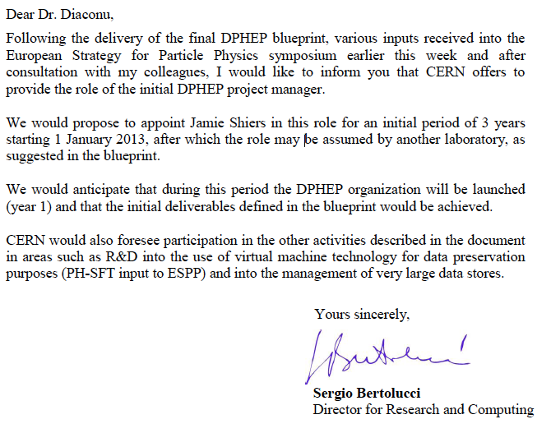
The DPHEP Collaboration
  October, 2012: CERN endorses the blueprint and appoints the DPHEP Project Manager (Jamie Shiers)
Retain the basic structure of the Study Group, with links to the host experiments, labs, funding agencies, ICFA
The collaboration agreements signed in 2013

Slide 16
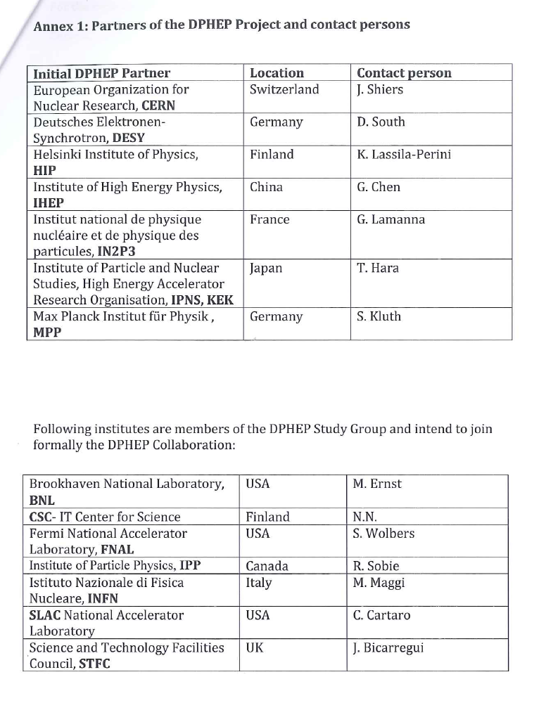
The DPHEP Collaboration
The DPHEP ICFA panel lead to a Collaboration officially started after the Collaboration Agreement was signed in 2014 by several large laboratories and funding agencies
  Give a clear sign of the will of all labs to co-operate and collaborate in this common challenge
Members:
  2014: CERN, DESY, HIP, IHEP, IN2P3, KEK, MPP
  2015: IOP
  US institutes, UK, Italy have not formally joined, but are represented in the Collaboration Board.
Retain the basic structure of the Study Group, with links to the host experiments, labs, funding agencies
The DPHEP collaboration continue to act as an ICFA panel, as indicated in the Collaboration Agreement.
2014
Joined 2015

Slide 17
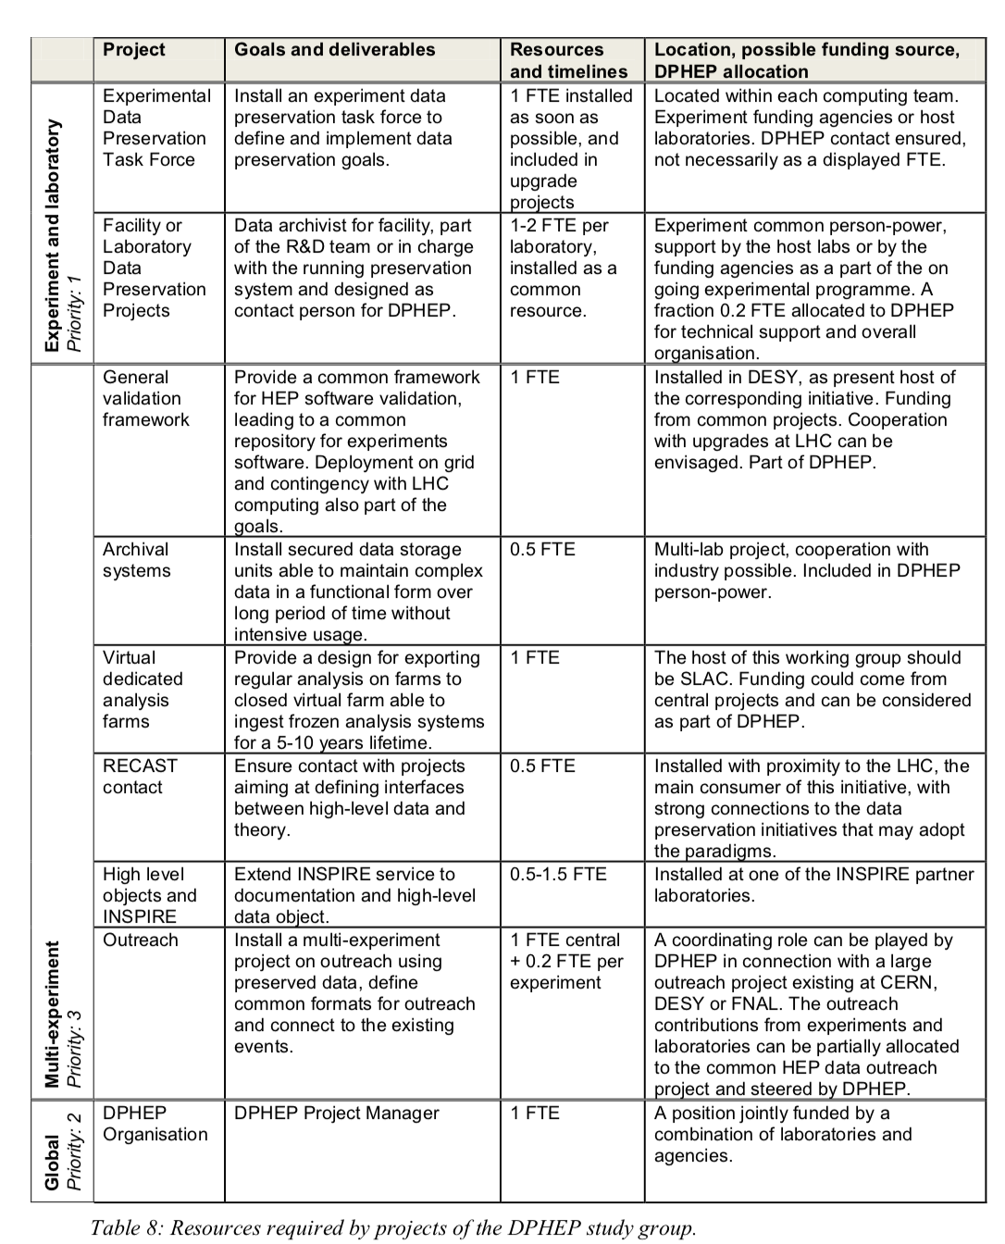
DPHEP ressources for DP
2012 Blueprint

Slide 18
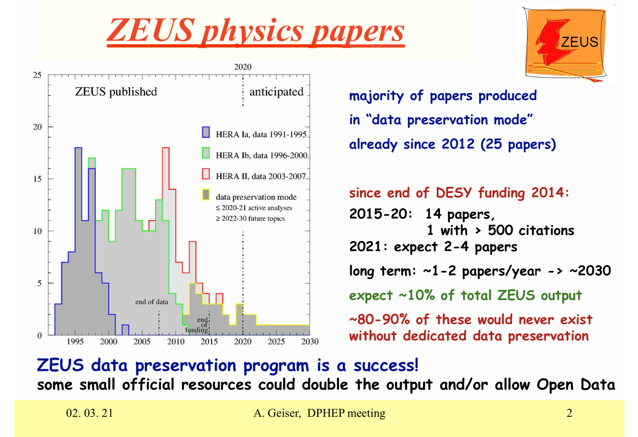
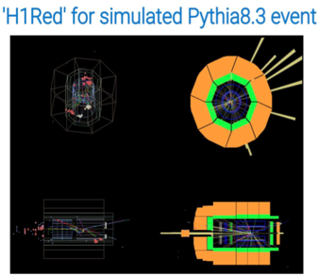
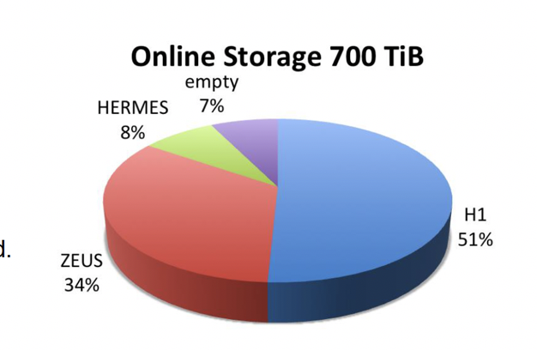
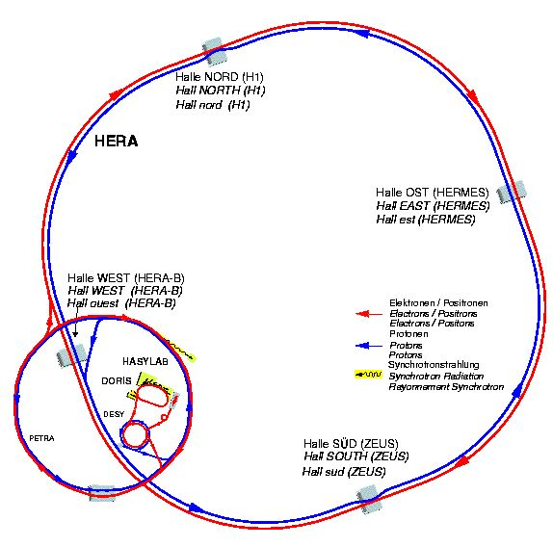
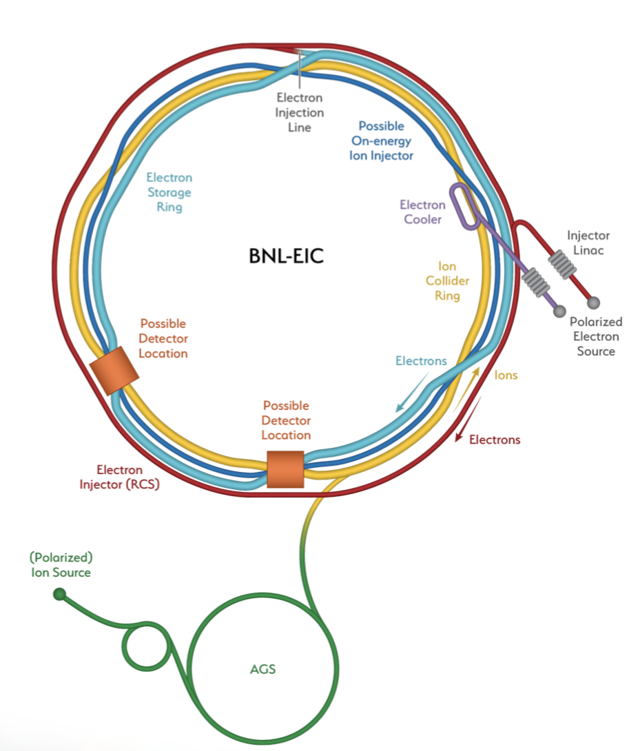
HERA: succesful DP, towards open data
H1: “Level 4” DPHEP strategy
  All data, full migration, including regular recompilation/validation
  Recent “technology jump” succesfull : in line with modern tools
    “LHC”-like tools, ready for opendata
ZEUS : “Level 2/3” DPHEP strategy
  Root ntuples produced in the preparatory phase
  easy to maintain/use/test/open
2030
HERA
EIC
  New topics/collaborators (EIC)

Slide 19
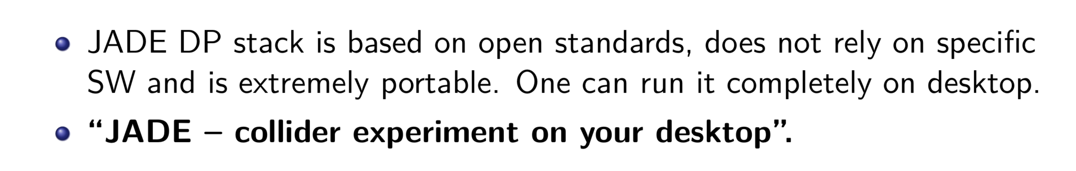
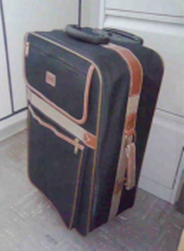
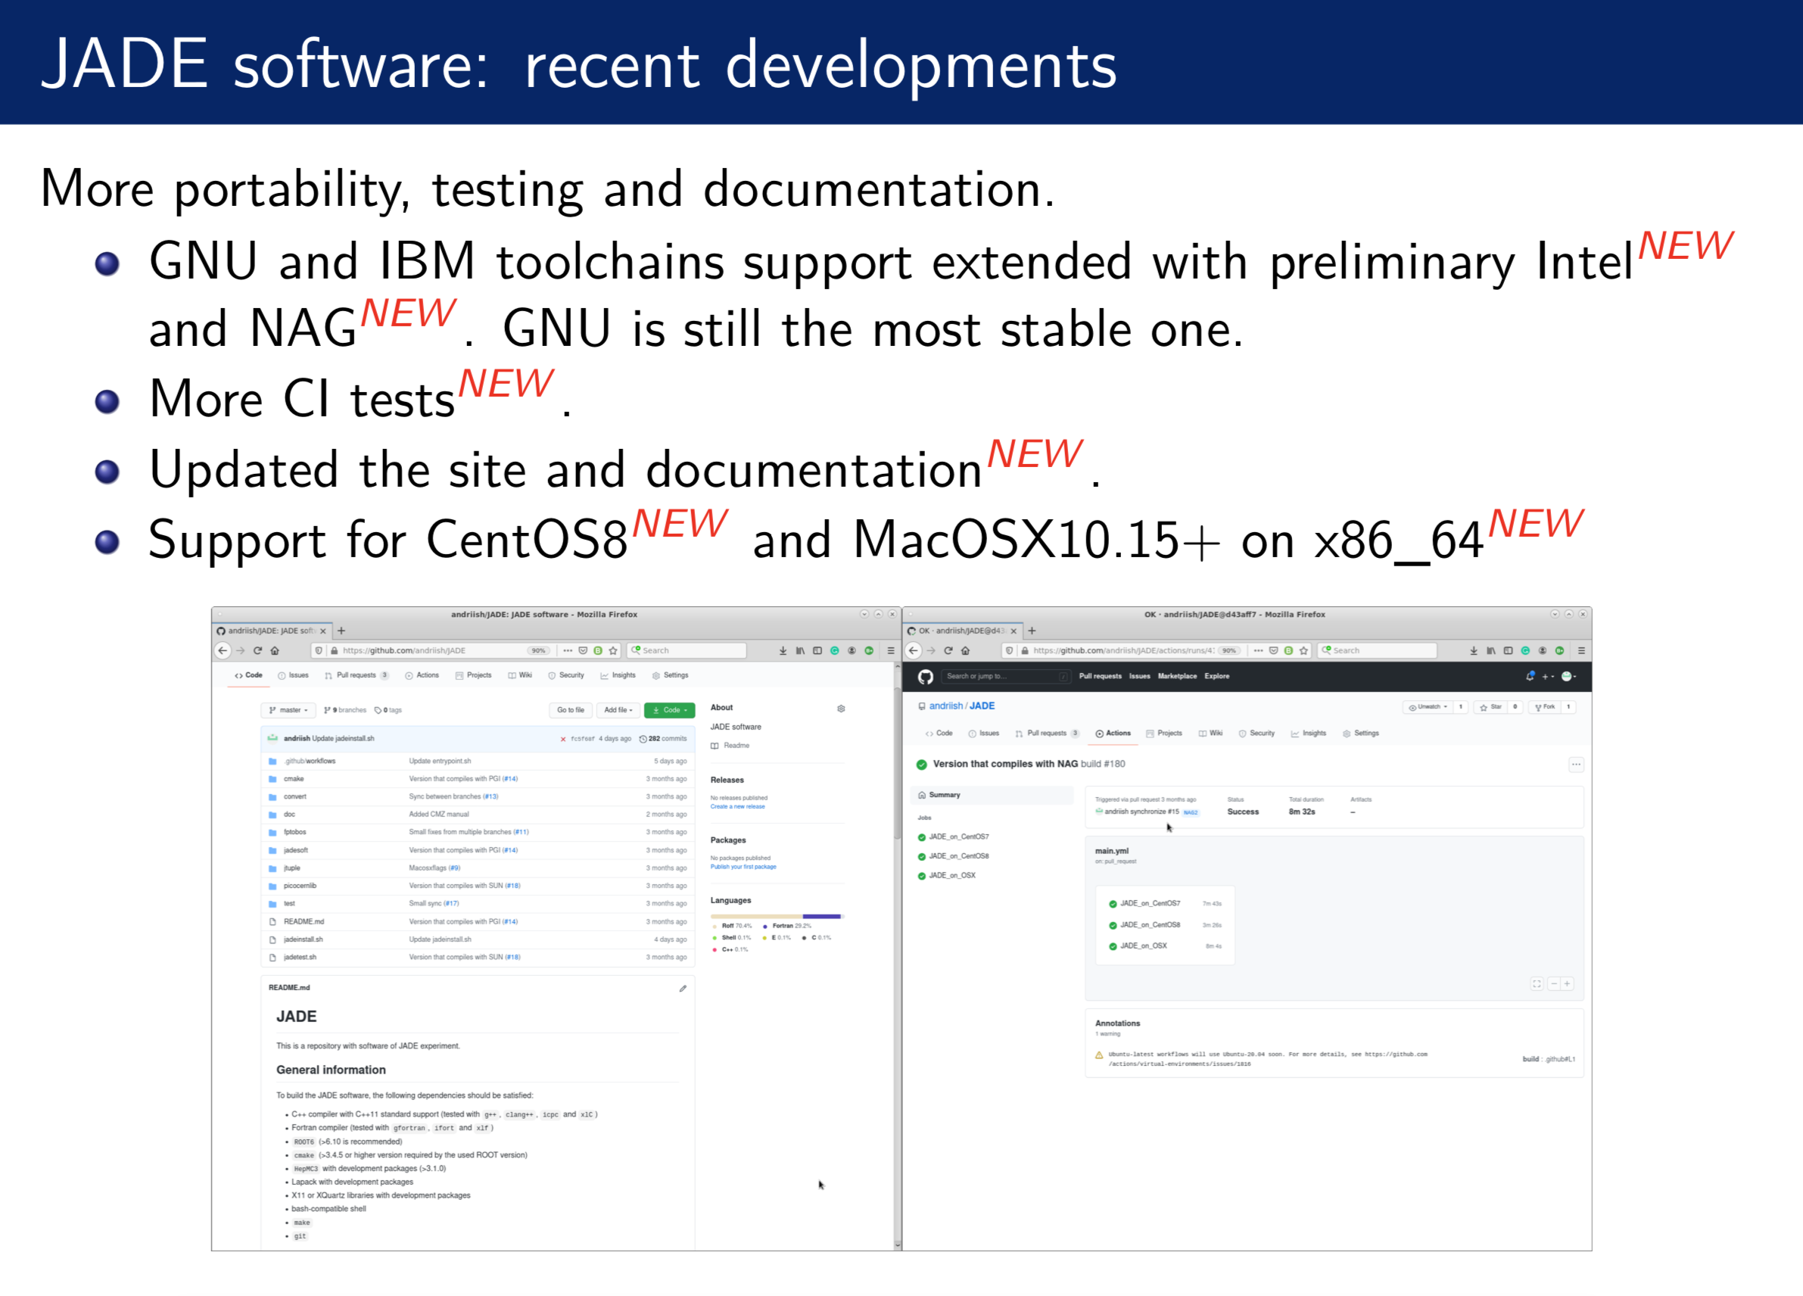
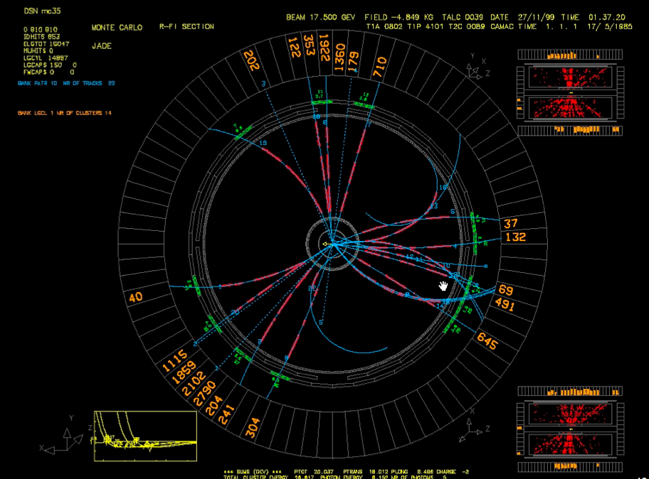
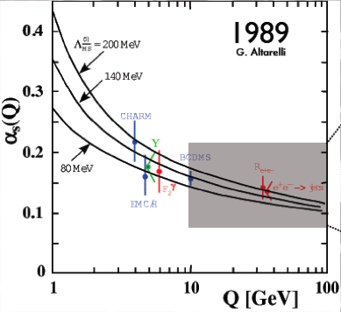
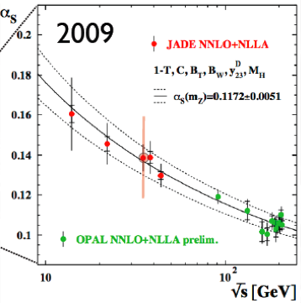
JADE
Data Preservation
model circa 1980-ies
2021

Slide 20
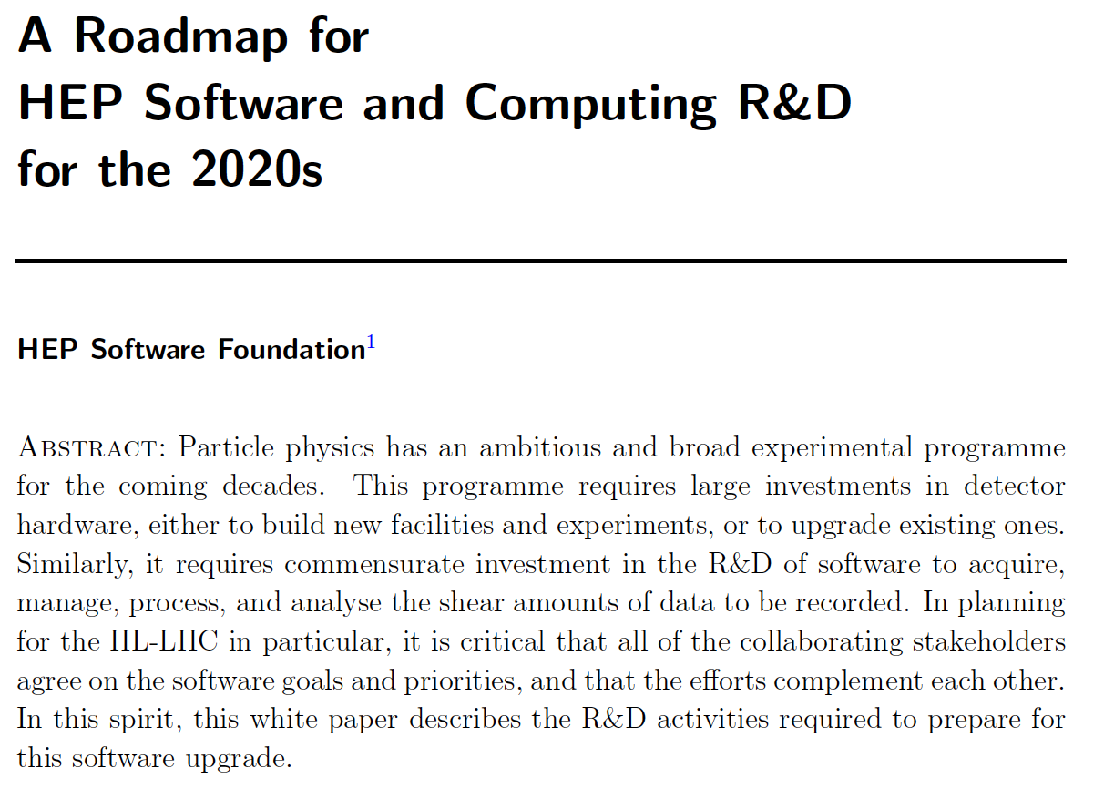
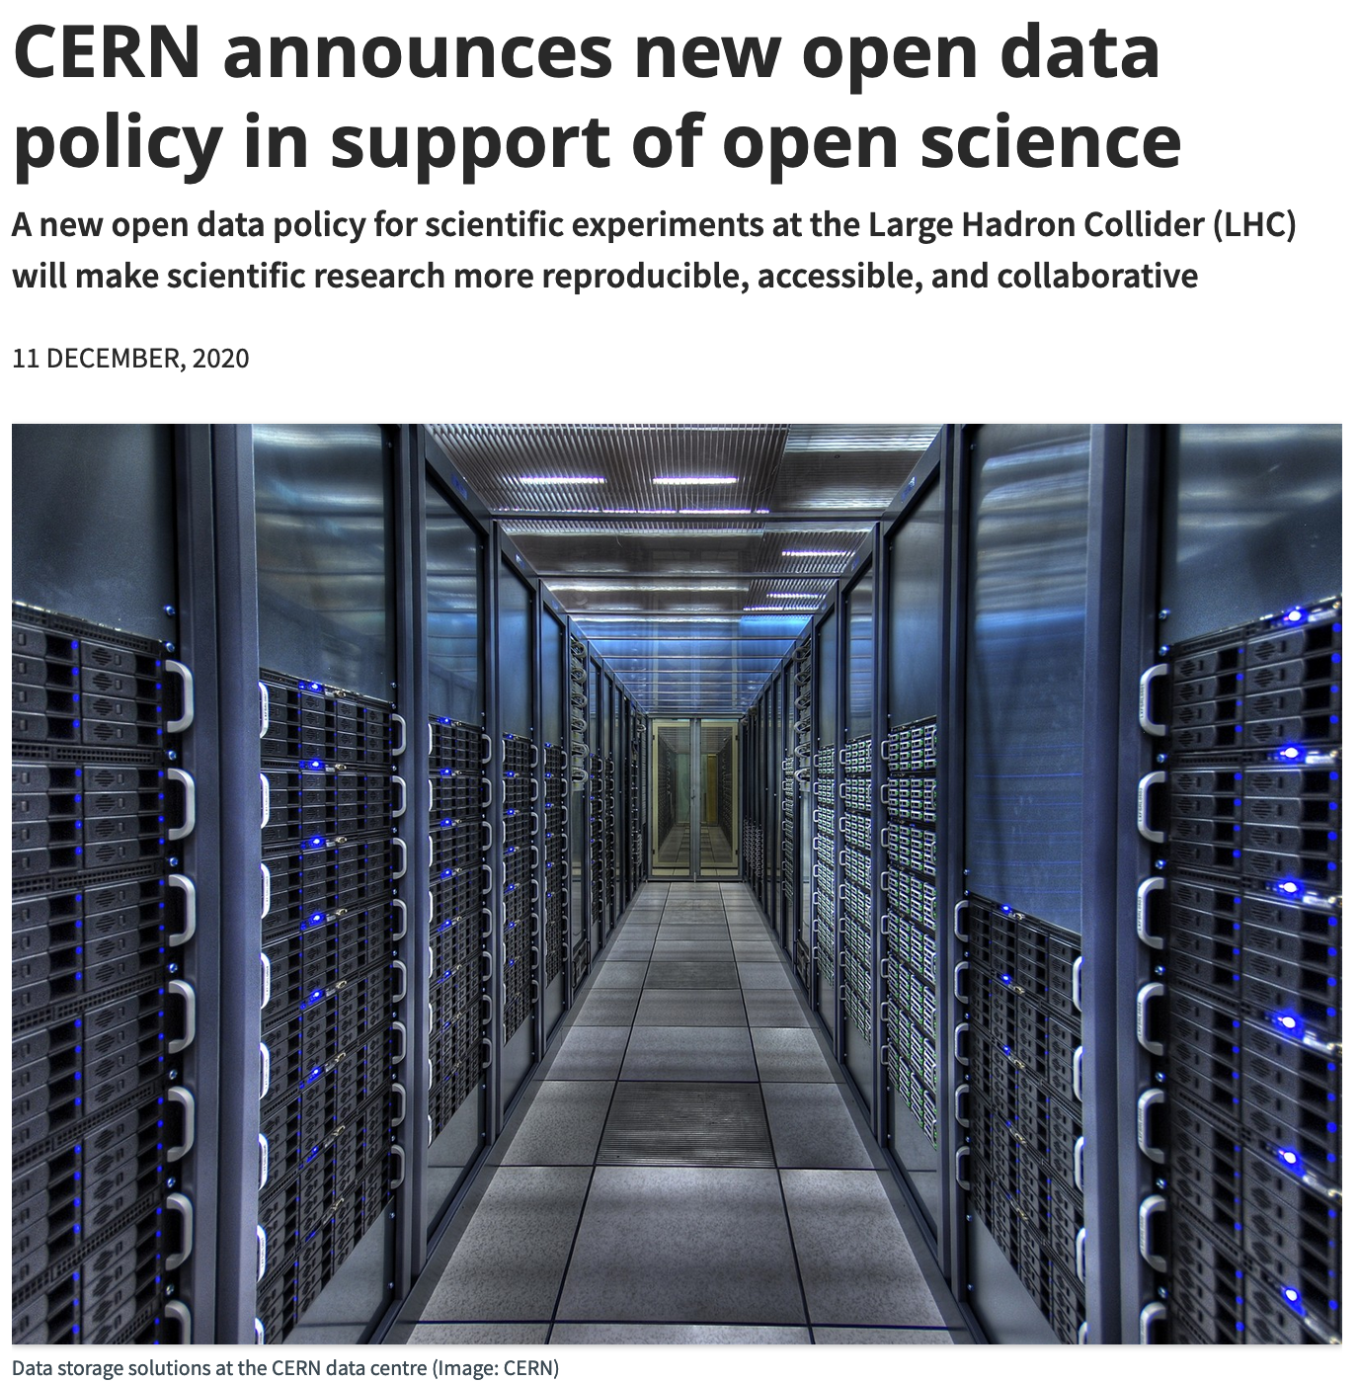
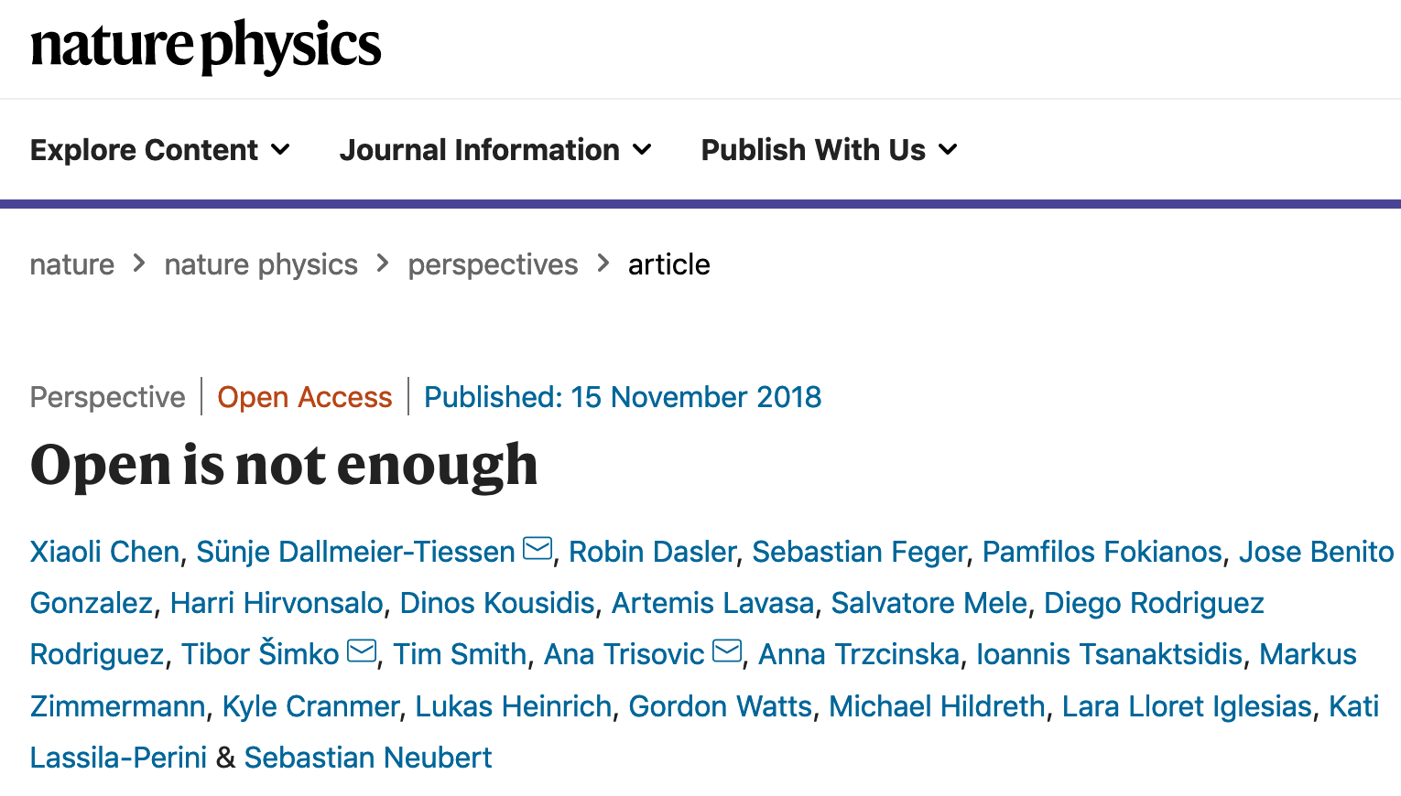
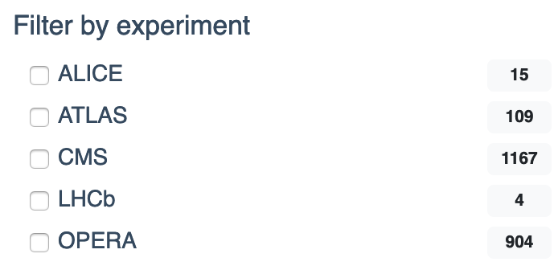
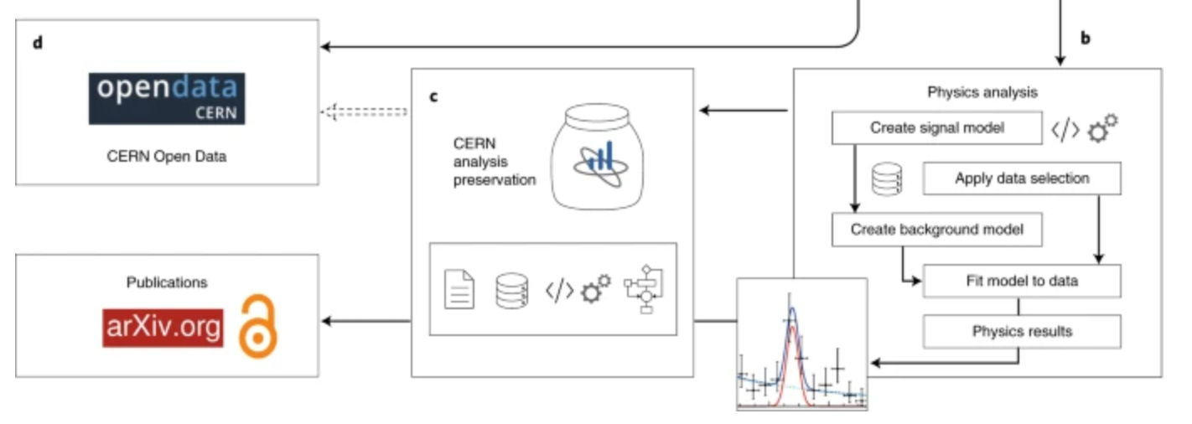
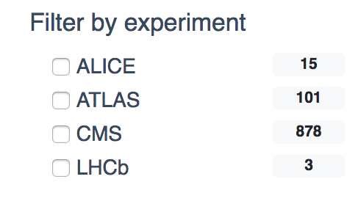

LHC Data Preservation
Data Preservation and Open Access policies (already since 2012-2014)
  DP is a « specification » included in the computing models and plans for upgrades
  HEP Software Foundation Roadmap
Strong initiative on Open Data and Open Science policy
Concrete implementation and technology-oriented survey
  Very active multi-experiment projects
  data re-use, réanalysis, réinterpretation, outreach etc.
    OpenData, Analysis Preservation, REANA…
arXiv:1712.06982
https://www.nature.com/articles/s41567-018-0342-2
2017
2021
Other experiments expressed clear intention to join : LEP, JADE, H1/ZEUS, BaBar (HR is an issue)

Slide 21
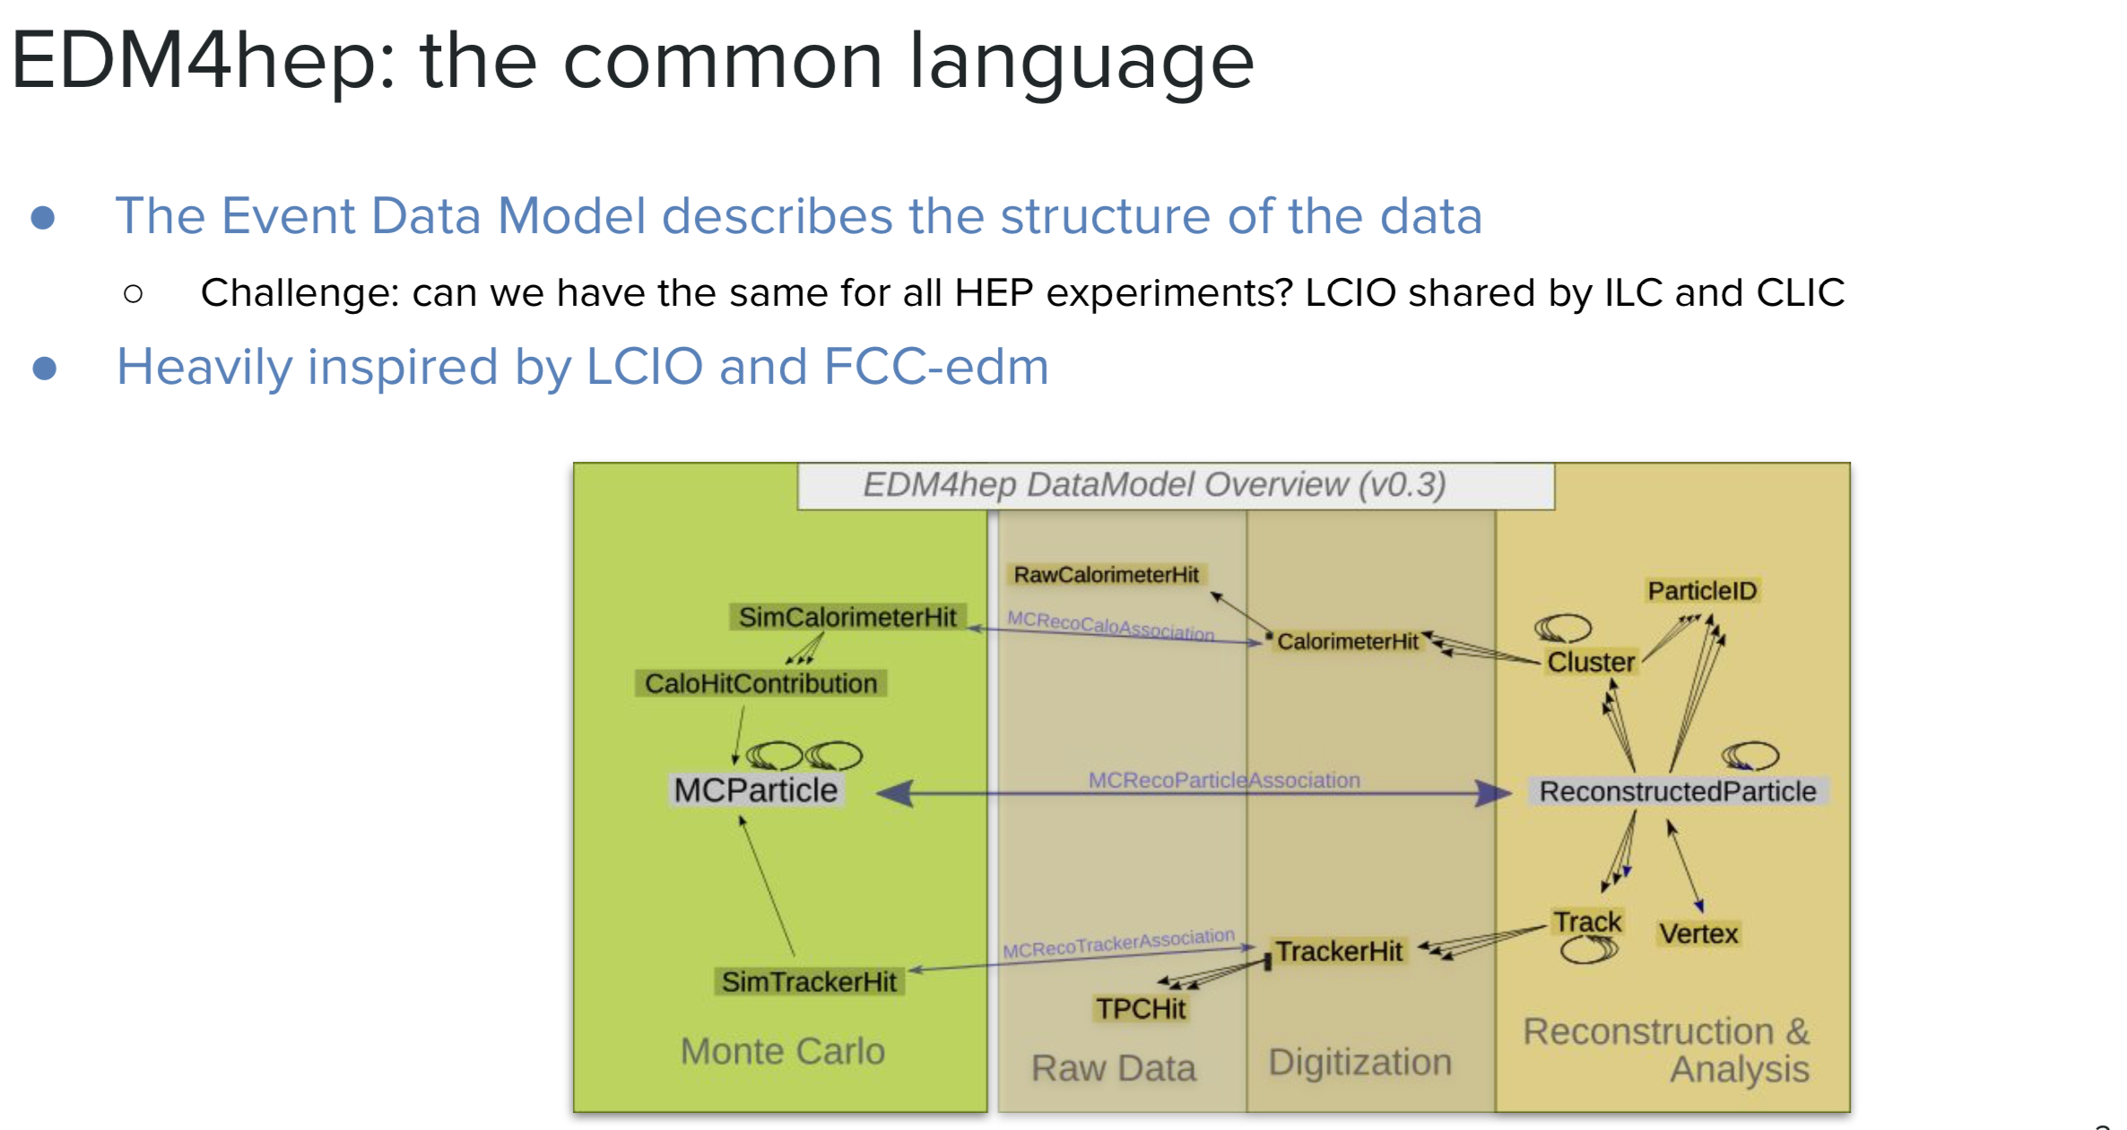
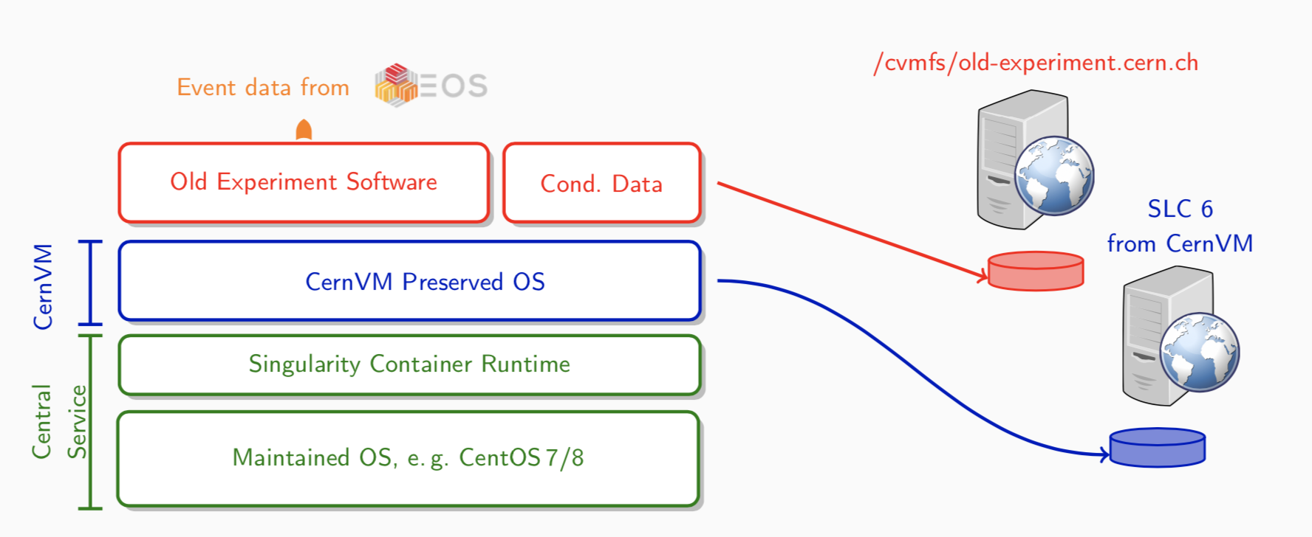
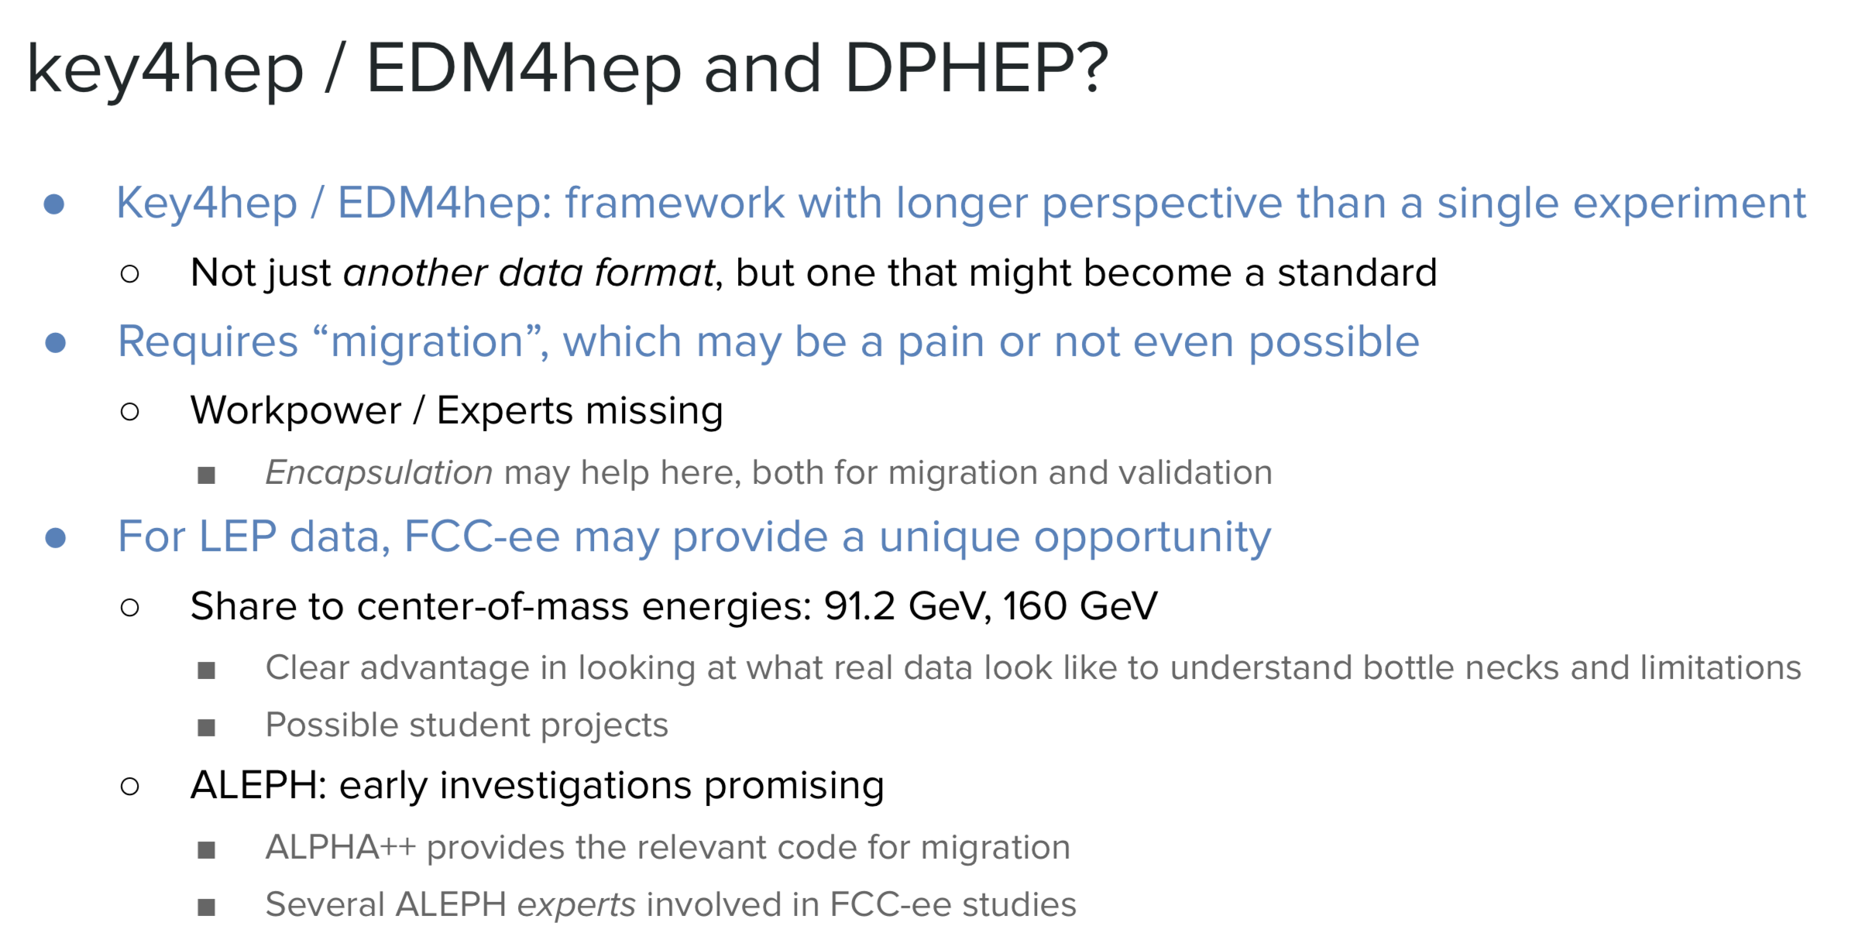
Towards more standards
CERNVM: the “freezer”

Slide 22
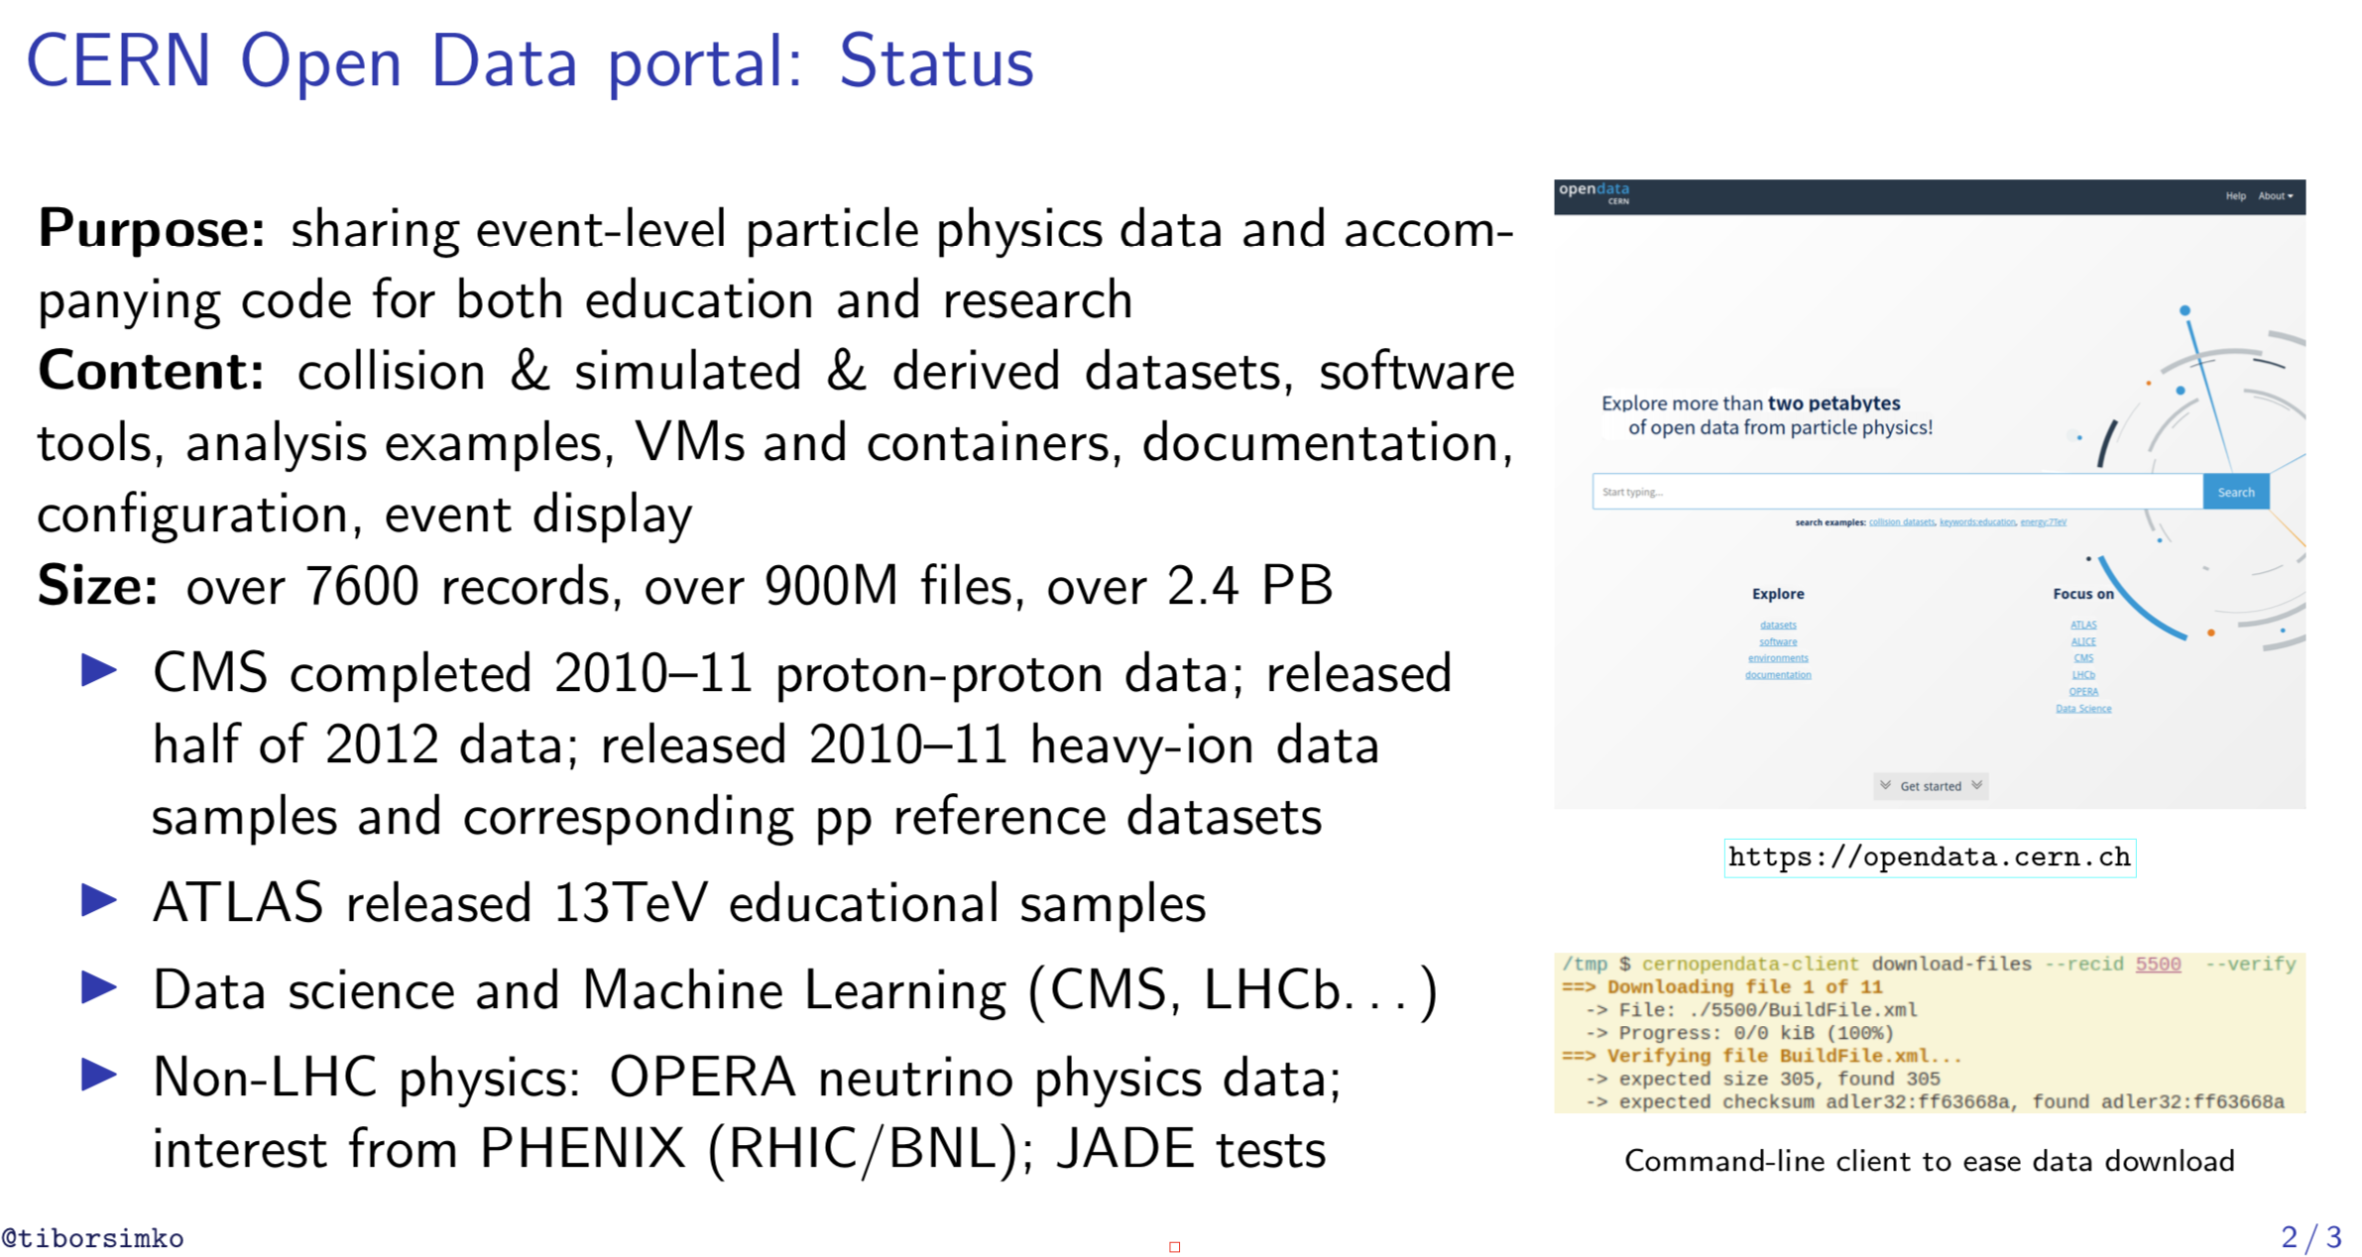
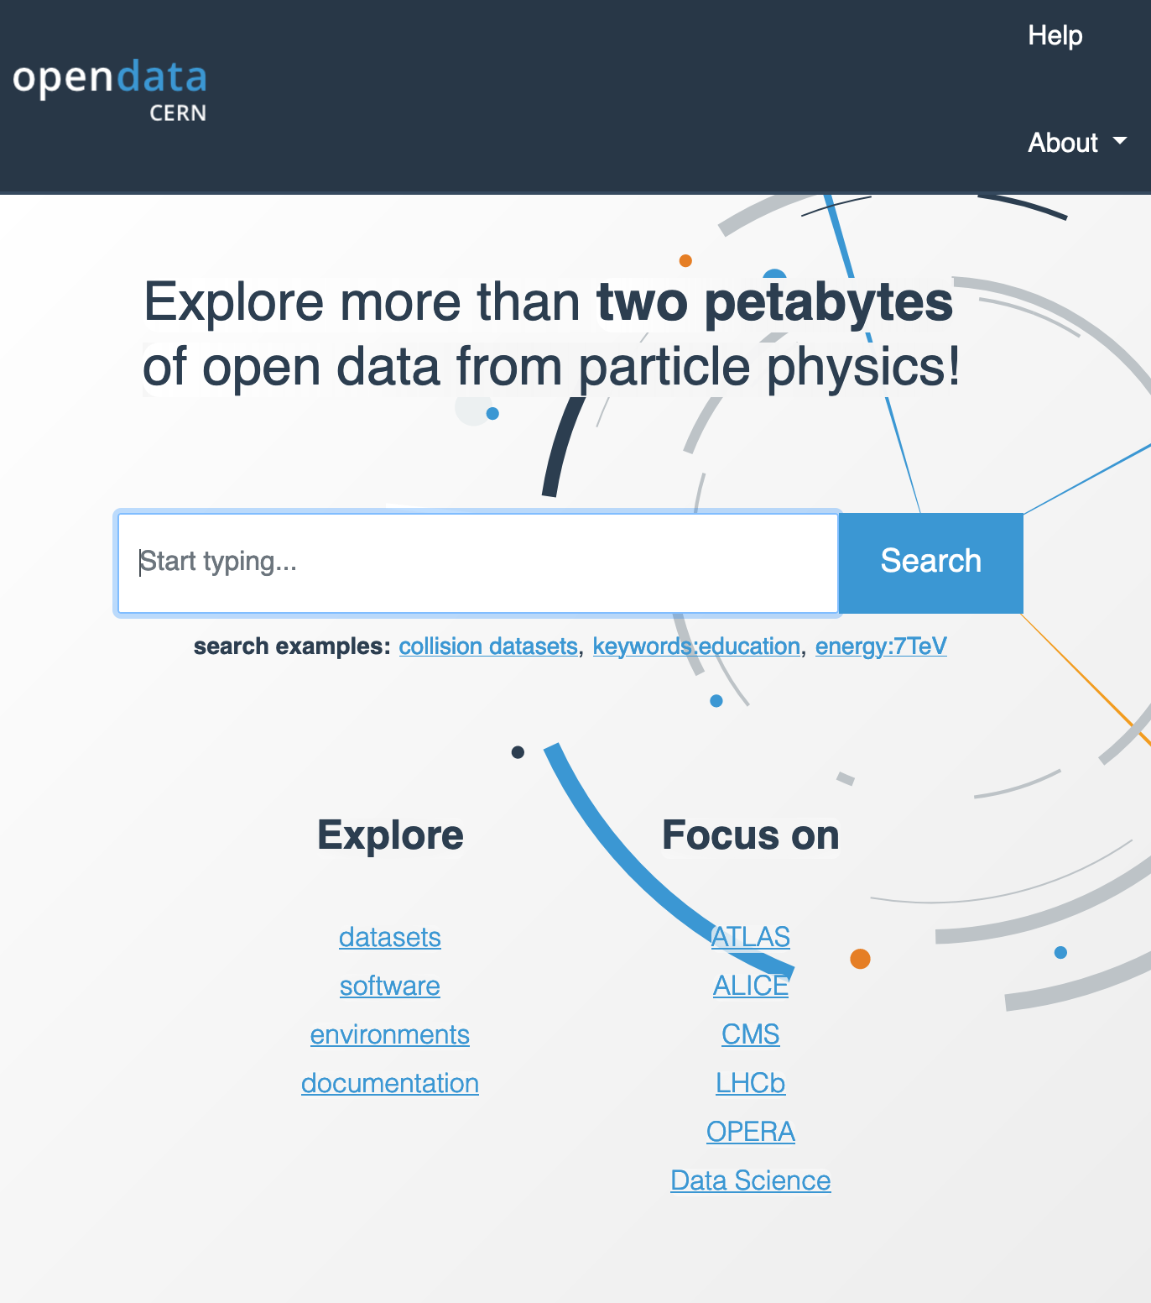
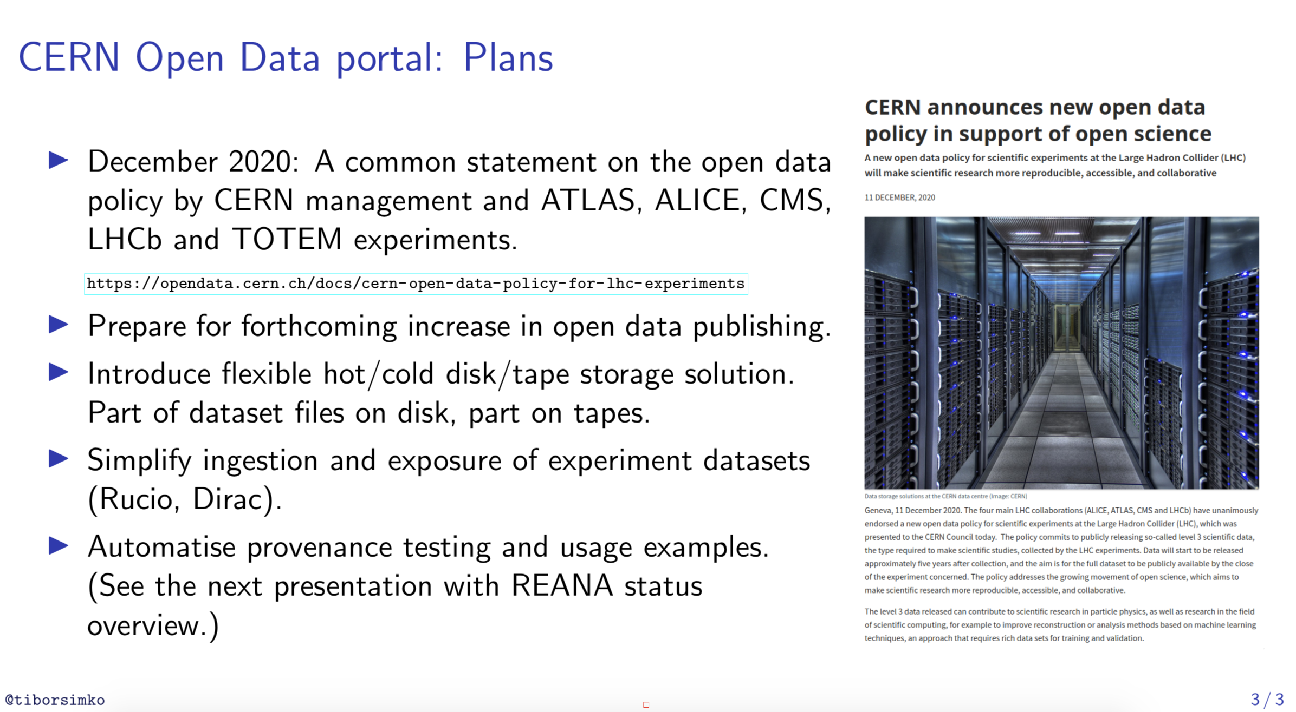

Slide 23
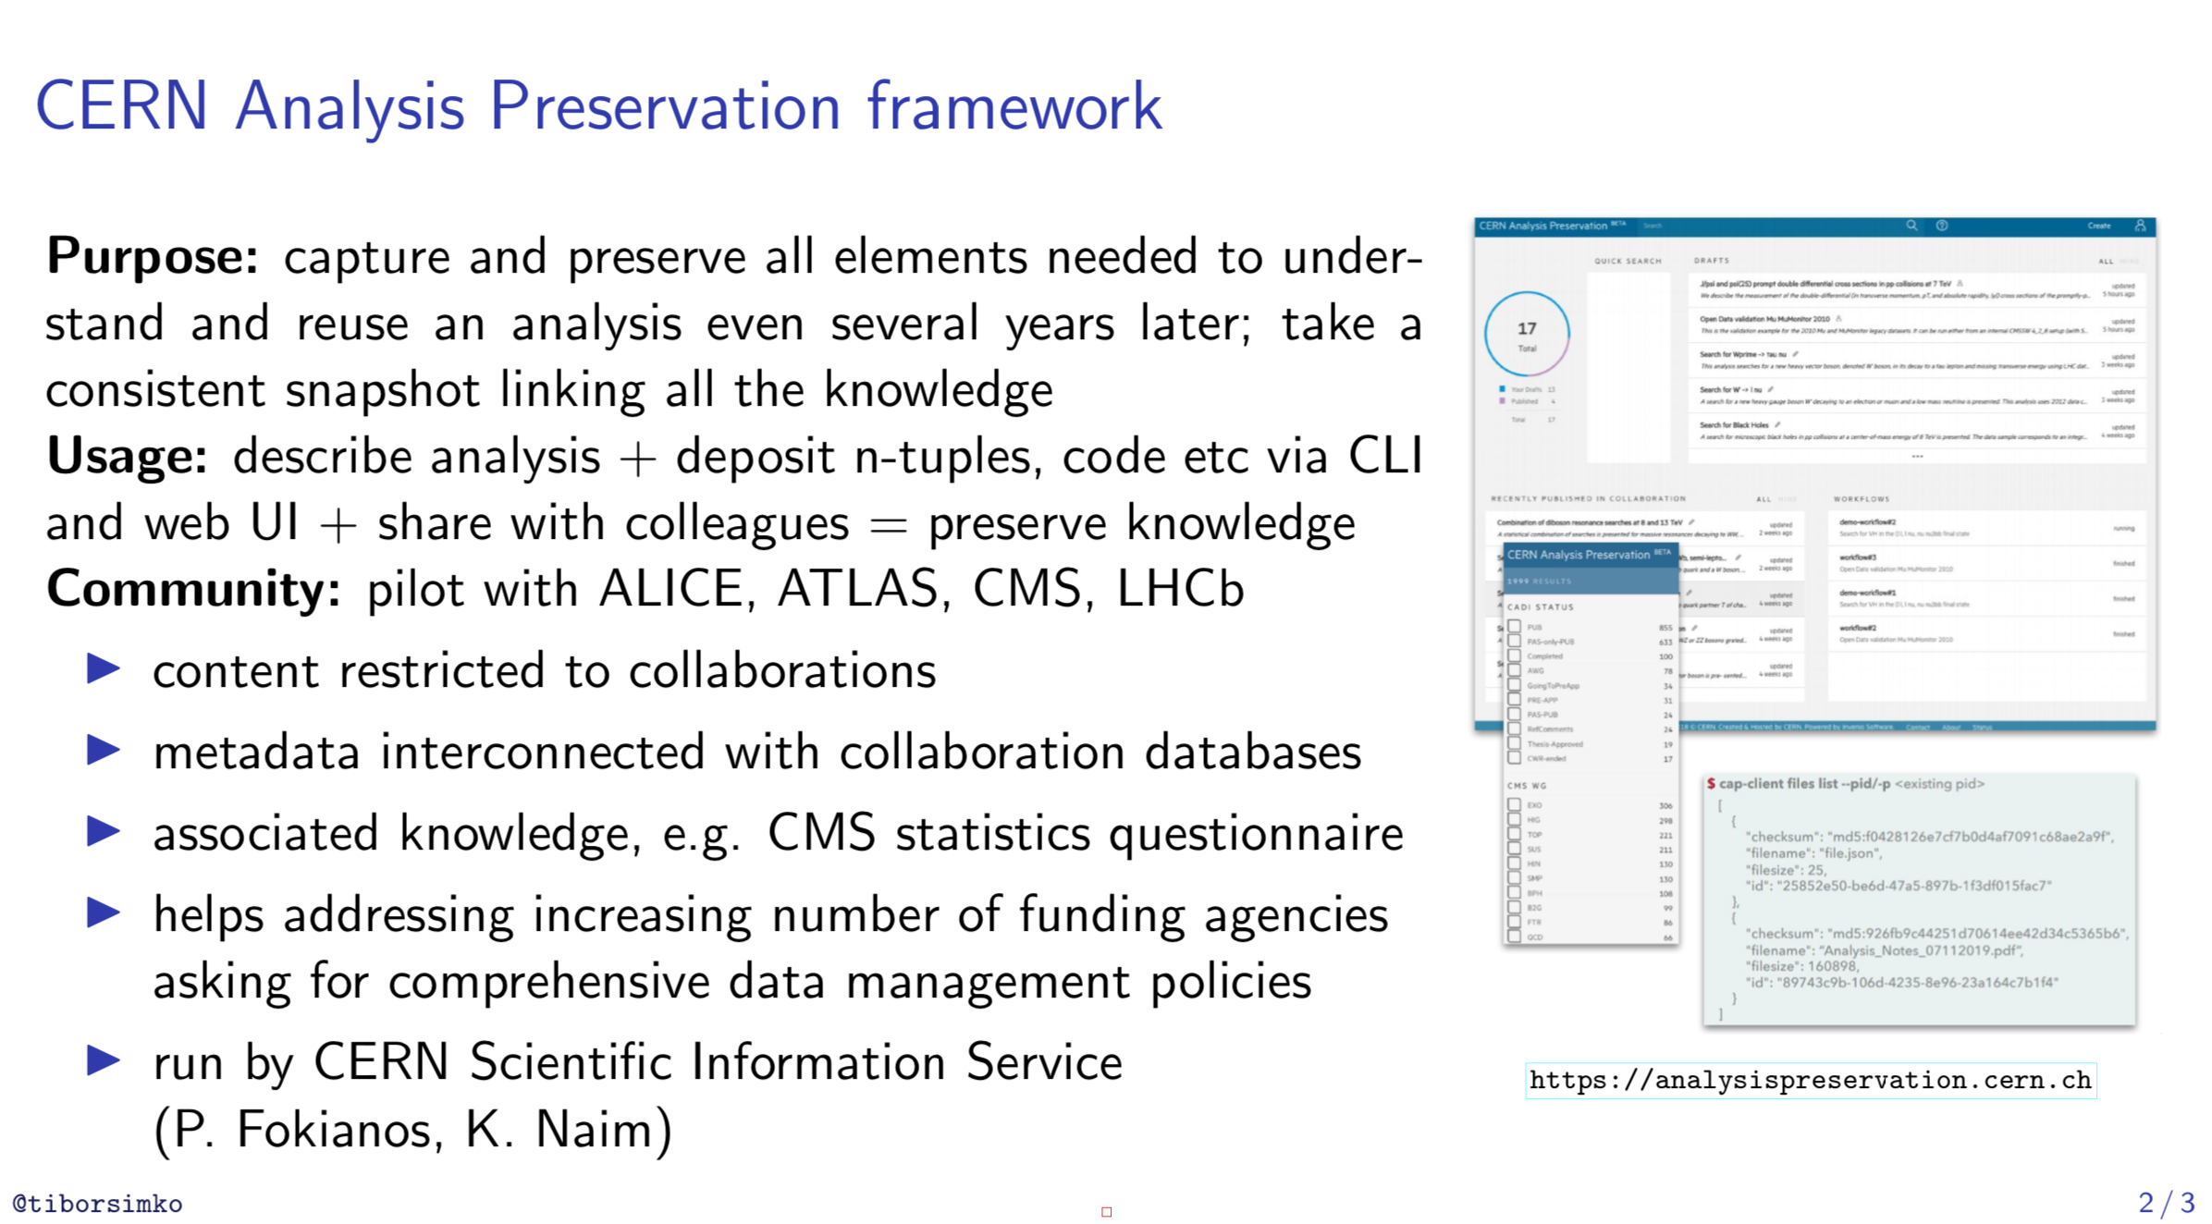
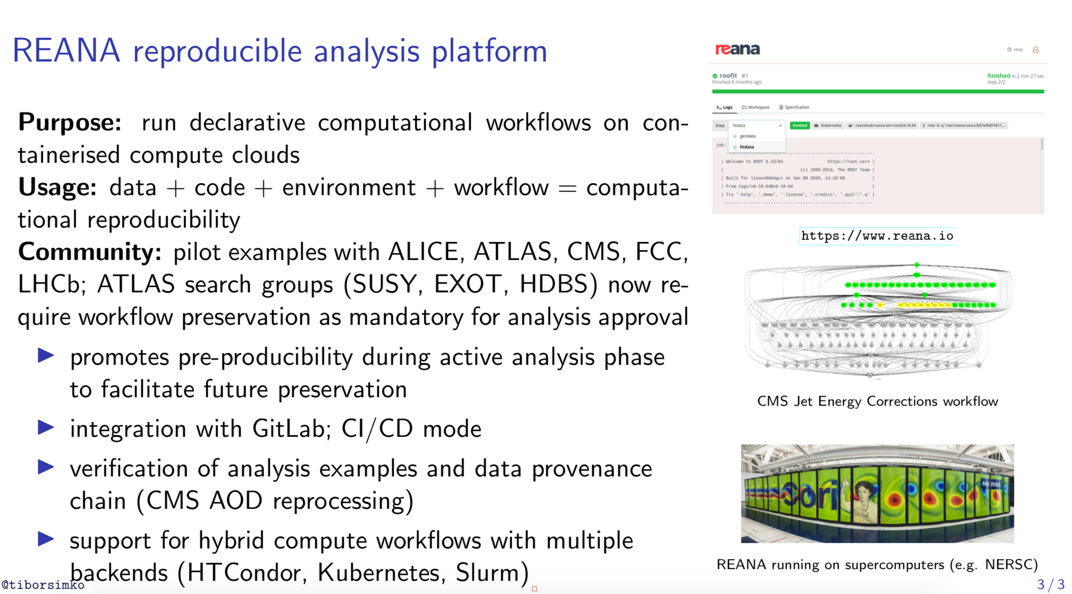
CERN Analysis Preservation and Reusable Analyses
CAP : preserve analysis
  http://analysispreservation.cern.ch/
REANA : improve workflow
  Run research data analyses on containerised compute clouds
  http://reana.io/

Slide 24
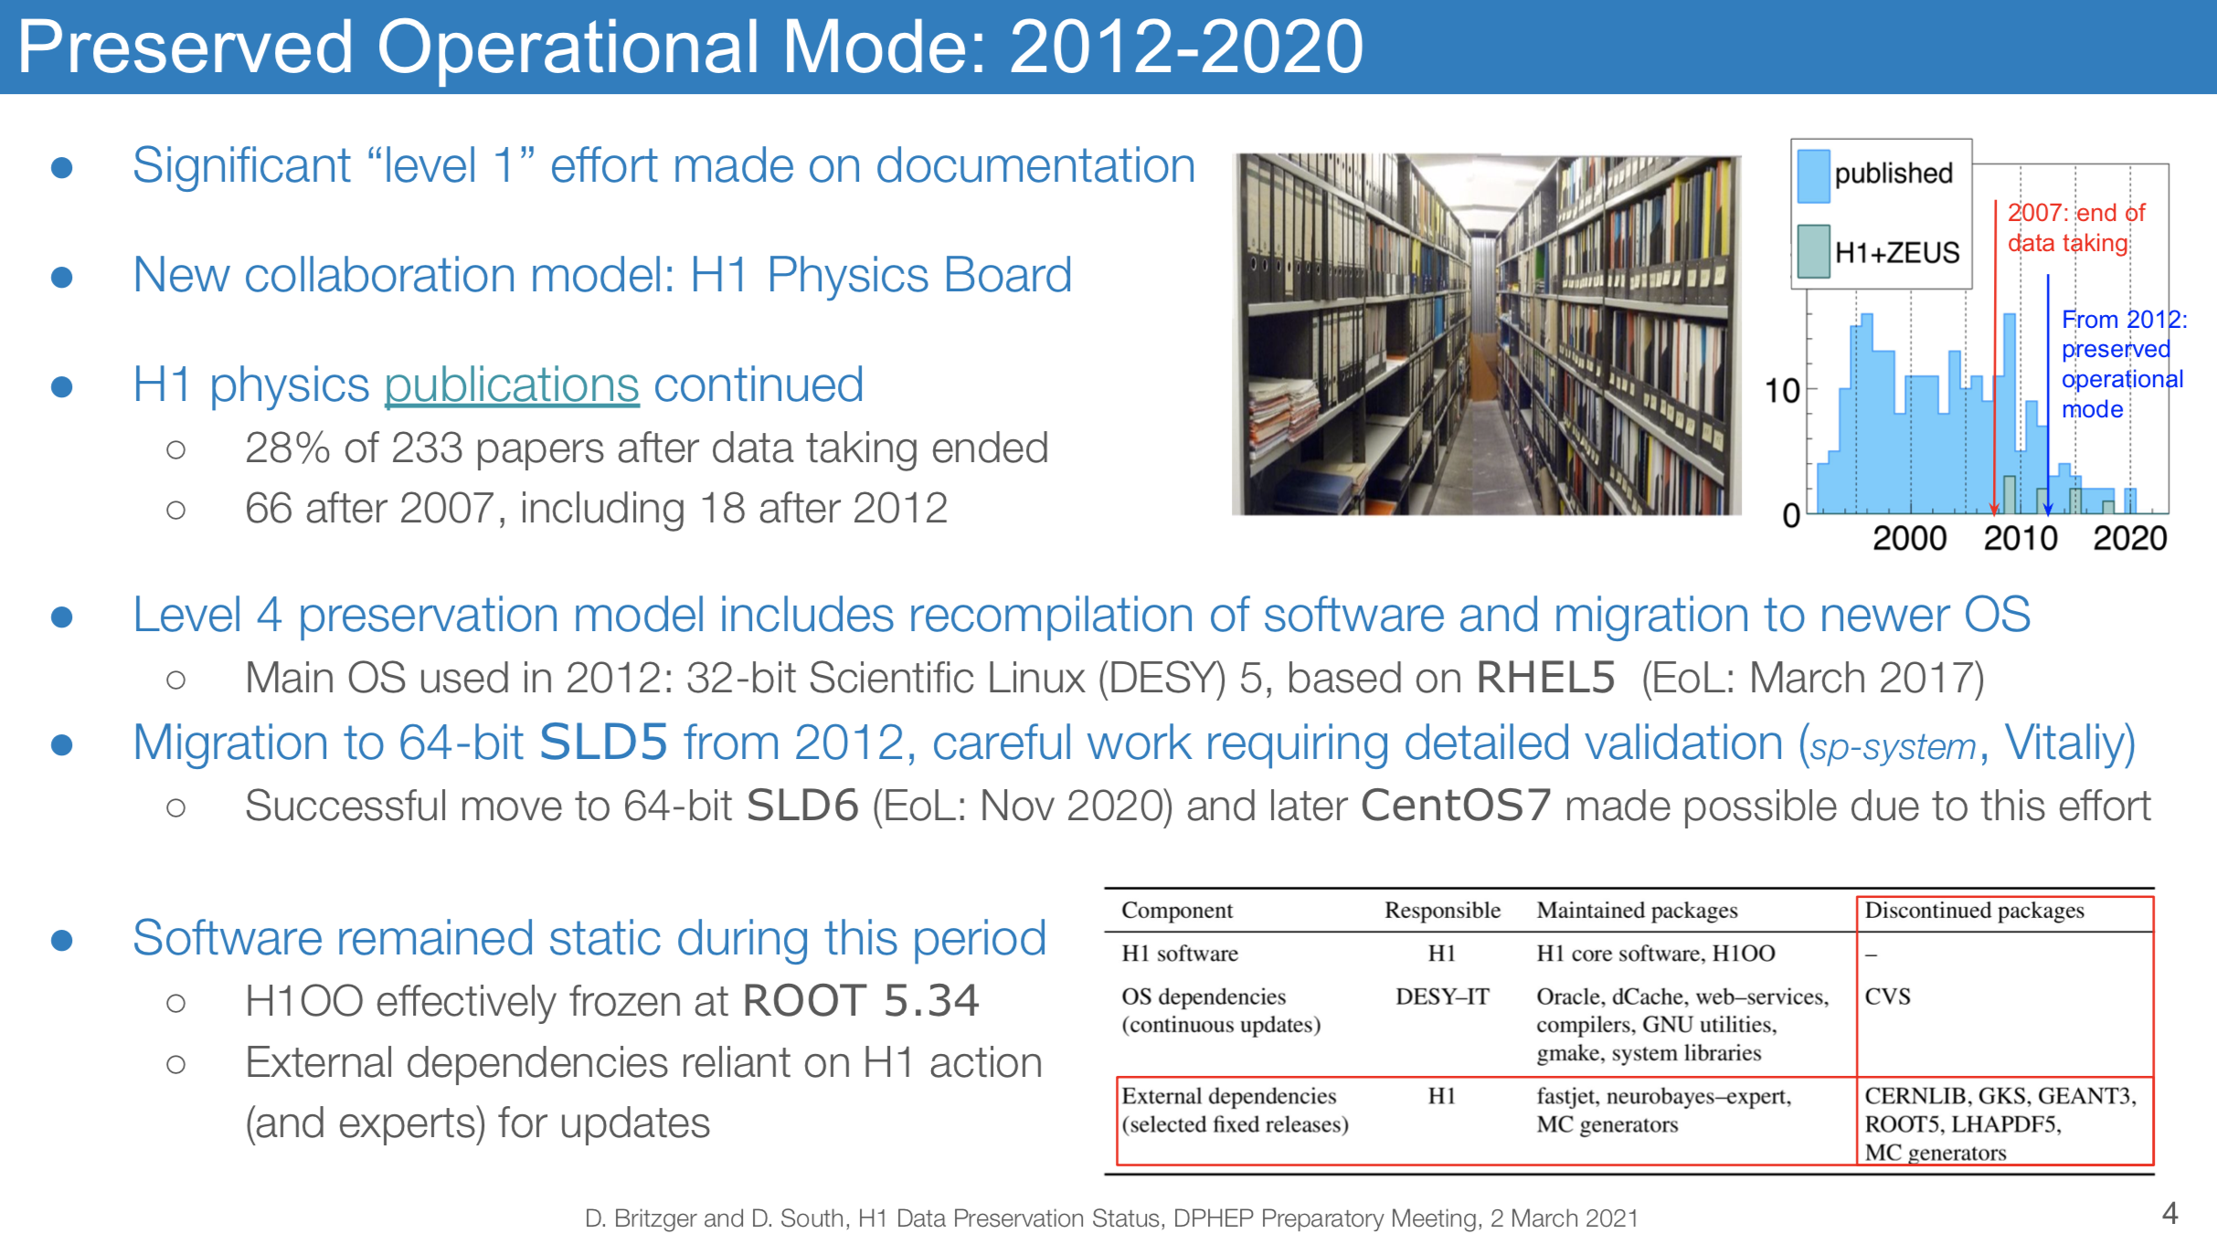
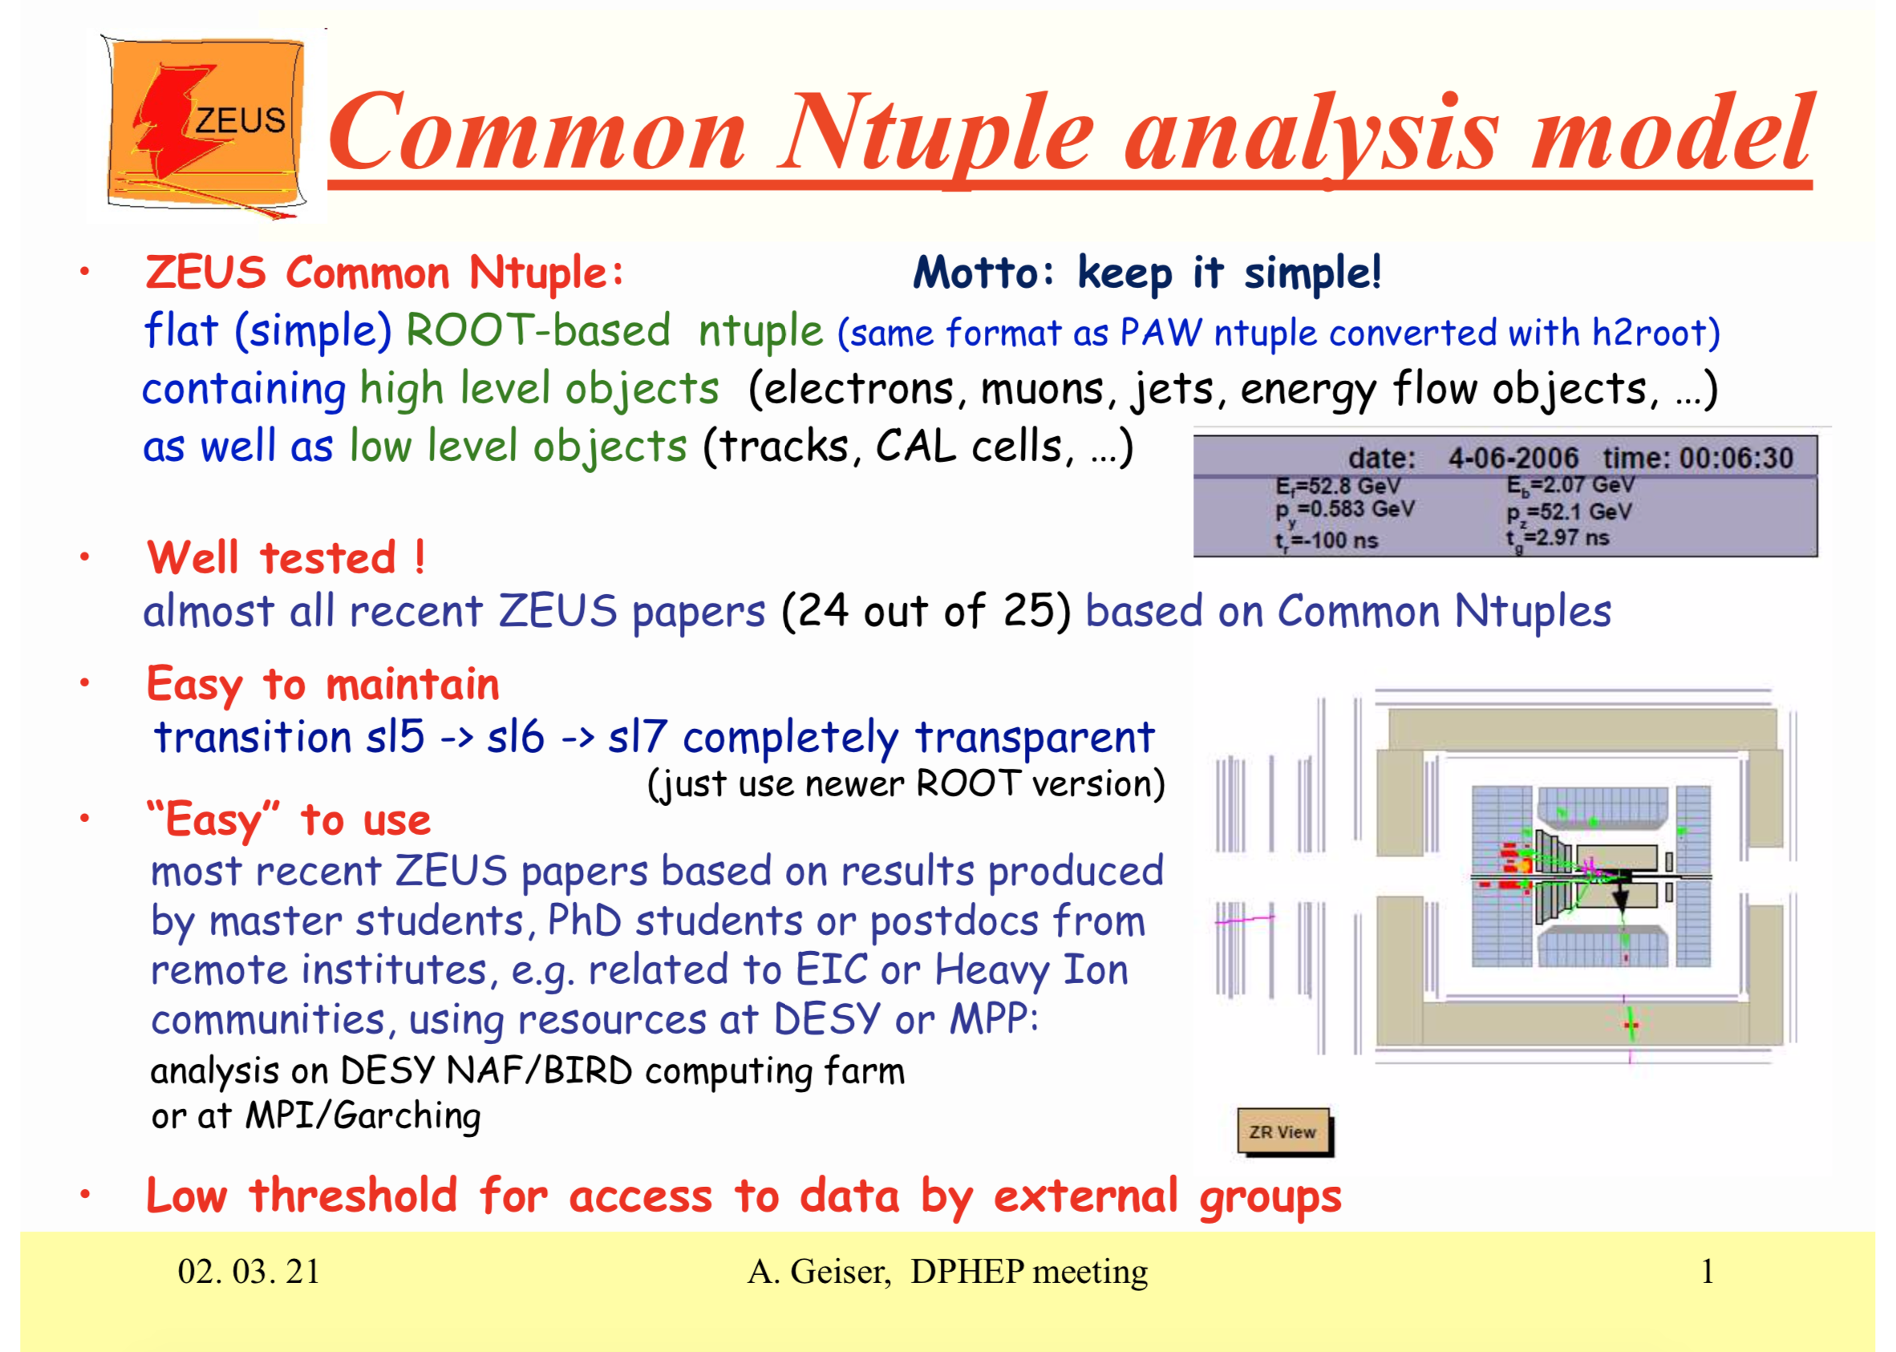
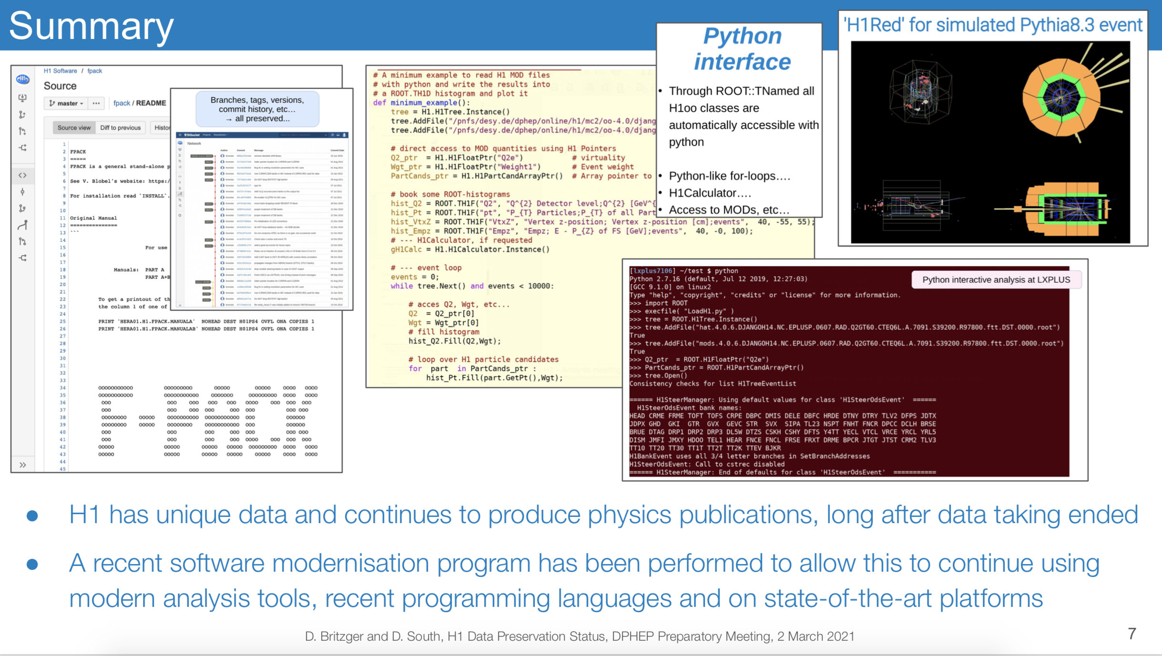
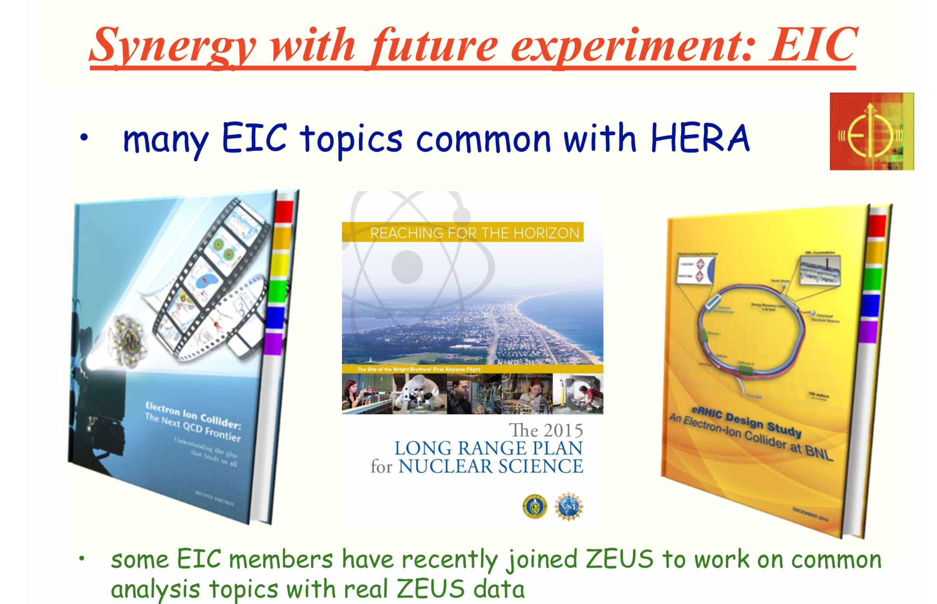
HERA: succesful DP, towards open data

Slide 25
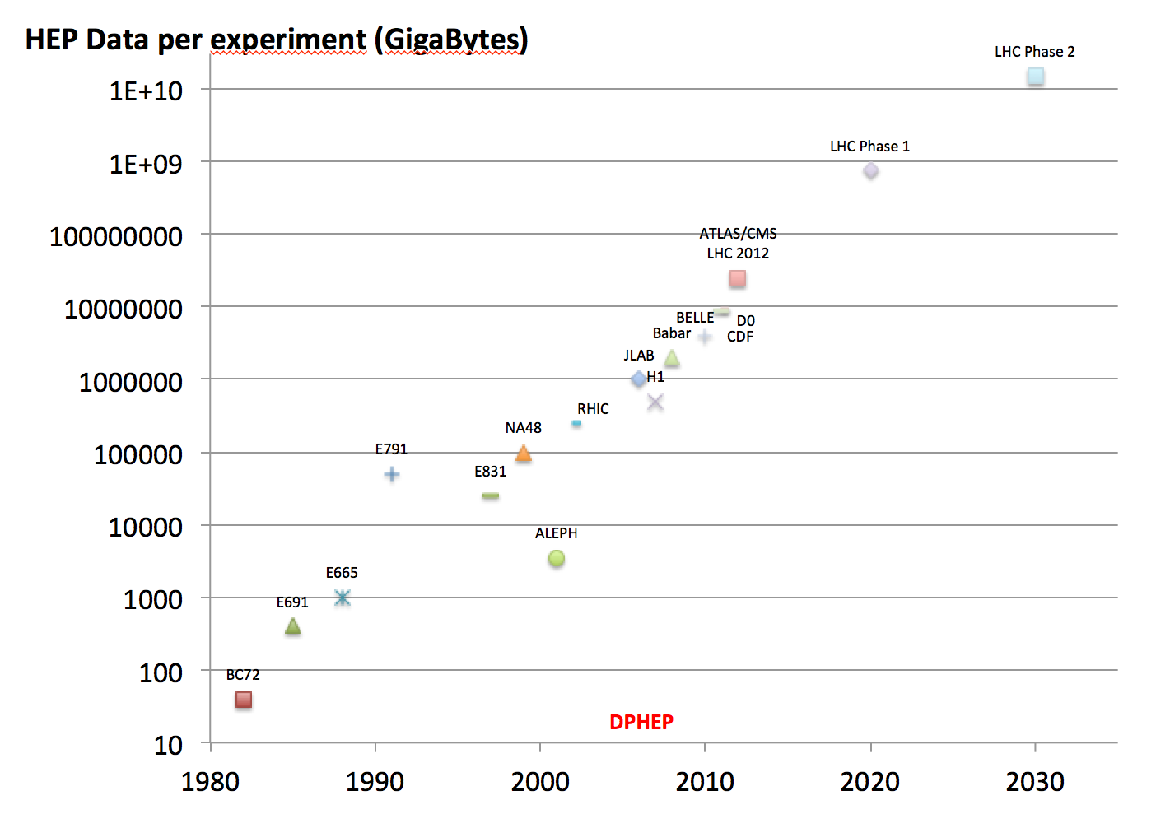
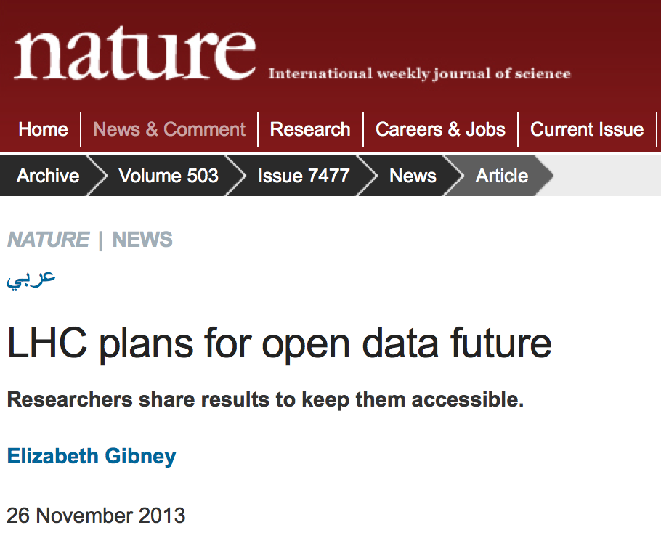
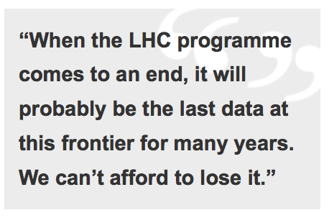
HEP Data
Scientific potential
Outreach, Training, Education
Arxiv: 1205.4667

Slide 26
Scientific output: status 2017
Still supporting few tens of analyses ~10papers/year.
~5 papers/year.
For 2-3 years
Source: web site
Source: web site
DP system
DP system
Source: web site
~10-20 papers/year.
For 2-3 years
Source: inspirehep.net
R2DP/CDFDP

Slide 27
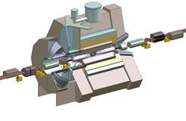

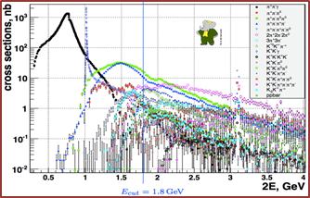
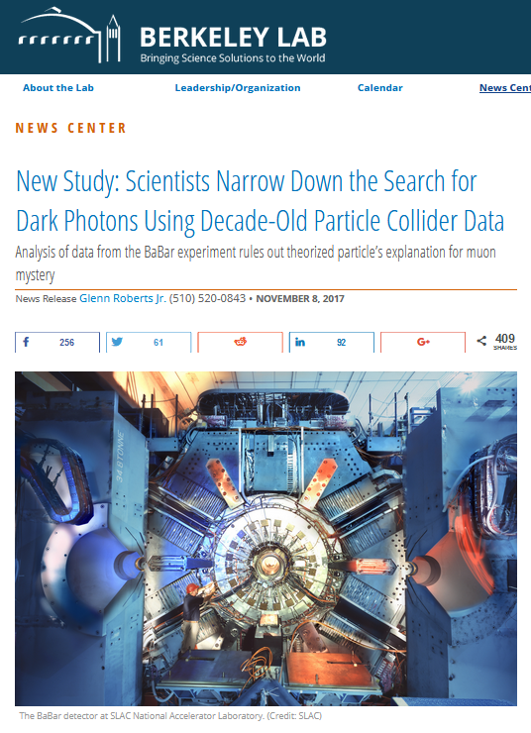
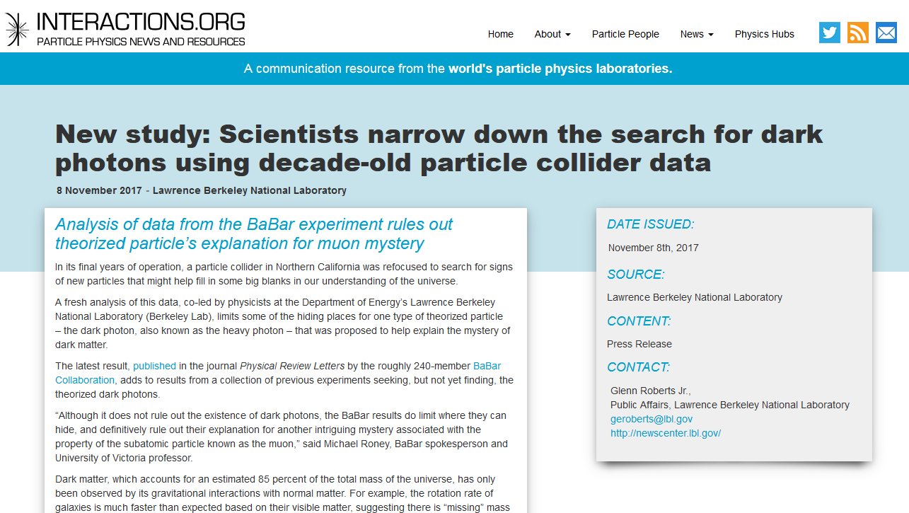
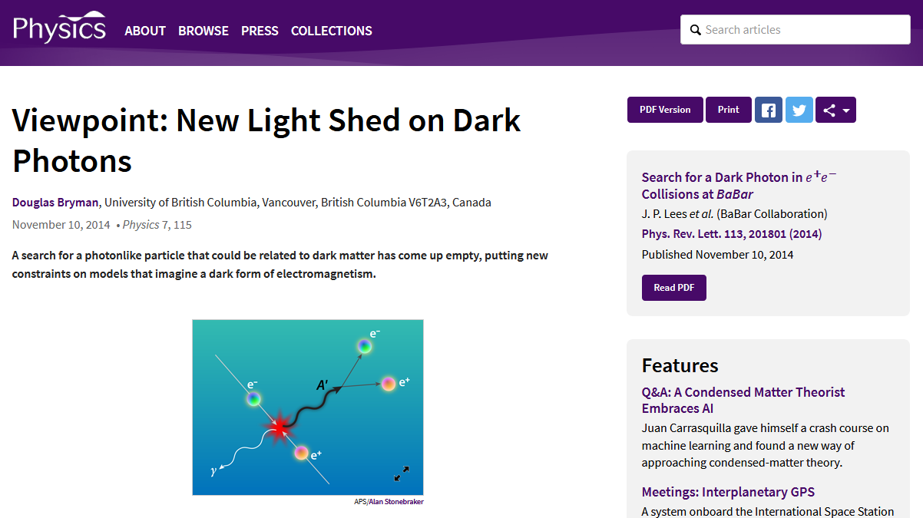
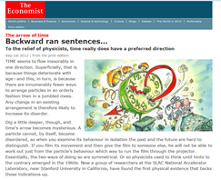




BaBar Highlights and Press Releases
2018 status
November 2017
Dataset:
Y(4S): 433/fb
Y(3S): 30/fb
Y(2S): 14/fb
Off resonance: 10%
Y(1S) accessed via
Y(2S,3S) → Y(1S) π⁺π–
June 2017

Slide 28
BaBar needs Help! BaBar in Numbers
2018 status
BaBar data actively being analyzed and high impact papers published (see slide 2). Expect this to continue to at least through 2021.
SLAC management plans to stop hosting BaBar computing in February 2020 at which time the tapes with data will be ejected.
DOE support ended in 2017, now running on international common funds (OCF).
Looking for possibility of support and long term data preservation at
  CERN,
  GridKa (BaBar site for analysis and XRootD federated dataset main redirector),
  University of Victoria (BABAR site for analysis, documentation, and tools support).
BaBar lightweight VMs come with the latest software release and xrootd client included, running under the most common virtual machine players. Just add the data via the GridKa main XRootD redirector.
2PB of data on T10k-D tapes
  raw, processed, Monte Carlo
  Unique dataset at the Y(3S) resonance (no plan at the moment to run at the Y(3S) @ Belle II)
Full environment enclosed in VMs (SL5,SL6)
~1TB of documentation, repositories, and dataset information (DBs, cvs, wiki, html)
  Internal documents archived on INSPIRE
574 papers, ~10 papers/year past 3 years
231 members (semi-frozen author list)
  Including PhD students in Canada, Germany, Israel, Italy, Russia, US
  Associated theorists mine data to test new ideas
~20 analyses on track, ~10 more in the pipeline
  Continue to have new analyses every year including joint BaBar -Belle analyses
Students analyze BaBar data while working on Belle II and other experiments in construction/commissioning phase

