Slide 1



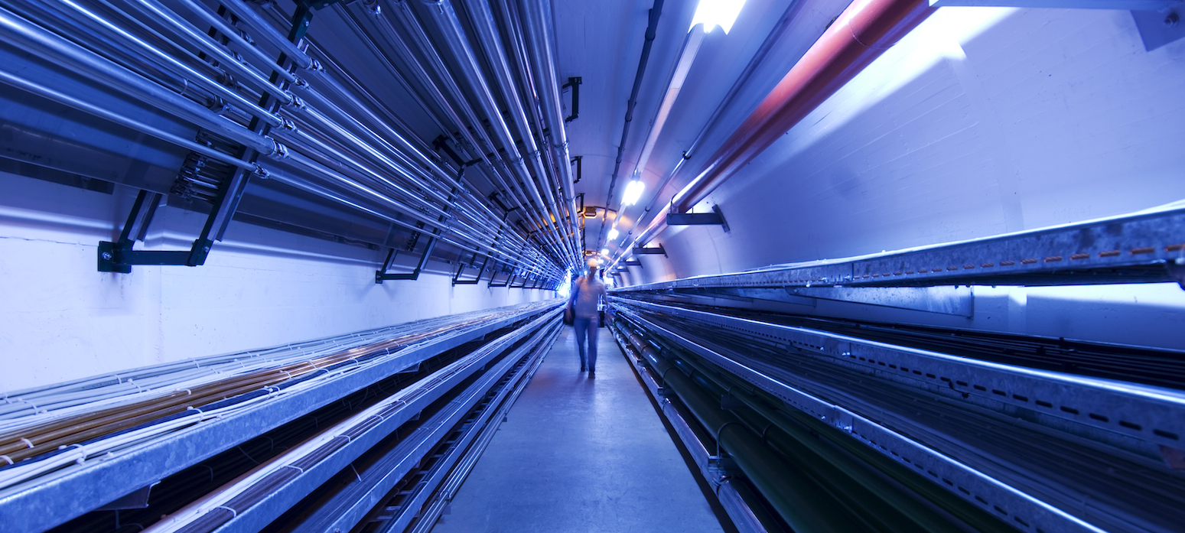


Conceptual layout of the MUC Test Facility
2nd Muon Community Meeting, 12-14 July 2021
by Rui FRANQUEIRA XIMENES*
CERN – Systems Department
Sources Targets Interaction (STI)
Targets Collimators Dumps (TCD)
rui.franqueira.ximenes@cern.ch

Slide 2
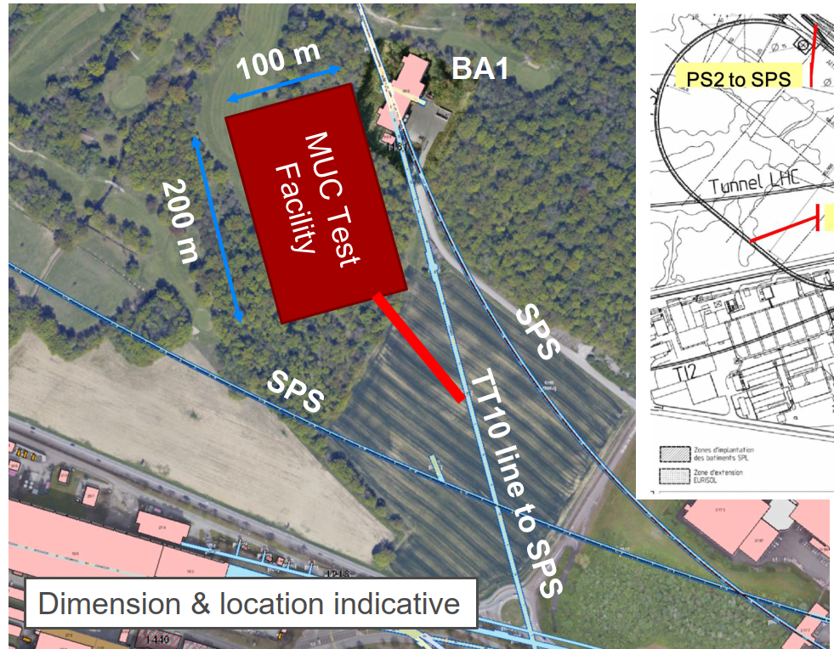
TT10 line option (recap)
First ideas proposed by Marco C. in the 1st Community meeting. TT10 line option seen as most attractive (Roberto L. presentation).
  O(80kW) should be easily feasible by going sufficiently underground.
  4 MW does not appear to be a showstopper in this layout, but detailed studies will have to be performed.
  Future upgrades towards a collider and HP-SPL should be compatible with this layout.
  Experience with other facilities available
  Important to collect all requirements at this stage in order to be able to provide a first cost estimate by end of 2021 as requested by the study

Slide 3
Layout
Layout components of the Demonstrator:
Target & Horn (first stage) and potentially superconducting solenoid at a later stage
Momentum selection chicane
Collimation & diagnostics area
Muon Cooling area
Downstream diagnostics area
++
Service areas (Cooling & ventilation, cryogenics, power, transport, etc…)
Radioactive storage
Branch to other experiments ?
… other??
Downstream diagnostics area: 5x4 m
Target + horn (1st phase) / superconducting solenoid (2nd phase)
Collimation and upstream diagnostics area: 10x4 m
Injection from TT10
Cooling area: 50x4 m
Momentum selection chicane 10x 4 m
Services (Cryogenics, cooling & ventilation, power, transport, etc)
*Indicative dimensions by C. Rogers

Slide 4
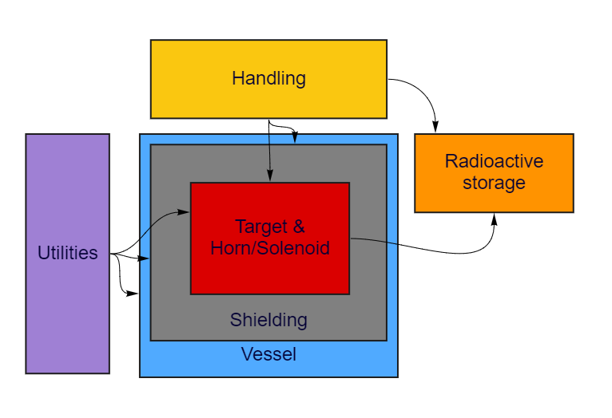
Layout ideas
Downstream diagnostics area: 5x4 m
Collimation and upstream diagnostics area: 10x4 m
Target + horn (1st phase) / superconducting solenoid (2nd phase)
Injection from TT10
Momentum selection chicane 10x 4 m
Target + Horn (and/or superconducting solenoid)
Target + Horn length (O) 5 m. (What volume with solenoid?)
Cooling (Target + Horn) and power (Horn) supplies required
High activation / radiation levels (specially for 4 MW case):
Service rooms for power & Cooling Ventilation
Shielding (& space for it)
Vessel
Handling solutions.
Radioactive storage in the surrounding area
Access from surface
Cooling area: 50x4 m
All of these set requirements for the layout

Slide 5
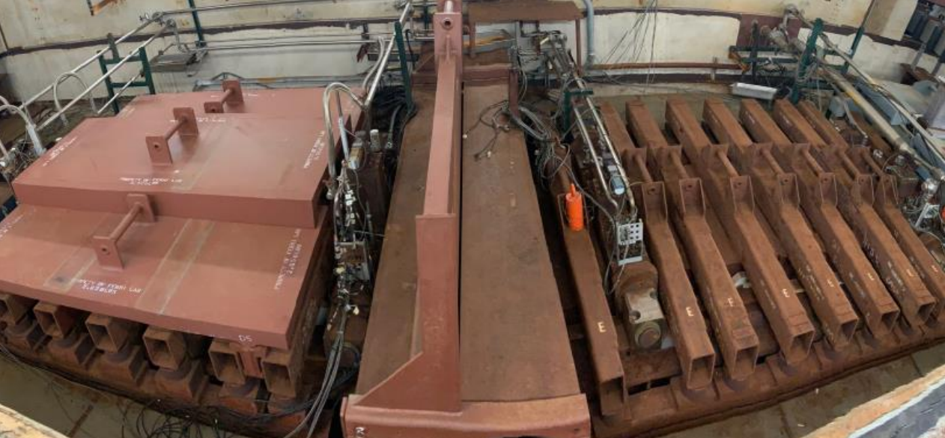
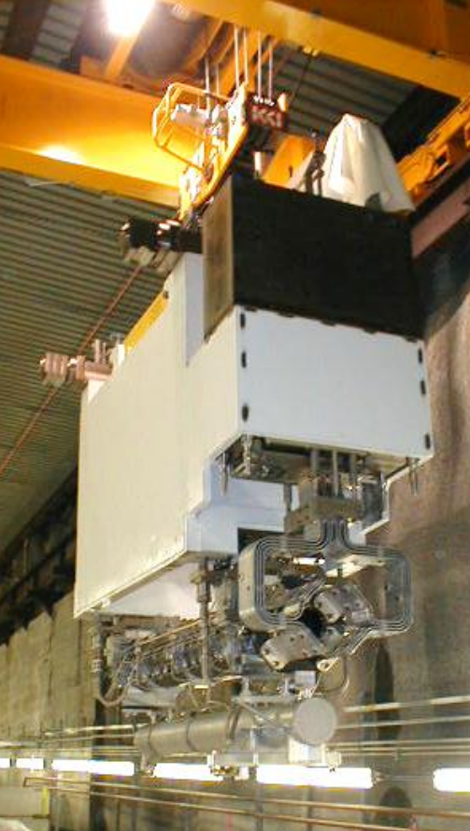
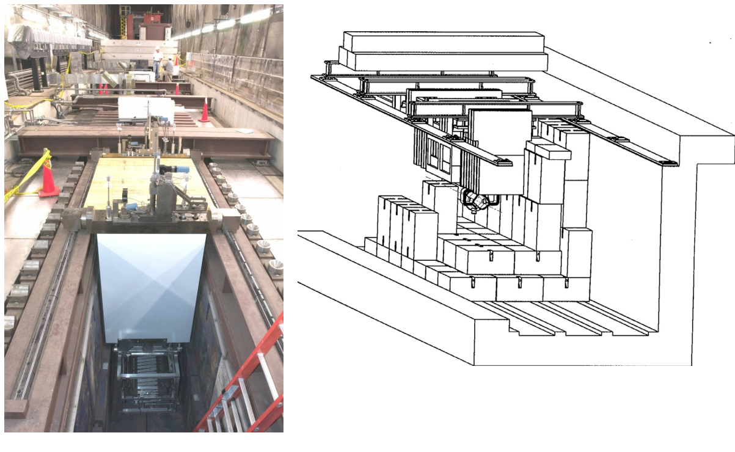
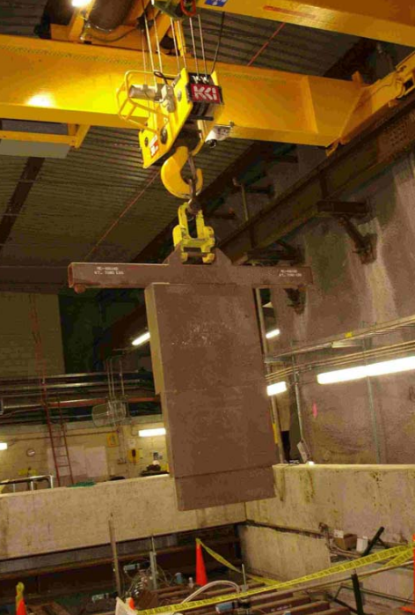
Layout ideas
Downstream diagnostics area: 5x4 m
Collimation and upstream diagnostics area: 10x4 m
Target + horn (1st phase) / superconducting solenoid (2nd phase)
Injection from TT10
Momentum selection chicane 10x 4 m
Target + Horn (and/or superconducting solenoid) - NuMI @ FNAL
Cooling area: 50x4 m
Underground hall
Vertical Handling
Equipment by modules
Module is a suspended frame w/ equipment + shielding + utilities connections
Yun He, NuMI Neutrino Beam Operations and Megawatt Upgrade, NUFACT2019

Slide 6
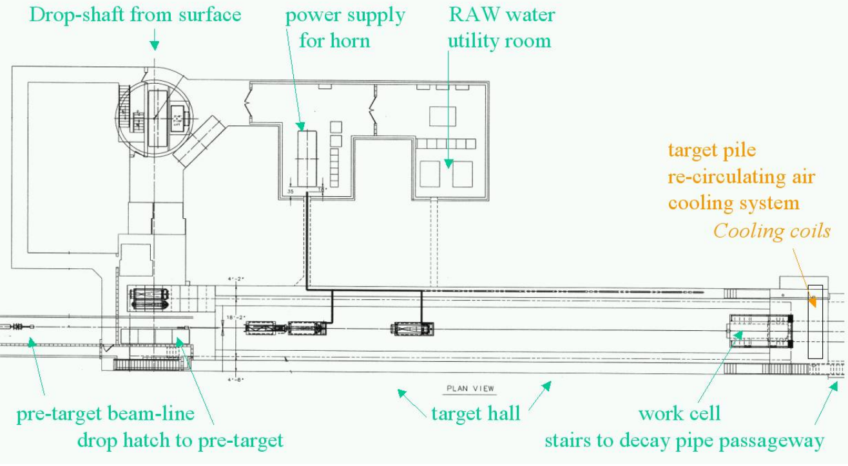
Layout ideas
Downstream diagnostics area: 5x4 m
Collimation and upstream diagnostics area: 10x4 m
Target + horn (1st phase) / superconducting solenoid (2nd phase)
Injection from TT10
Momentum selection chicane 10x 4 m
Target + Horn (and/or superconducting solenoid) - NuMI @ FNAL
Cooling area: 50x4 m
Utilities room on a separate gallery parallel to the beamline
Shielding between beam line access shaft
Yun He, NuMI Neutrino Beam Operations and Megawatt Upgrade, NUFACT2019

Slide 7
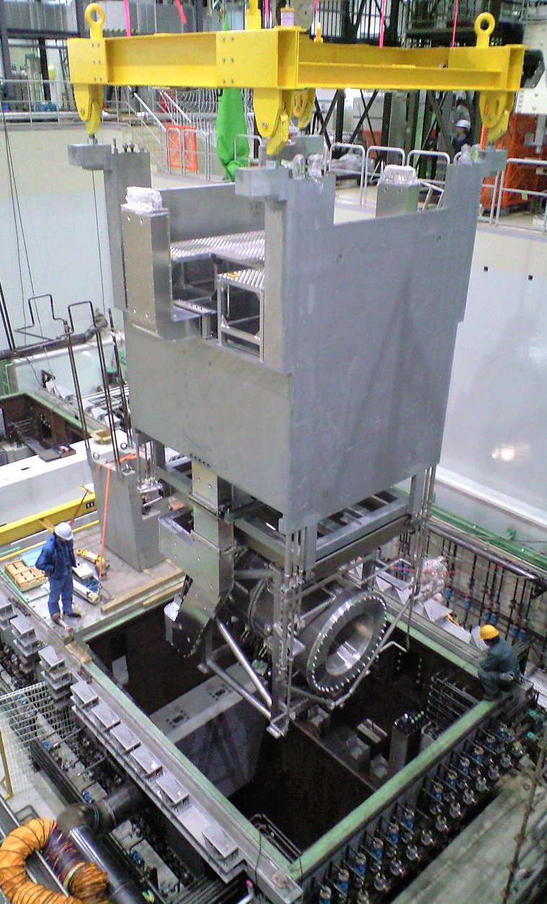
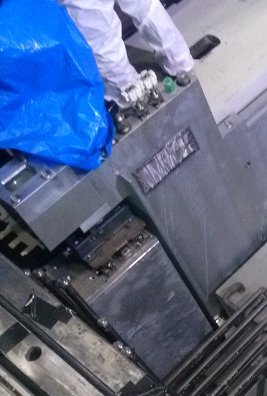
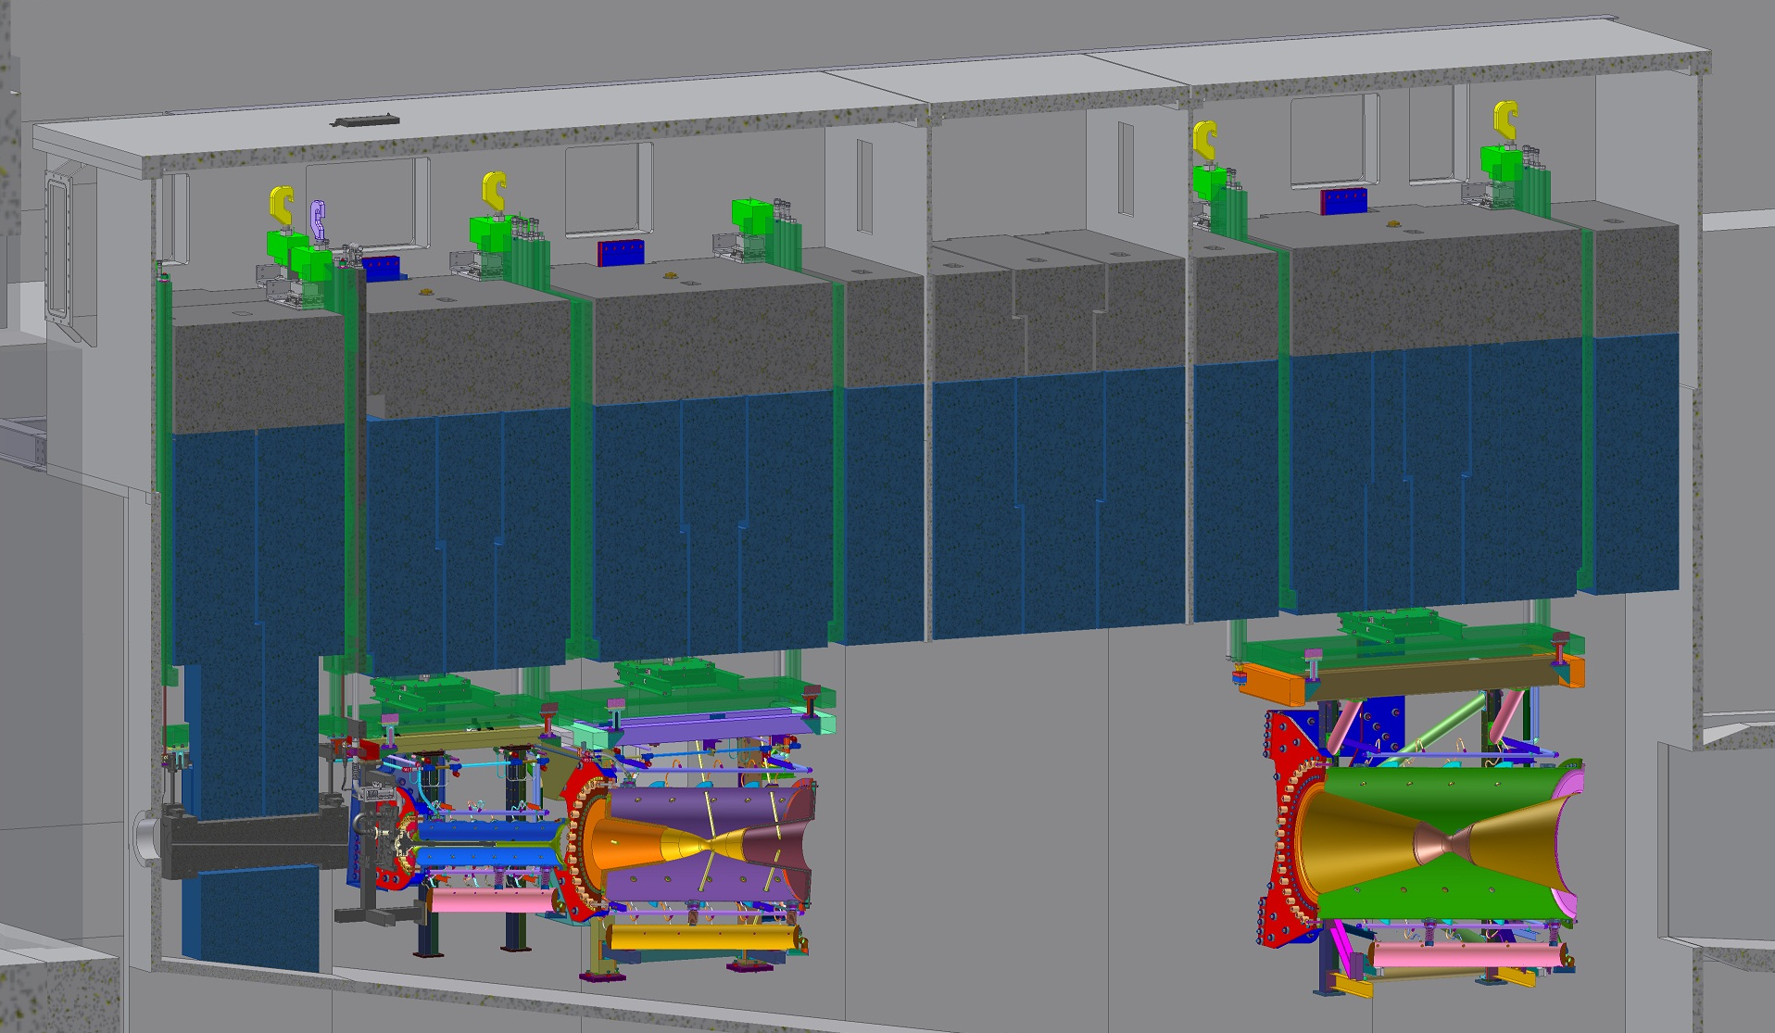
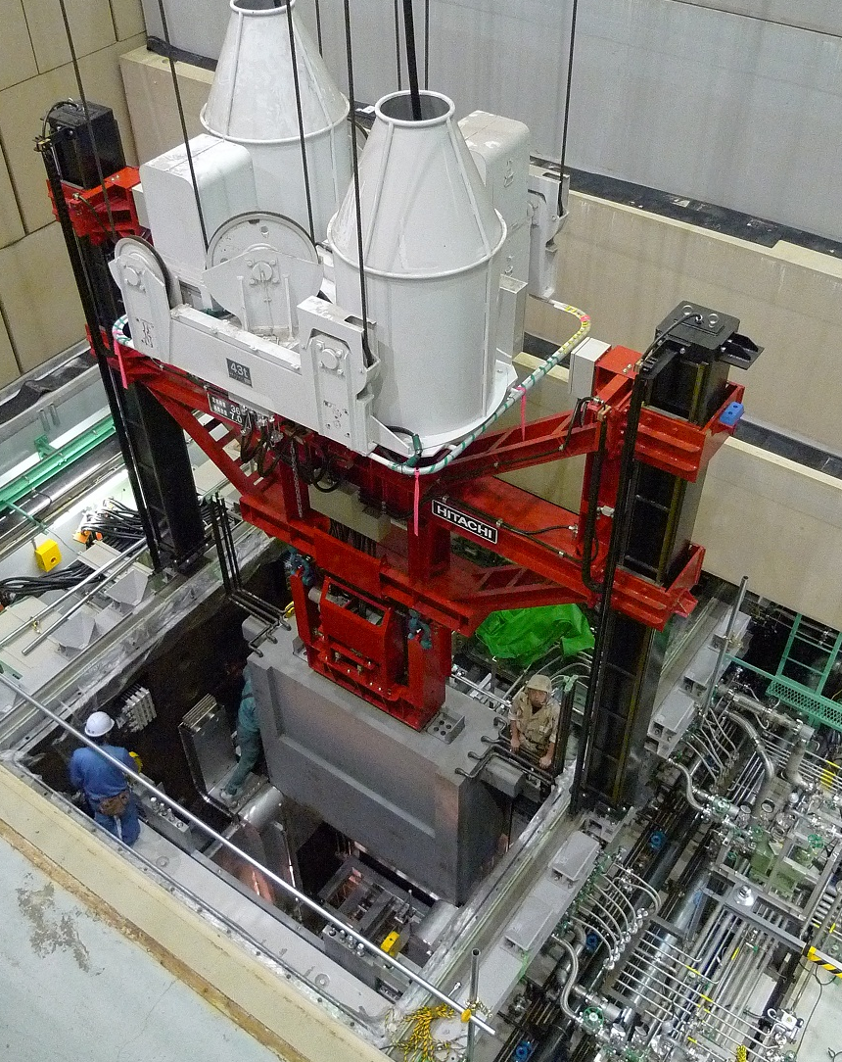
Layout ideas
Downstream diagnostics area: 5x4 m
Collimation and upstream diagnostics area: 10x4 m
Target + horn (1st phase) / superconducting solenoid (2nd phase)
Injection from TT10
Momentum selection chicane 10x 4 m
Target + Horn (and/or superconducting solenoid) - T2K @ J-PARC
Cooling area: 50x4 m
Vertical Handling
Equipment by modules
Module is a suspended frame w/ equipment + shielding + utilities connections
Installation by steps
Placed inside a He vessel
https://t2k.org/docs/photos/beamline
https://doi.org/10.1016/j.nima.2011.06.067

Slide 8
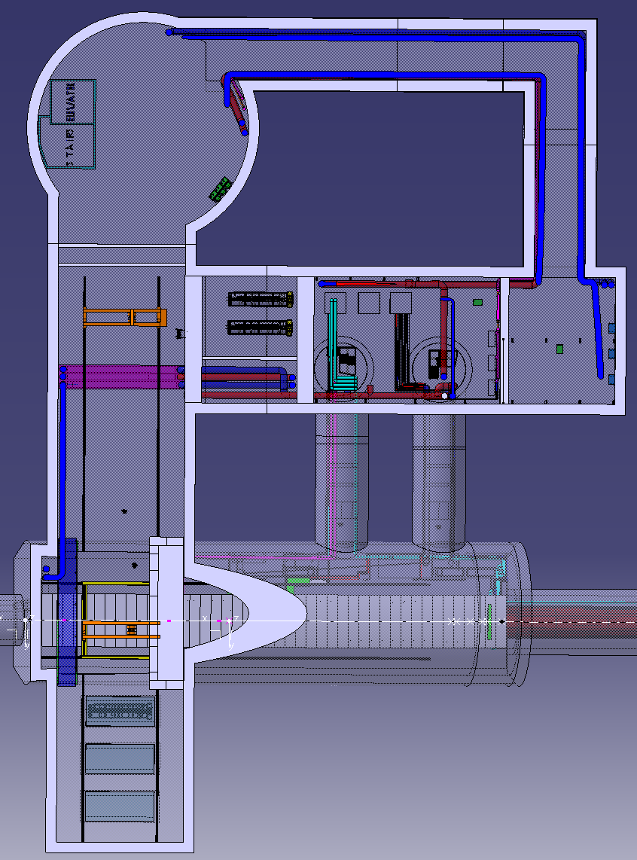
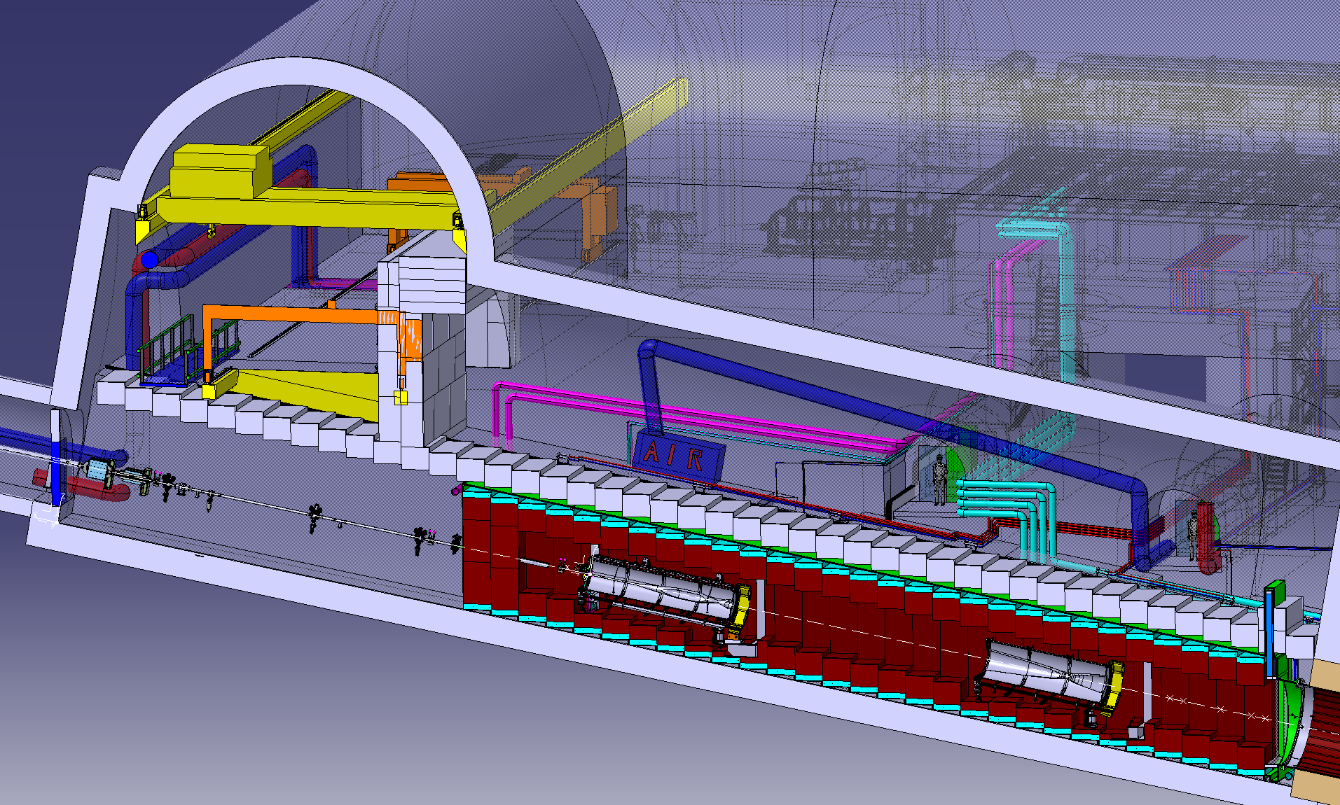
Layout ideas
Downstream diagnostics area: 5x4 m
Collimation and upstream diagnostics area: 10x4 m
Target + horn (1st phase) / superconducting solenoid (2nd phase)
Injection from TT10
Momentum selection chicane 10x 4 m
Target + Horn (and/or superconducting solenoid) - CN2PY - LBNO
Cooling area: 50x4 m
Wide transversal tunnel offset from target & Horn leading to a bunker area.
Vertical Handling along the beam line & access tunnel
Equipment is supported on the ground (shielding blocks) & contained in a vessel.
Multiple shielding blocks
Placed inside a He vessel
Utilities room on a separate gallery parallel to the beamline
I. Efthymiopoulos, Design Study For A Future Laguna-LBNO Long-baseline
Neutrino Facility At Cern, THPFI056, IPAC2013

Slide 9
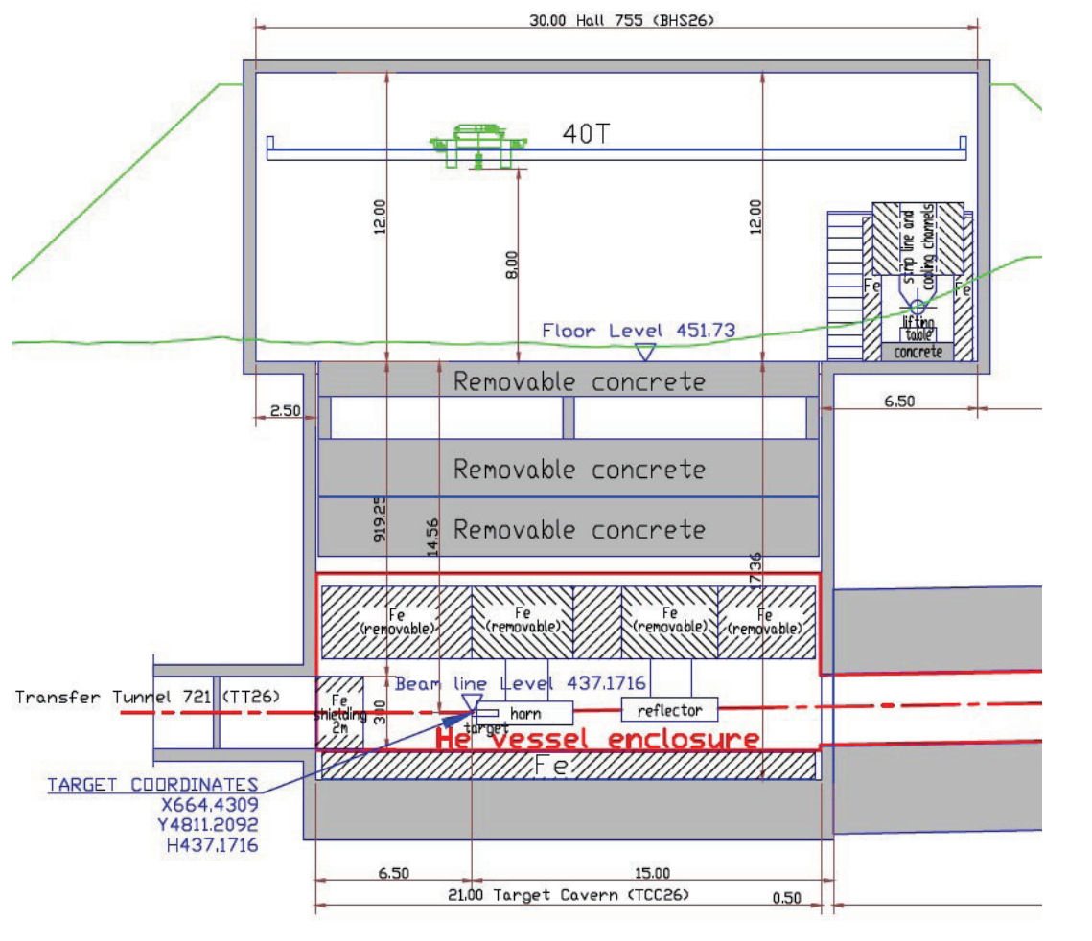
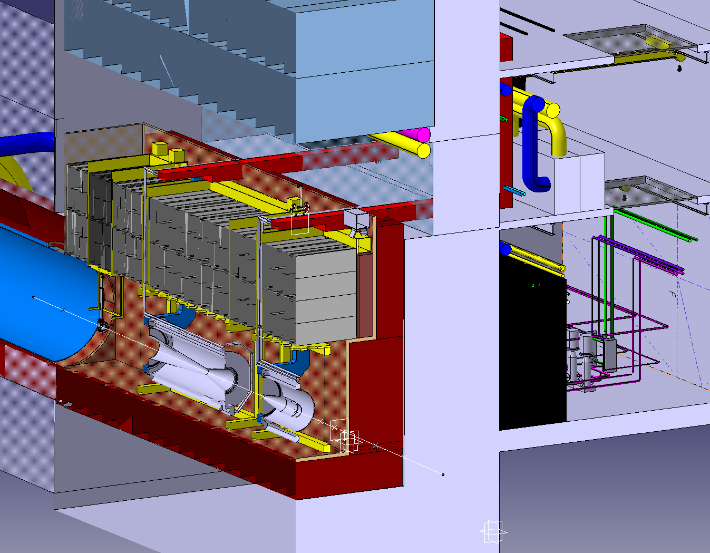
Layout ideas
Downstream diagnostics area: 5x4 m
Collimation and upstream diagnostics area: 10x4 m
Target + horn (1st phase) / superconducting solenoid (2nd phase)
Injection from TT10
Momentum selection chicane 10x 4 m
Target + Horn (and/or superconducting solenoid) - CENF
Cooling area: 50x4 m
Beam line located in a deep trench with handling made from the surface building
Trench with fixed shielding
Equipment on modules with integrated shielding, contained in a vessel.
Utilities connected on top of the module to the services rooms on the side
R.Steerenberg, Design Study for a CERN Short Base-Line Neutrino Facility, TUPEA052, IPAC2013

Slide 10
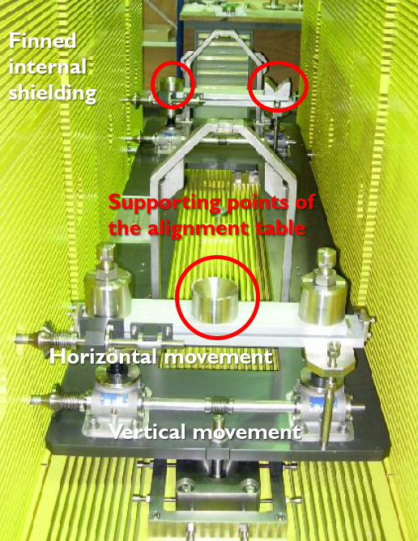
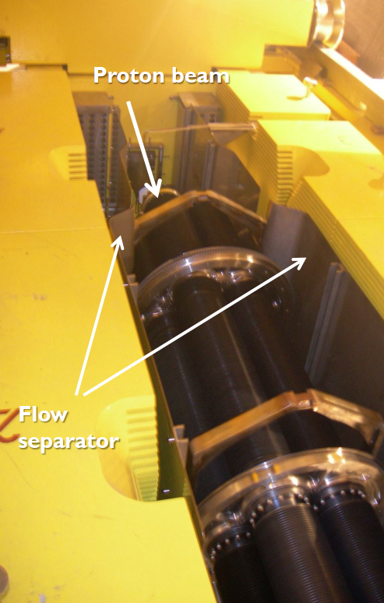
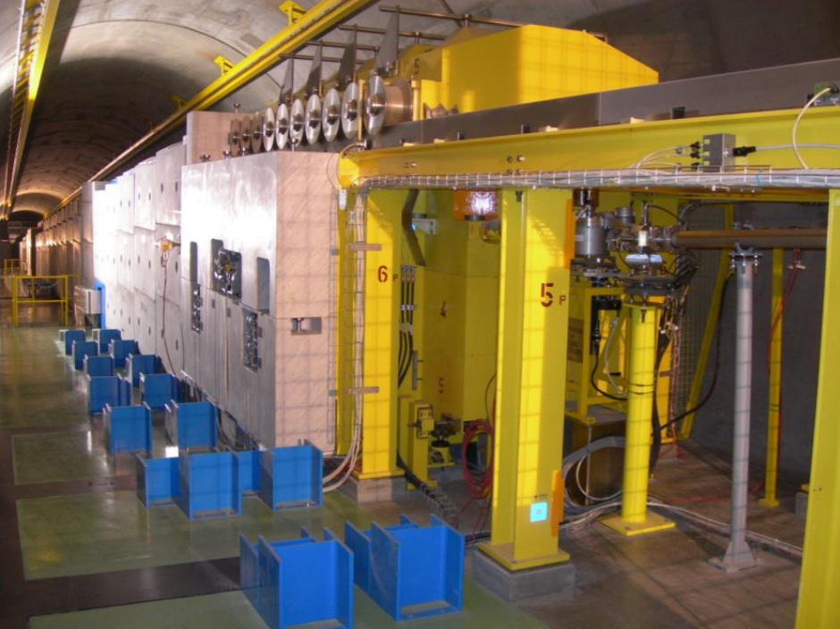
Layout ideas
Downstream diagnostics area: 5x4 m
Collimation and upstream diagnostics area: 10x4 m
Target + horn (1st phase) / superconducting solenoid (2nd phase)
Injection from TT10
Momentum selection chicane 10x 4 m
Target + Horn (and/or superconducting solenoid) - CNGS
Cooling area: 50x4 m
Vertical handling with longitudinal rail system
Target sits on a alignment table controlled laterally from the outside of the shielding.
Shielding with fins for cooling
M.Calviani, Design, maintenance and operational aspects of the CNGS target, 4th HPTW,

Slide 11
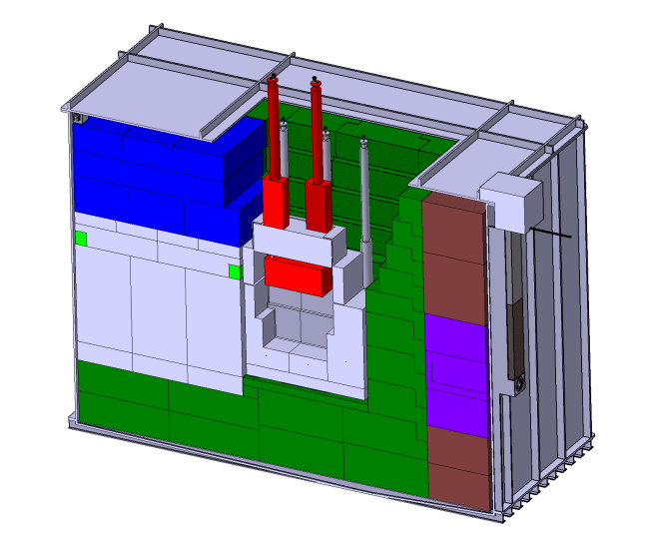
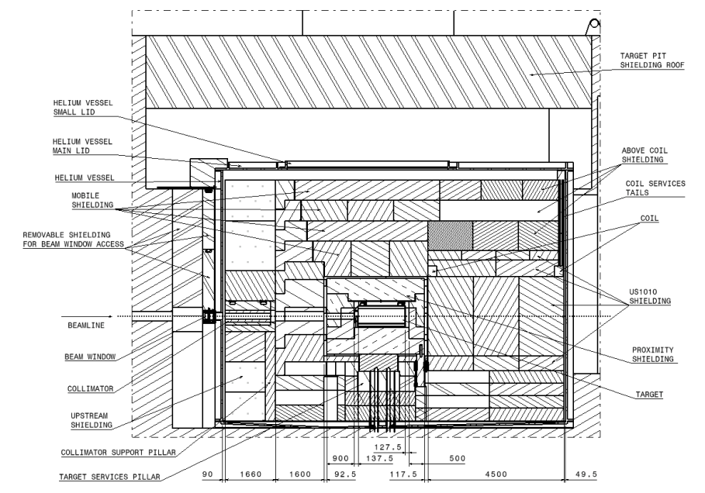
Layout ideas
Downstream diagnostics area: 5x4 m
Collimation and upstream diagnostics area: 10x4 m
Target + horn (1st phase) / superconducting solenoid (2nd phase)
Injection from TT10
Momentum selection chicane 10x 4 m
Target + Horn (and/or superconducting solenoid) - BDF
Cooling area: 50x4 m
Very detailed study thought from installation to decommissioning of the target
Target enclosed in a shielding bunker inside a helium vessel.
Target handled vertically with the building crane.
Services chimneys for electrical and cooling connections of the target and proximity shielding.
Target exchange via a shielded vessel.
Crane concept
Crane++ concept
https://doi.org/10.23731/CYRM-2020-002

Slide 12
Layout ideas
Downstream diagnostics area: 5x4 m
Collimation and upstream diagnostics area: 10x4 m
Target + horn (1st phase) / superconducting solenoid (2nd phase)
Injection from TT10
Momentum selection chicane 10x 4 m
Momentum selection chicane
Chicane (“dogleg”) for momentum selection
  What would be the momentum of the selected muons?
  And what would be the aperture of the magnets and beam line components?
Can also serve as extraction to other experiments (nuSTORM / ENUBET ?)
Set of Collimator, bending magnets, quadrupole magnets and a dump.
Highly radioactive
Cooling area: 50x4 m

Slide 13
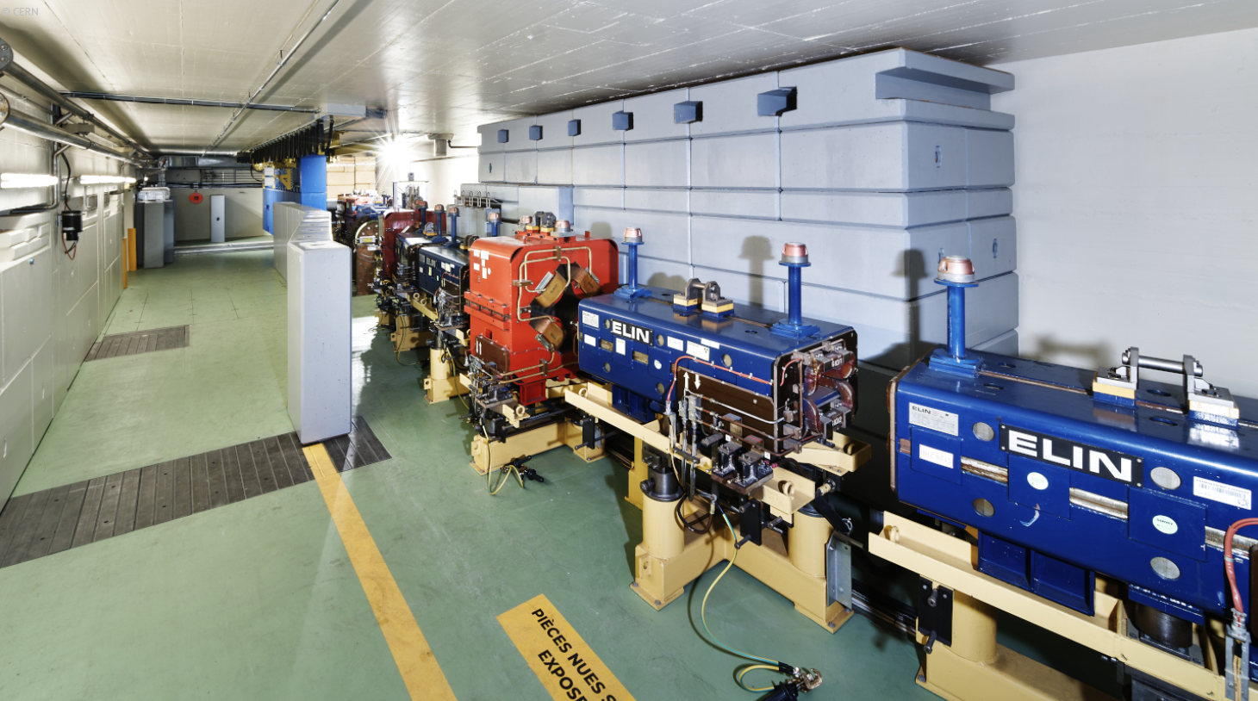
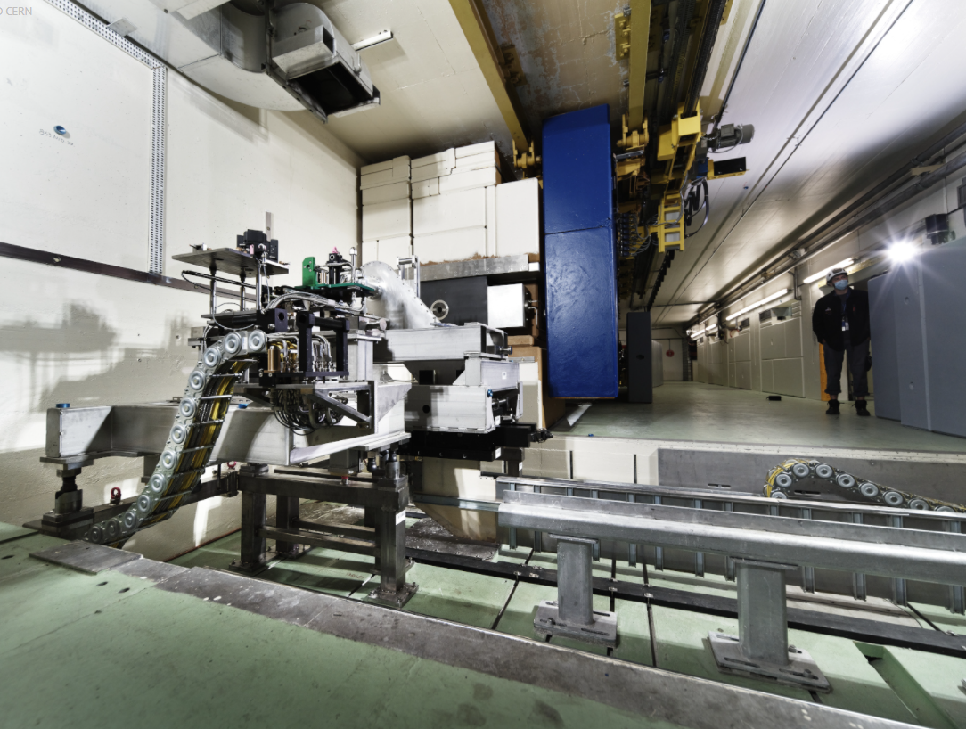
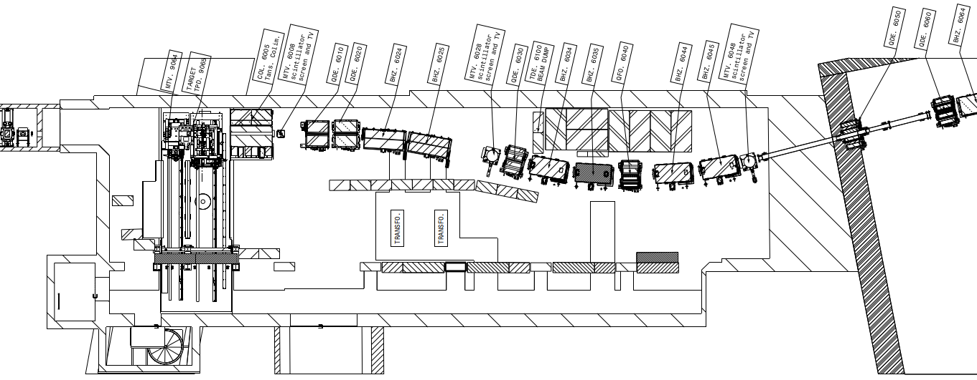
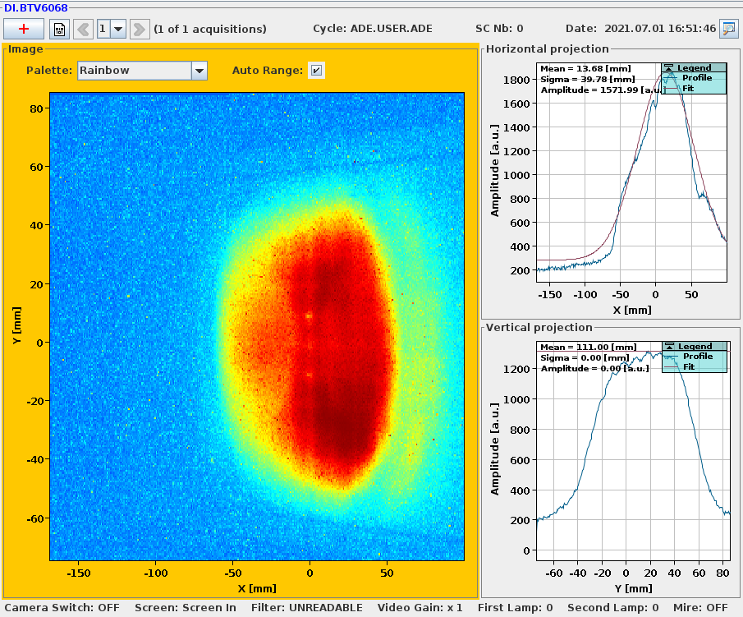
Layout ideas
Downstream diagnostics area: 5x4 m
Collimation and upstream diagnostics area: 10x4 m
Target + horn (1st phase) / superconducting solenoid (2nd phase)
Injection from TT10
https://cds.cern.ch/record/2773294?ln=en
Momentum selection chicane 10x 4 m
Momentum selection chicane – AD-Target Area @CERN
Cooling area: 50x4 m
Receives 26 GeV/c p⁺ beam from PS.
AD-T Chicane (“dogleg”) for 3.57 GeV/c momentum selection.
How will it be for the MUC ?
BTV downstream AD-T area

Slide 14
Layout ideas
Downstream diagnostics area: 5x4 m
Collimation and upstream diagnostics area: 10x4 m
Target + horn (1st phase) / superconducting solenoid (2nd phase)
Injection from TT10
Momentum selection chicane 10x 4 m
Muon Cooling Area
Collimation & upstream diagnostics + Muon Cooling area + Downstream diagnostics area
Collimation w/ ~5 x cryostats (Ø 2x4 m)
Cooling w/ ~10 x cryostats (Ø 2x4 m)
Needs a klystron area & other utilities
Cooling area: 50x4 m

Slide 15
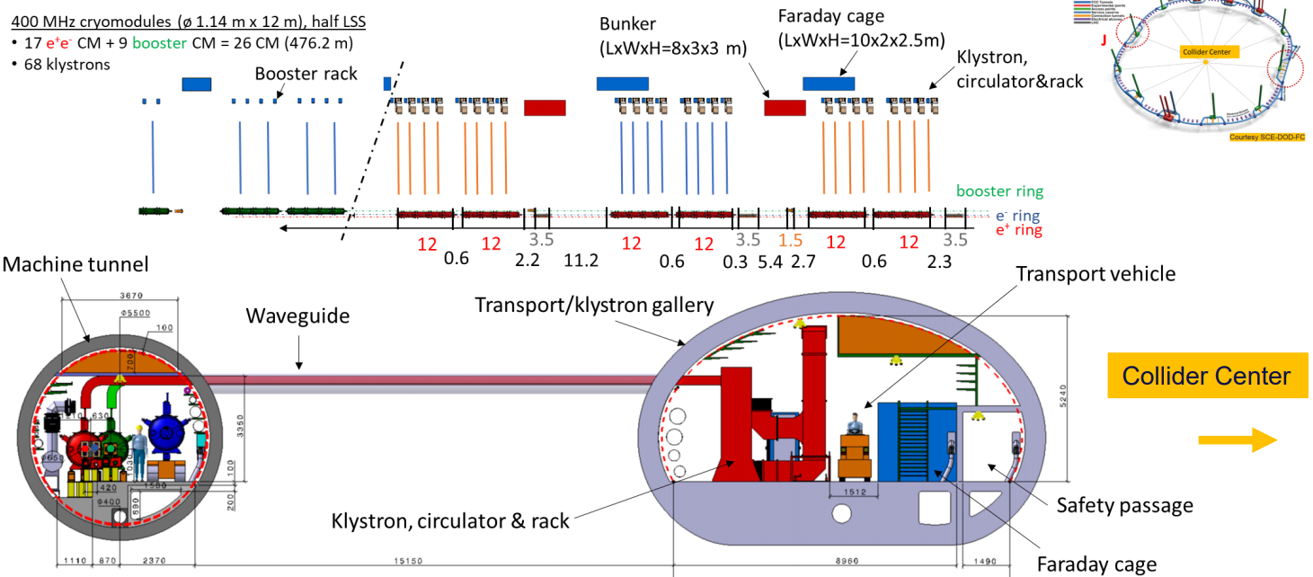
Layout ideas
Downstream diagnostics area: 5x4 m
Collimation and upstream diagnostics area: 10x4 m
Target + horn (1st phase) / superconducting solenoid (2nd phase)
Injection from TT10
Momentum selection chicane 10x 4 m
Muon Cooling Area - FCC e⁺e⁻ Crymodules tunnel & klystrons gallery
Cooling area: 50x4 m
Jean-Pierre Corso, Integration of the FCC, FCC Week 2021

Slide 16
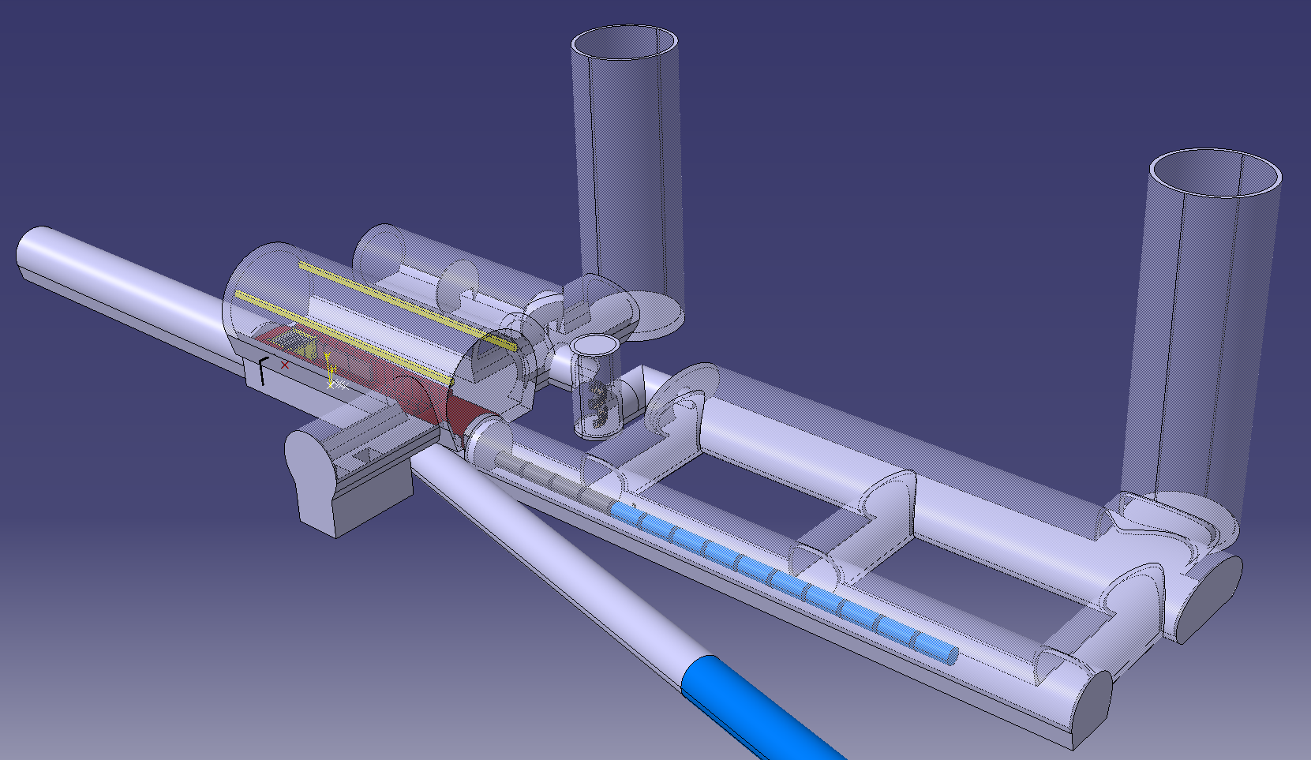
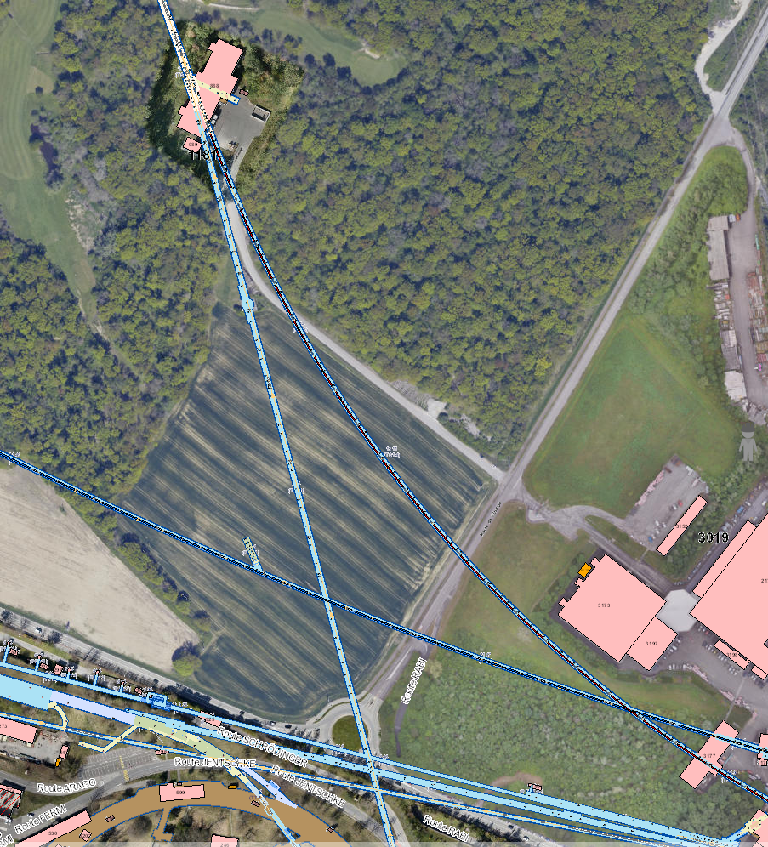
Conceptual layout
Downstream diagnostics area: 5x4 m
Collimation and upstream diagnostics area: 10x4 m
Target + horn (1st phase) / superconducting solenoid (2nd phase)
Injection from TT10
Momentum selection chicane 10x 4 m
MUC Demonstrator VERY Conceptual layout → To be taken with a “grain of salt”
Cooling area: 50x4 m
CERN TT10 branch

Slide 17
Conceptual layout
Downstream diagnostics area: 5x4 m
Collimation and upstream diagnostics area: 10x4 m
Target + horn (1st phase) / superconducting solenoid (2nd phase)
Injection from TT10
Momentum selection chicane 10x 4 m
MUC Demonstrator VERY Conceptual layout → To be taken with a “grain of salt”
Cooling area: 50x4 m
40 m
CERN TT10 branch
62 m
120 m
Indicative dimensions. Model is very flexible at this stage

Slide 18
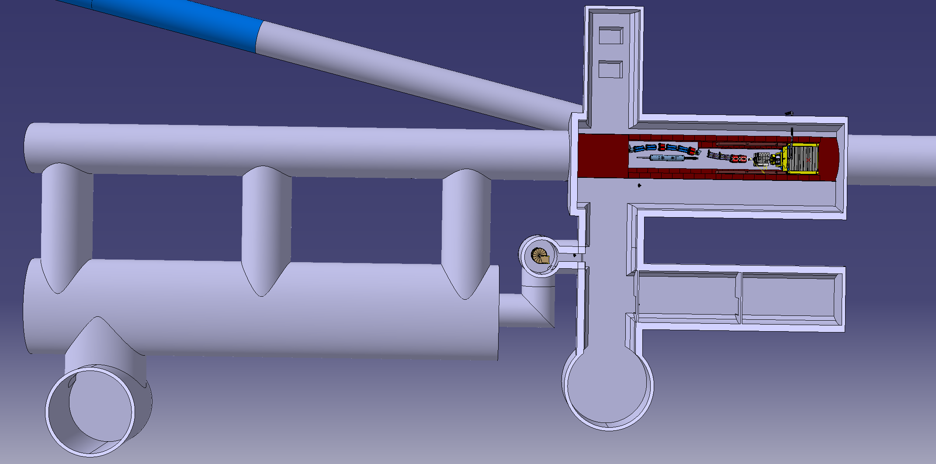
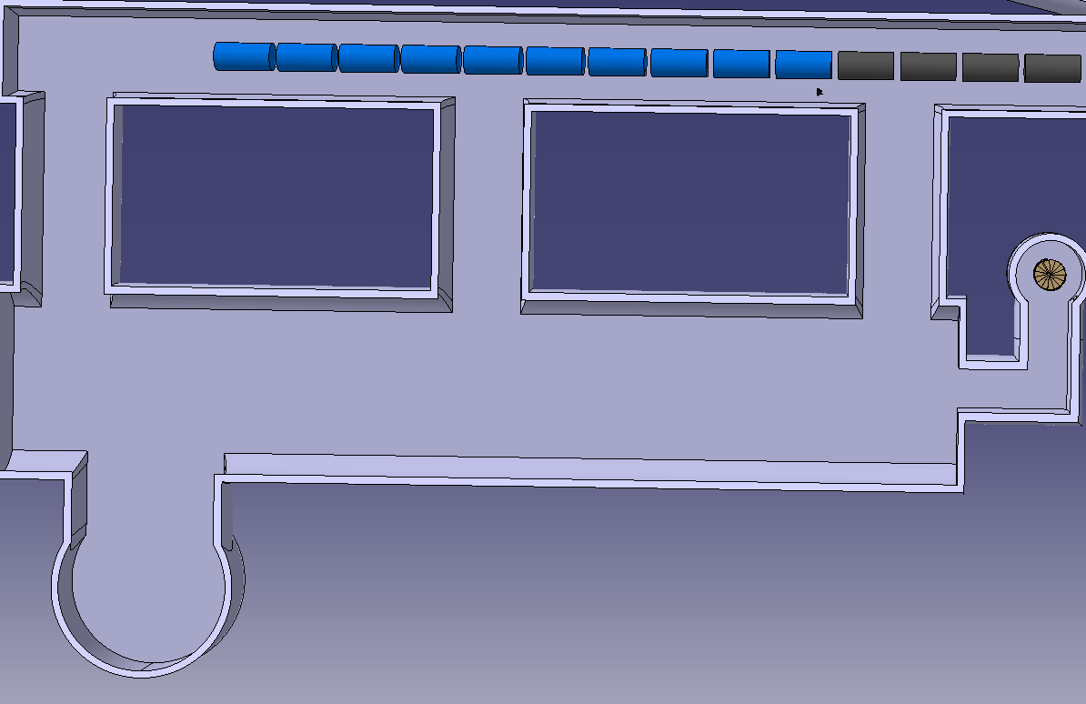
Conceptual layout
Downstream diagnostics area: 5x4 m
Collimation and upstream diagnostics area: 10x4 m
Target + horn (1st phase) / superconducting solenoid (2nd phase)
Injection from TT10
Momentum selection chicane 10x 4 m
MUC Demonstrator VERY Conceptual layout → To be taken with a “grain of salt”
Cooling area: 50x4 m
Space for radioactive storage
Branch to nuSTORM / ENUBET
Collimation + Cooling area
Extraction TT10
Target + Horn + dogleg
Service Gallery
Utilities room
Vertical shaft
Vertical shaft

Slide 19
Conceptual layout
Downstream diagnostics area: 5x4 m
Collimation and upstream diagnostics area: 10x4 m
Target + horn (1st phase) / superconducting solenoid (2nd phase)
Injection from TT10
Momentum selection chicane 10x 4 m
MUC Demonstrator VERY Conceptual layout → To be taken with a “grain of salt”
Cooling area: 50x4 m
Space for radioactive storage
Branch to nuSTORM / ENUBET
59.5 m
Collimation + Cooling area
Extraction TT10
Target + Horn + dogleg
5.5 m
81 m
11 m
38.5 m
5.5 m
Service Gallery
Utilities room
10.5 m
5.5 m
30 m
Indicative dimensions. Model is very flexible at this stage
Vertical shaft
Vertical shaft
Ø12 m

Slide 20
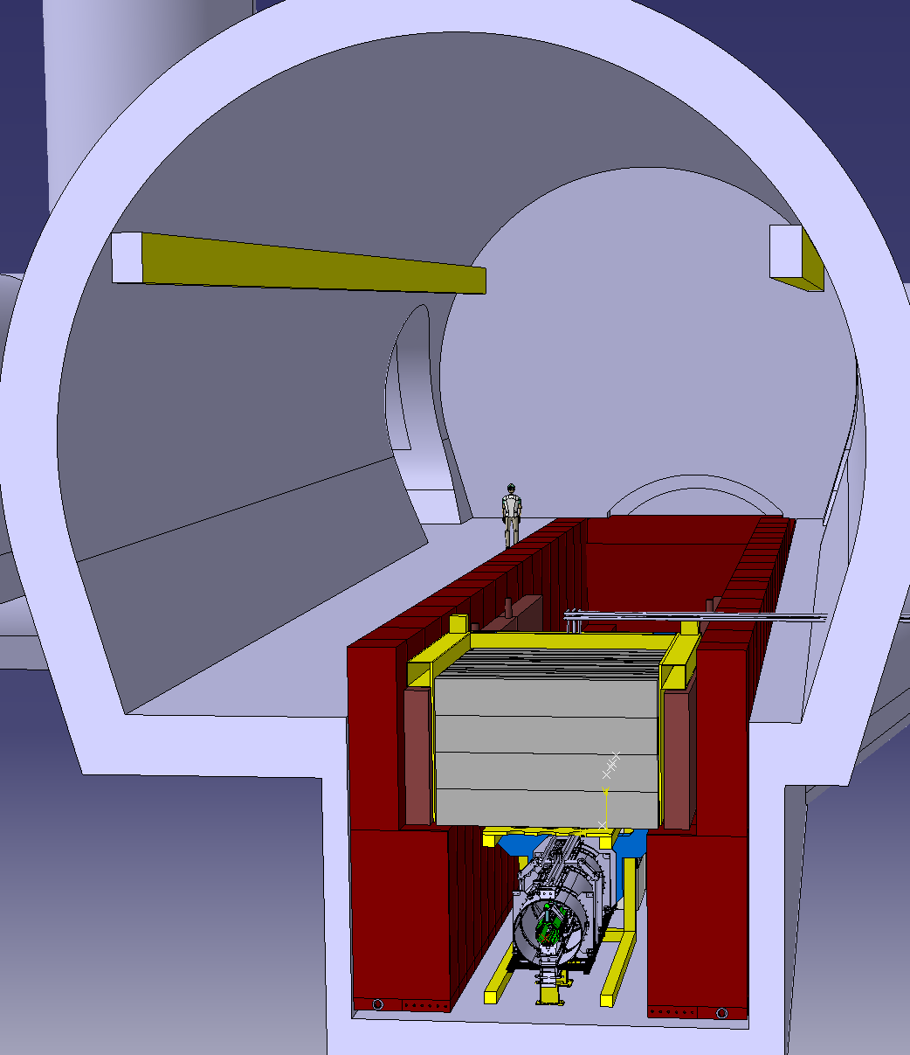
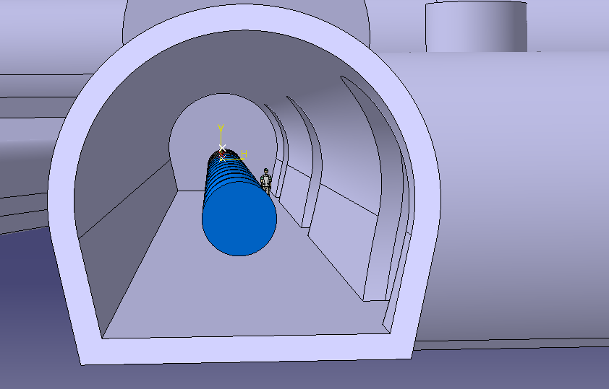
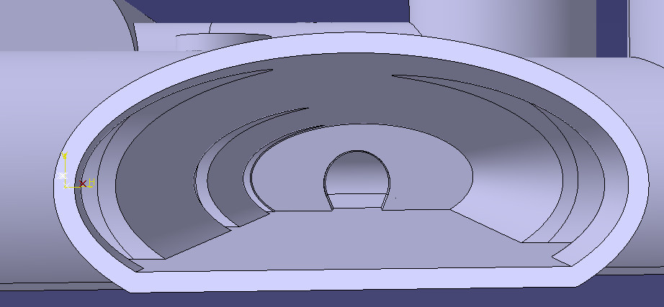
Conceptual layout
Downstream diagnostics area: 5x4 m
Collimation and upstream diagnostics area: 10x4 m
Target + horn (1st phase) / superconducting solenoid (2nd phase)
Injection from TT10
Momentum selection chicane 10x 4 m
MUC Demonstrator VERY Conceptual layout → To be taken with a “grain of salt”
Cooling area: 50x4 m
Target + Horn + chicane hall
Cooling tunnel
Services Gallery

Slide 21
Conceptual layout
Downstream diagnostics area: 5x4 m
Collimation and upstream diagnostics area: 10x4 m
Target + horn (1st phase) / superconducting solenoid (2nd phase)
Injection from TT10
Momentum selection chicane 10x 4 m
MUC Demonstrator VERY Conceptual layout → To be taken with a “grain of salt”
Cooling area: 50x4 m
Target + Horn + chicane hall
11 m
Cooling tunnel
Services Gallery
6.5 m
7 m
5.5 m
5.2 m
5.2 m
11 m
6.5 m
5.5 m
5 m
10.5 m
Indicative dimensions. Model is very flexible at this stage

Slide 22
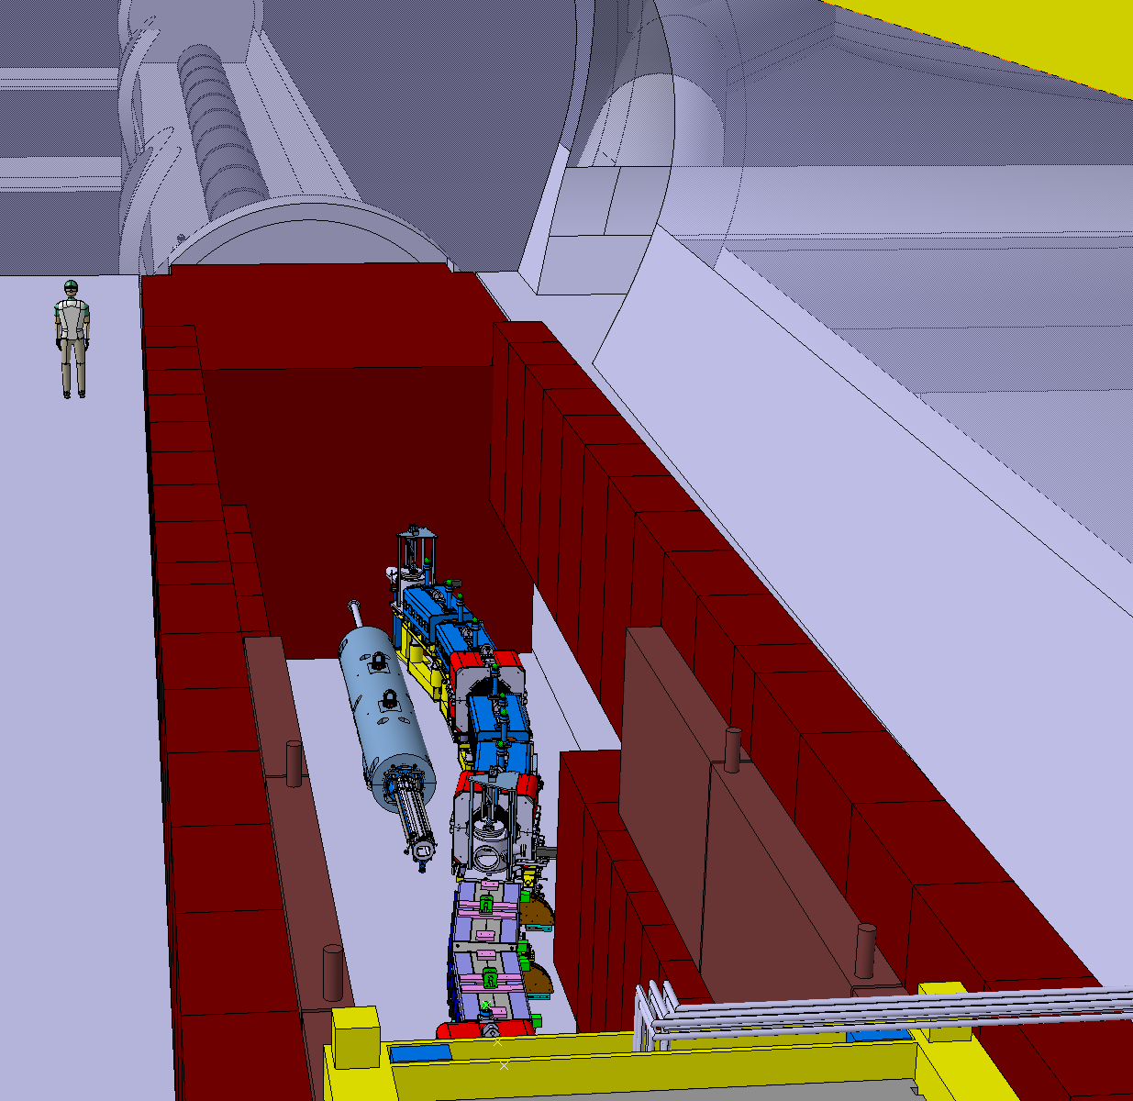
Conceptual layout
Downstream diagnostics area: 5x4 m
Collimation and upstream diagnostics area: 10x4 m
Target + horn (1st phase) / superconducting solenoid (2nd phase)
Injection from TT10
Momentum selection chicane 10x 4 m
MUC Demonstrator VERY Conceptual layout → To be taken with a “grain of salt”
Cooling area: 50x4 m
Target trench like system with beam line below tunnel floor level → robust solution for radio protection
Vertical handling with beam equipment in modules, placed in a vessel (N2) container
Close-by radioactive storage
Utilities in parallel gallery
Clear separation from downstream cooling area
Possibility to branch to other experiments
Flexible facility with space accounted for future upgrades. At an early stage (80 kW), shielding may be reduced for cost optimization and could start with a simple target & horn. Flexibility to introduce more complex target systems depending on the progresses of the studies for the final Muon collider .
**Representative elements only**
AD-T 3.57 GeV/c momentum chicane
TIDVG5 (450 GeV/c)
CENF Shielding, target & horn

Slide 23
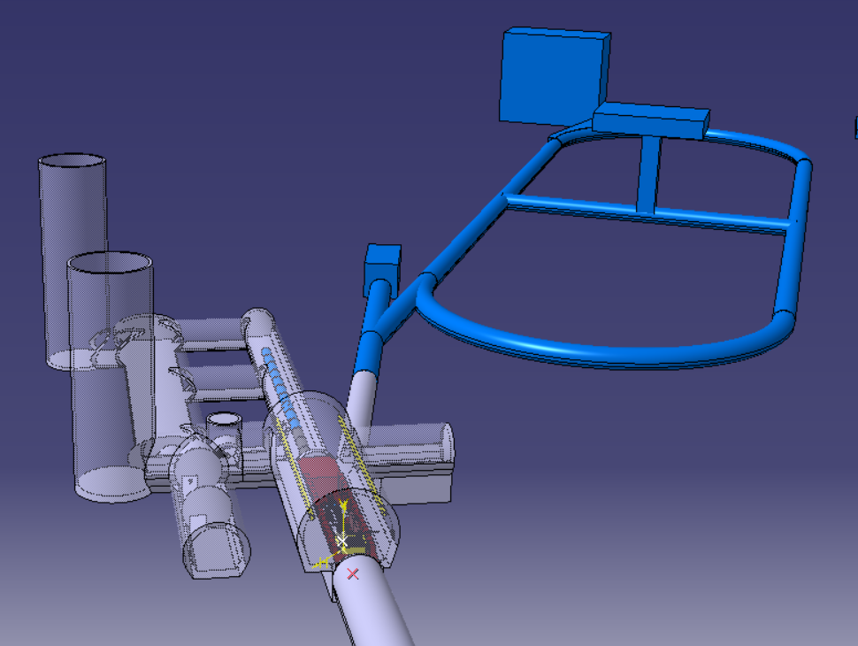
Conceptual layout
Downstream diagnostics area: 5x4 m
Collimation and upstream diagnostics area: 10x4 m
Target + horn (1st phase) / superconducting solenoid (2nd phase)
Injection from TT10
Momentum selection chicane 10x 4 m
MUC Demonstrator VERY Conceptual layout → To be taken with a “grain of salt”
Cooling area: 50x4 m
The Facility is flexible enough to accommodate other experiments.
nuSTORM and potentially ENUBET could be branched from the MUC Demonstrator Facility.
The same target complex would be used profiting from its shielding and general target systems infrastructure, utilities, and accesses.
The double deflection of the beamline could reduce radiation streaming towards the nuSTORM ring.
Synergies between experiments would reduce costs on both sides.
Is the 26 GeV/c beam from the PS appropriate for these two experiments?

Slide 24
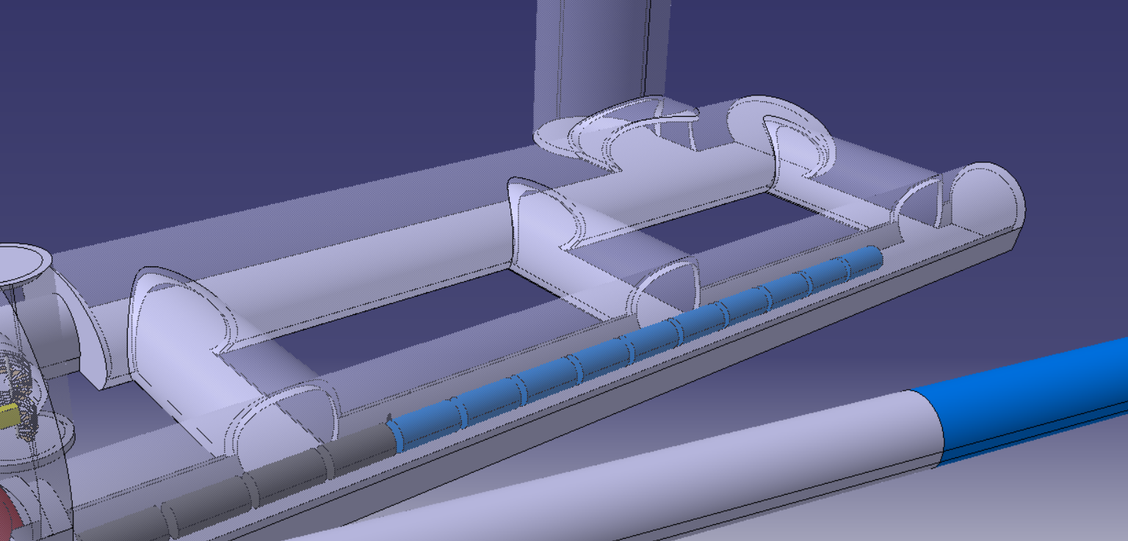
Conceptual layout
Downstream diagnostics area: 5x4 m
Collimation and upstream diagnostics area: 10x4 m
Target + horn (1st phase) / superconducting solenoid (2nd phase)
Injection from TT10
Momentum selection chicane 10x 4 m
MUC Demonstrator VERY Conceptual layout → To be taken with a “grain of salt”
Cooling area: 50x4 m
Muon Cooling section can be extended if needed
Experimental cavern (e.g. for low energy muons) can be foreseen downstream muon cooling tunnel

Slide 25
Conclusions
Supported on existing facilities and previous studies, a first MUC Demonstrator facility “concept” layout is show.
The facility shall be flexible enough & compatible with future upgrades.
3D facility modelling, even if with limited degree of detail is key for costing. Important to collect all requirements at this stage in order to be able to provide a first cost estimate by end of 2021, as requested by the study
Further inputs are needed, and early discussions with Civil engineering, RP, Transport, Cooling & ventilation, power, etc are of major importance
Comments and feedback are welcome! e.g. sizes of components in the collimator and muon cooling part, etc
by Rui FRANQUEIRA XIMENES* (on behalf of many other)
CERN – Systems Department
Sources Targets Interaction (STI)
Targets Collimators Dumps (TCD)
rui.franqueira.ximenes@cern.ch

Slide 26

Thank you
very much for your support and for your attention

