Slide 1


Pion Yield and Energy Deposition
Simulations
John Back
University of Warwick
2nd Muon Community Meeting, 12-14 July 2021

Slide 2
Introduction
Summary of νFact & μCollider π,μ yields & energy deposition
  Yields normalised to per proton per GeV (KE)
  Energy deposition studies: 4MW proton beam
  Published results from journals & conferences
Target simulation studies:
  International Design Study, Muon Accelerator Program, EUROnu, …
  Geometry based on solenoidal focusing
  MARS, FLUKA & GEANT4 packages (& ICOOL)
Target options: Hg or Ga liquid jets, W powder jet, W or C rods

Slide 3
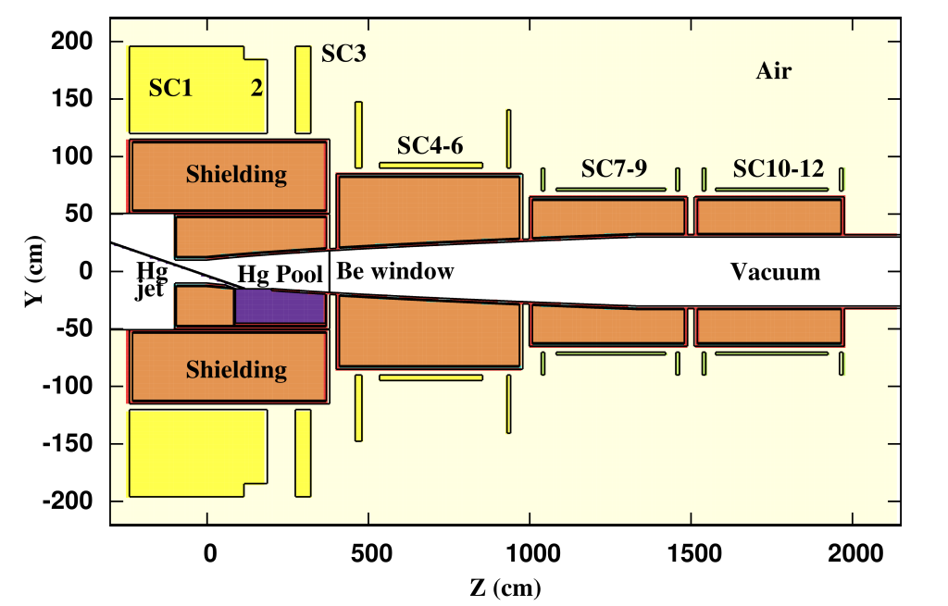
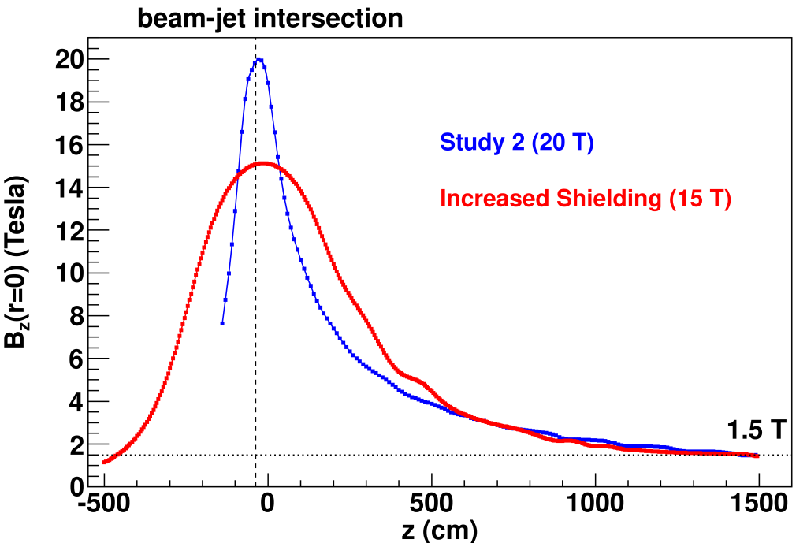
Target Simulation Geometry
IDS120j
Steel
60% W beads +
40% He cooling
Nb₃Sn
= 4 mm
Δ
θ_{B} = 65–90 mrad
Δθ = 20–30 mrad
σ = 0.3r_{jet}
Z
“IDS120j”: International Design Study, 120 cm SC inner radius, version j

Slide 4
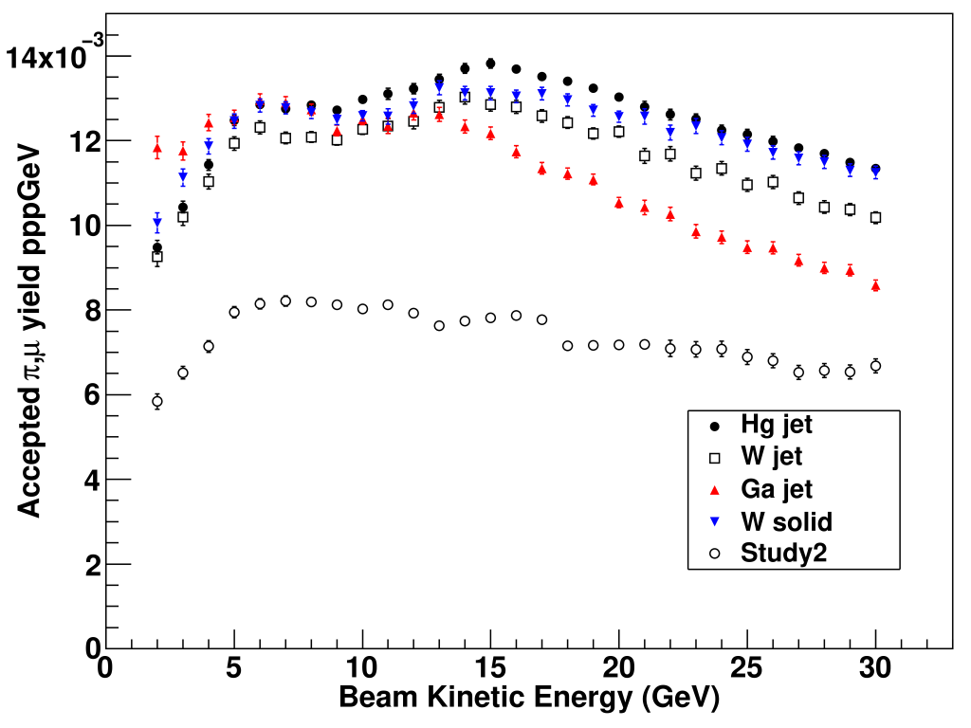
Accepted (π &) μ yields
Total N(μ⁺) + N(μ⁻)
Charge-averaged 0.5x[N(μ⁺) + N(μ⁻)]
Scoping Study
Design Report
MARS15 + ICOOL 3.2
Hg jet
FLUKA 2011.2.13
z = 50 m & 40 < E_{μ} < 180 MeV
W powder jet has 50% ρ
W solid bar: L = 20 cm, r = 1 cm
X. Ding et al., Phys. Rev. ST AB 14, 111002 (2011)
J. Back et al., Phys. Rev. ST AB 16, 021001 (2013)
Ga jet study: X. Ding et al., MOPPC044, IPAC12
W jet idea: C. Densham et al., WE1GRC04, PAC09

Slide 5
Graphite & Hg yields vs target radius (6.75 GeV p beam)
Graphite rod L = 80 cm, B = 20T – 2T over 5m
Hg jet, B = 15T – 2T or 4T over 5m
15-4T, 300 MeV
15-4T, 180 MeV
40 < KE < 300
15-2T, 300 MeV
ε_{geom}=σ²/β*
40 < KE < 180
10% increase
cf. 20T C target
15-2T, 180 MeV
MARS15(2014) study: X. Ding et al., TUPMY044, IPAC16

Slide 6

Global Front-End optimisation for graphite target yields
GEANT4 (G4beamline, QGSP model)
Lattice parameters from ICOOL
p beam: E = 6.75 GeV, σ = 2 mm
Graphite rod: L = 80 cm, r = 1 cm
θ_{rod} = θ_{beam} = 42 mrad (2.4º) wrt z axis
N_{μ}
$$\frac{Nμ}{p}$$
Saturates at ~7T
MARS15
Slide 5
End
Field
H. Sayed et al., MOPRI007, IPAC14

Slide 7
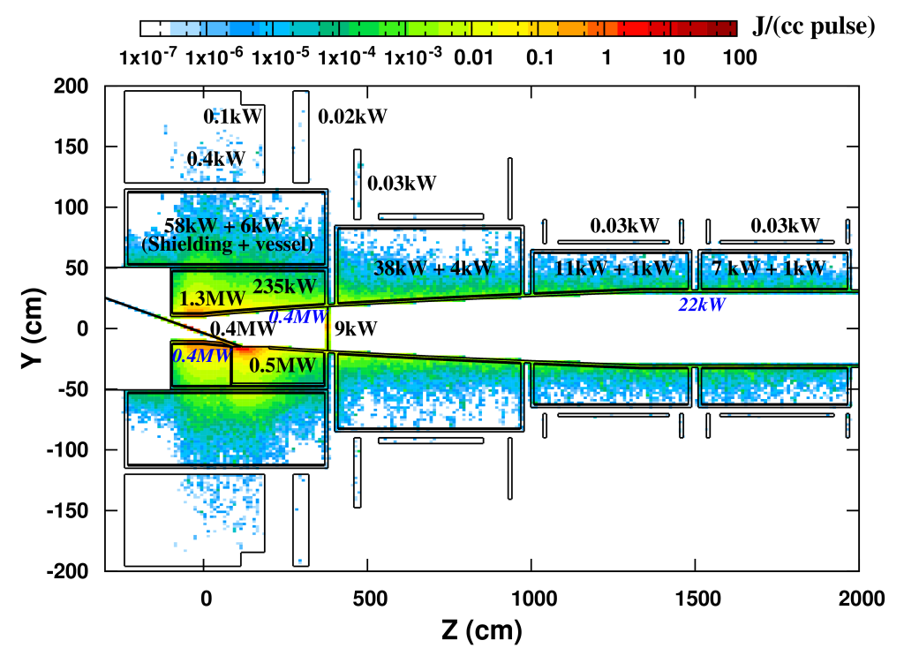
Energy Deposition (FLUKA 2011.2.13)
Phys. Rev. ST AB 16, 021001 (2013)
All SC coils: E_{dep} < 0.1mW/g
Hg jet target, B_{max} = 15T
IDS120j geometry
p beam:
8 GeV, 4MW, 50Hz,
3.125 x 10¹⁵ s⁻¹
Agrees with MARS15 (~10%)
N. Souchlas et al., WEPPD036, IPAC12

Slide 8
Graphite target energy deposition: 4MW & MARS15(2014)
B_{max}=20T
Power density in SC coils 1+2 vs z axis for different φ
Solenoidal helices: target π production peaks at φ = 235º
For 4MW, max E_{dep} = 0.2 mW/g = 2 x safe limit
K. McDonald et al., THPRI088, IPAC14

Slide 9
Conclusions
High atomic Z targets give best yields (p beam KE ~ 10 GeV)
  Important to also compare target operational lifetime & other safety issues
  Study of irradiated target materials: N. Simos et al., Phys. Rev. AB 21, 053001 (2018)
Graphite (He-cooled) “1st stage” 1MW target (L ~ 1m, r ~ 1cm)
  Normalised yields only 10% less (20T field) than Hg jet (15T field)
  More shielding needed for SC coils if beam power > 2 MW
Global optimisation with Front-End is required
  Solenoid field peak, taper & end-field depend crucially on SC + resistive coil setup
  Radiation shielding & structural (stored magnetic energy ~3GJ) constraints
Ideas for further discussion:
  Refine engineering details (structural supports & services) for a 1st stage graphite target
  Use hadronic model updates for MARS, GEANT4 & FLUKA
  Global optimisation with Front-End updates
  Maintain simulation input/geometry files in a github-like repository

Slide 10
Phys. Rev. ST AB 16, 021001 (2013)

