Slide 1
Study Horn-based Target System for Muon Collider
Katsuya Yonehara
Fermilab

Slide 2
Motivation
Challenge to make Multi-Mega-Watt Target System
  Heat and radiation treatment
    For NuMI, 1/3 of total beam power is deposited in Target hall, 1/3 in Decay Pipe, and 1/3 in Hadron Absorber
    For NuMI, C-graphite target was activated 75 Rad/hr on contact after servicing 2yrs with 1e21 POT
  Phase space manipulation for cooling channels
    Achromatic pion capture optics
Investigate horn based systems
  Sub-MW target system exist
  Make a conceptual model
  Run numerical simulation to validate a new horn concept
I introduced a solenoid-based target system which is shown in my previous presentation
https://indico.cern.ch/event/1049225/

Slide 3
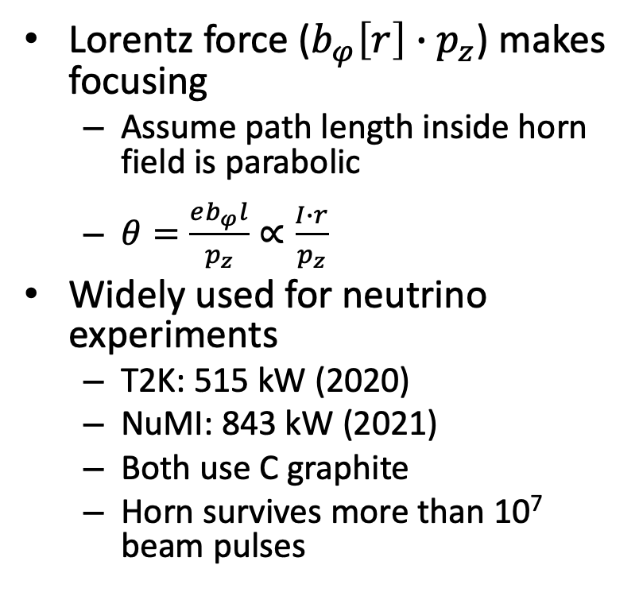
Horn-based target system
Lorentz force ($b_{φ}\left[r\right]∙p_{z}$) makes focusing
  Assume path length inside horn field is parabolic
  $θ=\frac{eb_{φ}l}{p_{z}}∝\frac{I∙r}{p_{z}}$
Widely used for neutrino experiments
  T2K: 515 kW (2020)
  NuMI: 843 kW (2021)
  Both use C graphite
  Horn survives more than 10⁷ beam pulses
Van der Meer’s original sketch of
magnetic horn in 1961

Slide 4
Neutrino target system
LBNF: State of the art target system
  1.5-m-long C graphite cantilever target
  He gas cooling
  Accept 1.2-MW beam
    Proton beam momentum 120 GeV/c
    Proton bunch length 5 ns
    Beam repetition rate 1.2 second

Slide 5
Apply Horn-based target system for Muon collider
Pros Cons
NuMI target scan
Technology exists
  A big confidence to operate > 1-MW beam
Focus single charge (?)
Complex beam optics (?)
Low energy pion will be lost at inner conductor and cooling water
  30 % pion lost reported in the past study (?)
Linear focusing by NuMI Horns
Horizontal proton beam position at NuMI target
No quantitative study made in the past
(or at least I cannot find any citation)

Slide 6
Conceptual design of Horn (I)
B. Zwaska (2021)

Slide 7
Numerical study of forward and backward pions/muons
P. Snopok, N. Muldrow (2021)
G4beamline
1-m-long Carbon
graphite target
(invisible in this plot)
Blue: positive charged particle
Red: negative charged particle
Green: neutral particle
Green circle: virtual detector
8 GeV protons

Slide 8
Preliminary simulation result (I)
Note: Proton momentum 1 to 10 GeV/c
1e6 POT

Slide 9
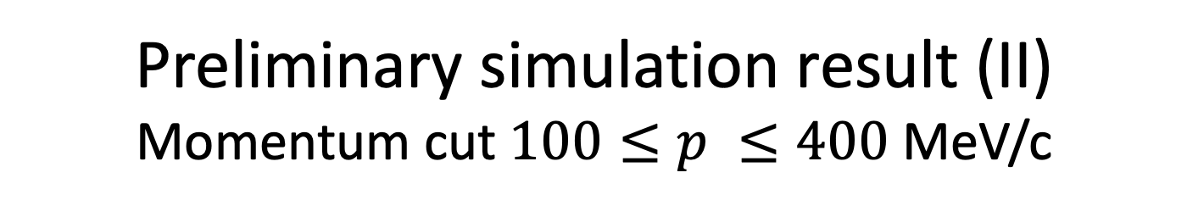

Preliminary simulation result (II)
Momentum cut $100≤p ≤400$ MeV/c
1e6 POT
Ratio of forward and backward $π/μ$ = 9:1

Slide 10
Conceptual design of Horn (II)
Horn is axisymmetric, no x-y asymmetry like quad
Focusing mode in horn depends on a direction of horn current vs beam current
Attractive
Repulsive
I
I
I
I
f
f
f
f

Slide 11

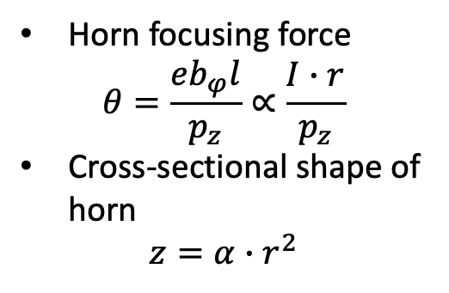
Toy model (I)
Horn
Horn focusing force
$$θ=\frac{eb_{φ}l}{p_{z}}∝\frac{I∙r}{p_{z}}$$
Cross-sectional shape of horn
$$z=α∙r^{2}$$
Target
Dashed line: actual particle track
Solid line: simplified ray trace
$$α∙r^{2}$$
Focusing geometry can be fixed from known dimensions with a simplified model
θ
Θ
r
δ
D
f

Slide 12
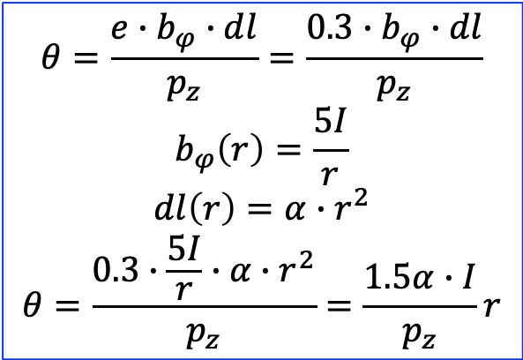
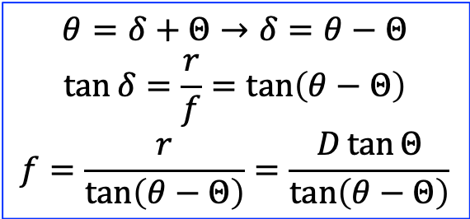
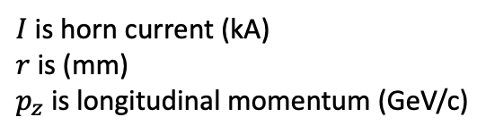
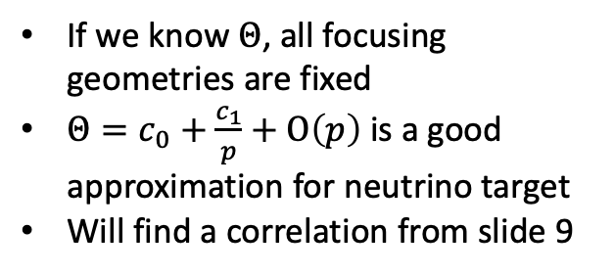
Toy model (II)
θ
Θ
r
δ
D
f
Geometry constraint
Focusing force
$$θ=δ+Θ→δ=θ−Θ$$
$$\tan{δ=\frac{r}{f}=\tan\left(θ−Θ\right)}$$
$$f=\frac{r}{\tan\left(θ−Θ\right)}=\frac{D\tan{Θ}}{\tan\left(θ−Θ\right)}$$
$$θ=\frac{e∙b_{φ}∙dl}{p_{z}}=\frac{0.3∙b_{φ}∙dl}{p_{z}}$$
$$b_{φ}\left(r\right)=\frac{5I}{r}$$
$$dl\left(r\right)=α∙r^{2}$$
$$θ=\frac{0.3∙\frac{5I}{r}∙α∙r^{2}}{p_{z}}=\frac{1.5α∙I}{p_{z}}r$$
If we know $Θ$, all focusing geometries are fixed
$Θ=c_{0}+\frac{c_{1}}{p}+Ο\left(p\right)$ is a good approximation for neutrino target
Will find a correlation from slide 9
$I$ is horn current (kA)
$r$ is (mm)
$p_{z}$ is longitudinal momentum (GeV/c)

Slide 13
Summary
Study a conceptually new horn-based target system
  Capture both charges

