Slide 1
Branching from TT10:
Very Preliminary Layout Studies
C. Bracco, K. Balazs and J. A. Osborne

Slide 2
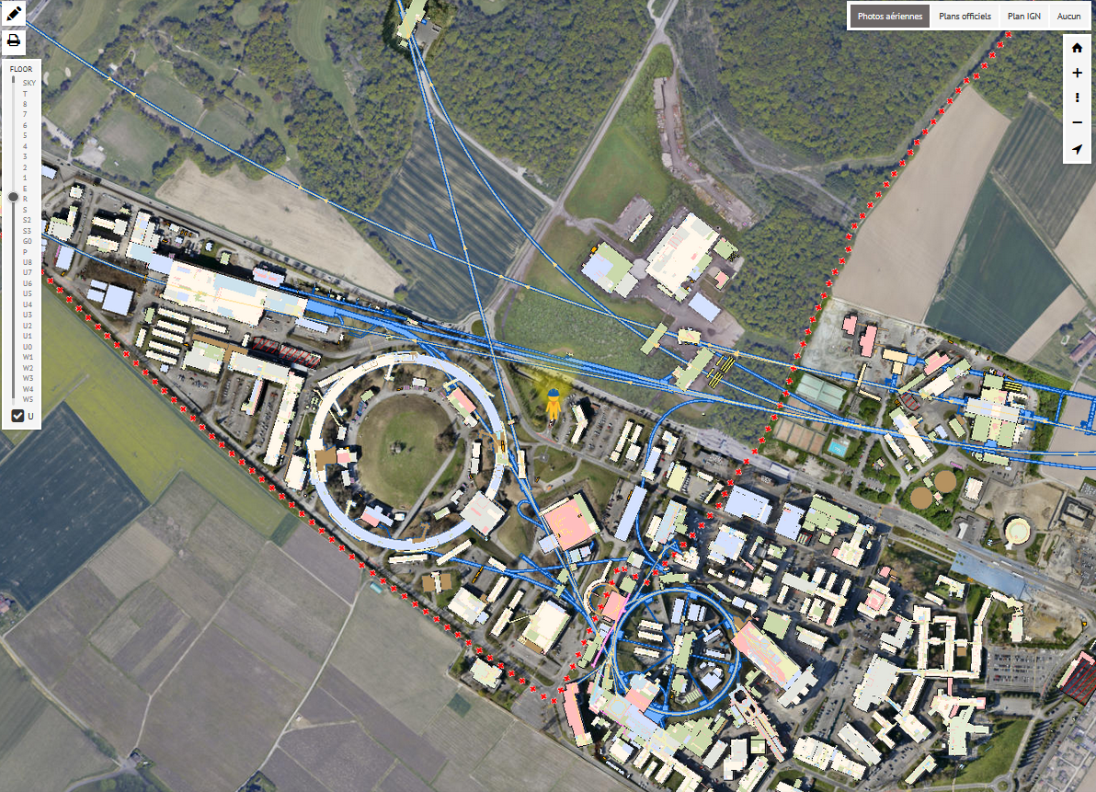
TT10 Branching
TT10
TT10: Transfer line from PS to SPS
First question: left or right?
The need of a junction cavern for this branching would constraint CE works to LS
Any way to avoid digging a junction cavern? ➔ have a as sharp as possible angle between line and tunnel walls!

Slide 3
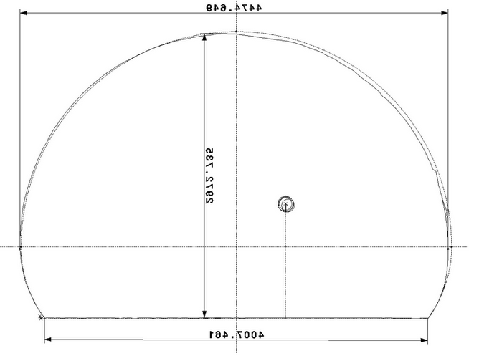
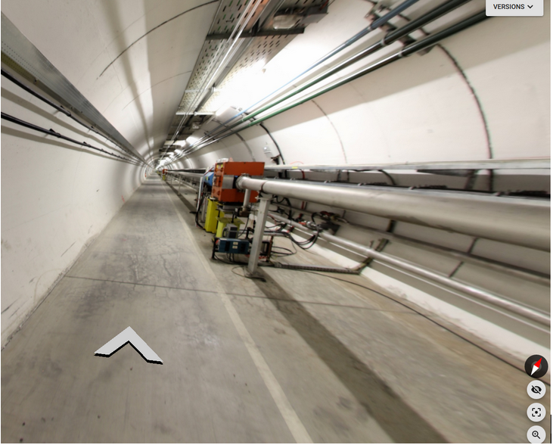
Tunnel and Present Layout
4744.649
2975.735
2771.83
1157.23
4007.461

Slide 4
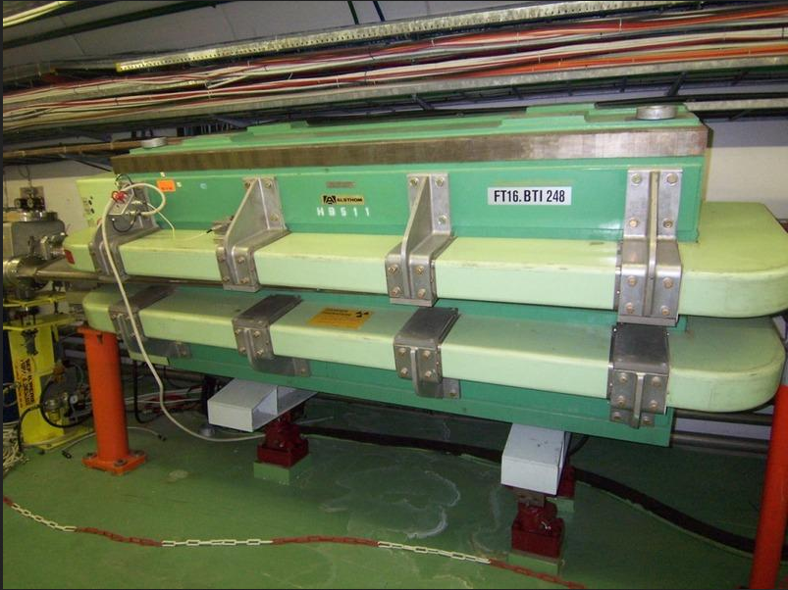
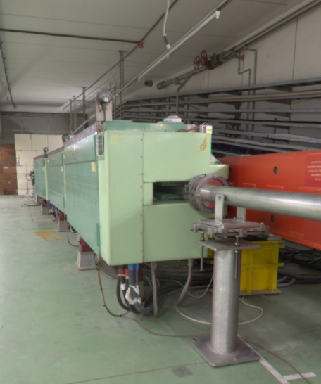
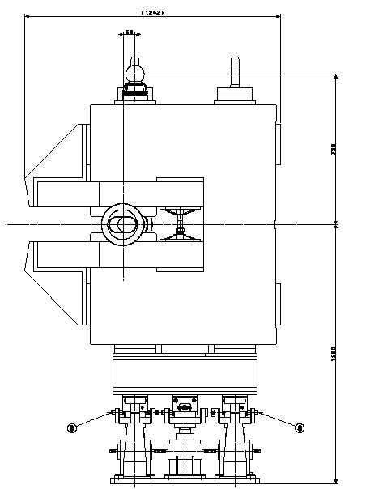
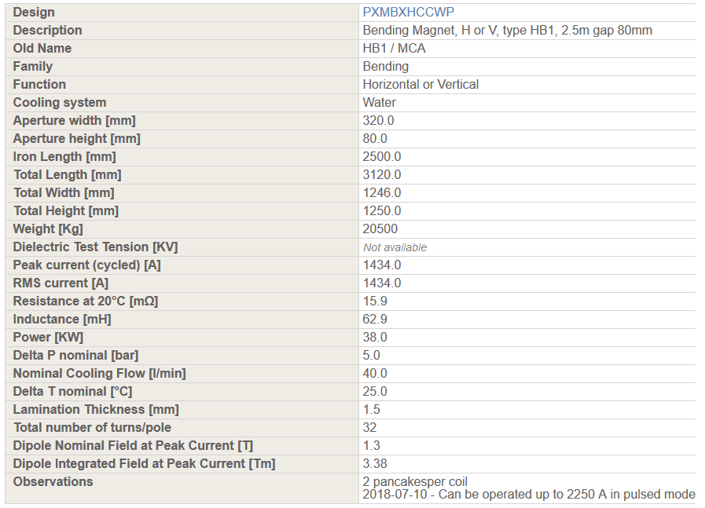
4744.649
1242.00
2536.70
PSZHMBAD0005
2975.735
1889.30
2771.80
1157.23
4007.461
Branching to the left (transport side!) gives the freedom of using more switch magnets ➔ sharper angle

Slide 5
4744.649
1242.00
PSZHMBAD0005
2975.735
1596.10
1157.23
4007.461
5 switch magnets each providing 0.0405 rad ➔ 1037 mm offset (without drifts) ➔Total angle wrt walls = 11.6°

Slide 6
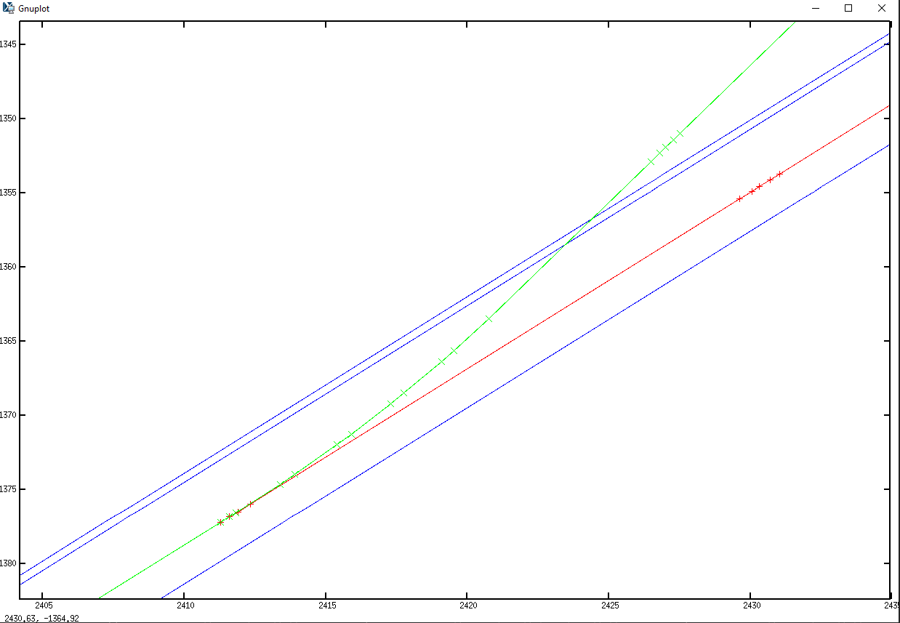
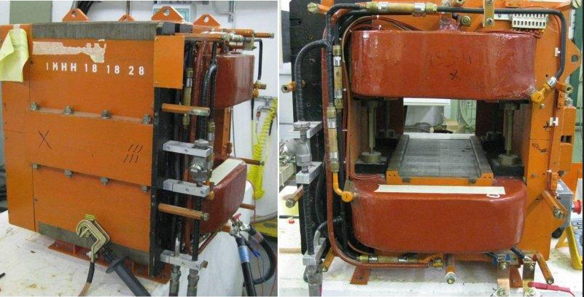
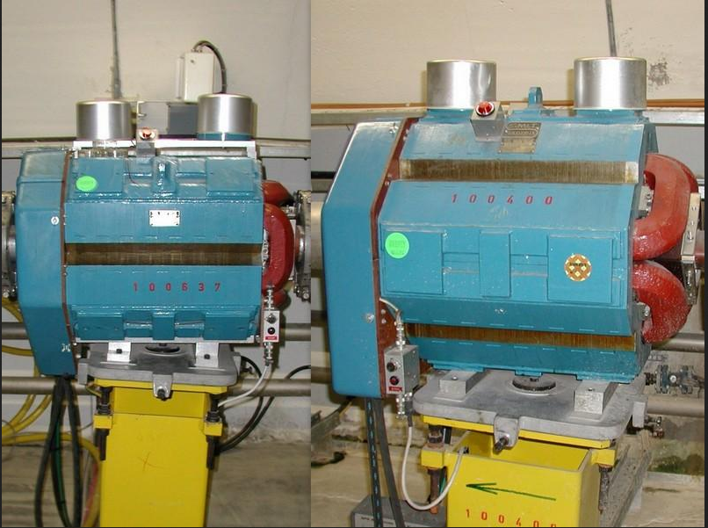
H [m] x W [m] x L [m] = 0.78 x 0.75 x 0.68
~5 m
~3 m
11.6°
H [m] x W [m] x L [m] = 1.25 x 1.25 x 3.12
H [m] x W [m] x L [m] = 0.78 x 0.75 x 0.68

Slide 7
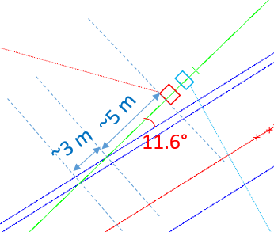
Zoom of critical region
< 1 m (0.13 m from wall to magnets)
Possible moving corrector+quadrupole further downstream? (enough aperture?)

Slide 8
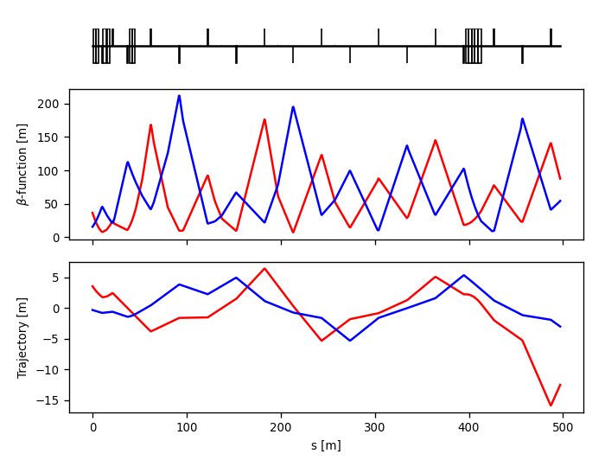
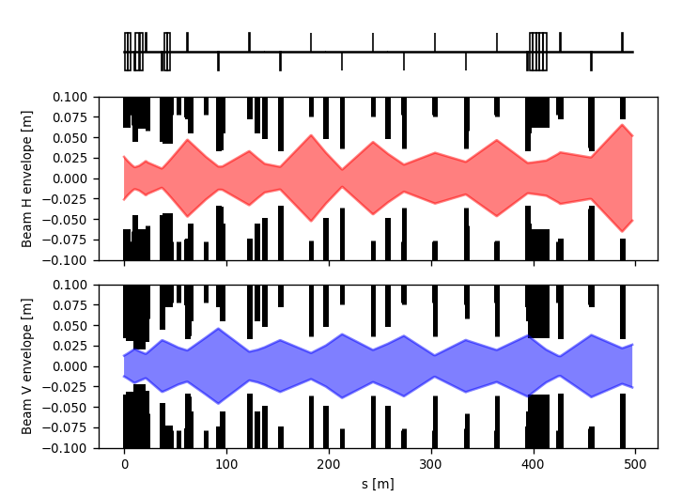
First glance at optics and Aperture
5 sigma envelope assuming 26 GeV and horizontal and vertical normalized 8 um and 6 um respectively

Slide 9
New extraction tunnel
Courtesy of K. Balazs
In order to allow the structural integrity of the existing and new tunnel we would need to keep a certain distance between the two. This distance it is marked with “D”, in our case the TT10 being 4 m wide that would mean approximately 5-6m distance between the two tunnels in the first 10-15 m, but in order to confirm we need to do a proper alignment drawing to see the exact dimensions.
Proposed location of the first magnet
0.5-1.0m free space for maintenance?
Approx. 35-40m
5-6 m (distance needed between the new and old tunnel)
11.6⁰
TT10
3m
In order to have D = 6 m the corrector+quadrupole magnets have to be moved 35-40 m more downstream
Junction cavern seems to be needed since also drilling a core of 35-40 m is not feasible

Slide 10
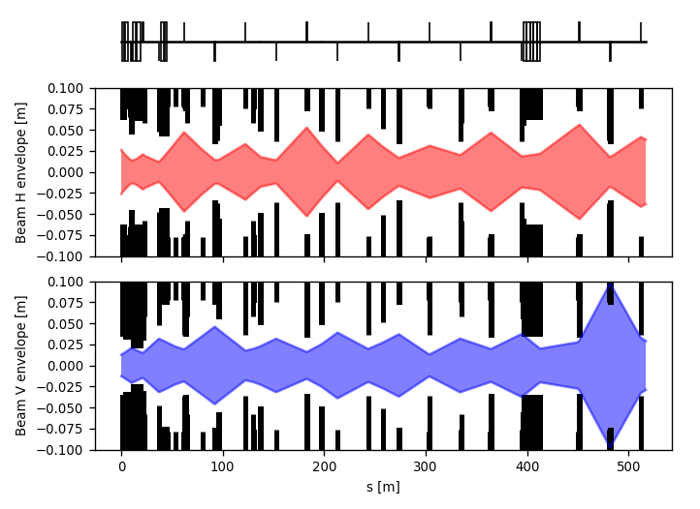
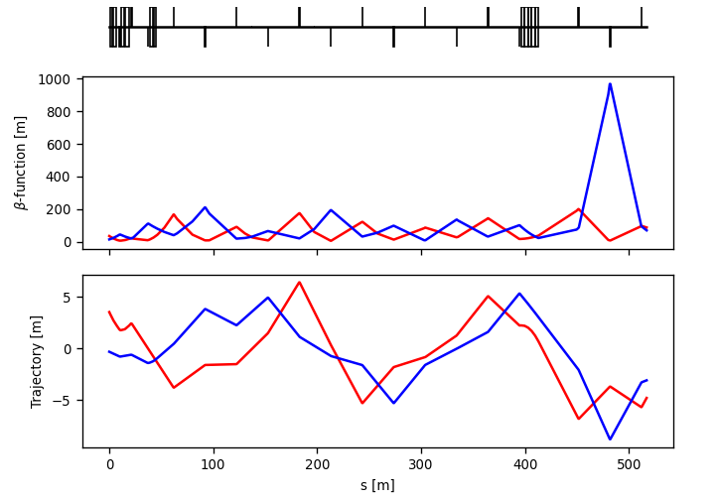
First glance at optics and Aperture
Moving Corrector+Quadrupole 25 m more downstream ➔ already out of aperture

Slide 11
Conclusions
Preliminary studies were performed to assess the possibility of avoiding a junction caver for branching from TT10 TL
Existing magnets are used
The sharpest angle (11.6°) can be obtained by branching towards the left side ➔ cutting transport passage (allowed?)
Also in this case, to allow for enough distance between the two tunnels, the first magnets in the new line should be to far (not enough aperture) and it would require drilling a 35-40 m core
Presently a junction cavern seems to be unavoidable….

Slide 12
Thank you for your attention!

Slide 13
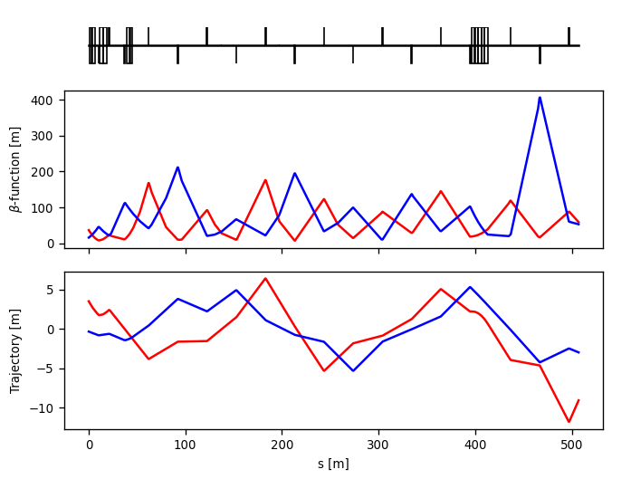
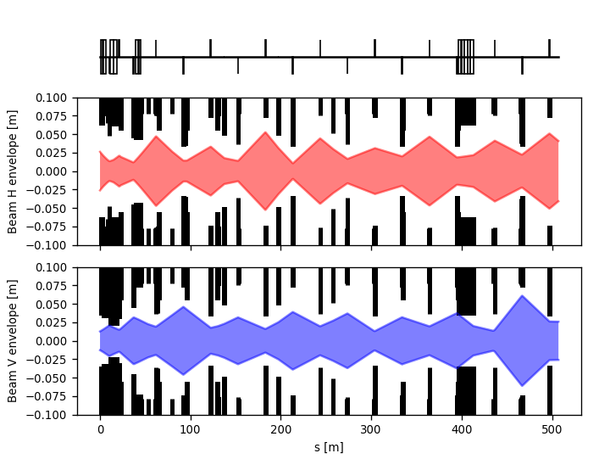
First glance at optics and Aperture
Moving Corrector+Quadrupole 10 m more downstream

Slide 14
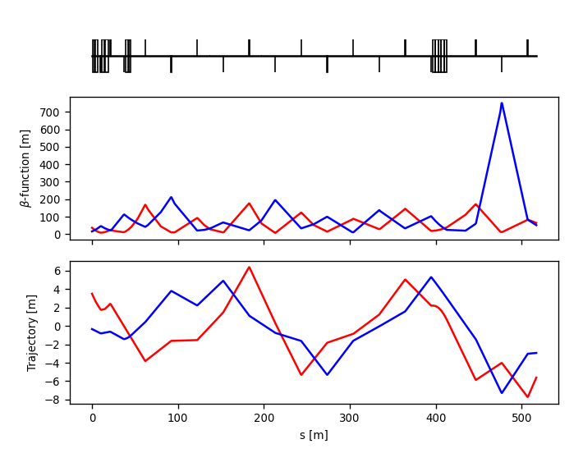
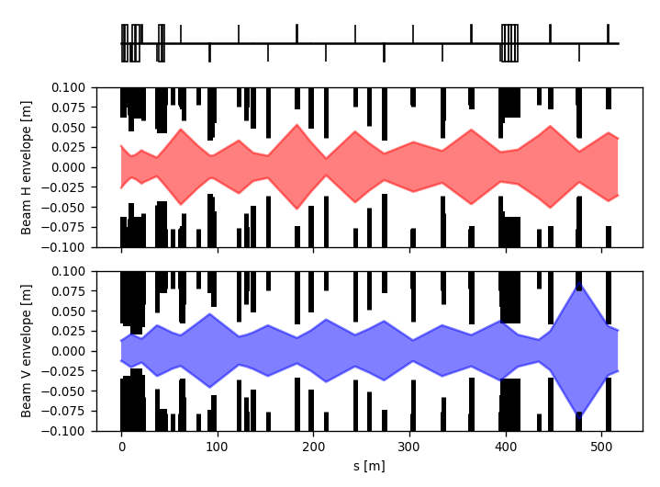
First glance at optics and Aperture
Moving Corrector+Quadrupole 20 m more downstream

