Slide 1
MC RF WG WP structure proposal - NRF
Jean-Pierre Delahaye, Alexej Grudiev, Derun Li, Akira Yamamoto
Monday, July 12, 2021

Slide 2
Charge for the 2nd community meeting
During the 1st community meeting, we identified a set of challenges in the delivery of the muon collider.
The goal now is to confirm those challenges and to develop them into a prioritised and resource loaded R&D list. In particular:
  Identify the R&D that has to be carried out before the next ESSU-PP to scientifically justify the investment into a full CDR for the muon collider and the corresponding demonstration programme. (next 5 years)
  Identify the main components of the demonstration programme together with the corresponding preparatory work.
  Realistic but ambitious targets for the performance goals of the different collider systems.
This includes R&D to develop a baseline collider concept, well-supported performance expectations and an assessment of the associated key risks, cost and power drivers.
Also the working groups should consider what could be assumed for the demonstration programme, i.e. in one or more test facilities starting in 2026, as well what one can anticipate to be available in 2035-2040 for a first collider stage and in 2050 for an energy upgrade.
Collect expression of interest (EOI) from potential collaborators interested to contribute to any specific work package (task)

Slide 3
Proposed Workpackage Description
Normal conducting RF (NRF) system for muon capture and cooling
Key Issues of NRF technology for muon capture and cooling
  High gradient at low frequencies
  In the presence of high magnetic field at multi-Tesla magnitude
  Large iris or Be windows;
  High peak RF power, independently powered cavities;
  RF sources and LLRF controls
  Engineering challenges of system integration with RF, SC magnet, cryogenics, and etc.
Many NRF cavities

Slide 4
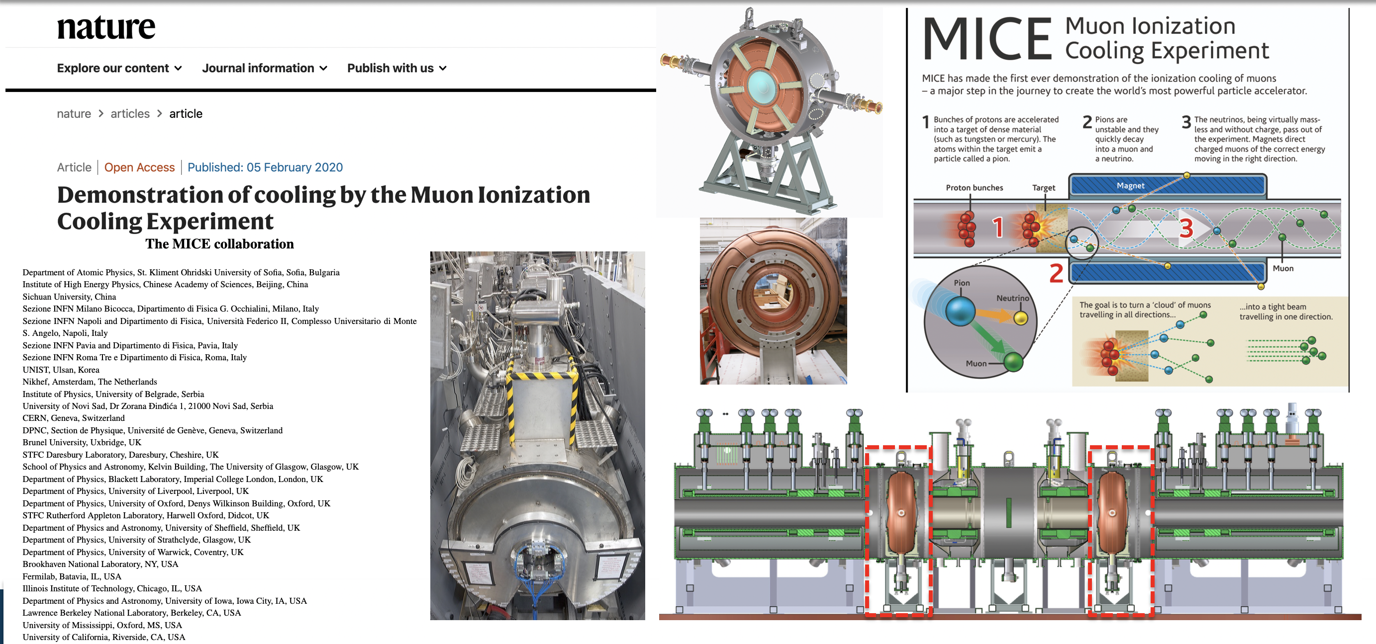
Proposed Workpackage Description
An example of MICE cooling channel:
Using normal conducting RF (NRF) system for muon cooling
The RF module has never been used in MICE, unfortunately

Slide 5
Summary of IMC RF systems https://www.dropbox.com/s/2e71dj9bzomglwm/MC_RF%20Summary%20Draft.xlsx?dl=0

Slide 6
NRF system parameters and challenges
High gradient NRF cavities are required for muon cooling, and complex normal conducting RF (NRF) system, and many of the cavities need to be independently powered and controlled at many different frequencies in the ranges from 20 to 650 MHz. Majority of the cavities operate at two main frequencies: 325 and 650 MHz at high gradients in a strong magnetic field at multi-Tesla magnitude.
Low frequency (large cavity): 325 - 650 MHz,
High gradient: 25 - 30 MV/m,
Strong magnetic field: 5 - 10 T
High peak current before bunch merge: 3.6E12 μ @325MHz => 187 A
Large bunch charge after bunch merge: 7.3E12 μ => 1168nC
Large beam aperture/window:
High level of beam losses and decay radiation
Technology is far from being mature. The closest example is a positron capture RF cavity: high frequency, high gradient, but not in so strong magnetic field.

Slide 7
Critical issues and R&D on NRF
Gap between performance of the prototype and the test cavities achieved so far must be closed. Based on the nominal parameters from the Muon Cooling WG: frequency, gradient, B-field, aperture and on the existing (and future) test results, design, build and test prototype cavities for the muon cooling test facility.
Achievable high gradient in a strong magnetic field requires continuous R&D on: alternative materials, gas versus vacuum, operation temperatures, pulse shapes and other new ideas. This requires a dedicated test stand on a time scale before the muon cooling test facility.
RF power source: Existing commercial RF power sources are by design operate at lower peak power but higher average power than what is needed for muon collider. This is driven by current applications. A new design of the RF power source targeting muon collider parameters (higher peak power, lower duty factor) and high efficiency must be pursuit.
Engineering design and integration: RF, SC magnet, cryogenics, etc.
Safety, maintenance and etc. associated with using Beryllium materials on cavity walls and beam windows.
Collective effects: beam loading, single and multi-bunch must be addressed.

Slide 8
NRF WP1: Baseline design of the RF system for Muon cooling complex. Design study for BDR
 | 1 | 2 | 3 | 4 | 5 | input | output
1. Collect consistent set of specification parameters for the design of all RF cavities for the muon cooling complex: frequency, gradient, length, B-field, aperture, … |  |  |  |  |  | MC
2. Based on available knowledge, identify best concept for achievable accelerating gradient in magnetic field: material, pulse shape, temperature, gas, …
3. Design few reference cavities which can be used to estimate parameters of all cavities specified in 1. Make a consistent set of parameters of all RF cavities and associated RF system |  |  |  |  |  |  | PPC
4. Integration RF cavities into cooling cell adapting design if necessary |  |  |  |  |  | MC,MG,CR, … | MC
5. Calculation of cavity parameters for simulation and mitigation of collective effects including beam loading |  |  |  |  |  | MC, BD | MC, BD

Slide 9
NRF WP2: Conceptual design of the RF system for Muon Cooling Test Facility. Design study for MCRF CDR
 | 1 | 2 | 3 | 4 | 5 | input | output
1. Collect consistent set of specifications for the design of RF cavity(es) for the MCTF: frequency, gradient, length, B-field, aperture, … |  |  |  |  |  | MC
2. Design the cavities specified in 1 using the concept identified in WP1.2 |  |  |  |  |  |  | TF
3. Design of the associated RF system for the MCTF |  |  |  |  |  |  | TF
4. Integration of the RF cavity into the MCTF cooling cell(s) including SC solenoid, cryogenics, diagnostics and etc. |  |  |  |  |  | MC,MG,CR,… | TF
5. Engineering design of the cavity in its environment including cooling, thermal and mechanical stability, alignment, RF diagnostic and tuning, …
6. Design of RF test stand for validating performance of RF cavities before installation in MCTF |  |  |  |  |  | MC,MG,CR,TF… | TF

Slide 10
NRF WP3: R&D on high gradient in a strong magnetic field and potential test cavities
 | 1 | 2 | 3 | 4 | 5 | input | output
1. Identify infrastructure available for potential use as (or setting up) a test stand for testing RF cavities in strong magnetic field: RF power source, SC solenoid,…
2. Design and build RF test stand based on available infrastructure, including diagnostics, vacuum and magnetic shielding and specified requirements
3. Propose test program adapted to potential test setup, considering possible limitations in terms of available frequency, power, magnetic field strength and size of the cavity
4. Design and build test cavities
5. Test the test cavities |  |  |  |  |  |  | RF

Slide 11
NRF WP4: RF power sources for muon cooling RF system. Design study + synergy
 | 1 | 2 | 3 | 4 | 5 | input | output
1. Based on the parameters of RF cavities set target specifications for the RF power sources for Muon cooling complex |  |  |  |  |  | MC
2. Address potential issues including: Large number of different frequency, Higher peak power requirements than currently available High efficiency
3. Baseline Design of RF power source(s) to provide information on the peak power capability, efficiency and cost |  |  |  |  |  |  | RF, PPC
4.

Slide 12
NRF WP5: ?
 | 1 | 2 | 3 | 4 | 5 | input | output
1.

Slide 13
Appendix:
General Guideline given by Daniel Shulte

Slide 14
Proposed Workpackage Description
Super conducting RF (SRF) system for muon acceleration to high energy
SRF system for high efficiency and highest acceleration rate to minimize the muon decay losses on the way to very high energies: ~10TeV
Key Issues:
  High charge, short bunches,
  High efficiency at high gradient
  Manufacturing quality
  Longitudinal and transverse stability

Slide 15
Timeline until next ESPPU
Exploratory Phase
Definition Phase
2021
2022
2023
2024
2025
4
1
2
3
4
1
2
3
4
1
2
3
4
1
2
3
4
1
2
3
4
Explore design
Identify critical issues
Explore and prioritise issues
Make design choices
Define realistic goals
Define design
Address feasibility issues
Develop design, refine choices
Develop R&D programme to demonstrate performances
Develop Muon Collider Roadmap
with LDG
Tentative list
Work
Study most critical issues from initial list to find solutions, further refine understanding, iterate
Initial list ready
Progressively formalise study structure
as work and contributions become clear
Work
Prioritised list ready

Slide 16
Proposed Workpackage Resources
A table of the initial estimated required resources in FTE years, specifying staff, post-doc and student. If possible, resources should be associated with the tasks.
This is only indicative to get over the shock of having to fill such tables.
Also a list of who is interested in participating to define the work and carry it out.
There is no commitment required.
Task | Staff [pm] | postdoc [pm] | student [pm] | Cash [kEUR] | Comment

Slide 17
Technically Limited Long-Term Timeline
ESPPU
ESPPU
Exploratory
phase
Definition
phase
Collider CDR phase
Test facility implementation
Collider TDR phase
Approval preparation
2021
2022
2023
2024
2025
2026
2027
2028
2029
2030
2031
2032
2033
2034
2035
2036
2037
2038
2039
2040
Collider Design
Baseline design
Design optimisation
Project preparation
Construction
Test Facility
Design
Construct
Exploit and upgrade
Technologies
Design / models
Prototypes / t. f. comp.
Prototypes / pre-series
Collider baseline and test facility design ready
Cost scale known
ESPP decision
Selected TF host
Ready to commit Cost known
Ready to construct

