Slide 1
MC RF WG WP structure summary
Jean-Pierre Delahaye, Alexej Grudiev, Derun Li, Akira Yamamoto
2021/07/13
2nd Muon community meeting

Slide 2
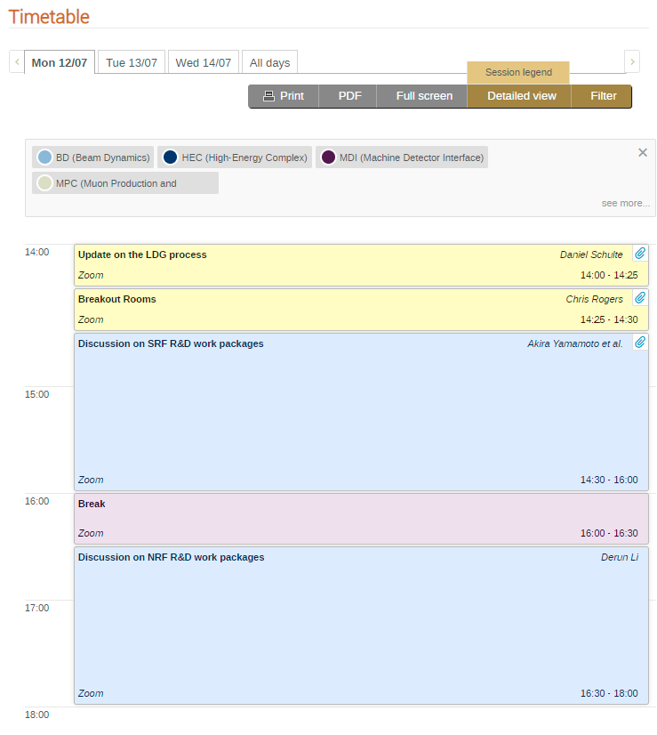
MC RF WG parallel session
Discussion on SRF
Chair: Akira Yamamoto
5 participants
Discussion on NRF
Chair: Derun Li
3 participants

Slide 3
Super conducting RF (SRF) system for muon acceleration to high energy
SRF system for high efficiency and highest acceleration rate to minimize the muon decay losses on the way to very high energies: ~10TeV
  High charge, short bunches,
  High efficiency at high gradient
  Manufacturing quality
  Longitudinal and transverse stability

Slide 4
Summary of IMC RF systems https://www.dropbox.com/s/2e71dj9bzomglwm/MC_RF%20Summary%20Draft.xlsx?dl=0

Slide 5
SRF system parameters and challenges
SRF system for high efficiency and highest acceleration rate to minimize the muon decay losses on the way to very high energies: ~10TeV
  Large bunch charge in the linacs: 3.6 x 10¹² μ => 576 nC
  Large bunch charge in the rings: 2.2 x 10¹² μ => 352 nC
  Short bunch length in the collider: 1.5 mm
  Highest possible gradient : ≥ 35 MV/m ?
  Power efficiency: > 70 % ?
  High energy gain per turn in the rings: ?
  High level of radiation: ?
  Stray magnetic field : ?

Slide 6
Critical issues and R&D on SRF
Design of the RF system: including acceleration, longitudinal beam dynamics, wake-fields, bunch length, and energy spread control for RF cavity design.
High gradient: at low frequency multi cell cavities: >> 20 MV/m ?, @ 325, 650 MHz with seeking for common SRF cavity frequency beneficially applicable to various project with saving synergy.
Technology choice: Bulk vs Coating; Different materials: Nb, (Nb3Sn, HTS, …) in 5 yrs
Cavity type(shape) and Surface Treatment: for high gradient and high Q (low loss factor)
Pulsed operation: Lorenz force detuning in pulsed (strong transient) mode.
RF power sources: pulsed, high peak power, high efficiency: > 70 % ?
Tolerance: to external (stray) magnetic field, … Which level?
  With common motivation with HTS beam-screen under ≥ 16 T for the FCC-hh
Tolerance: to the radiation and beam loss
Power couplers:

Slide 7
SRF WP1: Baseline design of the RF system for acceleration to high energy: Design study
 | 1 | 2 | 3 | 4 | 5 | input | output | EOI
Baseline design of the RF systems for RCSs including acceleration, longitudinal beam dynamics and stability, bunch length and energy spread control. Provide specifications for cavity design: frequency, R/Q, HOM suppression. Provide specification for RF power sources: frequency, power, … |  |  |  |  |  | HEC, BD, MG | PPC | CERN SY-RF
Calculation of cavity parameters for fundamental mode parameters: R/Q, Vmax; as well as for HOMs and wakes for the design work in 1. |  |  |  |  |  |  |  | UoR
RF design of the cavities for the RCSs as input to BDR |  |  |  |  |  |  |  | UoR
Design of the RF cavities for LA and RLAs based on the specifications from HEC and BD |  |  |  |  |  | HEC, BD |  | UoR

Slide 8
SRF WP2: High gradient SRF technology for muon accelerators. Synergy + potential prototypes
 | 1 | 2 | 3 | 4 | 5 | input | output
1. Provide limiting values for RF cavity and RF system design from SRF State of the Art: Gradient and Q0 at different frequencies: 325, 650, 1300 MHz Tolerances to external (stray) magnetic fields Tolerances to radiation and beam loss |  |  |  |  |  |  | RF
2. High gradient prototype of lowest frequency (325 MHz) accelerating structure to target high gradient: >20 MV/m
3. RF power sources: High efficiency baseline design based on the parameter specification from WP1 to provide information on the power and cost |  |  |  |  |  |  | PPC
4. Synergy: Look for synergy in SRF technology with already ongoing projects and R&D activities. Direct them to the parameter space relevant for muon collider High gradient at low frequencies Tolerances to magnetic field, radiation and beam loss |  |  |  |  |  |  | RF HEC BD

Slide 9
Normal conducting RF (NRF) system for muon capture and cooling
Key Issues of NRF technology for muon capture and cooling
  High gradient at low frequencies
  In the presence of high magnetic field at multi-Tesla magnitude
  Large iris or Be windows;
  High peak RF power, independently powered cavities;
  RF sources and LLRF controls
  Engineering challenges of system integration with RF, SC magnet, cryogenics, and etc.
Many NRF cavities

Slide 10
Summary of IMC RF systems https://www.dropbox.com/s/2e71dj9bzomglwm/MC_RF%20Summary%20Draft.xlsx?dl=0

Slide 11
NRF system parameters and challenges
Complex normal conducting RF (NRF) system, and many of the cavities need to be independently powered and controlled at many different frequencies in the ranges from 20 to 650 MHz. Majority of the cavities operate at two main frequencies: 325 and 650 MHz at high gradients in a strong magnetic field at multi-Tesla magnitude.
Low frequency (large cavity): 325 - 650 MHz,
High gradient: 25 - 30 MV/m,
Strong magnetic field: 5 - 10 T
High peak current before bunch merge: 3.6E12 μ @325MHz => 187 A
Large bunch charge after bunch merge: 7.3E12 μ => 1168nC
Large beam aperture/window:
High level of beam losses and decay radiation
Technology is far from being mature. The closest example is a positron capture RF cavity: high frequency, high gradient, but not in so strong magnetic field.

Slide 12
Critical issues and R&D on NRF
Gap between performance of the prototype and the test cavities achieved so far must be closed. Based on the nominal parameters from the Muon Cooling WG: frequency, gradient, B-field, aperture and on the existing (and future) test results, design, build and test prototype cavities for the muon cooling test facility.
Achievable high gradient in a strong magnetic field requires continuous R&D on: alternative materials, gas versus vacuum, operation temperatures, pulse shapes and other new ideas. This requires a dedicated test stand on a time scale before the muon cooling test facility.
RF power source: Existing commercial RF power sources are by design operate at lower peak power but higher average power than what is needed for muon collider. This is driven by current applications. A new design of the RF power source targeting muon collider parameters (higher peak power, lower duty factor) and high efficiency must be pursuit.
Engineering design and integration: RF, SC magnet, cryogenics, etc.
Safety, maintenance and etc. associated with using Beryllium materials on cavity walls and beam windows.
Collective effects: beam loading, single and multi-bunch must be addressed.

Slide 13
NRF WP1: Baseline design of the RF system for Muon cooling complex. Design study
 | 1 | 2 | 3 | 4 | 5 | input | output
1. Collect specifications for the design of all RF cavities for the muon cooling complex: frequency, gradient, length, B-field, aperture (window size and thickness), … |  |  |  |  |  | MC
2. Based on available knowledge both experimental and theoretical, identify best concept for achievable accelerating gradient in magnetic field: material, pulse shape, temperature, gas, …
3. Calculate parameters of all cavities specified in 1. Provide a consistent set of parameters of all RF cavities and associated RF systems |  |  |  |  |  |  | PPC
4. Integration of RF cavities into cooling cell, adapting design if necessary |  |  |  |  |  | MC,MG,CR, … | MC
5. Mitigation of collective effects including beam loading by design of RF cavities and RF systems |  |  |  |  |  | MC, BD | MC, BD
CEA, LBNL are interested

Slide 14
NRF WP2: Conceptual design of the RF system for Muon Cooling Test Facility (MCTF). Design study
 | 1 | 2 | 3 | 4 | 5 | input | output
1. Collect specifications for the design of RF cavities for the MCTF: frequency, gradient, length, B-field, aperture, … |  |  |  |  |  | MC
2. Design the RF cavities specified in 1 using the concept identified in WP1.2 |  |  |  |  |  |  | TF
3. Design of the associated RF systems for the MCTF |  |  |  |  |  |  | TF
4. Integration of the RF cavity into the MCTF cooling cell(s) including SC solenoid, cryo, etc |  |  |  |  |  | MC,MG,CR,… | TF
5. Engineering design of the cavity in its environment including cooling, thermal and mechanical stability, alignment, RF diagnostic and tuning, …
6. Design of RF test stand for validating performance of RF cavities before installation in MCTF (simplified muon cooling cell ?) |  |  |  |  |  | MC,MG,CR,TF… | TF
CEA, LBNL is interested

Slide 15
NRF WP3: R&D on high gradient in strong magnetic field. Potential test stand + test cavities
 | 1 | 2 | 3 | 4 | 5 | input | output
1. Identify infrastructure available for potential use as (or setting up) an RF test stand for testing RF cavities in strong magnetic field: RF power source, SC solenoid,…
2. Design and build RF test stand based on the available infrastructure and specified requirements.
3. Propose test program adapted to potential test setup, considering possible limitations in terms of available frequency, power, magnetic field strength and size of a SC solenoid(s) Materials, Temperature Pulse length/shape Surface preparation for FE reduction Gas
4. Design and build test cavities
5. Test the test cavities |  |  |  |  |  |  | RF, MC
CEA is interested

Slide 16
NRF WP4: RF power sources for muon cooling RF system. Design study + synergy
 | 1 | 2 | 3 | 4 | 5 | input | output
1. Based on the parameters of RF cavities set target specifications for the RF power sources for Muon cooling complex |  |  |  |  |  | MC, RF
2. Address potential issues including: Large number of different frequency, High peak power requirements High efficiency |  |  |  |  |  | MC | MC
3. Baseline Design of RF power source(s) to provide information on the peak power capability, efficiency and cost |  |  |  |  |  |  | RF, PPC

