Slide 1




Proton driver session
S Gilardoni, N. Milas,
F. Gerigk, H. Bartosik
Acknowledgements: this time in particular to ESS colleagues
2nd Community meeting of the International Muon Colliders Design Study - July 2021

Slide 2
Setting the scene

Slide 3
A first tentative parameter table

Slide 4
Where the R&D could go
Outstanding points from first Community meeting plus update discussion:
  High intensity/brightness H⁻ source
    Very positive experience from J-PARC and SNS
    Low repetition rate, long-pulse, high-current source needs dedicated experts and a continuous effort.
    Sources in general for multi-MW sources are challenging (both for protons as H-)
  Stripping foil at accumulator injection
    Lifetime and injection hardware activation might become a limiting factor
    SNS predicts limit for the foil at 5 MW
    Laser stripping R&D valid alternative (eventually baseline)
  Accumulator/buncher and combiner
    Short bunches and low repetition rate challenging
PD - 2nd Community meeting

Slide 5
Rings Studies done and to be resumed
  Mechanisms looked at in the accumulator/buncher ring
    Transverse space charge
    RF matching w/o and w/ space charge
    Longitudinal microwave instability from a broad-band impedance
    Longitudinal coupled-bunch instability from RF HOMs
    Transverse head-tail instability (single-bunch and coupled-bunch) from RW
    TMCI from a broad-band impedance
    BBU (single-bunch and multi-bunch) from a broad-band impedance
  Mechanisms looked at in the buncher ring
    Bunch rotation with longitudinal space charge (analytically and using the ESME program)
  No major obstacles have been found with the current parameters
  More detailed investigations have to be performed to investigate
    Electron-cloud effects
    Halo formation and beam losses in both rings
  Discussed with BD WP
  Specific studies must be done for the FFA option
  Less unknonws for the Linac BD inspired from existing/in construction linacs

Slide 6
Proposed Workpackage Description
2/3 sub-workpackages:
  Option 1
    Linac design → Multi-GeV superconducting H⁻ Linac
    Ring design → Accumulator, buncher and combiner (target delivery system)
    Alternative Proton driver schemes → full FFA scheme (target delivery system)
  Option 2
    Linac design + RCS-like ring
    Alternative Proton driver schemes → full FFA scheme (target delivery system)
PD - 2nd Community meeting

Slide 7
Outstanding studies
H- source : needs further studies/R&D
Linac BD: ESS linac as most recent example
  H- stripping :input from SNS.
Rings BD lattice design. Collective effects. Intensity limitations. Delivery recombiner system
  Beam stability with short bunches and low rep.rate
FFA full design → Collective effects specific to FFA
  Magnet design requires particular attentions
PD - 2nd Community meeting

Slide 8
Linac “construction” Tasks
Strong synergies with test facility for choice of RF frequencies
(>350 MHz?)
Inspired from Linac4 WBS
PD - 2nd Community meeting

Slide 9
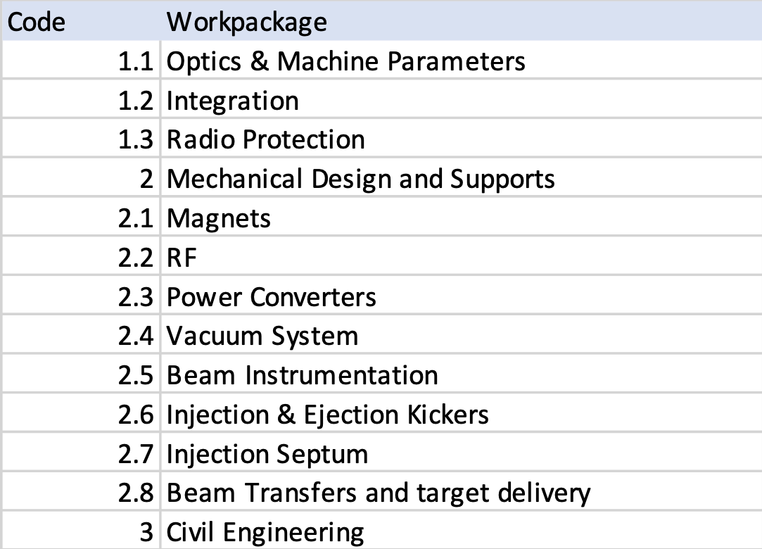
Rings “construction” Tasks
Inspired from ELENA WBS
PD - 2nd Community meeting

Slide 10
FFA “construction” Tasks
Strong synergies with HE acceleration
Magnet design is key
Would require specific beam dynamics studies
PD - 2nd Community meeting

Slide 11
Very tentative and educated guess planning
2021-2022 :
  Wrap-up of previous studies and performances of existing and future similar proton sources.
  Define preferred rings schemes : w. or w/o acceleration in accumulator.
  Identify studies with the BD work package to define possible energy intervals if any wrt to collective effects
  Specify dedicated studies for FFA option wrt collective effects
  Revise existing design of Linacs → needs to define final emittance (spot size on target)
2022 :
  revision of state of the art of H⁻ sources and define best promising source technology
  preliminary ring lattice design and target delivery system
  conceptual design of recombination scheme —> revision of MAPS
  FFA first lattice design
  Improved studies of collective effects
2023:
  Definition of the preferred energy range
  Integration of linac and rings in real geometry
2024
  conceptual design of proton complex

Slide 12
Proposed Workpackage Resources
Educated guess of exclusively the most urgent --- key activities
Task | Staff [pm] | postdoc [pm] | student [pm] | Cash [kEUR] | Comment
FFA | 0.2 | 2 | 2 | Tbd | Lattice+Physics + magnets
Accumulator | 0.2 | 1 | 2 | Tbd | Lattice and beam dynamics
Compressor | 0.2 | 1 | 2 | Tbd | Lattice and beam dynamics
Linac | 0.1 | 1 |  | Tbd | Preliminary lattice
H- sources | 3 |  | 1 | Tbd | Distributed between labs (2 eng, 1 Phys)
PD - 2nd Community meeting

Slide 13
Who did what for similar proton sources

Slide 14
SC linac – from N. Milas

Slide 15
SPL dedicated design – F. Gerigk

Slide 16
PIPII Linac - FNAL

Slide 17
H- stripping injection – SNS

Slide 18
Dedicated PDAC – F. Gerigk
Most recent studies from Aiba- PSI

Slide 19
High power study of J‐PARC Rapid Cycling
Synchrotron (RCS)
By K. Yamamoto
Maximum power limited by spallation target and water cooling in summer

Slide 20
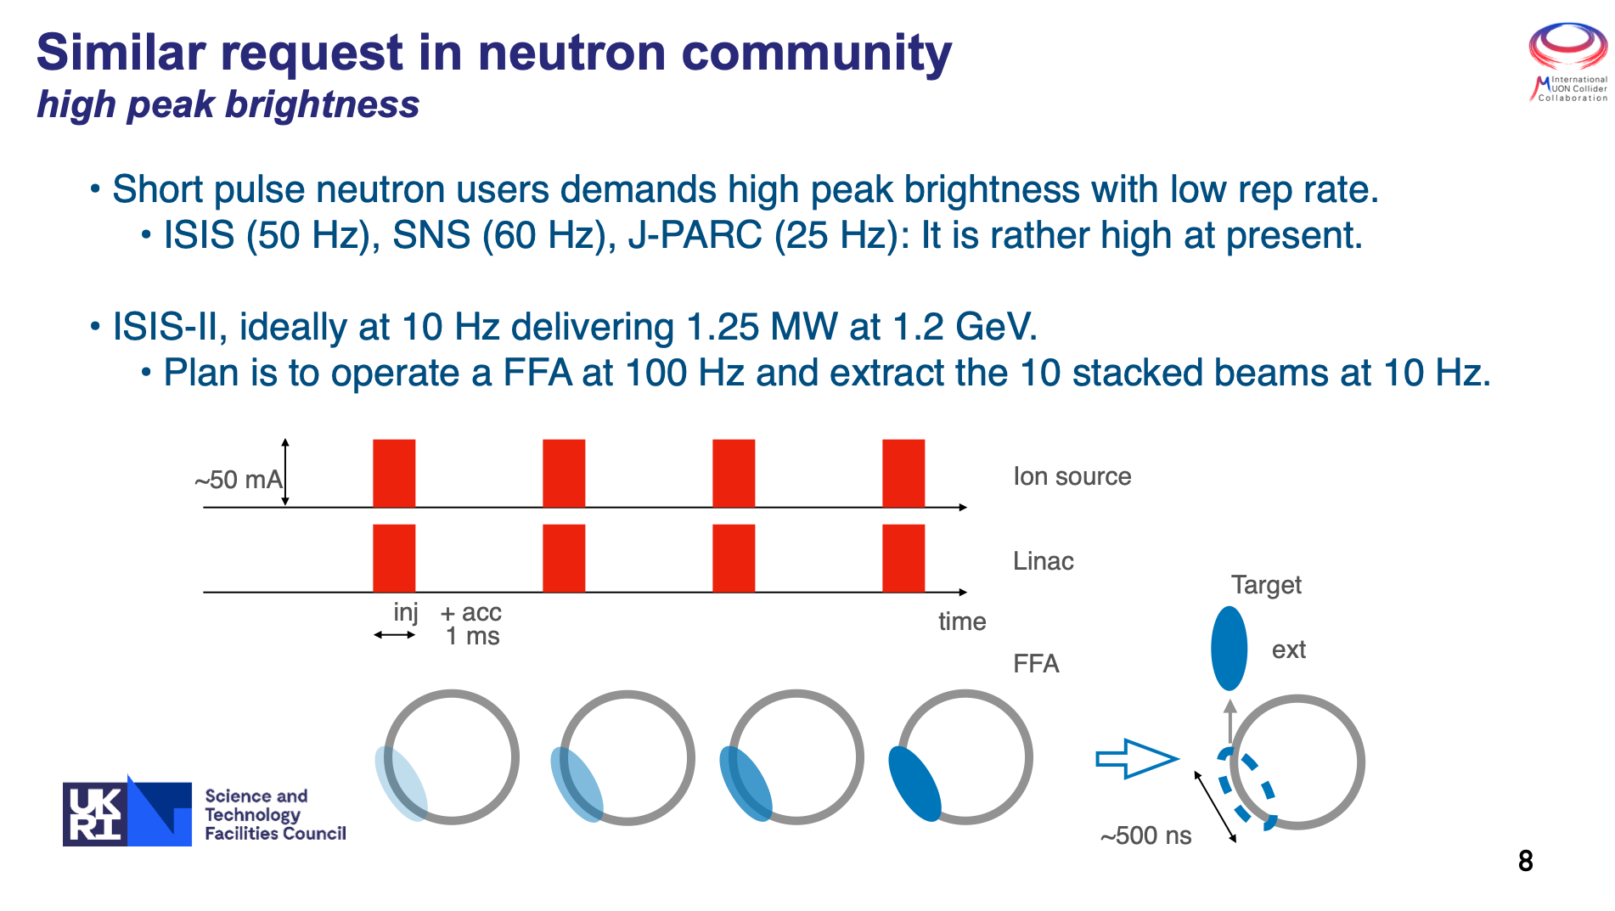
FFA – S. Machida

Slide 21
Thank you
very much for your support
and for your attention

