Slide 1
MC BD WG WP structure summary
Scott Berg, Xavier Buffat, Elena Fol, Shinji Machida, Elias Metral, Rob Ryne, Kyriacos Skoufaris, Tor Raubenheimer + members of PC and HEC WGs
2021/07/13
2nd Muon community meeting
Viewgraphs not shared – all errors and misstatements responsibility of Tor R.

Slide 2
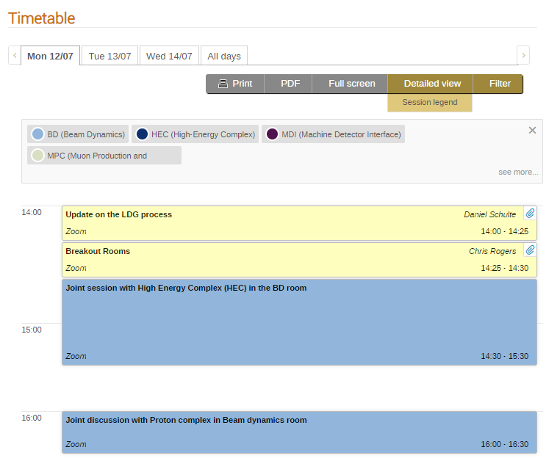
MC BD WG parallel session
16:30 – 18:30 Continued meeting with HE Complex

Slide 3
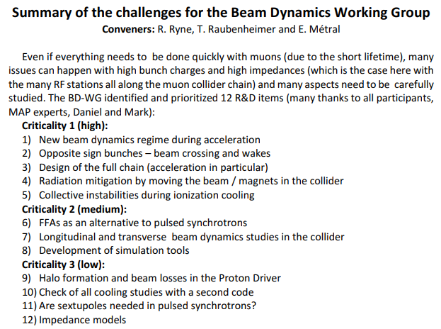
Critical issues and R&D on BD

Slide 4
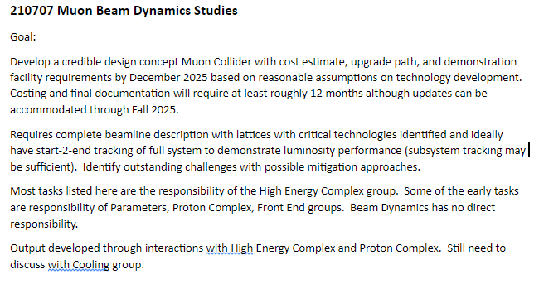
Google Doc listing tasks and relationships
Most details summarized in HE Complex discussion

Slide 5
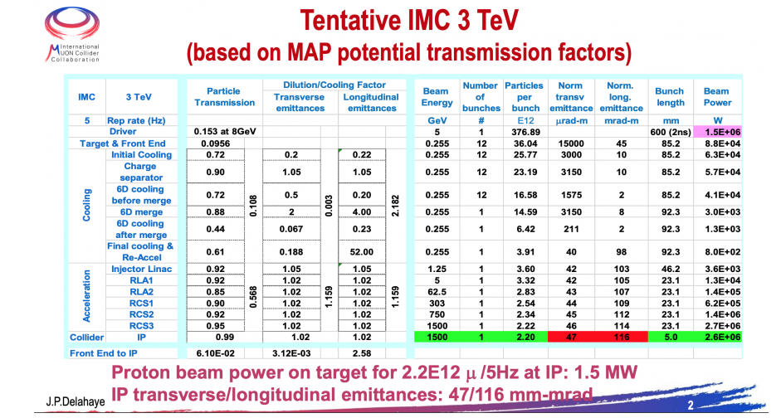
Muon Collider Parameters

Slide 6
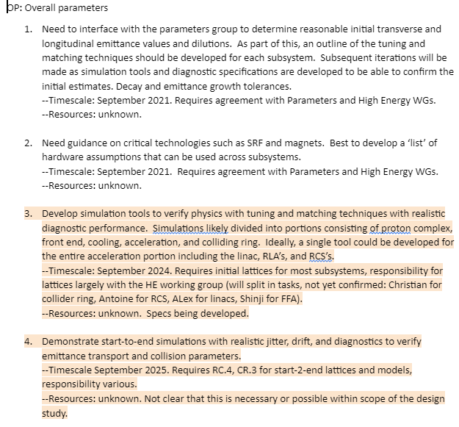

Slide 7
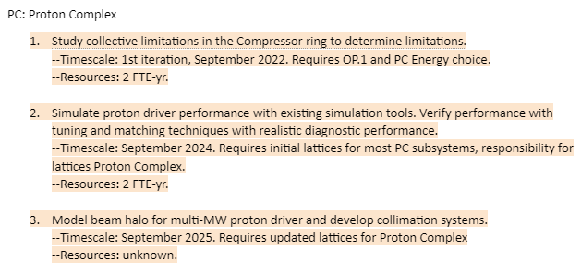

Slide 8
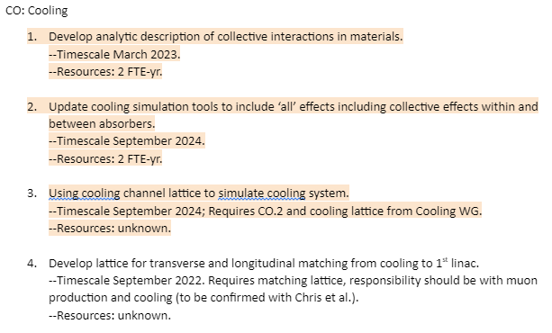

Slide 9
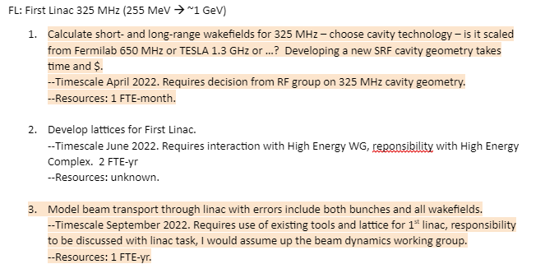

Slide 10
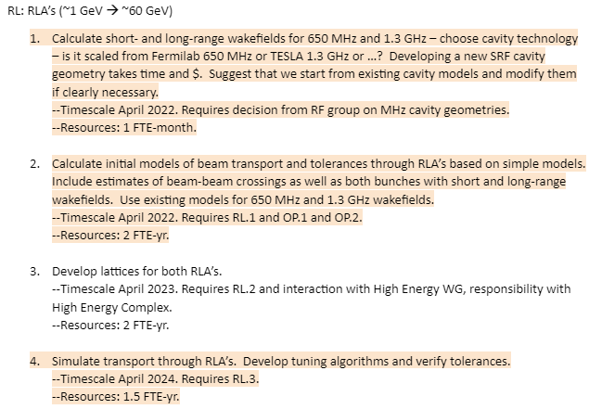

Slide 11
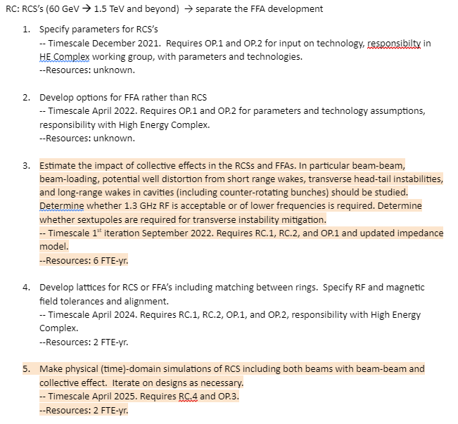

Slide 12
