Slide 1



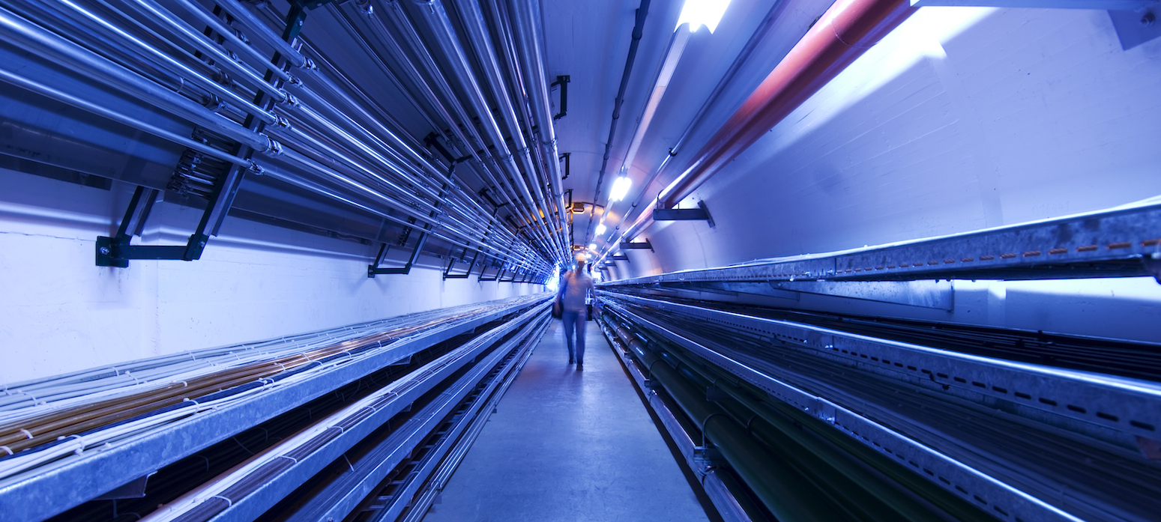
Summary of the RP Working Group
C. Ahdida, C. Carli, A. Lechner, H. Mainaud Durand, N. Mokhov, Y. Robert, P. Vojtyla, M. Widorski
2nd Muon Community Meeting
13 July 2021

Slide 2

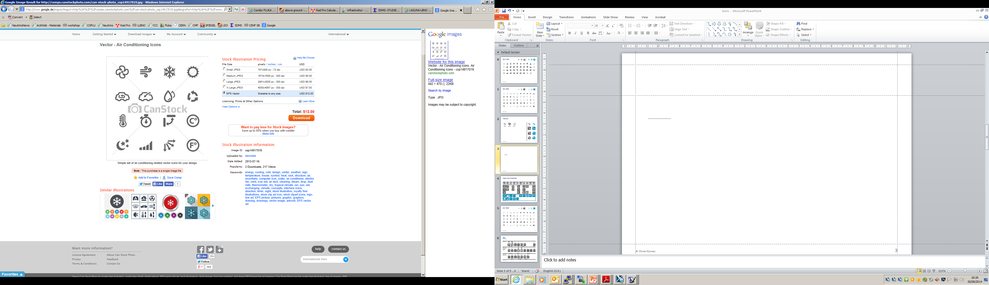

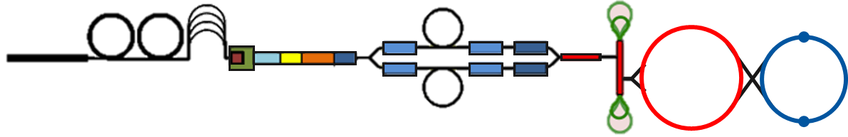
List of challenges identified by RP WG
Neutrino radiation challenges
‚Conventional’ radiation challenges
ν
ν
Collider Ring
Prompt and residual radiation
Air and He
activation
Water and
SOIL activation
Radioactive waste
μ
μ
‚Conventional‘ radiation challenges are principally well understood and can mitigated to levels as low as reasonably possible, but to be addressed at an early design stage
  Refined dose model
  Mitigation by movers
  Test facility
  Key areas of the complex
Unprecedented: Substantial neutrino induced radiation hazard at very far distance from the source

Slide 3
Overview of work related to a refined dose model
MC simulations
Dose surface map
Dose assessment
Operational scenarios
Sensitivity analysis
Demonstration of compliance
Folding with realistic source term
Optimization process

Slide 4
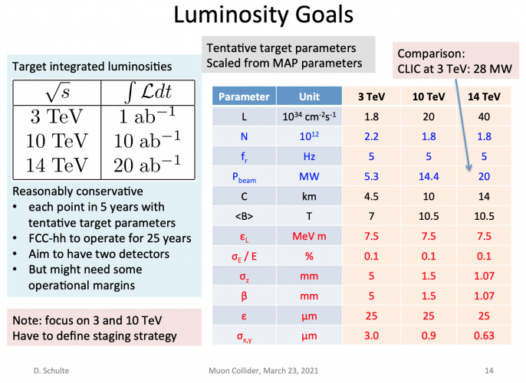
Operational scenarios
Dose model shall be based on the stipulated collider parameters
Tentative target parameters
A dose model will be defined for each parameter set
Prioritization (?):
  3 TeV
  10 TeV
  14 TeV
Defined by the Muon Beam Panel

Slide 5
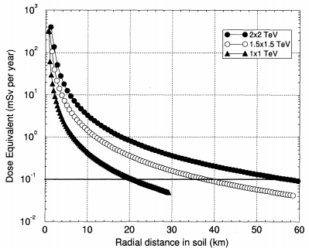
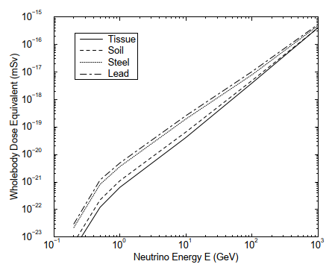
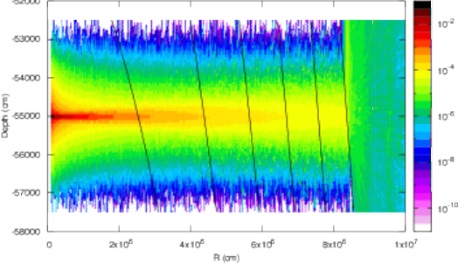
Past Monte Carlo simulations
Few examples
Comprehensive MARS15 simulations with a sophisticated neutrino interaction model crucial for induced dose calculated and secondary particle for monitoring
→ Mokhov and Ginneken, Neutrino Radiation at Muon Colliders and Storage Rings, 2000
Studies for E_{com} 0.5, 1, 3, and 4 TeV muon colliders:
  Effective dose for broad and pencil neutrino beams
  Secondary particle equilibrium and non-equilibrium cases
  Maximum and whole-body values for variety materials upstream the tissue-equivalent phantom
  Contributions from both the collider ring and field free drifts
  Standalone case of monoenergetic neutrino beams of energies from 100 MeV to 10 TeV
  Idea of vertical wobbling of muon beams in the ring was introduced and calculated showing substantial effect of dose reduction
Good agreement with FLUKA simulations
→ Bartosik et al., Preliminary Report on the Study of Beam-Induced Background Effects at a Muon Collider, 2019
→ To build on extensive accomplishments for additional MC studies
MARS15 dose eq. vs. distance + E_{ν} for diff. materials
Mokhov and Ginneken, Neutrino Radiation at Muon Colliders and Storage Rings, 2000
FLUKA H*(10) for 2 TeV vs. distance + depth
d [m]
50
150
250
350
450
550
( )
ν_{µ}
pSv/10¹⁰ µ decays
Bartosik et al., Preliminary Report on the Study of Beam-Induced Background Effects at a Muon Collider, 2019

Slide 6
Plans for Monte Carlo simulations
Simplified FLUKA and MARS simulations with a pencil muon beam for the given operational scenarios (E_{com} 3, 10, 14 TeV (tbc)) to evaluate main parameters for the dose predictions, such as:
  Dose distribution for different distances (collider depths) assuming secondary particle equilibrium (i.e. inside material)
  Sensitivity studies for underlying assumptions (e.g. material properties, nu_e/mu and antineutrino)
  Differences of possibly relevant dosimetric quantities (e.g. effective dose, ambient dose equivalent, eff. dose equivalent)
  Difference to a more realistic full path assessment
  Secondary particle spectra needed to design suitable monitoring instrumentation
Benchmarking of neutrino interaction models
Folding w realistic source term
Sensitivity analysis
Demonstration of compliance
Sensitivity analysis

Slide 7
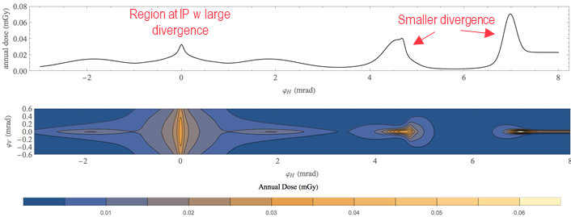
Folding with a realistic source term
Evaluate dose distributions for a realistic neutrino source term (well defined via µ decay) taking into account:
  The real lattice (collider, injection, accelerators)
Fold the information from MC simulations to estimate the dose distributions
→ more precise and less conservative dose estimation than analytical approach taking additional spread of secondary particle distribution into account
Identification of critical regions (high dose areas)
Optimization of the source term (e.g. lattice, wobbling) with respect to the dose
Sensitivity study of underlying assumptions (e.g. closed orbit positions)
Example of using analytical approach for region around IP
C. Carli, Considerations on Radiation, Muon Collider Design Meeting, 08.03.2021
(3 TeV, 100 m depth, analytical approach based on B. King)
Dose surface map
Sensitivity analysis

Slide 8
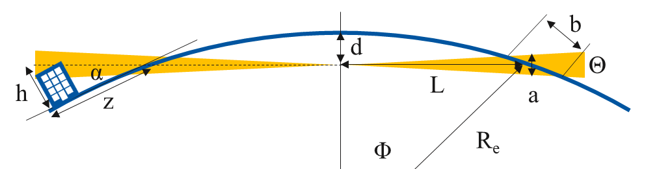
Dose surface map
Establish surface map of dose
Optimization w.r.t. depth, orientation and inclination
Investigation of different site options
Evaluation of uncertainties of methodology
(e.g. accuracy of terrain model)
Findings from simplified geometrical considerations (Earth as perfect sphere, no beam divergence, no collider inclination) for ν beam:
ν disk has a height (a) of ~1-2.5 m and traverses a region of width (b) of ~100-450 m
For dose additional spread of few m due to sec. particle shower
Exit angle of ν radiation is very small, wherefore impacted area can be of several km depending on height considered
L – distance, d – depth, R_{e} – Earth radius
Sensitivity analysis
E_{com} [TeV] | 3 | 10 | 10 | 14 | 14
d (m) | 100 | 200 | 300 | 400 | 500
L (km) | 36 | 51 | 62 | 71 | 80
a (m) | 2.5 | 1.1 | 1.3 | 1.1 | 1.2
b (m) | 449 | 135 | 135 | 96 | 96
α (rad) | 0.006 | 0.008 | 0.010 | 0.011 | 0.013
z (km) for h = 50 m | 9 | 6 | 5 | 4 | 4
100 m depth
500 m depth
L² = R_{e}² – (R_{e} – d)²
Θ~1/γ
a ≈ 2 ΘL
b ≈ a/Φ, sin Φ = L/R_{e}
α ≈ acos (1 – d/R_{e})
z ≈ h/tan (α)
36 km
9 km
80 km
4 km
See also paper from Johnson, Rolandi and Silari, Radiological Hazard Due to Neutrinos from a Muon Collider, 1998

Slide 9
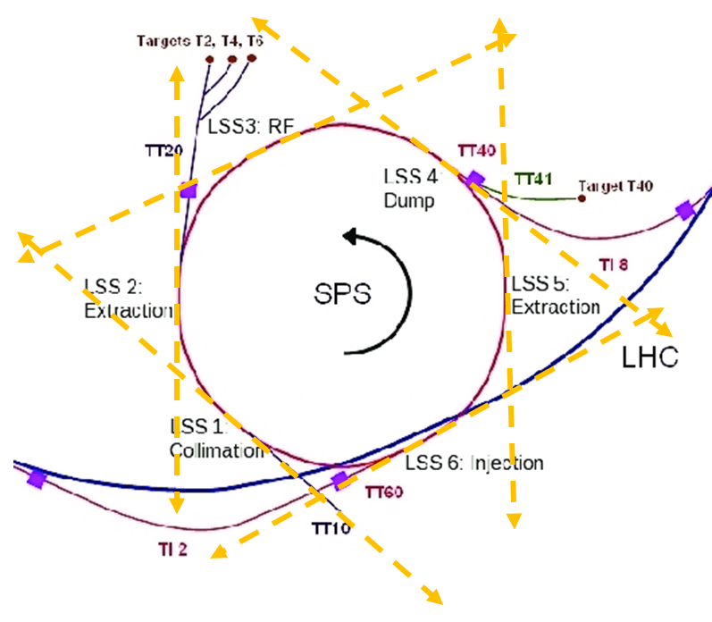

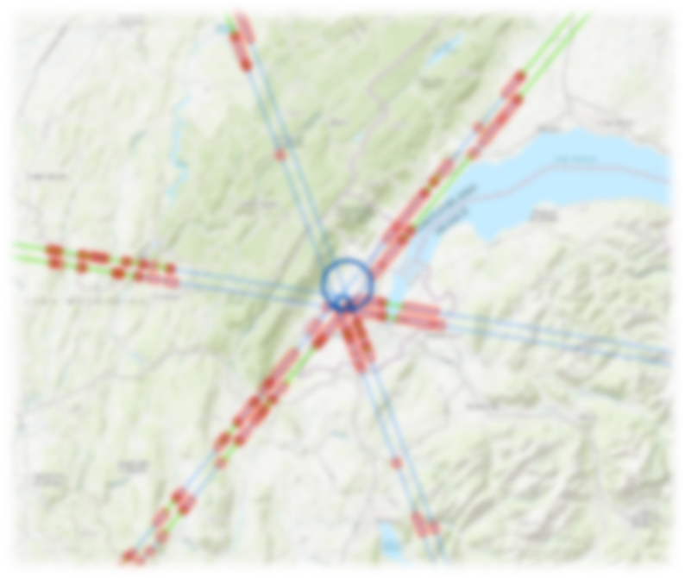

Preliminary study of where ν break ground for LHC/SPS straight sections
Assumed SPS straight sections
Exit points to Earth surface for SPS
A preliminary study of where ν would come out the earth’s surface for LHC and SPS straight sections was performed
Methodology is based on Geode Survey Database and Digital Surface Model for Europe (EU-DEM v1.1)
3D model of where ν break ground was developed
For SPS the longest distance (80 km) is on the other side of the Jura and for the LHC (263 km) it is on the other side of the alps
The depth of the SPS and its “horizontality” bring some uncertainty on the exact locations
→ no single exit point for both SPS and LHC straight sections
Assumed accuracy of terrain model ~± 30 m and 0.1 deg of the beam → further investigations for higher precision planned
Technical student already started work on automating the production of such maps according to the collider position →
will allow optimization w.r.t. depth, orientation and inclination
Y. Robert

Slide 10
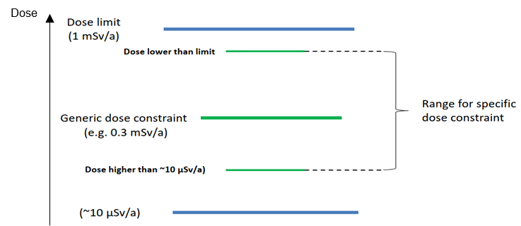
Dose assessment
Identify representative person from public for a final dose assessment
As a general worst case scenario, one would have to assume maximum exposure and irradiation conditions (e.g. sick person lying in bed 24/7 at the location of the maximum dose)
→ Dose optimization to O(10) μSv/year
Depending on the dose surface map, for certain regions of higher dose (e.g. for critical straight sections), possible exclusion of such a worst case scenario even for the far future
→ Dose higher than O(10) μSv/year depending on possible exposure scenarios (e.g. lake, mountains, ocean, exclusion area)
  Depends on acceptance by authorities and public
  Uncertainty of the dose surface map
ICRP and IAEA Safety standards –
Relationship between dose limit, generic and specific dose constraint, and optimization level
IAEA Safety Standards, General Safety Guide, No. GSG-9
Sensitivity analysis
100 rem = 1Sv

Slide 11
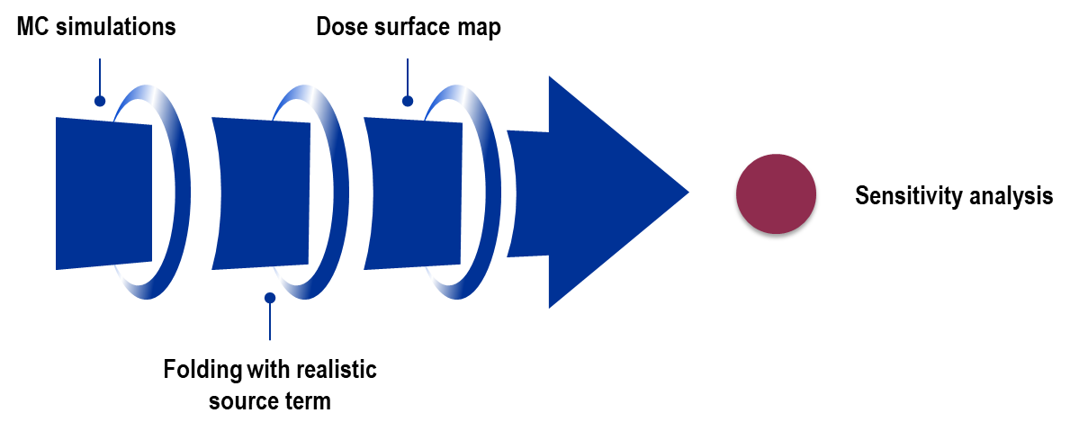
Sensitivity analysis and demonstration of compliance
Sensitivity analysis
Demonstration of compliance
Evaluate means to demonstrate compliance of the dose estimates, both at the source (emission) and impact side (immission)
Source side
Impact side
Measure muon beam parameters (e.g. divergence)
Design suitable monitoring instrumentation for measuring the dose from the secondary particles
Uncertainties of dose estimate to be defined based on the various underlying parameters and assumptions
This includes uncertainties for the dose distribution as well as its projection on the surface

Slide 12
Proposed workpackage description
Neutrino radiation
Refined dose model
  A refined dose model for a reliable and precise estimation of neutrino-induced doses outside the complex shall be developed and used for a collider ring optimization to minimise the dosimetric impact on the public

Slide 13
Proposed workpackage tasks–
Refinded dose model
Preliminary – Timeline tbd
Input: Specific collider parameters (E, circumference) are needed as input for the refined dose model
MC simulations
  MC simulations (FLUKA, MARS) to evaluate main parameters for the dose predictions and their uncertainties
  Benchmarking of neutrino interaction models
Folding with realistic source term
  Evaluation of a realistic neutrino source term and folding with dose distributions from MC simulations
  Further optimization and sensitivity analysis
Surface map
  Surface map of the dose for given site options
  Further optimization and sensitivity analysis
Dose assessment + demonstration of compliance
  Perform final dose assessment and develop possible methods to demonstrate compliance

Slide 14
Proposed workpackage description
Neutrino radiation
Refined dose model
  A refined dose model for a reliable and precise estimation of neutrino-induced doses outside the complex shall be developed and used for a collider ring optimization to minimise the dosimetric impact on the public
Mitigation by movers
Mitigation by movers, which move the beam line components to change the beam direction by deforming the beamline in the vertical plane

Slide 15
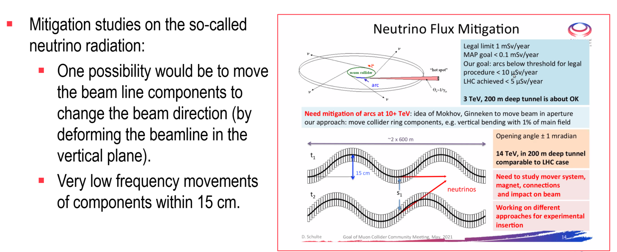
Mitigation using movers
From H. Mainaud Durand

Slide 16
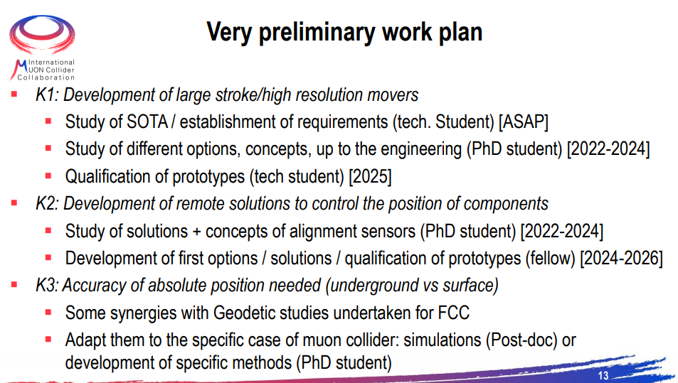
Proposed workpackage tasks and timeline –
Mitigation using movers
3 key issues
From H. Mainaud Durand
Notes:
Identified key issues

Slide 17
Proposed workpackage description
Neutrino radiation
Refined dose model
  A refined dose model for a reliable and precise estimation of neutrino-induced doses outside the complex shall be developed and used for a collider ring optimization to minimise the dosimetric impact on the public
Mitigation by movers
Mitigation by movers, which move the beam line components to change the beam direction by deforming the beamline in the vertical plane
Additional RP challenges
Test facility
  The test facility design will have to be optimised w.r.t. prompt and residual radiation, air/He/N activation, water and soil activation, and radioactive waste production, particularly when aiming at potentially upgrading to O(4) MW beam power
Key areas of the complex
  Similarly to the test facility, also for the key areas of the muon collider complex, the main RP challenges should be investigated at an early design stage

Slide 18
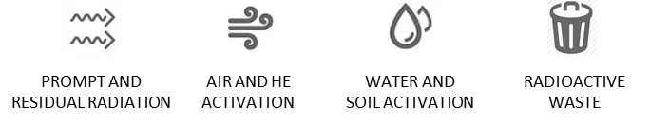
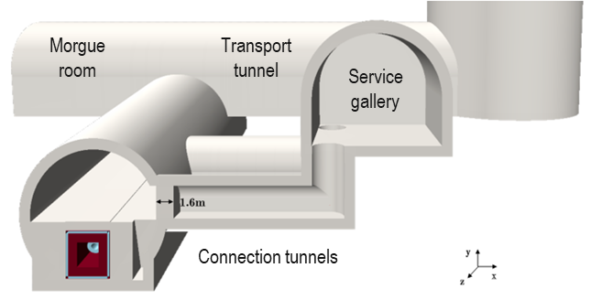
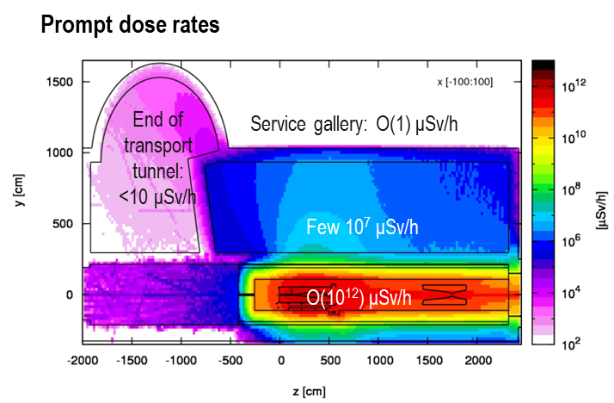
Additional RP challenges
Based on the experience from past design studies (LLBNO, BDF, CENF), the radiological environmental impact of a MW facility, should be manageable at the present state of technology
The past studies have however also shown that the RP considerations strongly determine the design of high power facilities
When aiming at a O(4) MW facility several RP aspects should be studied beforehand such as (non-exhaustive list of examples):
The required shielding and other infrastructure (e.g. morgue room) as well as streaming of radiation through shafts (e.g. avoided by chicanes)
The required depth of the facility for avoiding ground water activation and a hydrogeological study
He/N vessel around the most critical region (target) to avoid air activation
The possibility for minimizing the radioactive waste production
Uncertainties related to H-3 out-diffusion may impact air/He/water activation
→ Precise evaluation based on FLUKA simulations needed

Slide 19
Proposed workpackage resources
Preliminary – More information to come
Task | Staff [pm] | postdoc [pm] | student [pm] | Cash [kEUR] | Comment
MC simulations |  |  |  |  | SY-STI (CERN), Fermilab, HSE-RP (CERN)
Folding w realistic source term |  |  |  |  | BE-ABP (CERN)
Surface map |  |  |  |  | SCE-SAM (CERN)
Dose assessment | 0.25 – 0.35 FTE/y |  |  |  | HSE-RP (CERN); includes also coordination+discussion for above tasks
Mitigation with movers |  |  |  |  | BE-GM (CERN)
Test facility | 0.25 FTE/y + 0.1 FTE/y (tbd) | 1-2 senior fellows – 2022-2025 (tbd) |  |  | HSE-RP (CERN); includes radiation protection and environmental assessment
Key areas of complex
Additional people interested in participating to define and carry out the work are of course very welcome!

Slide 20

Thank you
for your attention!

Slide 21
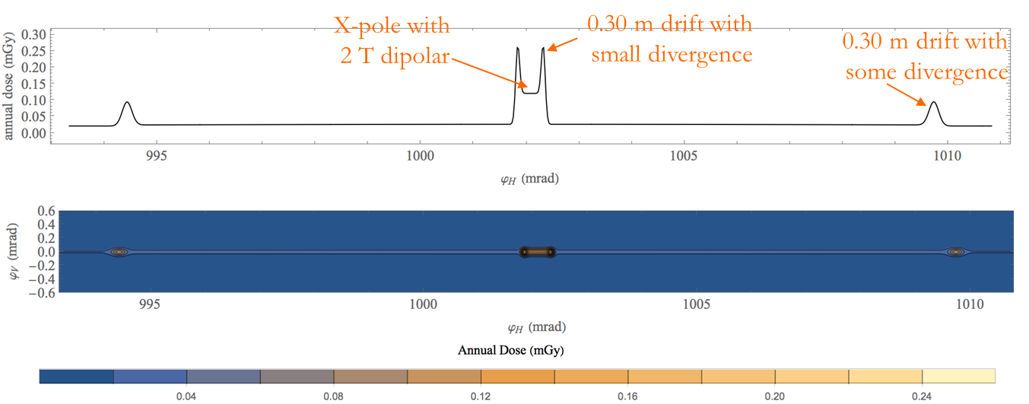
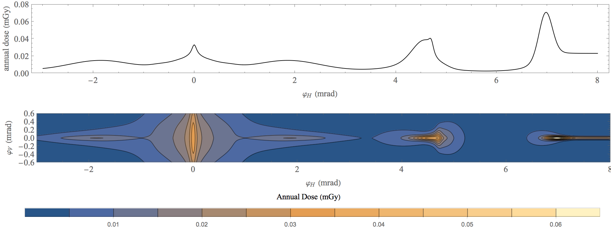
Dose estimation with MAP lattice – C. Carli
Center of arc cell
Combined fct magnet w reduced field
Region around IP
Region at IP w large divergence
Smaller divergence
Arc dipole of ~10 T
Larger divergence (momentum spread,D’)
According to paper of B. King Gy!=Sv
Based on analytical approach by B. King
Application to 3 TeV c.o.m. lattice from MAP study (9e20 μ decays per year, depth = 100)
Findings from the arcs: higher doses for reduced field sections and peak doses for small (30 cm) drift sections
Findings close to IP: beam divergence relatively large at IP and higher dose from regions with smaller vertical/horizontal divergence
Conclusions:
    Beam divergence not always negligible (contributions from D’ w large momentum spread), which mitigates radiation from straight sections
    → avoid combined function magnets w too low dipolar field components
  Outlook:
    Improve lattice designs in arcs (e.g. avoid short straight sections w D’=0, increase dipolar component of combined function magnets)

Slide 22
Mitigation using movers – H. Mainaud Durand
Studies to undertake / points to check (only subset given here)
Study in further details the state of the art concerning adjustment solutions
Have a better understanding of the requirements
  Range of movers ? Resolution? Accuracy?
  Long-term stability, impact of vibrations?
  Frequency of adjustment?
  Constraints from other equipment like cryo and vacuum (acting forces, flexibility)?
  Weight, size and number of components?
Study and develop alignment solutions and associated sensors for allowing to do such remote adjustment
Identified key issues
K1. Development of large stroke/high resolution movers to perform safe remote displacements
K2. Development of remote solutions to control the position of components (for circular collider), adapted to such ranges of displacements
K3. Study of the accuracy needed / necessity to develop a solution to determine in a continuous way the absolute position of components underground vs. surface
+ specific points to address (impact on other equipment, safe control system)

Slide 23
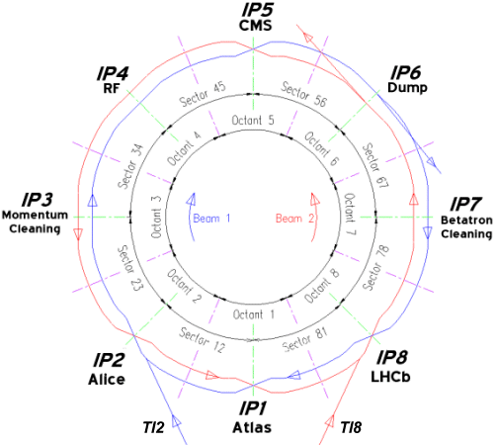
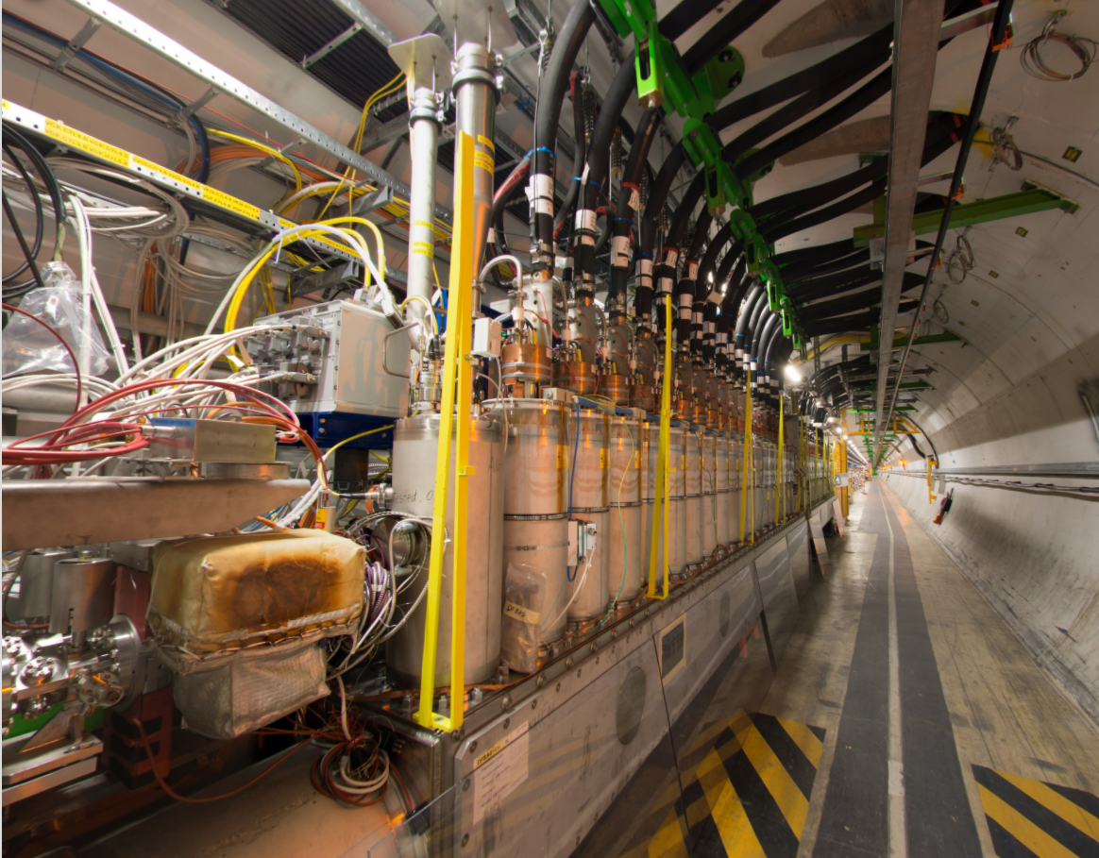
PRELIMINARY STUDY
If we extend the LHC straight insertion
where would the neutrinos come out to the surface of the earth?
Problem:
« If we extend the LHC straight insertions where would the neutrinos come out the surface of the earth?”
Hypothesis:
The LHC straight insertions directions are given by the lines built from the middle of Beam 1 and Beam 2 DFBA elements on each side of the Insertion Point.

Slide 24
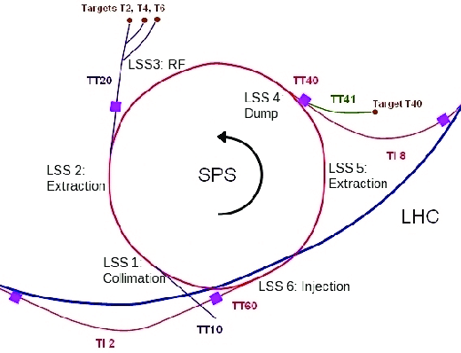
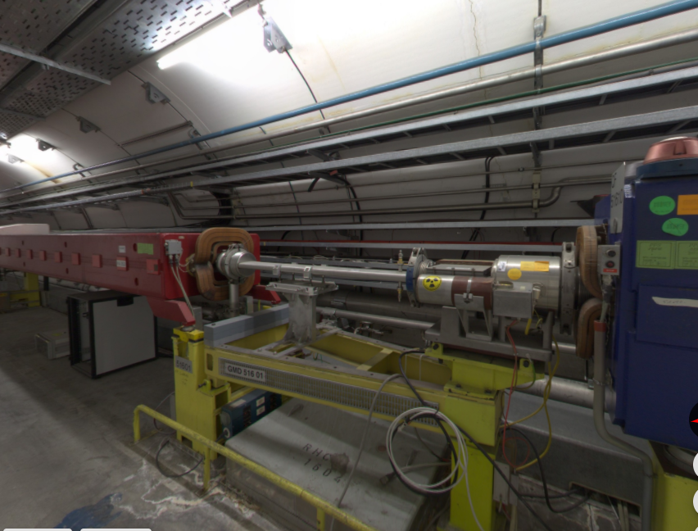
PRELIMINARY STUDY
If we extend the SPS straight sections
where would the neutrinos come out to the surface of the earth?
Problem:
« If we extend the SPS straight sections where would the neutrinos come out the surface of the earth?”
Hypothesis:
The SPS straight sections directions are given by the lines built on dipole MBA X1590 beam exit points on one side and MBA X2030 beam entrance point on the other side. (X for the SPS point)

Slide 25
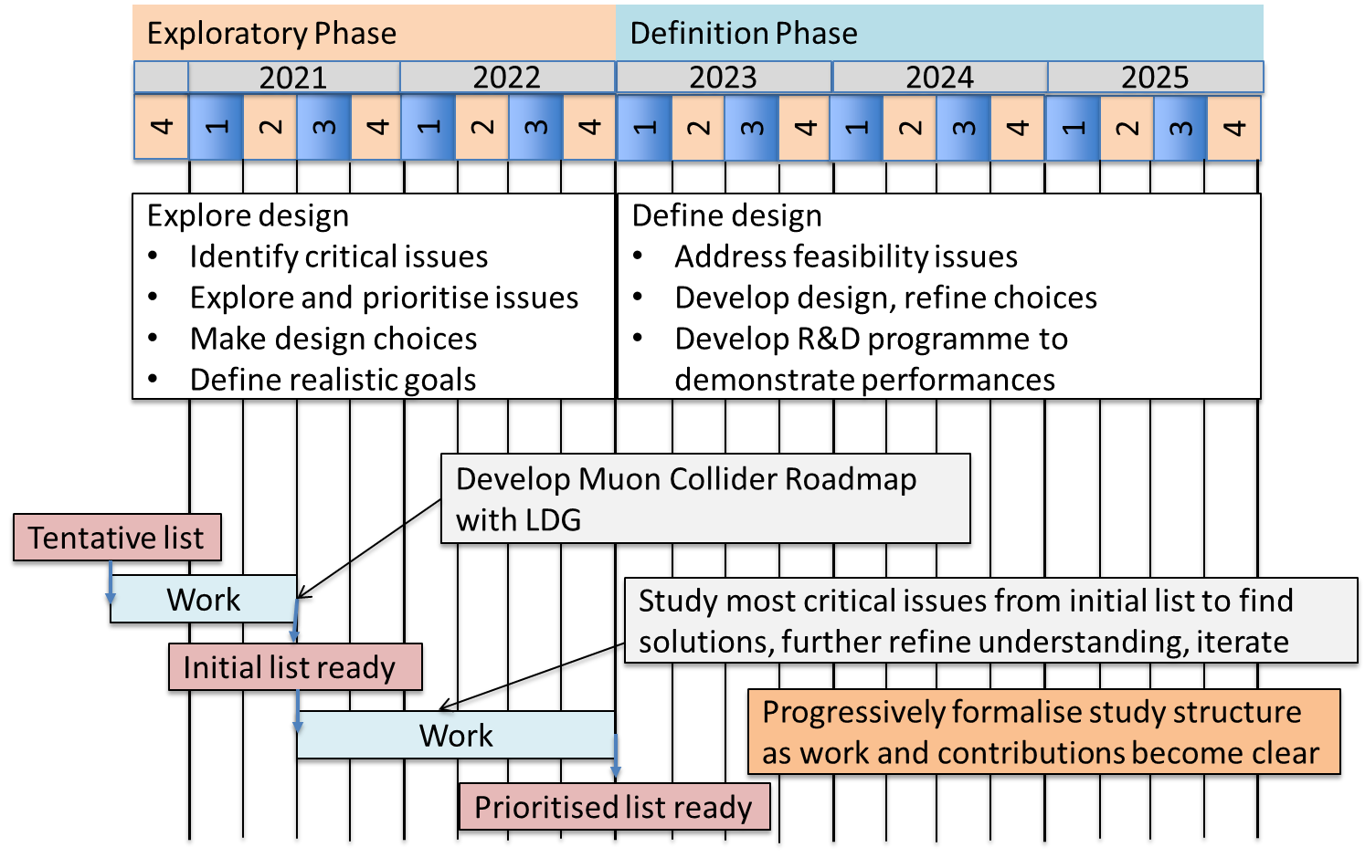
Timeline until next ESPPU

Slide 26
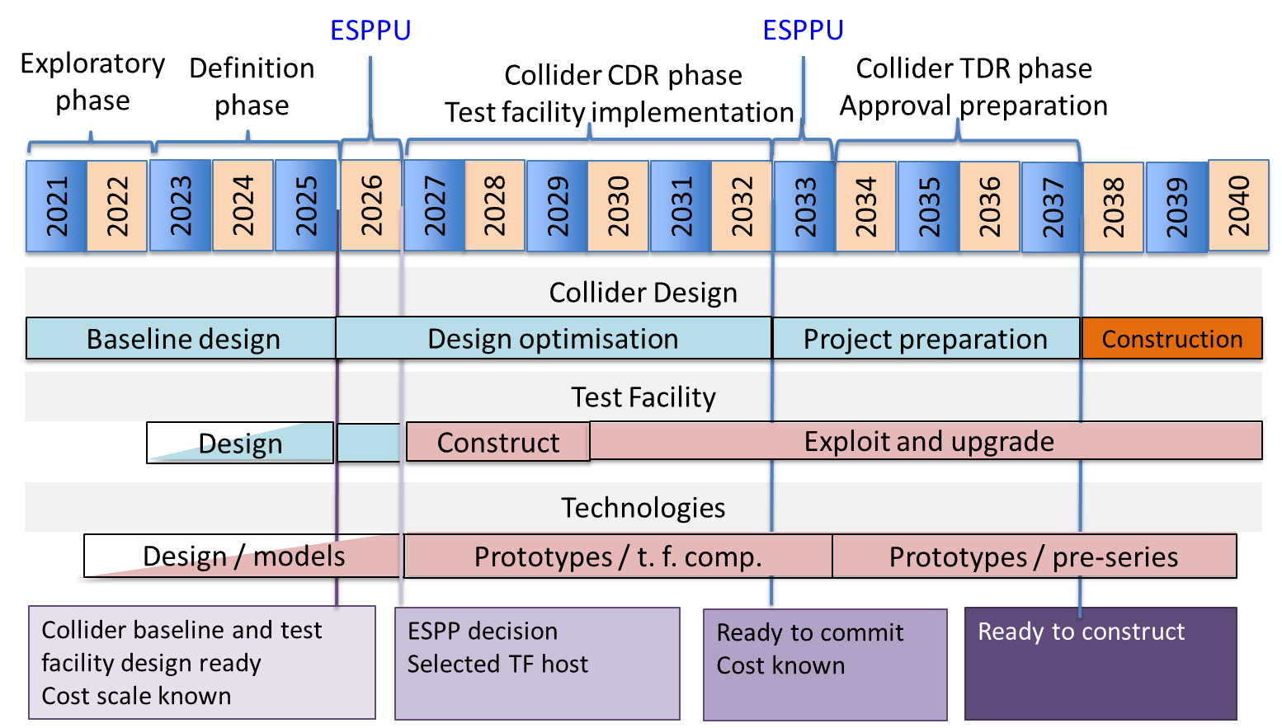
Technically Limited Long-Term Timeline

