Slide 1



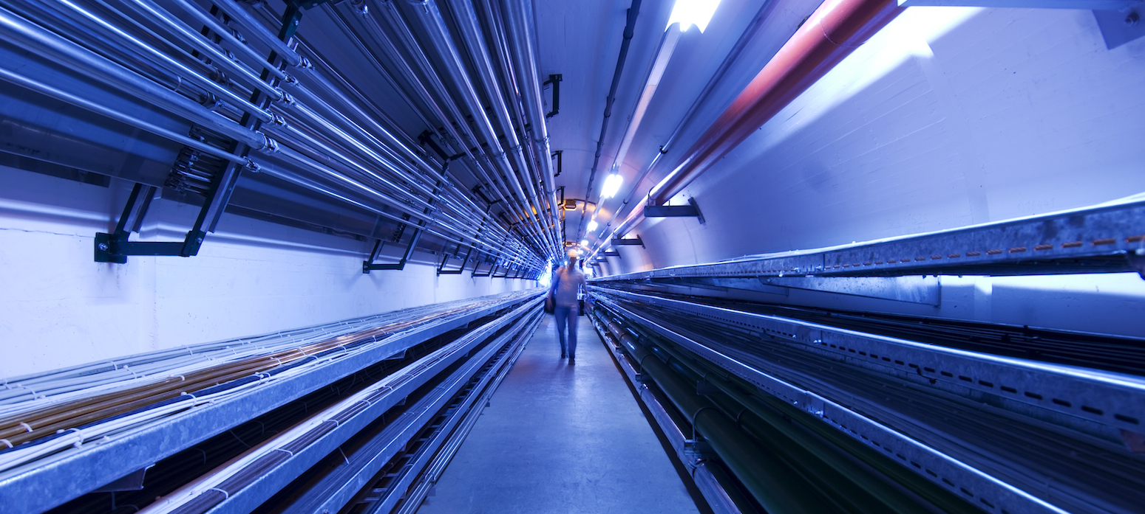
Synergies
Kenneth Long
Imperial College London/STFC

Slide 2
Synergies
Synergies:
  R&D that creates enhanced capabilities to the benefit of:
    The development of a high energy (multi-TeV) muon collider and
    Another first-rank scientific, innovative, or impactful programme
Creation of world-class science with intense muon beams
  As demonstrators, technology test beds, & to create community

Slide 3
Next steps
Second meeting; engage with Asia:
  COMET, PRISM, …
Consolidate places were R&D programme can benefit muon physics activities beyond the muon collider
Last Muon Community meeting conclusions

Slide 4
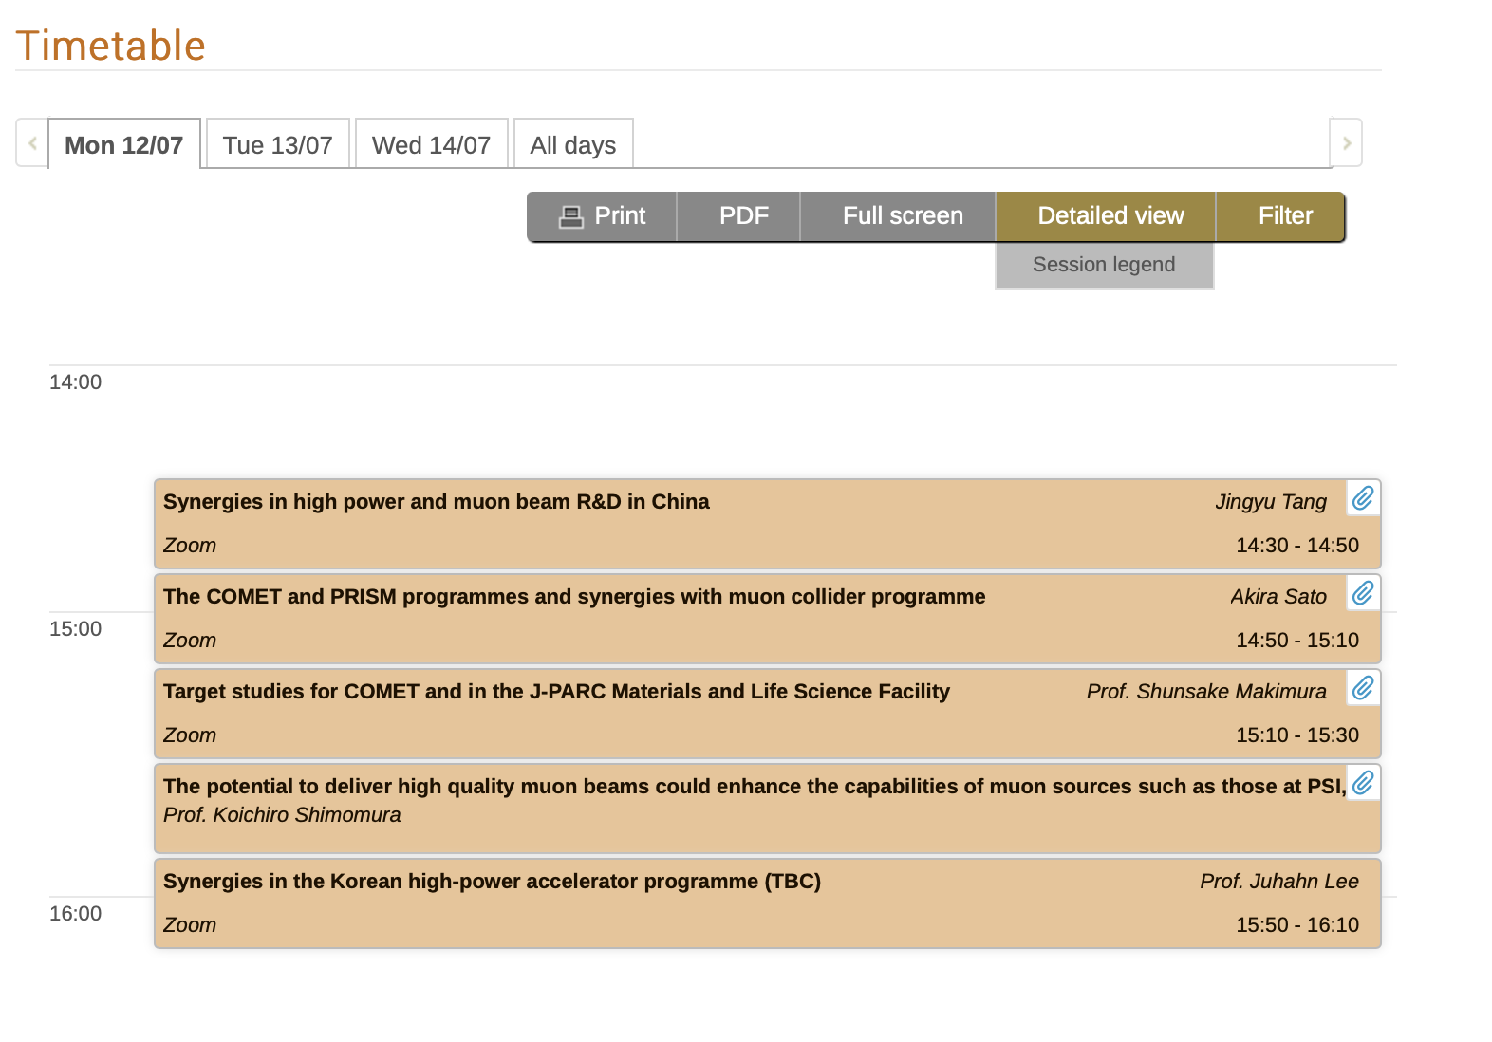
Our session at the 2nd Muon Community meeting

Slide 5
Synergies in high-power proton and muon beams in China: Jingyu Tang
CSNS ugrades:
  Upgrade to 500 kW
    “Step 1” approved
    Construction expected to start ’22
  CSNS-II:
    Approval required for next step
    Muon experiment included in proposal

Slide 6
Synergies in high-power proton and muon beams in China: Jingyu Tang

Slide 7
Synergies in high-power proton and muon beams in China: Jingyu Tang

Slide 8
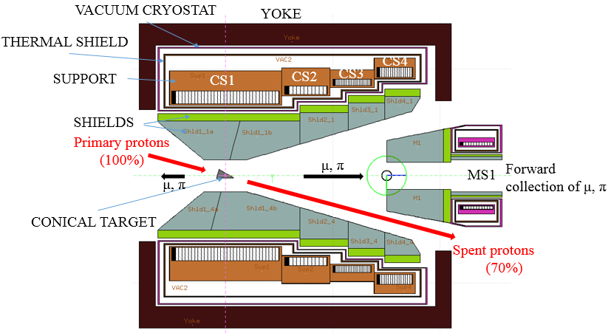
Synergies in high-power proton and muon beams in China: Jingyu Tang
MOMENT:
  A muon-decay, medium-baseline neutrino-beam facility
  Exploit high-power, low-energy linac for ADS studies to deliver high flux muon beam that is used to make a neutrino beam
Component R&D:
  EMuS target station

Slide 9
The COMET and PRISM programs and synergies with muon collider program: A. Sato
Discussed at MC1: clear synergies with MC programme

Slide 10
Muon production at J-PARC (and MLF target):
S. Makimura

Slide 11
Muon production at J-PARC (and MLF target):
S. Makimura

Slide 12
Synergies in high-power and muon programmes in Japan: K. Shimomura

Slide 13
Conceptual layout of MUC test facility:
R. Franqueira Ximenes
Yes:
28 GeV can give “sufficient” pion flux
in phase-space of interest
SPS solution chosen in PBC study
owing to civil-engineering constaints

Slide 14
Next steps
Clear synergies in high-power proton and muon development programmes in Asia
  Conclusion as for the N/A and European contributions from last time
Need further discussion to understand programmes by which to enhance scientific o/p with R&D work done in support of muon collider development
nuSTORM-4-MUC test facility:
  nuSTORM synergies as part of MUC test facility discussed last time
  Pion yield in phase space of interest sufficient
    Will now include in nuSTORM discussions

