Slide 1




Test Facility
(Demonstrator)
Roberto Losito
CERN-ATS-DO
1st Community meeting of the International Muon Colliders Design Study - 20 May 2021

Slide 2
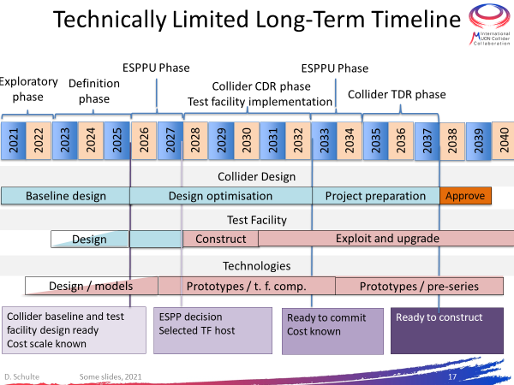

Slide 3
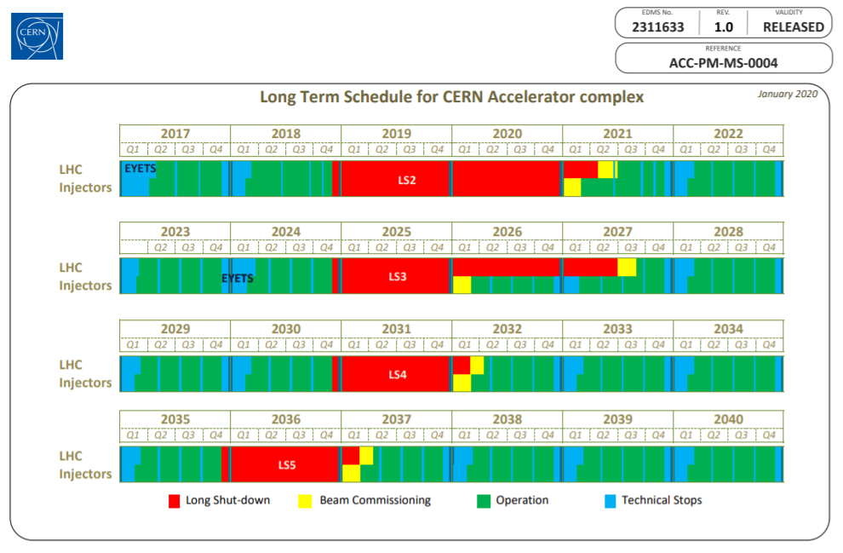

Slide 4
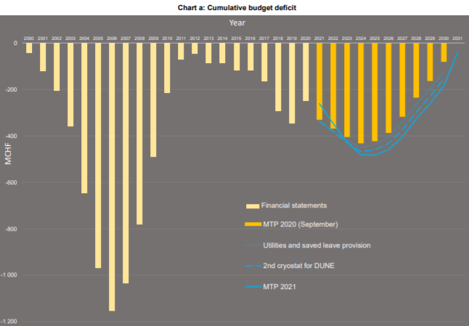
Medium term Plan approved in June 2021

Slide 5
Proposed Workpackage Description
A beam test facility is key to demonstrate items of critical importance to achieve the required luminosity in the Muon Collider, namely, 6D cooling, the integrated engineering of the cooling cells.
The workpackage deliverable will the design and cost estimate of a test Facility including:
  Muon production and capture, including collimation and momentum selection at a level of at least 10⁶ muons per pulse
  6D cooling based on HFOFO rectilinear cooling, including full conceptual engineering design of the cell.
  Study eventual alternative cooling schemes as defined by the Muon Production and Cooling working group
  Coordinate the site dependent studies, entirely funded by each interested laboratory, in order to provide a full cost estimate for a given test facility
  Collaborate with the other working groups to establish a list of ancillary test facilities (e.g. high power targets, RF, magnets, Proton Beam preparation etc…) in order to avoid duplication of efforts and ensure optimal use of resources.
  The muon production working group will be asked to assess whether one can use in a first stage a horn instead of a Superconducting solenoid in order to reduce cost.
  Synergy with other facilities/experiments to be investigated

Slide 6
Proposed Workpackage Tasks
Simulations & Engineering design
  Proton beam preparation and evolution (Accumulator, compressor, mainly connection to Proton Complex WG)
  Extraction and transfer line
  Infrastructure (civil Engineering and services)
  Muon production (target+horn)
  RP, Remote handling, waste management, environmental impact (if necessary).
  Momentum selection, collimation & proton beam dump
  Cooling based on schemes developed by the cooling, RF and Magnet WG
  Beam Instrumentation
  Synergy (ESS, NuStorm, Enubet…)

Slide 7
Proposed Workpackage Timeline
(test Facility at CERN)

Slide 8
Proposed Workpackage Resources for
CDR & TDR
Task | Staff [pm] | postdoc [pm] | student [pm] | Cash [kEUR] | Comment
Proton beam preparation | - | - | - | - | Funded and coordinated by proton Complex WG
Extraction and transfer line |  |  |  |  | Funded (and coordinated) by CERN
Civil Engineering & Infrastructure |  |  |  |  | Funded and coordinated by CERN
Muon Production
RP, Remote handling, waste management, environmental impact (if necessary). |  |  |  |  | Funded and coordinated by CERN
Momentum selection, collimation & proton beam dump
Cooling
Beam Instrumentation
Synergy |  |  |  |  | Funded by CERN and Synergic experiments/facilities.

Slide 9
Consideration on CERN budget
If ESPPU is accepted in Dec. 2027, fresh budget can be injected in the June 2028 MTP document, if approved budget would become available in Jan. 2029.
EU seed budget essential for the CDR/TDR phase
Present level of CERN funding (2 MCHF/year, M+P) would not be sufficient in the 2025÷2029 period to sustain a prototyping phase

Slide 10
Thank you
for your attention

