Slide 1
Synergies in High-power Hadron Beams and Muon Beam R&D in China
Jingyu Tang
Institute of High Energy Physics, CAS
2nd Muon Community Meeting, ZOOM, 2021.07.12-14

Slide 2
Outline
High-power hadron accelerator facilities and projects in China
Muon-related studies
Summary

Slide 3
High-power hadron accelerators
China Spallation Neutron Source (CSNS)
  Phase-I: 2011.10-2018.3
  Operation since 2018.9
  Operation at 100 kW: 2019.2
  Phase-II: approved in principle by the central government, 2022-2028
 | CSNS-I | CSNS-II
Beam Power (kW) | 100 | 500
Repetition rate (Hz) | 25 | 25
Target stations | 1 | 1
Average beam current (μA) | 63 | 313
Protons per pulse (10^13) | 1.56 | 7.8
Linac output energy (MeV) | 80 | 300
RCS output energy (GeV) | 1.6 | 1.6

Slide 4
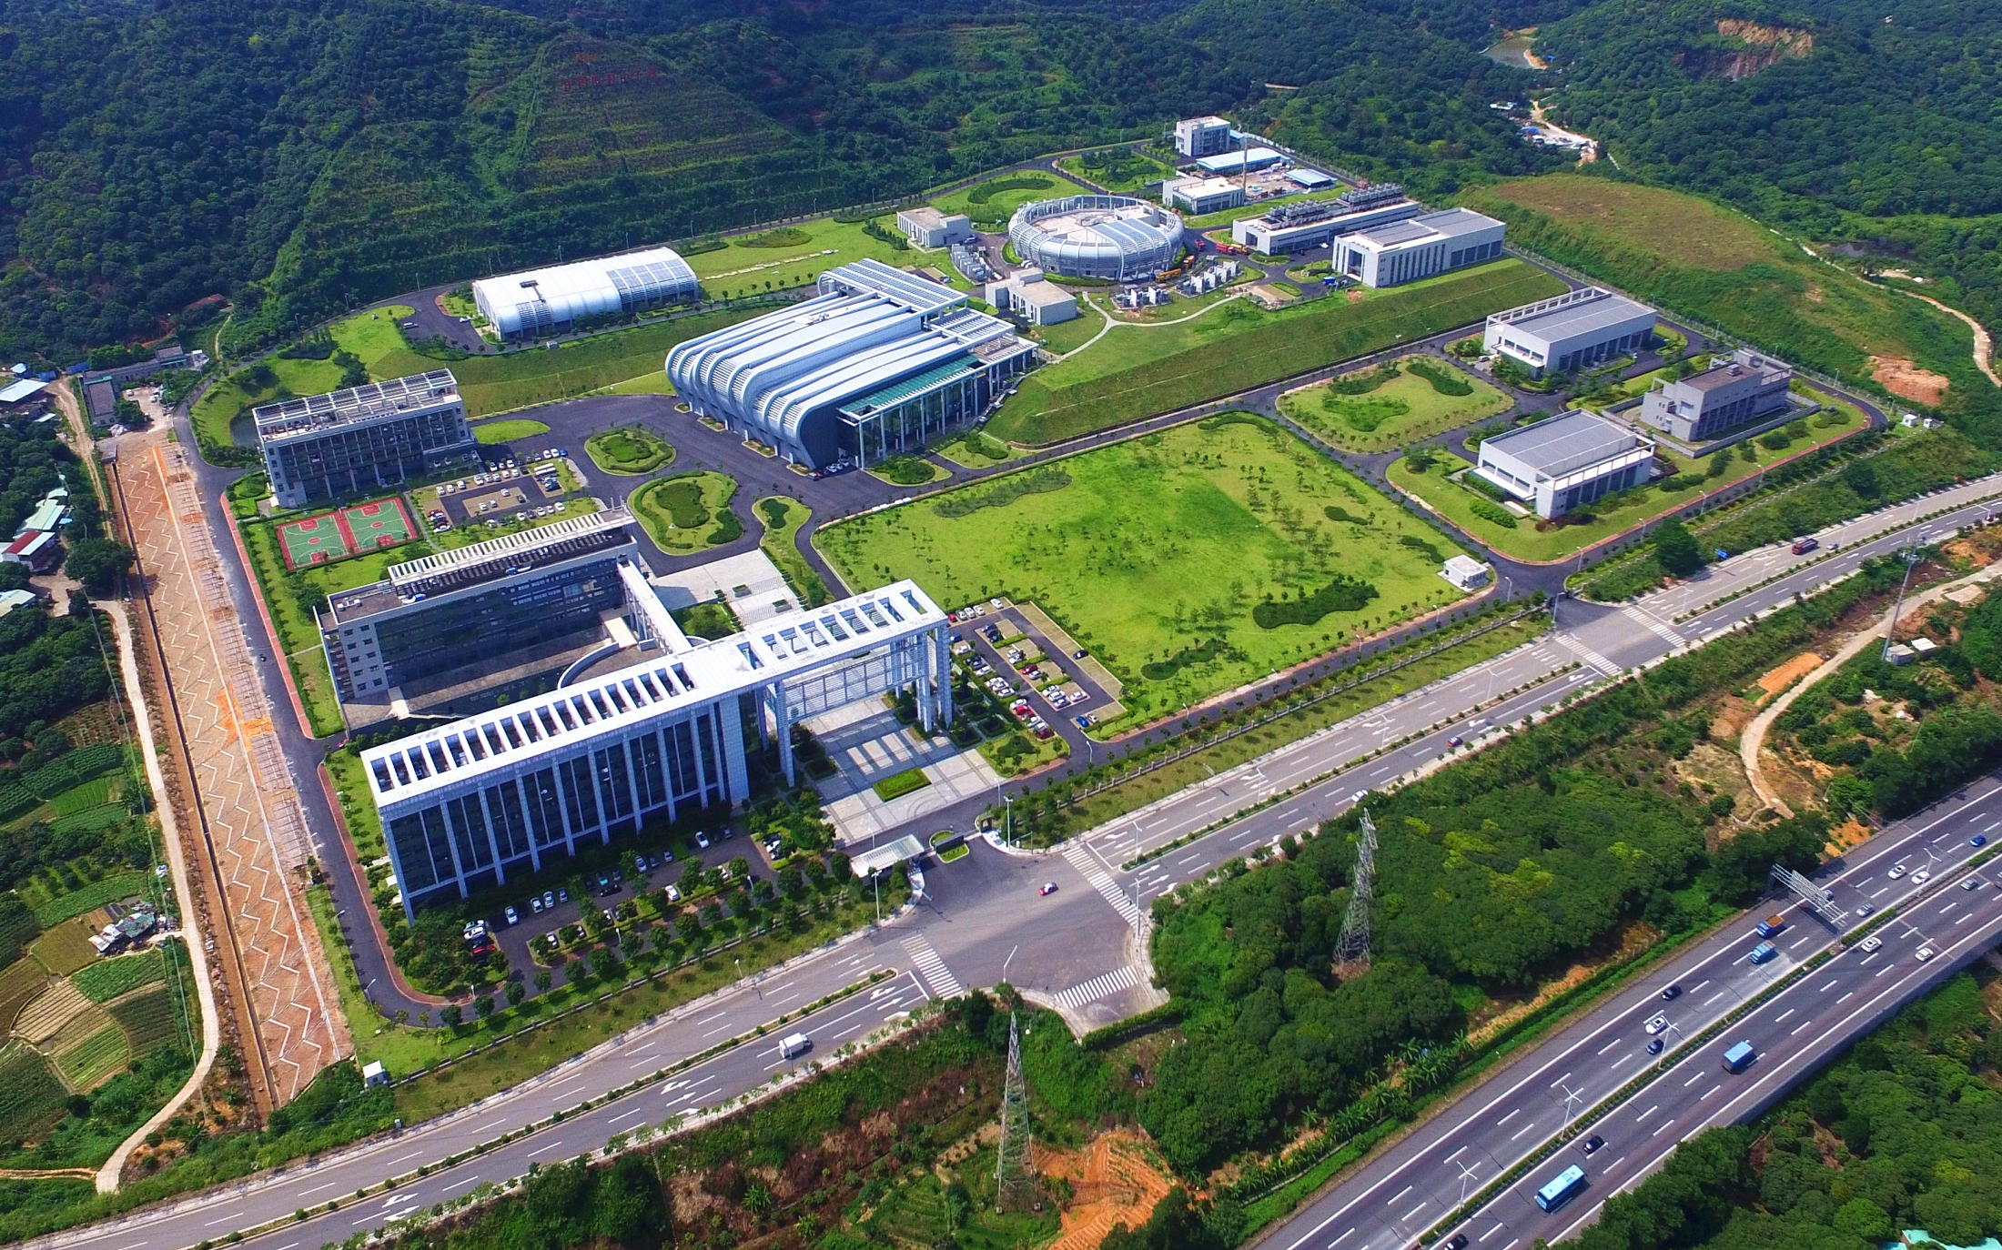
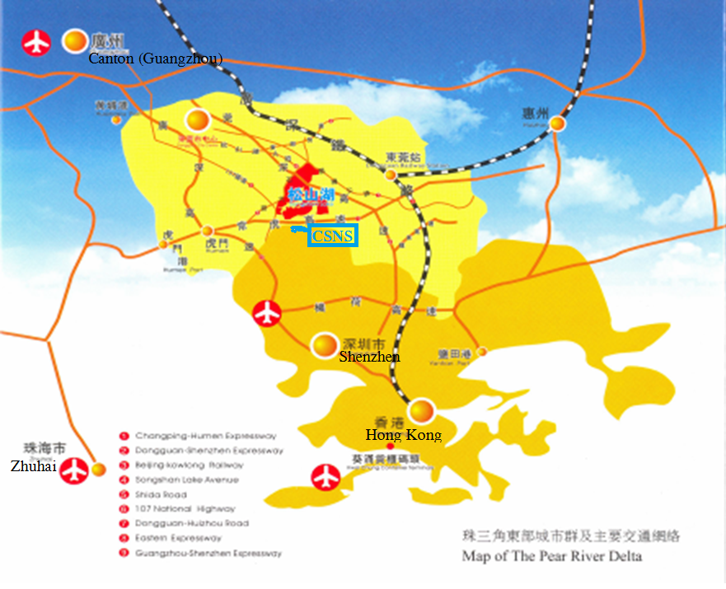
CSNS campus
Eastern part of the Pearl River Delta
HIAF/CiADS
The site for CSNS is in Dongguan, Guangdong Province.
CSNS is the first large scientific facility in southeastern China, jointly invested by the central government and local government. It aims to promote advanced researches in the economic developed zone of Guangdong-Hong Kong.
Total budget: ~2.3B CNY (or 350M USD)

Slide 5
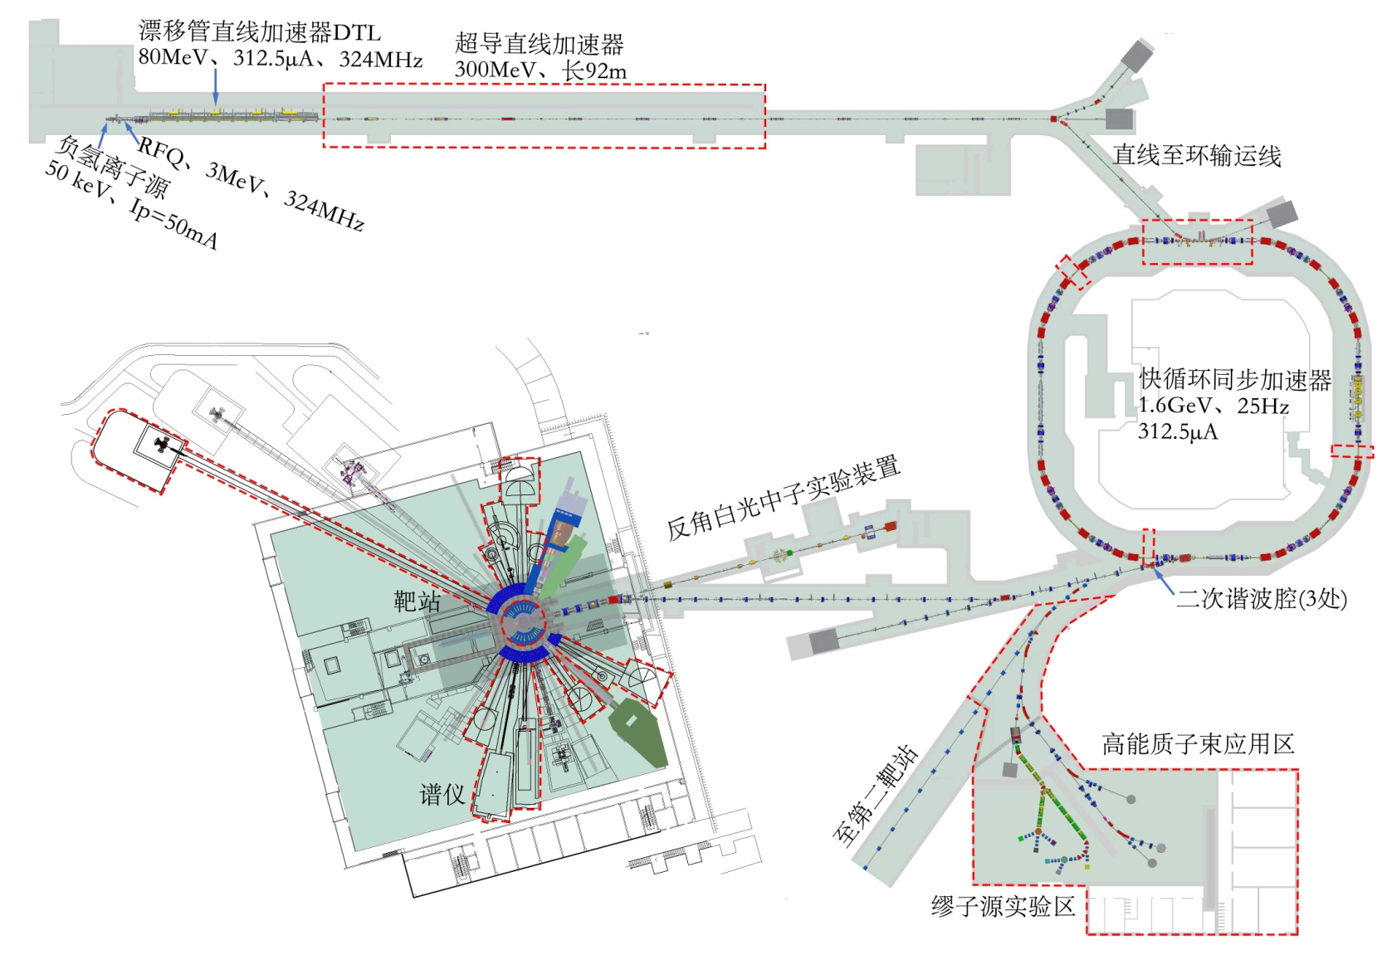
Linac (RFQ-DTL-Spokes)
RCS
TS1
CSNS-II Schematic
EMuS

Slide 6
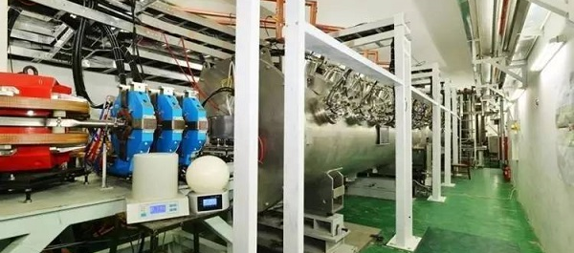
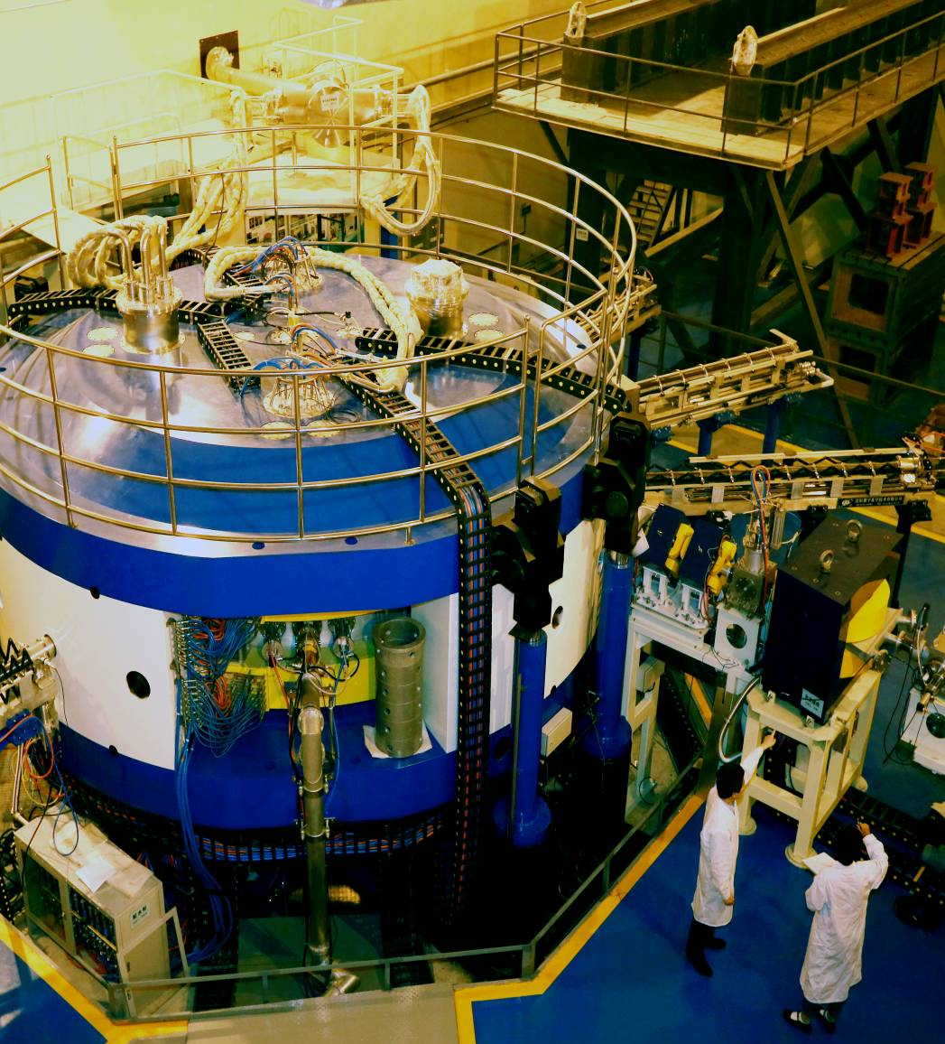
Low-energy high-power accelerators
ADS test facilities
  IMP: CW proton front-end, 25 MeV, 10 mA, max: 200 kW, RFQ-HWR-Spoke (162.5 MHz)
  IHEP: CW proton front-end, 10 MeV, 10 mA, 100 kW, RFQ-Spoke (325 MHz)
CYCIAE-100 H- cyclotron @CIAE
  100 MeV, 500 μA, max: 50 kW
  Multi-purpose: ISOL driver for radioactive ion beams, neutron source, isotope production, etc.

Slide 7
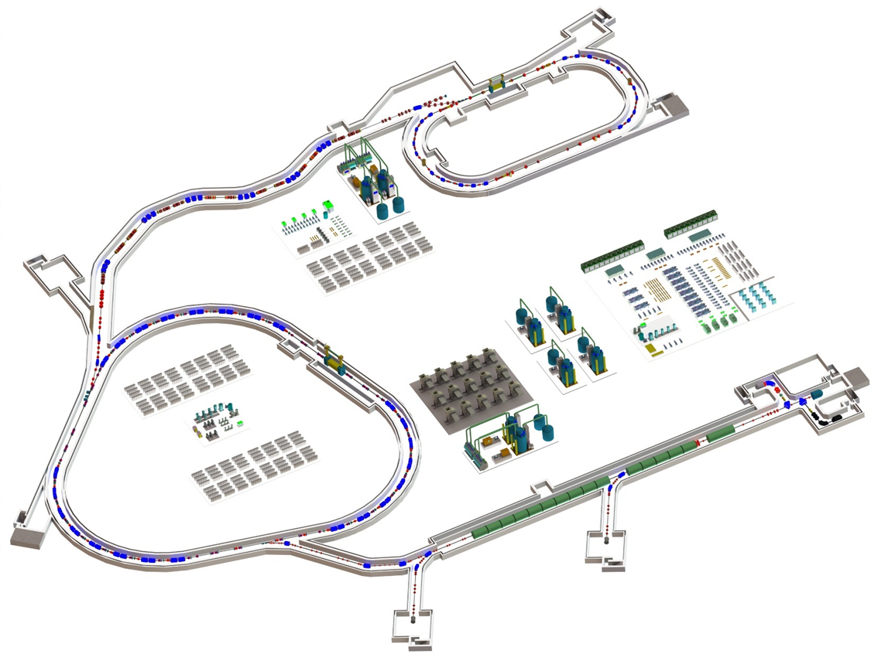
HIAF Project (Under construction)
E_{B1}: 0.8 AGeV, 3×10¹⁰ppp ²³⁸U³⁵⁺
1.75AGeV, 7.5×10¹⁰ppp ⁷⁸Kr¹⁹⁺
2.6~3.0AGeV, 1.0×10¹¹ppp ¹⁶O⁶⁺
HIAF-I: 2018-2025
Budget: 1.62+1.2 B CNY, approved
External target station
High Energy Density Physics
Nuclear Matter study-CEE
Hypernuclear
High energy irradiation
L: 180m, Bρ: 25 Tm
HFRS
SRing: Spectrometer ring
Circumference: 273m
Rigidity: 13-15 Tm
Electron/Stochastic cooling
Pricise Measurement by Two TOF detectors, Four operation modes
BRing1: Booster ring 1
Circumference: 600 m
Rigidity: 34 Tm
Large acceptance (200/100)
Two planes painting injection
Fast ramping rate（5-10Hz）
SECRAL and FECR
28-45GHz,1.0emA(U³⁵⁺)
iLinac: Superconducting linac
Length:100 m
Energy: 17~22 MeV/u(U^{35+ ~ 46+})
Low energy nuclear
structure terminal

Slide 8
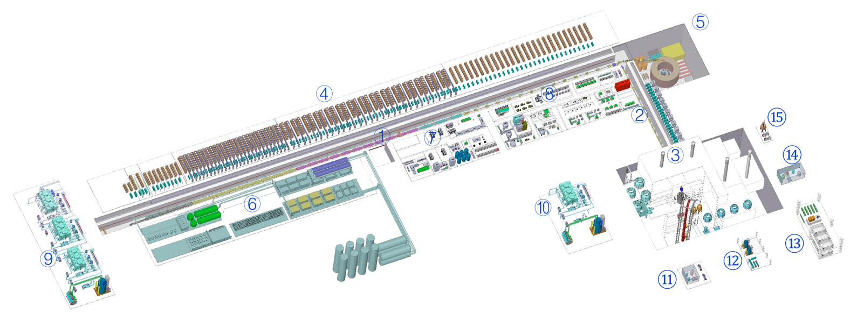
CiADS (Construction: 2021-2027)
Beam trips goal:
<10s, -
10s～5min, 2500/y
>5min, 300/y
Availability > 90%
Design Particle | proton
Energy | 500 (250) MeV
Beam current | 5 (10) mA
Beam power | 2.5 MW
Operation mode | CW&Pulse
Beam loss | ＜1 W/m
Reactor power | 7.5 MWt
Cryogenic | 2 K
① SC linac
② Coupling transport
③ Target and reactor hall
④ Accelerator equ. hall
⑤ Beam dump and granular target exp.
⑥ Cryogenic plant
⑦ SRF hall
Funding: 3.9 BCNY

Slide 9
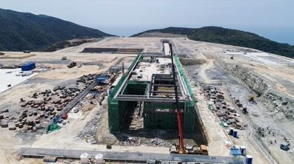
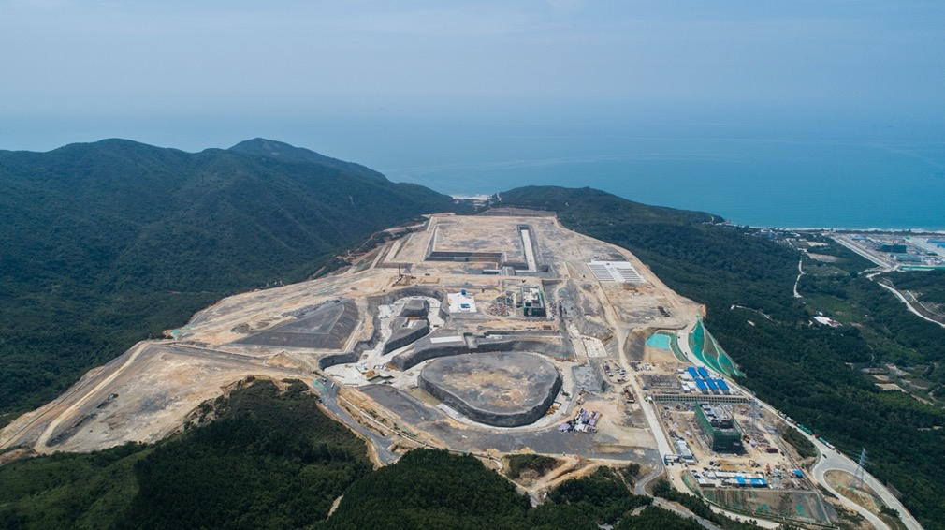
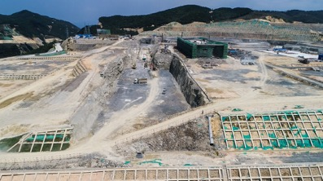
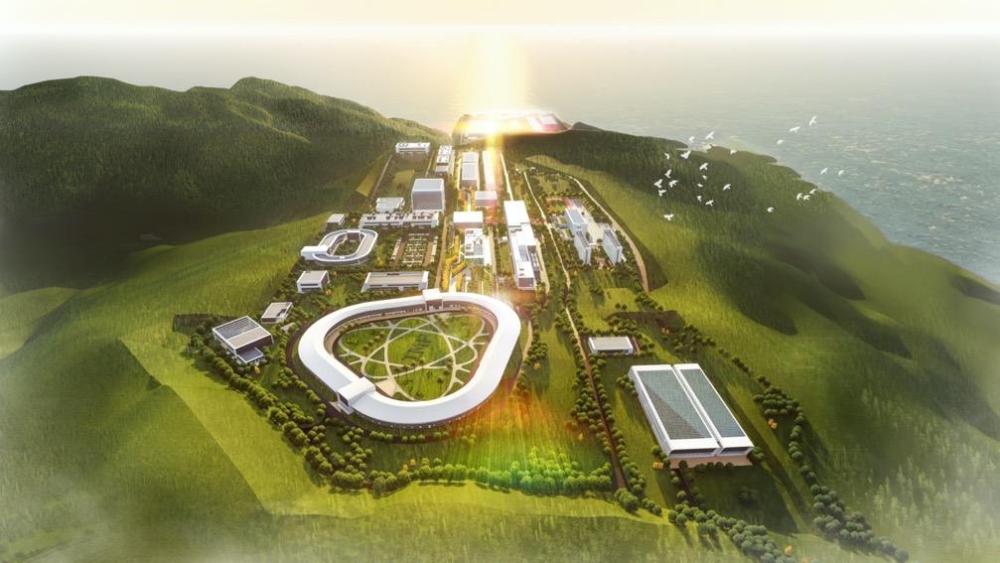
Campus for HIAF and CiADS
2020.11: Site preparation completed
2020.12: HIAF civil construction started

Slide 10
Muon related studies

Slide 11
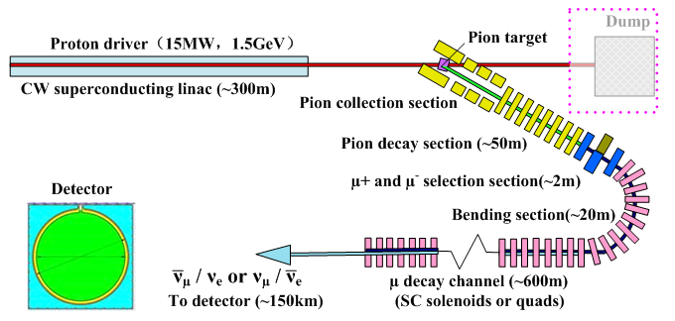
MOMENT: a muon-decay medium-baseline neutrino beam facility
Based on ADS-type accelerator, muon decayed neutrinos (200-300 MeV), for LCPV and other neutrino physics
Study since 2013, as a part of the neutrino program in China
  Studies: proton driver, target station, muon channels, detector and physics

Slide 12
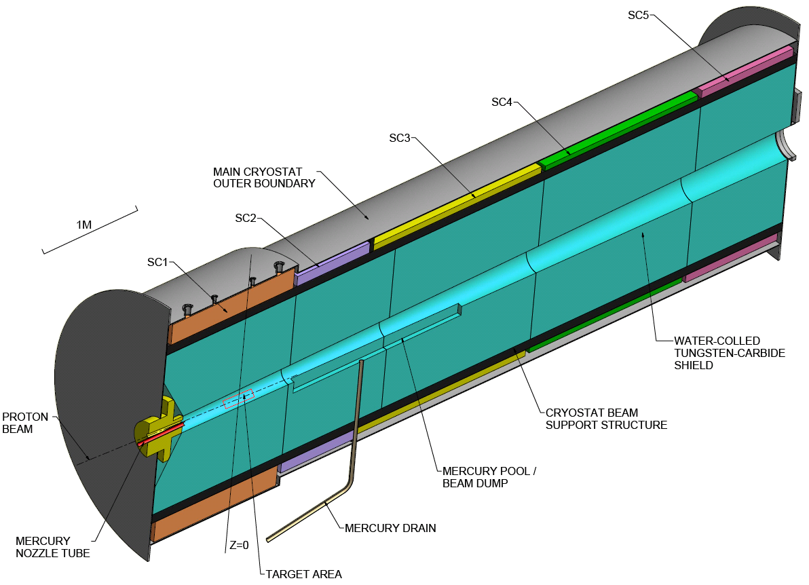
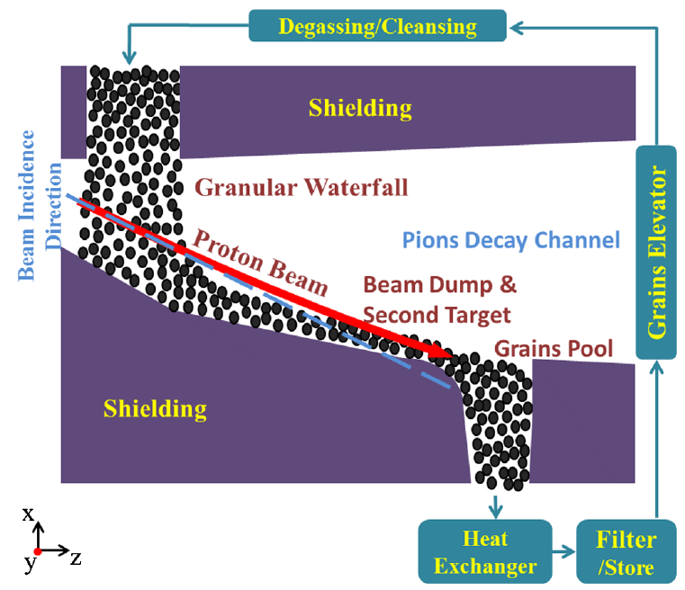
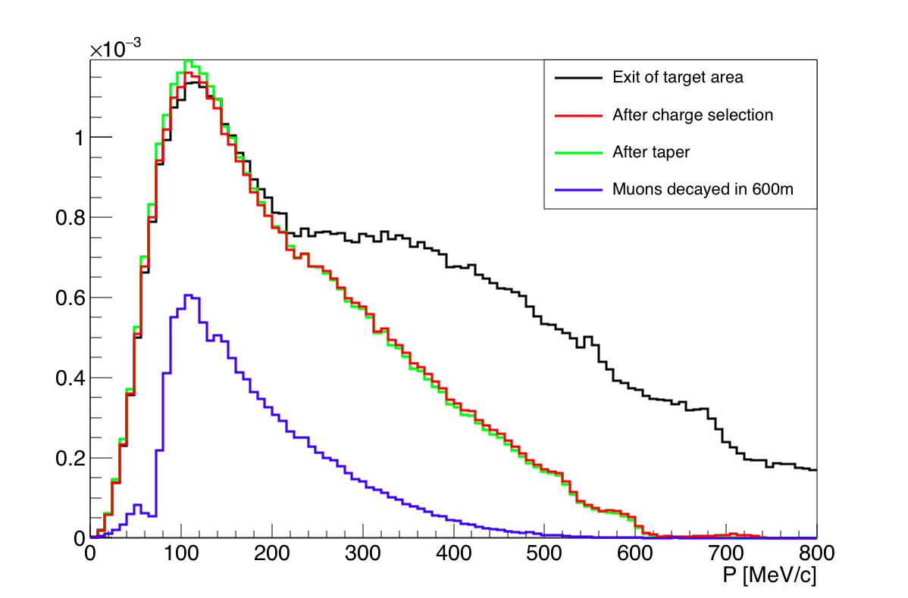
Proton linac
  CW, 1.5 GeV, 15 MW, synergy with China-ADS study
Target station
  Basic: Capture SC solenoids (14 T), Hg jet, Forward collection + extracting spent protons
  Fluidized granular target (waterfall target)
Muon channels
  Charge selection by curved solenoids
  Wide spectrum transport (stopband)
  Low-divergent muon decay channel

Slide 13
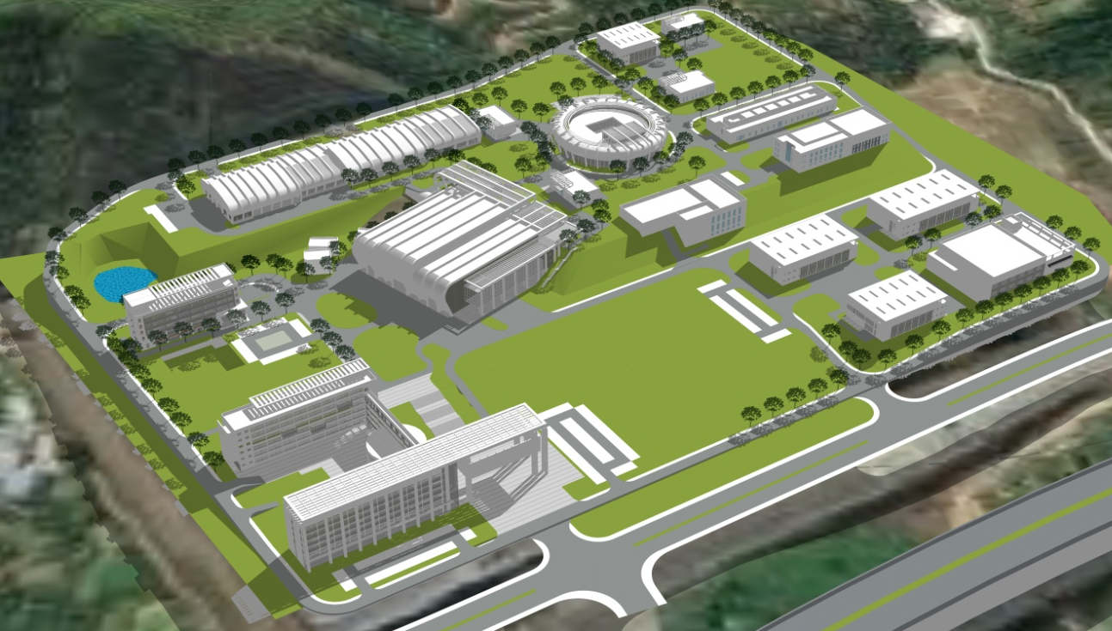
Experimental Muon Source (EMuS) at CSNS
Study on EMuS at CSNS started from 2007, from early time focusing μSR applications to later multi-purpose muon facility
  Proton beam at CSNS-II : 1.6 GeV, 500 kW, 25 Hz
  Proton beam for EMuS: 1.6 GeV, 25 kW, 2.5 Hz, standalone
Phased construction:
  Simplified scheme (included in CSNS-II): surface muons for μSR
  Baseline scheme: multi-purpose, based on SC solenoids
EMuS

Slide 14
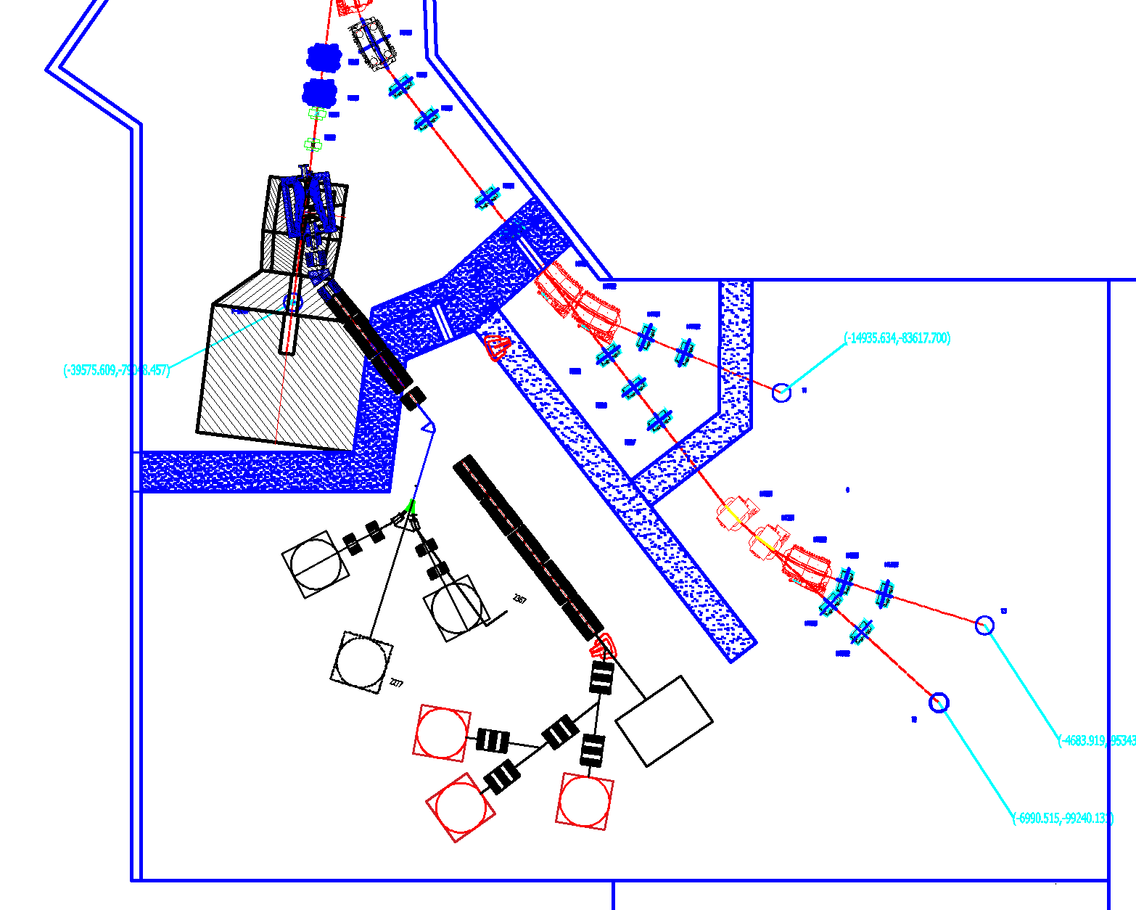
Working modes (indep.):
Surface μ mode
  Δp/p: <±4%
  Ref. Pμ=29 MeV/c
Decay μSR mode
  Δp/p: <± 5%
  Ref. Pμ =40-150 MeV/c
High-momentum μ mode
  μ imaging, neutrinos
  Ref. Pπ=200-450 MeV/c
EMuS Layout and Working Modes
Special design features:
Conical graphite target
Trumpet capture solenoids
Forward collection
Multiple working modes
Muon momentum up to 450 MeV/c
Surface muons
Slow muons
Decay muons
Neutrino
Detector

Slide 15
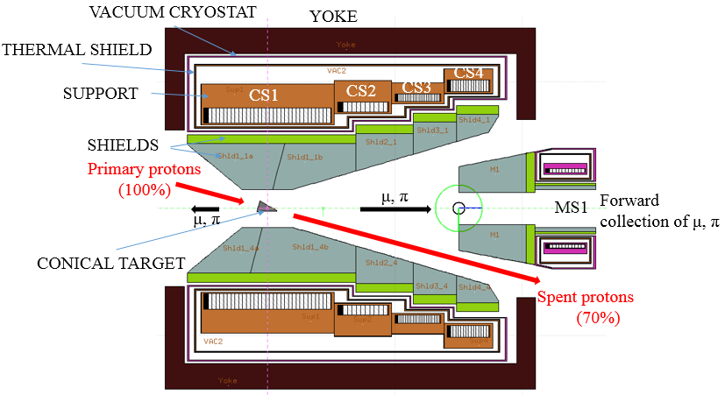
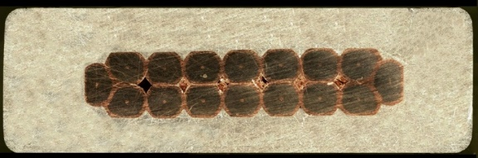
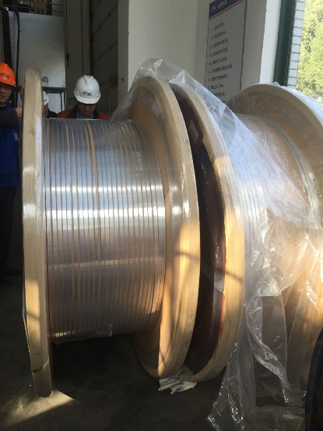
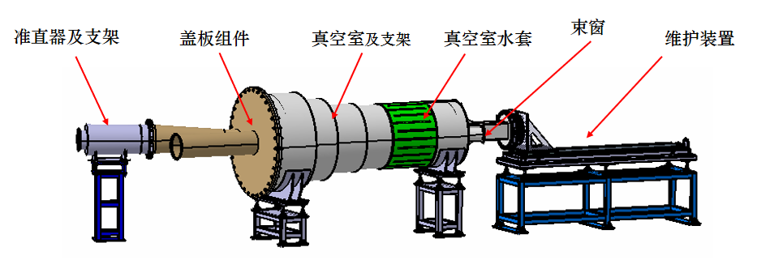
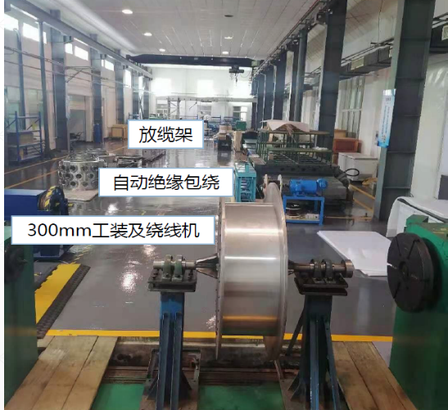
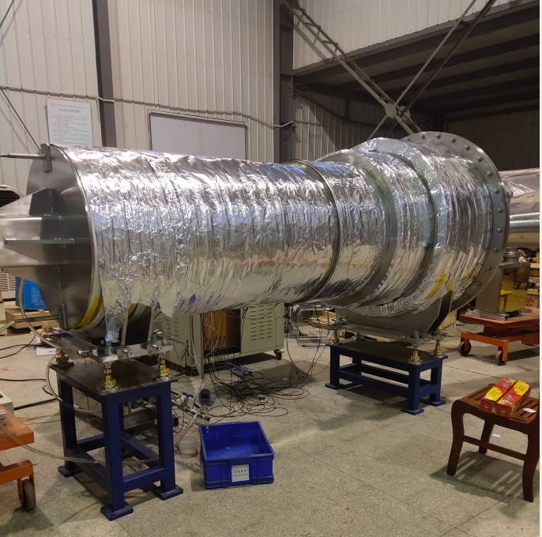
R&D and prototyping of EMuS target station
EMuS target station
(Baseline scheme)
Target assembly prototype
Al-stabilizer NbTi cable
Capture solenoid prototype

Slide 16
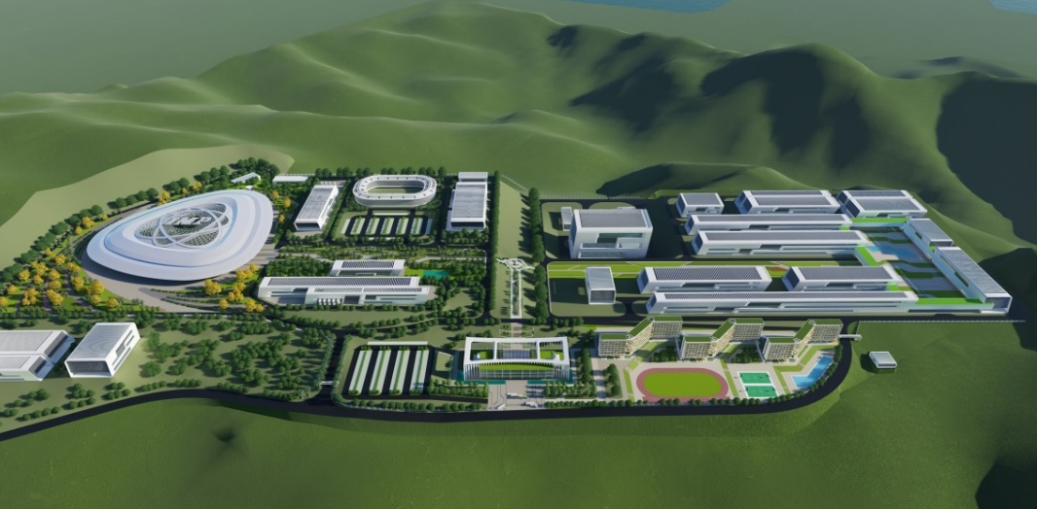
Possible Muon Facilities at CiADS/HIAF
@CiADS
  CW/pulsed beam: 500-600 MeV, Max: 2.5 MW (CW)
  A possible muon facility in the application hall (project: to a subcritical reactor)
  μSR, muon physics
@HIAF
  Pulsed intense heavy-ion beams for production of pions/muons
  1-3 Hz, 1-5 GeV/c, 10¹⁵ nucleon/pulse
  Possible muon experiments: μ-e conversion, μ g-2, Kaon rare decay etc.
HIAF
CiADS

Slide 17
Summary
Design studies on different muon beams have been working in China: MOMENT, EMuS@CSNS, muons@CiADS/HIAF
R&D and prototypes for EMuS almost completed
Different studies profit from the synergies on design concepts, key technologies, simulation tools, etc.
Thanks for your attention!

