Slide 1
Synergies in the high-power and muon programs in Japan
Koichiro Shimomura KEK-IMSS,J-PARC

Slide 2
What is muon ?
Today’s understanding
Mass 1/9 of proton 200 of electron
Positive muon ~ light proton
Negative muon ~ heavy electron
Spin 1/2
2nd generation of charged lepton
Electro-Weak Interaction 〇
Strong Interaction ✕
Spin polarized in birth
Relatively long life time (2.2μs) parity non conserving decay
High transmission capability (useful for imaging)
⇒These unique feature enable us to produce
various applications

Slide 3
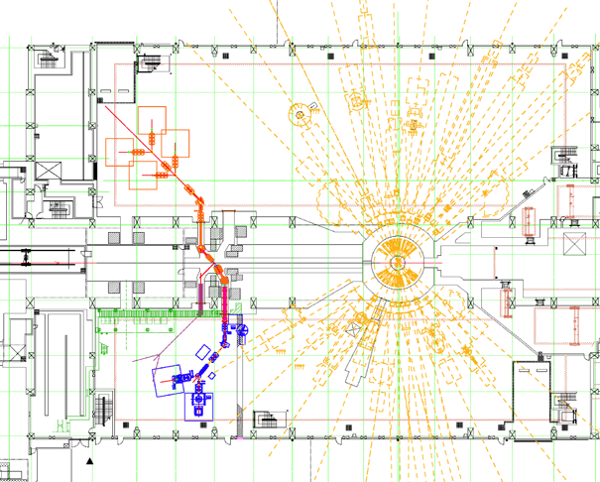
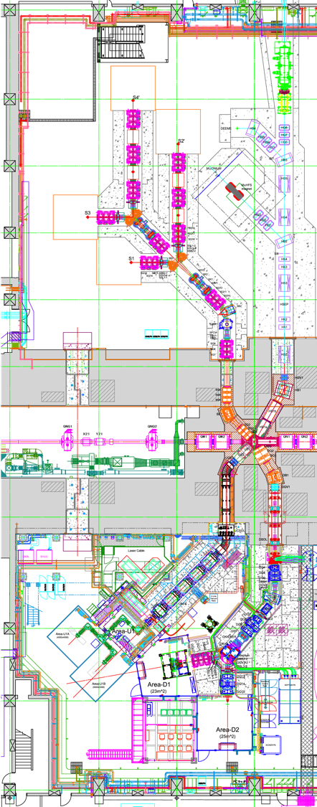
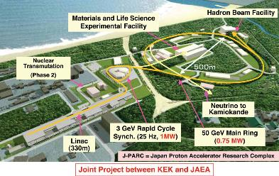
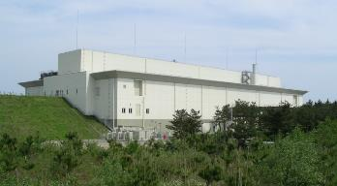
Muon Facility @J-PARC
MUSE=“Muon Science Establishment”
Muon Facility (MUSE)
Neutron Facility
(JSNS)
← 9 beam lines will be available upon the completion.
5 is under operation.
Materials and Life Science Experiment Facility

Slide 4
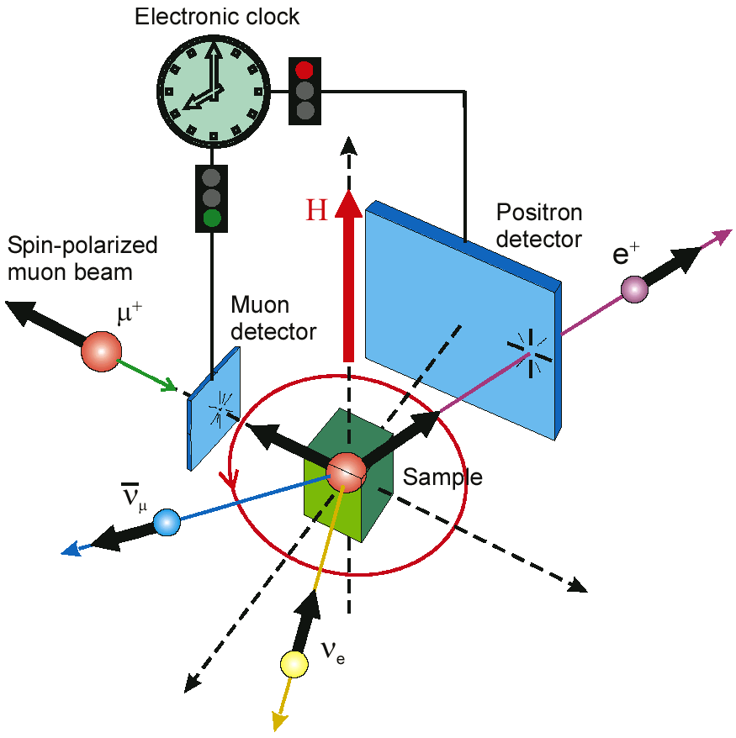
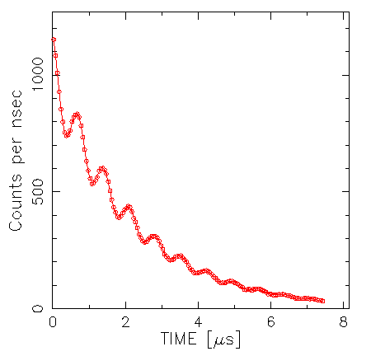
Transverse Field (TF) µ⁺SR
Typical time spectrum (histogram)
Notes:
A VERY quick review of the familiar µ⁺SR technique. Parity violation in the weak interaction gives us 100% polarized muons and the asymmetric decay that makes their polarization easy to follow as a function of time. See Web site for details.
[1 min]

Slide 5
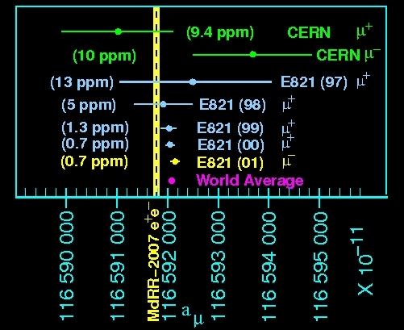
How about muon g factor ?
⁻ theory

Slide 6
Muon Spin Precession in Ring
if g=2 (a=0)
Momentum
vector
μ
Spin vector

Slide 7
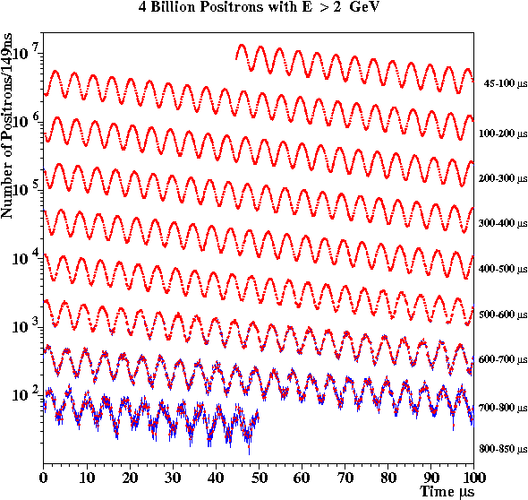
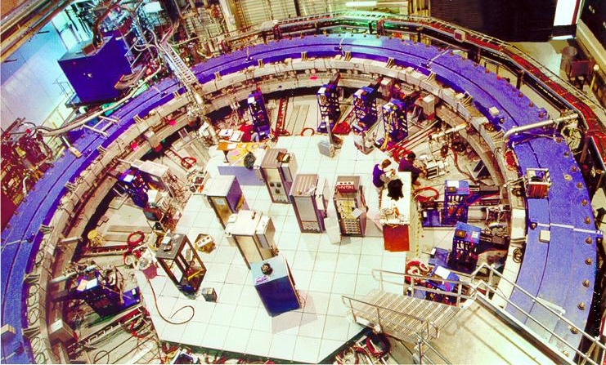
The Magnet (at BNL)
Muon lifetime γτ_{μ} = 64.4 μs
(g-2) period τ_{a} = 4.37 μs
Cyclotron period τ_{C} = 149 ns

Slide 8

The muon ring moved to Fermilab
(22 June – 25 July 2013)

Slide 9
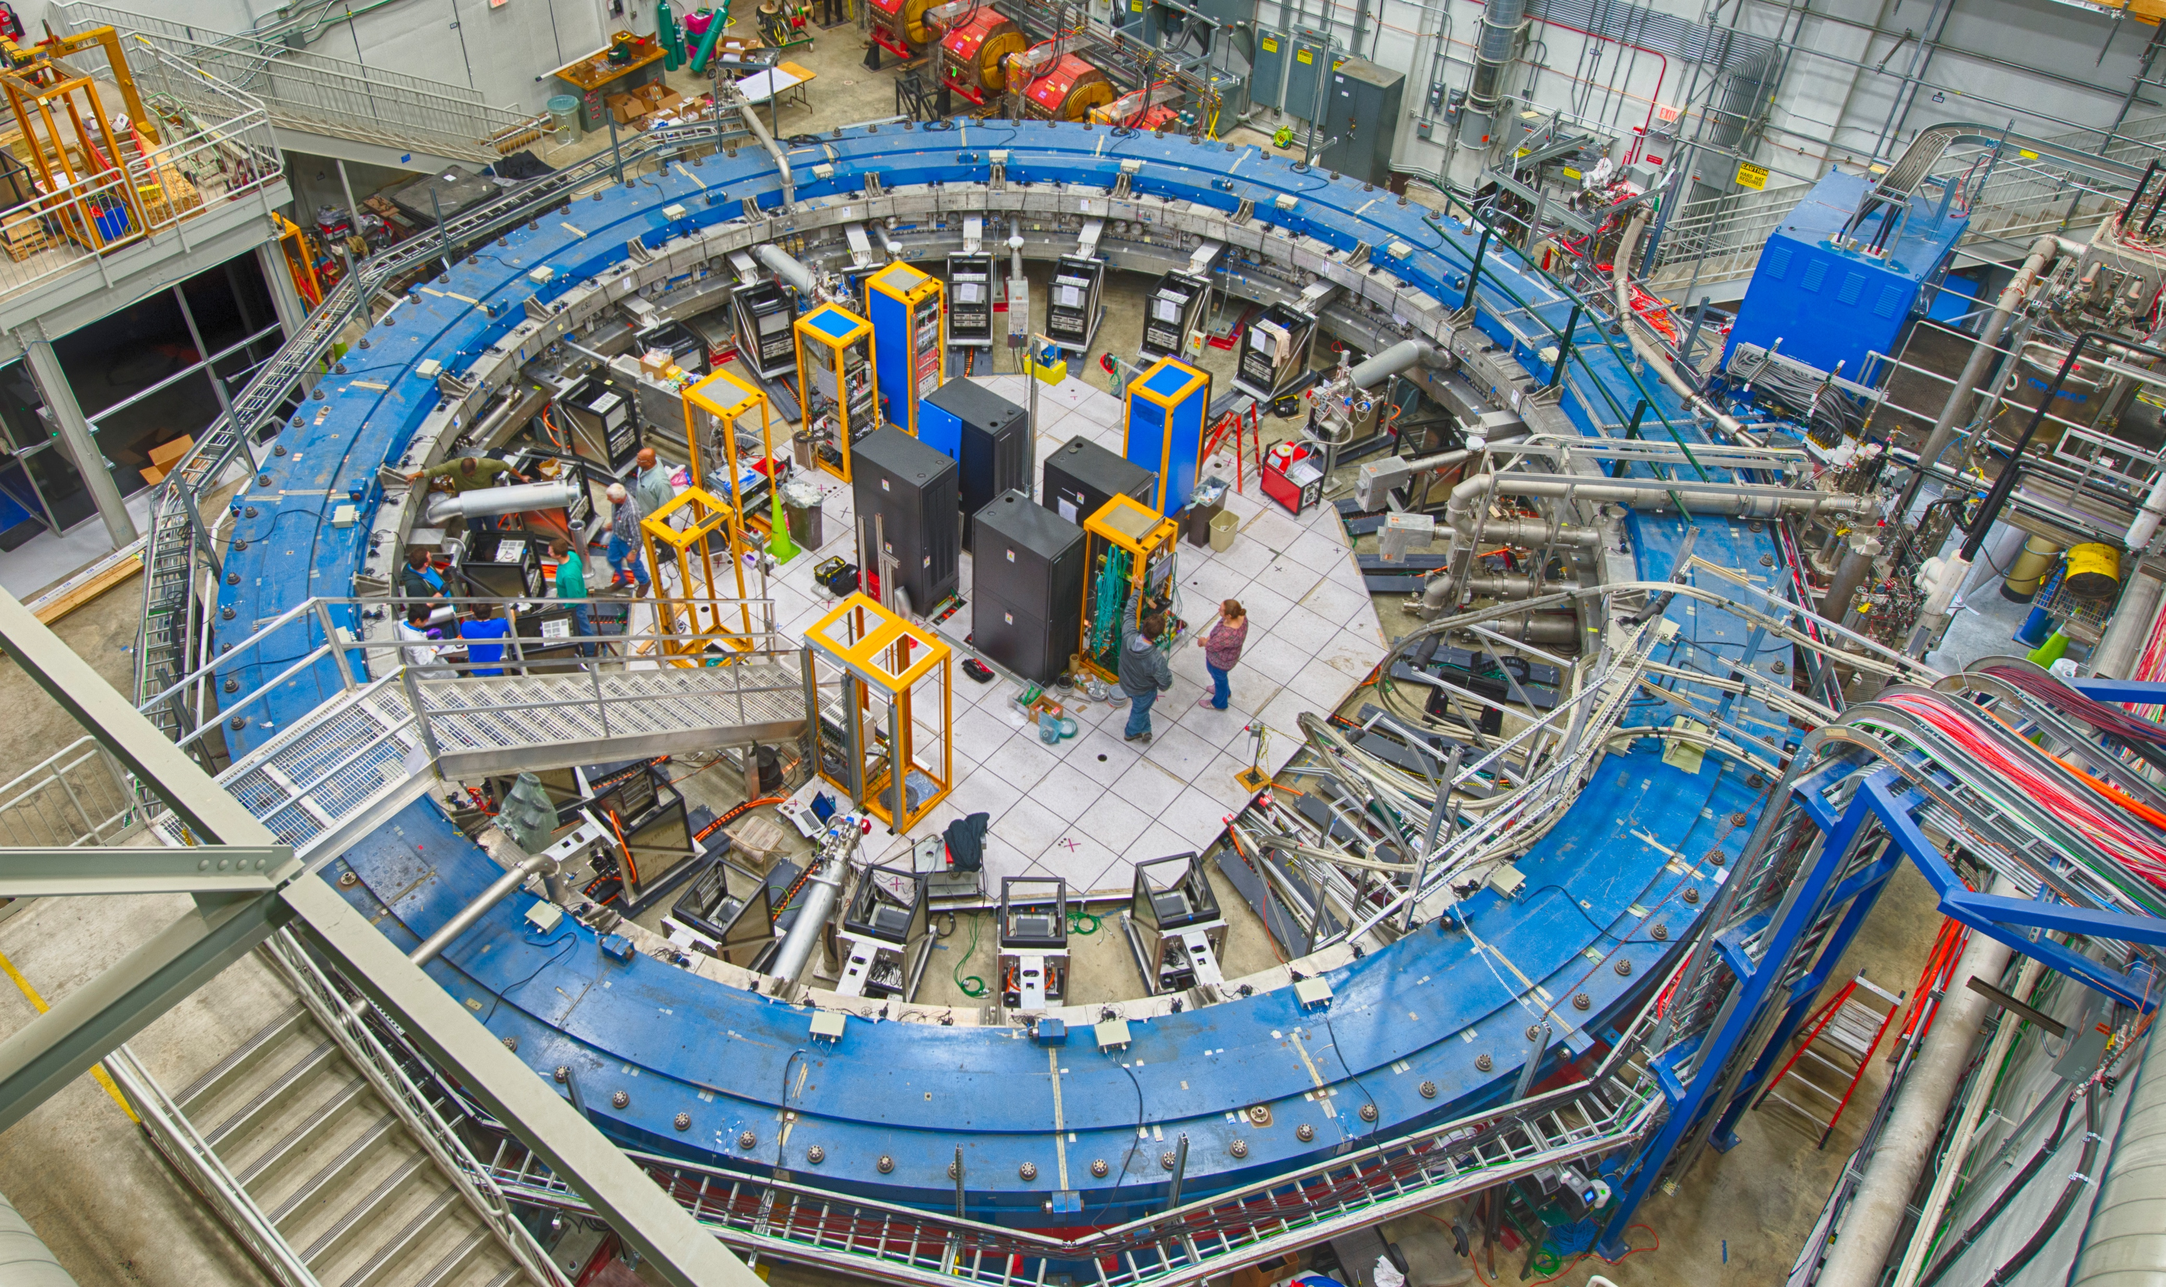
The Magnet (at Fermlab)
APRIL 2017
24 Calorimeter stations located all around the ring
Measure arrival time & energies of the decay e⁺

Slide 10
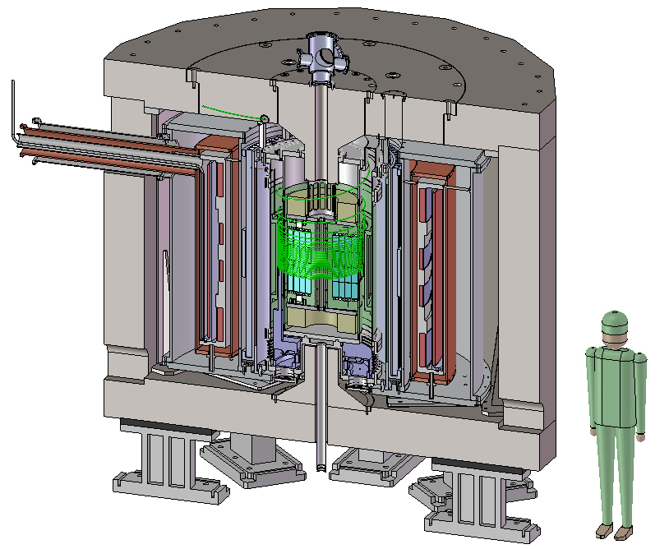
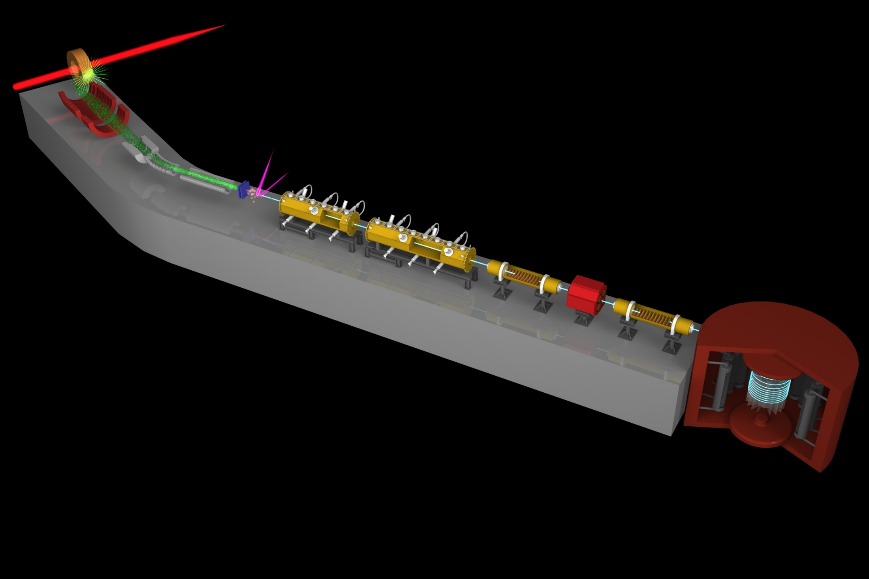
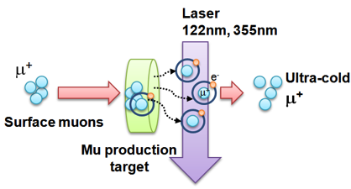
Muon g-2/EDM Experiment at
J-PARC with Ultra-Cold Muon Beam
Silicon
Tracker
3 GeV proton beam
( 333 uA)
Production target
(20 mm)
Surface muon beam
(28 MeV/c)
Muonium Production
(300 K ~ 25 meV⇒2.3 keV/c)
66 cm
Surface muon
Super Precision Storage Magnet
(3T, ~1ppm local precision)
Ultra Cold μ+ Source
Muon
storage
Resonant Laser Ionization of Muonium (~10⁶ μ⁺/s)
Muon LINAC (300 MeV/c)
Δ(g-2) = 0.1 ppm
ΔEDM = 10⁻²¹ e・cm

Slide 11
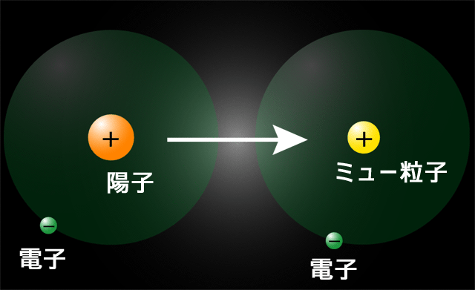
Muonium
Ｈｙｄｒｏｇｅｎ
Ｍｕｏｎｉｕｍ
Proton
Positive Muon
Electron
Electron
Pure leptonic bound system, free from finite size effect.
Good example for testing QED,
HFS,1s-2s, Lamb shift
Muonium is also useful in condensed matter physics and chemistry
Reduced mass of electron in hydrogen and muonium differ only 0.5%

Slide 12
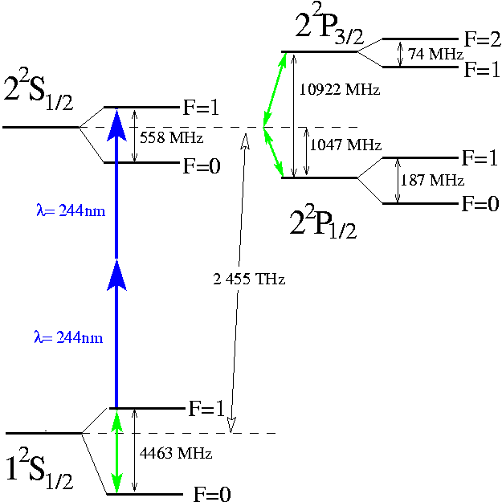

Mu(H) Energy Diagram
Fine Structure
explained by Dirac
Classical Lamb Shift
QED
Tomonaga, Shwinger,
Feynman
Not included QED weak hadronic correction

Slide 13
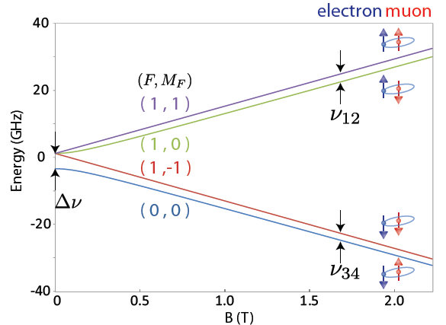
Muonium Hyperfine Structure
Hamiltonian of muonium
Δν : Mu Hyperfine Structure
Zeeman Splitting
e⁻
μ⁺
Δν
e⁻
μ⁺
Very weak (zero) field
Magnetic field (T)
High Field
ν₁₂+ν₃₄=Δν
ν₁₂−ν₃₄ ∝ μ_{μ}/μ_{p}

Slide 14
Precise measurement of Mu HFS
The most rigorous validation of
the bound-state QED
ν_{HFS}(exp) 4463.302 765(53) MHz (12 ppb) LAMPF1999
μ_{μ}/μ_{p} =3.18334524(37) (120ppb)
m_{μ}/m_{e}=206.768277(24) (120ppb)
ν_{HFS}(theory) 4463.302 891 (272) MHz (63 ppb) D. Nomura (2013)
ν_{HFS}(QED) 4463.302 720 (253) (98) (3) MHz(m_{μ}/m_{e}) (QED) (α)
ν_{HFS}(weak) -65 Hz
ν_{HFS}(had v.p) 232(1) Hz
ν_{HFS}(had. h.o) 5 Hz
QED calculation →Effort for 10 Hz is in progress by Eides et al.
Phys. Rev. A 86, 024501 (2012), PRL.. 112, 173004 (2014),
Phys. Rev. D 89, 014034 (2014)
Notes:
bound state QED

Slide 15
Precise measurement of Mu HFS
Strong relationship with muon g−2
  3.7σ deviation btw. theory and experiment
  Angular frequency of spin precession ω
  It is important to measure precise muon mass independently
  μ_{μ}/μ_{p} accuracy from direct measurement 120ppb
  W. Liu et al. ， Phys. Rev. Lett. 82 ， 711 (1999).
From g−2 storage ring
From muonium HFS

Slide 16
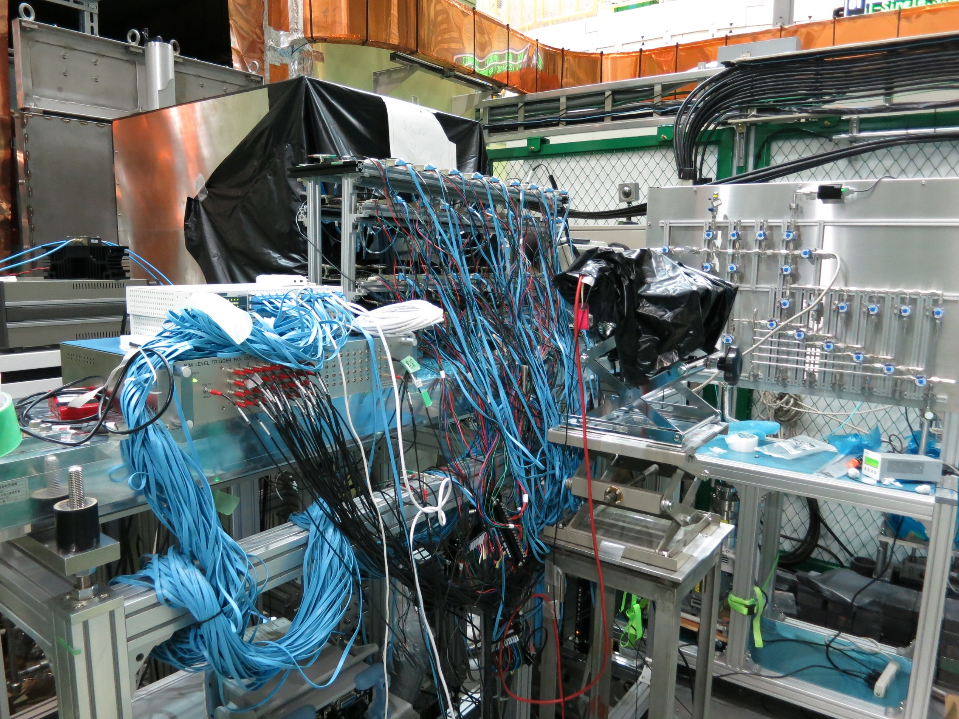

Slide 17
What is negative muon?
Elementary particle
Leptons
Charge -e
Spin：1/2
Lifetime： 2.2 μs
  μ ⁻ → e⁻ + ν_{e} + ν_{μ}
No strong interaction
Mass: 106 MeV/c²
  ~207 m_{e}、~1/9 m_{p}
e
μ
τ
ν_{e}
ν_{μ}
ν_{τ}
–
Muon production
π ⁻ → μ ⁻ + ν_{μ}
π ± are produced by
p⁺ (≥ 280 MeV ) + nucleus
26 ns
Muons in material
  μ⁺ : light proton
  μ – : heavy electron

Slide 18
Negative muon and muonic atom
Muonic atom formation and following processes
negative muon
nucleus(Z)
Energetic muon slows down and stops in material
Muonic atom formation
Muon capture in atomic
muonic orbital
Muon cascading process
Characteristic muonic
X-ray emission
Muon in muonic 1s state
Spends several lifetimes
(50-2000 ns)
Natural decay or muon capture
in the nucleus
Gamma-ray emission
electron
Characteristic muonic X-ray
nucleus (Z-1)
Gamma-ray

Slide 19
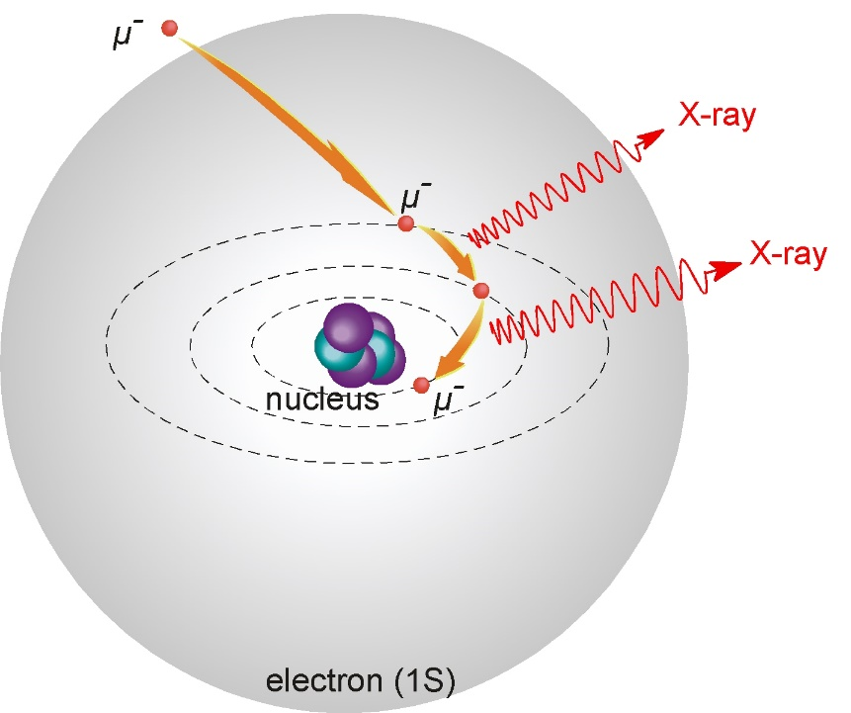
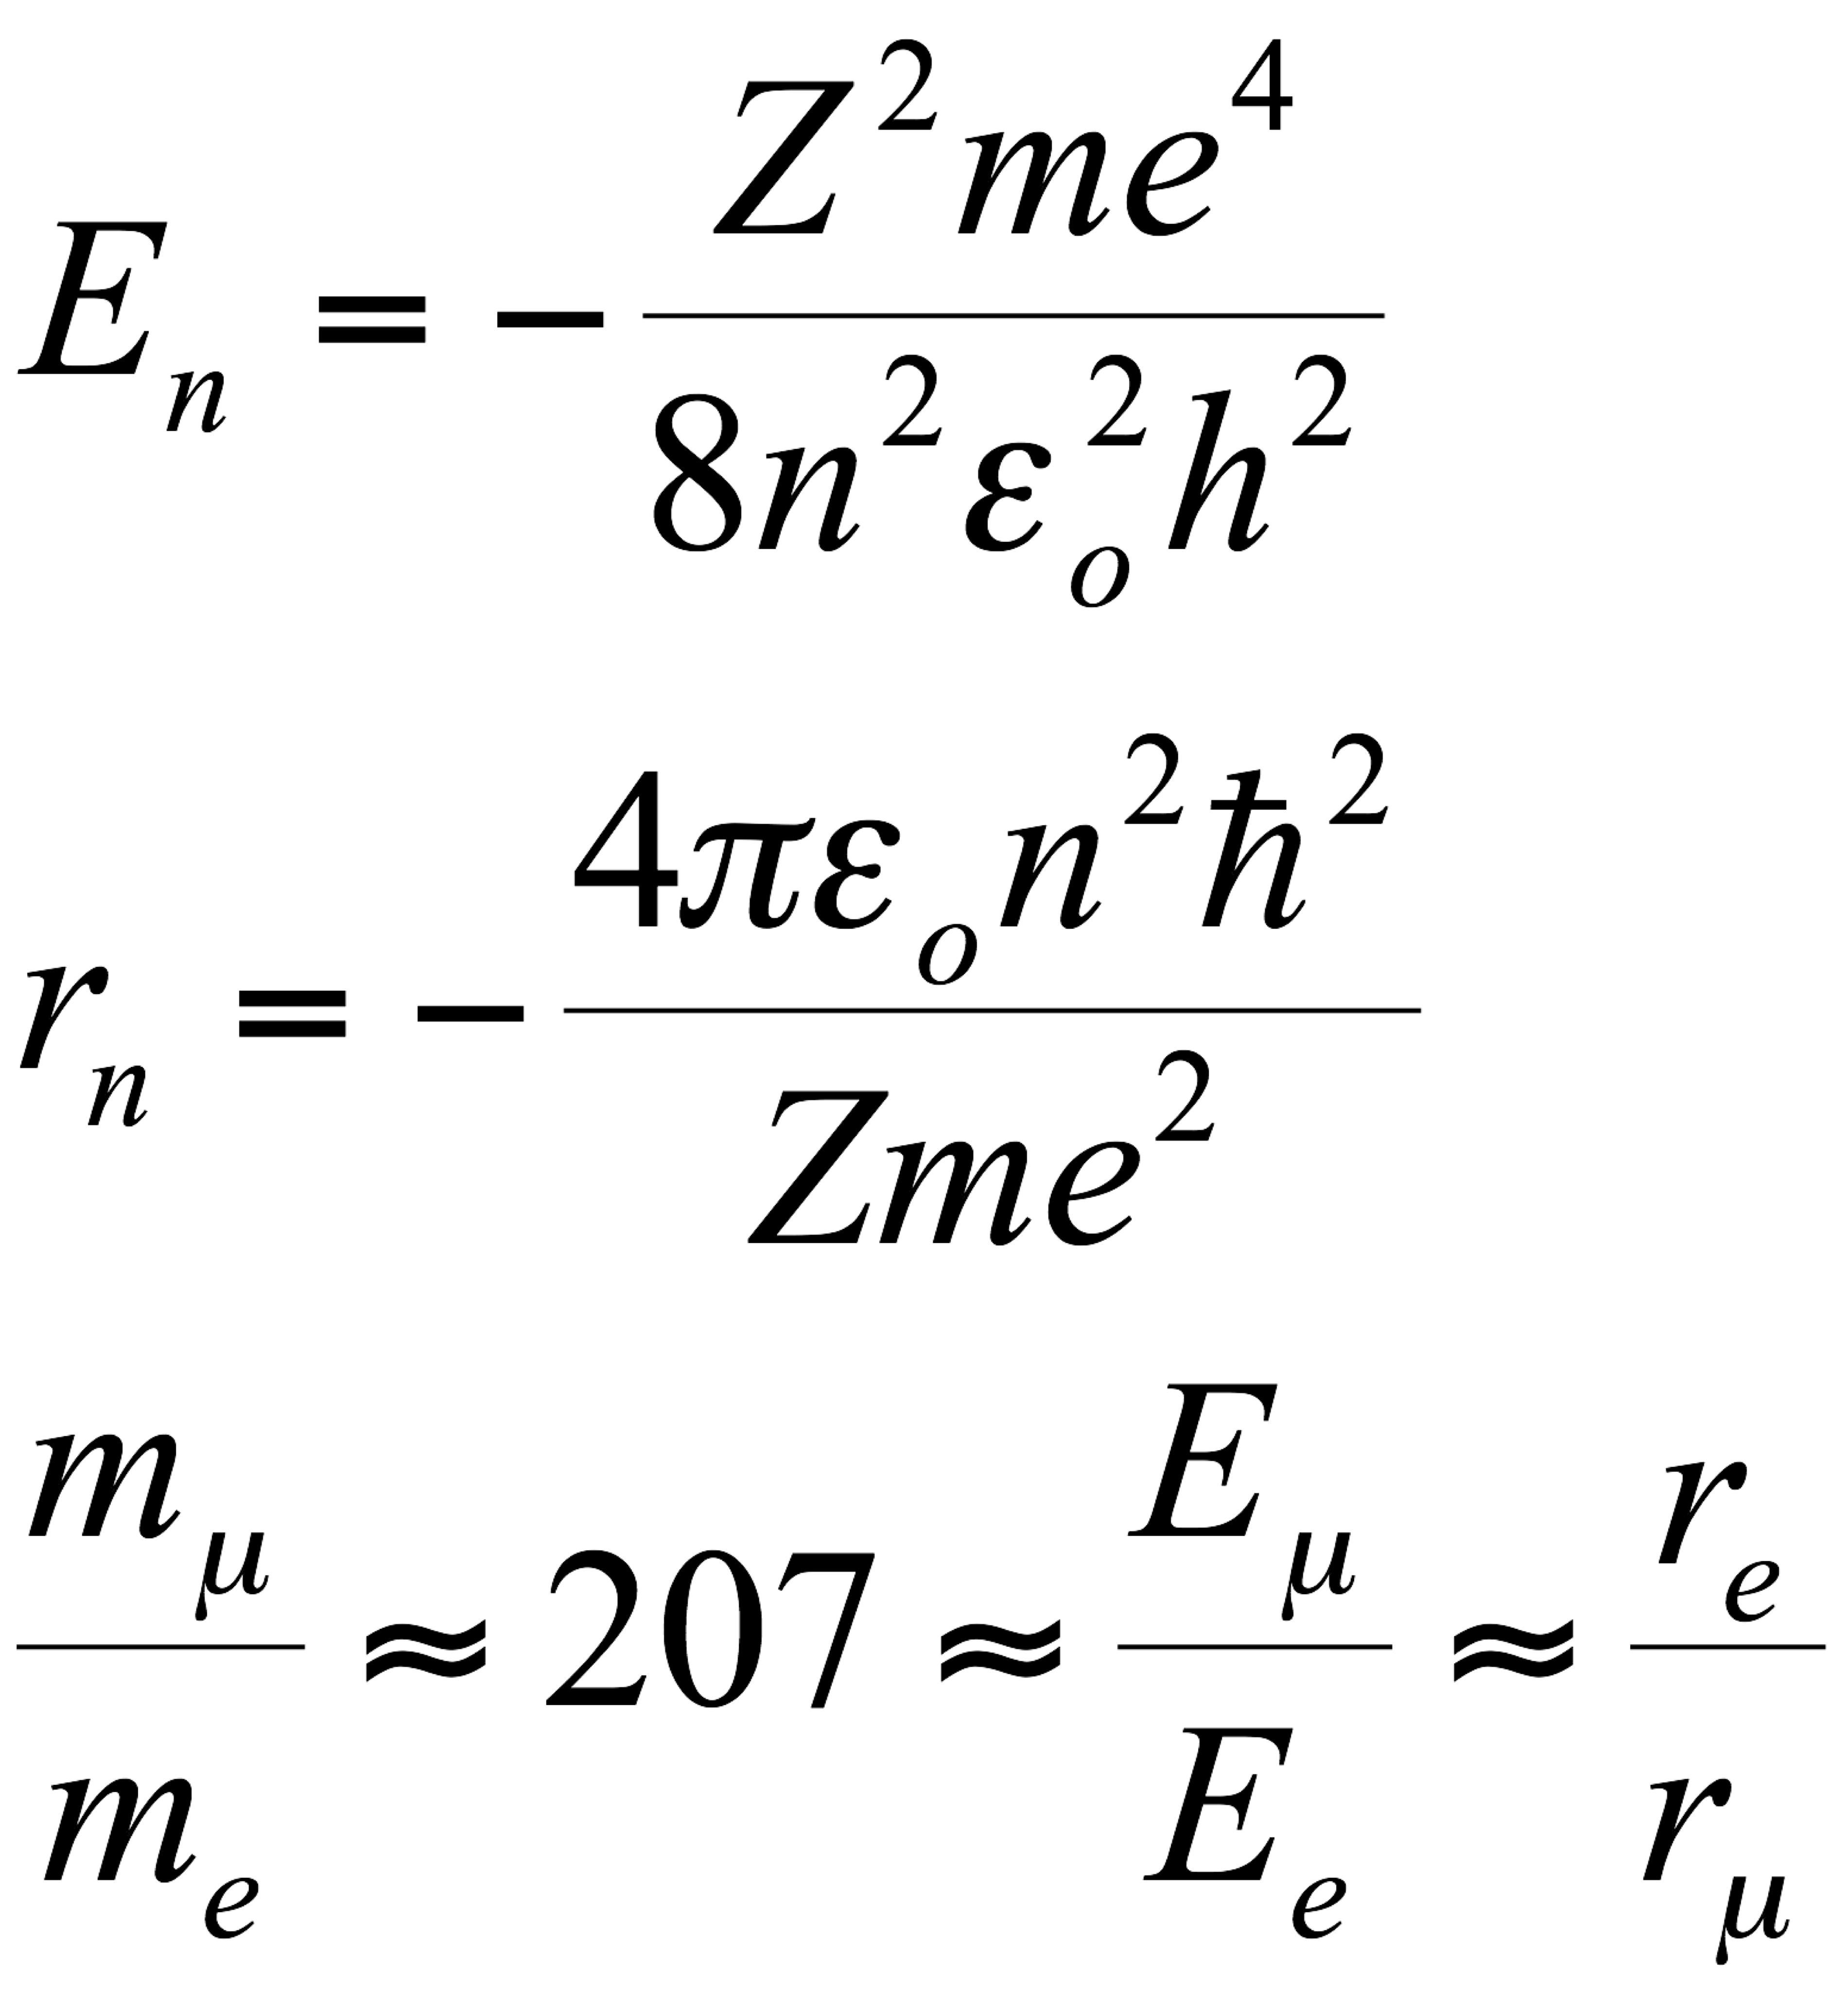
What is muonic X-ray?
Characteristic X-ray emitted during de-excitation process of muonic atom
Bohr model

Slide 20
Composition analysis with negative muons
Emission of characteristic muonic X-ray with specific energy to the element
- Applicable to every element except for hydrogen
multi-elemental, simultaneous
- No need of previous knowledge
- High energy (0.01- 10 MeV) deep inside, light elements
Observable from outside of sample
No need of vacuum huge / porous / bio sample
- No chemical process non-destructive / damage-less
- Stopping depth control + beam scan
depth-selective / 3D mapping
- More than 1 photons by 1 muon highly efficient
< Capture probability: proportional to Z with slight chemical effects >

Slide 21
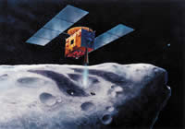
Multi-elemental ・ Non-destructive ・Depth-selective
Asteroid sample
Negative muon is the answer
  Wide variety of samples:
  historical, archaeological,,,etc.
  e. g. asteroid sample by MUSES-C probe
(Our research proposal around 2000)
MUSES-C (renamed as Hayabusa) returned in 2010 with a few hundreds of micrograms of dust samples of the asteroid
Hayabusa-2 sample analysis group joined.
H-2 is now traveling to asteroid 1999JC3 supposed to have abundant of B, C, N, O,
and returned with samples in Dec.2020.

Slide 22
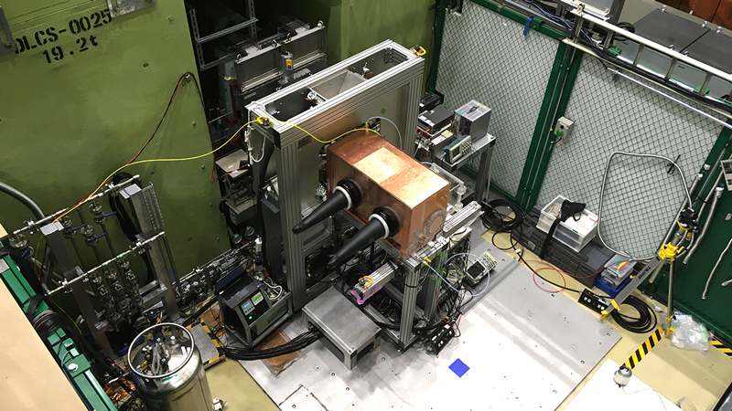
Measurements are on going

