Slide 1
Proposed Workpackage Description
The physics goals of a multi-TeV ( up to 10+ TeV Muon Collider can only be achieved with a
self-consistent design of the collider ring, interaction region (IR), high-field SC magnets,
Machine Detector Interface (MDI) and detector. The role of MDI is unique, due to muon beams
decay products interacting with the mach­­­ine components tens of meters from the Interaction
Point (IP), generating high fluxes of beam induced background (BIB) on the detector.
BIB composition, distribution, rates and arrival time may vary at different beam energies and
are strongly related to IR design optimization. The ultimate goal of MDI design is to suppress
by several orders of magnitude the BIB rates reaching the detector volume.
At the moment, this is achieved by adding absorber shielding around the beampipe region
impacting on the detector acceptance and performance.
The most recent studies are based on MAP IR design and optimized MDI at 1.5 TeV [1], as
benchmark, and they are summarized in [2] and references therein.
The present absorber solution, proposed by MAP is a twofold cone shaped tungsten “nozzle”
with the vertex close to the IP. To face the need to prepare for specific MDI designs and study
the detector constraints, tuned at different energies in the center of mass, a flexible framework was implemented to read the lattice and optics code optimized at each energy with traditional code like MAD-X, importing the beam line geometry in FLUKA [3].
Dedicated studies and optimization are needed for the forward region, covered at 1.5 TeV by
the tungsten polyethylene-borated nozzle, if it could be instrumented to extend
detector acceptance.

Slide 2
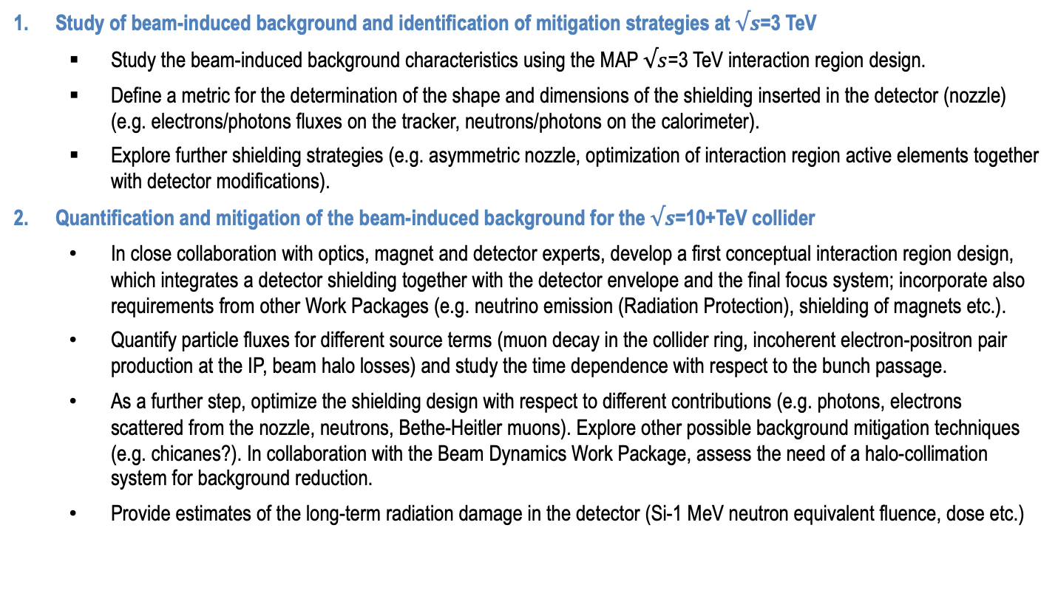
Proposed Workpackage Tasks
Study of beam-induced background and identification of mitigation strategies at $√s$=3 TeV
  Study the beam-induced background characteristics using the MAP $√s$=3 TeV interaction region design.
  Define a metric for the determination of the shape and dimensions of the shielding inserted in the detector (nozzle) (e.g. electrons/photons fluxes on the tracker, neutrons/photons on the calorimeter).
  Explore further shielding strategies (e.g. asymmetric nozzle, optimization of interaction region active elements together with detector modifications).
Quantification and mitigation of the beam-induced background for the $√s$=10+TeV collider
  In close collaboration with optics, magnet and detector experts, develop a first conceptual interaction region design, which integrates a detector shielding together with the detector envelope and the final focus system; incorporate also requirements from other Work Packages (e.g. neutrino emission (Radiation Protection), shielding of magnets etc.).
  Quantify particle fluxes for different source terms (muon decay in the collider ring, incoherent electron-positron pair production at the IP, beam halo losses) and study the time dependence with respect to the bunch passage.
  As a further step, optimize the shielding design with respect to different contributions (e.g. photons, electrons scattered from the nozzle, neutrons, Bethe-Heitler muons). Explore other possible background mitigation techniques (e.g. chicanes?). In collaboration with the Beam Dynamics Work Package, assess the need of a halo-collimation system for background reduction.
  Provide estimates of the long-term radiation damage in the detector (Si-1 MeV neutron equivalent fluence, dose etc.)

Slide 3
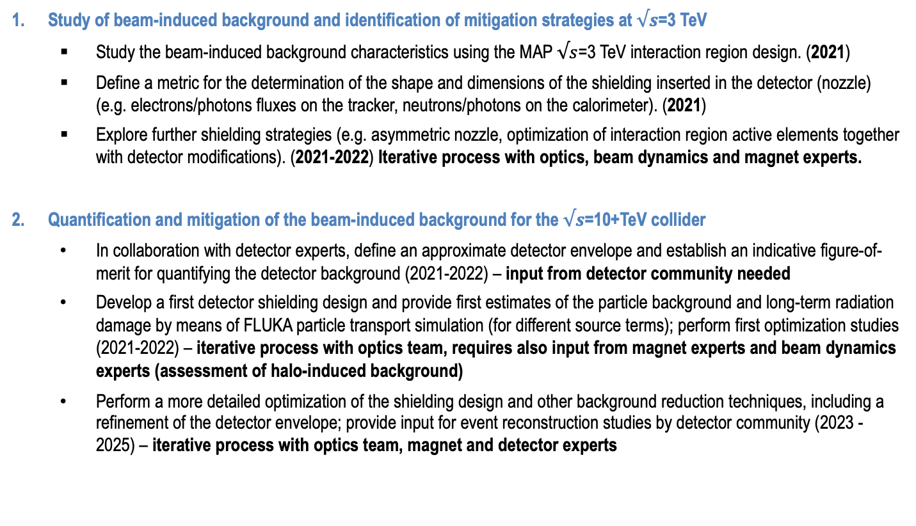
Proposed Workpackage Timeline
Study of beam-induced background and identification of mitigation strategies at $√s$=3 TeV
  Study the beam-induced background characteristics using the MAP $√s$=3 TeV interaction region design. (2021)
  Define a metric for the determination of the shape and dimensions of the shielding inserted in the detector (nozzle) (e.g. electrons/photons fluxes on the tracker, neutrons/photons on the calorimeter). (2021)
  Explore further shielding strategies (e.g. asymmetric nozzle, optimization of interaction region active elements together with detector modifications). (2021-2022) Iterative process with optics, beam dynamics and magnet experts.
Quantification and mitigation of the beam-induced background for the $√s$=10+TeV collider
  In collaboration with detector experts, define an approximate detector envelope and establish an indicative figure-of-merit for quantifying the detector background (2021-2022) – input from detector community needed
  Develop a first detector shielding design and provide first estimates of the particle background and long-term radiation damage by means of FLUKA particle transport simulation (for different source terms); perform first optimization studies (2021-2022) – iterative process with optics team, requires also input from magnet experts and beam dynamics experts (assessment of halo-induced background)
  Perform a more detailed optimization of the shielding design and other background reduction techniques, including a refinement of the detector envelope; provide input for event reconstruction studies by detector community (2023 -2025) – iterative process with optics team, magnet and detector experts

Slide 4
Timeline until next ESPPU
Exploratory Phase
Definition Phase
2021
2022
2023
2024
2025
4
1
2
3
4
1
2
3
4
1
2
3
4
1
2
3
4
1
2
3
4
Explore design
Identify critical issues
Explore and prioritise issues
Make design choices
Define realistic goals
Define design
Address feasibility issues
Develop design, refine choices
Develop R&D programme to demonstrate performances
Develop Muon Collider Roadmap
with LDG
Tentative list
Work
Study most critical issues from initial list to find solutions, further refine understanding, iterate
Initial list ready
Progressively formalise study structure
as work and contributions become clear
Work
Prioritised list ready

Slide 5
Proposed Workpackage Resources
A table of the initial estimated required resources in FTE years, specifying staff, post-doc and student. If possible, resources should be associated with the tasks.
This is only indicative to get over the shock of having to fill such tables.
Also a list of who is interested in participating to define the work and carry it out.
There is no commitment required.
Task | Staff [pm] | postdoc [pm] | student [pm] | Cash [kEUR] | Comment
MDI 10+TeV | 0.1-0.2 FTE/y | 0.5 FTE/y |  |  | SY-STI (CERN)
MDI 3 TeV | 0.3 FTE/y | 0.5 FTE/Y |  |  | INFN

