Slide 1
Program of joint RP, MDI and HEC session
Plans for a refined dose model (Claudia Ahdida)
First considerations for a surface map (Youri Robert)

Slide 2



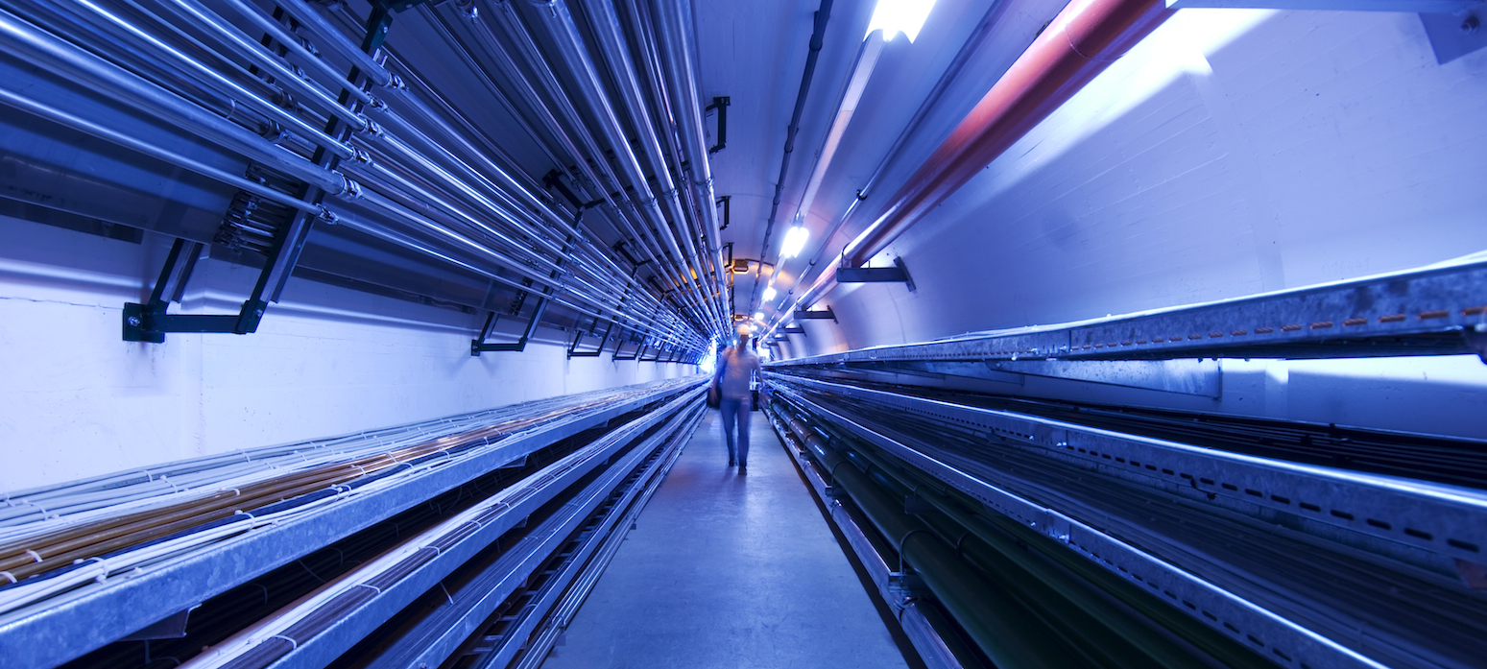
Plans for a refined dose model
C. Ahdida, C. Carli, A. Lechner, H. Mainaud Durand, N. Mokhov, Y. Robert, P. Vojtyla, M. Widorski
2nd Muon Community Meeting
13 July 2021

Slide 3
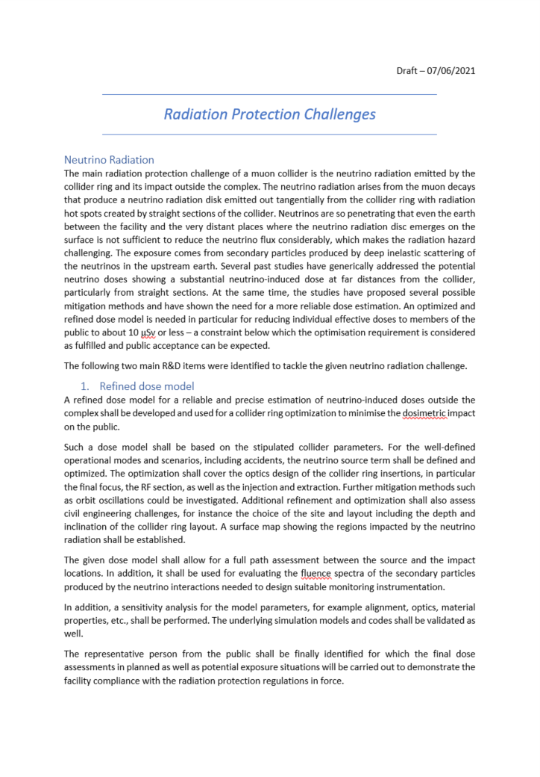
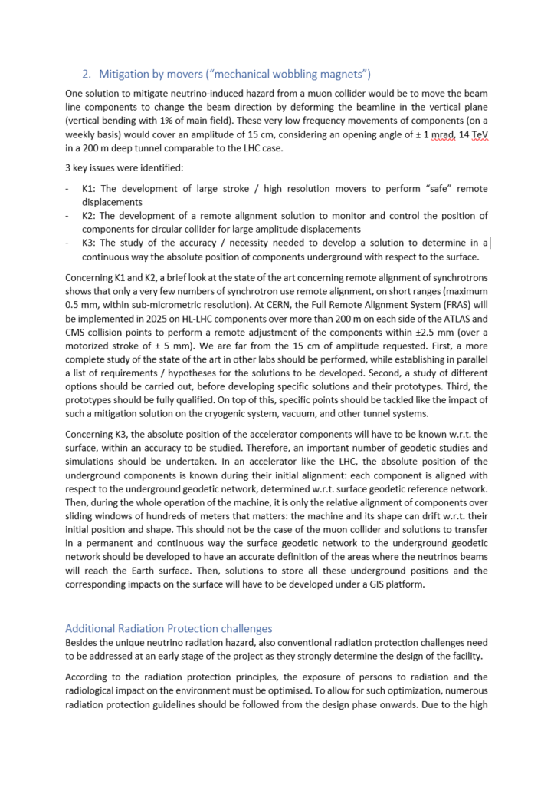
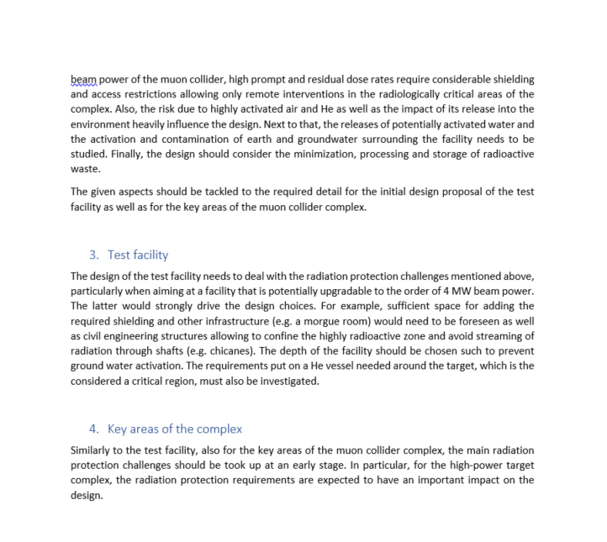
List of challenges identified by RP WG
Neutrino Radiation
  Refined dose model
  Mitigation by movers
  (“mechanical wobbling magnets”)
Additional Radiation Protection challenges
  Test facility
  Key areas of the complex

Slide 4
Overview of work related to a refined dose model
MC simulations
Dose surface map
Dose assessment
Operational scenarios
Sensitivity analysis
Demonstration of compliance
Folding with realistic source term
Optimization process

Slide 5
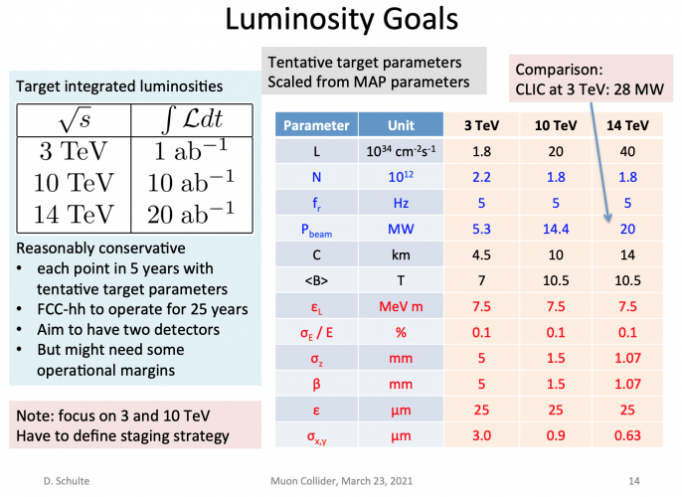
Operational scenarios
Dose model shall be based on the stipulated collider parameters
Tentative target parameters
A dose model will be defined for each parameter set
Prioritization (?):
  3 TeV
  10 TeV
  14 TeV
Defined by the Muon Beam Panel

Slide 6
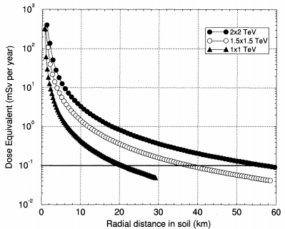
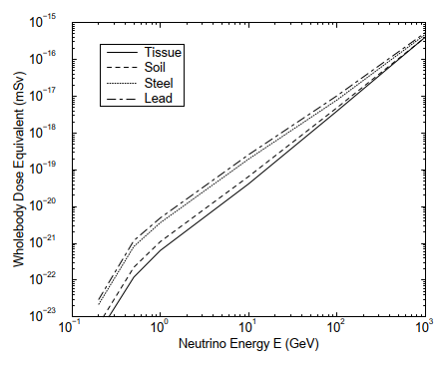
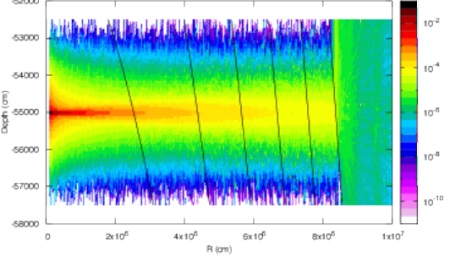
Past Monte Carlo simulations
Few examples
Comprehensive MARS15 simulations with a sophisticated neutrino interaction model crucial for evaluation of induced dose and secondary particle for monitoring
→ Mokhov and Ginneken, Neutrino Radiation at Muon Colliders and Storage Rings, 2000
Studies for E_{com} 0.5, 1, 3, and 4 TeV muon colliders:
  Effective dose for broad and pencil neutrino beams
  Secondary particle equilibrium and non-equilibrium cases
  Maximum and whole-body values for variety materials upstream the tissue-equivalent phantom
  Contributions from both the collider ring and field free drifts
  Standalone case of monoenergetic neutrino beams of energies from 100 MeV to 10 TeV
  Idea of vertical wobbling of muon beams in the ring was introduced and calculated showing substantial effect of dose reduction
Good agreement with FLUKA simulations
→ Bartosik et al., Preliminary Report on the Study of Beam-Induced Background Effects at a Muon Collider, 2019
→ To be built on for additional MC studies
MARS15 dose eq. vs. distance + E_{ν} for diff. materials
Mokhov and Ginneken, Neutrino Radiation at Muon Colliders and Storage Rings, 2000
FLUKA H*(10) for 2 TeV vs. distance + depth
d [m]
50
150
250
350
450
550
( )
ν_{µ}
pSv/10¹⁰ µ decays
Bartosik et al., Preliminary Report on the Study of Beam-Induced Background Effects at a Muon Collider, 2019

Slide 7
Plans for Monte Carlo simulations
Simplified FLUKA and MARS simulations with a pencil neutrino beam for the given operational scenarios (E_{com} 3, 10, 14 TeV (tbc)) to evaluate main parameters for the dose predictions, such as:
  Dose distribution for different distances (collider depths) assuming secondary particle equilibrium (i.e. inside material)
  Sensitivity studies for underlying assumptions (e.g. material properties, nu_e/mu and antineutrino)
  Differences of possibly relevant dosimetric quantities (e.g. effective dose, ambient dose equivalent, eff. dose equivalent)
  Difference to a more realistic full path assessment
  Secondary particle spectra needed to design suitable monitoring instrumentation
Benchmarking of neutrino interaction models
Folding w realistic source term
Sensitivity analysis
Demonstration of compliance
Sensitivity analysis

Slide 8
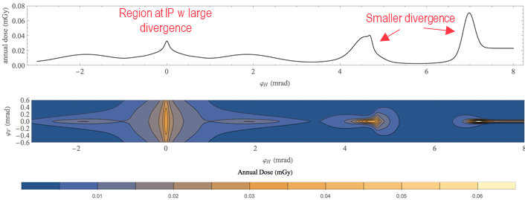
Folding with a realistic source term
Evaluate dose distributions for a realistic neutrino source term taking into account:
  The real lattice (collider, injection, accelerators)
  The angular distribution from the muon decay
Fold the information from MC simulations to estimate the dose distributions
→ more precise and less conservative dose estimation than analytical approach taking additional spread of secondary particle distribution into account
Identification of critical regions (high dose areas)
Optimization of the source term (e.g. lattice, wobbling) with respect to the dose
Sensitivity study of underlying assumptions (e.g. closed orbit positions)
Example of using analytical approach for region around IP
C. Carli, Considerations on Radiation, Muon Collider Design Meeting, 08.03.2021
(3 TeV, 100 m depth, analytical approach based on B. King)
Dose surface map
Sensitivity analysis

Slide 9
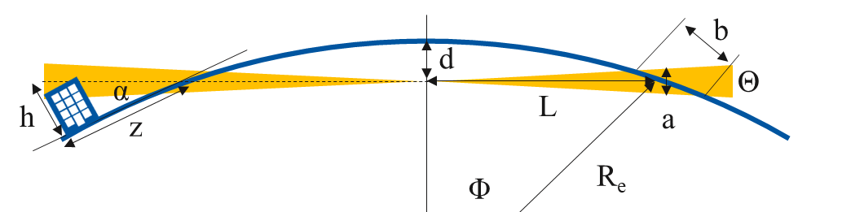
Dose surface map
Establish surface map of dose
Optimization w.r.t. depth, orientation and inclination
Investigation of different site options
Evaluation of uncertainties of methodology
(e.g. accuracy of terrain model)
Preliminary study of where ν break ground for LHC/SPS straight sections (see presentation Y. Robert)
Findings from simplified geometrical considerations (Earth as perfect sphere, no divergence, no collider inclination) for ν beam:
ν disk has a height (a) of ~1.1-2.5 m and traverses a region of width (b) of ~100-450 m
For dose additional spread of few m due to sec. particle shower
Exit angle of ν radiation is very small, wherefore impacted area can be of several km depending on height considered
L – distance, d – depth, R_{e} – Earth radius
Sensitivity analysis
E_{com} [TeV] | 3 | 10 | 10 | 14 | 14
d (m) | 100 | 200 | 300 | 400 | 500
L (km) | 36 | 51 | 62 | 71 | 80
a (m) | 2.5 | 1.1 | 1.3 | 1.1 | 1.2
b (m) | 449 | 135 | 135 | 96 | 96
α (rad) | 0.006 | 0.008 | 0.010 | 0.011 | 0.013
z (km) for h = 50 m | 9 | 6 | 5 | 4 | 4
100 m depth
500 m depth
L² = R_{e}² – (R_{e} – d)²
Θ~1/γ
a ≈ 2 ΘL
b ≈ a/Φ, sin Φ = L/R_{e}
α ≈ acos (1 – d/R_{e})
z ≈ h/tan (α)
36 km
9 km
80 km
4 km
See also paper from Johnson, Rolandi and Silari, Radiological Hazard Due to Neutrinos from a Muon Collider, 1998

Slide 10
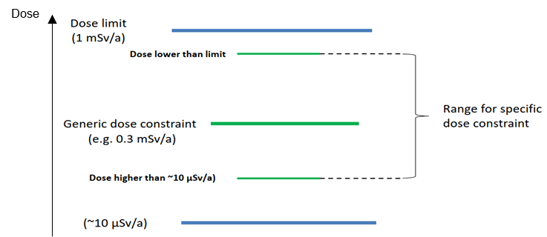
Dose assessment
Identify representative person from public for a final dose assessment
As a general worst case scenario, one would have to assume maximum exposure and irradiation conditions (e.g. sick person lying in bed 24/7 at the location of the maximum dose)
→ Dose optimization to O(10) μSv/year
Depending on the dose surface map, for certain regions of higher dose (e.g. for critical straight sections), possible exclusion of such a worst case scenario even for the far future
→ Dose higher than O(10) μSv/year depending on possible exposure scenarios (e.g. lake, mountains, ocean, exclusion area)
  Depends on acceptance by authorities and public
  Uncertainty of the dose surface map
ICRP and IAEA Safety standards –
Relationship between dose limit, generic and specific dose constraint, and optimization level
IAEA Safety Standards, General Safety Guide, No. GSG-9
Sensitivity analysis
100 rem = 1Sv

Slide 11
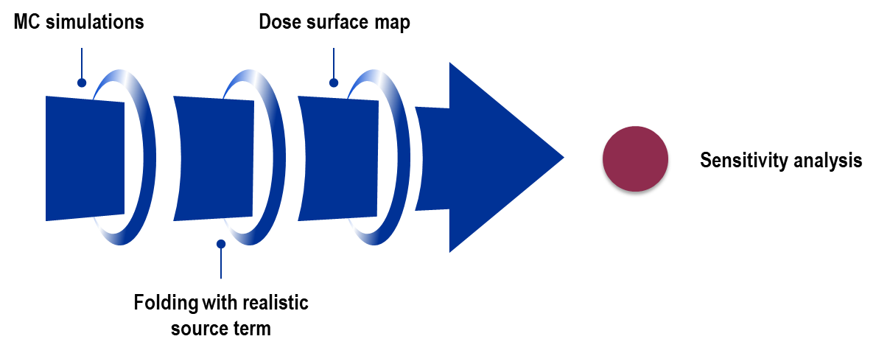
Sensitivity analysis and demonstration of compliance
Sensitivity analysis
Demonstration of compliance
Evaluate means to demonstrate compliance of the dose estimates, both at the source (emission) and impact side (immission)
Source side
Impact side
Measure muon beam parameters (e.g. divergence)
Design suitable monitoring instrumentation for measuring the dose from the secondary particles produced by the neutrino radiation
Uncertainties of dose estimate to be defined based on the various underlying parameters and assumptions
This includes uncertainties for the dose distribution as well as its projection on the surface

Slide 12
Proposed Workpackage Description
Neutrino radiation
Refined dose model
  A refined dose model for a reliable and precise estimation of neutrino-induced doses outside the complex shall be developed and used for a collider ring optimization to minimise the dosimetric impact on the public
Mitigation by movers
Mitigation by movers, which move the beam line components to change the beam direction by deforming the beamline in the vertical plane
Additional RP challenges
Test facility
  The test facility design will have to be optimised w.r.t. prompt and residual radiation, air/He/N activation, water and soil activation, and radioactive waste production, particularly when aiming at potentially upgrading to O(4) MW beam power
Key areas of the complex
  Similarly to the test facility, also for the key areas of the muon collider complex, the main RP challenges should be investigated at an early design stage

Slide 13
Proposed Workpackage Tasks and Timeline –
Refinded Dose Model
Preliminary – Timeline tbd
MC simulations
  MC simulations (FLUKA, MARS) to evaluate main parameters for the dose predictions and their uncertainties [202X-202X]
  Benchmarking of neutrino production and interaction models [202X-202X]
Folding with realistic source term
  Evaluation of a realistic neutrino source term and folding with dose distributions from MC simulations [202X-202X]
  Further optimization and sensitivity analysis [202X-202X]
Surface map
  Surface map of the dose for given site options [202X-202X]
  Further optimization and sensitivity analysis [202X-202X]
Dose assessment + demonstration of compliance
  Perform final dose assessment and develop possible methods to demonstrate compliance [202X-202X]

Slide 14
Information Needed For Workpackage
Specific collider parameters (E, circumference) are needed as input for the refined dose model [ASAP]
Other?

Slide 15
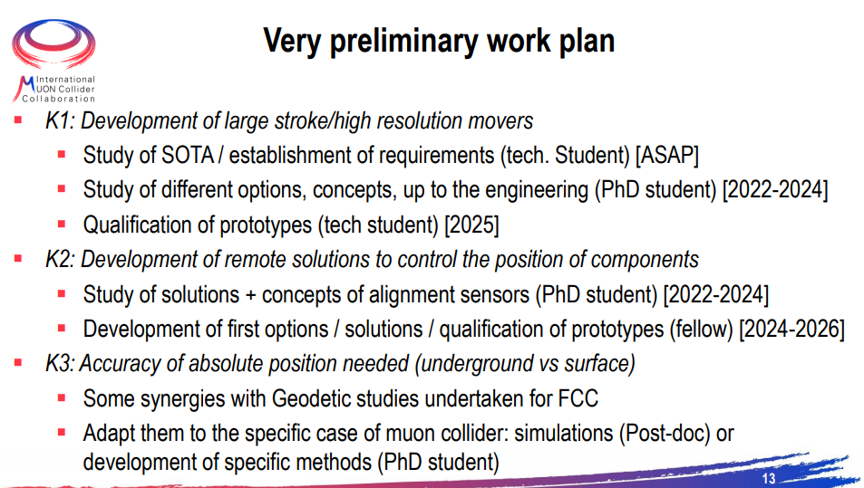
Proposed Workpackage Tasks and Timeline –
Mitigation Using Movers
From H. Mainaud Durand

Slide 16
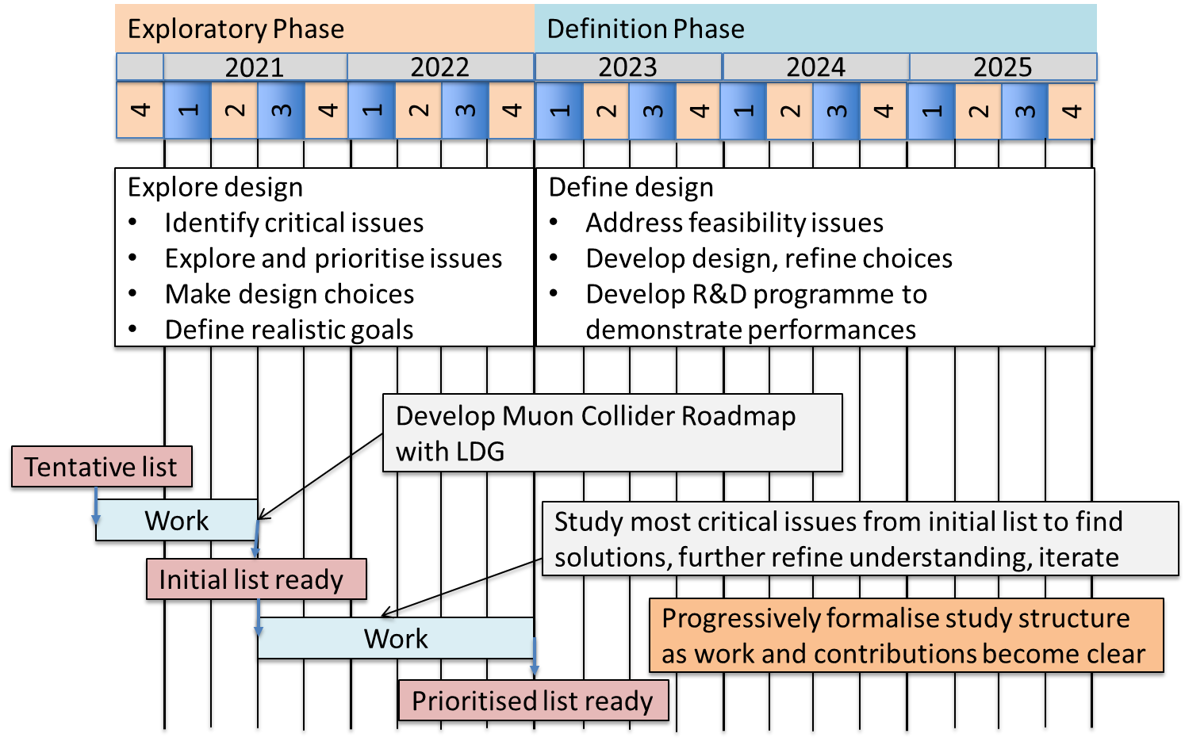
Timeline until next ESPPU

Slide 17
Proposed workpackage resources
Preliminary
Task | Staff [pm] | postdoc [pm] | student [pm] | Cash [kEUR] | Comment
MC simulations |  |  |  |  | SY-STI (CERN), Fermilab, HSE-RP (CERN)
Folding w realistic source term |  |  |  |  | BE-ABP (CERN)
Surface map |  |  |  |  | SCE-SAM (CERN)
Dose assessment | 0.25 – 0.35 FTE/y |  |  |  | HSE-RP (CERN); includes also coordination+discussion for above tasks
Mitigation with movers |  |  |  |  | BE-GM (CERN)
Test facility | 0.25 FTE/y + 0.1 FTE/y (tbd) | 1-2 senior fellows – 2022-2025 (tbd) |  |  | HSE-RP (CERN); includes radiation protection and environmental assessment
Key areas of complex
Additional people interested in participating to define and carry out the work are of course very welcome!

Slide 18
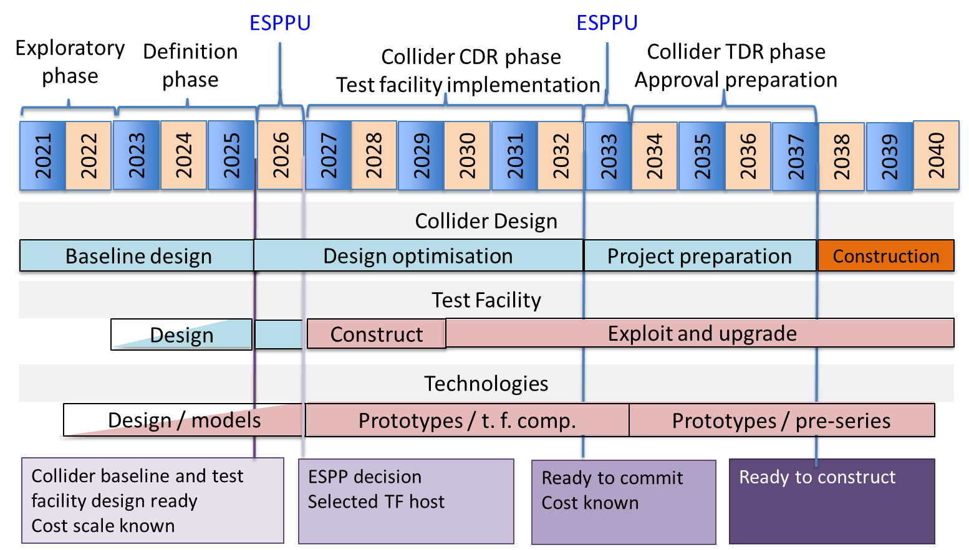
Technically Limited Long-Term Timeline

Slide 19

Thank you
for your attention!

Slide 20
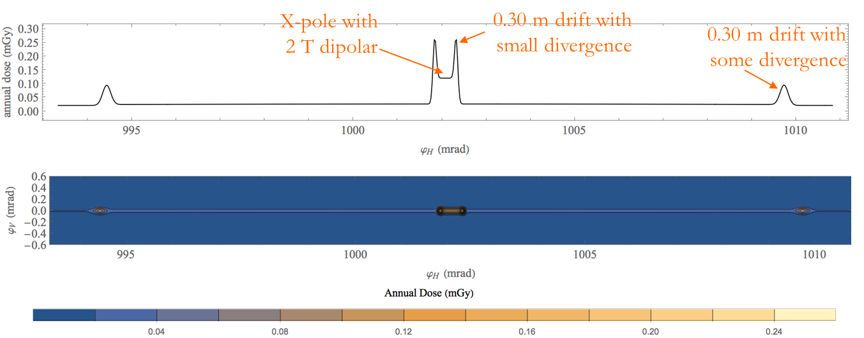
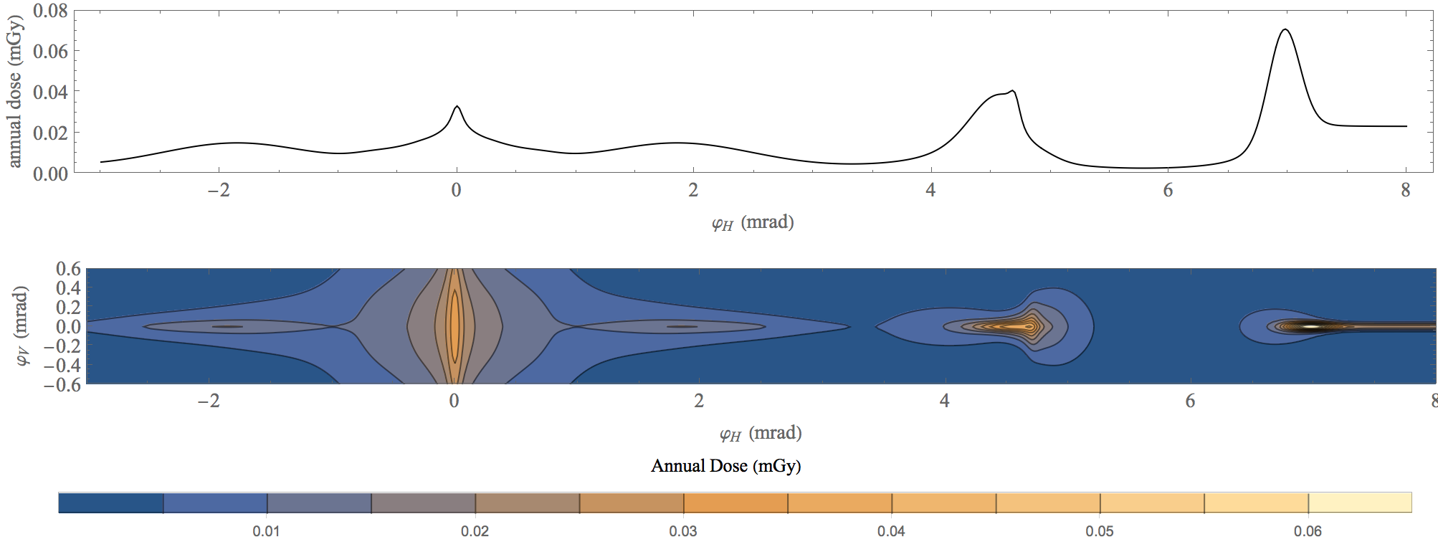
Dose estimation with MAP lattice – C. Carli
Center of arc cell
Combined fct magnet w reduced field
Region around IP
Region at IP w large divergence
Smaller divergence
Arc dipole of ~10 T
Larger divergence (momentum spread,D’)
According to paper of B. King Gy!=Sv
Based on analytical approach by B. King
Application to 3 TeV c.o.m. lattice from MAP study (9e20 μ decays per year, depth = 100)
Findings from the arcs: higher doses for reduced field sections and peak doses for small (30 cm) drift sections
Findings close to IP: beam divergence relatively large at IP and higher dose from regions with smaller vertical/horizontal divergence
Conclusions:
    Beam divergence not always negligible (contributions from D’ w large momentum spread), which mitigates radiation from straight sections
    → avoid combined function magnets w too low dipolar field components
  Outlook:
    Improve lattice designs in arcs (e.g. avoid short straight sections w D’=0, increase dipolar component of combined function magnets)

Slide 21
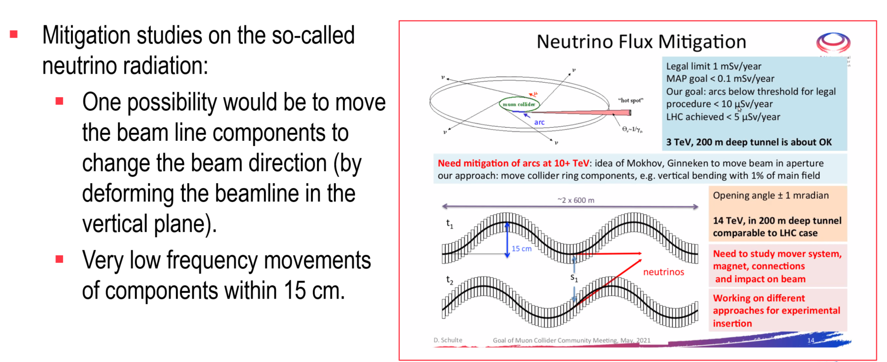
Mitigation using movers – H. Mainaud Durand
Brief overview of state of the art including Full Remote Alignment System (FRAS): ± 5 mm

Slide 22
Mitigation using movers – H. Mainaud Durand
Studies to undertake / points to check (only subset given here)
Study in further details the state of the art concerning adjustment solutions
Have a better understanding of the requirements
  Range of movers ? Resolution? Accuracy?
  Long-term stability, impact of vibrations?
  Frequency of adjustment?
  Constraints from other equipment like cryo and vacuum (acting forces, flexibility)?
  Weight, size and number of components?
Study and develop alignment solutions and associated sensors for allowing to do such remote adjustment
Identified key issues
K1. Development of large stroke/high resolution movers to perform safe remote displacements
K2. Development of remote solutions to control the position of components (for circular collider), adapted to such ranges of displacements
K3. Study of the accuracy needed / necessity to develop a solution to determine in a continuous way the absolute position of components underground vs. surface
+ specific points to address (impact on other equipment, safe control system)

