Slide 2
PRELIMINARY STUDY
If we extend the LHC or SPS straight insertion where would the neutrinos come out to the surface of the earth?
Patrimony and Site Information
EDMS: 2065924

Slide 3
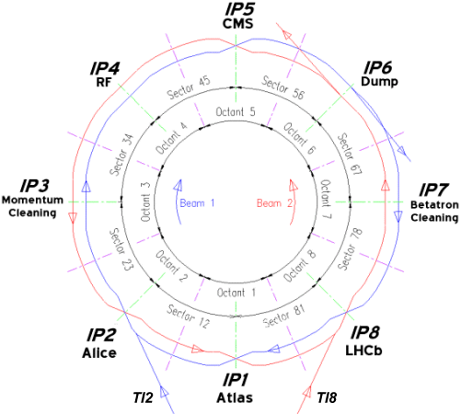
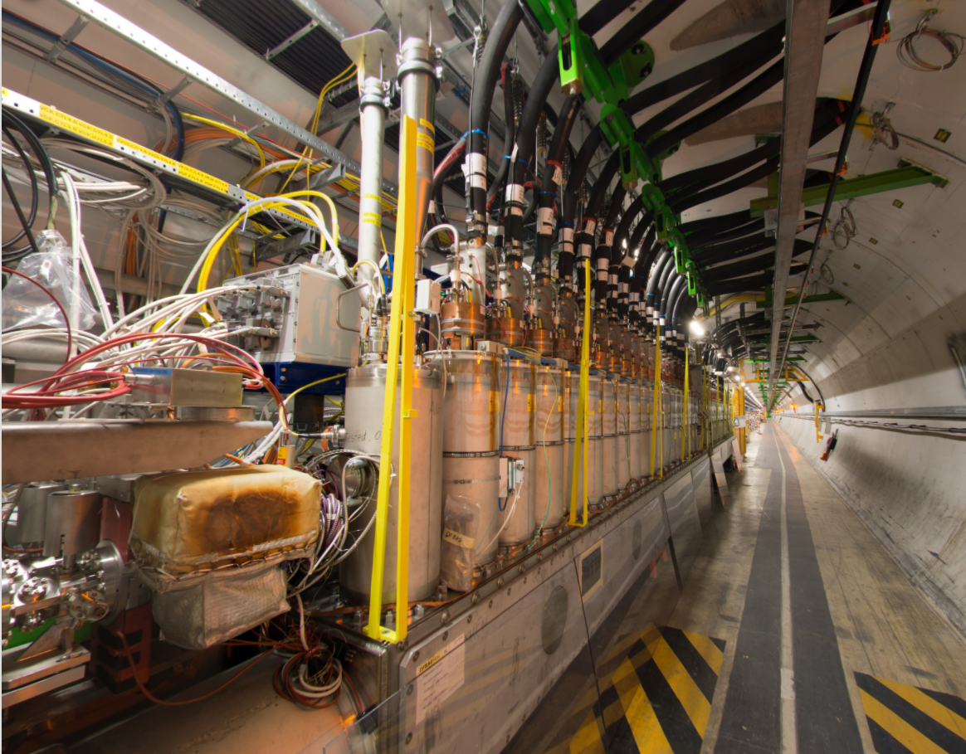
PRELIMINARY STUDY
If we extend the LHC straight insertion
where would the neutrinos come out to the surface of the earth?
Problem:
« If we extend the LHC straight insertions where would the neutrinos come out the surface of the earth?”
Hypothesis:
The LHC straight insertions directions are given by the lines built from the middle of Beam 1 and Beam 2 DFBA elements on each side of the Insertion Point.
EDMS: 2065924

Slide 4
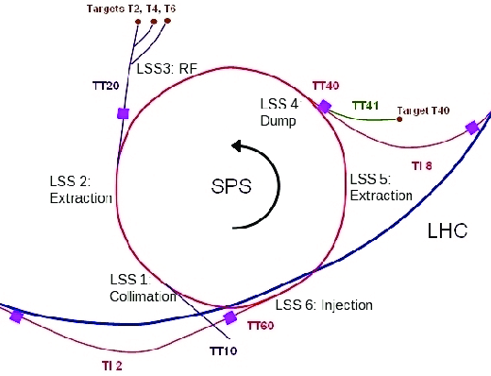
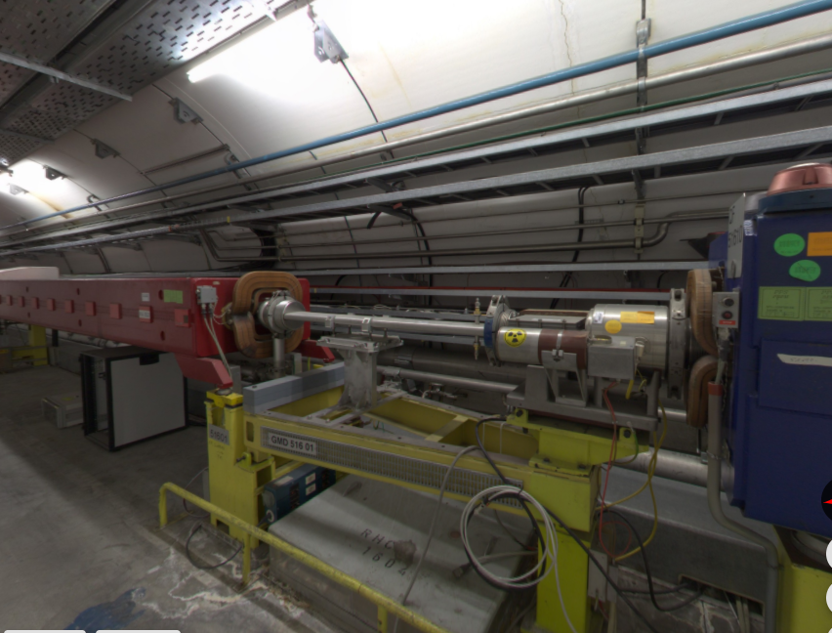
PRELIMINARY STUDY
If we extend the SPS straight sections
where would the neutrinos come out to the surface of the earth?
Problem:
« If we extend the SPS straight sections where would the neutrinos come out the surface of the earth?”
Hypothesis:
The SPS straight sections directions are given by the lines built on dipole MBA X1590 beam exit points on one side and MBA X2030 beam entrance point on the other side. (X for the SPS point)
EDMS: 2353912

Slide 5

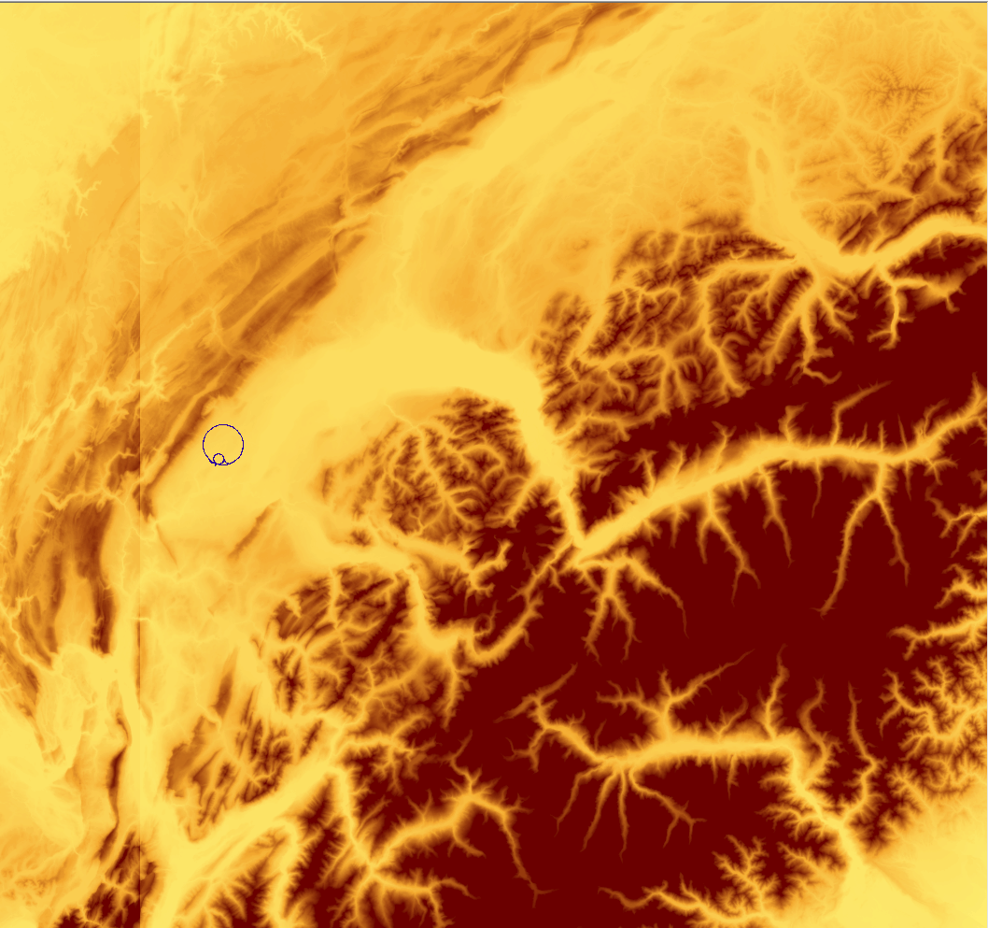
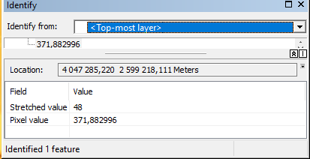
PRELIMINARY STUDY
If we extend the LHC straight insertion
where would the neutrinos come out to the surface of the earth?
Data:
Coordinates of DFBA beam points
  from Geode Survey database
  in CCS (XYZ) coordinate system
EU-DEM v1.1 : Digital Surface model for Europe
  The spatial reference system is geographic, lat/lon with horizontal datum ETRS89, ellipsoid GRS80 and vertical datum EVRS2000 with geoid EGG08.
  https://opendem.info/opendemeu_meta_eudem.html
EDMS: 2065924

Slide 6
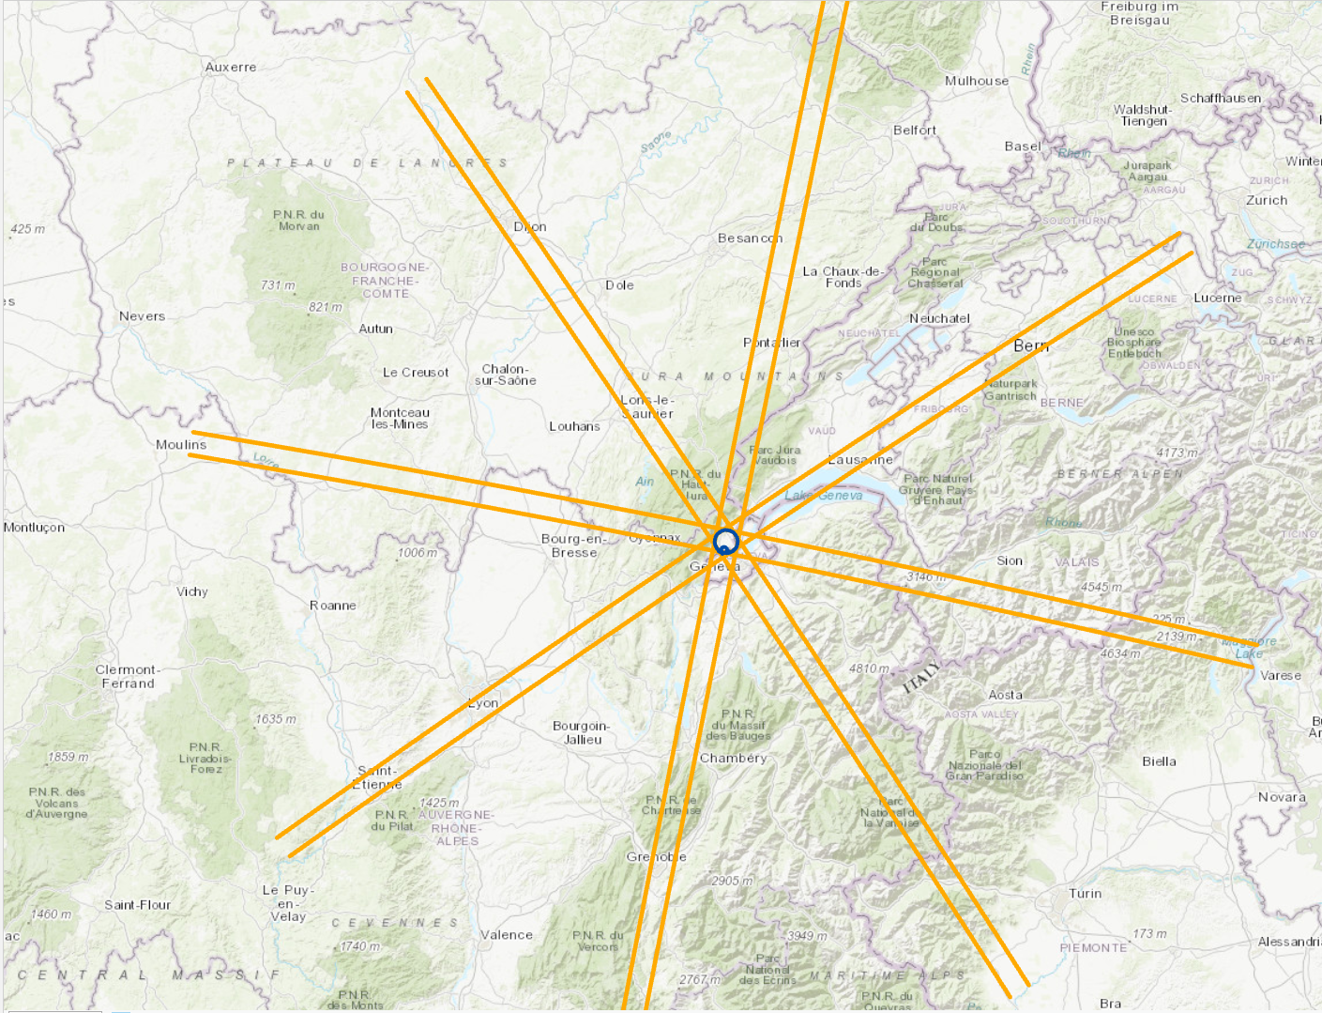
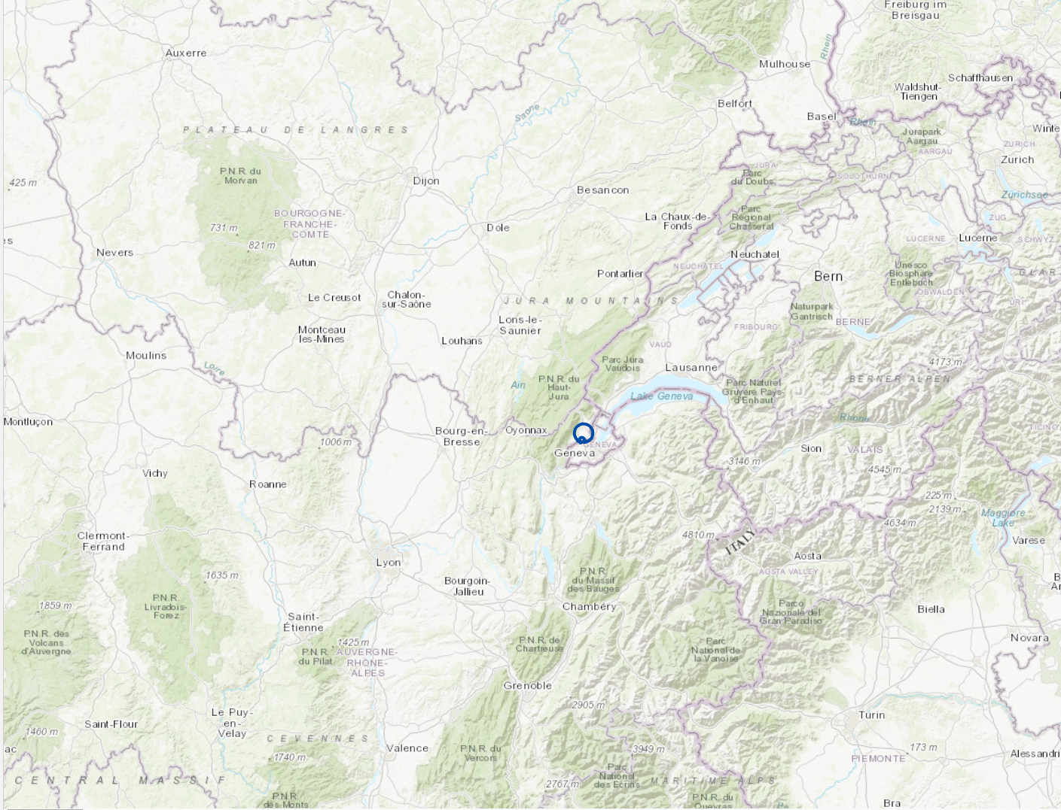
PRELIMINARY STUDY
If we extend the LHC straight insertion
where would the neutrinos come out to the surface of the earth?
Methodology:
LHC straight insertions lines are extended in CCS coordinate system
One point is created every 200 m along these lines (CCS coordinate system) – (Discretisation of the Beam lines)
3) XYZ Coordinates of each point are converted to WGS84 Geodetic Coordinates System
  The results is geographic coordinates (lat, long) with ellipsoidal heights (He) of each point.
4) The EU-DEM is converted to WG84
  The Geoid heights (Hg) are unchanged as the ellipsoids WGS84 and GRS80 are slightly equivalent).
EDMS: 2065924

Slide 7
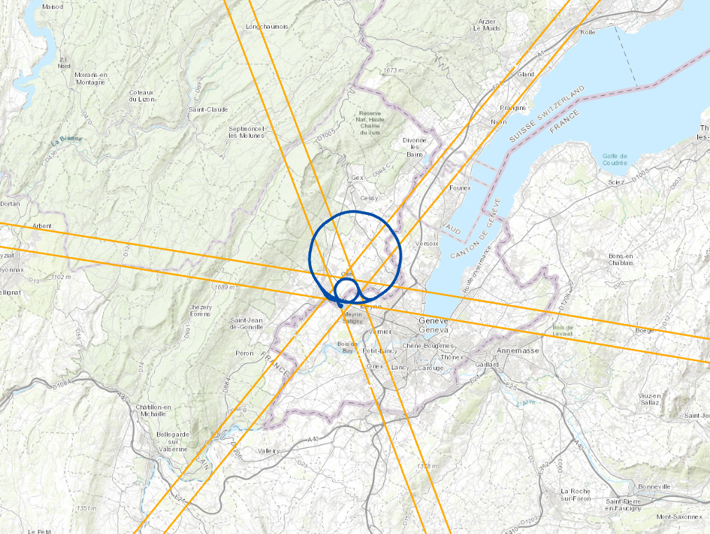
PRELIMINARY STUDY
If we extend the SPS straight sections
where would the neutrinos come out to the surface of the earth?
Methodology:
SPS straight sections lines are extended in CCS coordinate system
One point is created every 200 m along these lines (CCS coordinate system) – (Discretisation of the Beam lines)
3) XYZ Coordinates of each point are converted to WGS84 Geodetic Coordinates System
  The results is geographic coordinates (lat, long) with ellipsoidal heights (He) of each point.
4) The EU-DEM is converted to WG84
  The Geoid heights (Hg) are unchanged as the ellipsoids WGS84 and GRS80 are slightly equivalent).
EDMS: 2353912

Slide 8
PRELIMINARY STUDY
If we extend the LHC straight insertion
where would the neutrinos come out to the surface of the earth?
Methodology:
5) The Geoidal ellipsoidal heights (He) of the beam points are converted to Geoidal Heights (H) :
  N is the ondulation of geoid in the studied area estimated to 50 m. In reality it varies from + 47 m to + 54 m.
6) The difference between the heights (H) of each point and their projection to the DEM (Hgprj) is calculated.
  If the Delta > 0, the point is at the surface of the earth
  If Delta is < 0 the point is underground.
H = He – N
Delta = H – Hgprj
Hgprj
Extended Insertion line
Delta
He
H
DEM Topography
N
Ellipsoid
Geoid
H = h_{ellipsoid} - N_{geoid}
EDMS: 2065924

Slide 9
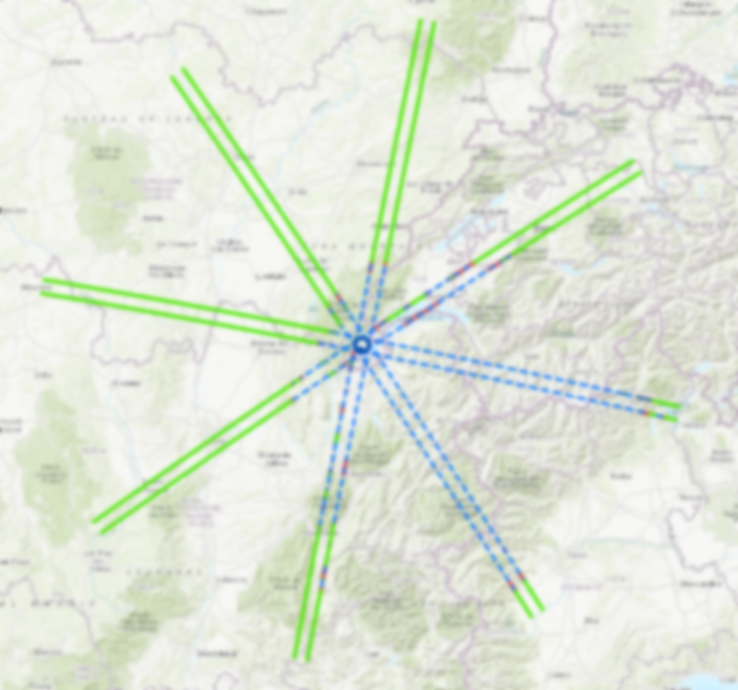

PRELIMINARY STUDY
If we extend the LHC straight insertion
where would the neutrinos come out to the surface of the earth?
Results:
Point | Side | First exit to the surface of the earth (Distance from IP in Km)
1 | L | 263
1 | R | 40
2 | L | 258
2 | R | 25
3 | L | 17
3 | R | 74
4 | L | 37
4 | R | 30
5 | L | 26
5 | R | 237
6 | L | 35
6 | R | 255
7 | L | 76
7 | R | 161
8 | L | 145
8 | R | 35
 | Min | 17 km
 | Max | 263 km

Slide 10

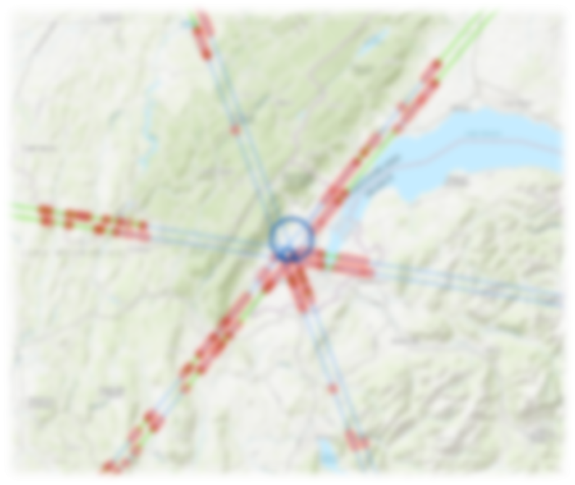
PRELIMINARY STUDY
If we extend the SPS straight insertion
where would the neutrinos come out to the surface of the earth?
Results:
Point | Side | First exit to the surface of the earth (Distance from SPS point in Km)
1 | L | 64
1 | R | 7
2 | L | 28
2 | R | 35
3 | L | 44
3 | R | 10
4 | L | 80
4 | R | 6
5 | L | 10
5 | R | 21
6 | L | 51
6 | R | 10
 | Min | 6 km
 | Max | 80 km
EDMS: 2065924

Slide 11
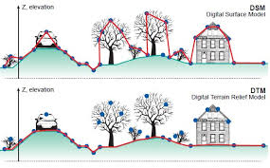
PRELIMINARY STUDY
If we extend the LHC straight insertion
where would the neutrinos come out to the surface of the earth?
Tolerance and accuracy:
Heights
  EU-DEM: Accuracy : +/- 7.0 m RMSE
  EU-DEM is a DEM, and not a DTM (Digital terrain Model).
  An error of + 20.0 m is estimated
  The assumption for the Geoid undulation is +/- 3.0 m
= > The accuracy of the DTM is roughly evaluated to +/- 30 m
LHC straight insertions directions:
The error is estimated to max 0.1 degree in both horizontal and vertical directions. This corresponds to 20cm /100 m
=> To simulate the uncertainty of the results, the calculations are made for the worst possible cases
Uncertainty
0.1deg
30 m
=> To get rid of the influence of any parameter that would not have been taken into account in this preliminary study a buffer of 1000 m is added

Slide 12

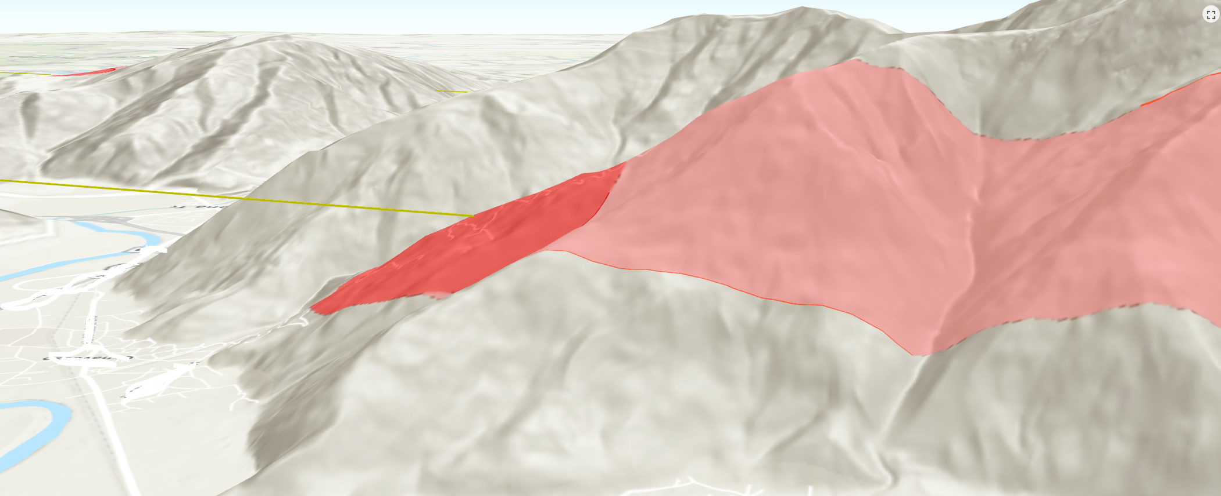
PRELIMINARY STUDY
If we extend the LHC straight insertion
where would the neutrinos come out to the surface of the earth?
3D View

Slide 13
PRELIMINARY STUDY
If we extend the SPS straight sections
where would the neutrinos come out to the surface of the earth?
Conclusions:
The presented maps are a very quick and preliminary study of the question. But the geographic tools and the data are available.
For LHC the longest distance is on the other side of the alps. For SPS, it is on the other side of the Jura
The depth of the SPS and its “horizontality” bring some uncertainty on the exact locations. The beam is grazing the surface of the earth
For a more precise study, some more investigations have to be performed
We now have Gil a technical Student to automatise the production of such maps according to the collider position
EDMS: 2065924

