Slide 1
Stress management for high-energy MC SR and IR magnets
E. Barzi and A.V. Zlobin
Fermilab

Slide 2
Introduction
Conceptual design studies of MC SRs and IRs with muon beam energy of 0.75 and 1.5 TeV have been performed in the U.S. in 2010-2012
Studies included beam optics, magnet design concepts and radiation shielding ➔ Tungsten internal absorber ≥ 50 mm is required + vacuum insulation + helium channel
It was shown that large-aperture shell-type magnet coils produce better properties than block-type coils and/or open mid-plane coils
The next two slides will show conceptual designs and parameters of SR and IR magnets based on Nb₃Sn technology for 3 TeV (1.5×1.5 TeV) MC

Slide 3
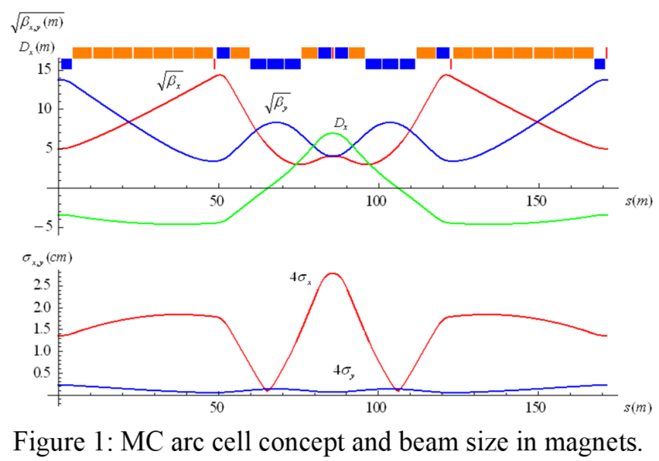
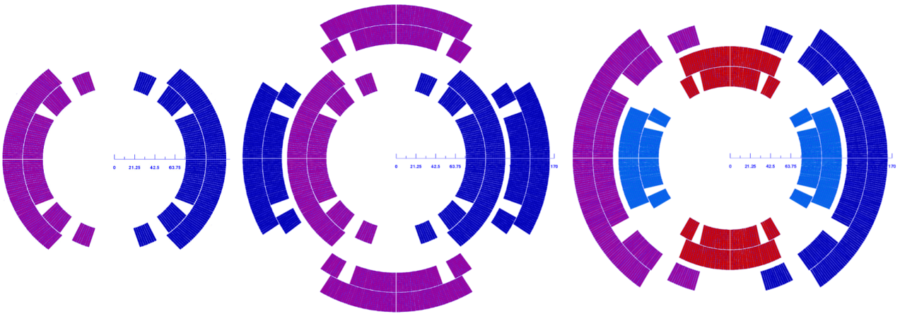
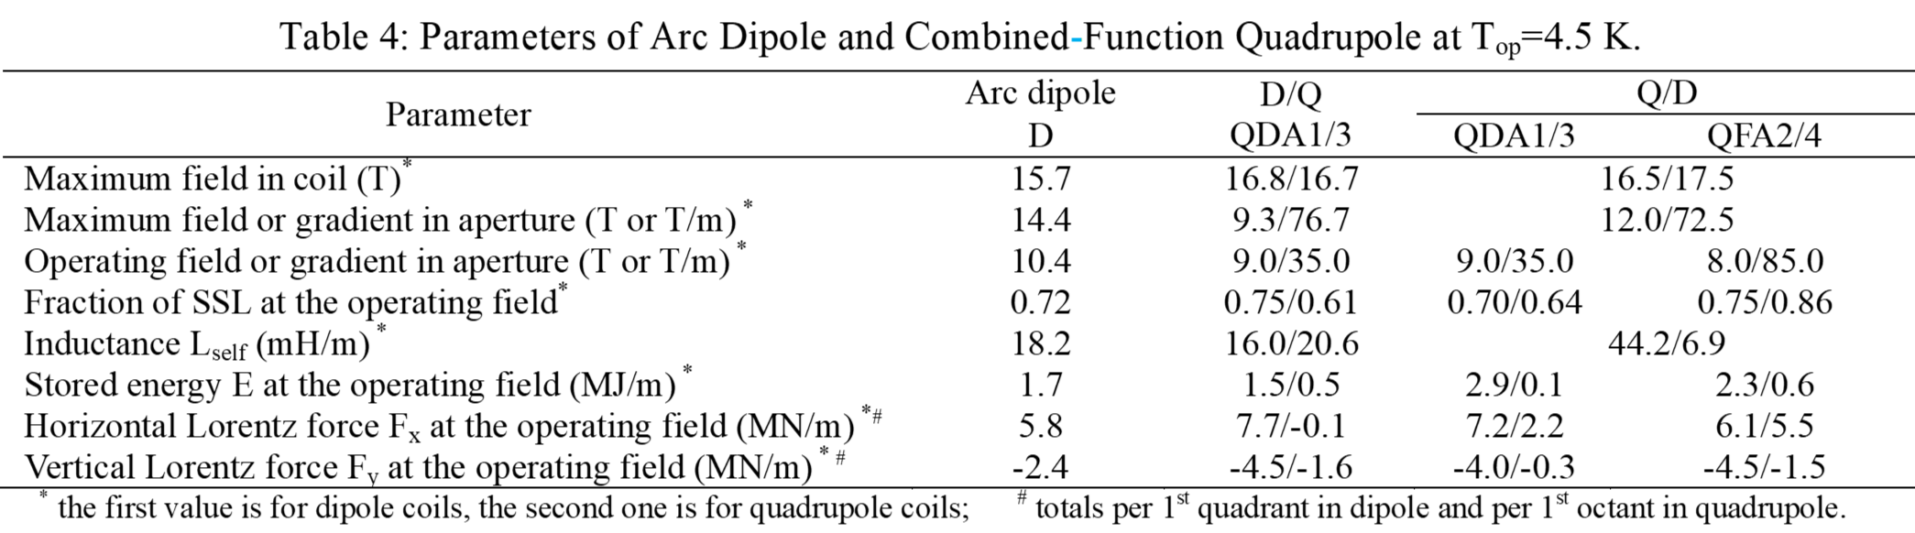
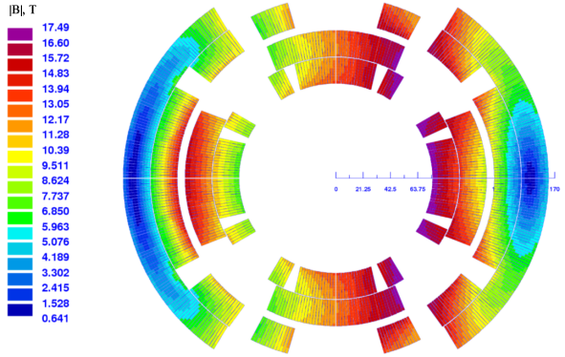
3 TeV MC SR magnets
High-Field Combined-Function Magnets for a 1.5×1.5 TeV Muon Collider Storage Ring
V.V. Kashikhin, Y.I. Alexahin, N.V. Mokhov, A.V. Zlobin, Fermilab, Batavia, IL, IPAC2012
150 mm
Large aperture, high field, operation margin, Lorentz forces

Slide 4
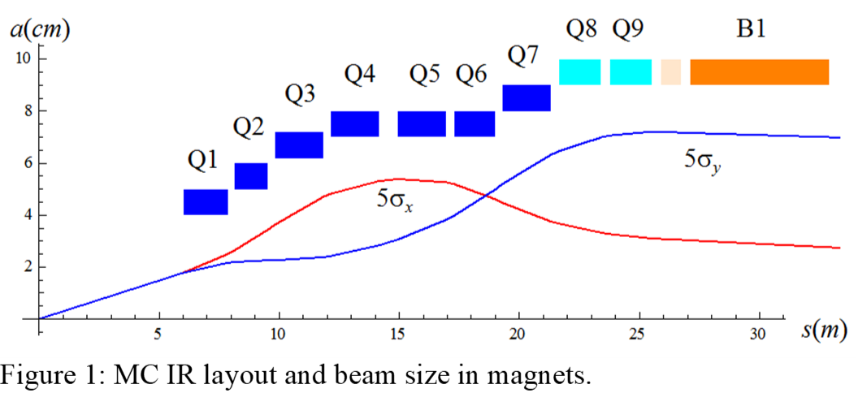
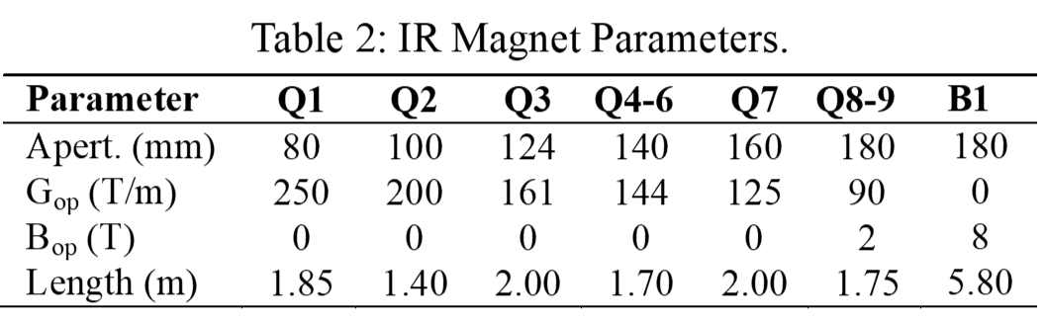
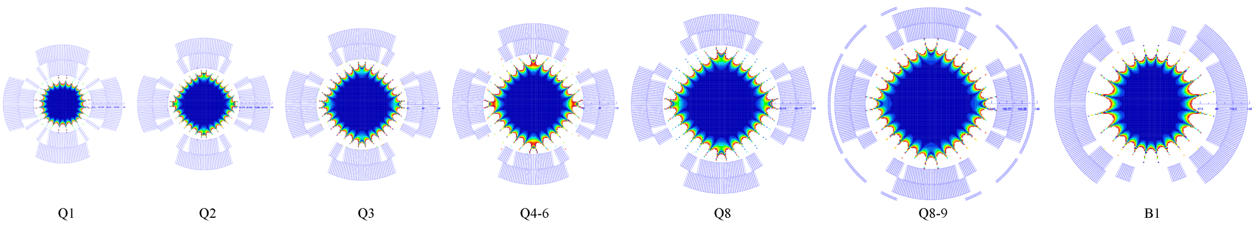
3 TeV MC IR magnets
Magnets for Interaction Regions of a 1.5×1.5 Tev Muon Collider
V.V. Kashikhin, Y.I. Alexahin, N.V. Mokhov, A.V. Zlobin, Fermilab, Batavia, IL, IPAC2012
Large aperture, high field, operation margin, Lorentz forces

Slide 5
MC SR and IR magnet general features
Large aperture – up to 180 mm
  larger aperture will be needed for higher muon beam energies to use thicker absorber
High field level – ~8-10T (aperture)/~14-17.5T (coil)
  within the limit of Nb₃Sn technology
  higher operation fields will require HTS/Nb₃Sn hybrid coils
Large operation margin ≥ 30%
Large Lorentz forces

Slide 6
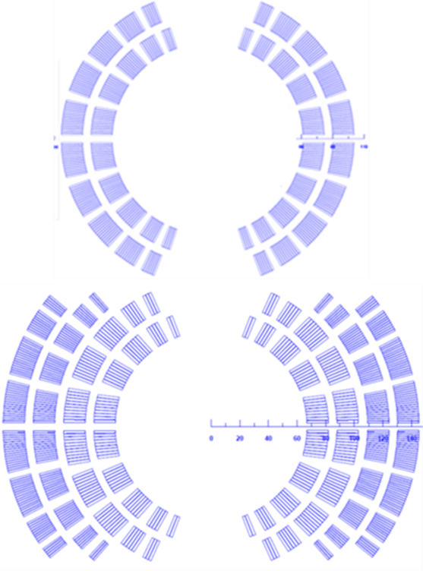
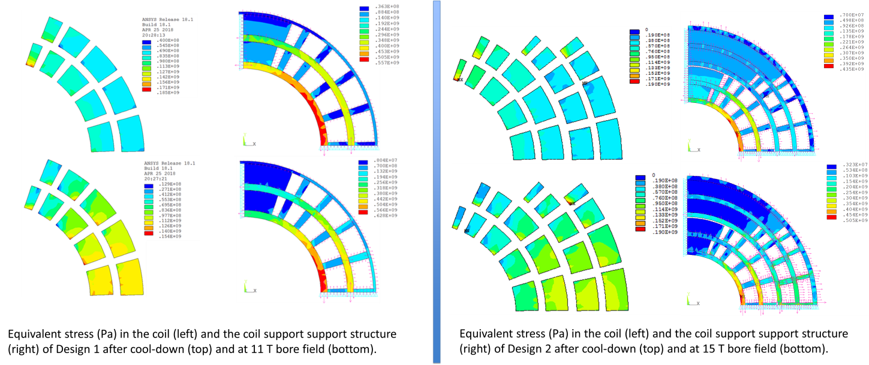
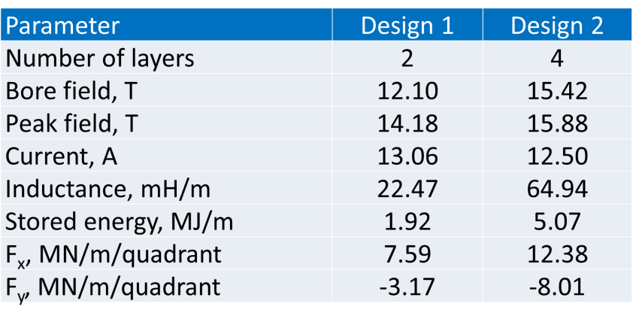
Stress management for high-field large-aperture magnets
LARGE-APERTURE HIGH-FIELD Nb₃Sn DIPOLE MAGNETS
A.V. Zlobin, V.V. Kashikhin, I. Novitski (Fermilab, Batavia, IL) , IPAC2018
120mm
185 Mpa
At cool-down
190 Mpa
At cool-down
120mm
190 Mpa
At 15 T
154 Mpa
At 11 T
Studies have shown that stress management is critical for HF/LA magnets
It is even more important for HF/LA combined Q/D magnets used in MC
Future conceptual magnet design studies for MC need to consider this concept

Slide 7
Conclusion
SR and IR in HE MC 3+ TeV will use SC magnets with large aperture (~200 mm) and high fields (15-20 T) for highest luminosity
  Nb₃Sn or HTS/LTS hybrid technologies
Stress management is a critical coil design concept which needs serious theoretical and experimental studies
This is an important part of the U.S. Magnet Development Program
There is possible synergy also with Europe, for instance CSI is also working on this concept

